Slide 1
Continental and global hydro-climatic forecasting services to address user needs for the water-related sectors
T. Bosshard, B. Arheimer, L. Crochemore, F. Gyllensvärd, I. Pechlivanidis, C. Photiadou
NEXT

Slide 2
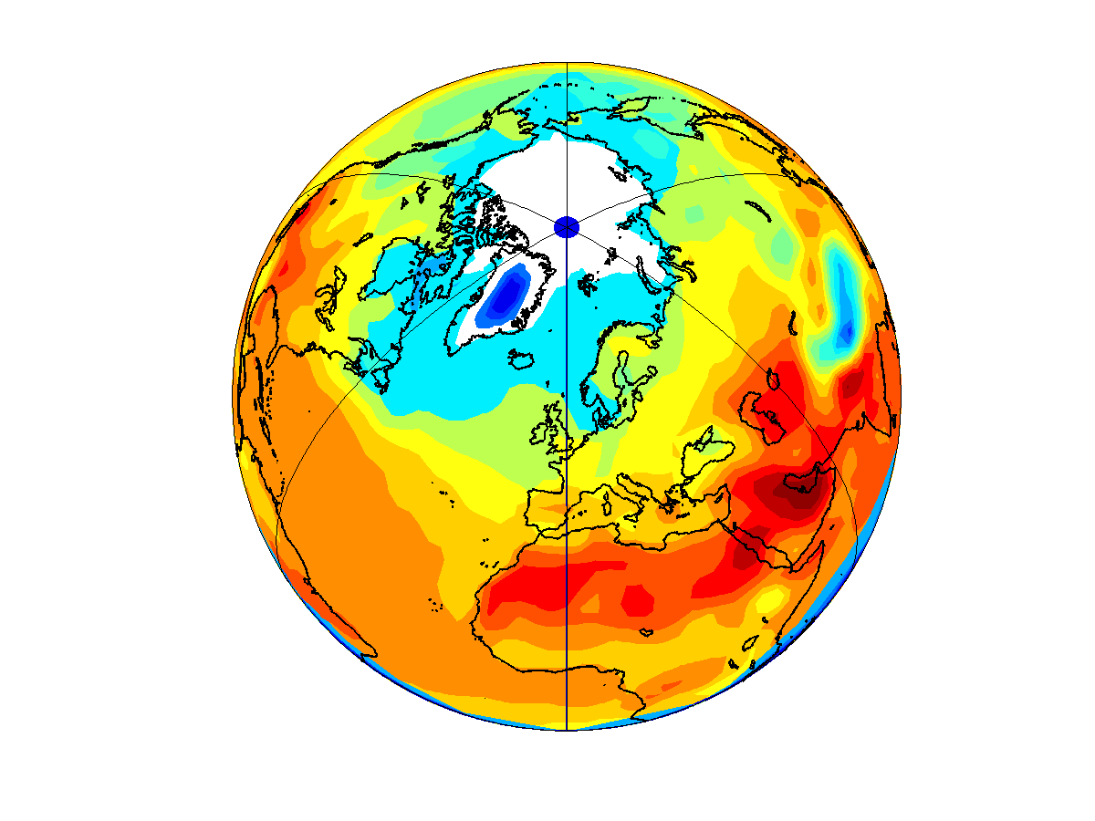
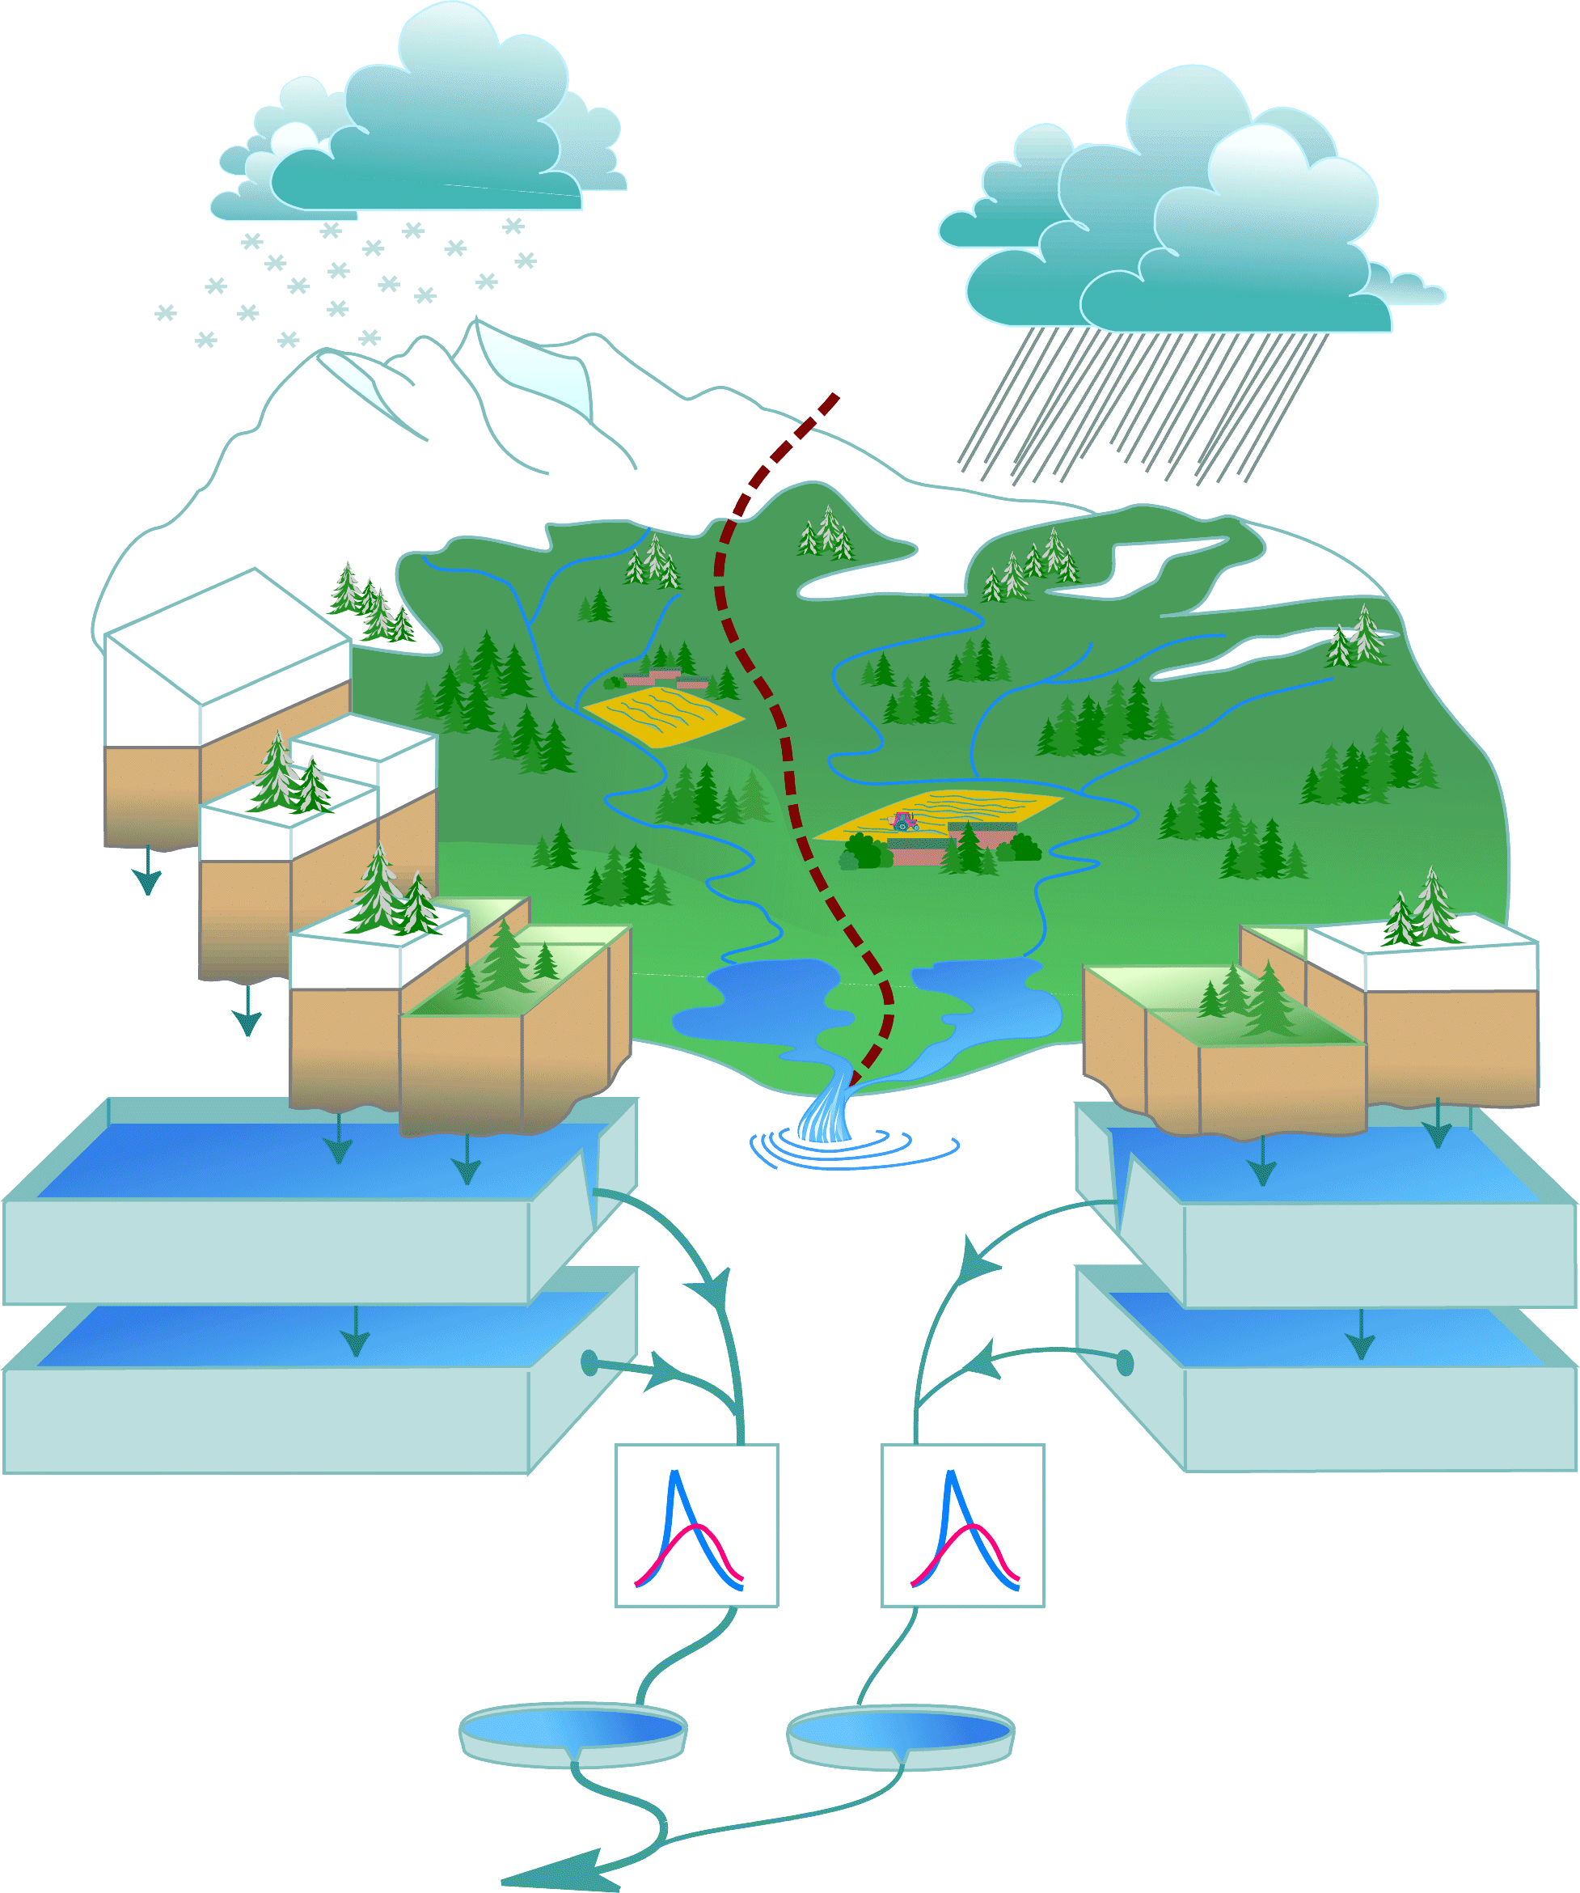
Production line for S2S forecasts
Collecting and preparing climate forecasts
Running hydrologic models
Climate observations
Hydrologic (pseudo-) observations
ECMWF
Extended-range
Historic weather
Historic hydrologic info
Hydrologic thresholds of normal conditions
P
T
Climate forecast skill
Hydrologic forecast skill
P
T
Climate hindcast
Hydrologic hindcast
ECMWF SEAS5
Downscaling & bias-adjustm.
(DBS method)
ensemble member
Hydrological models (HYPE)
ensemble member
P
T
Climate forecast
Hydrologic forecast
ensemble member
ensemble member
Climate forecasting
Hydrologic forecasting
Hypeweb https://hypeweb.smhi.se/explore-water/forecasts/
ECMWF
Extended-range
J1
J2
J3
J4
F1
F2
Producing and storing final products
Weeks
ECMWF SEAS5
Months
NEXT

Slide 3
Meteo observations: HydroGFD 2.0
START

Slide 4
Downscaling and bias-adjustment
START

Slide 5
Prediction systems and mode
ECMWF Extended-range
45 days ahead
Issued once a week
lead time 1 week
Oct
Nov
Dec
Jan
Feb
Mar
ECMWF SEAS5
7 months ahead
Issued once a month
lead time 1 month
Oct
Nov
Dec
Jan
Feb
1 Oct
1 Nov
1 Dec
1 Jan
1 Feb
1 Mar
START

Slide 6
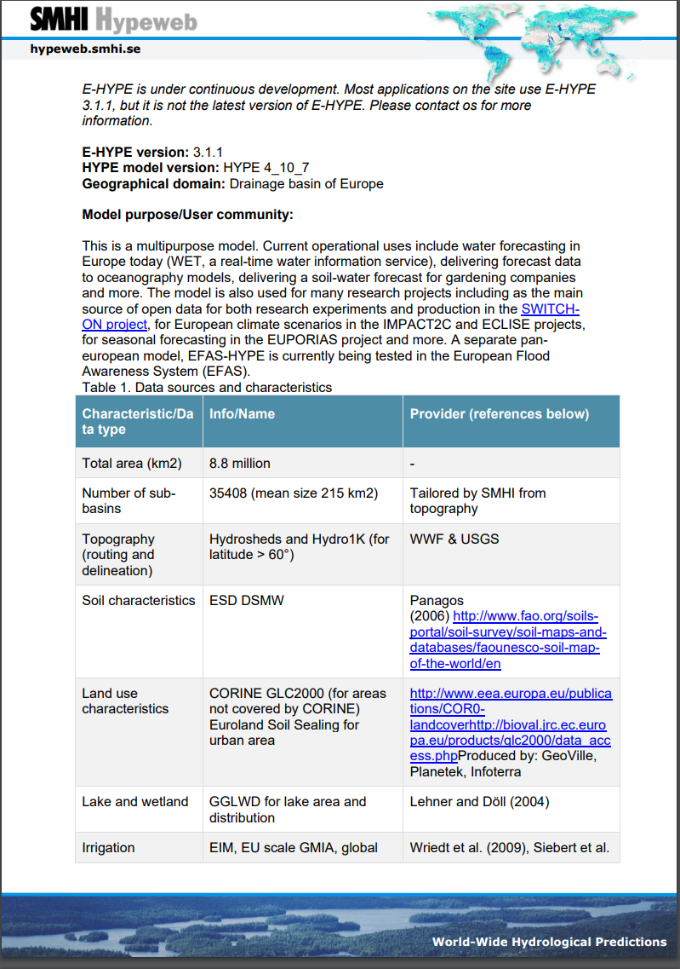
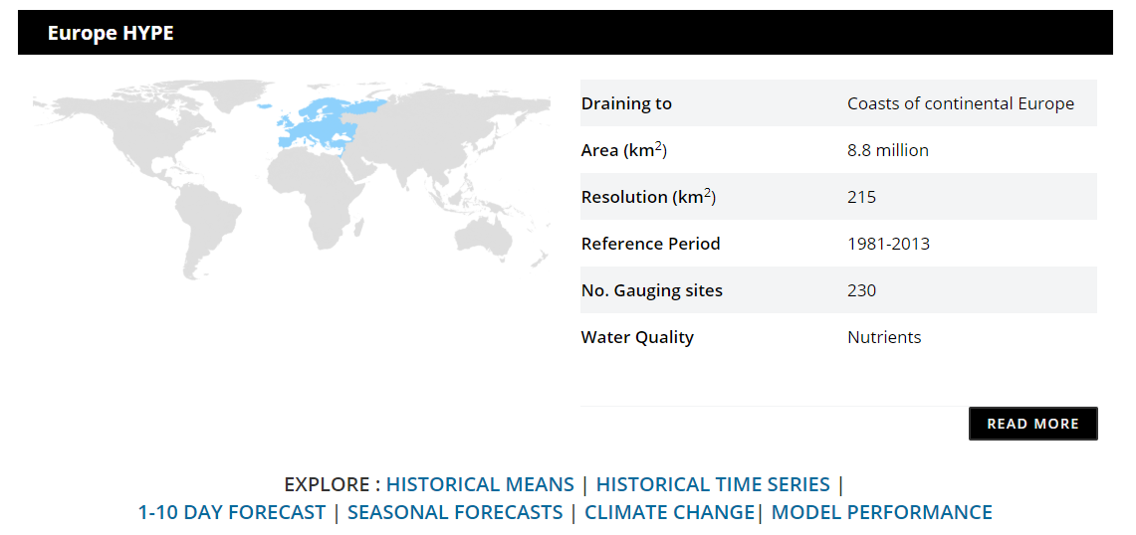
E-HYPE http://hypeweb.smhi.se
Donnelly, C, Andersson, J.C.M. and Arheimer, B. (2016): Using flow signatures and catchment similarities to evaluate a multi-basin model (E-HYPE) across Europe. Hydr. Sciences Journal 61(2):255-273, doi: 10.1080/02626667.2015.1027710
NEXT

Slide 7
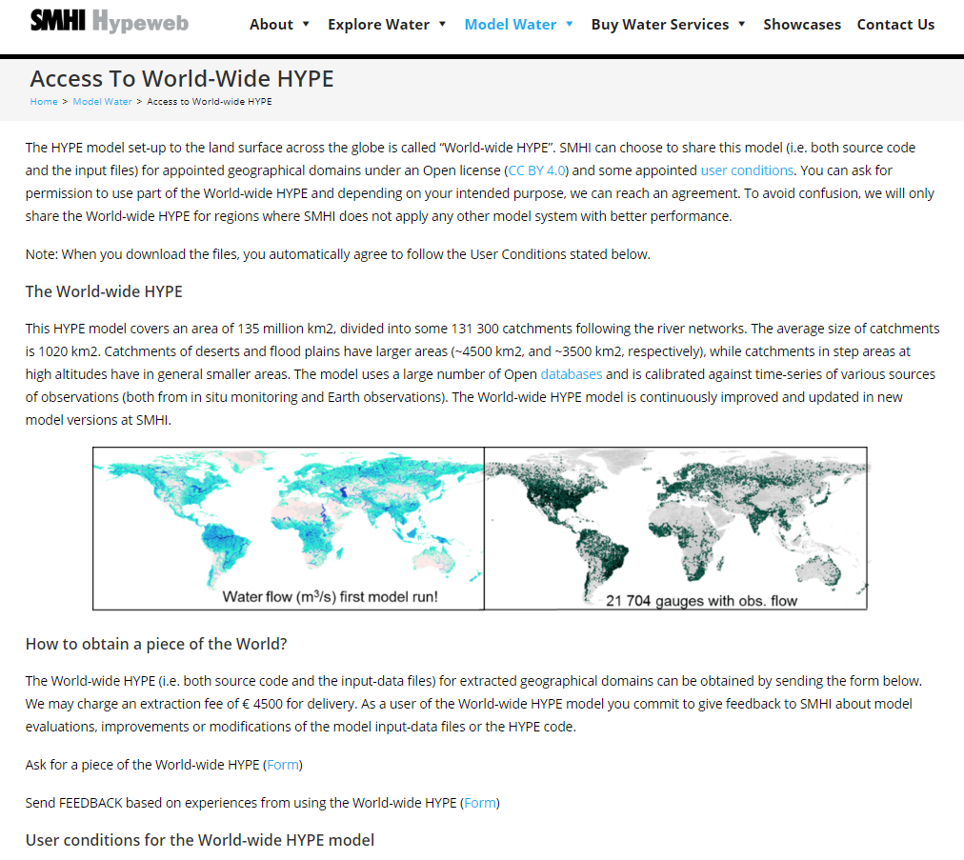
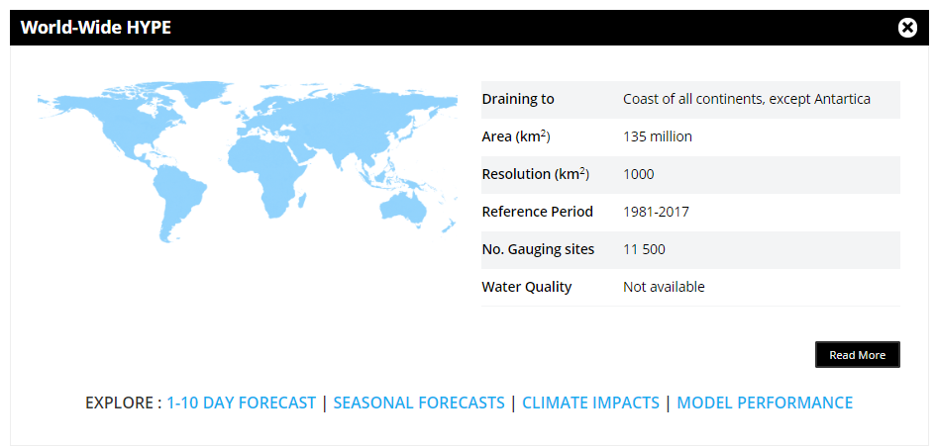
World-Wide HYPE http://hypeweb.smhi.se
Arheimer, B., Pimentel, R., Isberg, K., Crochemore, L., Andersson, J. C. M., Hasan, A., and Pineda, L.: Global catchment modelling using World-Wide HYPE (WWH), open data, and stepwise parameter estimation, Hydrol. Earth Syst. Sci., 24, 535–559, https://doi.org/10.5194/hess-24-535-2020, 2020.
START

Slide 8
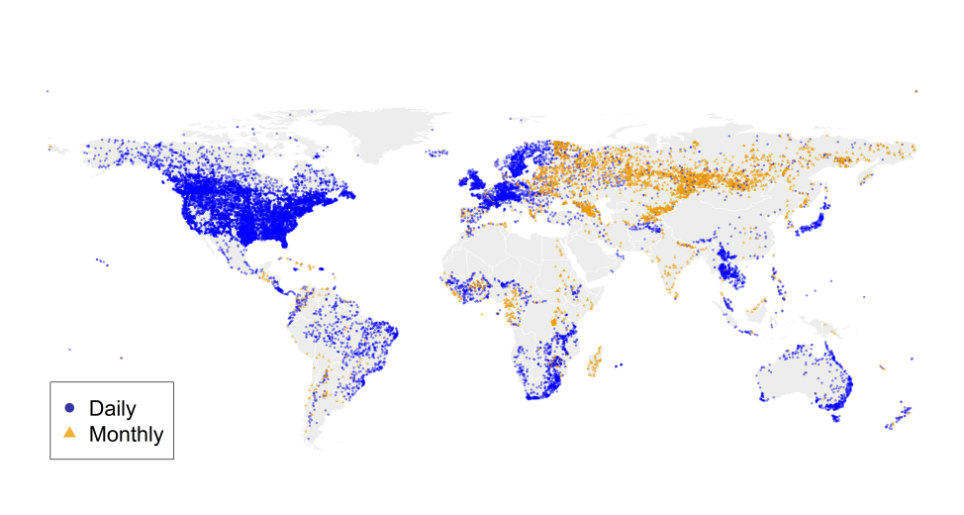
Hydrological observations
Short Name | Link | Coverage | Time series | Provider/References
GRDC | https://www.bafg.de/GRDC/ | Global | ~6900 | Global Runoff Data Center
EWA | https://www.bafg.de/GRDC/EN/04_spcldtbss/42_EWA/ewa.html | Europe | ~120 | GRDC – EURO-FRIEND-Water
Russian River data | https://rda.ucar.edu/datasets/ds553.2/ | Former Soviet Union | ~800 | Bodo, 2000
R-ArcticNet v 4.0 | http://www.r-arcticnet.sr.unh.edu/v4.0/ | Arctic | ~750 | Pan-Arctic Project Consortium
RIVDIS v 1.1 | https://daac.ornl.gov/RIVDIS/guides/rivdis_guide.html | Global | ~10 | Vörösmarty et al., 1998
USGS | https://waterdata.usgs.gov/nwis/sw | USA | ~6800 | U.S. Geological Survey
HYDAT | https://www.canada.ca/en/environment-climate-change/services/water-overview/quantity/monitoring/survey/data-products-services/national-archive-hydat.html | Canada | ~5000 | Water Survey of Canada (WSC)
Chinese Hydrology Data Project | https://depts.washington.edu/shuiwen/ | China | ~150 | Henck et al., 2011
Spanish Water Authorities |  | Spain | ~20 | Ecological Transition Ministry
WISKI | https://vattenwebb.smhi.se/station/ | Sweden | ~400 | Swedish Meteorological and Hydrological Institute
Crochemore et al., 2019. Lessons learnt from checking the quality of openly accessible river flow data worldwide. HSJ, https://doi.org/10.1080/02626667.2019.1659509
START

Slide 9
Forecasting skill
NEXT

Slide 10
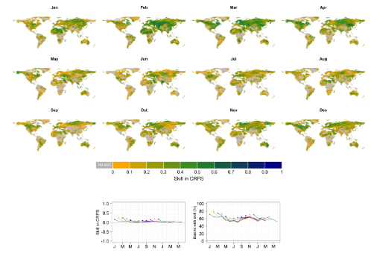
Forecasting skill
START

Slide 11
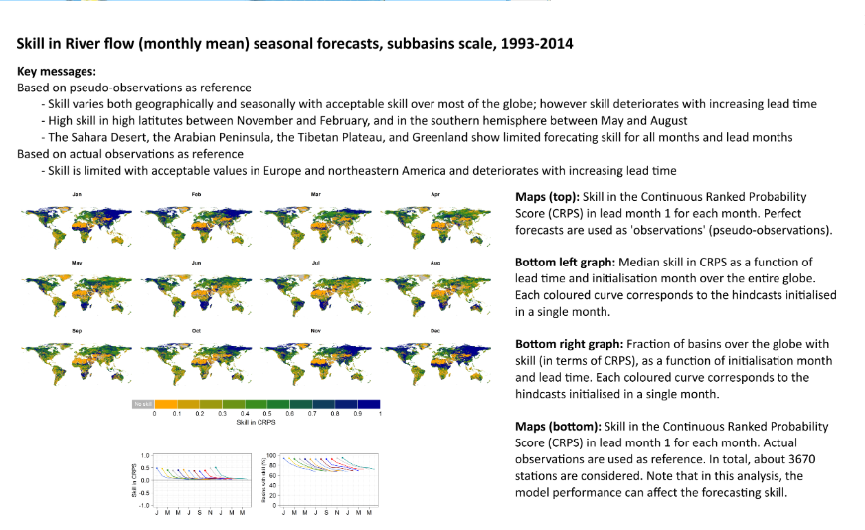
Forecasting skill
NEXT

Slide 12
Forecasting skill
START

Slide 13
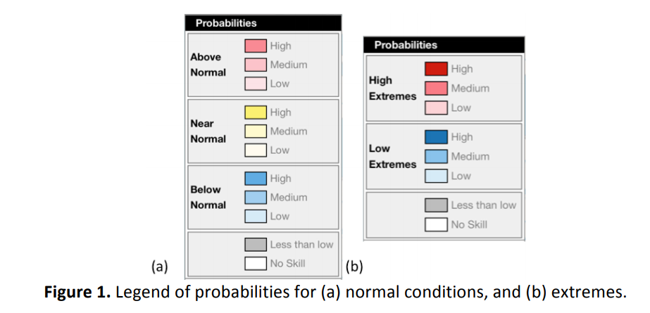
Forecasting certainty
Compare to normal conditions:
blue (yellow) [red] colors indicate the probability of forecasts being above (near) [below] normal conditions for the forecast month.
Normal conditions are defined with the 66th and 33rd percentiles based on a water balance simulation over 1985-2015. Percentiles are computed for monthly averages and for each calendar month.
Extremes (high and low):
blue [red] colors indicate the probability of forecasts being above [below] the extreme conditions for the forecast month.
Extreme conditions are defined with the 90th and 10th percentiles based on a water balance simulation over 1985-2015. Percentiles are computed for monthly averages and for each calendar month.
NEXT

Slide 14
Forecasting certainty
The intensity of the colour represents the forecast probability (percentage of ensemble members) of exceeding (falling in between) [falling below] the selected thresholds (either for the normal conditions or the extremes) within the forecast month.
The probability categories are defined:
high = 75 - 100%,
medium = 50 - 75%
low = 35 - 50%.
< 35% for crossing either threshold, the region is shown as grey on the map (“Less than low”).
START

Slide 15
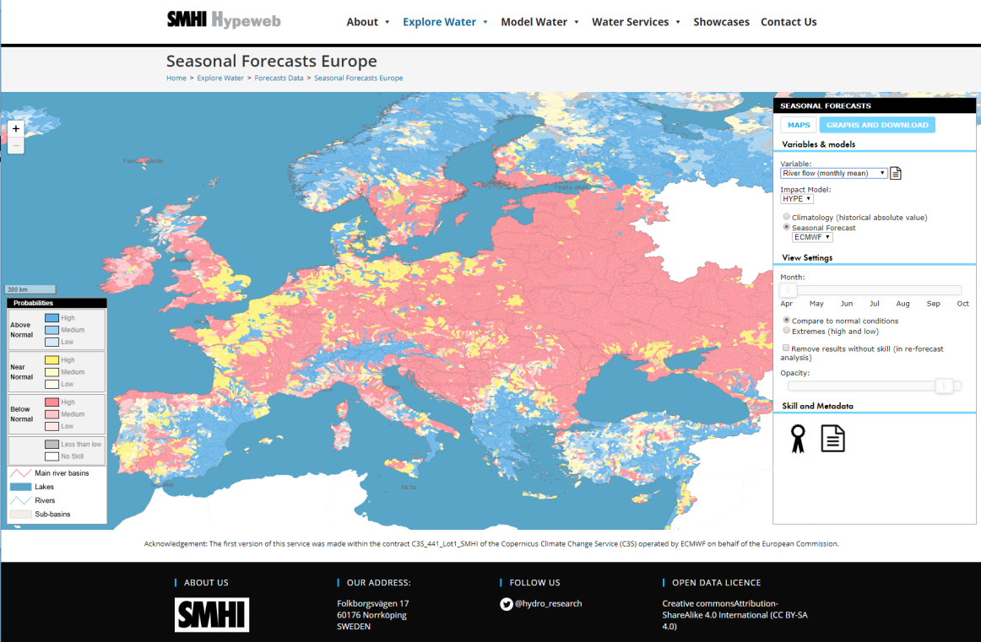
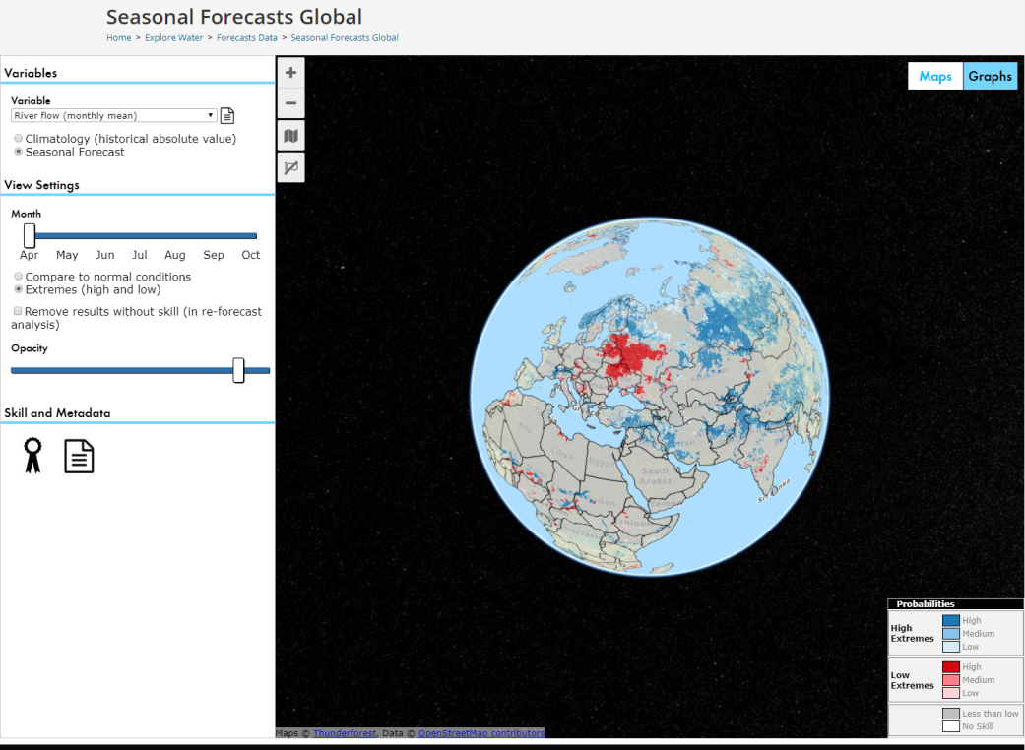
Hydro-meteorological outlook
Precipitation
Temperature
Discharge
Soil water content
Potential evapotranspiration
START

