Slide 1
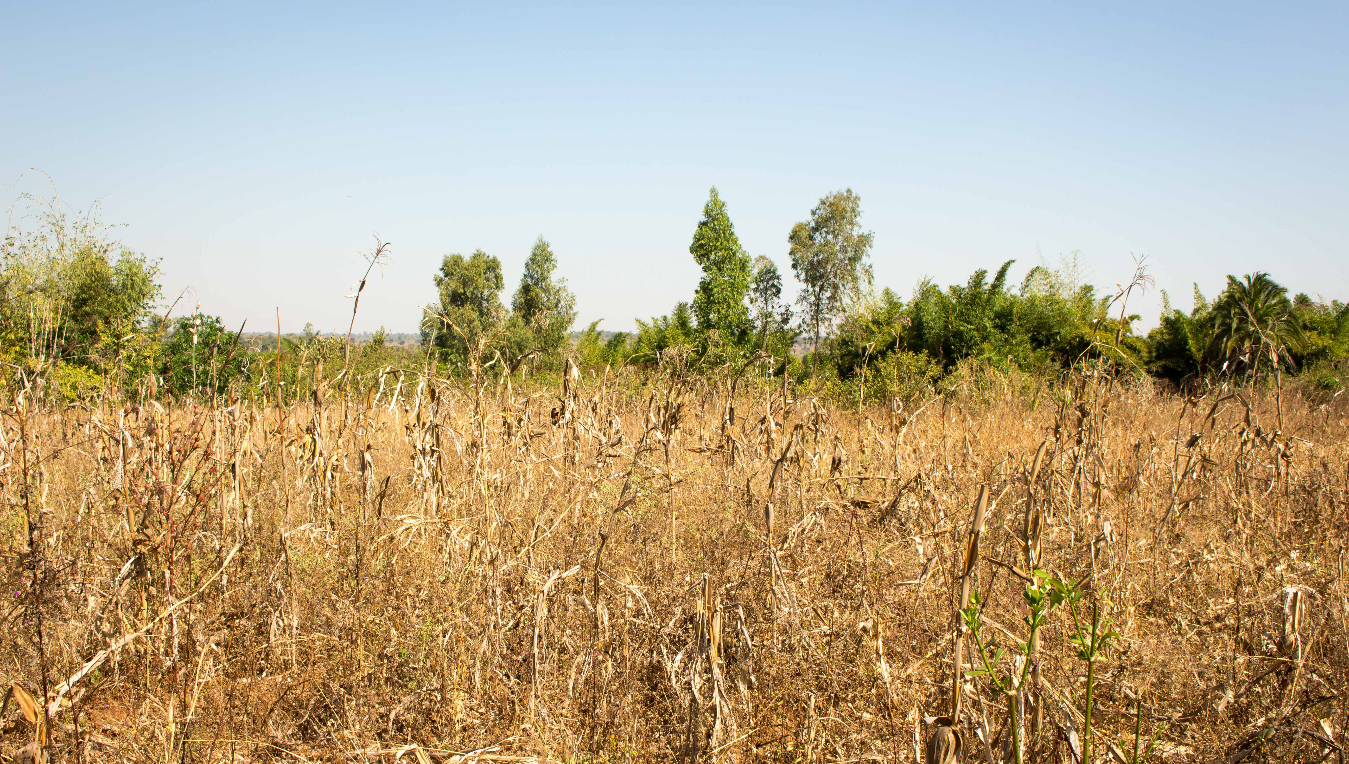




Linking Drought Forecast Information
to Smallholder Farmer’s Agricultural Strategies and Local Knowledge
in Southern Malawi
Ileen Streefkerk
Hessel Winsemius | TU Delft
Marc van den Homberg | 510
Micha Werner | IHE
Tina Comes |TU Delft
Maurits Ertsen | TU Delft
Neha Mittal | University of Leeds
Gumbi Gumbi | Malawi Red Cross Society
Link to Thesis Report
Notes:
Master Thesis of Ileen Streefkerk (MSc Civil Engineering, Water Management). Cooperation between TU Delft and 510: An Initiative of the Red Cross. Project: NERC SHEAR IPACE.
Purpose 510
Improve the speed, quality and cost-effectiveness of humanitarian aid by using data & digital products.

Slide 2


CONCLUSIONS
Tailoring of forecast information to farmers
Local knowledge indicators have predictive value
Forecast accuracy differs per location
Inclusion of local knowledge can potentially improve current forecast information for farmers
Notes:
Conclusions of study:
Forecast Information on the upcoming rainfall season can be usefull since farmers can adapt their strategies
The information that is currently received could be better tailored to the context of farmers
Local knowledge indicators (wind, temperature) can be captured in a technical approach and have predictive value for predicting drougt indicators
Accuracy of forecast differs per location (increased skill to south of Malawi)
Anwswer main question:
Inclusion of local knowledge can potentially improve current forecast information for farmers-> increase understanding and trust of farmers

Slide 3



RECOMMENDATIONS
Forecast model informed by local knowledge
  Robustness of model
  Include forecast products
Continuous feedback from farmers
  Threshold setting
  Required skill
  Etc.
Stakeholders
  Local knowledge
  Do not provide unskillful information
  Build upon existing capacities
Notes:
Some recommendations for stakeholders involved.
Forecast model
The robustness of the model has not yet been analysed.
Exploring the inclusion of other existing forecast products (wind or temperature) into the model, might give a longer lead time.
The farmers -> important to have continuous feedback with them, since you are desiging a product for them.
In this study, the threshold setting (i.e. How many dry spells of what period is critical to farmers) should be checked in the field and can differ per area.
The skill that is required for the farmer’s strategies might differ per decision and farmer. More can be explored on the willingness to act upon (wrong) forecast.
Stakeholders involved
Consider including local knowledge, either in communication or in production
Do not give unskillful forecast information, since it can have adverse impact on the farmers.
Build upon existing capacities (e.g. include farmers and schools in weather observations)

Slide 4
Linking Drought Forecast Information
to Smallholder Farmer’s Agricultural Strategies and Local Knowledge
in Southern Malawi
Ileen Streefkerk
Hessel Winsemius | TU Delft
Marc van den Homberg | 510
Micha Werner | IHE
Tina Comes |TU Delft
Maurits Ertsen | TU Delft
Neha Mittal | University of Leeds
Gumbi Gumbi | Malawi Red Cross Society
Link to Thesis Report
Notes:
Master Thesis of Ileen Streefkerk (MSc Civil Engineering, Water Management). Cooperation between TU Delft and 510: An Initiative of the Red Cross.
Purpose 510
Improve the speed, quality and cost-effectiveness of humanitarian aid by using data & digital products.

Slide 5
MAIN RESEARCH QUESTIONS
Can drought forecast information for smallholder farmers be improved by linking it to agricultural strategies and local knowledge in Southern Malawi?
Current Situation of
Smallholder Farmers
Forecast Model informed
by Local Knowledge
Notes:
The main research question is separated in two sub-questions:
The current situation of smallholder farmers in Malawi.
The development of a forecast model that is informed by local knowledge of the farmers.

Slide 6



CONTENT
Background
Situation of Smallholder Farmers
Forecast Model informed by Local Knowledge
Conclusions & Recommendations
Notes:
Firstly, background information is given on the topic drought and its impact and drivers in Southern Malawi. Afterwards, the results of the first and second research question are elaborated on. Finally, some conclusions and recommendations are drawn.

Slide 7







BACKGROUND | TYPES OF DROUGHT
Meteorological
Agricultural
Hydrological
Agricultural
Socio-Economic
Jul
Aug
Sep
Oct
Nov
Dec
Jan
Feb
Mar
Apr
May
Jun
Notes:
Drought is typically categorized in 4 types; meteorological, agricultural, hydrological, socio-economic.
This research focusses on agricultural drought. Agricultural drought is a deficit in soil moisture which causes a reduced crop yield or total crop failure resulting in devastating consequences for farmers. In Malawi, two season are apparent; the dry and rainy season. The rainy season is typically from November to April and is in line with the growing season of the stable crop maize. This is thus also the period agricultural drought has its impacts on.

Slide 8
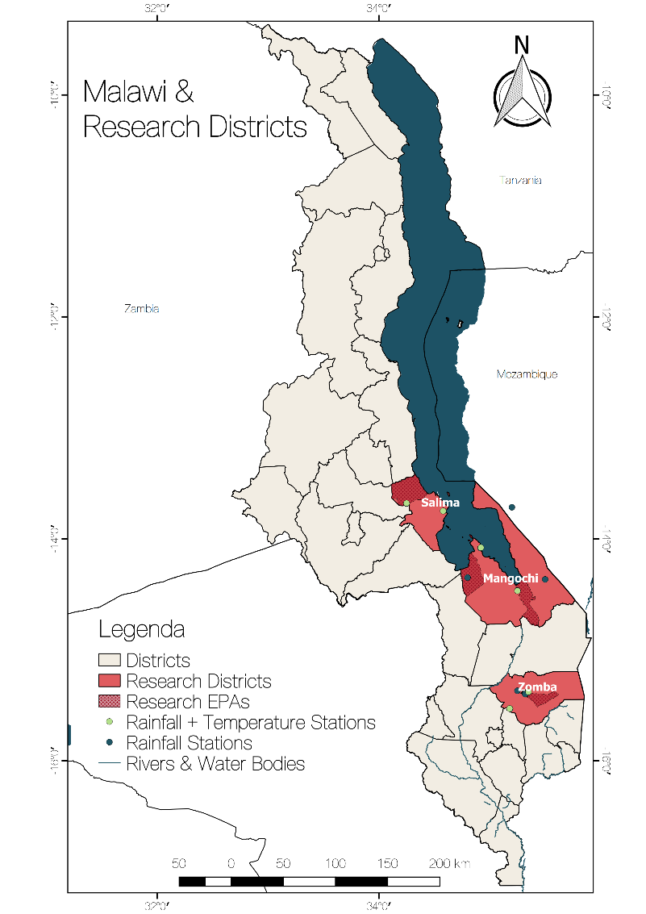
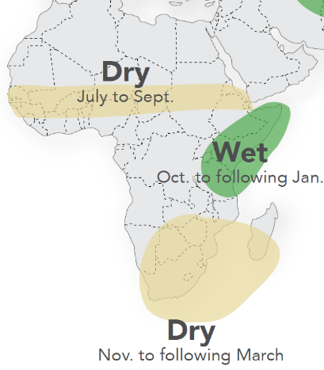
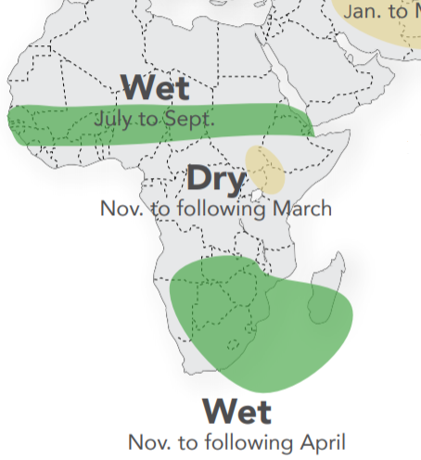
BACKGROUND | DRIVERS OF DROUGHT
El Niño La Niña
IRI©
Notes:
The main driver of drought in Malawi is the El Nino Southern Oscillation (ENSO) phenomena. Its impacts on Africa is illustrated in the two left illustrations. On the most right illustration the research districts are shown, all located in the Southern half of Malawi. During El Niño, Southern Malawi is abnormally dry while during La Niña Southern Malawi is abnormally wet during the rainy season.

Slide 9

AGRICULTURAL STRATEGIES
Clearing & Mulching
Manuring
Making (box) ridges
Seed/Crop Selection
Planting
Fertilizer appl.
(Light) Weeding
Harvesting & Storing
Grading & Marketing
Influenced by Drought
Not Influenced by Drought
Jul
Aug
Sep
Oct
Nov
Dec
Jan
Feb
Mar
Apr
May
Jun
?
Notes:
Here, the farm calender is illustrated starting in July and ending in June. The dry an rainy season, together with the growth period of the crop is illustrated. On the left we can see the practises farmers (generally speaking) undertake within a year. The timing and duration of the practises are indicated by the horizontal lines. Some of these practises are influenced by drought, other are not. When a practise is inluenced, a decision should be made.
For example, the expected timing of the rainy season determines the starting of the ridge making (in August). The onset of rain embarks the beginning of the rainy season. Whether a drought in the upcoming rainy season is expected (in September) determines what type of ridge is made and what type of seeds or crops are selected or bought. When a drought is expected, box ridges should be made and drought-resistand seeds of crops should be selected. These decisions require an investment, either in time (extra box ridge) or money (more expensive seeds). Futhermore, the expected timing of the onset of the rainy season also determines when to plant the seeds. The onset of the rain should therefore not be followed by a dry spell (causing the seeds not to germinate).

Slide 10

REQUIRED FORECAST INFORMATION IN TIME
?
Jul Aug Sep Oct Nov Dec Jan Feb Mar Apr May Jun
Timing of Onset
Start of ridge making
Timing of Onset
Planting
Drought?
- Seed selection
- Type of ridge
Notes:
The most important decisions/strategies of the previous slide are summarized above. It shows what forecast information of the drought indicators farmers would like to receive in what month:
In August the timing of the onset can inform the start of the ridge making
In September information on whether a drought is expected informed what seed of crop to select and what type of ridge to make.
In beginning of November updated informtion on the timing of the onset of rain can inform the planting of seeds.

Slide 11
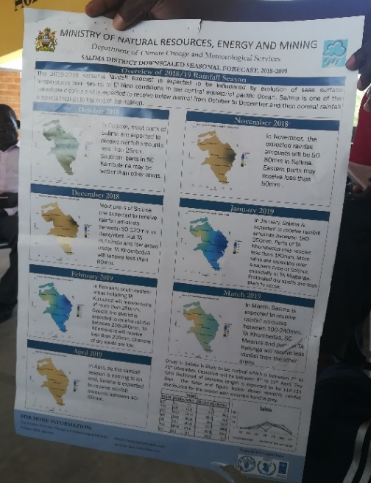


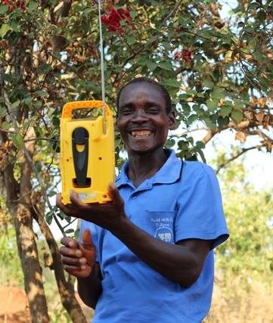

FORECAST INFORMATION
Produced by Farmers
Produced by National Meteorological Office
Local knowledge forecast
based on meteorological indicators:
ENSO
Seasonal forecast
from extension officers
Wind
Temperature
Weather updates
on radio
FRT ©
Notes:
Farmers recieve diffent kinds of forecast information.
The forecast produced by the farmers, the local knowledge forecast, is based observations of wind and temperature. For example, when it is cold in June, or Mwera winds (local name for South Easternly winds) prefail in September, they expect a drought in the upcoming rainy season.
The farmers also recieve a seasonal forecast from their agricultural extension officers and is produced by the meteorological office which is based on the ENSO phenomena. They also recieve weather updates on the radio. Although the farmers appriciate the forecasts they recieve, a ‘translation’ is needed from ‘technical’ forecast of the national meteorological office to agricultural advise.

Slide 12
AIM OF FORECAST MODELS
Can a forecast model that includes local knowledge indicators predict drought?
Timing of onset
Drought?
ENSO
?
Jul Aug Sep Oct Nov Dec Jan Feb Mar Apr May Jun
Timing of Onset
Start of ridge making
Timing of Onset
Planting
Drought?
- Seed selection
- Type of ridge
Number of Dry Spells
Drought Index
Notes:
Now, we would like to link the local knowledge and agricultural strategies to a scientific forecasting approach. To do so, two aims are created. Firstly, can a forecast model inclused local knowledge indicators to predict drought?
Here, we like to use wind, temperature and ENSO observations in the dry season to predict drought indicators in the rainy season; timing of onset and drought. Drought is expressed in the number of dry spells and a composite drought index. In this presentations we will just focus on the number of dry spells.

Slide 13
AIM OF FORECAST MODELS
Can local knowledge indicators predict drought?
Can it predict relevant drought indicators on time?
?
Jul Aug Sep Oct Nov Dec Jan Feb Mar Apr May Jun
3+ Dry Spells
- Seed selection
- Type of ridge
Notes:
In the second aim, we take it a step further. Can the model also predict the relevant drought indicators on time? After an historical analysis, we found that 3 or more dry spells (of 5 days) is already critical for the farmer’s practices. The farmers would like to receive that drought indicator information in September.

Slide 14
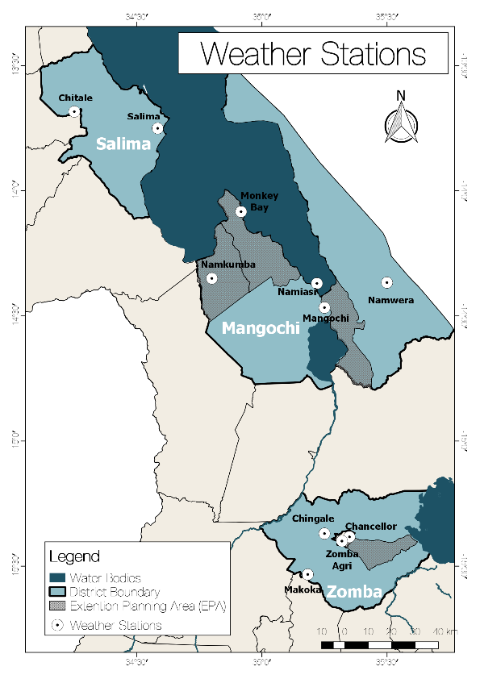
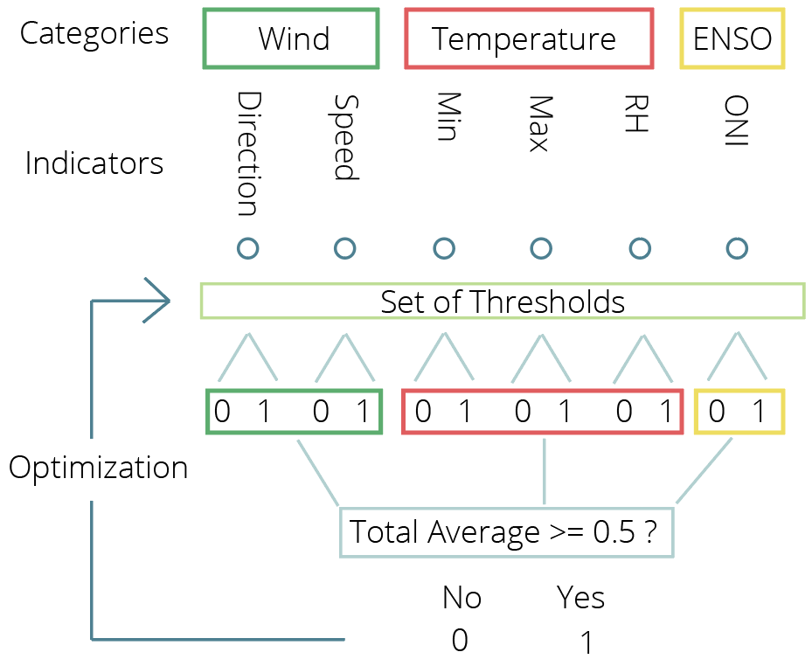
FORECAST MODEL
Preprocessing
Input
Model
Output
Monthly
Guided by Local Knowledge
Yearly
Weather Stations
Min & Max Temperature: 24-54 years
Reanalysis data (ERA5)
RH, Wind (direction & speed): 30 years
Oceanic Niño Index (ONI)
70 years
Notes:
Some steps are undertaken to go from data to output of the forecast model.
Firstly, the observed data of weather stations, reanalysis data (ERA5) that is informed by local knowledge and the Oceanic Niño Index (ONI) is preprocessed to form the ‘local knowledge indicators’. It differs per station which data is eventually included in the model; only the indicators that is significant correlated with the drought indicators are considered. Here, some observations were already made. For example, mostly wind and temperature indicators were correlated to the local drought indicators (timing of onset, # of dry spells)
Secondly, the monthly ‘local knowledge’ indicators (which were correlated) acts as input for the model. It thus differs per station which indicators are included in the model.
In the model, a set of thresholds in set for the indicators, theryby generating either a zero or one. This set of thresholds is optimized by the model.
The output gives a yearly binary outcome; either zero or one. In other words, the model forecasts in the dry season either a ‘drought’ (= 1) or ‘no drought’ (=0).
The output should then be verified with the observed data.

Slide 15

FORECAST VERIFICATION
 |  | Event Observed
 |  | Yes (1) | No (0)
Event Forecasted | Yes (1) | Hit | False Alarm
 | No (0) | Miss | Correct Negative
$$Hit Rate(HR)$$
$$False Alarm Rate (FAR)$$
$$Probability Of False Detection (POFD)$$
Notes:
This table illustrates how a forecast output can be verified with the observed data (whether a drought was actually observed or not). Different metrics can be defined to express that verification (HR, POFD, FAR).

Slide 16
FORECAST VERIFICATION
Model always forecasts an event
1
1
Increased Skill
Increased
Skill
Hit Rate (HR)
Hit Rate (HR)
No skill
No skill
Model never forecasts an event
0
Probability Of False Detection (POFD)
1
0
False Alarm Rate (FAR)
1
Notes:
By plotting the different metrics for different thresholds of ‘drought’, the skill of the forecast can be expressed (how well a forecast performs). So for example, we can try to predict either 2, 4, or 5 dry spells of more, depending on the severity of drought you want to predict.

Slide 17
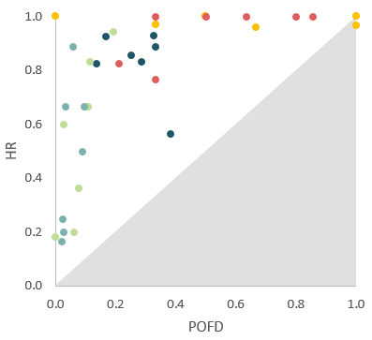
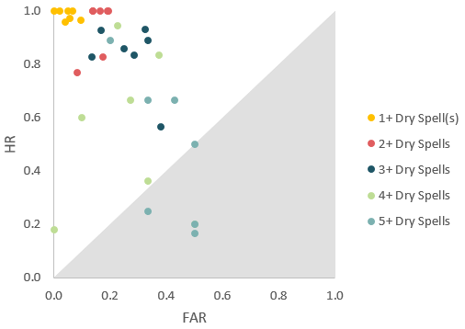
1) LOCAL KNOWLEDGE INDICATORS PREDICTIVE?
Notes:
This are the results for predicting the number of dry spells, every point represents a weather station. The results show that the model gives skill, however, predicting 5 or more dry spells gives no skill. However, we can conclude that the first aim is reached and that indicators that are informed by local knowledge have a predictive value in predicting the number of dry spells.

Slide 18
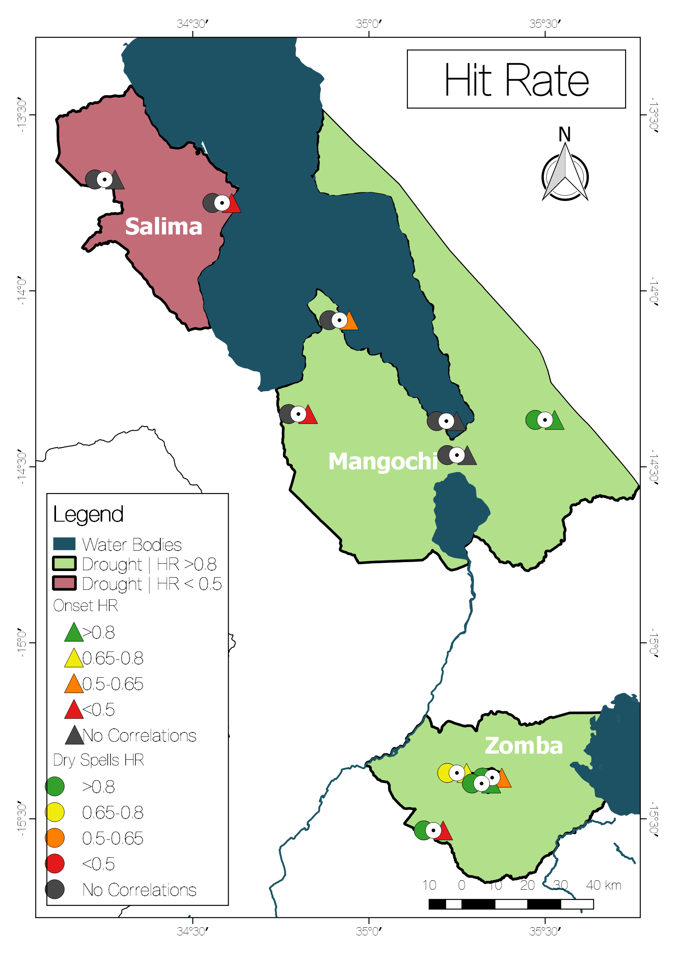
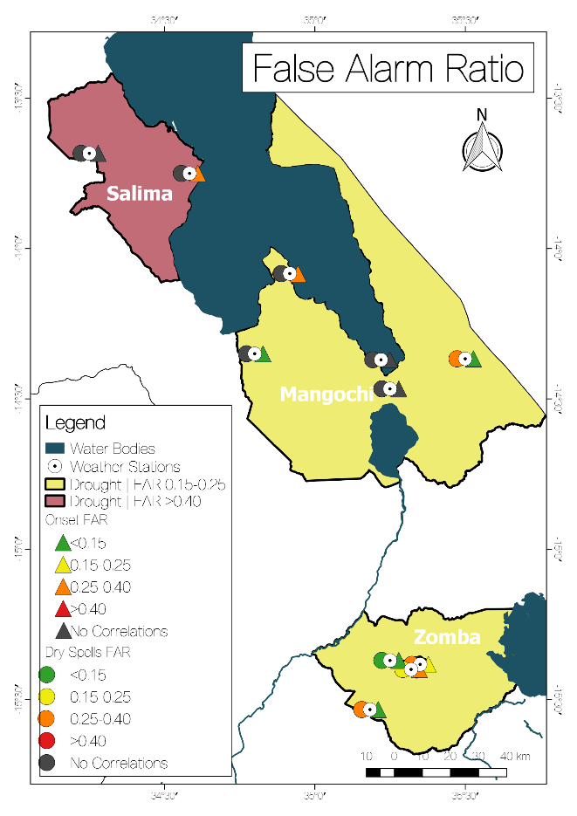
2) PREDICTING RELEVANT & TIMELY INFORMATION
Notes:
The results of the second aim are spatially illustrated. The left figure shows the hit rate, and the right figure the false alarm ratio. The white dots indicate the weather stations. Next to the stations are coloured circles and triangles and indicate the results for predicting ‘critical’ dry spells and onset, respectively. Green indicates a skillfull result, while red indicates no skill. Grey indicates that there are no correlated indicators, meaning there was also no input data for the model. The areas (districts) indicate the results for predicting the ‘drought index’, and have the same colour coding.
It can be observed that Southern locations show more skillfull results. This could have to do with the geographical features ( e.g. the lake and elevation).

Slide 19
CONCLUSIONS
Tailoring of forecast information to farmers
Local knowledge indicators have predictive value
Forecast accuracy differs per location
Inclusion of local knowledge can potentially improve current forecast information for farmers
Notes:
Some conclusions:
Forecast Information can be usefull since farmers can adapt their strategies
The current information could be better tailored to the context of farmers
Local knowledge indicators can be captured in a technical approach and have predictive value for predicting drougt indicators
Accuracy of forecast differs per location (increased skill to south)
Anwswer main question:
Inclusion of local knowledge can potentially improve current forecast information for farmers-> increase understanding and trust of farmers

Slide 20
RECOMMENDATIONS
Forecast model informed by local knowledge
  Robustness of model
  Include forecast products
Continuous feedback from farmers
  Threshold setting
  Required skill
  Etc.
Stakeholders
  Local knowledge
  Do not provide unskillful information
  Build upon existing capacities
Notes:
Some recommendations for stakeholders involved.
Forecast model
The robustness of the model has not yet been analysed.
Exploring the inclusion of other existing forecast products (wind or temperature) into the model, might give a longer lead time.
The farmers -> important to have continuous feedback with them, since you are desiging a product for them.
In this study, the threshold setting should be checked in the field and can differ per area.
The skill that is required for the farmer’s strategies might differ per decision and farmer. More can be explored on the willingness to act upon (wrong) forecast.
Stakeholders involved
Consider including local knowledge, either in communication or in production
Do not give unskillful forecast information, since it can have adverse impact on the farmers.
Build upon existing capacities (e.g. include farmers and schools in weather observations)

