Slide 1
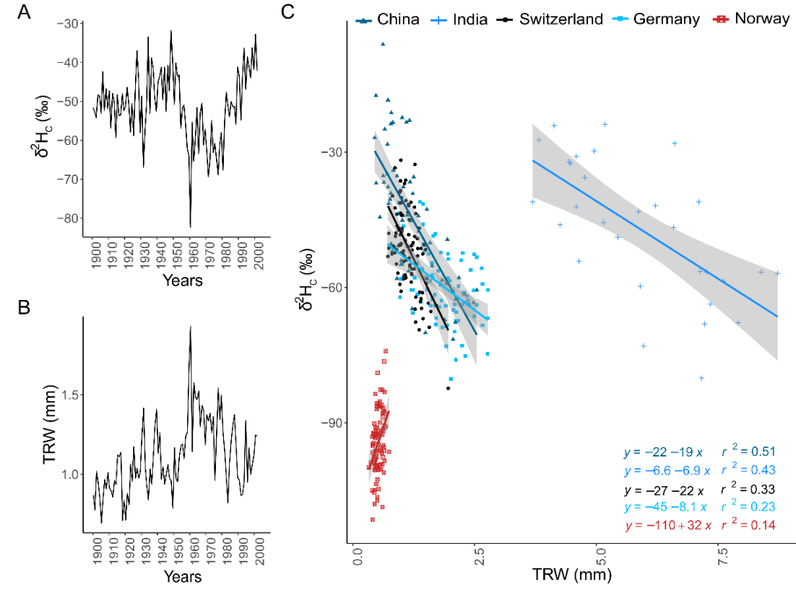
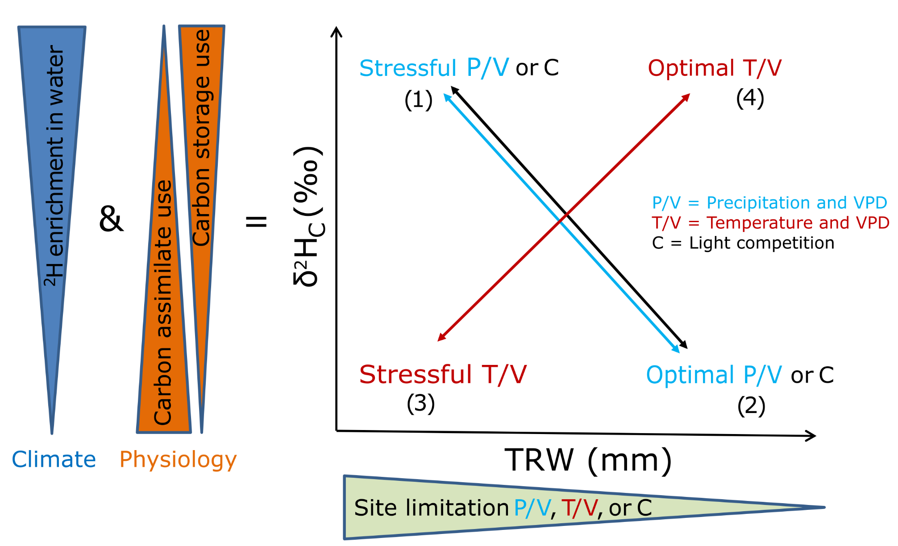
A new conceptual framework for the use of hydrogen isotopes in tree rings
Marco M. Lehmann*, Valentina Vitali, Philipp Schuler, Markus Leuenberger, Matthias Saurer *marco.Lehmann@wsl.ch
The analysis of hydrogen isotopes of tree-ring cellulose (δ²H_{C}) is still rarely applied, but might be a powerful indicator of plant physiological changes. Across 5 study sites in Europe and Asia we found significant relationships between the chronologies of tree-ring width (TRW) and δ²H_{C} in annual resolution (Fig. 1). We observed that when precipitation and light are the main growth limiting factors, this relationship was negative (r² = 0.23 - 0.51); but on a temperature-limited site it was positive (r² = 0.14).
Based on the δ²H_{C} – TRW relationships, we have developed a novel conceptual framework that may help to understand if trees used carbon storage or fresh assimilates for growth and when trees experienced stress conditions (Fig. 2). We strongly believe that this new concept could find widespread application in modern- and paleo-tree physiological and ecological studies focusing on climate extremes, carbon starvation, abiotic and biotic disturbances, and forest mortality. We acknowledge the large remaining gaps in the understanding of mechanisms driving ²H-fractionations, however, newest developments allow cheaper and more straightforward δ²H analysis of organic material helping to overcome this issues. Thus, the main purpose of this presentation is to stimulate scientists to consider δ²H_{C} as a potential tool in their future research.
Figure 1: (A) and (B): δ²H_{C} and TRW chronology of Quercus petraea from 1901 to 2002 of a Suisse (CHE) site. (C): Linear relationship (coloured lines) and confidence interval (grey area) between TRW and δ²H_{C} chronologies across five studies sites. All linear regression models were significant (P < 0.05). TRW-δ²H_{C} relationships are similar for both, raw TRW and detrended TRW.
Figure 2: Conceptual figure for the relationship between tree-ring width (TRW) and the hydrogen isotope ratio of tree-ring cellulose (δ²H_{C}). δ²H_{C} values are determined by climatic impacts affecting the δ²H values of environmental and plant water via evaporative effects, as well as by physiological changes reflecting the relative use of ²H-enriched carbon storage vs. ²H-depleted photosynthetic carbon assimilate. If hydro-climatic influences are low or can be excluded (e.g. via δ²H-δ¹⁸O relationships), δ²H_{C} mainly indicates the carbon use strategy of tree under specific environmental conditions. This information can then be combined with tree growth pattern. The TRW-δ²H_{C} relationship depends on site-specific limiting factors such as climate (i.e. precipitation, temperature, VPD) and light competition.

