Slide 1
Performance Evaluation of different time schemes for a Nonlinear diffusion equation on multi-core and many core platforms
Lucas Bessone, Pablo Gamazo,
Julián Ramos, and Mario Storti

Slide 2
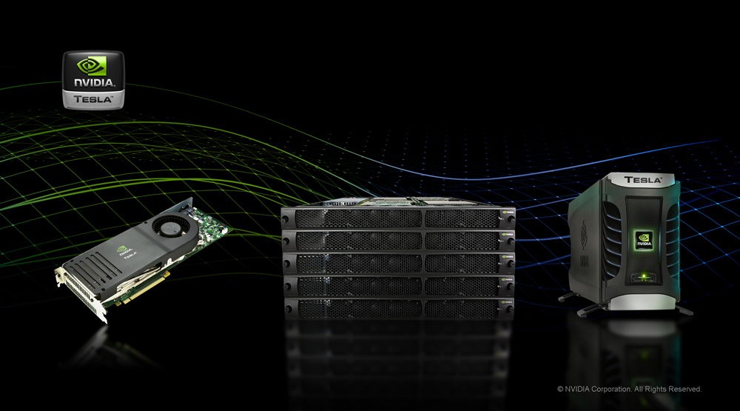
HPC platform
CPU vs GPU

Slide 3
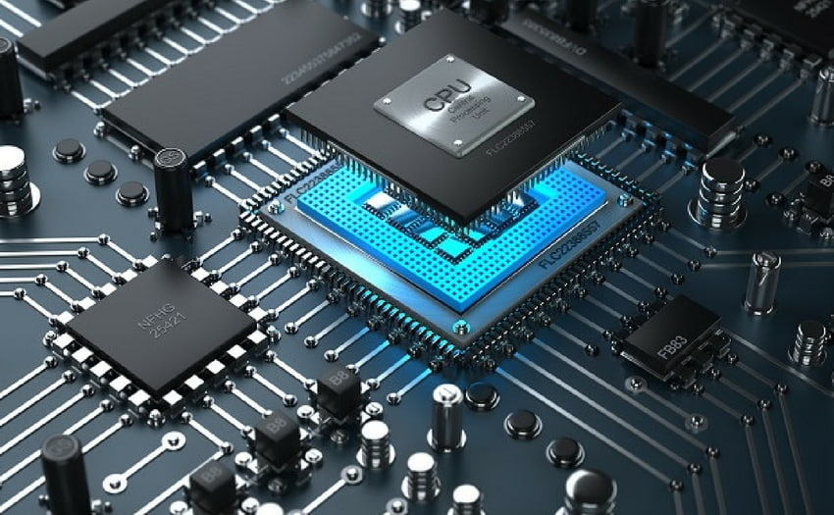
CPU
STRENGTHS
Large main memory
Very fast clock speeds
Optimized latency across large caches
WEAKNESSES
Few threads
Relatively low memory bandwidth
Loss of cache is very expensive
Low ratio performance/watt
Intel Xeon E5-2620 v2 (Oct/2013) ($Usd 400x2)
Max Bandwich 51,2GB/s, Cores: 6x2=12
Max Memory 768GB
Intel Xeon Gold 6138 (jul/2017) ($Usd 2612x2)
Max Bandwich 119,21GB/s , Cores: 20x2=40
Max Memory 768GB
Few threads can run very quickly

Slide 4
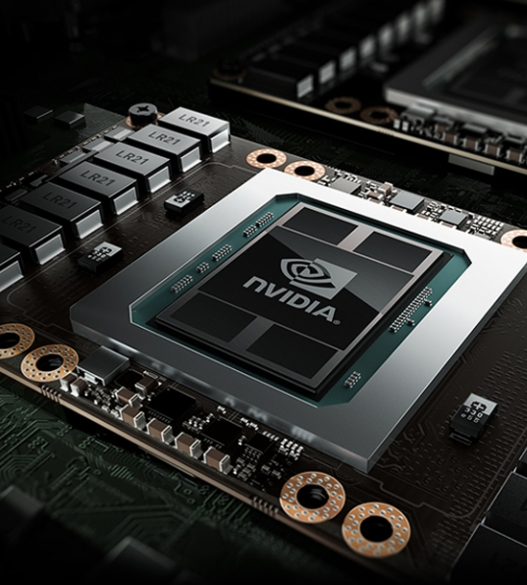
GPU
STRENGTHS
High main memory bandwidth
Latency tolerant via parallelism
Significantly more computing resources
High throwput
High ratio performance/watt
WEAKNESSES
Relatively low memory capacity
Poor performance per thread
Nvidia tesla K40 (Oct/2013) ($Usd 750)
Max Bandwich 288GB/s, Cores: 2880
Max Memory 12GB
Nvidia Tesla V100 (jun/2017) ($Usd 12000)
Bandwich 900GB/s, Cores: 5120
Max Memory 32GB
Lots of threads can be run simultaneously

Slide 5
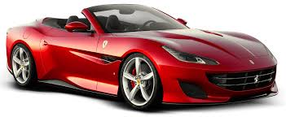
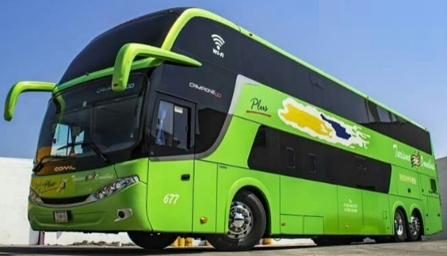
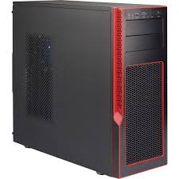
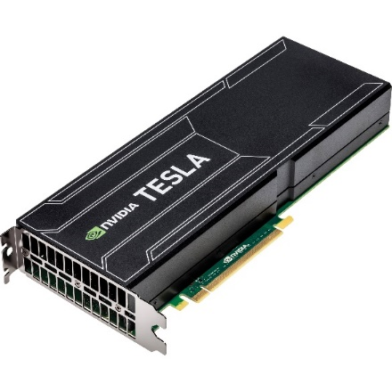
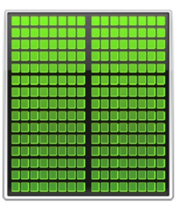
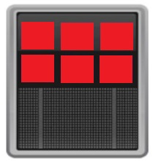
Speed
Throwput
CPU
Optimized for serial calculations
GPU
Optimized for parallel calculations

Slide 6
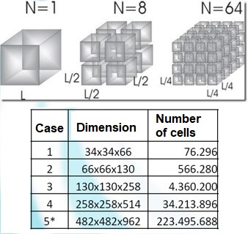
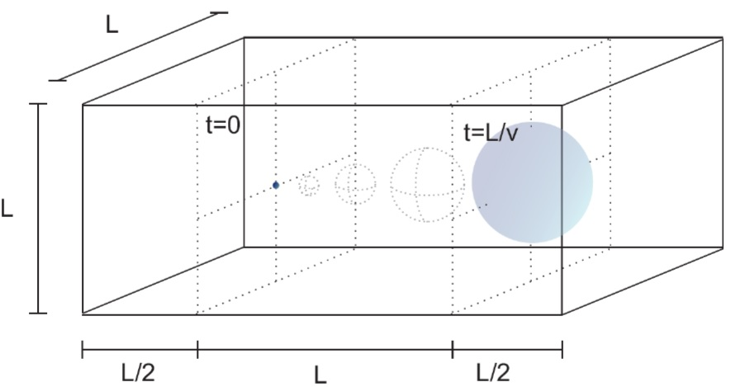
Previous research about GPU performance…
$$\frac{∂φ}{∂t}=∇.\left(D∇φ\right)−∇.\left(vc\right)$$
Case study: transport of a pulse in a domain $L×L×2L$, for a time $t=v/L$, with$D=0,1L/4v$
Bondarenco et al. compared implementations of explicit and implicit algorithms in GPU and CPU for the solution of the linear transport equation in 3D
- Bondarenco, M., Gamazo, P., & Ezzatti, P. (2017). A comparison of various schemes for solving the transport equation in many-core platforms. The Journal of Supercomputing, 73(1), 469-481.
- Bondarenco, M. (2018). Paralelización de la ecuación del transporte en arquitecturas de hardware masivamente paralelas. MSc thesis.

Slide 7
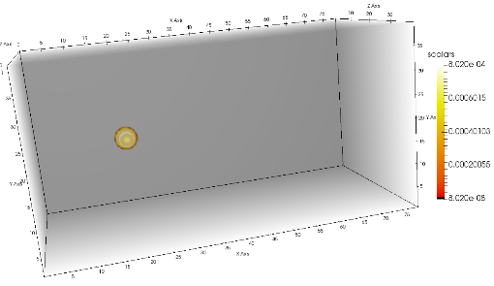
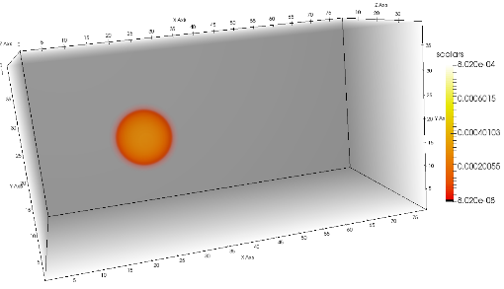
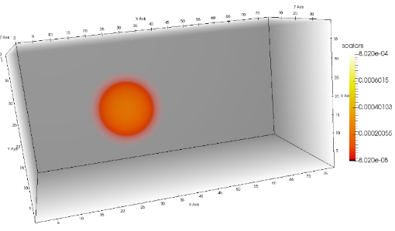
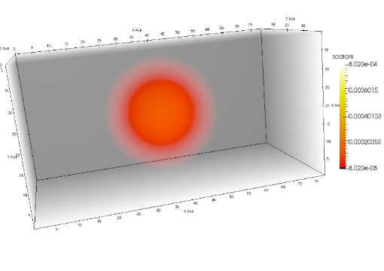
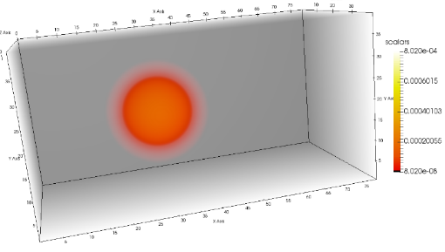
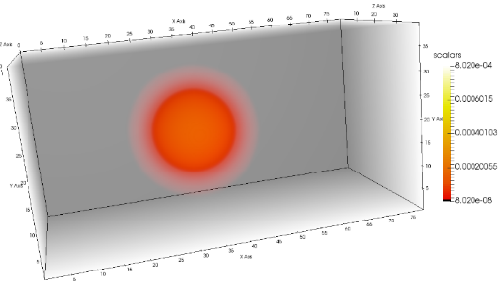
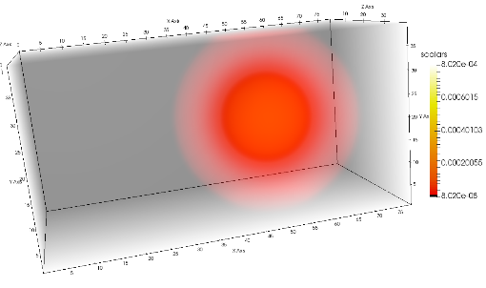
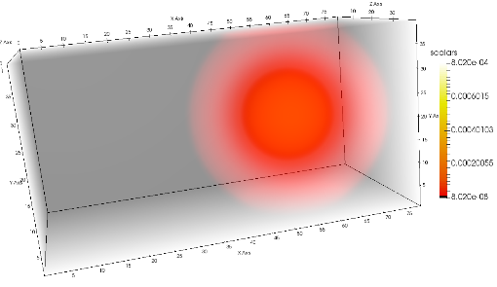
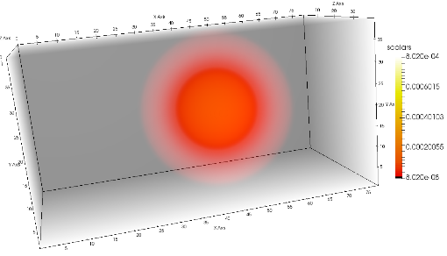
Previous research about GPU performance…
Bondarenco et al. compared implementations of explicit and implicit algorithms in GPU and CPU for the solution of the linear transport equation in 3D

Slide 8
Previous research about GPU performance…
Bondarenco et al. compared implementations of explicit and implicit algorithms in GPU and CPU for the solution of the linear transport equation in 3D

Slide 9
Previous research about GPU performance…
They found that for a linear transport equation, explicit method consume 10 times less time for a “large” simulation.
In this work we will study if this trend is maintained for nonlilnear problems.
- Bondarenco, M., Gamazo, P., & Ezzatti, P. (2017). A comparison of various schemes for solving the transport equation in many-core platforms. The Journal of Supercomputing, 73(1), 469-481.
- Bondarenco, M. (2018). Paralelización de la ecuación del transporte en arquitecturas de hardware masivamente paralelas. MSc thesis.

Slide 10
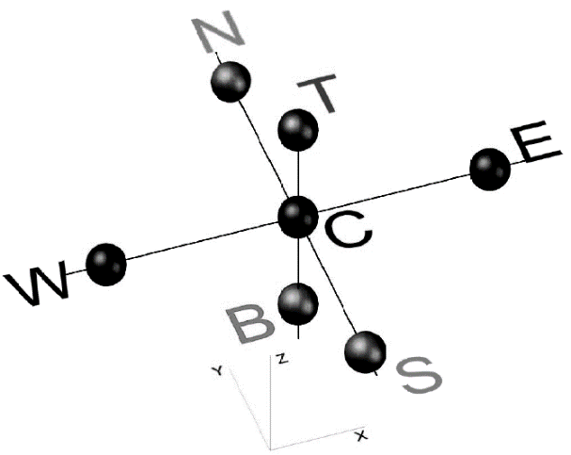
Non linear diffusion equation
In this work, a nonlinear diffusion equation was solved:
$\frac{∂φ}{∂t}=∇.\left(D\left(φ\right) ∇φ\right)+f$, in $Ω=\left[0,1\right]×\left[0,1\right]×\left[0,1\right]$
$φ=0$, on $∂Ω$, with $φ\left(0\right)=φ^{0}$ in $Ω$
For the case study we consider:$D\left(φ\right)=diag\left(κ\left(φ+1\right)\right)$
The Finite Volume method was used in uniform cartesian meses (equivalent to finite differences)
Two method were compared: pure explicit (Forward Euler) and implicit (Crank Nicolson)
Nomenclature: computational molecule

Slide 11
Non linear diffusion equation:
Spatial and temporal discretization
$$\frac{∂φ}{∂t}=∇.\left(D\left(φ\right) ∇φ\right)+f$$
Explicit scheme: forward differences in time and centered scheme (CD) in space
$$φ_{C}^{n+1}=φ_{C}^{n}+f_{C}^{n}Δt+\frac{κΔt}{2h^{2}}\left[\sum_{F\sim \left\{E,N,W,S,T,B\right\}}{{\left(φ_{F}^{n}+1\right)}^{2}}−6{\left(φ_{C}^{n}+1\right)}^{2}\right]$$
Boundary conditions: second order approximations were implemented at the boundary for all cases analyzed

Slide 12
Non linear diffusion equation:
Spatial and temporal discretization
$$\frac{∂φ}{∂t}=∇.\left(D\left(φ\right) ∇φ\right)+f$$
Implicit scheme: time centered differences and space centered scheme (CD)
$$\frac{{φ_{C}^{n+1}−φ}_{C}^{n}}{Δt}h^{3}=\frac{κh^{2}}{2}\left[\sum_{F\sim NB(C) }{\left(\frac{\left(φ_{C}^{n}+1\right)+\left(φ_{F}^{n}+1\right)}{2}\right)\left(\frac{\left(φ_{F}^{n}−φ_{C}^{n}\right)}{h}\right)+f_{C}^{n}h}\right]$$
$$+\frac{κh^{2}}{2}\left[\sum_{F\sim NB(C) }{\left(\frac{\left(φ_{C}^{n+1}+1\right)+\left(φ_{F}^{n+1}+1\right)}{2}\right)\left(\frac{\left(φ_{F}^{n+1}−φ_{C}^{n+1}\right)}{h}\right)+f_{C}^{n+1}h}\right]$$
At each time step, a nonlinear system of equations must be solved. For this, the Newton-Raphson method was used.

Slide 13
Hardware & Software
Computer equipment 1:
Dell PowerEdge R720, 2 Intel Xeon CPU E5-2620v2 processors.
12 (6x2) Cores of 2,1 GHz, Sandy-Bridge architecture with 128GB DDR3 RAM.
GPU NVIDIA K40, 2880 CUDA cores running at 745MHz, with 12GB DDR5 connected to CPU via PCI-e.
Computers equipment 2:
Dell PowerEdge R740, 2 Intel Xeon Gold 6138 .
40 (20x2) Cores of 2GHz, with 128GB DDR4.
CentOS Linux v7.5 operating system
CUDA GCC 4,8,5 compiler, nvcc v9.1 and OpenMP compiler.
Double precision (DP) implementations.
Linear algebra operations via CuBlas.

Slide 14
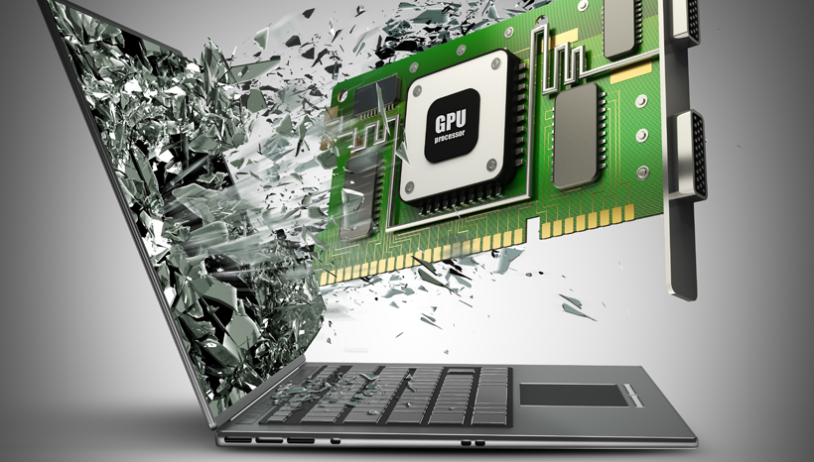
GPU and CPU implementation details

Slide 15
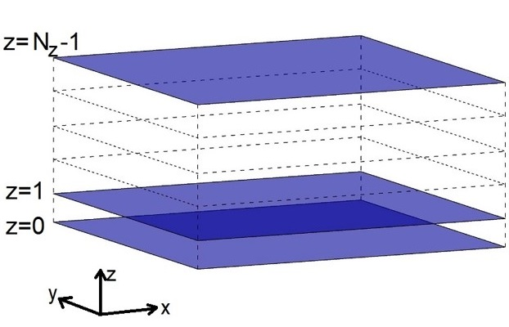
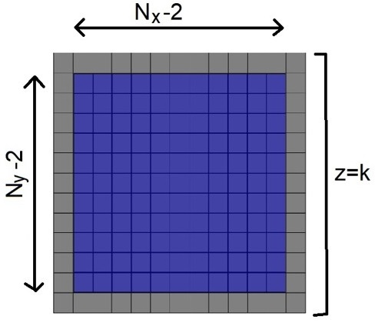
Implementation details. Parallelization of the explicit method
CUDA’s SIMT (Single Instruction Multiple Threads) architecture was taken into account.
The following scheme was adopted: 8 kernels for the vértices of the domain, 12 kernels for the edges, 6 kernels to process the faces, 1 kernel for the interior of the domain.

Slide 16
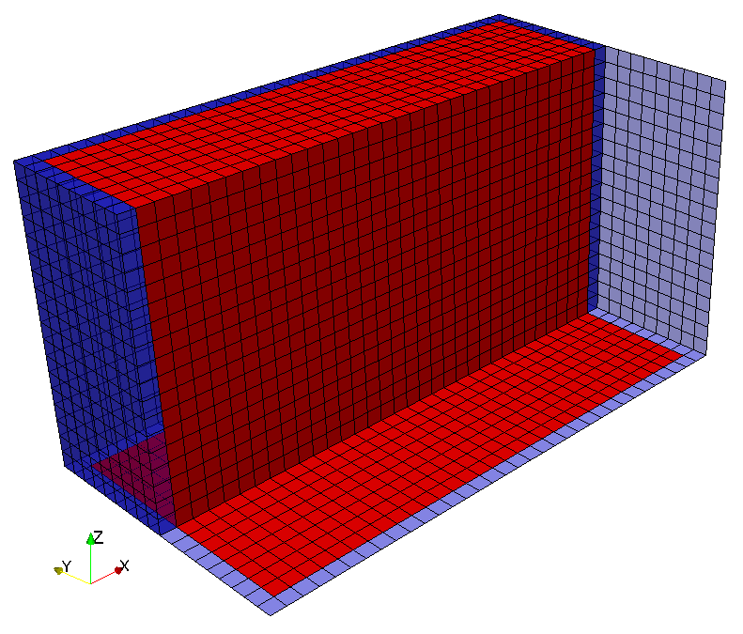
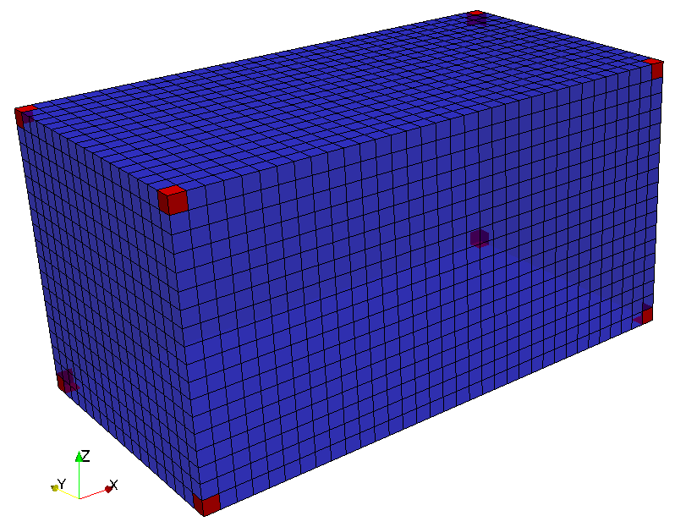
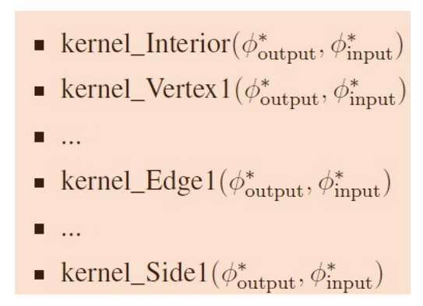
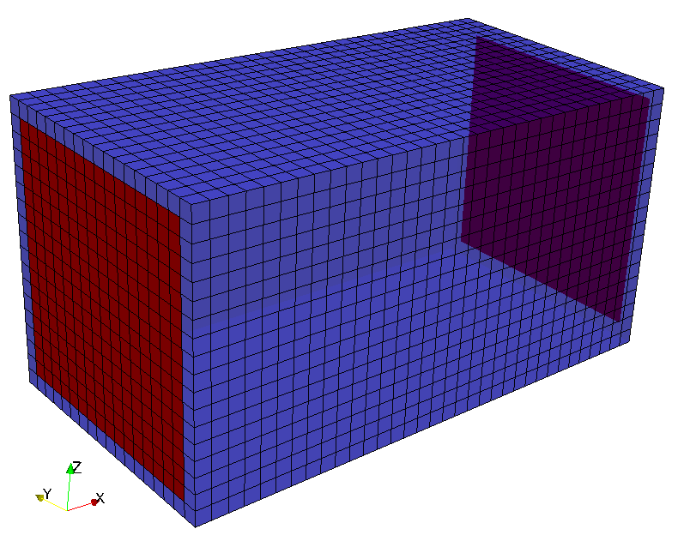
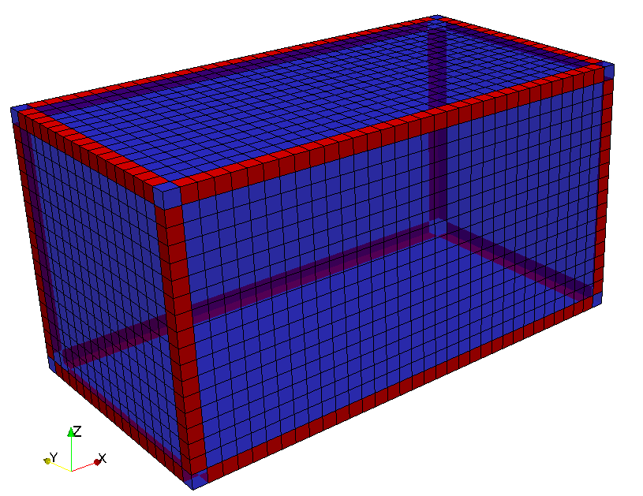
Implementation details. Algorithm: explicit method
$φ_{input}^{∗} φ^{n}$ (initial state vector), $φ_{output}^{∗} { φ}^{n+1}$ (new solution)
$t t+Δt$
Update solution:
Device sincronization
Pointer swap: $φ_{input}^{∗} φ_{output}^{∗}$
While ($t<T$) go back to step 2, else return

Slide 17
Implementation details. Algorithm: implicit method
The calculations consist of the following kernels:
The matrix is SPD and the CG (Conjugate Gradient) solver was used (using matrix free style).
Processing methodology similar to explicit: via non-concurrent kernels.
Product of a row of the matrix $J(φ^{\left(k\right)})$ by an auxiliary vector of the solver (the matrix is not saved).
Residual computation $R(φ^{\left(k\right)})$.

Slide 18
Implementation details Comparison explicit - implicit
$$φ_{C}^{n+1}=φ_{C}^{n}+f_{C}^{n}Δt+\frac{κΔt}{2h^{2}}\left[\sum_{F\sim \left\{E,N,W,S,T,B\right\}}{{\left(φ_{F}^{n}+1\right)}^{2}}−6{\left(φ_{C}^{n}+1\right)}^{2}\right]$$
Explicit
Residual in the implicit algorithm:
Jacobian:
$$R_{C}^{(k+1)}=\frac{h^{3}}{Δt}\left[φ_{C}^{n}−φ_{C}^{\left(k\right)}+\frac{Δt}{2}\left(f_{C}^{n}+f_{C}^{n+1}\right)\right]$$
$$+\frac{κh}{4}\left[\sum_{F\sim \left\{E,N,W,S,T,B\right\}}{{\left(φ_{F}^{n}+1\right)}^{2}}−6{\left(φ_{C}^{n}+1\right)}^{2}\right]$$
$$+\frac{κh}{4}\left[\sum_{F\sim \left\{E,N,W,S,T,B\right\}}{{\left(φ_{F}^{(k)}+1\right)}^{2}}−6{\left(φ_{C}^{(k)}+1\right)}^{2}\right]$$
$$\frac{∂R}{∂φ_{C}^{n+1}}\left(φ^{(k)}\right)=\frac{h^{3}}{Δt}+3κh\left(φ_{C}^{(k)}+1\right)$$
$$\frac{∂R}{∂φ_{F}^{n+1}}\left(φ^{(k)}\right)=−\frac{κh}{2}\left(φ_{F}^{\left(k\right)}+1\right)$$
with $F\sim \left\{E,N,W,S,T,B\right\}$

Slide 19
Implementation details. Algorithm: implicit method
$φ_{input}^{∗} φ^{n}$ (initial state vector), $φ_{output}^{∗} { φ}^{n+1}$ (new solution)
$t t+Δt$.
Compute initial residual $R\left(φ^{\left(0\right)}\right)$ via non-concurrent kernels, sincronization.
Compute the norm of initial residual $r^{\left(0\right)}$.
Solve the linear system with CG solver.
$φ^{(k+1)} φ^{(k)}+Δφ^{(k)}$ axpy operation with non-concurrent kernels, sincronization.
Compute residual vector $R\left(φ^{(k)}\right)$ with non-concurrent kernels, sincronization.
Compute the residual norm $r^{\left(k\right)}$.
If ($r^{(k)}>tol_{rel} r^{(0)}+tol_{abs}$) back to step 5, else continue (and set $φ^{(k+1)}$ as updated solution $φ^{n+1}$).
Pointer swap: $φ_{input}^{∗} φ_{output}^{∗}$.
While ($t<T$) go back to step 2, else return.

Slide 20
Implementation details. CPU implementation
As for CPU solutions, they are built similarly using OpenMP directives for parallel execution of different loops. This means that the same operations are performed as in the GPU code, obtaining the same numerical result. There isn’t much more detail to say about the CPU OpenMP implementation.

Slide 21
Case study: analytical solution

Slide 22
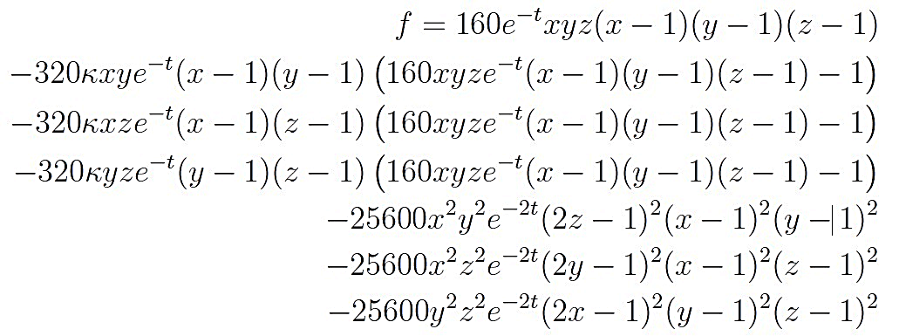
To evaluate the errors in the different implementations, the following analytical solution was considered:
$$φ\left(x,t\right)=160e^{−t}\left(x−x^{2}\right)\left(y−y^{2}\right)\left(z−z^{2}\right)$$
Then $f$ is calculated so that $φ(x,t)$ satisfies the differential equation:

Slide 23
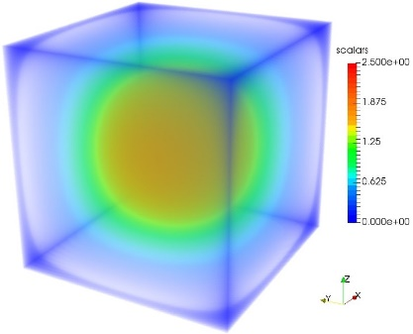
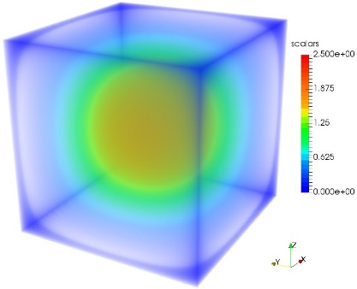
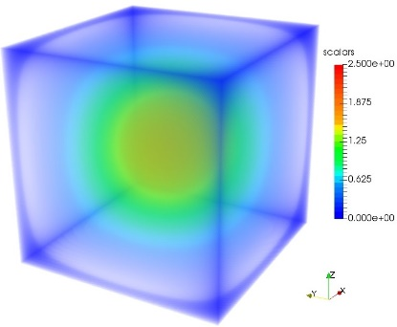
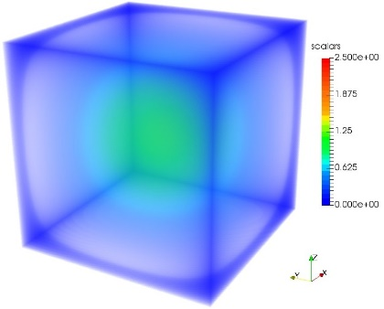
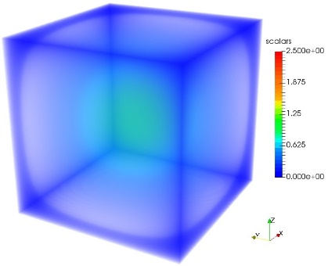
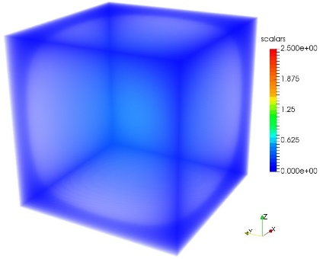
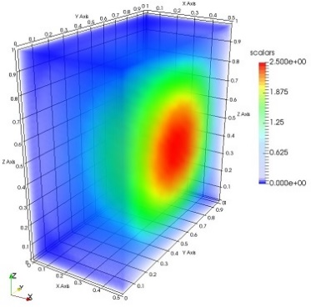
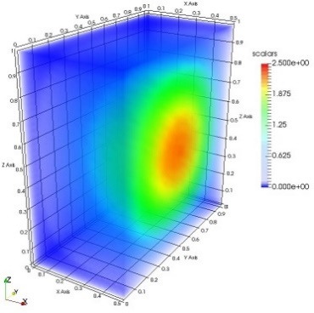
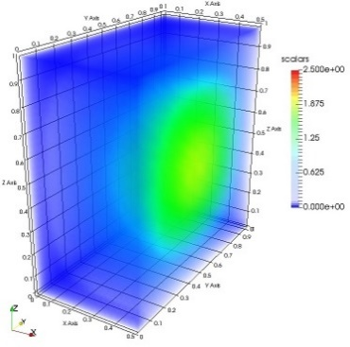
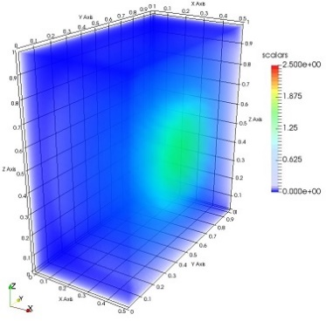
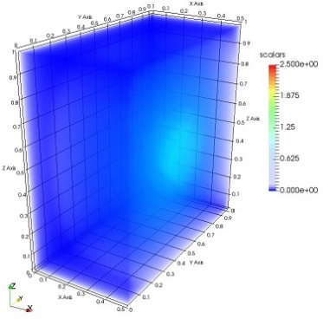
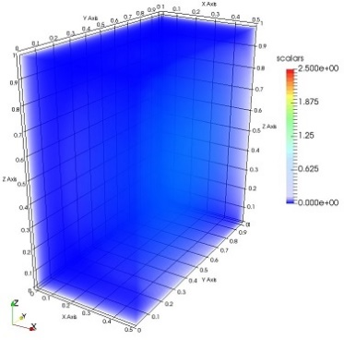
Numerical result:

Slide 24
Numerical result:

Slide 25
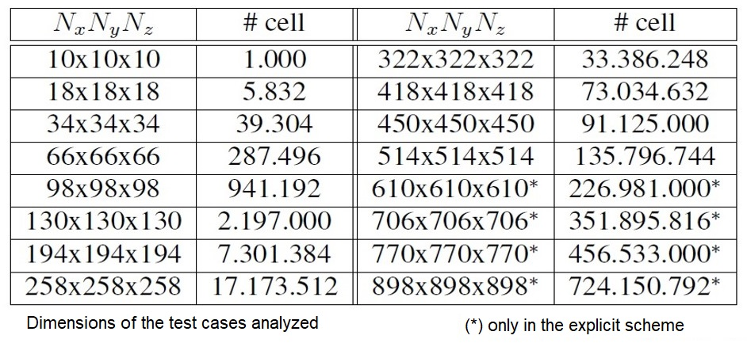
Error analysis and numerical convergence
The following configurations were considered:
Dimension of the test cases analyzed
(*) problem to big to solve with the implicit scheme, only the explicit scheme was applied
Error calculated with $RMS=\sqrt{\frac{1}{N_{x}N_{y}N_{z}}\sum_{i=1}^{N_{x}N_{y}N_{z}}{{\left(φ_{i,exac}−φ_{i,num}\right)}^{2}}}$

Slide 26
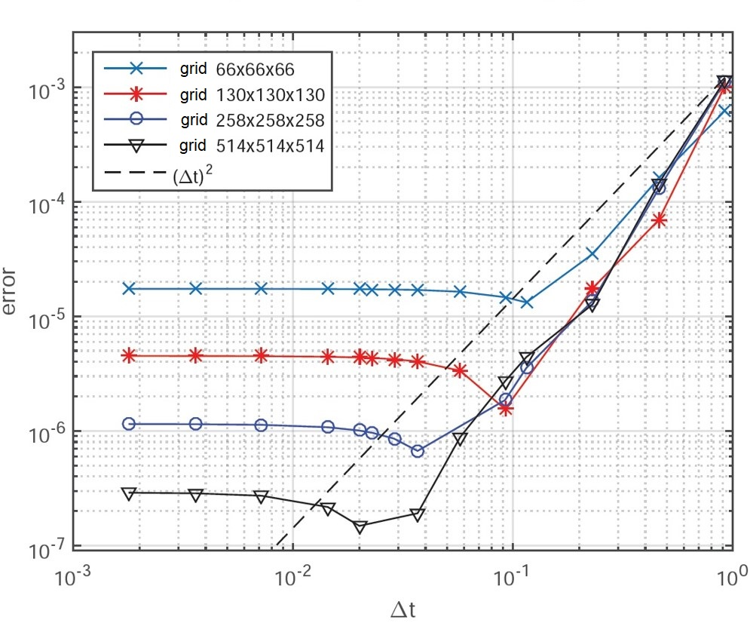
Temporal scheme convergence

Slide 27
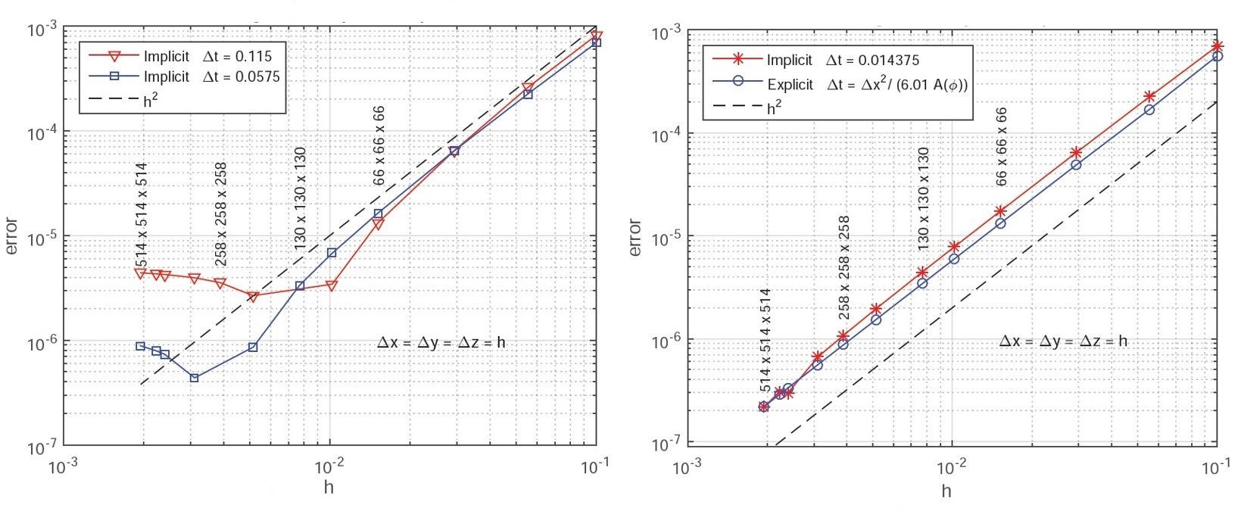
Spatial scheme convergence

Slide 28
Performance analysis This is a measure of how parallelism is exploited
The speed at which the cells are processed was evaluated as follows:
explicit case:
$$rate=\frac{N_{steps}×N_{x}×N_{y}×N_{z}}{t_{total}×{10}^{6}} \left[\frac{Mcells}{sec}\right]$$
$$rate=\frac{\left(N_{it,CG}+N_{it,NR} \right)×N_{x}×N_{y}×N_{z}}{t_{total}×{10}^{6}} \left[\frac{Mcells}{sec}\right]$$
Implicit case:

Slide 29
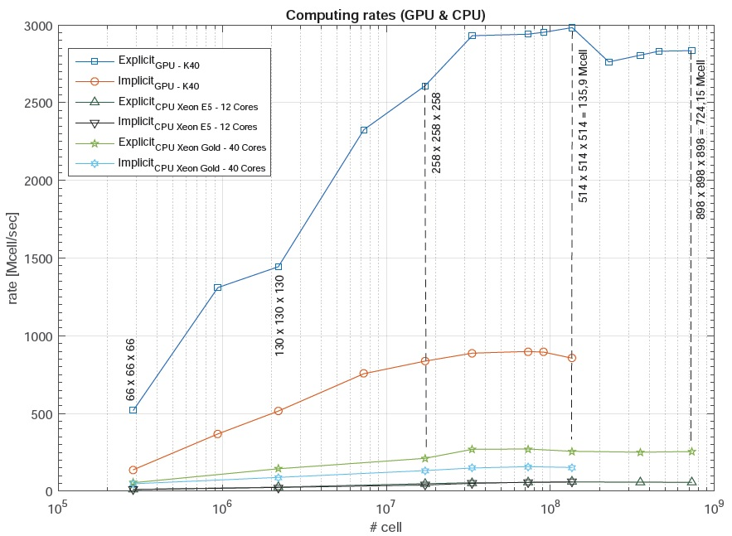
Performance:
Both schemes take great advantage of the computing power of the GPU.
The explicit performs two global memory reads/writes for each time step: ($φ_{input},φ_{output})$
While in the implicit 3 are required for CG and the residue respectively:
(${Δφ}_{input}^{(k)},Δφ_{output}^{\left(k\right)},φ^{(k)})$
($R^{\left(k\right)},φ^{n},φ^{(k)})$

Slide 30
Performance:
Both schemes take great advantage of the computing power of the GPU.
The explicit performs two global memory reads/writes for each time step: ($φ_{input},φ_{output})$
While in the implicit 3 are required for CG and the residue respectively:
(${Δφ}_{input}^{(k)},Δφ_{output}^{\left(k\right)},φ^{(k)})$
($R^{\left(k\right)},φ^{n},φ^{(k)})$

Slide 31
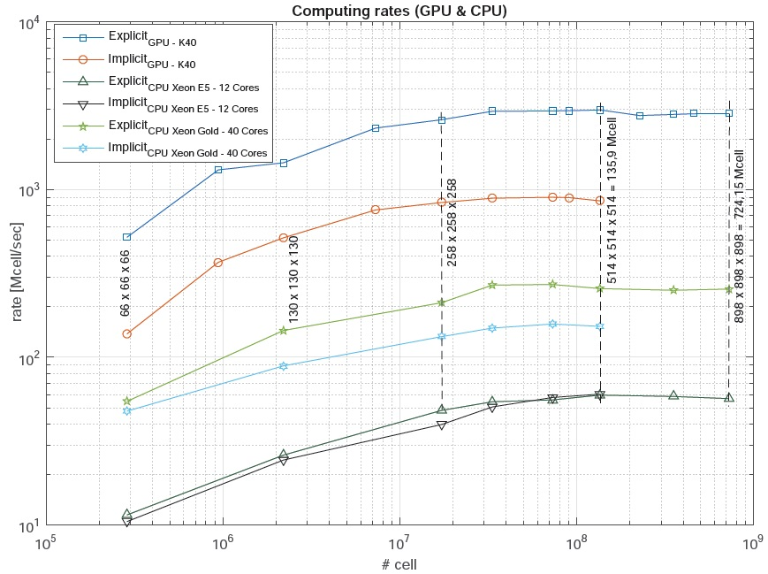
Performance:
To appreciate the difference in performance between GPU and CPU, we show the result on a log scale.
The difference is 1 order of magnitude in some cases.
It can also be seen that the computing resources are saturated in all cases, both for GPU and CPU.
We see that the explicit algorithm always performs better than the implicit one.

Slide 32
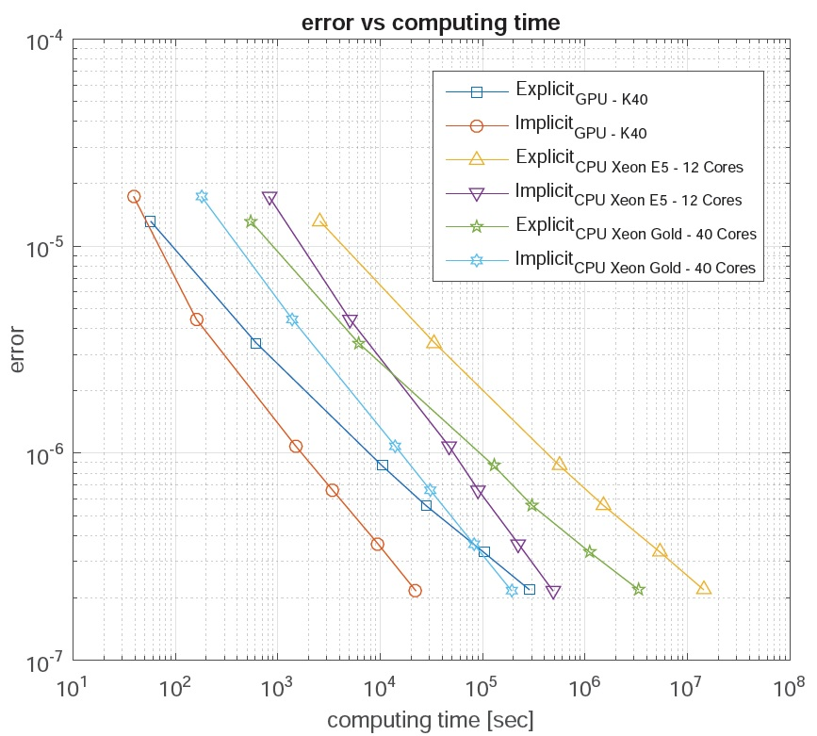
Errors & calculation times
We found that the computation times are less for the implicit algorithm. The difference comes to an order in the GPU and CPU codes respectively compared to the explicit.
Furthermore, the implicit CPU manages to be faster than the explicit GPU in one of the cases.
This behavior is due to an algorithmic reason, as we will comment later.

Slide 33
Conclusions and future work

Slide 34
Conclusions
Efficient GPU and CPU algorithms were implemented according to the specific characteristics of the hardware and the numerical precision of the diferente methods was verified.
Both algorithms fully exploits the capabilities of the GPU, managing to simulate problems with high resolution in the explicit case (up to 724 million cells, but there is a strong restriction on stability requiring extremely small $Δt$)
In the implicit method it was found that despite having lower rates by varying the convergence criteria of the CG solver according to the evolution of NR, it is possible to obtain a good overall performance.

Slide 35
Conclusions
The implemented algorithms reach the GPU bandwich limit before reaching the limit on processing capacity.
This is because the operations of each thread have a very low arithmetic intensity and more time is consumed in Reading/writing the data.
It is higlighted that the combination of criteria and methods in the implicit accelerate the global convergence of the problema, requiring fewer total operations to reach the same result.
The results show a behavior contrary to that observed in linear problems, as is the case of the linear advection diffusion equation where the explicit algorithm in GPU is much more efficient.

Slide 36
Future work
As future work the result will be compared with the next generation of GPUs (Nvidia tesla V100, 5136 CUDA cores).
And parallel implementations in distributed memory using MPI for the CPU codes.

Slide 37
Acknowledgement
Departamento del Agua (Water Department), Centro Universitario Regional Litoral Norte, sede Salto, Universidad de la República. Salto, Uruguay.
Universidad Tecnológica Nacional, Facultad Regional Concordia (“Becas de formación de doctores para fortalecer las áreas de I+D+i”)

Slide 38
Thanks for your attention

