Slide 1

Identification of a shear mechanism in moderately overburied chemical explosive experiments and relation to the DPRK declared nuclear tests
David Steedman, Christopher Bradley
Los Alamos National Laboratory
4-8 May 2020
The authors wish to thank the National Nuclear Security Administration, Defense Nuclear Nonproliferation Research and Development (DNN R&D) for funding the Source Physics Experiment (SPE). This work was sponsored by the NNSA under award number DE-AC52-06NA25396.
LA-UR-19-31131

Slide 2
Outline
Motivation
The Source Physics Experiments
Solution approach
Research results
Relating results to the initial problem
Summary and path forward

Slide 3
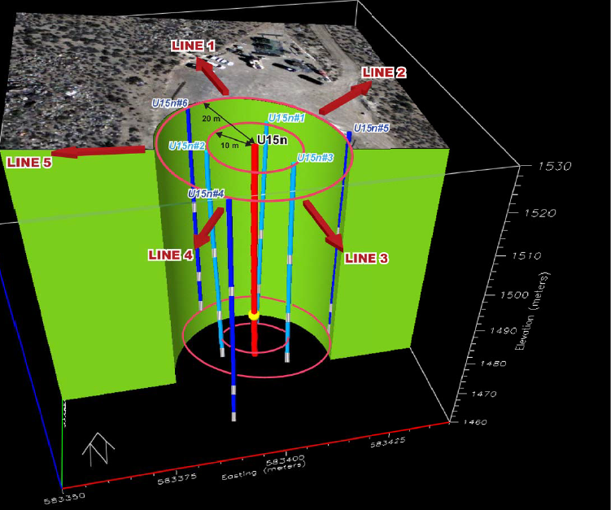
The Source Physics Experiments (SPE)
SPE was a series of experiments designed to provide insight into wave propagation from chemical explosions.
Wave diagnostics include:
  Explosive source diagnostics
  Near-source accelerometers
  Far-field seismometers
Tests conducted in two geologic settings
  SPE Phase I in a jointed, hard rock geology; a proxy for Pyongye-ri
  Phase II in a dry alluvium geology (DAG) to approximate an unjointed continuum; i.e., a baseline “null” case
Three depth categories for SPE
  The legacy discriminant is based mainly on “nominal” scaled-depth-of-burial; i.e., SDOB between 100 m/KT^{1/3} and 200 m/KT^{1/3}
  The DPRK events were moderately obverburied; estimated SDOB between 400 m/KT^{1/3} and 700 m/KT^{1/3}
  Deeply overburied provides Green’s function; >1000 m/KT^{1/3}
Schematic of SPE Phase I Testbed

Slide 4
Motivation
SPE top level science questions
  Can we improve yield estimation?
  Can we identify non-ideal source of shear?
On a more fundamental level
  KIM1 and KIM2 occurred prior to conduct of SPE
  Why do these recent events confound long accepted explosion/earthquake discriminants (e.g., the m_{b}:M_{S} approach from Bonner et al.*)?
  Can we identify a mechanism for the apparent “excess” shear developed in these moderately overburied events?
*Bonner has used the M_{s}(VMAX) method to estimate surface wave magnitudes for all North Korean explosions (see Bonner et al, 2006, 2008, 2009, and 2015 for details).

Slide 5

Three Distinct Physics Regions in Explosive Events
Source physics, shock physics, wave physics
Two fundamental SPE issues
  We consider the source to not produce shear
  We focus here on the shock physics region monitored by accelerometers
    Shock physics ≠ wave physics
    Near-source plasticity and inertial effects dominate
Geomaterial Stress-Strain Response in Compression
Shock Physics-to-Wave Physics Transition
Source Physics--
Compressive shock loading
A no shear zone
Wave Physics--
Shock has dissipated and dispersed
Elastic, Hz wave that is seconds long
Shear from known sources (P-to-S conversion, etc.)
SHEAR
Shock Physics--
Geodynamic response to shock load
Plasticity, kHz shock front with meters-long tail
How might geomechanics cause shear?

Slide 6
Data from SPE Phase I “End Member” Cases
SPE-4Prime: SDOB = 1550 m/KT^{1/3}
The deeply buried Green’s function experiment (SDOB = 1500 m/KT^{1/3}) indicates very little tangential motion relative to the radial component
  This is indicative of the ideal case for an explosion
  Expect limited shear generation in the near-field
The nominally buried experiment (SDOB = 190 m/KT^{1/3}) indicates small initial tangential motion relative to the radial, which quickly returns to zero
  Expect limited shear generation in the near-field
Deeply Overburied
SPE-6: SDOB = 190 m/KT^{1/3}
Nominal Burial

Slide 7
Data from SPE Phase I “End Member” Cases
The moderately overburied experiments indicate significant post-arrival tangential relative to radial motion
  Occurs immediately following the peak radial
  The rise is sudden suggesting a “rupture” accompanied by quick energy release
SPE-4Prime: SDOB = 1550 m/KT^{1/3}
The deeply buried Green’s function experiment (SDOB = 1500 m/KT^{1/3}) indicates very little tangential motion relative to the radial component
  This is indicative of the ideal case for an explosion
  Expect limited shear generation in the near-field
The nominally buried experiment (SDOB = 190 m/KT^{1/3}) indicates small initial tangential motion relative to the radial, which quickly returns to zero
  Expect limited shear generation in the near-field
Deeply Overburied
SPE-1: SDOB = 976 m/KT^{1/3}
SPE-3: SDOB = 387 m/KT^{1/3}
Moderately Overburied
Moderately Overburied
SPE-6: SDOB = 190 m/KT^{1/3}
Nominal Burial

Slide 8
Timing of the Sudden Transverse Motion
T component departure time (t_{a} Transverse) consistently occurs after R component peak
Implied speed (C_{T}) is close to loading speed (C_{L}) and too fast relative to first arrival (C_{P}) to be a shear wave emanating from the source
t_{a} Transverse
t_{p} Radial
t_{a} Radial
t_{a} Transverse

Slide 9
The Data Suggest a Shear Release Mechanism*
Non-radial motion occurs under certain conditions during unloading in a jointed medium
  A continuum does not provide a mechanism to create shear
  Consistent response throughout the testbed for moderately overburied tests
Moderate overburial in granite satisfies these conditions
  For nominal burial there is insufficient in situ stress to resist initial sliding
  For deeply overburied there is insufficient shock load to overcome sliding resistance provided by in situ stress
*Analysis supported by FEM modeling not presented herein

Slide 10
Relate SPE Phase I to Legacy Nuclear Data
For explosive-caused ground motion we plot velocity vs. yield-scaled range to compare events in a similar geologic setting
Perrett and Bass* compiled near-field data for a number of historic nuclear events for various geologic settings, including “hard rock”
The fit to the SPE Phase I data match the P&B hard rock fit, with the full data set falling with the P&B bounds
Suggests that SPE data might be useful for providing insight into nuclear response
Perrett and Bass Fit
w/Bounds
SPE Phase I Data Fit
*Perret, W.R. and Bass, R.C. (1974), Free-Field Ground Motion Induced by Underground Explosions, SAND74-0252.

Slide 11
Relate SPE Phase I to DPRK Events
Revisit the m_{b}:M_{S} discriminant plot*
  KIM3 though KIM6 occurred during conduct of SPE
Estimates for KIM3 through KIM5 indicate moderately overburied conditions
  These events are within the earthquake population or on a transition
Estimates for KIM6 indicate nominal burial
  This event falls within the explosion population
*Bonner has used the M_{s}(VMAX) method to estimate surface wave magnitudes for all North Korean explosions (see Bonner et al, 2006, 2008, 2009, and 2015 for details).

Slide 12
The Shear Release Model Considers SDOB Influence
The driving force (stored shear strain) must overcome resisting force (in situ stress + joint friction)
  The likelihood of creating shear release in SPE is seen to be a function of SDOB and geologic setting
  The likelihood of a DPRK event failing m_{b}:M_{S} discrimination appears to be a function of SDOB in a similar geology
Do these two phenomena correlate as suggested here?

Slide 13
Summary
A conceptual shear release model is proposed
  Based on fundamental geomechanical considerations
  The mechanics-based model explains how the response is conditional
    i.e., why excess shear can occur (KIM1 through KIM5), and when it will not occur (KIM6 and legacy tests)
The model appears to map to explosion/earthquake discrimination uncertainties for the DPRK events
Future analysis will focus on relating these SPE/DAG near-field observations to the SPE/DAG far-field data

