Slide 1
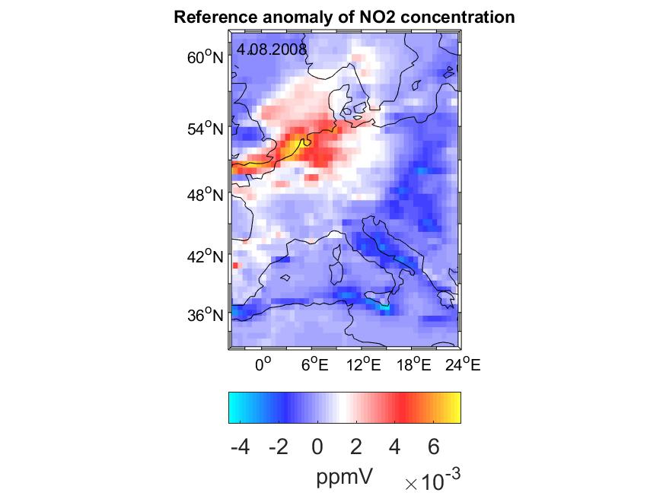
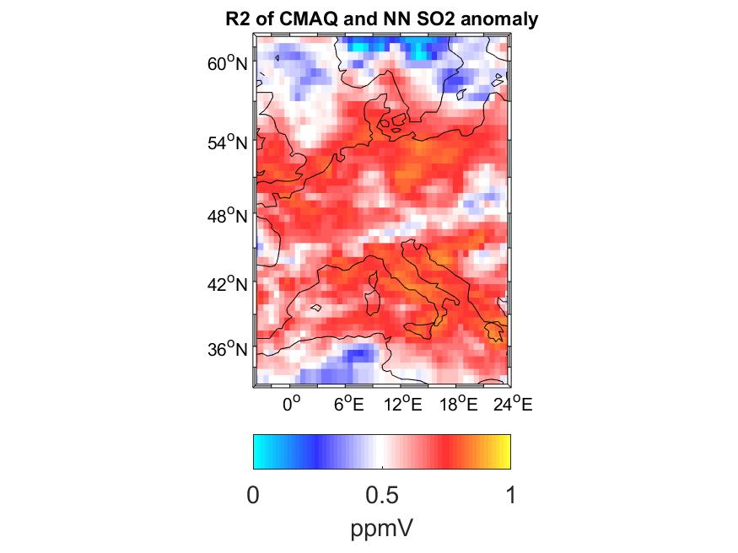
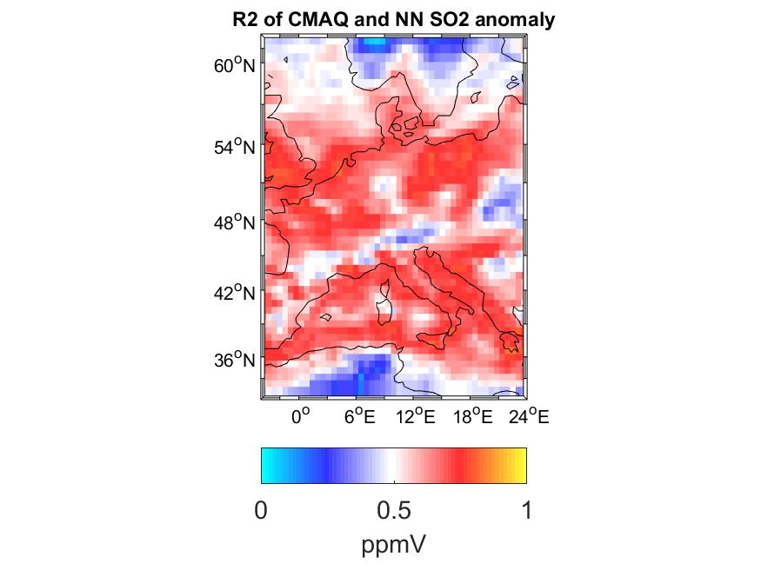

Estimation of NO₂ and SO₂ concentration changes in Europe from meteorological conditions using a Neural Network.
Andrey Vlasenko, Volker Matthias, Ulrich Callies Helmholtz-Zentrum Geestacht, Kontakt: andrey.vlasenko@hzg.de
Introduction
Chemical substances of anthropogenic and natural origin released into the atmosphere affect air quality and, as a consequence, the health of the population. As a result, there is a demand for reliable air quality simulations and future scenarios investigating the effects of emission reduction measures. Due to high computational costs, the prediction of concentrations of chemical substances with discretized atmospheric chemistry transport models (CTM) is still a great challenge. An alternative to the cumbersome numerical estimates is a computationally efficient neural network (NN). The design of the NN is much simpler than a CTM and allows to approximate any bounded continuous function (i.e. concentration time series) with the desired accuracy. We test the ability of a NN to approximate CTM concentration estimates with the example of summer daily mean NO₂ and SO₂ concentrations. Relying on the fact that after spin-up, CTM estimates are independent of the initial concentrations, we show that recurrent NN can also spin-up and predict the atmospheric chemical state without using concentration data input. Moreover, we show that if the emissions do not change significantly from year to year the NN can predict daily mean concentrations from meteorological data, only.
Materials and Methods
We used a three-layer NN for predicting NO₂ and SO₂ concentrations. The first layer is a recurrent layer, which is followed by two dense layers. In all layers, we
took tanh as activation functions; for the cost function, we used the L2 norm. The NN is trained on the results of CTM runs with CMAQ 5.0.1 for the period 1979-2005 in Europe. For better predictive skill and fair error analysis, we estimate and subtract the climatological mean from the daily average concentration data in the corresponding training, test and validation data sets. Note that we applied the same emission inventory for each year. After such simplification, the concentration estimates using the NN require only anomalies of wind, temperature, humidity and cloud cover as input. Moreover, the NN trained for this case, has the same predictive skill for different emission scenarios.
We test the predictive skill of the NN on the test and validation data sets from the periods 2006-2008 and 2009-2012 (always from 1 June to 15 September). Since we want the NN to reproduce CMAQ calculations as accurately as possible, we these calculations as the truth in all experiments. Based on this, we consider the NN design as successful, if it reproduces the CMAQ calculations with minimal error. We evaluate the NN performance with R2 measure:
Here is the true anomaly in concentration obtained from CMAQ computations at a given location at a time step i, is the corresponding NN estimate.
Results
A verification of the accuracy of the calculations with the test and the validation networks has shown that the NN can reproduce the CMAQ calculations. Figures 1-2 show the example of the true NO₂ concentrations and those computed with the NN. The NN explains the variations in the SO₂ and NO₂ concentrations almost everywhere with an R2 score of more than 0.5. Figure 2 shows the spatial distribution of R2 scores for the test and the validation data sets. The verification showed that the prediction accuracy of the concentration anomalies increases with the increase of the local standard deviation of the time series. The accuracy of the calculation is also affected by weather conditions: in case of strong winds in northern Europe, the correspondence of the NN predictions with the CMAQ results decreases.
We give the results here for concentrations of NO₂ only. For SO₂, the quality of the forecasts is the same.
Fig 1: The NO₂ concentration anomalies estimated with NN (left) and CMAQ (right). The correlation between patterns is 0.96.
Conclusion
We discussed the development and test of neural networks that estimates NO₂ and SO₂ concentration close to ground from meteorological inputs. The test and validation showed that the neural network explains 65% of NO₂ and SO₂ daily mean variability in the regions with high NO₂ and SO₂ variations, i.e. ship routes, large cities and also on the European part of the Mediterranean basin. Based on the comparison, we conclude that the presented neural network reproduces the daily mean CMAQ estimates of NO₂ an SO₂ with a reasonably small error.
Acknowledgements:
The authors would like to acknowledge gratefully the Digital Earth project which supported this research.
All results will be submitted to the Atmospheric Environment journal.
Fig 2. The spatial distribution of R2 score for NO₂ concentrations for the training data set (left) and the test data set (right)
Helmholtz-Zentrum Geesthacht • Max-Planck-Straße 1 • 21502 Geesthacht / Germany • Phone +49 (0)4152 87-0 • Fax +49 (0)4152 87-1403 • contact@hzg.de • www.hzg.de
Contact: Dr. Andrey Vlasenko• Phone +49 (0)4152 87-1528 • andrey.vlasenko@hzg.de

