Slide 1


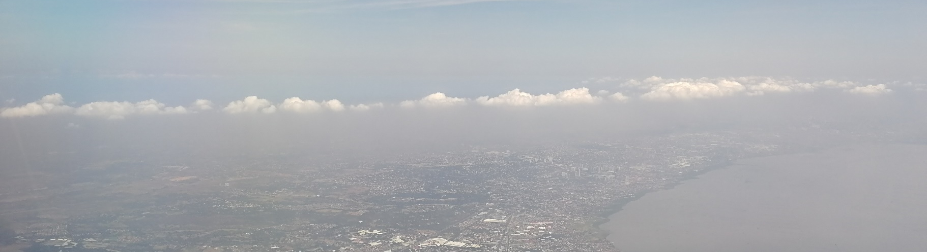
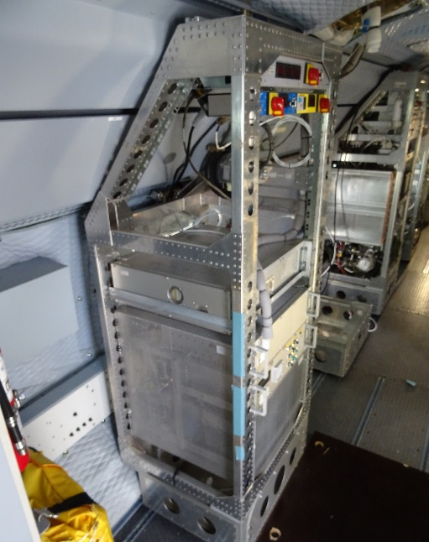



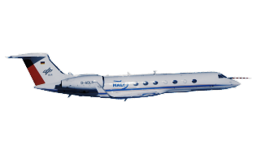




Air mass characterization based on VOC measurements downstream of European and Asian Major Population Centers (MPC) during the research aircraft campaign EMeRGe (2017/2018)
Eric Förster*, Harald Bönisch*, Marco Neumaier*, Florian Obersteiner*, Michael Lichtenstern⁺, Andreas Hilboll$,
Anna B. Kalisz Hedegaard^{+$}, Mihalis Vrekoussis$, Andreas Zahn*
⁺DLR IPA - Deutsches Zentrum für Luft- und Raumfahrt, Institut für Physik der Atmosphäre, Oberpfaffenhofen, Germany
$IUP Bremen - Institut für Umweltphysik, Universität Bremen, Bremen, Germany
*KIT - Institute of Meteorology and Climate Research – Atmospheric Trace Gases and Remote Sensing

Slide 2

Introduction
This display introduces an air mass characterization during the research aircraft campaign EMeRGe in Europe and Asia, based on a well suited set of volatile organic compound (VOC) measurements, with a variety of (same/different) sources/life times.
We use acetonitrile, benzene and isoprene for the identification of biomass burning, anthropogenic pollution and fresh biogenic emissions, respectively.
Results show only minor BB influenced air masses in Europe, whereas in Asia numerous plumes are affected by BB, mostly originating from Southeast Asia.
In Europe, anthropogenic pollution was observed downwind of the Po-Valley, Rome, Barcelona and the English Channel. In Asia, plumes were identified along the west coast of Taiwan, over the East China Sea and Manila originating from local sources as well as transported from Mainland China.
Significant fresh biogenic influence was found in Europe, as the measurements were performed mostly in summer over land in contrast to Asia were just a minor influence was detected.

Slide 3
Effect of Megacities on the Transport and Transformation of Pollutants on the Regional to Global Scales
EMeRGe
… aims to investigate the impact of MPC emissions on air pollution and chemical processing by making dedicated airborne measurements using the German research aircraft HALO
General scientific focus of EMeRGe
What are the dominating factors of chemical transformation and transport of major population center (MPC) emissions?
Regional, hemispheric and global effect of European and Asian MPCs
Relevance of MPC emissions for radiative forcing and climate change
Adequacy of chemical models for the simulation of transport and transformation processes
Improve our knowledge and prediction of the transport and transformation patterns of European and Asian MPC outflows

Slide 4
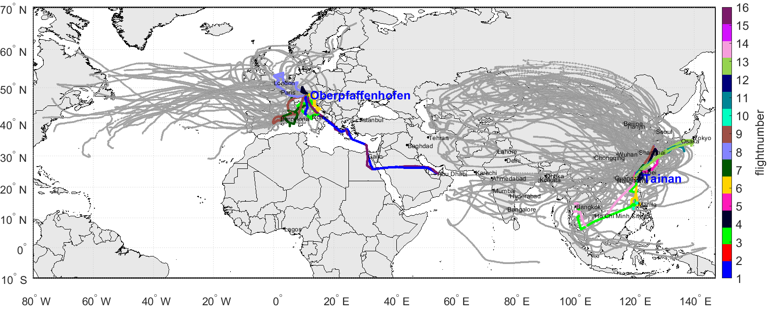
EMeRGe = EMeRGe Europe and EMeRGe Asia
21 research flights (incl. 2 transfer) + 2 transfer without measurement permission
Trajectories based on FlexPart (Stohl et al., 2010)
Data by Anna B. Kalisz Hedegaard, Andreas Hilboll, Mihalis Vrekoussis

Slide 5
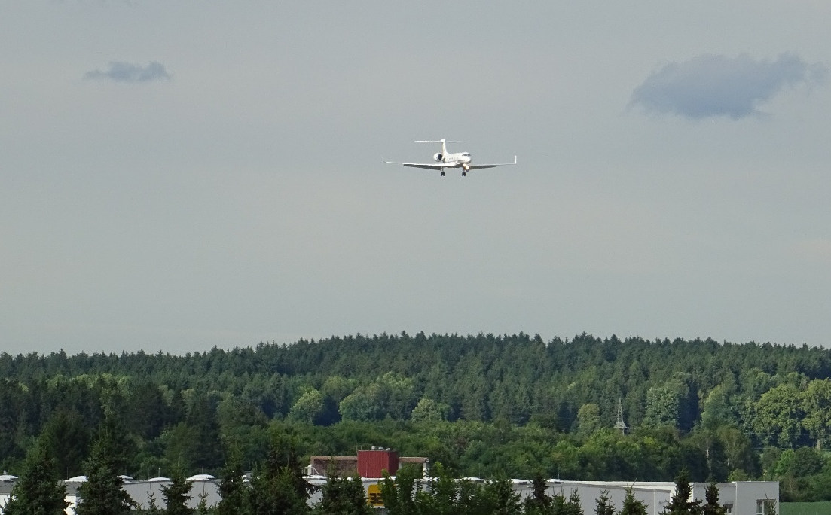
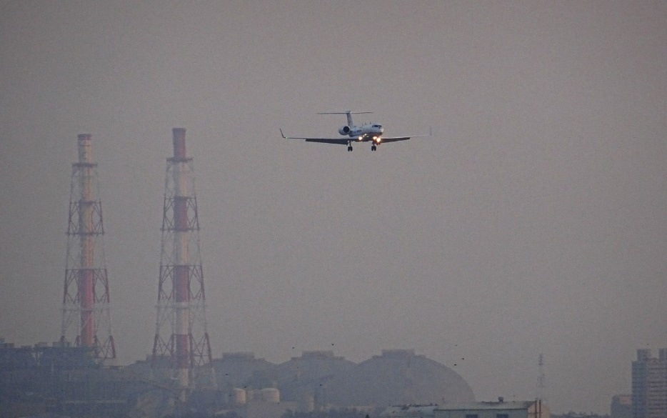
EMeRGe
EMeRGe Europe
Base: Oberpfaffenhofen, Germany
Background: Bavarian Forest during cloudy day
EMeRGe Asia
Base: Tainan, Taiwan
(Background: power plant during smoggy day)

Slide 6
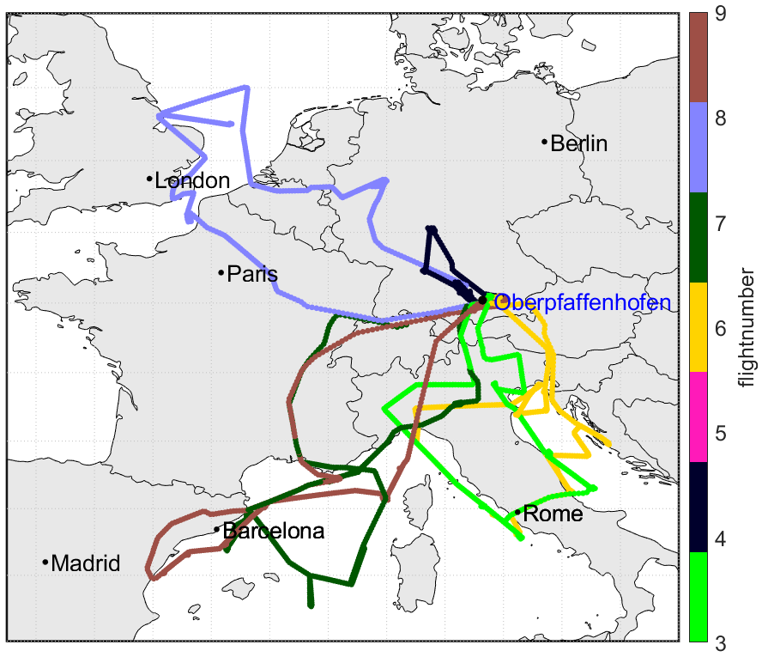
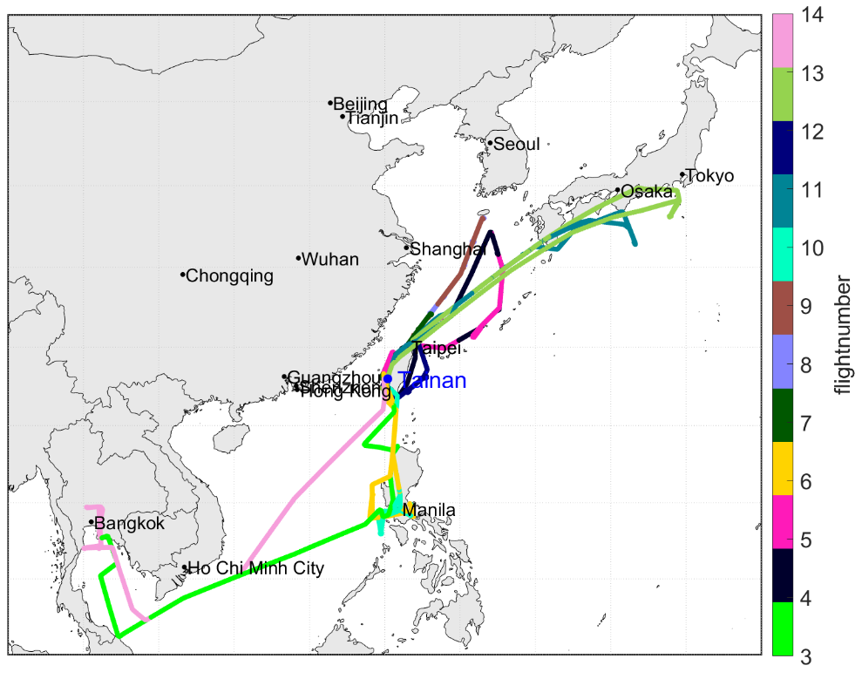
EMeRGe
7 flights in Europe, July 2017
12 flights in Asia, March/April 2018
Lows with frontal systems in Northern Europe
High pressure influence in Southern Europe
Dust from Northern Africa
Biomass Burning in Southern Europe
Influence of storm and frontal systems
Dust from Gobi desert
Biomass Burning in India, SE Asia and in Mainland China
Notes:
Flight restrictions did not allow to go closer to London and Paris
Tried to study inflow and outflow as far as possible -> will be hard to study transformation of plumes

Slide 7
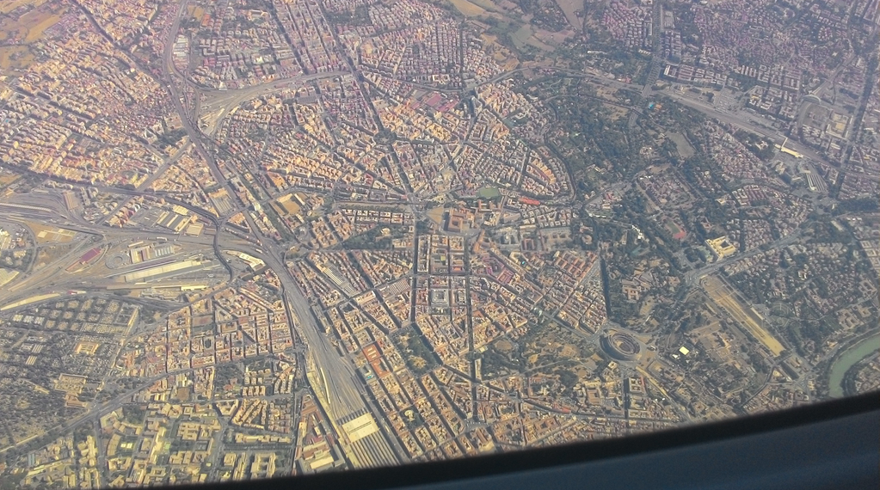
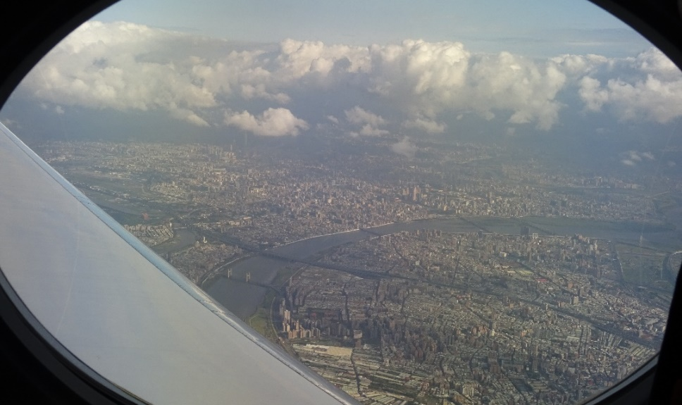
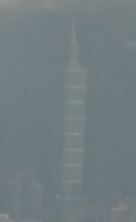
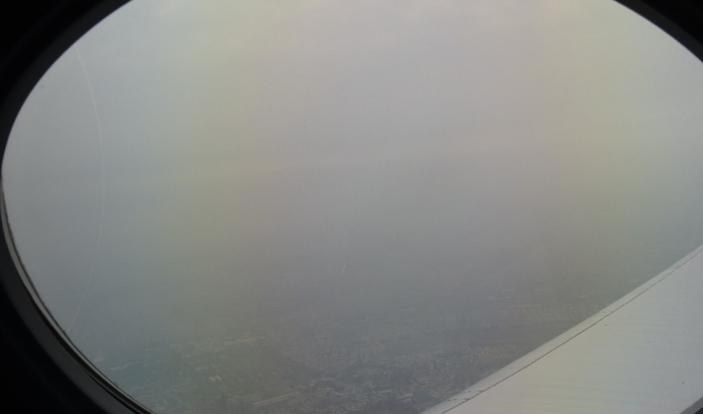
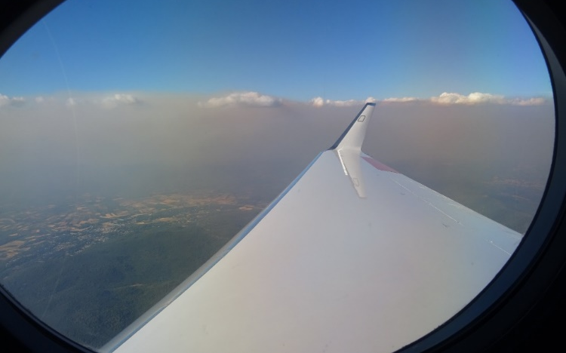
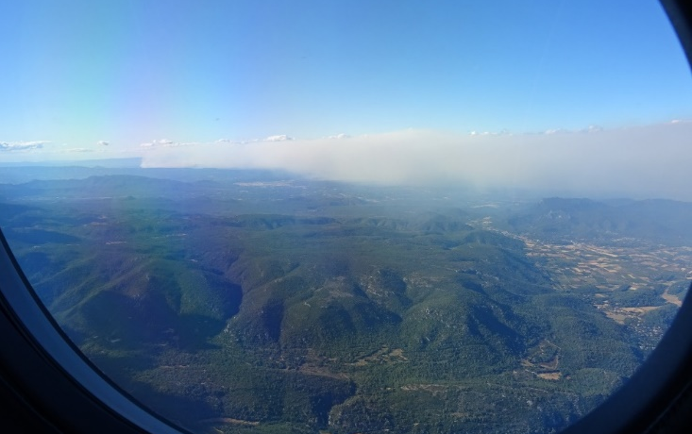
EMeRGe Europe
EMeRGe Asia
Taipei 101
Photo taken by Midhun George
Rome (top) and Biomass Burning near Marseille (bottom)
Taipei City, clear day (top) and smoggy day (bottom)

Slide 8

Effect of Megacities on the Transport and Transformation of Pollutants on the Regional to Global Scales
EMeRGe
Measurement of volatile organic compounds (VOC)
Scientific focus within EMeRGe
Characterization of air masses (biomass burning, anthropogenic influence, biogenic influence, mixed air masses)
Further questions and tasks
Are there differences in the VOC fingerprints of European and Asian MPCs?
What role play biogenic emissions?
How is the chemical processing of other trace gases in different air masses?
Does the ozone formation potential change in different types of air masses and concentrations of VOCs?
Characterization of VOC compositions in MPCs and their chemical transformation downwind
Comparing VOC measurements to models to improve emission scenarios, chemical prossessing and transport

Slide 9
Importance of VOCs in the atmosphere
Anthropogenic sources:
Solvents, paints, household chemicals
Fossil fuel – production, storage, use (aromatic compounds BTX – Benzene, Toluene, Xylene)
Natural sources:
Tropical/extra-tropical forests
(e.g. isoprene, methanol, acetone)
Biomass Burning – BB
(e.g. acetonitrile, benzene, toluene)
Sinks:
Reaction with OH radicals, Photolysis, Oxidation by O₃ and NO₃
Impacts of VOCs:
Precursors of SOA, O₃
Sink of OH
→ Indirect effect of cloud formation and indirect/direct health impacts!
Notes:
The VOCs play an important role in the atmosphere as they are a source of ozone under high Nox conditions and a sink of OH at low Nox conditions. Although VOCs have little or no direct radiative forcing impact, increasing VOC emissions may
contribute indirectly to climate change, first via influencing OH on the abundance of the two green-
house gases ozone and methane, and secondly via forming organic aerosols.
For EMeRGe the VOC measurements are important as enhanced concentrations indicate photochemically active air masses and the different sources they have can help to identify different types of source emissions.
Why are VOCs important in the atmosphere?
-> Source of Ozone (health), sink of OH -> contribute indirectly to climate change, first via influencing OH on the abundance of the two greenhouse gases ozone and methane, and secondly via forming organic aerosols
Important for EMeRGe?
-> show photochemically active air masses, determine types of air masses
Importance of biogenic VOCs?
-> formation of oxygenated VOCs (acetone, acetaldehyde, formaldehyde)
-> formation of organic acids
Importance of anthropogenic VOCs (link to later results)?
-> formation of Ozone and SOA

Slide 10
Measured VOCs during EMeRGe
Measurement via Proton Transfer Reaction – Mass Spectrometry (PTR-MS)
Measured consecutively in a cycle of ~ 60 s
 | Life time | Main source
Isoprene | 2 h | Biogenic
Xylene | 6 h | Anthropogenic, Biomass burning (BB)
Acetaldehyde | 9 h | Secondary production, Anthropogenic
Formaldehyde | 1 day | Secondary production, Anthropogenic
Toluene | 2 days | Anthropogenic, BB
Benzene | 10 days | Anthropogenic, BB
Methanol | 12 days | Biogenic, Biofuel, Secondary prod.
Acetone | 2 months | Secondary prod., BB, Biogenic
Acetonitrile | 6 months | Specific for BB
VOCs in colored boxes are used in the following air mass characterization

Slide 11
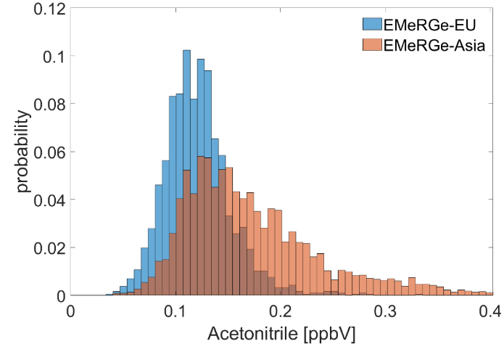
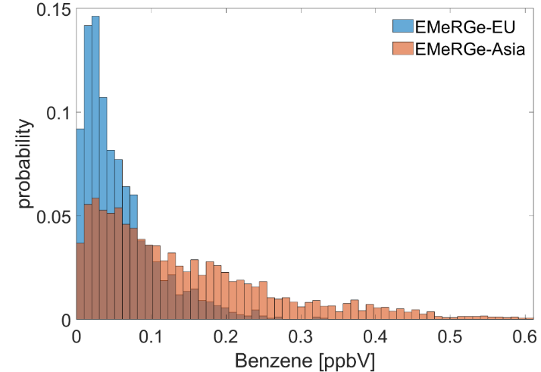
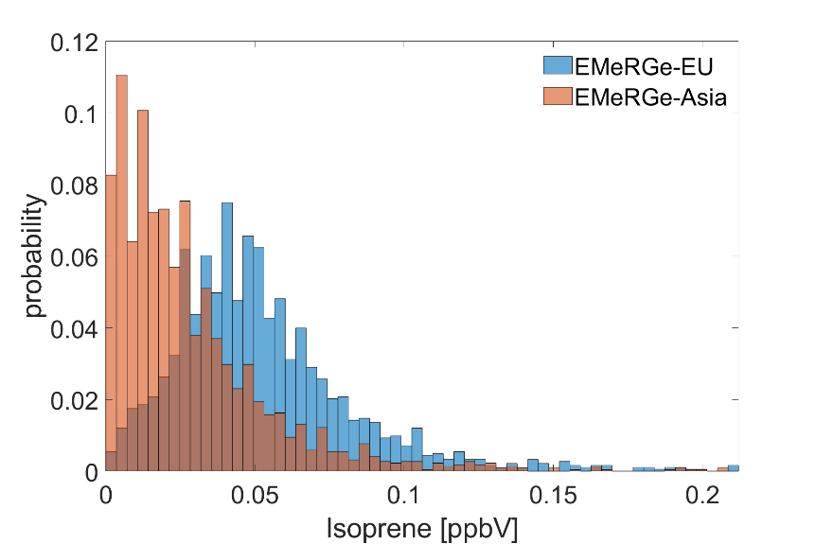
Air mass characterization
Identifying …
biomass burning (BB)
anthropogenic pollution (AP)
fresh biogenic influence (BIO)
with acetonitrile as specific tracer
long lifetime → existing background
BB influence → enhanced acetonitrile concentrations over background
with benzene
short lifetime → no background
AP → enhanced benzene concentrations over detection limit (LOD) with filtered out BB
with isoprene as specific tracer
very short lifetime → no background
BIO → enhanced isoprene concentrations over LOD.
recent biogenic emissions
Shown are distributions of the selected VOCs for all flights of the respective part (see slide 7)

Slide 12
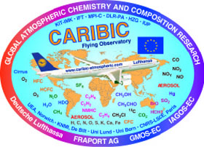
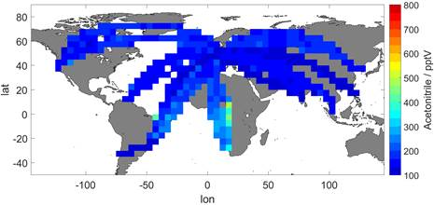
Identification of biomass burning
Determination of the acetonitrile (AN) atmospheric (upper tropospheric) background using the IAGOS-CARIBIC data set
IAGOS-CARIBIC: regularly flying laboratory on a passenger aircraft measuring ~ 100 species
AN measurements DJF 2012-2016
DJF 2012-2016, 35°-65°N
Northern Hemisphere Troposphere (-2 to 2 pvu)
AN instrumental noise during flight:
AN_{bg} = 145 pptv
1σ_{inst} = 18 pptv

Slide 13
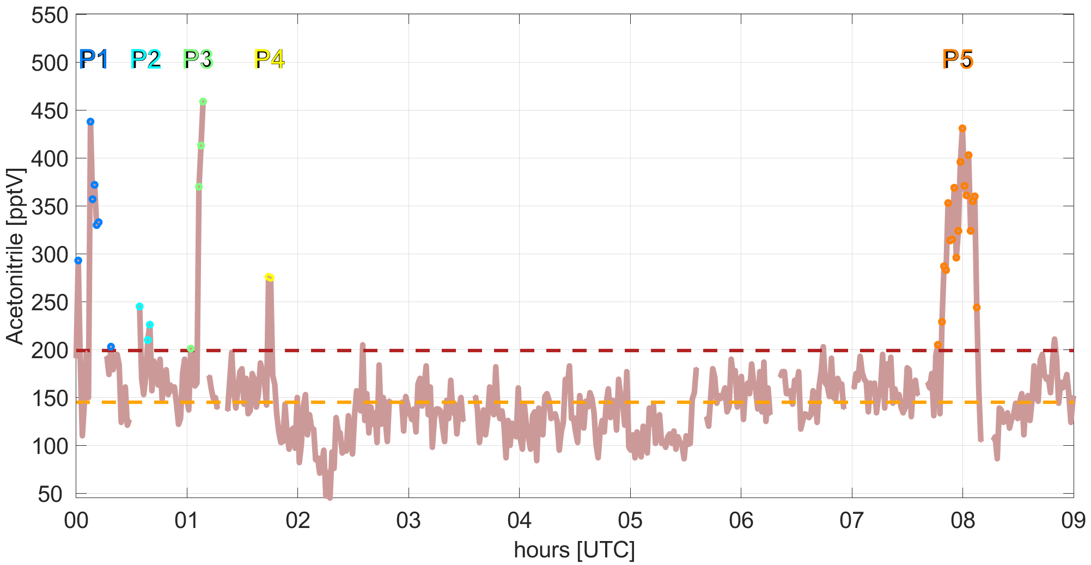
Identification of biomass burning
Air masses with: AN_{signal} > AN_{bg} + 3σ_{inst} → BB
Example:
EMeRGe-Asia, Flight 11, departure 30th March 2018
Only two or more consecutively enhanced AN measurements are marked here as plume
200 ppt
145 ppt

Slide 14
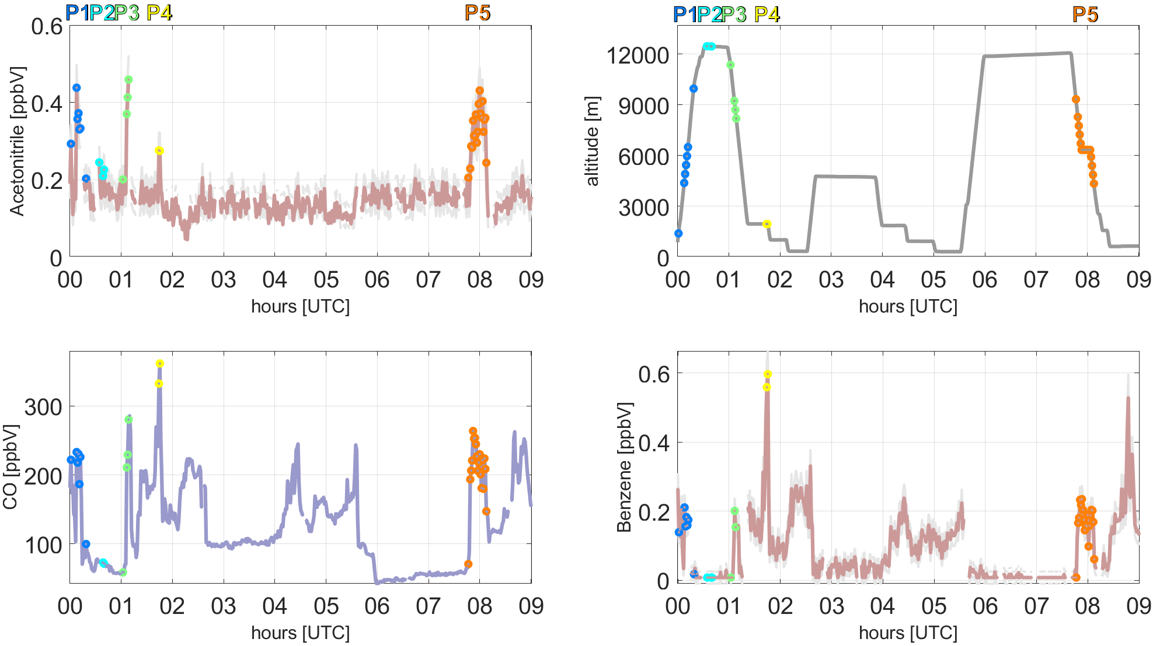
Identification of biomass burning
acetonitrile
altitude
Example:
EMeRGe-Asia, Flight 11, departure 30th March 2018
Only two or more consecutively enhanced AN measurements are marked here as plume
CO
benzene
CO data by Michael Lichtenstein, DLR, Germany

Slide 15
Identification of biomass burning
Identified BB correlates well with enhancements/peaks in CO and benzene, as both are also emitted in combustion processes
P4 is a fresh BB plume in lower altitude with high concentrations in CO and benzene
P2 is an aged BB plume in higher altitude with still enhanced but already degraded AN, degraded CO and completely degraded benzene
At this example flight, BB is mostly present in higher altitudes due to long range transport (LRT)
BB with benzene enhancements at the same time can also include anthropogenic pollution
Like P4, with high benzene concentrations around → mixing of BB and AP
to identify pure anthropogenic pollution, BB (enhanced acetonitrile) has to be filtered out (see slide 17)

Slide 16
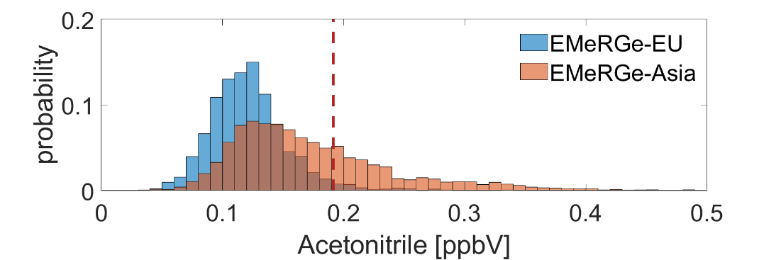
Identification of biomass burning
BB with Benzene enhancement
Acetonitrile distribution
3.4 % of data during EMeRGe-EU
22.3 % of data during EMeRGe-Asia
Fresh biomass burning and/or mixed with anthropogenic pollution
Enhancements in Acetonitrile
BB without Benzene enhancement
4.3 % of data during EMeRGe-EU
29.7 % of data during EMeRGe-Asia
0.9 % of data during EMeRGe-EU
7.4 % of data during EMeRGe-Asia
(can include anthropogenic signals!)
Aged biomass burning
(benzene is degraded)
All percentages refer to the complete VOC data set and according to the defined VOC thresholds

Slide 17
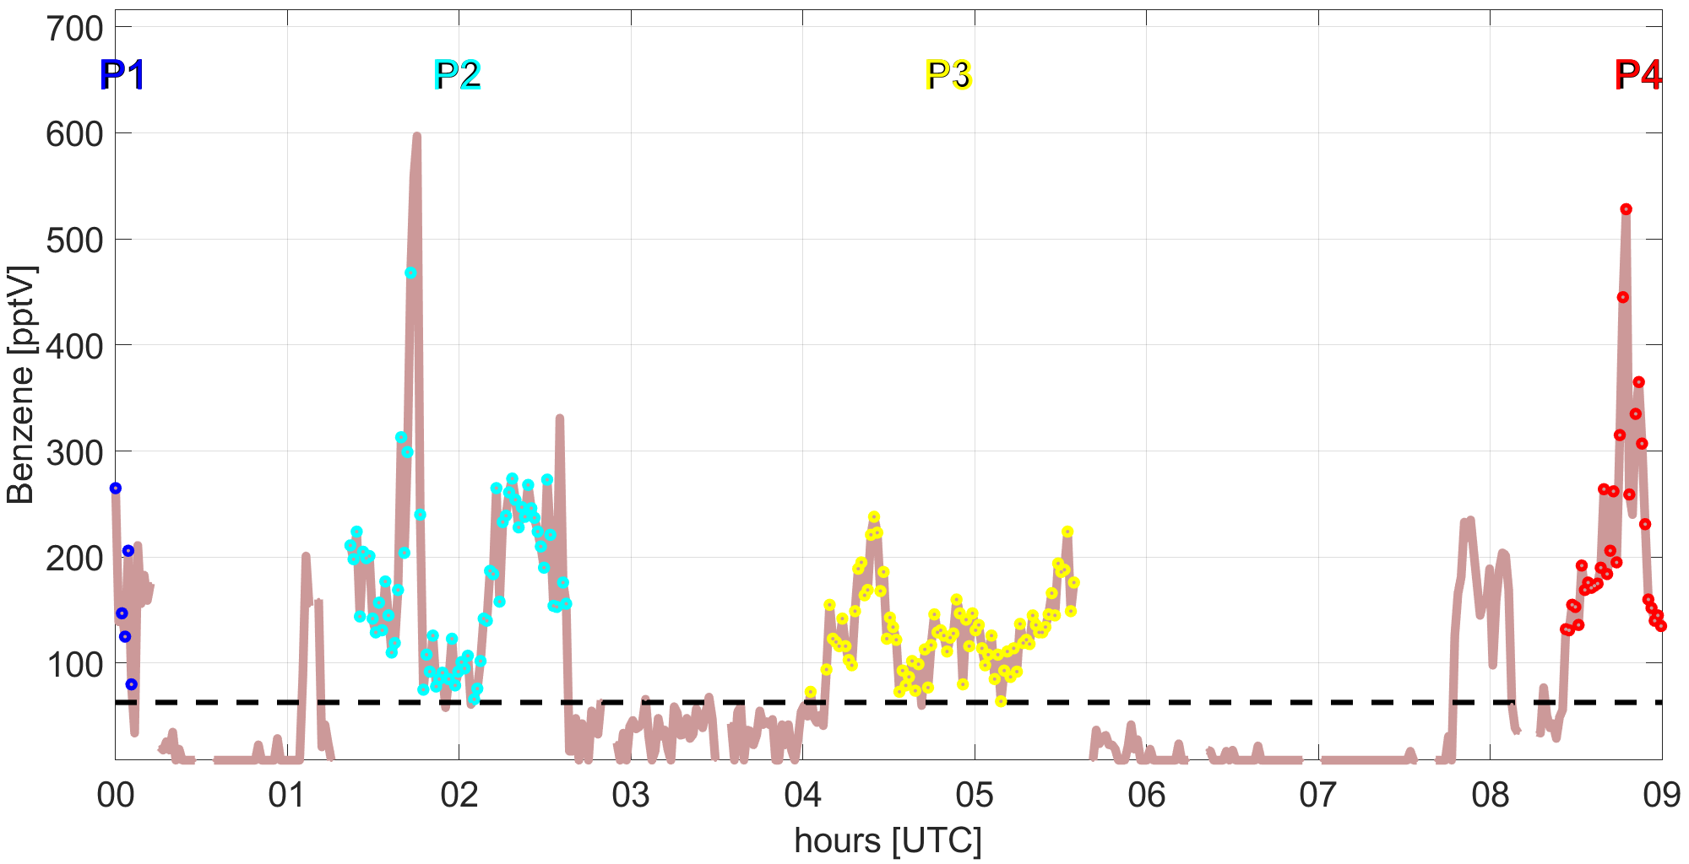
Identification of (pure) anthropogenic pollution
Air masses with: benzene > LOD_{Ben} + 3σ_{Ben} & AN_{signal} < AN_{bg} + 3σ_{AN} → AP
LOD_{Ben} = 16 ppt
σ_{Ben} = 15 ppt
Example:
EMeRGe-Asia, Flight 11, departure 30th March 2018
Only two or more consecutively enhanced AN measurements are marked here as plume
BB influence is filtered out
BB
BB
61 ppt

Slide 18
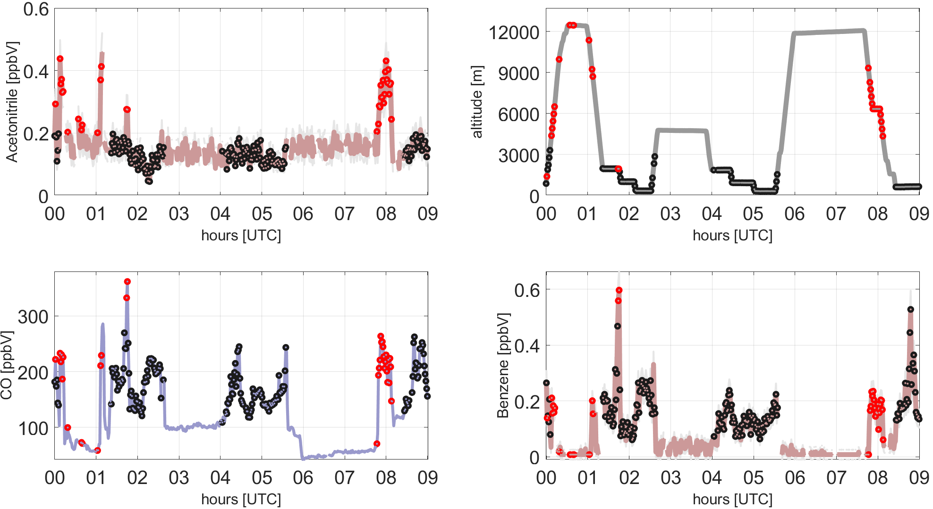
Identification of (pure) anthropogenic pollution
Acetonitrile
altitude
Example:
EMeRGe-Asia, Flight 11, departure 30th March 2018
Only two or more consecutively enhanced measurements are marked here as plume,
Black dots →
pure AP
Red dots →
BB influenced
CO
Benzene
CO data by Michael Lichtenstein, DLR, Germany

Slide 19
Identification of (pure) anthropogenic pollution
Pure anthropogenic pollution is mostly identified in lower altitudes and correlates also well with CO
Every enhancement in CO of flight #11 in Asia is now either identified as influenced by BB or anthropogenic pollution
BB plumes can overlay/ be overlaid by benzene enhancements
this can be mixing of BB and AP, or recently emitted BB plumes
Inside a BB plume, benzene enhancement can not be assigned to either BB or AP with our VOC set

Slide 20
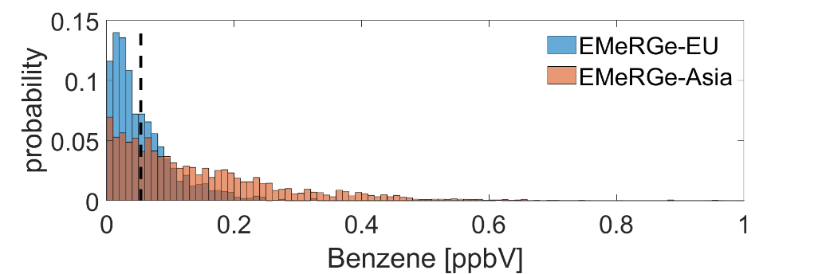
Identification of anthropogenic pollution
Benzene enhancement with BB signal
Benzene distribution
3.4 % of data during EMeRGe-EU
22.3 % of data during EMeRGe-Asia
anthropogenic pollution and/or mixed with fresh biomass burning
Enhancements in Benzene
Benzene enhancement without BB
40.3 % of data during EMeRGe-EU
66.4 % of data during EMeRGe-Asia
36.9 % of data during EMeRGe-EU
44.1 % of data during EMeRGe-Asia
(can include BB signals)
“pure” anthropogenic pollution
All percentages refer to the complete VOC data set and according to the defined VOC thresholds
All percentages refer to the complete data set

Slide 21
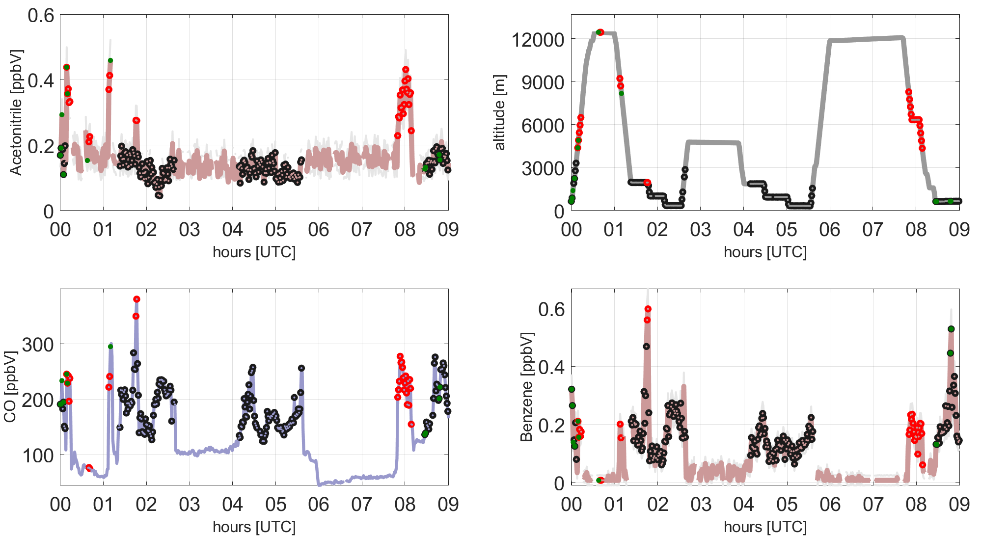
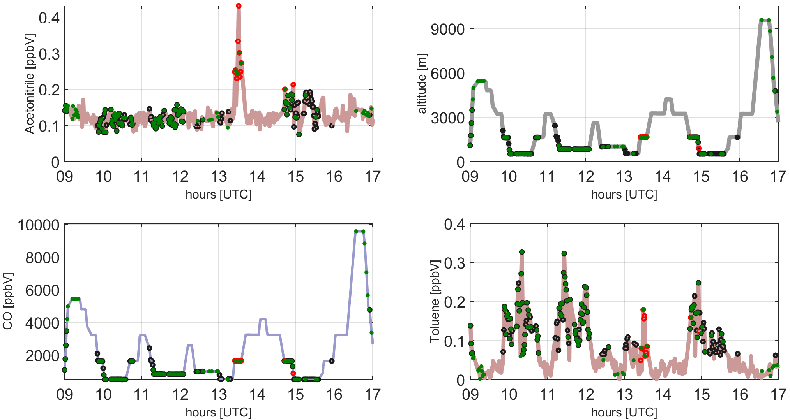
Identification of fresh biogenic emission
Air masses with: Isoprene > LOD_{Iso} + 3σ_{Iso} → BIO
LOD_{Iso} = 25 ppt
σ_{Iso} = 14 ppt
Example 1:
EMeRGe-Asia, Flight 11, departure 30th March 2018
Generally less biogenic influence during EMeRGe-Asia → flight tracks mostly over the ocean
Example 2:
EMeRGe-EU, Flight 6, departure 20th July 2017
More biogenic influence during EMeRGe-EU, often in lower altitudes together with AP → flight tracks mostly over land
CO data by Michael Lichtenstein, DLR, Germany

Slide 22
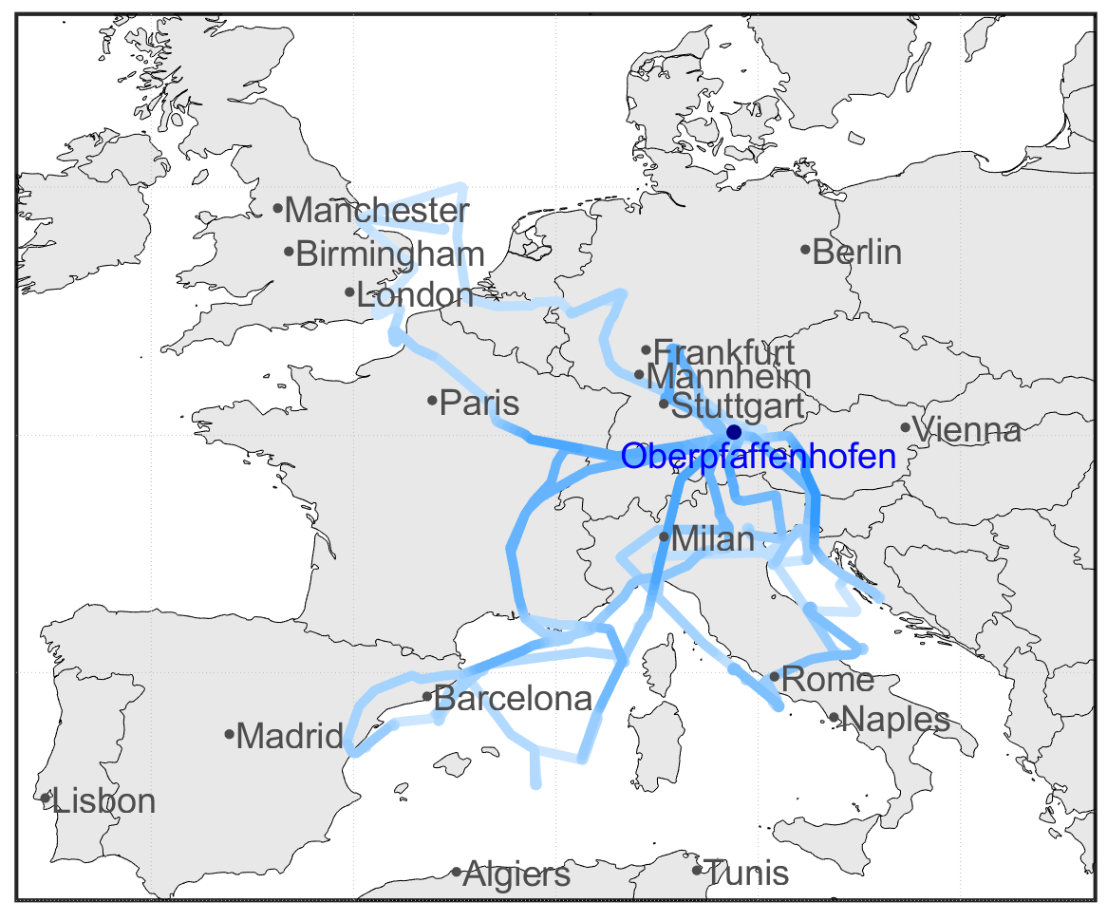
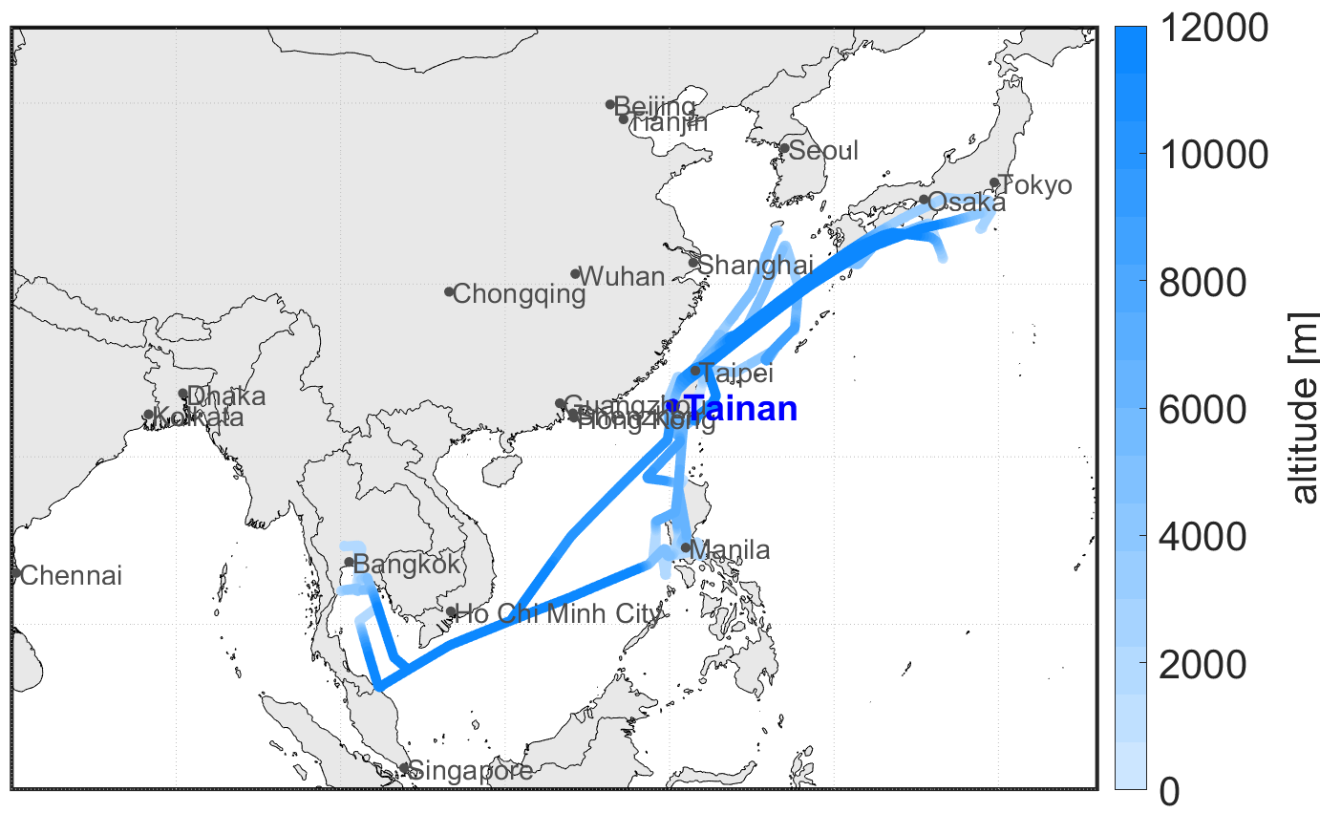
Air mass characteristics of EMeRGe-EU (left) and EMeRGe-Asia (right)
Flight tracks of both campaign flights, color-coded with flight altitude
EMeRGe-EU mostly over land and in lower altitudes, except over the Alps.
MPC destinations: London, BeNeLux countries, Ruhr area, Po Valley, Rome, Barcelona, Madrid
EMeRGe-Asia mostly over the ocean only in lower altitudes around Taiwan the East China Sea and Manila.
MPC destinations: Taiwan, Taipei, Manila, Bangkok, Southern Japan, Chinese outflow

Slide 23
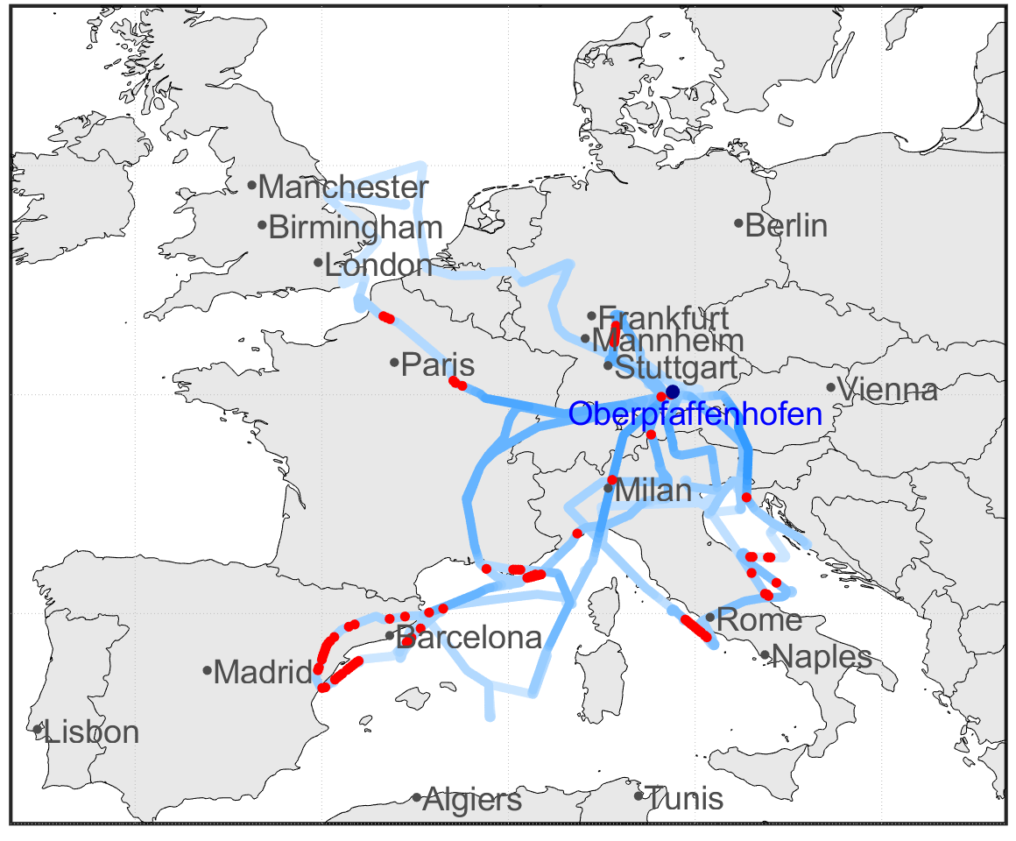
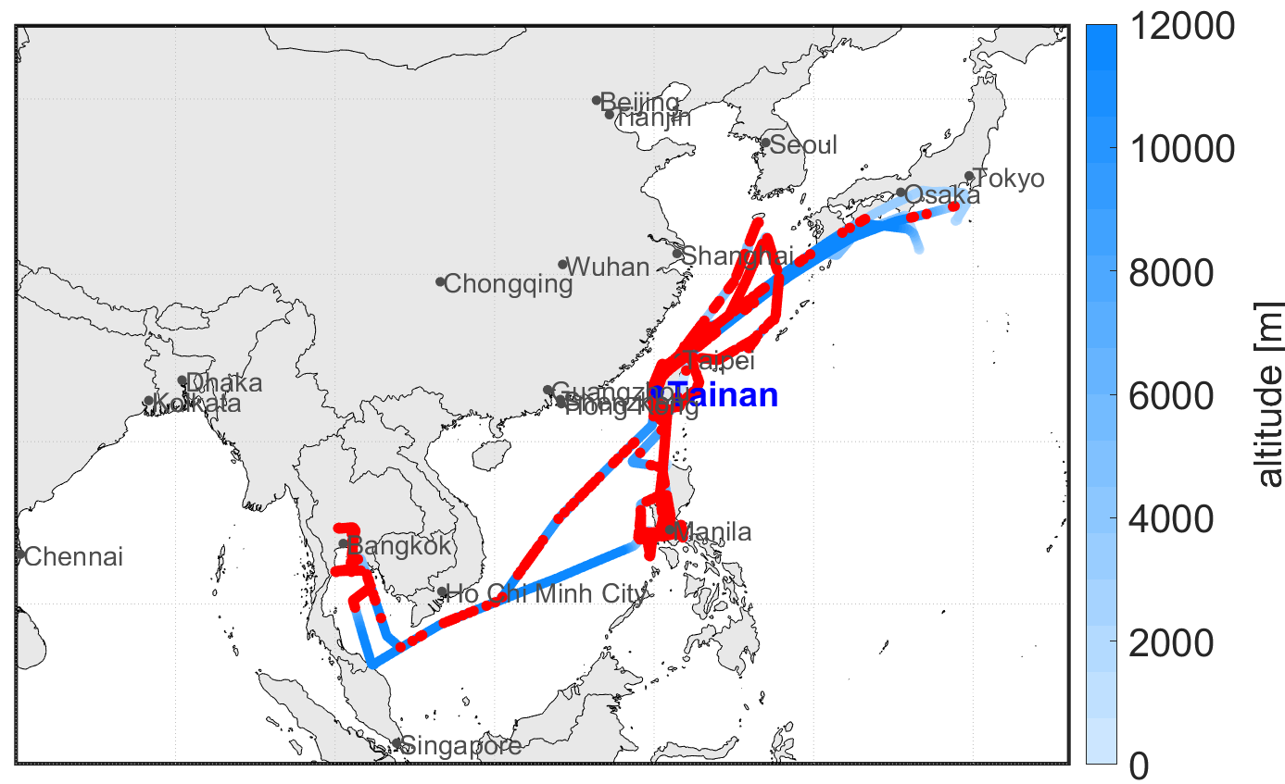
Identification of biomass burning influence
Red color shows BB influenced air masses
Only minor BB influenced air masses observed in EMeRGe-EU, mainly in southern Europe. Near Frankfurt and northern France → most likely from LRT.
Very frequent BB influenced air masses in EMeRGe-Asia, nearly on every flight and partly with a large extent.

Slide 24
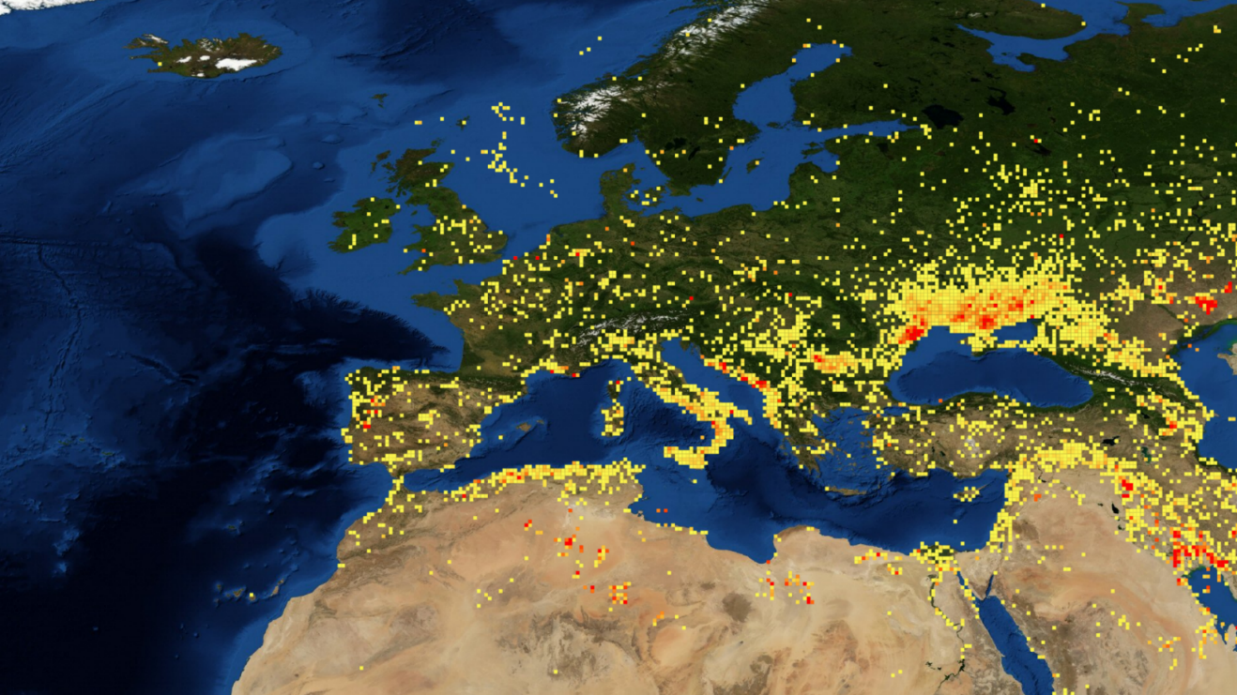
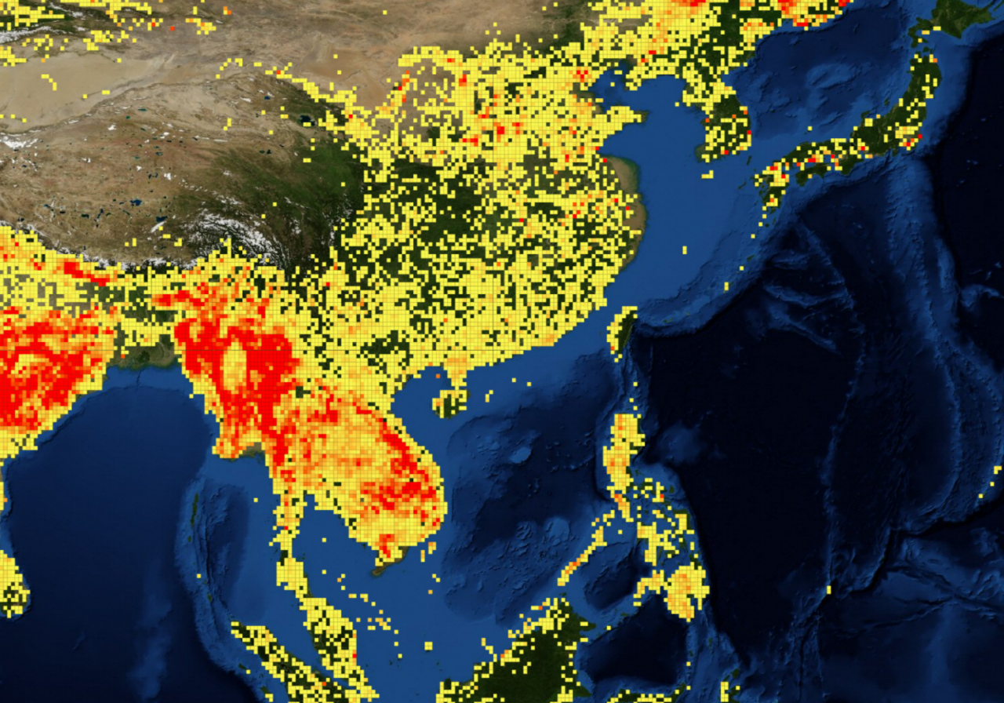
Identified biomass burning sources from space (FIRMS)
10th – 28th July, 2017
12th March – 7th April 2018
Sources of BB in Europe are reported in Italy, Southeast Europe, Northern Africa, on the Iberian Peninsula and slightly scattered over Central Europe.
Large sources of BB in Asia are reported in India, Myanmar, Thailand, Cambodia, on the Philippines, Singapore as well as densely scattered over Eastern China.
Source: https://firms.modaps.eosdis.nasa.gov/map

Slide 25
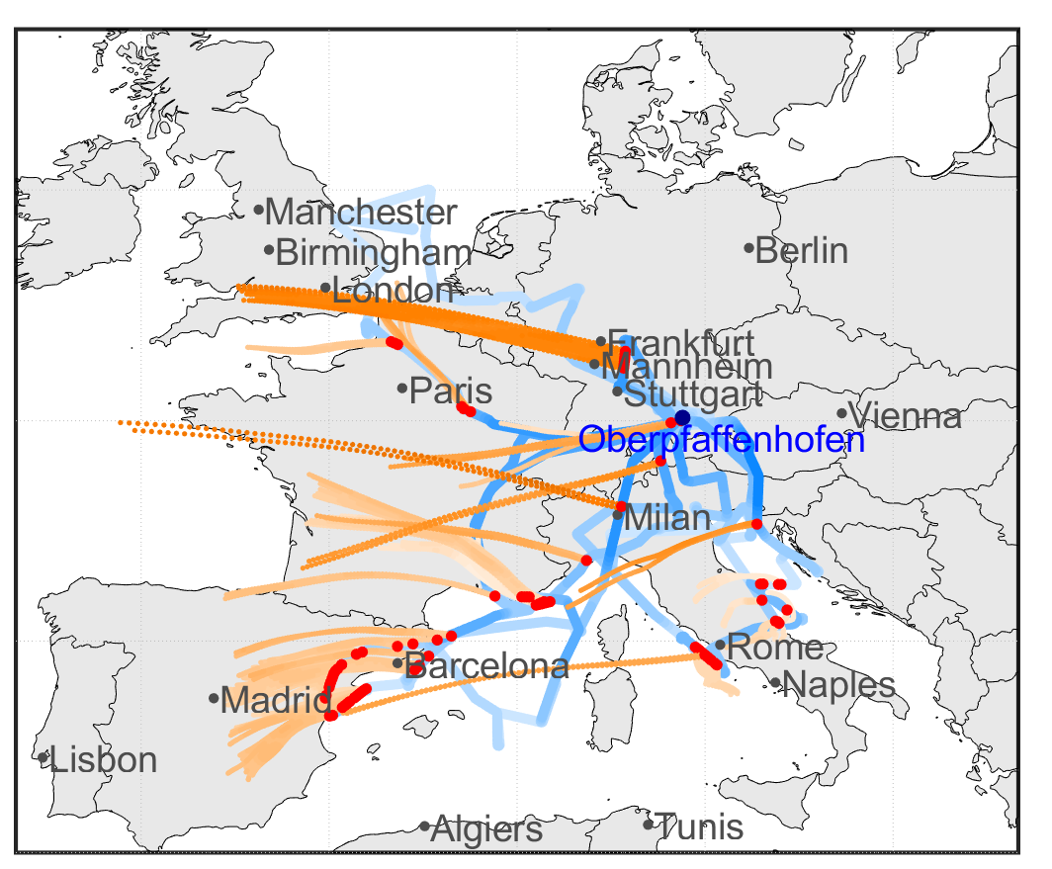
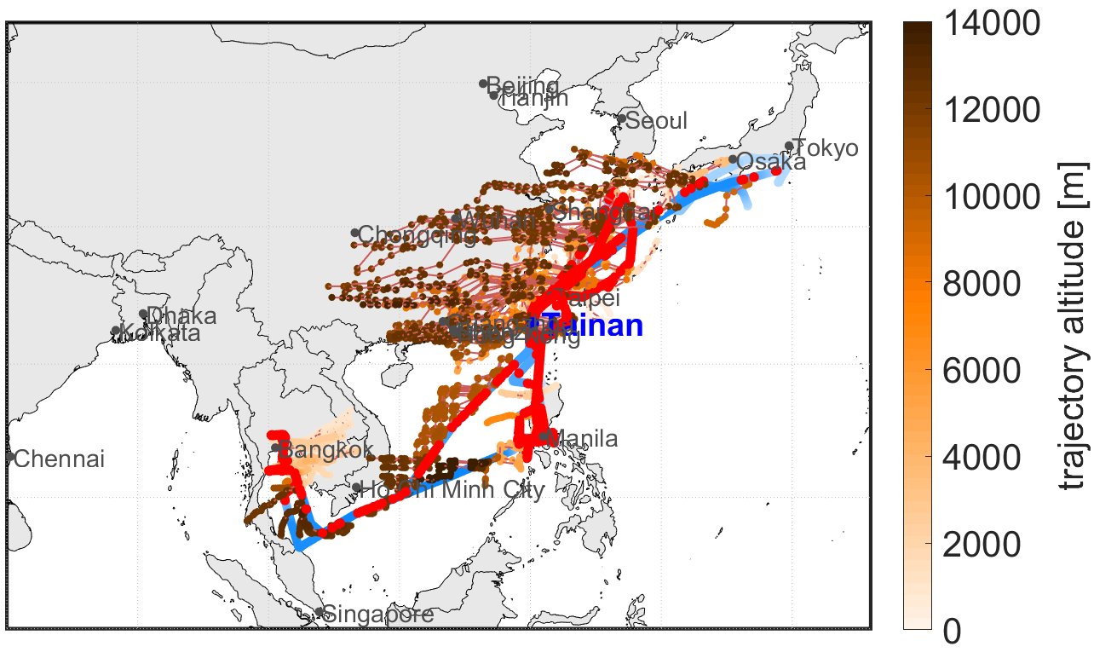
Identification of biomass burning influence,
0.5 days back-trajectories
local
fire
Southern BBs could be local fires from Italy, France and Spain, as trajectories are below 4000 m. Near Frankfurt → most likely from LRT. Local BB in Southern France near Marseille, 24th July 2017 (picture slide 7).
Asian BBs observed in higher altitudes → LRT.
Near Bangkok local fires from Thailand in lower altitudes.
All Trajectories of EMeRGe-Asia based on FlexTra (Stohl et al., 2010)
All Trajectories of EMeRGe-Asia based on FlexPart (Stohl et al., 2010)

Slide 26
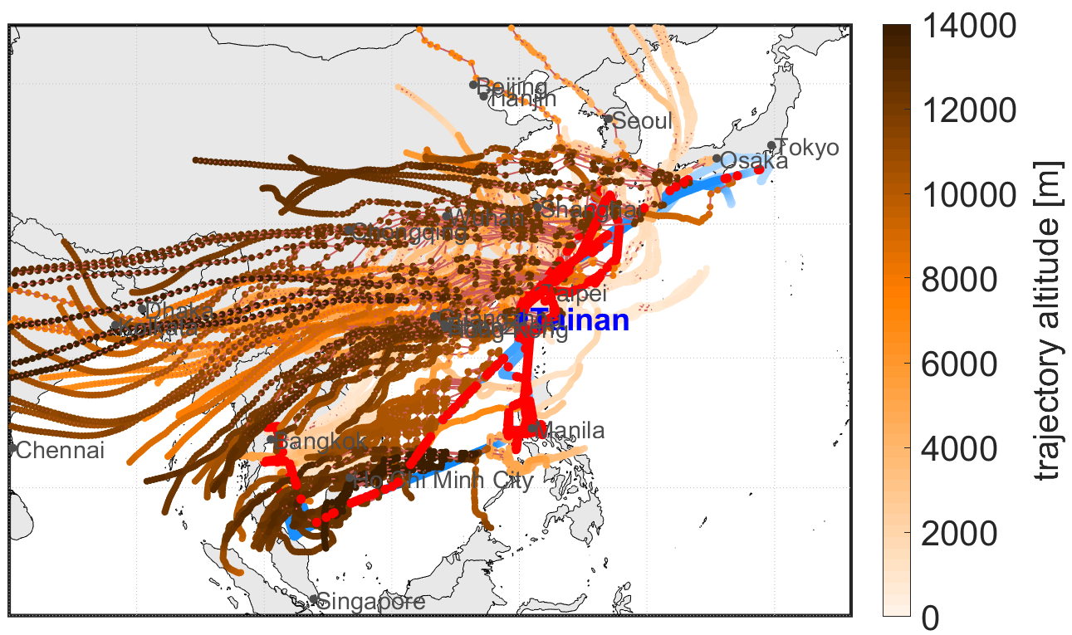
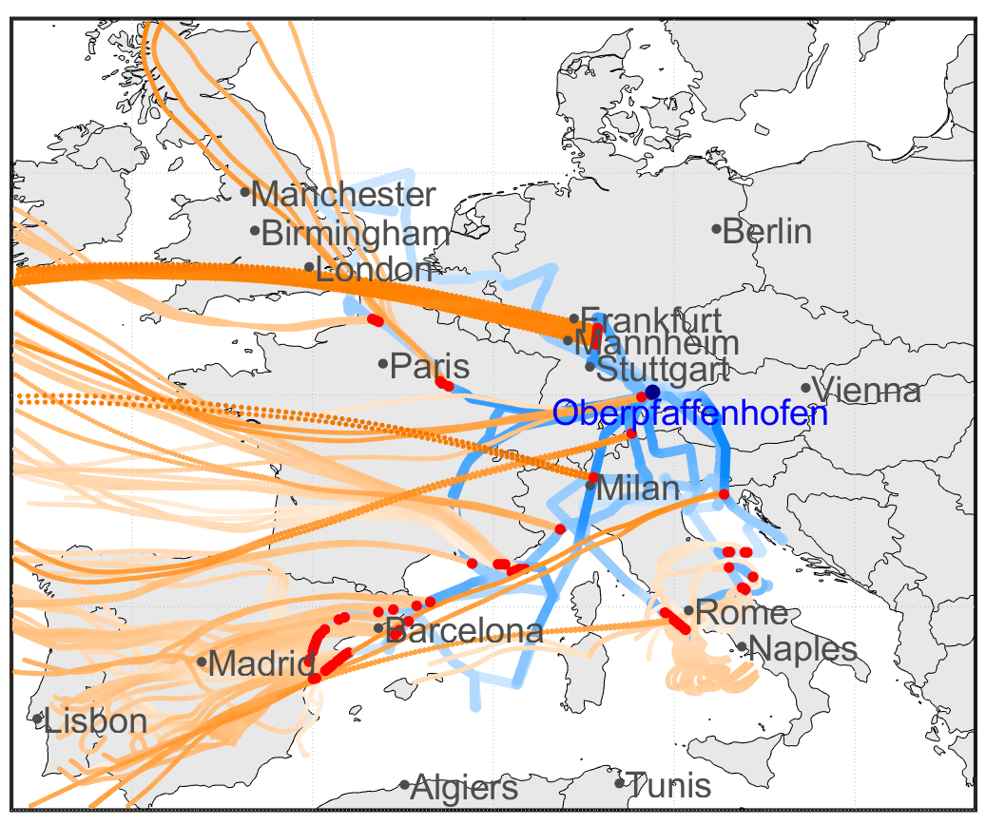
Identification of biomass burning influence,
2 days back-trajectories
Southern BBs could be local fires from Italy, France and Spain, as trajectories are below 4000 m. Near Frankfurt → most likely from LRT. Local BB in Southern France near Marseille, 24th July 2017 (picture slide 7).
Asian BBs observed in higher altitudes → LRT from India, Thailand, Singapore.
Near Bangkok local fires from Thailand. Fires in lower altitudes near Taiwan possibly originating from China mixed with AP (see slide 29).

Slide 27
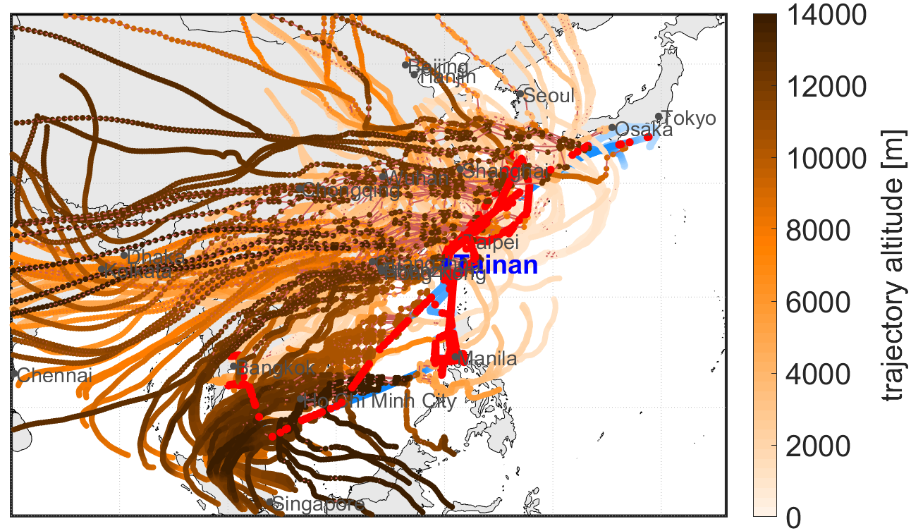
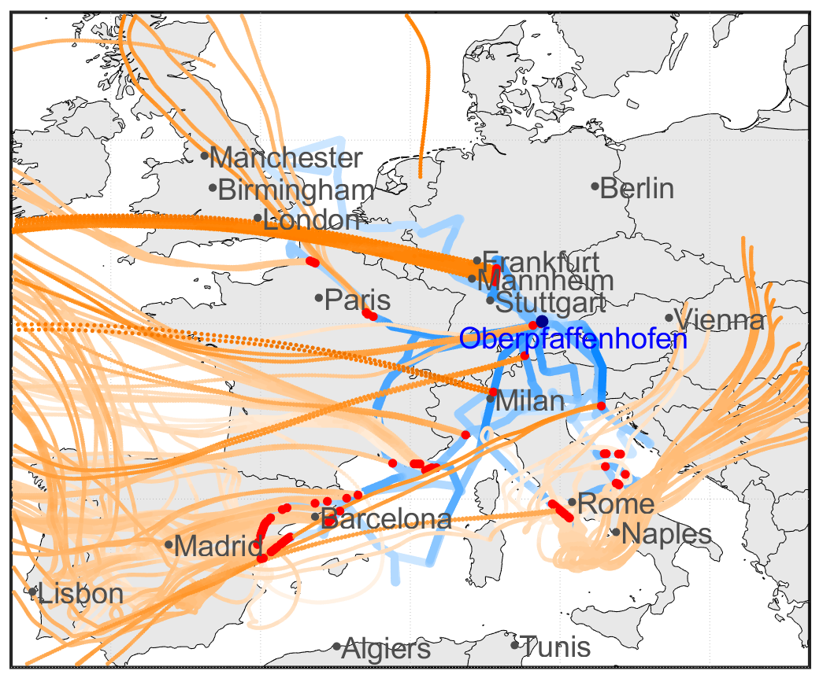
Identification of biomass burning influence,
4 days back-trajectories
Southern BBs could be local fires from Italy, France and Spain, as trajectories are below 4000 m. Fire west of Rome can also be transported from Southeast Europe.
Asian BBs observed in higher altitudes → LRT from India, Thailand, Singapore or even farther.
Fires in lower altitudes near Taiwan possibly originating from China mixed with AP and recirculated over the Pacific Ocean (see slide 29).

Slide 28
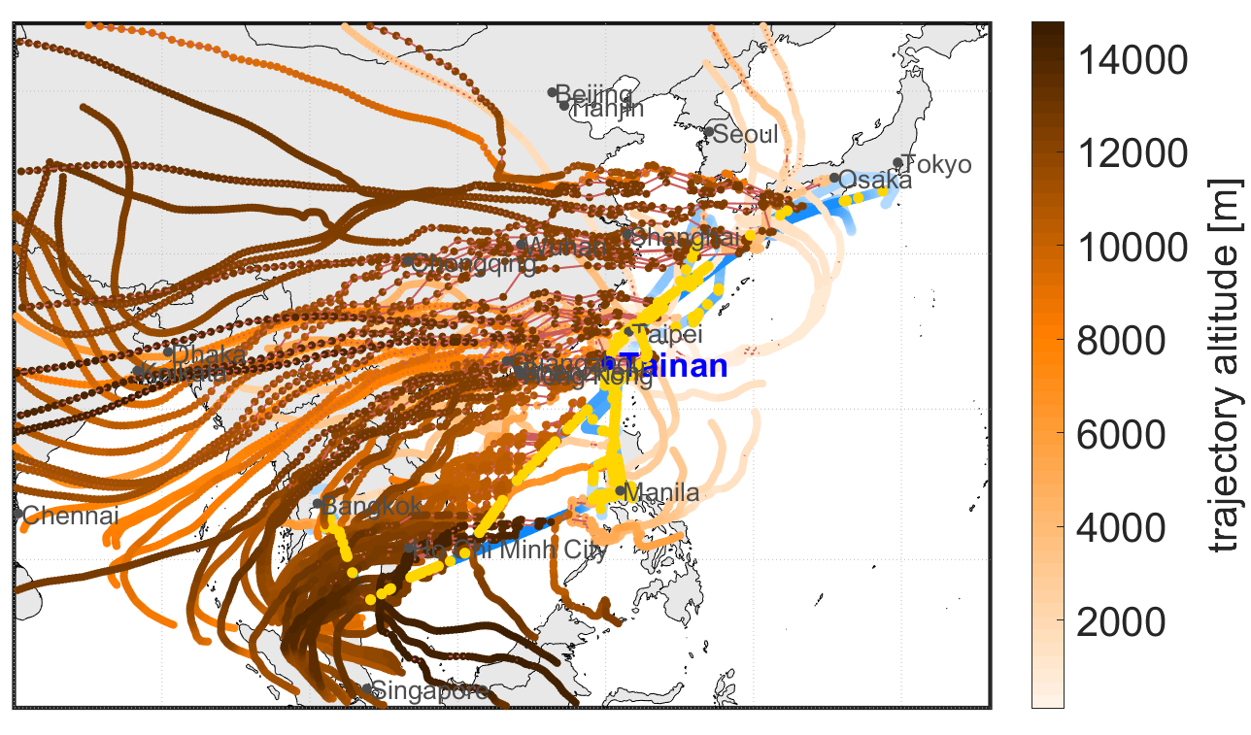
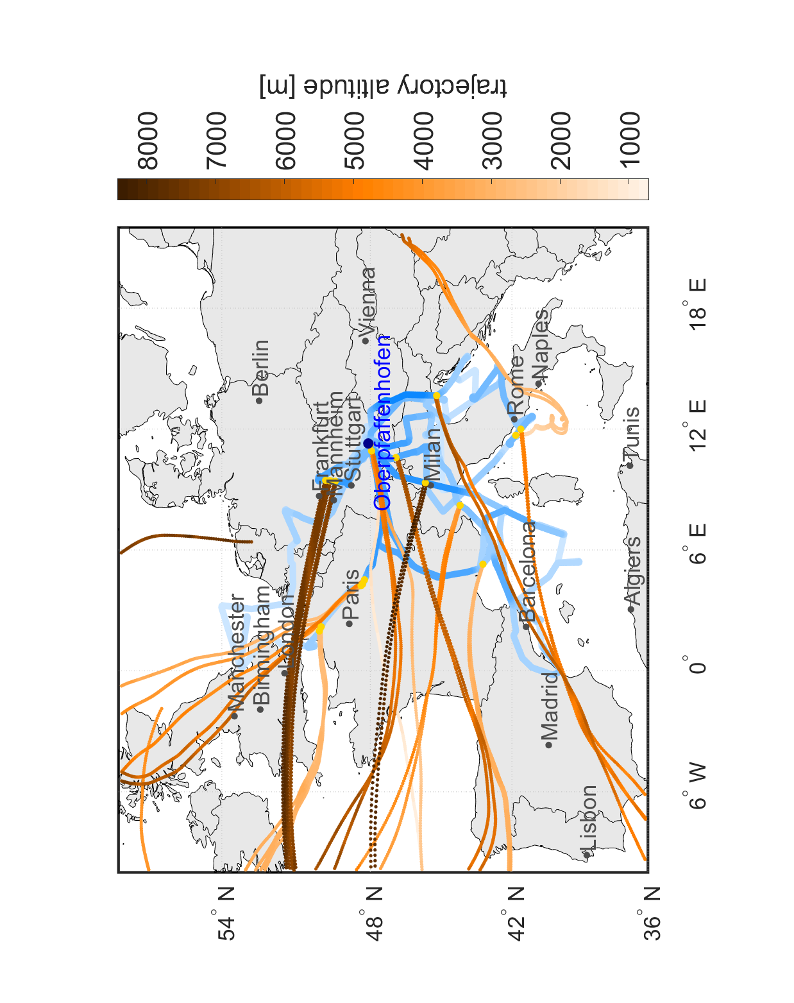
Identification of aged biomass burning,
4 days back-trajectories
Near Frankfurt → aged BB most likely from LRT. Also in Northern France and in higher altitudes over the Alps.
Asian aged BBs detected in higher altitudes → LRT from India, Thailand, Singapore or even farther away.

Slide 29
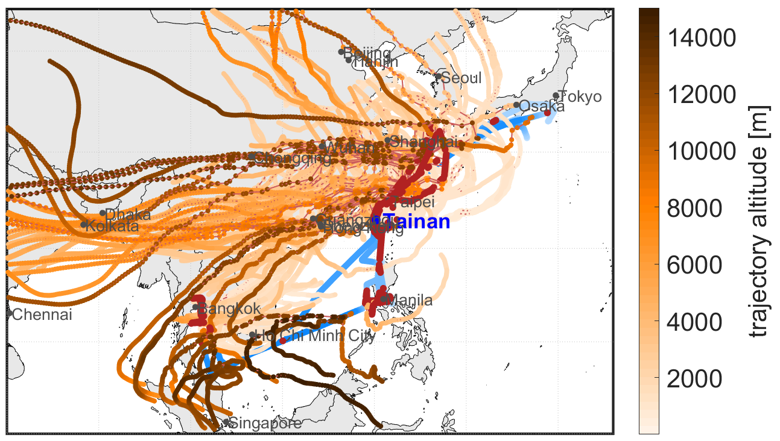
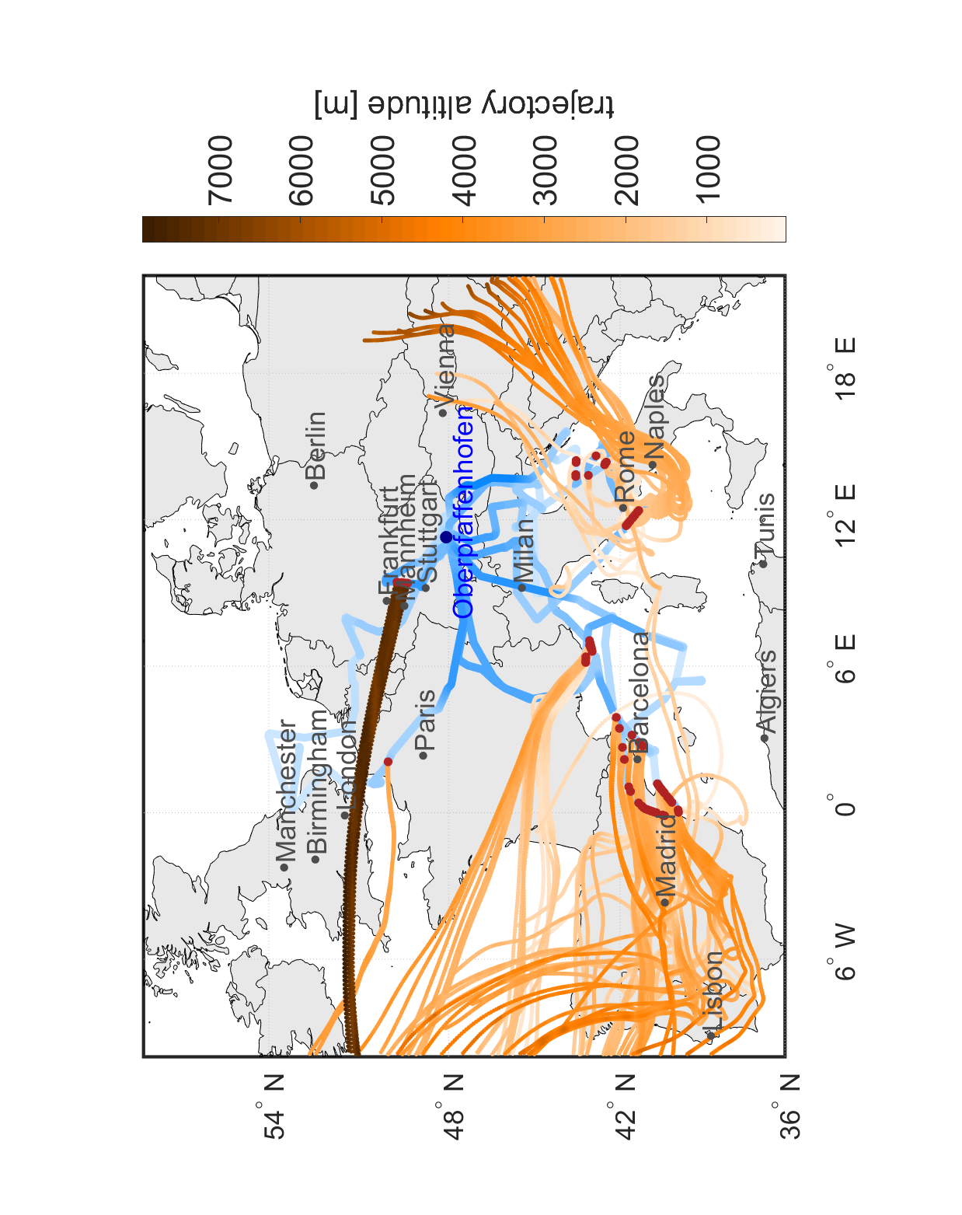
Identification of
fresh BB and/or mixed with AP
4 days back-trajectories
Southern BBs could be fresh local fires from Italy, France and Spain.
Near Frankfurt → diluted (former strong) BB with and without benzene enhancements?
Fires in lower altitudes near Taiwan and the East China Sea possibly originating from China mixed with AP and recirculated over the Pacific Ocean.
However, also fresh BBs or mixed with AP in mid and higher altitudes → LRT from India, Thailand, Singapore.

Slide 30
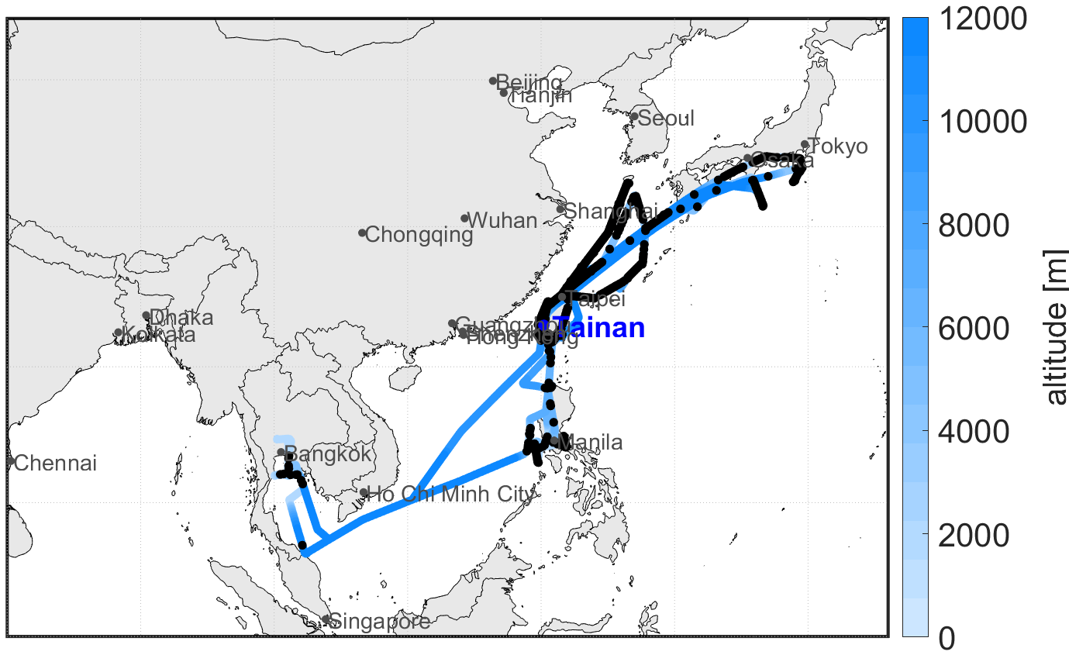
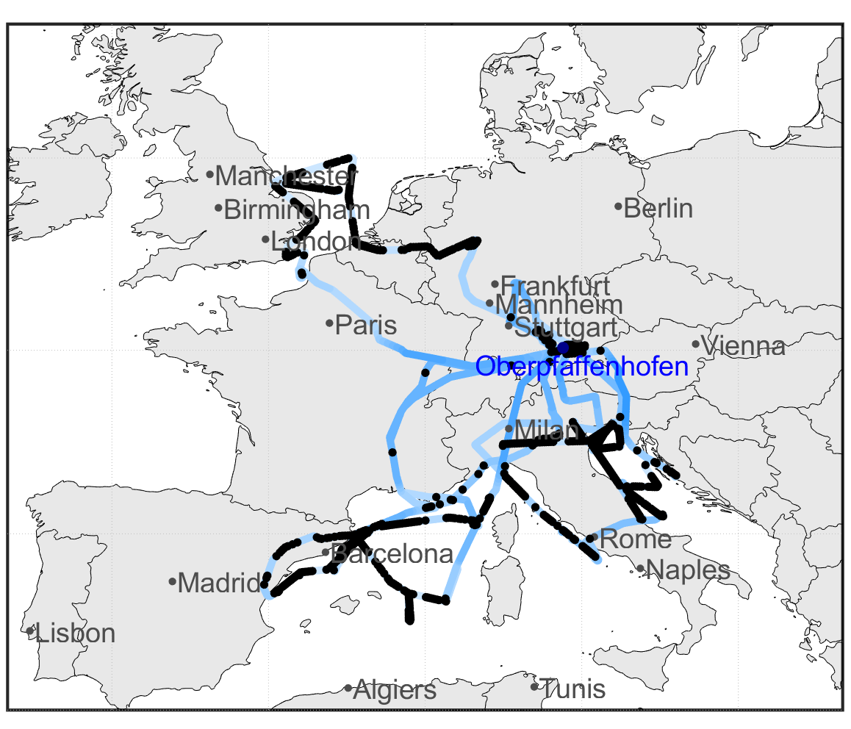
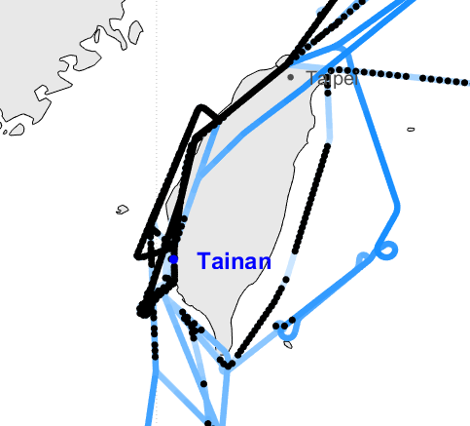
Identification of pure anthropogenic pollution
Black color shows pure anthropogenic pollution
AP observed during EMeRGe-EU near London, BeNeLux countries, Munich, Po Valley, Barcelona.
AP observed during EMeRGe-Asia around Taiwan (west coast), over the East China Sea, Manila, Bangkok and the southern Japanese coast.

Slide 31
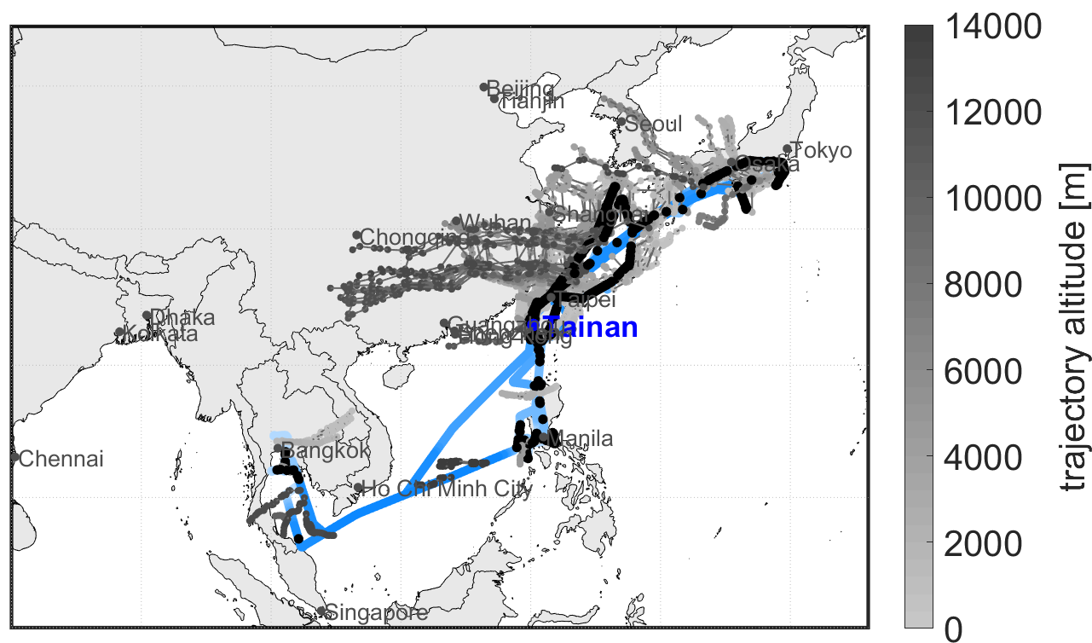
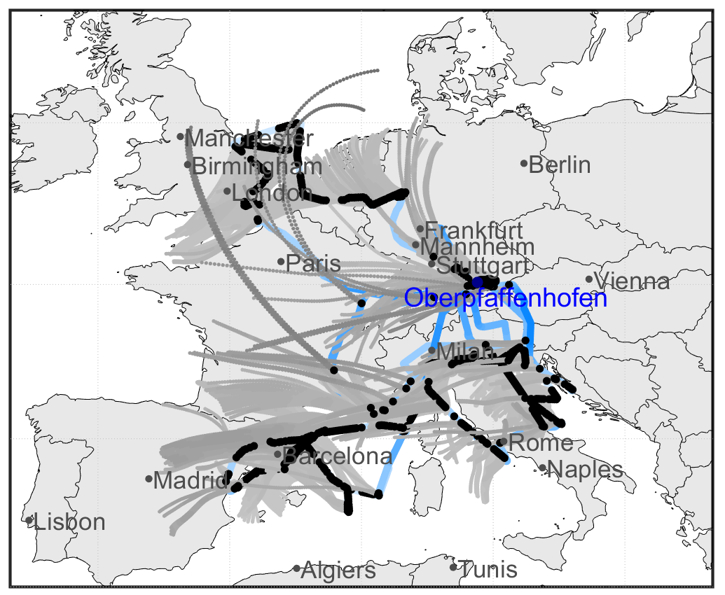
Identification of pure anthropogenic pollution,
0.5 days back-trajectories
In Europe we expect only local sources of AP. Trajectories show here mostly the expected source regions within a half day. However, west of Rome the pollution originates from the Mediterranean Sea?
Trajectories show in Asia sources from Mainland China after a half day.

Slide 32
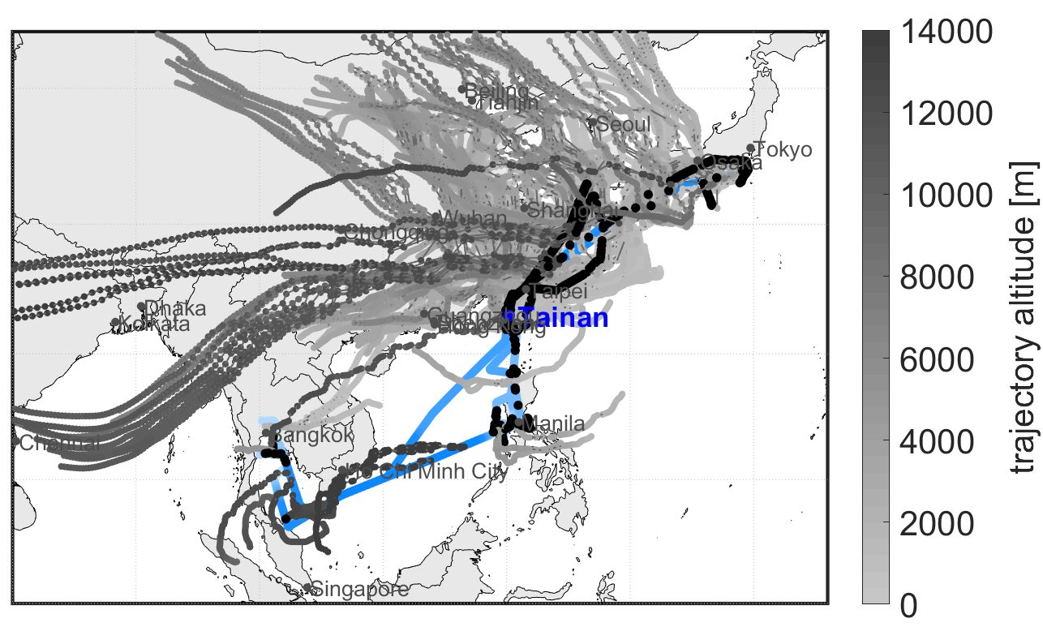
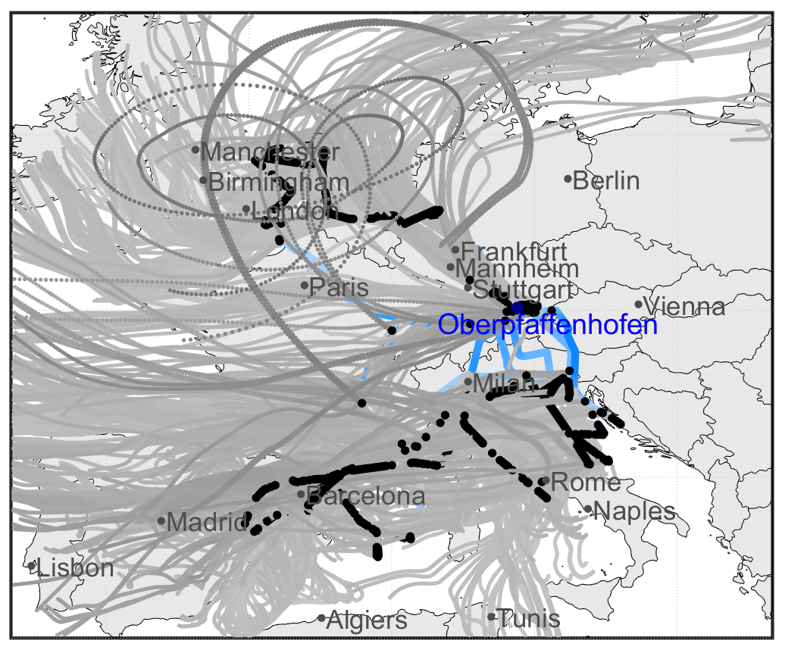
Identification of pure anthropogenic pollution,
2 days back-trajectories
In Europe we expect only local sources of AP. Trajectories give no clear information after 2 days.
Trajectories show in Asia sources from Mainland China also after two days. However, there is also pollution transported in higher altitudes from India/ South Asia.

Slide 33


Identification of fresh biogenic influence
In Europe we could observe fresh biogenic influence in lower altitudes, over the sea near the coast and also in higher altitudes due to convection.
In Asia only minor fresh biogenic influence was observed, mainly near Taiwan or Manila but also over the East China Sea (due to fast advection from Mainland China?)

Slide 34


Summary of VOC based air mass characterization
EMeRGe EU
Biomass burning influenced air during EMeRGe-EU mostly in southern Europe. Aged BB in higher altitudes during the northernmost flights.
Pure anthropogenic pollution observed downstream of London, BeNeLux countries, Italy (Po Valley), East of Spain.
Mixing of fresh biogenic emissions with AP
Percentage of VOC data (without stratosphere → < 100 ppb O₃)
EMeRGe Asia
What have we learned so far:
Set of VOC measurements is an excellent tool to distinguish between plume types
“Cleaner” (no BB/ no AP) conditions in Europe
Percentage of pure AP slightly higher in Asia
More biogenic influence in Europe, but minor BBs
large BB influence (fresh and aged) in Asia and significant mixing of BB and anthropogenic pollution
Significant Biomass burning influenced air observed in Asia, transported from India, Thailand, Myanmar, China.
More frequent aged biomass burnings observed in Asia.
Pure anthropogenic pollution transported from Mainland China but also locally emitted (west coast of Taiwan).
Significant mixing of BB and anthropogenic pollution in Asia.
Fresh biogenic emissions only observed near the coasts.

Slide 35

Outlook
How can we use the results for further analysis, also regarding the VOC scientific focus?
CO filtered
Can we identify distinct MPCs as source of air mass types?
Are there differences in the VOC fingerprints in general, and in the air masses of European and Asian MPCs?
What role play biogenic emissions in Europe?
How is the chemical processing of other trace gases in different air masses (e.g. CO or Ozone) in Europe and Asia?
Does e.g. the ozone formation potential change in different types of air masses and concentrations of VOCs (Benish, et. al, 2020, in Rev.)?
What role play VOCs as precursors for SOA in air masses from MPC plumes?
clean air
anthropogenic pollution
probability
strong anthropogenic pollution
(Benzene > 130 pptV)
BB
CO [ppbV]

Slide 36

Thank you for your interest
If you have any remarks or questions: eric.forester@kit.edu
In memory of our dear colleague Andreas Hilboll

