Slide 1







Insights into recharge processes and speleothem proxy archives from long-term monitoring networks of cave drip water hydrology
Andy Baker¹, Pauline C. Treble^{2, 1}, Andreas Hartmann^{3, 1}, Mark O. Cuthbert^{4, 1}, Monika Markowska⁵, Romane Berthelin³, Carol V Tadros^{2, 1}, Matthias Leopold⁶, Stuart Hankin² and the KSS Cave Monitoring Team⁷
¹Connected Waters Initiative, UNSW Sydney, Australia Contact Andy at a.baker@unsw.edu.au
²ANSTO, Lucas Heights, Australia
³University of Freiburg, Germany
⁴Earth and Ocean Sciences, Cardiff University, UK
⁵ Max Planck Institute for Chemistry, Mainz, Germany
⁶School of Agriculture and Environment, University of Western Australia, Perth, Australia
⁷ Kempsey Speleological Society

Slide 2
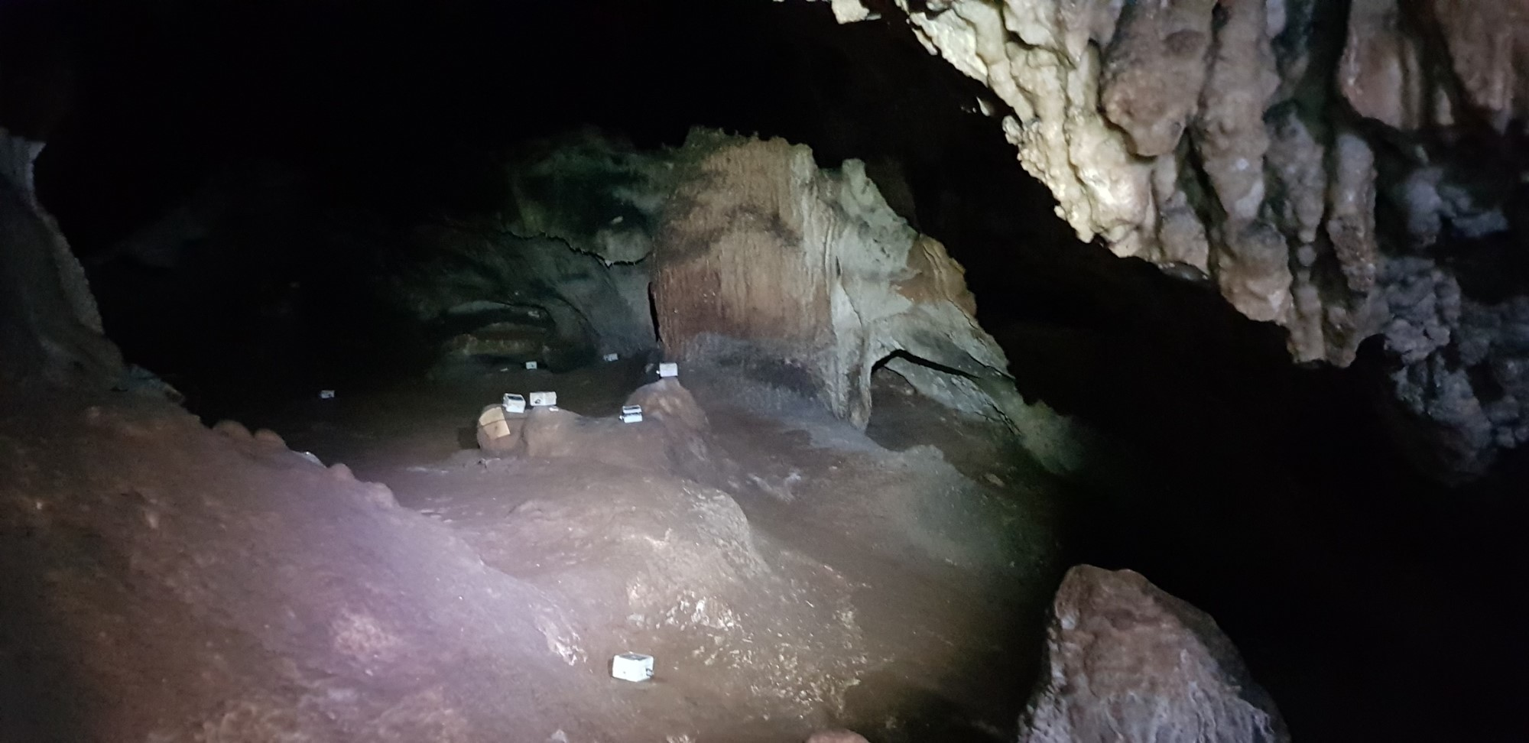

What is the rainfall amount needed to generate recharge?
Long-term monitoring of drip hydrology using networks of automated loggers can be used to compare recharge events to antecedent rainfall using both observational data and modelling.
Multiple drip loggers deployed in a chamber in Cathedral Cave, Wellington, NSW (photo: Ian Eddison)

Slide 3
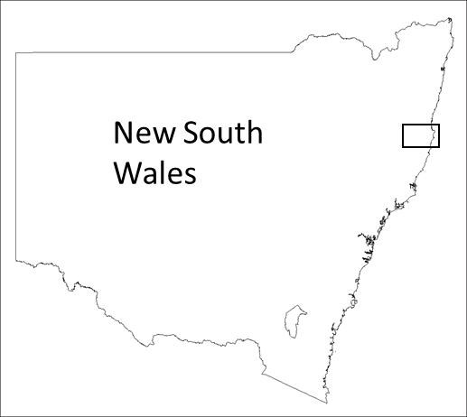
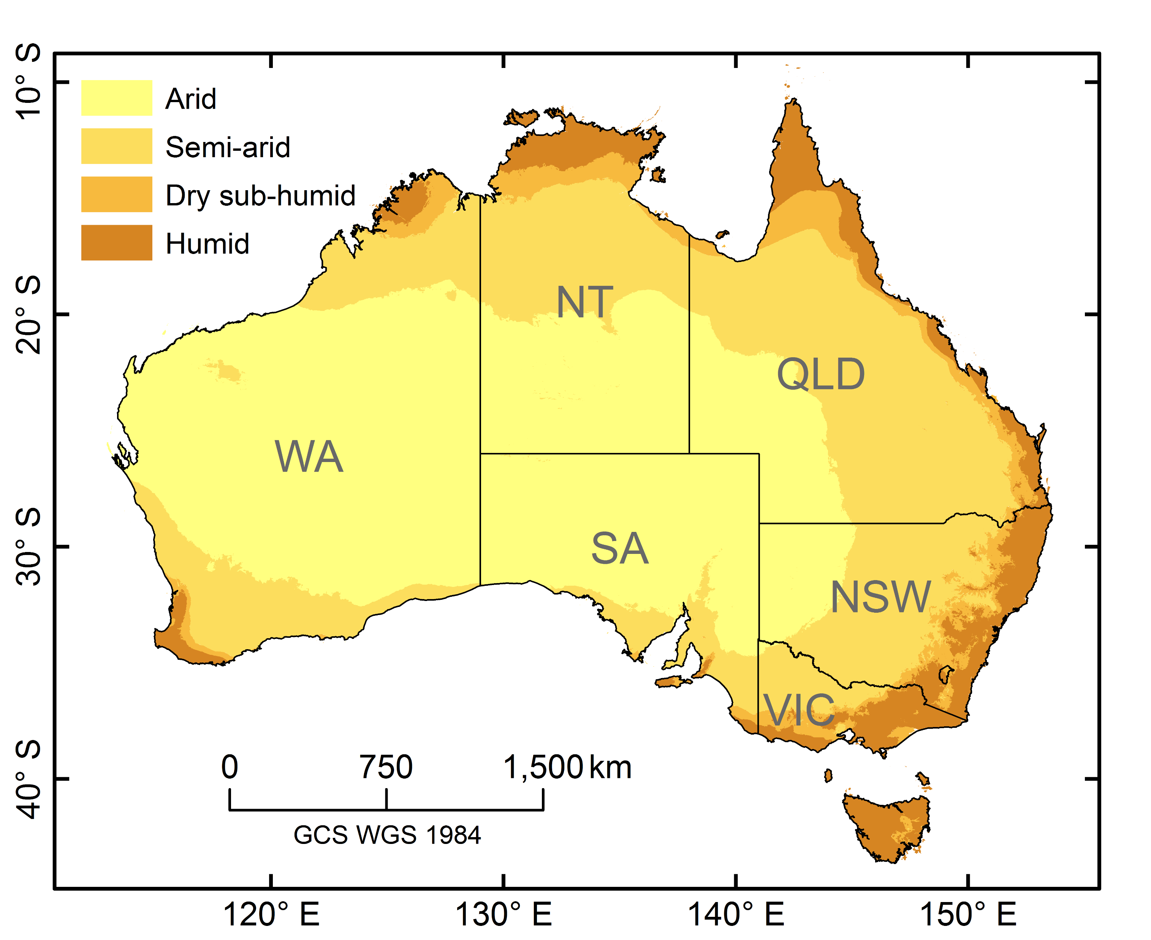

Example 1: Macleay Karst, New South Wales, Australia
(in revision, Journal of Hydrology)
Fourteen continuous drip discharge time series from 2014 CE onwards, in a karstified, fractured limestone, from six caves of varying depths and vegetation cover in the sub-tropical humid Macleay Valley of the mid-north coast of New South Wales, Australia.
Upper Macleay
Macleay River
Location of the Macleay Karst region. Inset box shows the region shown: Upper and Lower Macleay cave monitoring sites (circles) and the nearest weather station (Kempsey automated weather station). Image is from Google Earth, used with permission. Mean annual temperature (MAT) of 18.6 °C and total annual precipitation (P) of 1218 mm. Annual P/PET varied between 0.62 (2016 CE) to 1.13 (2015 CE).
Kempsey AWS
Lower Macleay
Kempsey

Slide 4
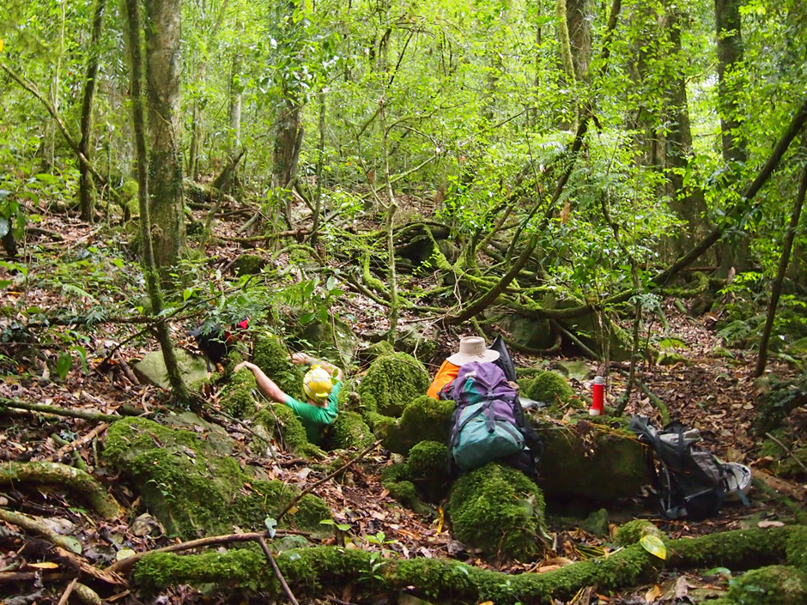
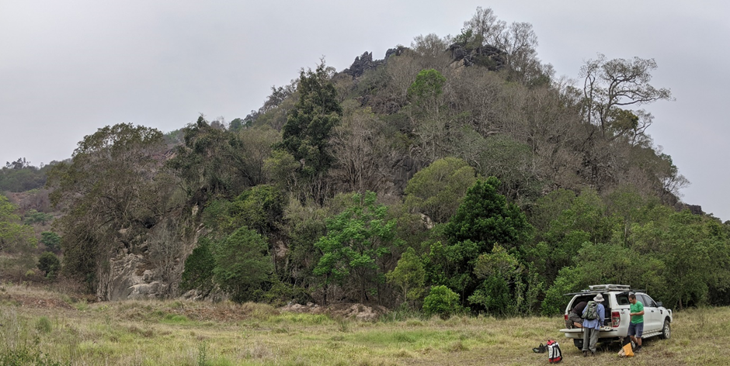
We observe thirty-one cave drip water recharge events over a five-year monitoring period. Monitoring is on-going.
The entrance to one of our monitoring sites in the subtropical rainforest. Carter Cave, Upper Macleay
Upper Macleay
Macleay River
Kempsey AWS
Lower Macleay
Kempsey
(a) Daily precipitation from Lower Macleay (black) and Upper Macleay (red). (b) Daily AET (c) Daily cumulative water balance. (d) Event number. (e) All drip logger data for the Lower Macleay (red) and Upper Macleay (black).
Lower Macleay. The monitored caves are situated c. 40 m above the valley floor in this isolated karst hill. The source of rainfall recharge is only from this hill. Photo taken during the 2019 drought and bushfires.

Slide 5
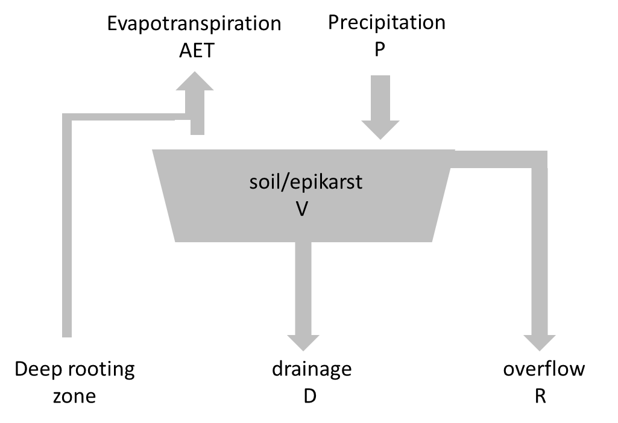
We used a simple water balance model (below) to quantify soil and epikarst water storage volumes and to test hypotheses of the hydrological controls. Driven by P and AET, two model parameters, soil and epikarst water storage capacity (V) and diffuse drainage (D) were calibrated to obtain the optimised solution such that overflow R occurred at the same time as observed recharge events. Modelled storage capacity (V) of about 65 mm (Lower Macleay) and 80 mm (Upper Macleay) confirm a correspondence between observed weekly precipitation thresholds and soil and epikarst capacities (see Table, part B).
Comparison to antecedent precipitation (see Table, part a) demonstrates a median observed recharge threshold of 76 mm / week precipitation (Lower Macleay) and 79 mm / week precipitation (Upper Macleay), with lower precipitation thresholds (down to 30 mm / week) possible.
(a) Recharge thresholds (mm)
 | Lower Macleay |  |  |  | Upper Macleay
 | Antecedent precipitation |  |  |  | Antecedent precipitation
 |  | 7-day | 14-day | 21-day |  | 7-day | 14-day | 21-day
 | MEAN | 85.3 | 111.2 | 130.2 | MEAN | 97.6 | 124.5 | 153.4
 | MEDIAN | 76.2 | 98.6 | 127.1 | MEDIAN | 79.4 | 108.0 | 149.8
 | MIN | 33.3 | 43.1 | 43.4 | MIN | 30.1 | 32.6 | 47.9
(b) Water balance model
 | Lower Macleay |  |  |  | Upper Macleay
Overflow Capacity (mm) | 65 |  |  |  | 80
Drainage (mm) | 4.8 |  |  |  | 0.5
Number of observed events | 14 (+3 low volume events, with indistinct hydrographs) |  |  |  | 27
Number of observed events correctly simulated | 7 (+3 low volume events with indistinct hydrographs) |  |  |  | 19
Number of observed events not simulated | 7 |  |  |  | 9
Number of simulated events not observed | 0 |  |  |  | 3
Model code at https://github.com/KarstHub/Simple-Water-Budget-Model. Credit: Mirjam Scheller

Slide 6

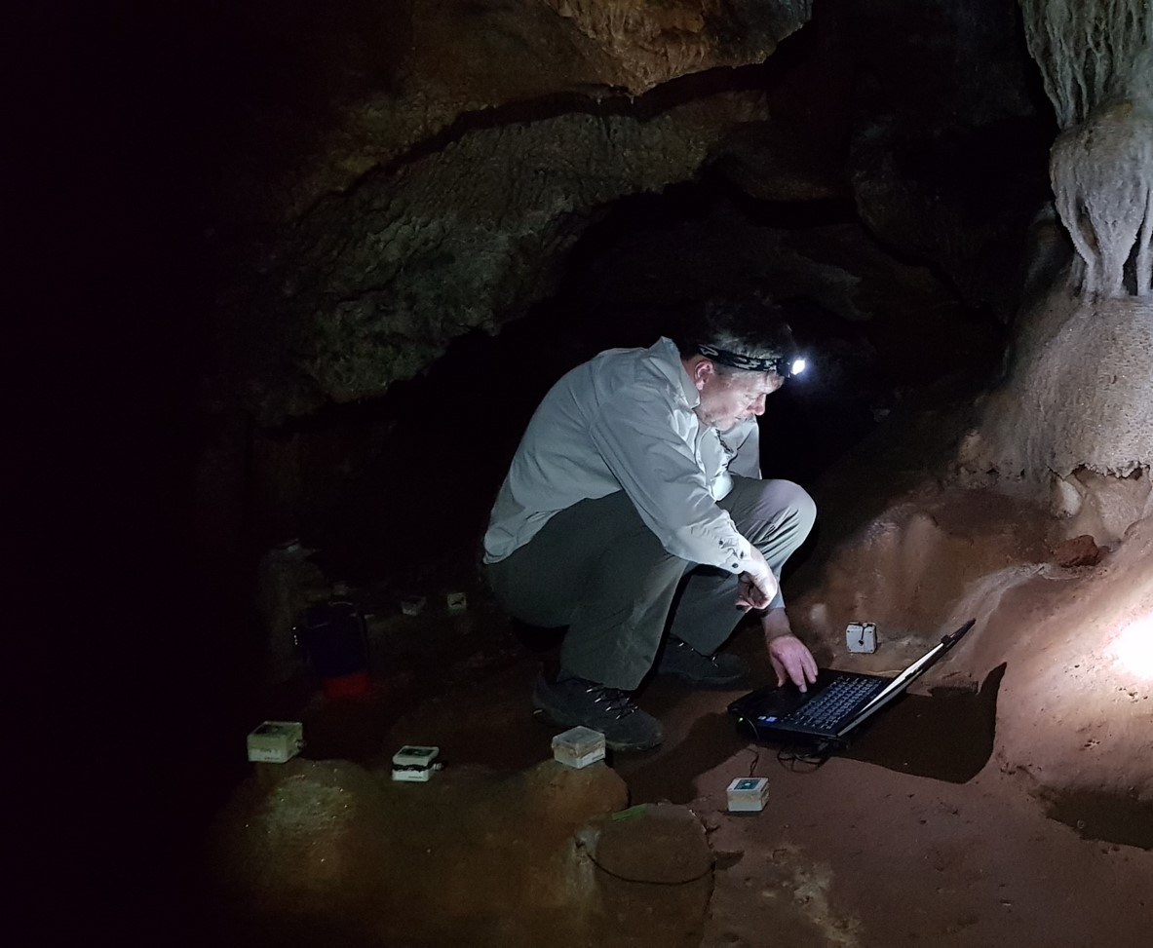
Example 2: Wellington, New South Wales, Australia
(Markowska et al., 2020; Cuthbert et al., 2014, and unpublished data)
Photo: Ian Eddison
At Cathedral Cave, NSW, with a temperate semi-arid climate, we have almost ten years of drip hydrology monitoring from a network of drip loggers. Mean total annual precipitation is 629 mm and mean annual temperature is 18.2 °C. P/PET = 0.45 (Baker et al., 2019).
The time series graphs on this slide show the normalised hydrology for the eighteen most reliable loggers. The 2019 drought year is evident.
We now have enough recharge events (n=21) to determine the antecedent rainfall volume needed for drip recharge, using the methodology presented previously. This will be completed through a 2020 UNSW Honours research project.

Slide 7
We previously applied a soil moisture balance - karst model (schematic below) to the drip recharge data for 2010-2014 (Cuthbert et al. 2014).
The best fit between observed recharge events and modelled recharge (Rch) was determined. Modlelling suggested a maximum soil moisture deficit of 87 mm is needed to be overcome prior to cave drip water recharge.
Matlab model code available at:
https://doi.org/10.6084/m9.figshare.10282868
This isotope enabled model was then used to compare modelled and measured δ¹⁸O for two modern stalagmites, WB and WC (Markowska et al., 2020). The isotope model only includes a parameterised rainfall amount effect and isotope fractionation due to epikarst evaporation.
For stalagmite WC, almost all major peaks and troughs could be replicated within the age uncertainty, suggesting that epikarst evaporation provides a good explanation for the variability in WC δ¹⁸O_{spel.} WC can be explained by a simple single-reservoir model, which is very sensitive to karst evaporation and changes in water storage volumes, controlled by alternating periods of recharge and decline. WB cannot be explained by a simple single-reservoir model and likely is fed by multiple reservoirs.

Slide 8

How unique is a drip? What is the heterogeneity in drip rate between sites within a cave, and between caves?
Long-term monitoring of two caves at the montane Yarrangobilly Caves, NSW by ANSTO and UNSW teams can be used to quantify variability in drip hydrology response.
Harrie Wood Cave
South Glory Cave
Published in
Markowska
et al. (2015)
At Yarrangobilly, mean annual temperature = 11.1 °C. Mean total annual precipitation = 1177 mm. P/PET = 1.07
Published in
Coleborn et al. (2016)

Slide 9
The current dataset comprises over four million unique drip rate measurements over eight years, from twenty drip sites, from two caves (red – South Glory Cave; Black – Harrie Wood Cave).
Cumulative frequency drip rate distributions for each of the twenty drip sites is shown on the left. All drip rates are from the same time period and same hydroclimate forcing. This graph reveals the natural varaibility of drip discharge.
Two drip rates (180 s and 750 s per drip) are shown as examples. Modelled drip water oxygen isotope fraction using iSOLUTION is shown in blue. The graph below shows that drip rates slower than 180 s per drip are experienced at these monitored drip sites for 11.8% of the time (75% quartile).
iSOLUTION modelled fractionation
Up to 0.3‰
Up to 0.9‰

Slide 10
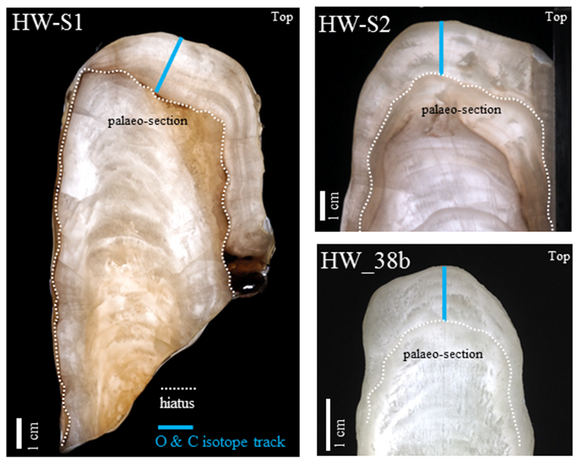
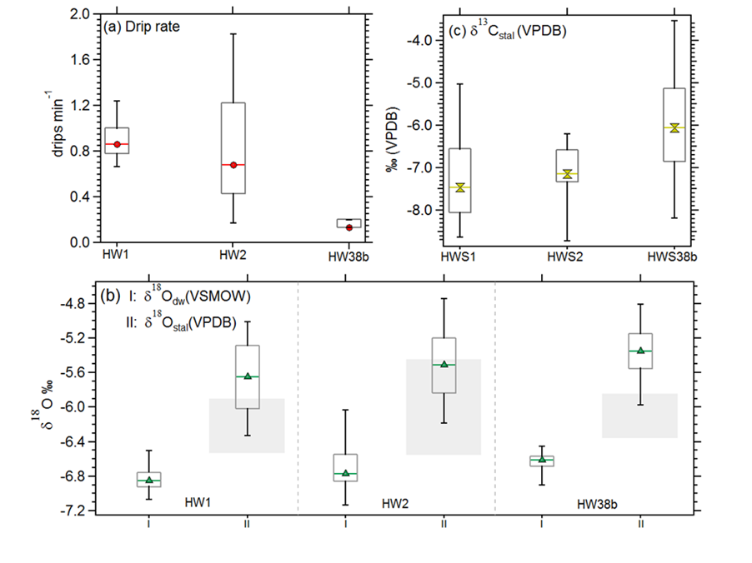
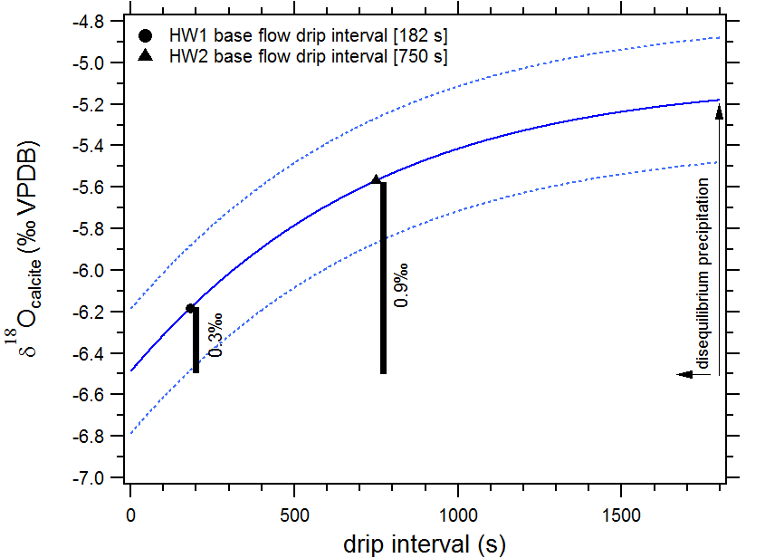
Long term monitoring of both cave drip water oxygen isotope composition and drip rates therefore allows the quantification of the extent of speleothem oxygen isotope variability due to fractionation associated with changes in drip rate.
ANSTO long-term monitoring site, Yarrangobilly Caves, NSW, Australia. Carol Tadros and Pauline Treble, unpublished data (Tadros et al. in prep)
ISOLUTION modelled evolution of speleothem calcite δ¹⁸O values with varying drip intervals. The solid line represents the modelled evolution from the mean HW1 δ¹⁸O drip water value and the dashed lines correspond to the 90% confidence interval.
Box plots of: (a) drip rate; (b) drip water δ¹⁸O values, δ¹⁸O_{dw} (VSMOW) and stalagmite δ¹⁸O values, δ¹⁸O_{stal} (VPDB); from sites HW1, HW2 and HW38b in Harrie Wood Cave, south-eastern Australia. Grey shading in (b) represents the box plot of calcite-equivalent δ¹⁸O_{dw} (VPDB) values for comparison with calcite δ¹⁸O (VPDB) measurements.

Slide 11
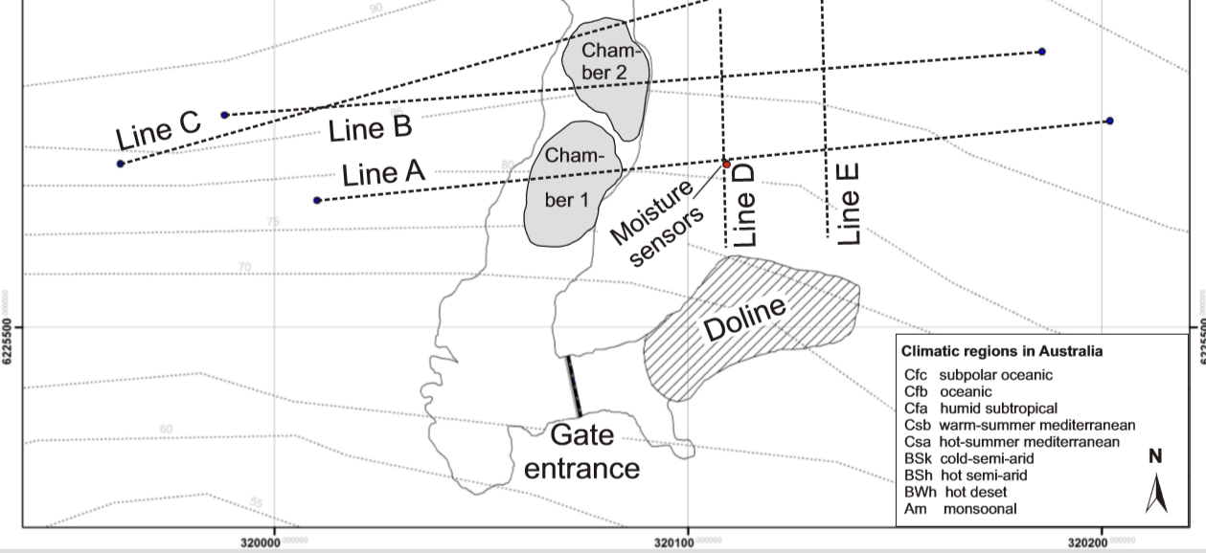
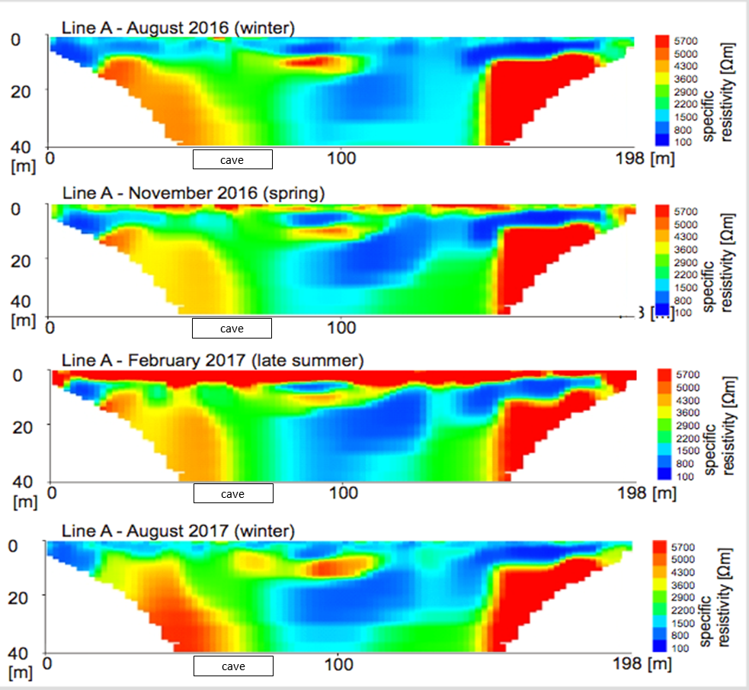
Long-term monitoring can be combined with time-lapse electrical resistivity tomography (ERT) to observe seasonal patterns in unsaturated zone water movement to better interpret the speleothem oxygen isotope archive.
At Golgotha Cave, Western Australia, Electrical Resistivity Tomography (ERT) measurements used an array of electrodes on the surface above the cave (upper figure).
Differences in resistivity can be linked to the water saturation of the rock profile at this site where flow through both primary porosity and fractures is possible.
In the left-hand figure, low resistivity (blue) = water-filled cavities / porous damp rock. High resistivity (maroon) = dry/solid rock.
‘Time lapse’ repeat surveys such as this can image water movement. Note the connected saturated rock from surface to depth in winter, and a late summer disconnection at the surface (February 2017).

Slide 12
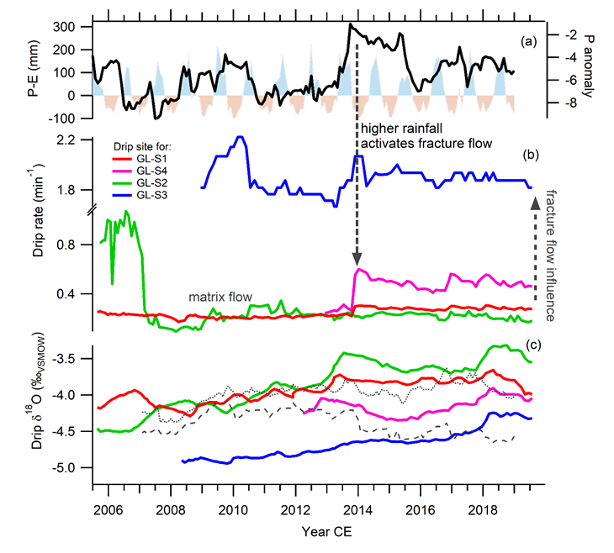
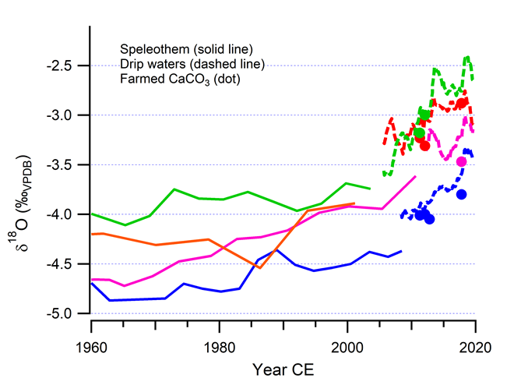
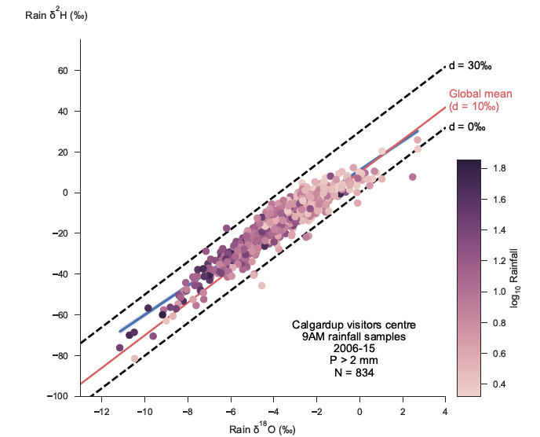
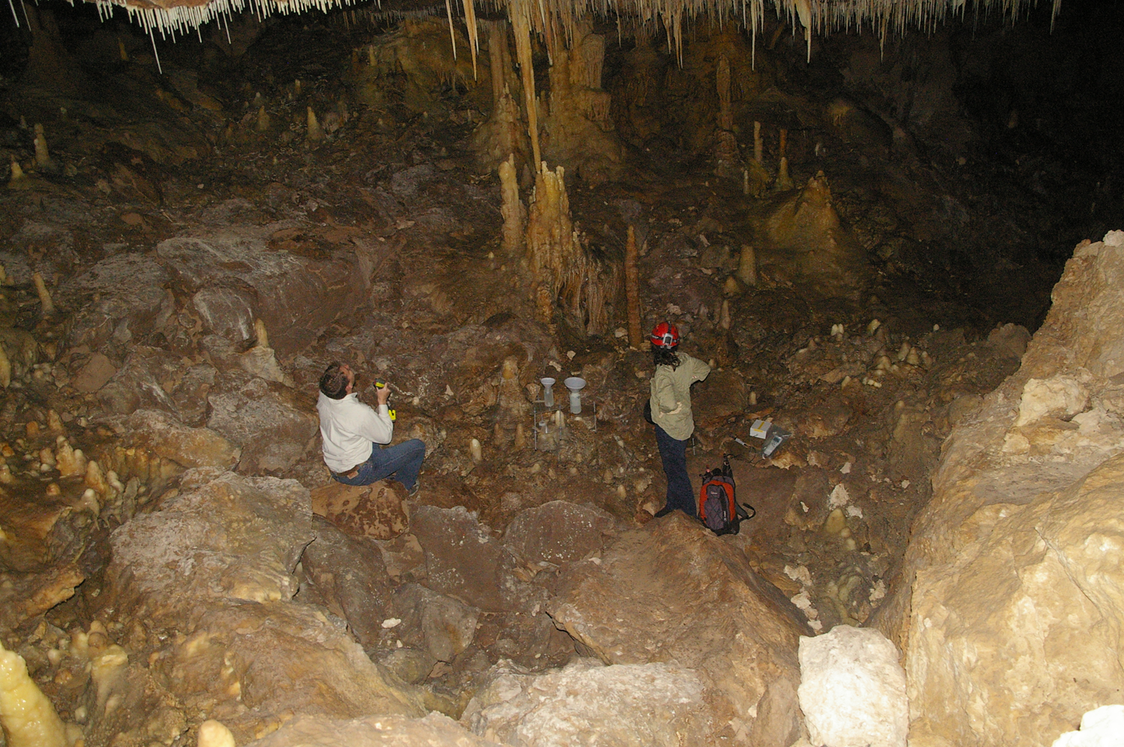
ERT data corresponds with the strongly seasonal water balance (upper left figure) in this region of Mediterranean climate.
Long-term monitoring identifies an inverse relationship between drip rate and drip water δ¹⁸O (middle left figures), due to the influence of fracture flow leading to lower drip water δ¹⁸O.
Fractures activate in wetter years e.g. 2013, and local rainfall water isotope data (lower left figure) shows that wetter years typically lower rainfall δ¹⁸O due to the “amount effect” for region.
Differences between speleothem δ¹⁸O time series and ‘farmed calcite’ (lower figure) mirror that of drip water, and are explicable by the heterogeneity in karst hydrology.

Slide 13
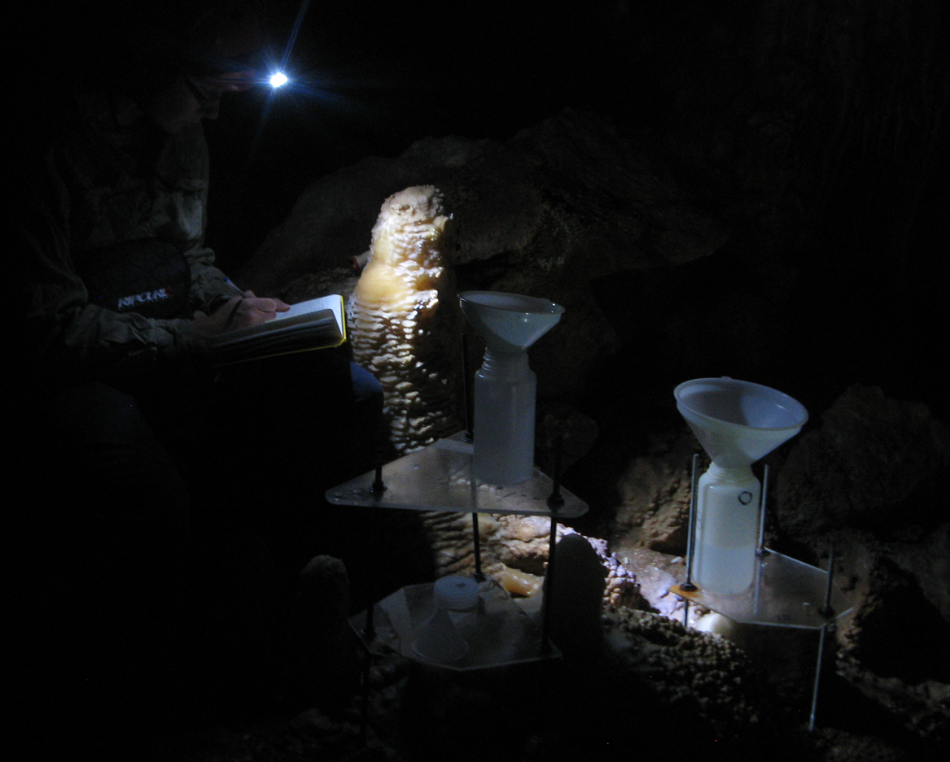
Conclusions
We demonstrate the utility of long-term, spatially dense monitoring of drip water hydrology, combined with hydrological modelling, measurement of drip water isotope composition, and time-lapse electrical resistivity tomography.
Networks of automated drip loggers permits the quantification of the recharge bias for speleothem forming drip waters. The focus here is on Australian, water limited environments (E >= P). They also permit the quantification of the heterogeneity of speleothem forming drip water discharge.
The focus here is on quantifying the hydrological controls on the within-cave variability in drip water oxygen isotopic composition, to better quantify uncertainties in the speleothem oxygen isotope archive.
References
Baker, A. Berthelin, R., Cuthbert, M.O., Treble, P.C., Hartmann, A. and the KSS Cave Studies Team. Rainfall recharge thresholds in a subtropical climate determined using a regional cave drip water monitoring network. J. Hydrology, in revision.
Baker, A., Hartmann, A., Duan, W., Hankin, S., Comas-Bru, L., Cuthbert, M.O., Treble, P.C., Banner, J., Genty, D., Baldini, L., Bartolomé, M., Moreno, A., and Pérez-Mejías, C., 2019. Global distribution and controls on cave drip water oxygen isotope composition. Nature Communications, 10, Article number: 2984
Coleborn, K., Rau, G.C, Cuthbert, M.O., Baker, A and Navarre, O., 2016. Solar forced diurnal regulation of cave drip rates via phreatophyte evapotranspiration. Hydrology and Earth System Sciences, 20, 4439-4455
Cuthbert, M.O., Baker, A., Jex, C.N., Graham, P.W., Treble, P., Andersen, M.S and Acworth, R.I., 2014 Drip water isotopes in semi-arid karst: implications for speleothem paleoclimatology. Earth and Planetary Science Letters, 395, 194-204
Markowska, M., Andersen, M.S., Treble, P.C., Baker, A., Tadros, C., Hankin, S., and Jex, C.N., 2015. Unsaturated zone hydrology and cave drip discharge water response: Implications for speleothem palaeoclimate record variability. J. Hydrology, 529, 662-675.
Markowska, M., Cuthbert, M.O., Baker, A., Treble, P.C., Andersen, M.S., Adler, L., Griffiths, A., and Frisia, S., 2020. Modern speleothem oxygen isotope hydroclimate records in water-limited SE Australia. Geochimica et Cosmochimica Acta, 270, 431-448.

