Slide 1
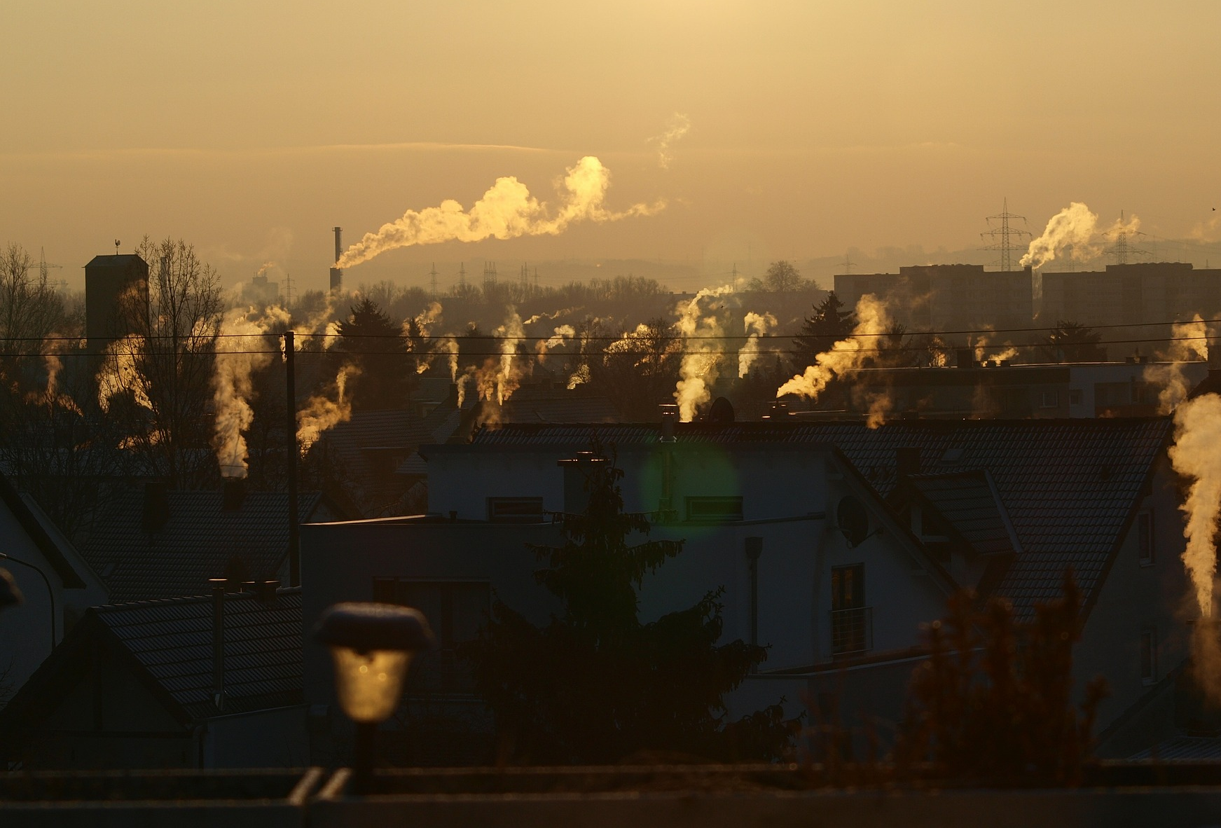
Spatial and temporal variability of benzo[a]pyrene over Poland based on modelling and observations
Jacek W. Kaminski, Joanna Struzewska, Pawel Durka,
Grzegorz Jeleniewicz, Marcin Kawka,
Aleksander Norowski, Aneta Gienibor, Paulina Jagiełło
Department of Atmospheric and Climate Modelling
Institute of Environmental Protection – National Research Institute
#ŚrodowiskoŻyciem

Slide 2
Outline
BaP observational network in Poland
Trends and seasonal variability of B[a]P
B[a]P emissions in Poland
B[a]P modelling results
Future work: case study with EMEP-East

Slide 3
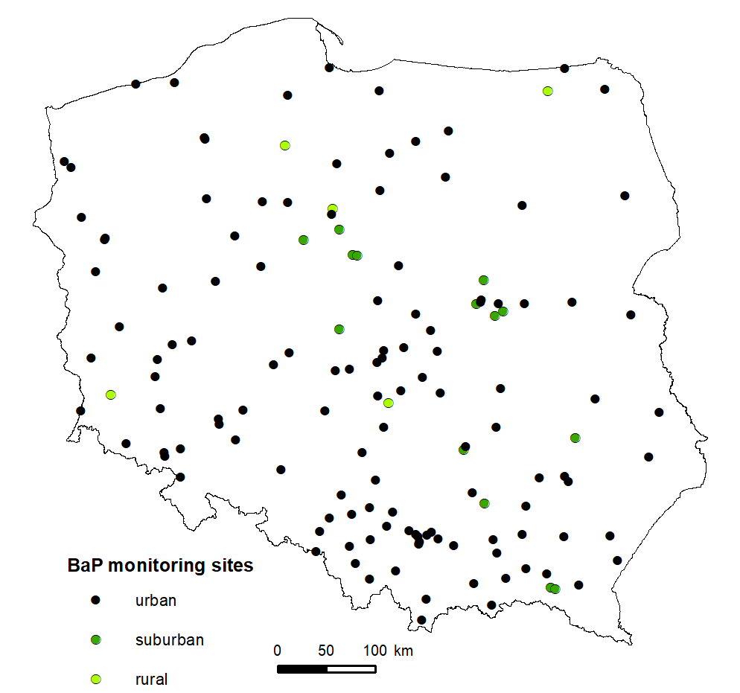
B[a]P observational network in Poland
BaP monitoring sites
Type | Number
urban | 123
suburban | 14
rural | 5

Slide 4
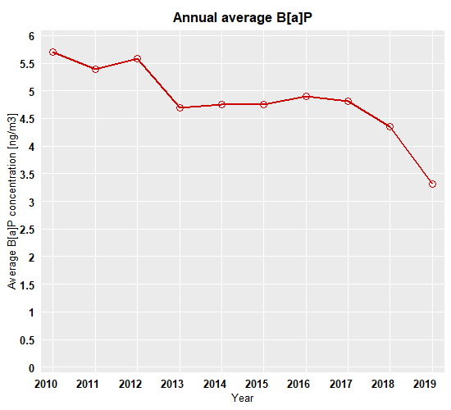
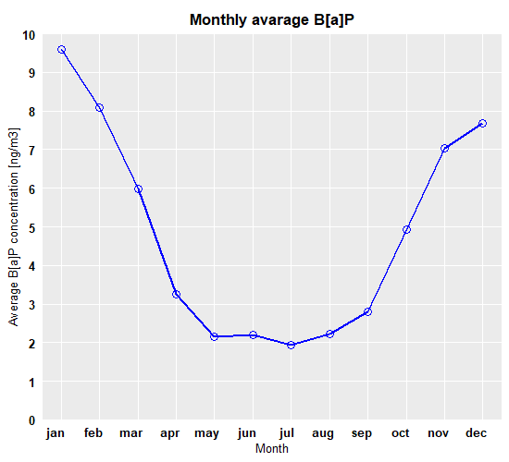
Observed B[a]P variability in Poland

Slide 5
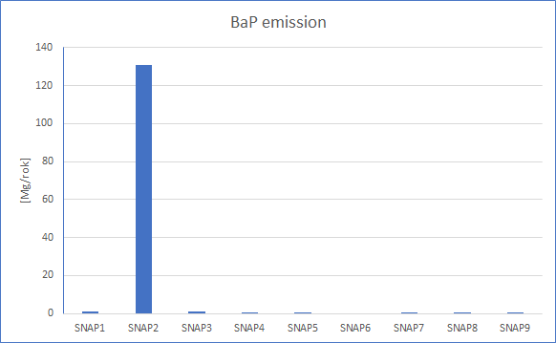
B[a]P emissions used for modelling
Central Emission Database 2018
(a high resolution inventory for Poland)
EMEP 2017
Low combustion is the dominant source of B[a]P emission in Poland

Slide 6
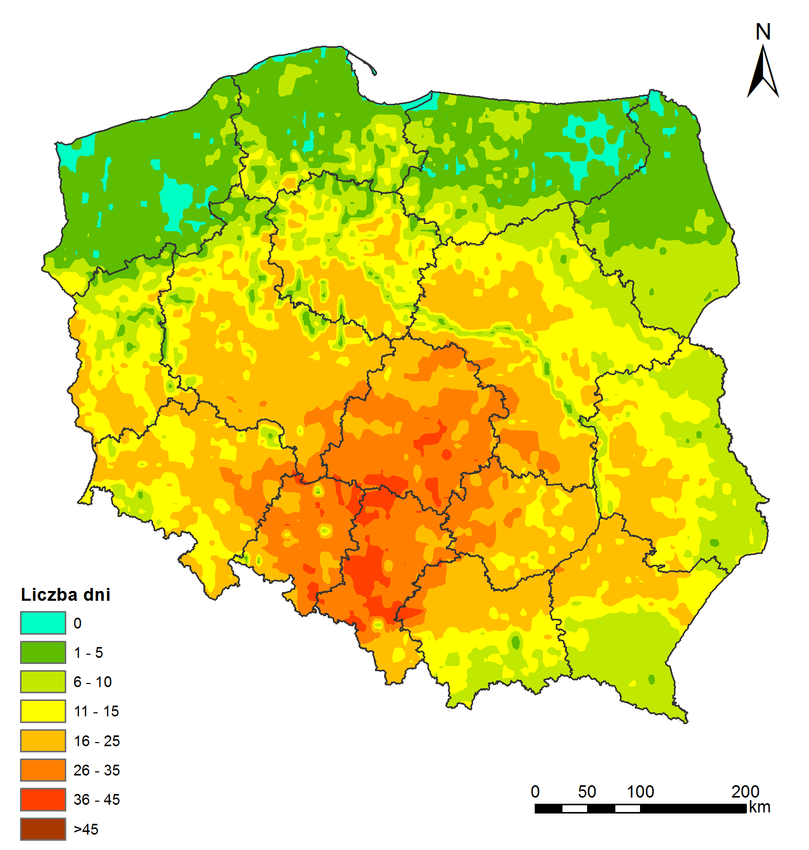
Air Quality Modelling - policy support
Starting in 2018 the Institute of Environmental Protection, National Research Institute is responsible for modelling in support of air quality policy for Poland (State Inspectorate of Environmental Protection and Ministry of Climate)
Modelling of B[a]P concentrations is undertaken for the purpose of:
Annual assessment (46 zones, including 30 urban areas)
Transboundary transport assessment
Representativeness of monitoring stations
5 year assessment for the zone classifications

Slide 7
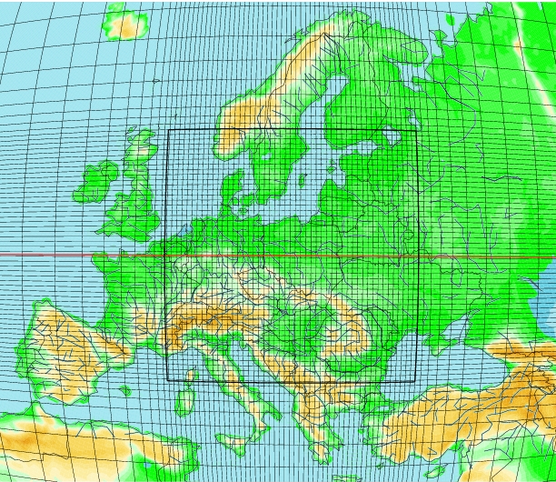
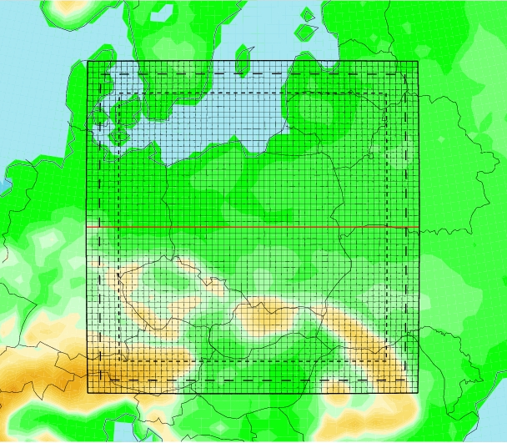
GEM-AQ model configuration
National modelling system is based on the GEM-AQ atmospheric chemistry model (Kaminski et al., 2008)
Depending on the purpose the model is run at ~10km over Europe, ~2.5km over Poland and 0.5km over agglomerations

Slide 8
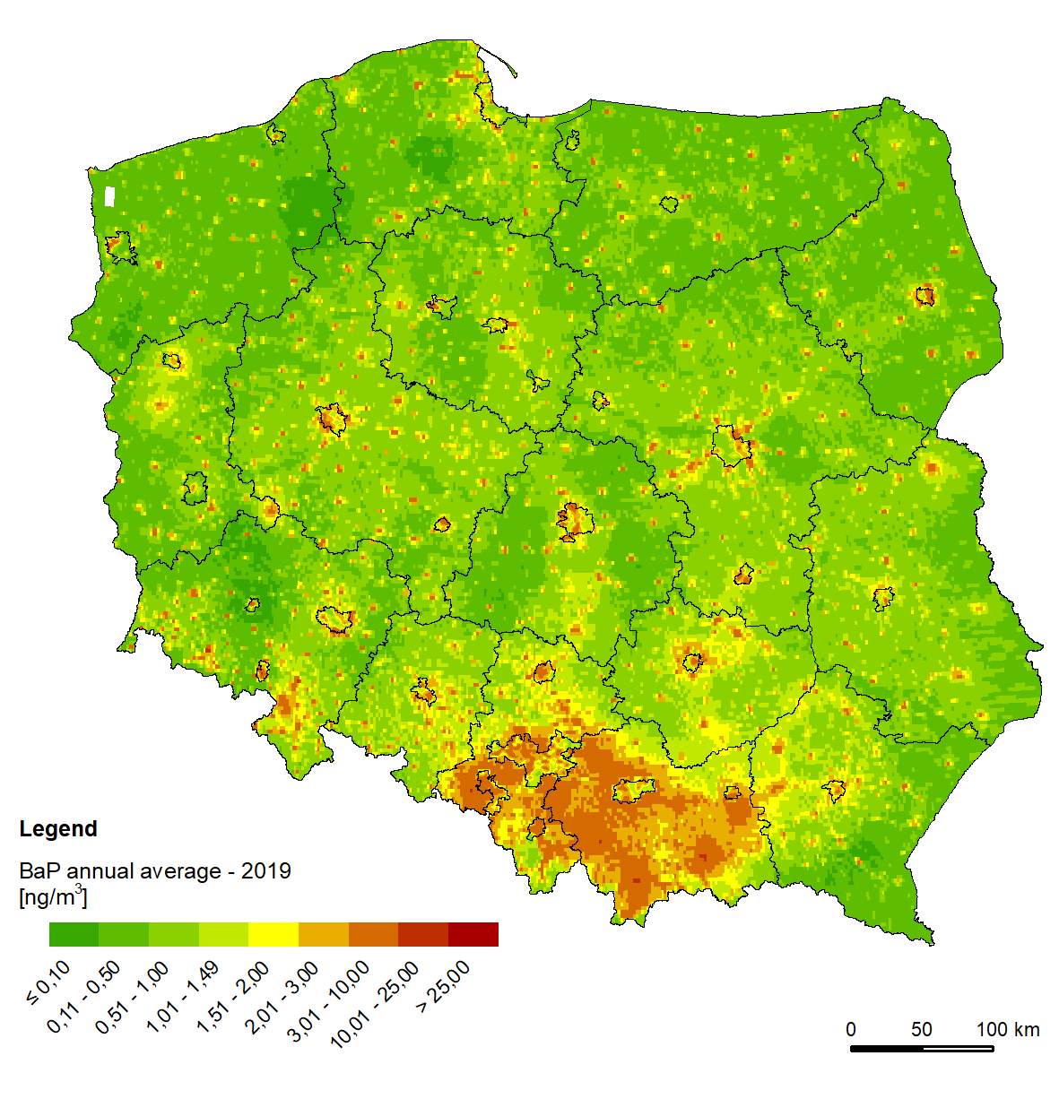
Results from 2019 AQ assessment for PL
For the year 2019 reanalysis showed:
The lowest values below 1 ng/m³ were modelled in north-west Poland and along the eastern border.
High concentrations, above 25 ng/m³ were modelled over Silesia and Lesser Poland and locally in agglomerations.

Slide 9
Evaluation against measurements from 2019
The model evaluation showed good agreement with observations for all spatial and temporal scales.

Slide 10
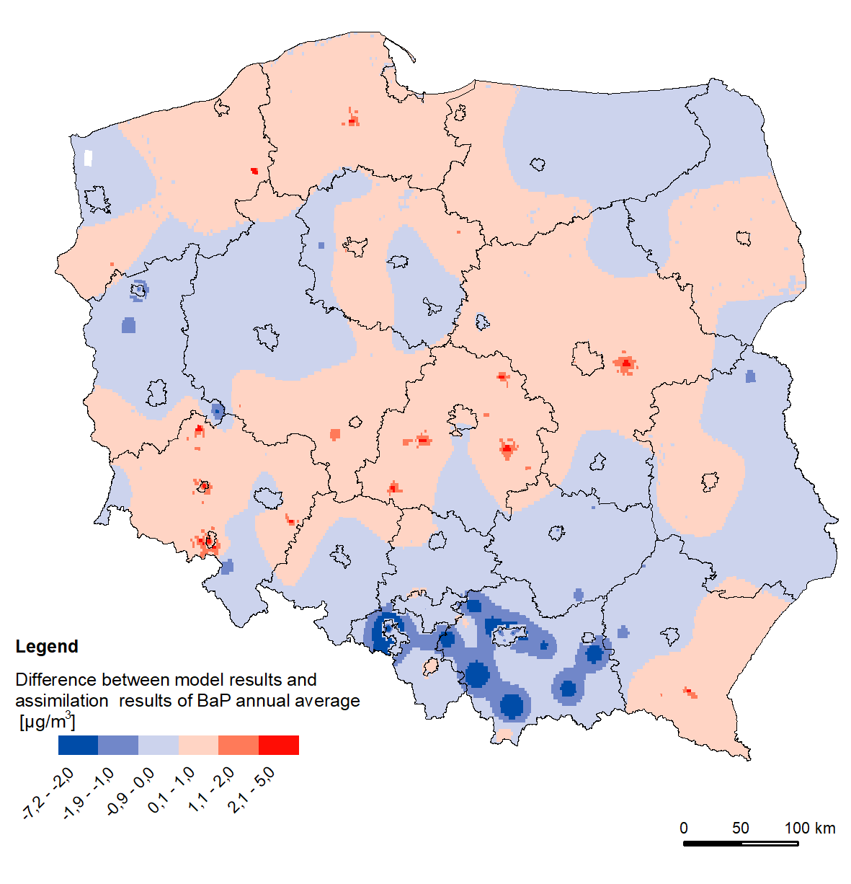
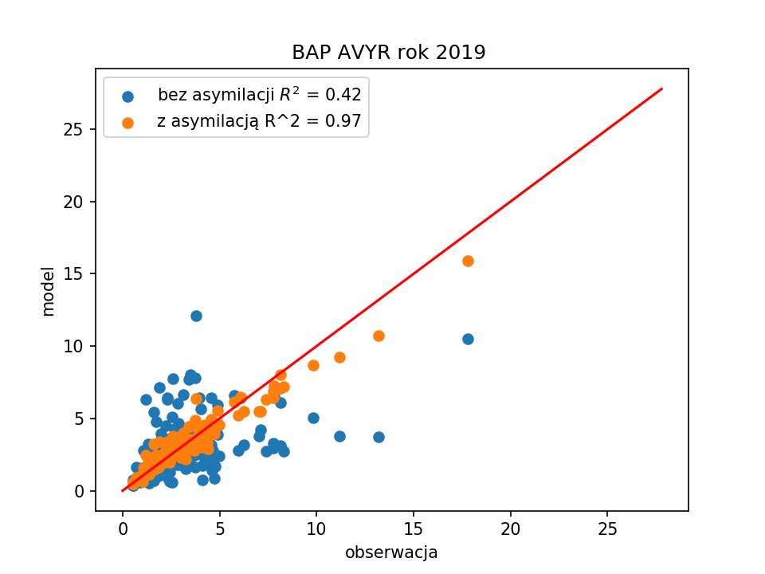
Assimilation of surface observations
Data assimilation (orange dots) significantly improved raw modelling results (blue dots)
Model underestimated over southern Poland and slightly overestimates in central regions

Slide 11
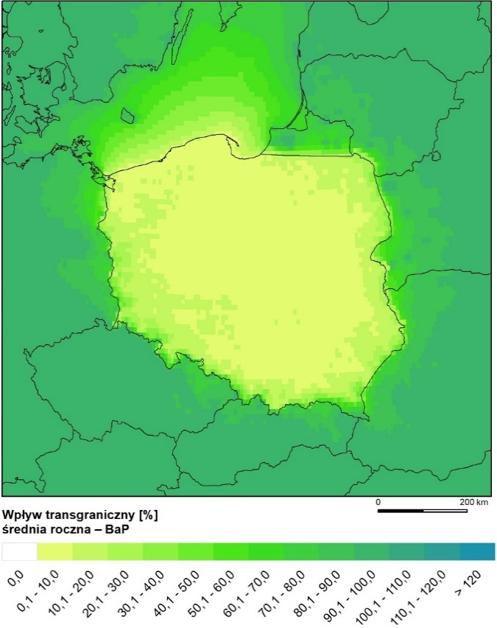
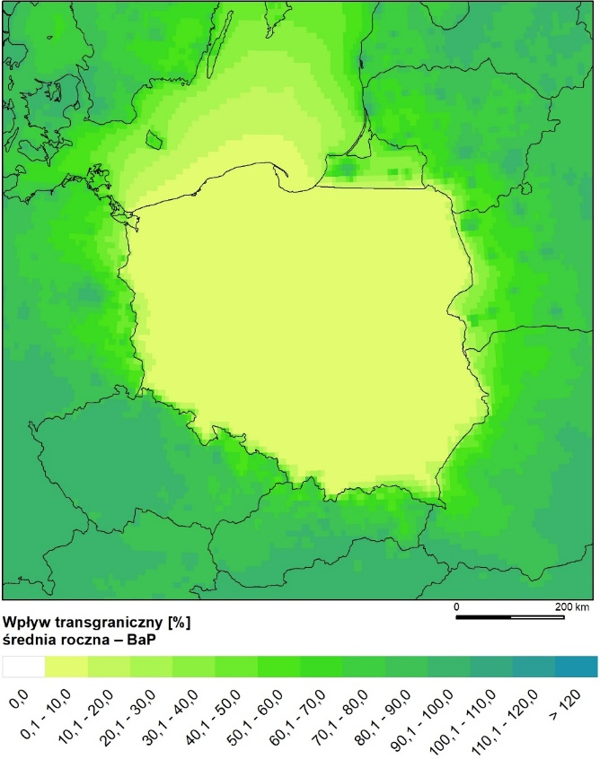
B[a]P transboundary impact in 2018
EMEP 2016
CBE 2017
The transboundary contributions for B[a]P are not significant.
This could be due to significant differences in estimating emission fluxes in Poland and other countries.
The transboundary contribution is in the range of 2 to 35% with the average approx. 10%

Slide 12
B[a]P case study for Poland
Purpose: to better understand processes governing high concentrations of B[a]P over Poland and model uncertainties
Cooperation with EMEP-East
Planned intercomparison between the GELMOS model (EMEP-East) and the GEM-AQ model
Focus on the sink processes and model underestimation for the winter period

Slide 13
Summary
B[a]P concentrations show decreasing trend over last decade. However, average concentrations are much higher than the threshold
Seasonal variation of B[a]P in Poland shows maximum concentrations during wintertime due to household heating
Underestimated modelled concentrations might be due to missing emission sources in the emission inventory
Modelling results show very good spatial and temporal agreement with the observations
International cooperation will be undertaken to improve understanding of source and sinks processes

Slide 14
THANK YOU! contact e-mail: jacek.kaminski@ios.edu.pl
#ŚrodowiskoŻyciem

