Slide 1
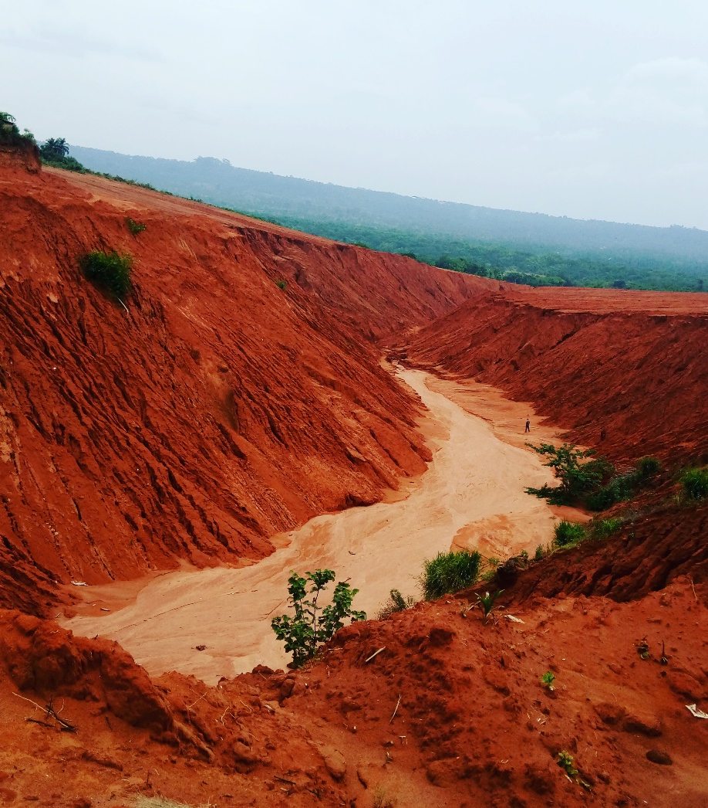

The gullies of southeast Nigeria: an ecogeomorphic investigation
Ikenna Osumgborogwu., J. Wainwright., L. Turnbull-Lloyd.
Department of Geography, Durham University, Durham, UK
Ikenna.e.osumgborogwu@durham.ac.uk

Slide 2
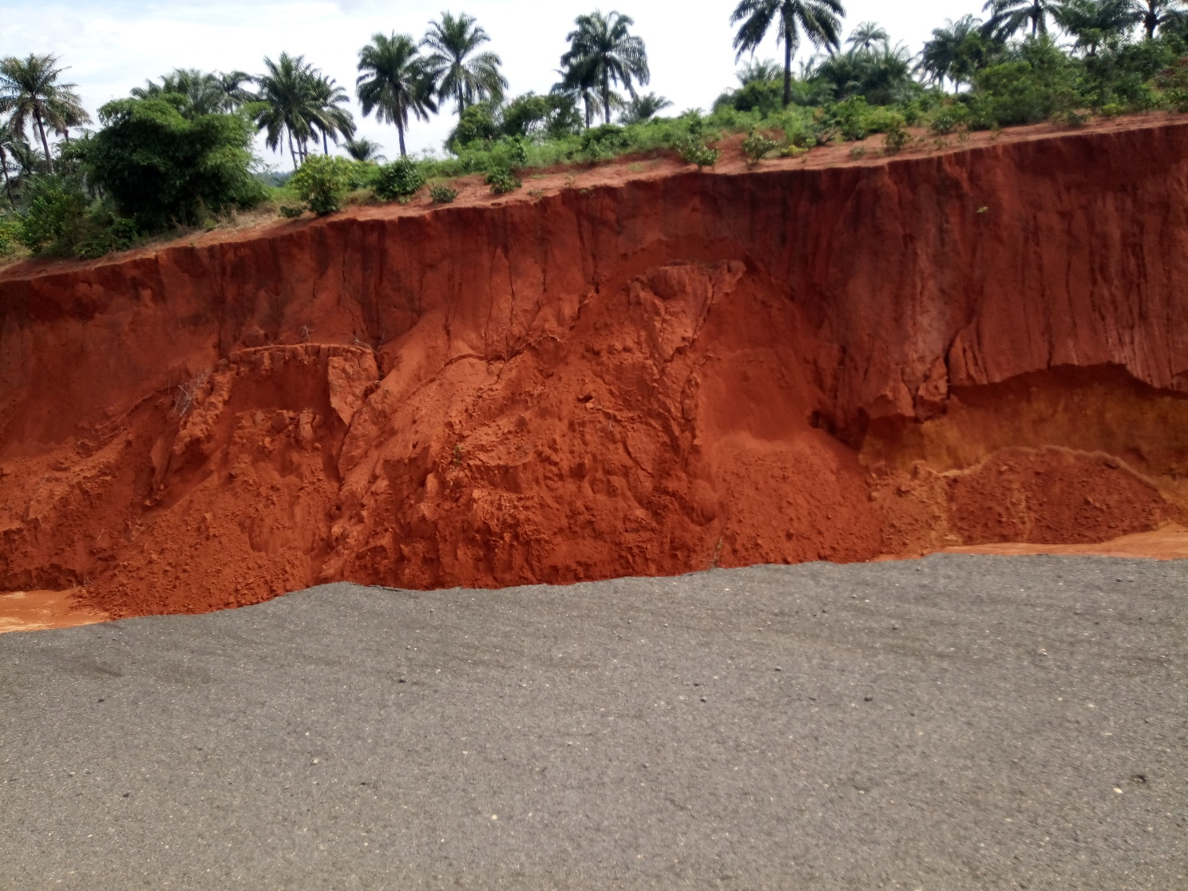
Aim
To improve understanding of ecogeomorphic drivers of gully erosion
Study period – 2009 to 2018.

Slide 3
Ecogeomorphic perspectives
Geomorphic processes
Ecogeomorphology – studies the coupled evolution of geomorphological and ecosystem structures.
Interactions/feedbacks between geomorphic and ecological (including human) processes within an environment
Humans – ecosystem engineers
Vegetation distribution, agricultural activities
Vegetation removal, land use changes
Ecological system including humans

Slide 4

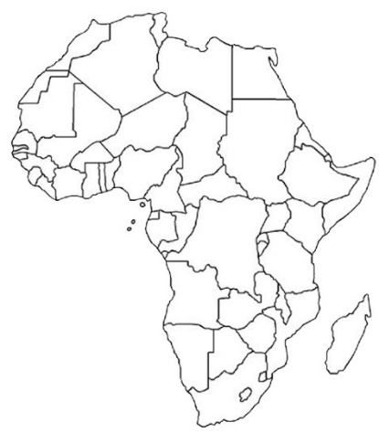
Southeast Nigeria
High population density (up to 2107 p/km² in places)
Gully-endemic
Tropical climate: 29 – 33°C
Rainfall: 2500 mm – 1500 mm
Rainfall intensity: 100 – 150 mm h⁻¹

Slide 5
Study catchments
A
U

Slide 6
Methods
Novelty
Remote sensing – large scale and desk study analysis
Qualitative research – important questions

Slide 7
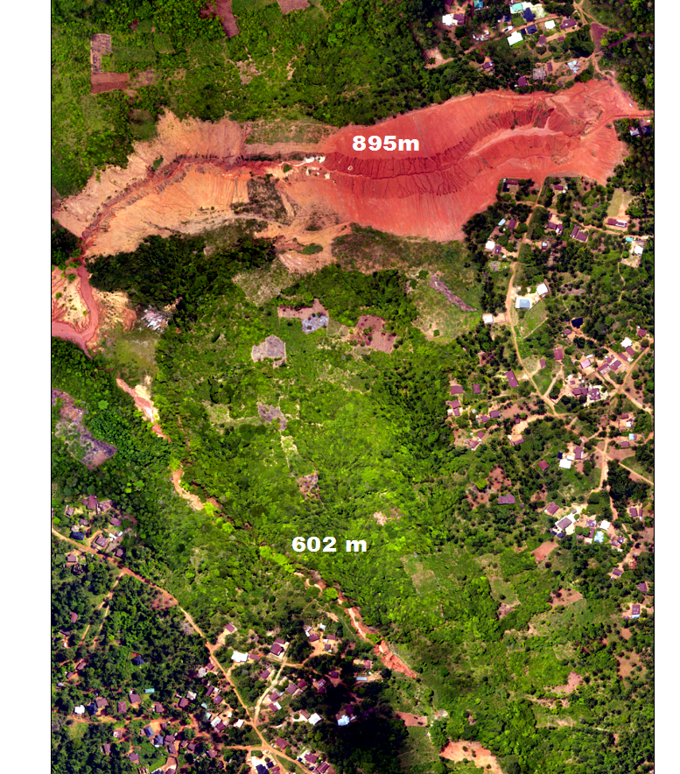
RapidEye-1, RapidEye-3, WorldView-2 and SAS Planet imagery – Gully mapping, image classification
Drone survey (0.4m), 30 m SRTM DEM – topological parameters
Weather data – Climate Forecast System Reanalysis (CFSR)
Soil map – DSMW
Geomorphological fieldwork – ground-truthing
SWAT model – hydrological modelling.

Slide 8
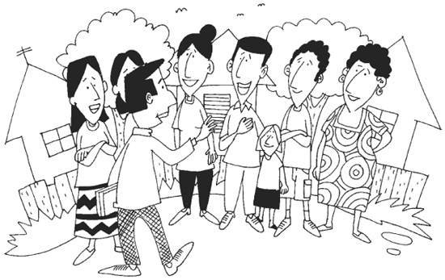
Focus group meetings
10 elders – two communities
Exact date of gully erosion
Principle driving factor
Mode of evolution till date
Informal interview sessions

Slide 9
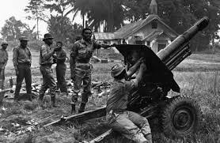
Primary cause – civil war (1967 – 1970)
Gully initiation date – 1969
Summary of focus group meeting on principle driver of gully erosion
Increase in population density
Digging of trenches
Erection of training facilities (shooting range) for soldiers
Desecration of sacred rivers and deities

Slide 10
Gully A – vegetation cover classification
Catchment size: 10.3 km²
Cover | %
Non–vegetated | 15.64
Open vegetation | 80.98
Trees | 3.37
Cover | %
Non–vegetated | 51.75
Open vegetation | 48.24
Trees | 0.01

Slide 11
Gully A – average annual gully growth rates
Length – 22.2 m
Width – 1.4 m
Area – 2217.2 m²
Gully dimension | size
Length (km) | 0.7
Width (m) | 43.6
Area (m²) | 32507.6
Gully dimension | size
Length (km) | 0.9
Width (m) | 56.7
Area (m2) | 19954.8

Slide 12
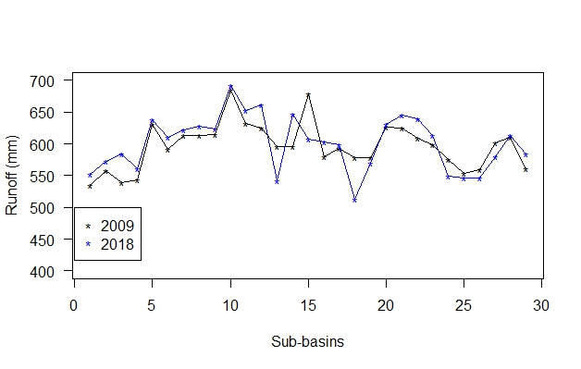
Gully U – 6.7 km²
Average annual gully growth rates
Length – 11.1 m
Width – 0.02 m
Area – 1546.4 m²
Vegetation cover | 2009 (%) | 2018 (%)
Non-vegetated | 13.68 | 30.27
Open vegetation | 83.5 | 69.46
Trees | 2.82 | 0.27
Gully sizes | 2009 | 2018
Length (km) | 0.8 | 0.9
Width (m) | 38.7 | 38.9
Area (m²) | 38163.6 | 52081.2

Slide 13
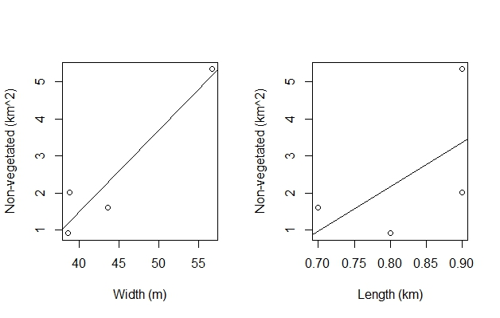
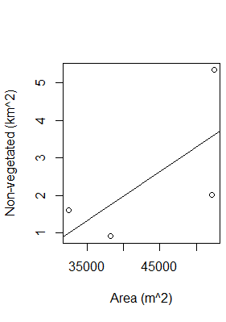
Vegetation cover changes vs gully dimensions
r² = 0.9
r² = 0.3
r² = 0.4

Slide 14
Summary
Gully A recorded a higher change in non-vegetated areas
Gully A exhibited a greater change in dimensions
Gully U is currently under management by the government
Actual change in Gully U masked by human intervention
Change in gully catchment from green-cover to non-vegetated cover positively associates with increase in surface runoff and gullying
Study helps improve our understanding of catchment changes and gully responses

