Slide 1
A smoother algorithm with a multiple calibration-constrained null-space Monte Carlo method toward land subsidence prediction with uncertainty analysis
EGU2020-16906
Masaatsu Aichi
Graduate School of Frontier Sciences, University of Tokyo
Acknowledgement: Council for Science, Technology and Innovation(CSTI), Cross-ministerial
Strategic Innovation Promotion Program (SIP), Enhancement of National Resilience against Natural
Disasters (Funding agency:NIED)
Note: Part of this study has been published in Aichi M. (2020): Land subsidence modelling for decision making on groundwater abstraction under emergency situation. Proc. IAHS, 382, 403–408, 2020
https://doi.org/10.5194/piahs-382-403-2020

Slide 2
Background:
Typical land subsidence behavior in Tokyo
Hydraulic head
(@Kameido #1)
Hydraulic head [m]
Ground surface elevation [m]
Hydraulic head at well construction
(Koto area)
after Endo et al. (2001)
Leveling (@Pile 3377)
Year

Slide 3
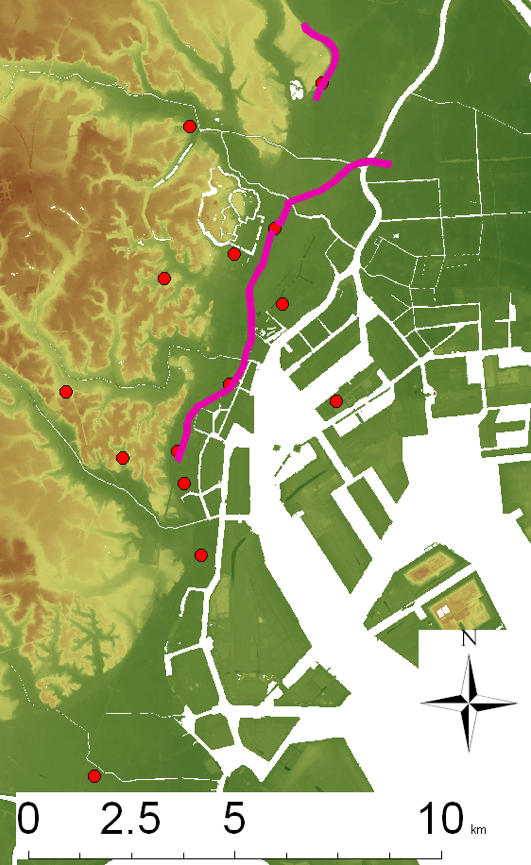

Background: New problem after groundwater recovery
No Data
Koto area Pumping rate
GL (m)
(1000m³/day)
0
B1
-10
B2
Groundwater level
(m, T.P): Kameido
-20
B3
Weight
B4
-30
-40
Buoyancy
Ground
Anchor
-50
Buoyancy problem (Ueno)
Land subsidence
(mm): Kameido
Construction of Shinkansen express at Ueno station
Countermeasures against high groundwater level
Construction of Soubu line at Tokyo station
1951
1961
1971
1981
1991

Slide 4
Background:
Heterogeneity of the past maximum effective stress
Pore pressure, kPa
0
100
200
300
Holocene
0
Part of the thick clay was not fully drained
10
Depth (m, GL)
(unsaturated)
The past maximum effective stress is heterogeneous
20
Void ratio
30
hydrostatic
Numerical modelling is necessary to reproduce & predict land subsidence
40
1974
1977
1983
A history of pore pressure profile
in the aquitard. (Aichi, 2008)
Log (mean effective stress)

Slide 5
Research objectives
Highly uncertain modeling is expected in land subsidence simulation
  Heterogeneity of the subsurface formations
  the evolution of the past maximum effective stress under the historical groundwater abstraction
  Observation is limited
→Continuous model calibration and uncertainty analysis as monitoring data is obtained

Slide 6


Concept & Algorithm
Filter vs Smoother
  Smoother was chosen to follow hysteresis of clay deformation
Resampling strategy
  Every observation time step
  Next model ensemble should be generated near current better models in parameter space
  Null-space Monte Carlo method (Doherty, 2015) was adopted for effective generation (though not Bayesian)
$$t=0$$
Generating models by Initial guess
Observed data collection
Determining the number of the models to be generated from the i-th model based on the likelihood
Generating models by null-space Monte Carlo method
Future predictions by generated models
$$t←t+∆t$$

Slide 7
1D vertical test model and boundary condition
Head=0 condition
0m
Hydraulic head
(@Kameido #1)
Yurakucho
Hydraulic head [m]
Ground surface elevation [m]
-35m
7gouchi
Hydraulic head at well construction
(Koto area)
after Endo et al. (2001)
Leveling (@Pile 3377)
-56m
Year
Specified head
condition
aquifer

Slide 8
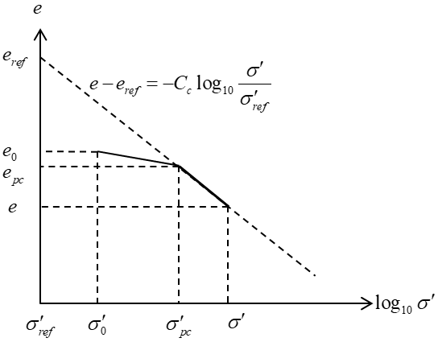

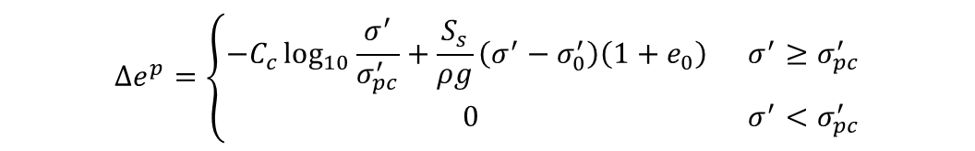
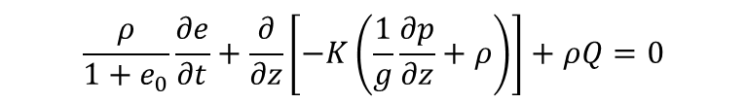
Land subsidence simulator
Modified Cam-Clay model with linear elasticity
$$∆e^{e}=−\frac{S_{s}}{ρg}\left(σ^{′}−σ_{0}^{′}\right)\left(1+e_{0}\right)$$
$$∆e^{p}=\left\{\begin{matrix}−C_{c}\log_{10}{\frac{σ^{′}}{σ_{pc}^{′}}}+\frac{S_{s}}{ρg}\left(σ^{′}−σ_{0}^{′}\right)\left(1+e_{0}\right) & σ^{′}≥σ_{pc}^{′} \\ 0 & σ^{′}<σ_{pc}^{′}\end{matrix}\right.$$
（$S_{s}$ :Specific storage[1/m],$C_{c}$:compression index [-]、ρ:water density[kg/m³], g:gravitaional acieration factor[m/s²]）
Darcy’s law & Mass conservation of groundwater
$$\frac{ρ}{1+e_{0}}\frac{∂e}{∂t}+\frac{∂}{∂z}\left[−K\left(\frac{1}{g}\frac{∂p}{∂z}+ρ\right)\right]+ρQ=0$$

Slide 9
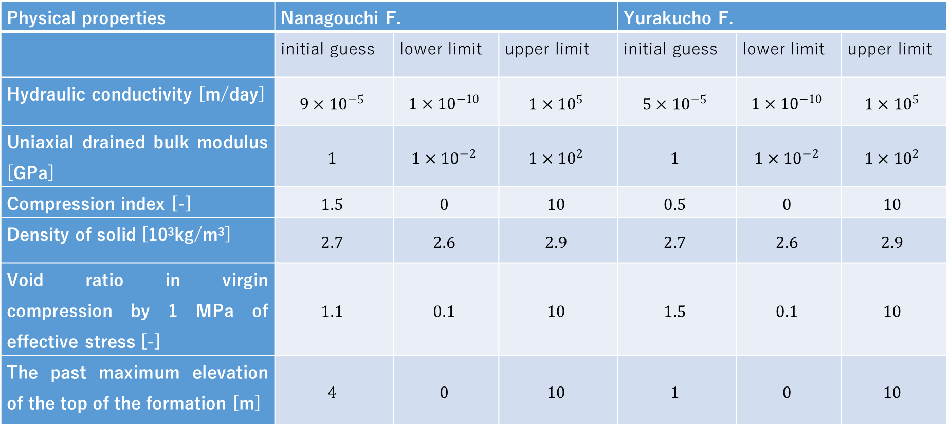
Parameter space
Physical properties | Nanagouchi F. |  |  | Yurakucho F.
 | initial guess | lower limit | upper limit | initial guess | lower limit | upper limit
Hydraulic conductivity [m/day] | $$9×{10}^{−5}$$ | $$1×{10}^{−10}$$ | $$1×{10}^{5}$$ | $$5×{10}^{−5}$$ | $$1×{10}^{−10}$$ | $$1×{10}^{5}$$
Uniaxial drained bulk modulus [GPa] | $$1$$ | $$1×{10}^{−2}$$ | $$1×{10}^{2}$$ | $$1$$ | $$1×{10}^{−2}$$ | $$1×{10}^{2}$$
Compression index [-] | $$1.5$$ | $$0$$ | $$10$$ | $$0.5$$ | $$0$$ | $$10$$
Density of solid [10³kg/m³] | $$2.7$$ | $$2.6$$ | $$2.9$$ | $$2.7$$ | $$2.6$$ | $$2.9$$
Void ratio in virgin compression by 1 MPa of effective stress [-] | $$1.1$$ | $$0.1$$ | $$10$$ | $$1.5$$ | $$0.1$$ | $$10$$
The past maximum elevation of the top of the formation [m] | $$4$$ | $$0$$ | $$10$$ | $$1$$ | $$0$$ | $$10$$

Slide 10
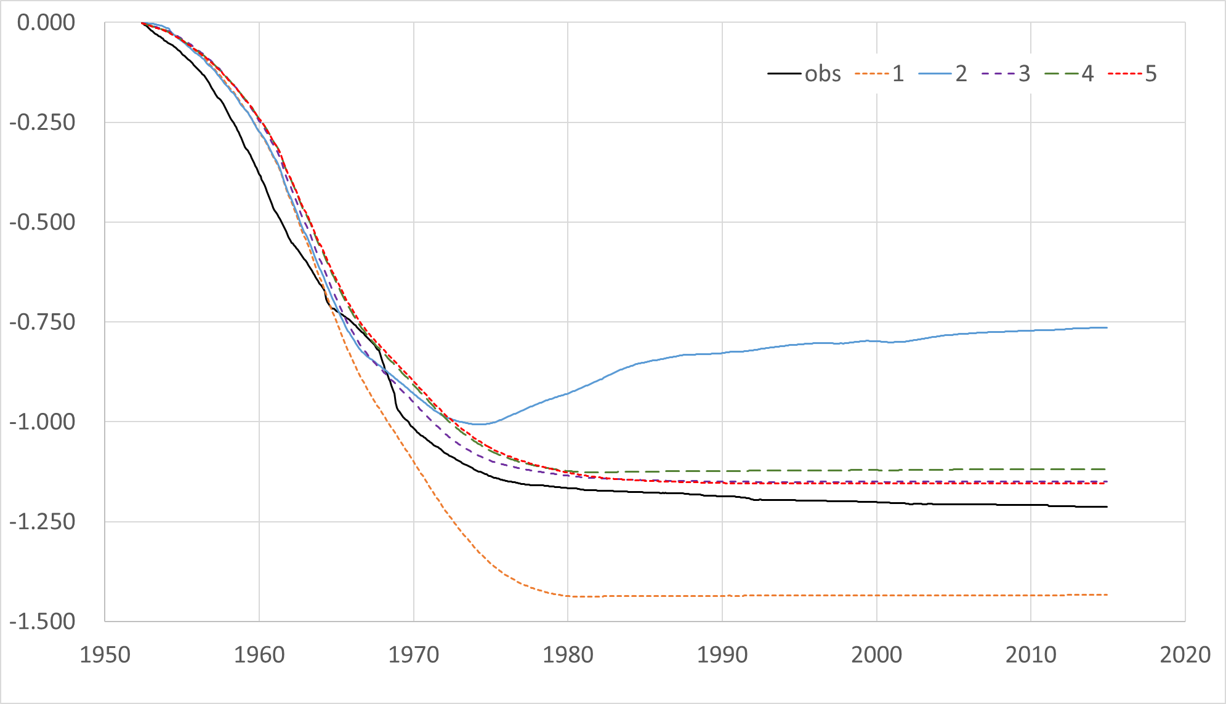
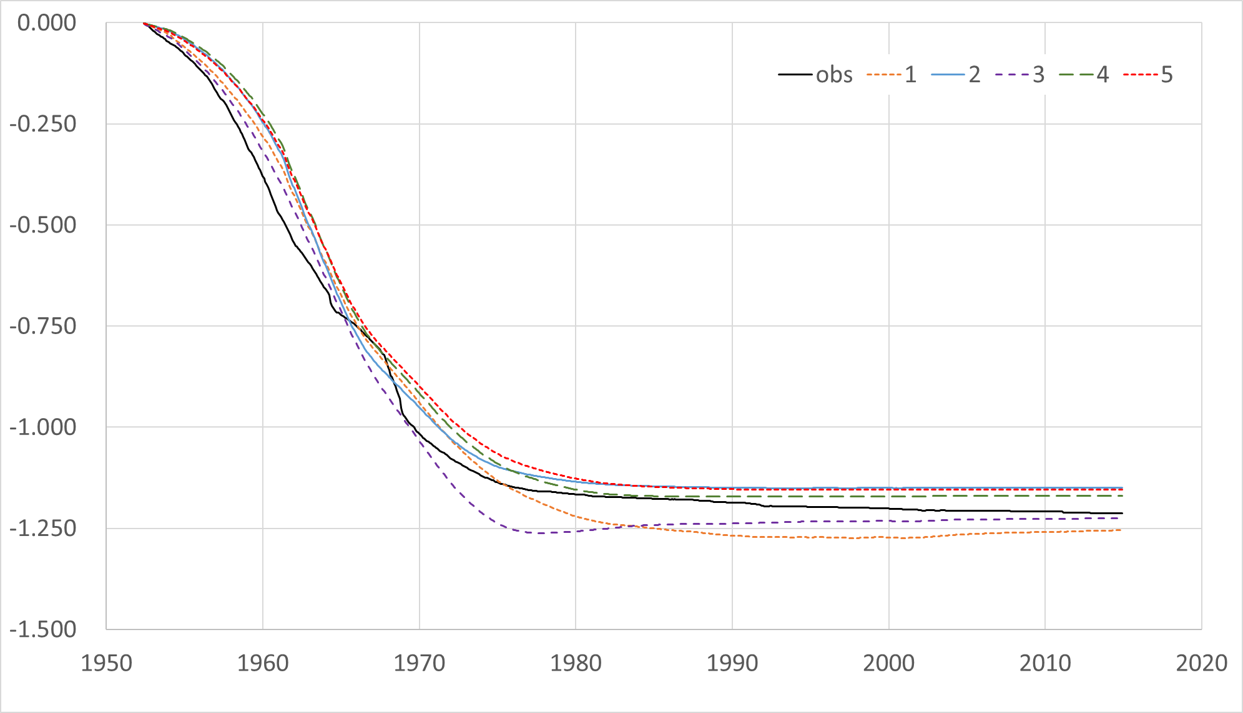
Test Result
The convergence of predictive uncertainty was confirmed by the test with the existing hydraulic head/land subsidence monitoring data
Learning
“Prediction”
Learning
“Prediction”
Subsidence [m]
Subsidence [m]
Total size of ensemble is 50 in this test. Top 5 models are extracted in this figures.
Computational load was not learge: Laptop (NEC LAVIE, Intel Core i7-7500U 2.7GHz, 8GB RAM, Windows 10) could conduct 95 year analysis in 3 hours

Slide 11
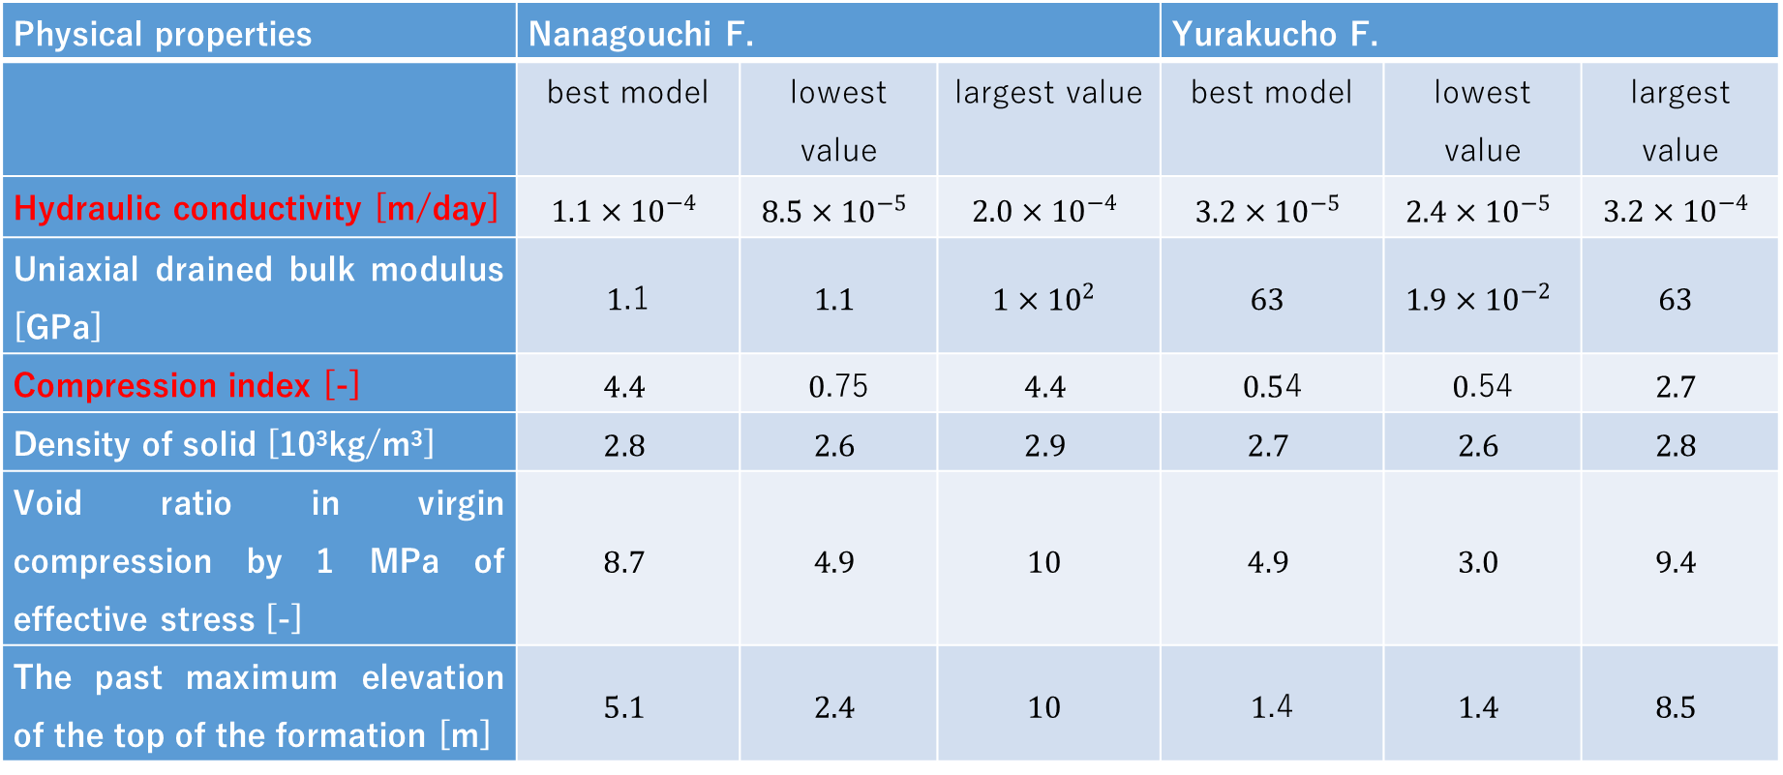
Parameter range of best 5 models after the calibration
Physical properties | Nanagouchi F. |  |  | Yurakucho F.
 | best model | lowest value | largest value | best model | lowest value | largest value
Hydraulic conductivity [m/day] | $$1.1×{10}^{−4}$$ | $$8.5×{10}^{−5}$$ | $$2.0×{10}^{−4}$$ | $$3.2×{10}^{−5}$$ | $$2.4×{10}^{−5}$$ | $$3.2×{10}^{−4}$$
Uniaxial drained bulk modulus [GPa] | $1$.1 | $$1.1$$ | $$1×{10}^{2}$$ | $$63$$ | $$1.9×{10}^{−2}$$ | $$63$$
Compression index [-] | $$4.4$$ | $0$.75 | $$4.4$$ | $0.5$4 | $0$.54 | $$2.7$$
Density of solid [10³kg/m³] | $$2.8$$ | $$2.6$$ | $$2.9$$ | $$2.7$$ | $$2.6$$ | $$2.8$$
Void ratio in virgin compression by 1 MPa of effective stress [-] | $$8.7$$ | $$4.9$$ | $$10$$ | $$4.9$$ | $$3.0$$ | $$9.4$$
The past maximum elevation of the top of the formation [m] | $$5.1$$ | $$2.4$$ | $$10$$ | $1$.4 | $$1.4$$ | $$8.5$$
The parameter uncertainty of hydraulic conductivity and compression index was reduced well while that of the other parameters was not because of less sensitivity.

Slide 12
Conclusion
A numerical scheme for the land subsidence modelling with the visualization of prediction uncertainty based on the Monte Carlo smoother approach with the null-space Monte Carlo method for model resampling.
The proposed scheme demonstrated that it can satisfactory reproduce the existing land subsidence with real time inversion and uncertainty analysis.
Further improvements to include
  the boundary condition uncertainty
  the methodology to find the optimal number of models.

Slide 13
References
Aichi, M.: Coupled groundwater flow/deformation modelling for predicting land subsidence, In Groundwater management in Asian cities: technology and policy for sustainability, Takizawa S (eds.), 105-124, Springer-Verlag: Tokyo, 2008.
Doherty J.: Calibration and uncertainty analysis for complex environmental models, Watermark Numerical Computing, 2015.
Endo, T., Kawashima, S., and Kawai, M.: Historical review of development of land subsidence and its cessation in Shitamachi Lowland, Tokyo, J Japan Soc Eng Geol, 42,74-87, 2001. (in Japanese)

