Slide 1
Future impact of the Harmony InSAR satellite mission on land ice monitoring
Gert Mulder, Marcel Kleinherenbrink, Andreas Theodosiou and Paco Lopez-Dekker
Delft University of Technology (g.mulder-1@tudelft.nl)
Gert Mulder, Marcel Kleinherenbrink, Andreas Theodosius and Paco Lopez-Dekker
Delft University of Technology (g.mulder-1@tudelft.nl)

Slide 2
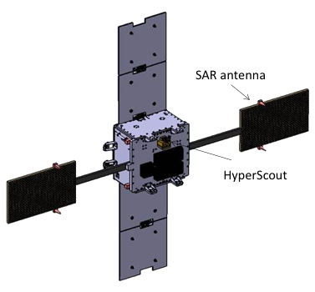
Sentinel-1 D
Harmony Constellation
Earth Explorer 10 candidate
Harmony will be a companion mission of Sentinel-1D
Observation of ice, land and ocean surface dynamics
Simultaneous measurement of Sentinel-1 radar signal by two satellites will be used to create digital elevation models (DEMs) over glaciers, ice sheets and ice caps worldwide
> 250 km
Harmony satellites
XTI-Formation

Slide 3
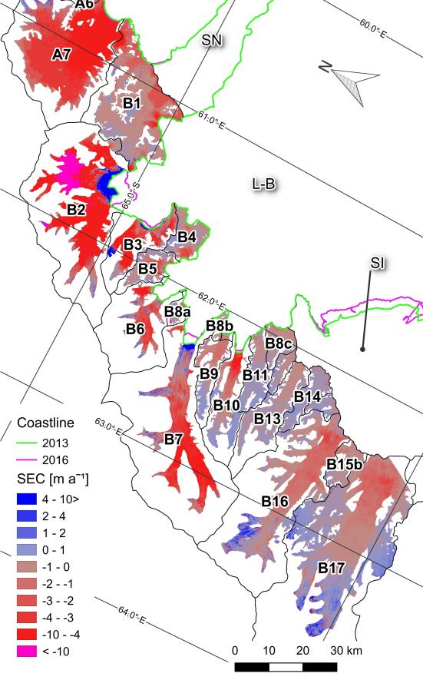
Larsen B glacier mass balance:
2011-2013 > B_{n} = -6.29 Gt/yr
2013-2016 > B_{n} = -2.90 Gt/yr
Large scale DEM differencing for worldwide mass balance
Worldwide coverage of land ice
Existing research with similar measurements like TanDEM-X shows value of these measurements, but lacks coverage
Single pass measurements will have an accuracy of about 1 meter with 100x100 meter resolution
Especially valuable for outflow glacier and fast moving or dynamic ice
Follows Sentinel-1 acquisition plan, which will result in a 12 repeat pass for about 2 years of the mission lifetime
Rott et al., 2018

Slide 4
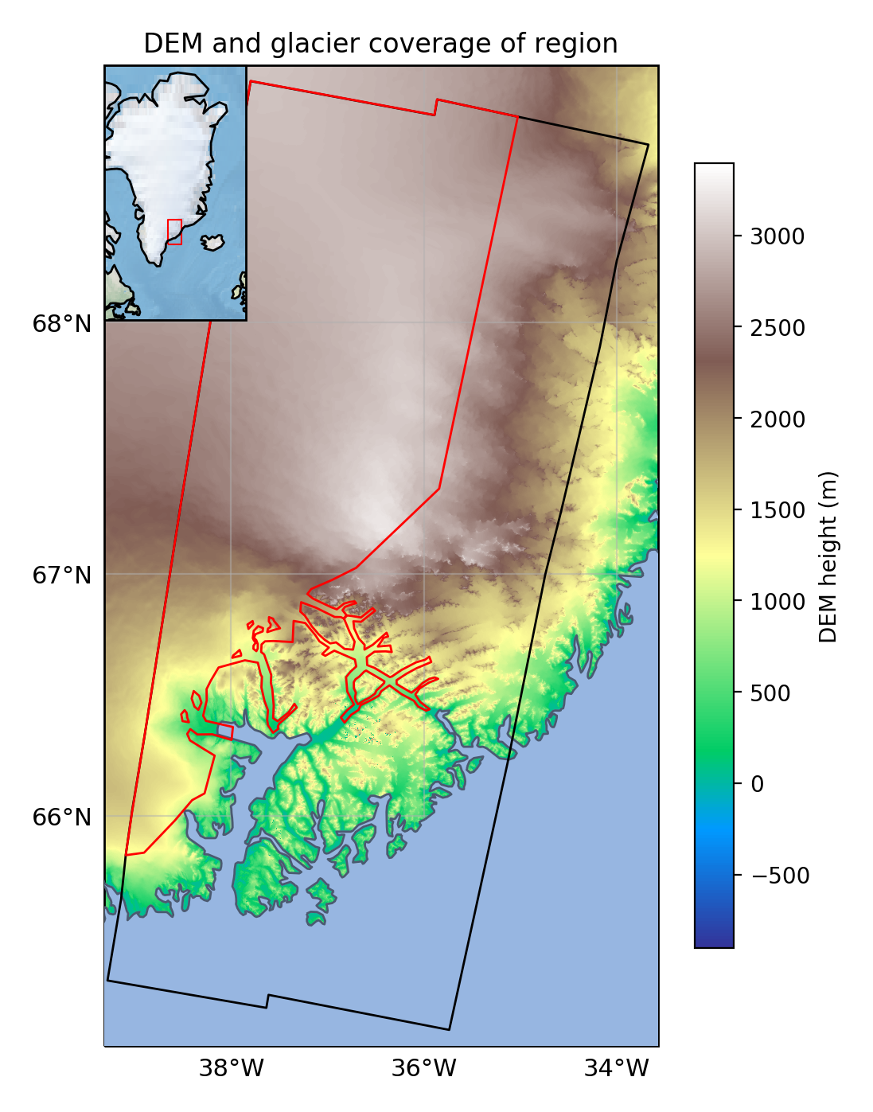
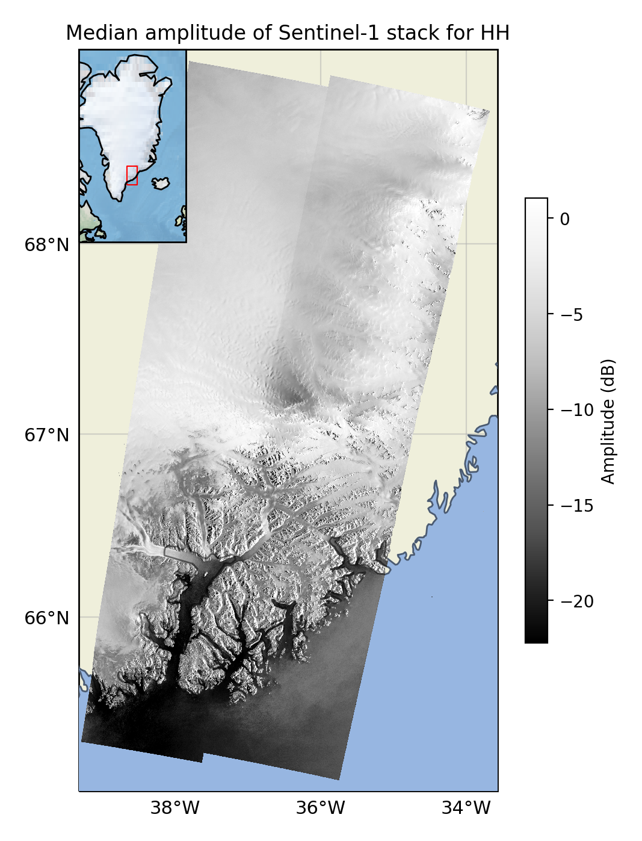
Accuracy DEM one satellite overpass (12 days)
Case outflow glaciers South-East Greenland

Slide 5
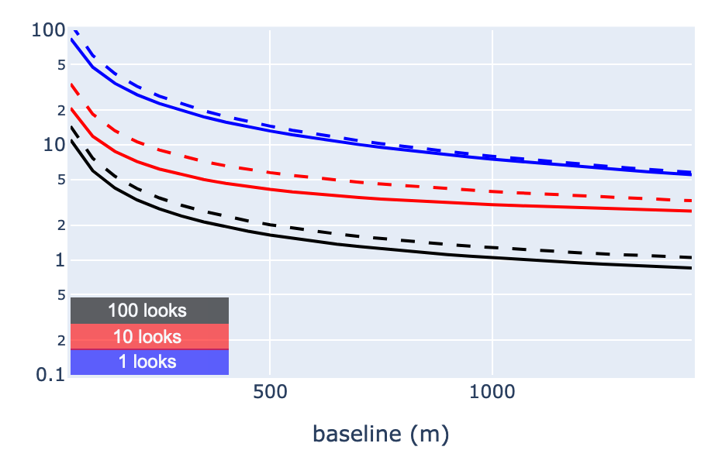
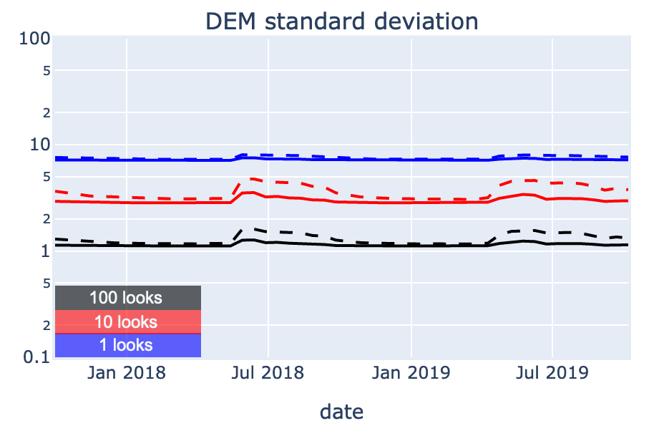
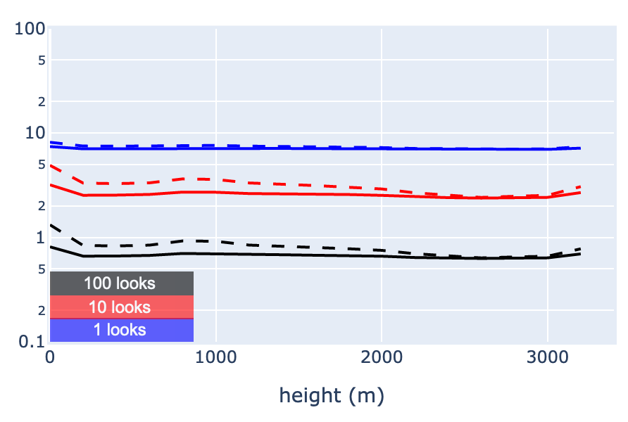
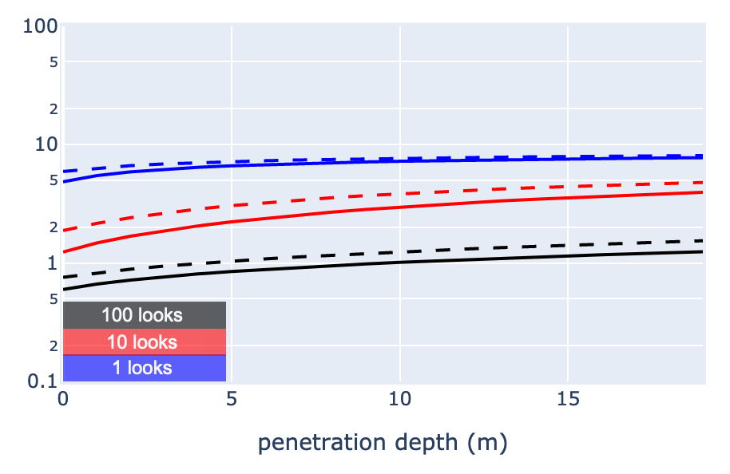
Accuracy DEM one satellite overpass (12 days)
Case outflow glaciers South-East
Greenland using current satellite configuration
Dependent on:
Number of looks of radar pixel 20x5 m
1 look > 5x20 m
10 looks > 30x30 m
100 looks > 100x100 m
Polarization
HH > solid line
HV > dotted line
Time, with lower during the melting season
Distance between Harmony satellites or baseline
Incidence angle (narrow band for this case)
DEM height, as it reflects different ice types
Penetration depth of radar signal in the ice
DEM standard deviation in meters for HH and HV polarization

Slide 6
Coverage of Harmony mission over land ice
Coverage of satellites is best over the Arctic and Antarctic regions.
Two examples of coverage of Greenland and Antarctica from ESA projects
Best coverage over outlet glaciers of ice caps
PSTG SAR WG meeting, 12 September 2016, ESTEC

Slide 7
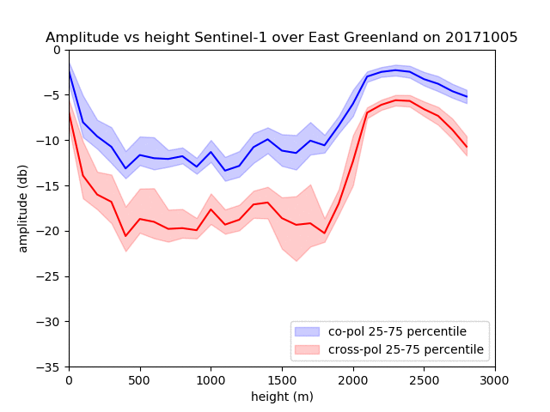
Ice and snow characteristics
Combinations of coherence, phase and amplitude data can give insights in ice- and snow types
Time-series of amplitude data from Sentinel-1 gives a view on the development of the melting season of a Greenland glacier. The Harmony mission will add coherence and phase information (view as slide show to see animation)
Penetration depth of Greenland ice sheet using TanDEM-X data. Rizzoli et al. 2017

Slide 8
Summary
Harmony is the Earth Explorer 10 candidates that focusses on land ice dynamics
Using Harmony measurements we can create differential elevation maps worldwide
Single measurement can be done on a sub-meter level for 100x100 meter and accuracy increases with longer observation periods
Harmony can capture ice dynamics during long (years) and short (weeks/months) timescales
Monitoring of ice sheet dynamics using amplitude, coherence and phase can give us new information on snow and ice characteristics

