Slide 1



Human influence strengthens the contrast between tropical wet and dry regions
Andrew Schurer, A. Ballinger, A. Friedman, and G. Hegerl
European Geophysical Union 2020
Author’s Rights Reserved

Slide 2
Recently published…
Schurer et al. 2020 (ERL)

Slide 3
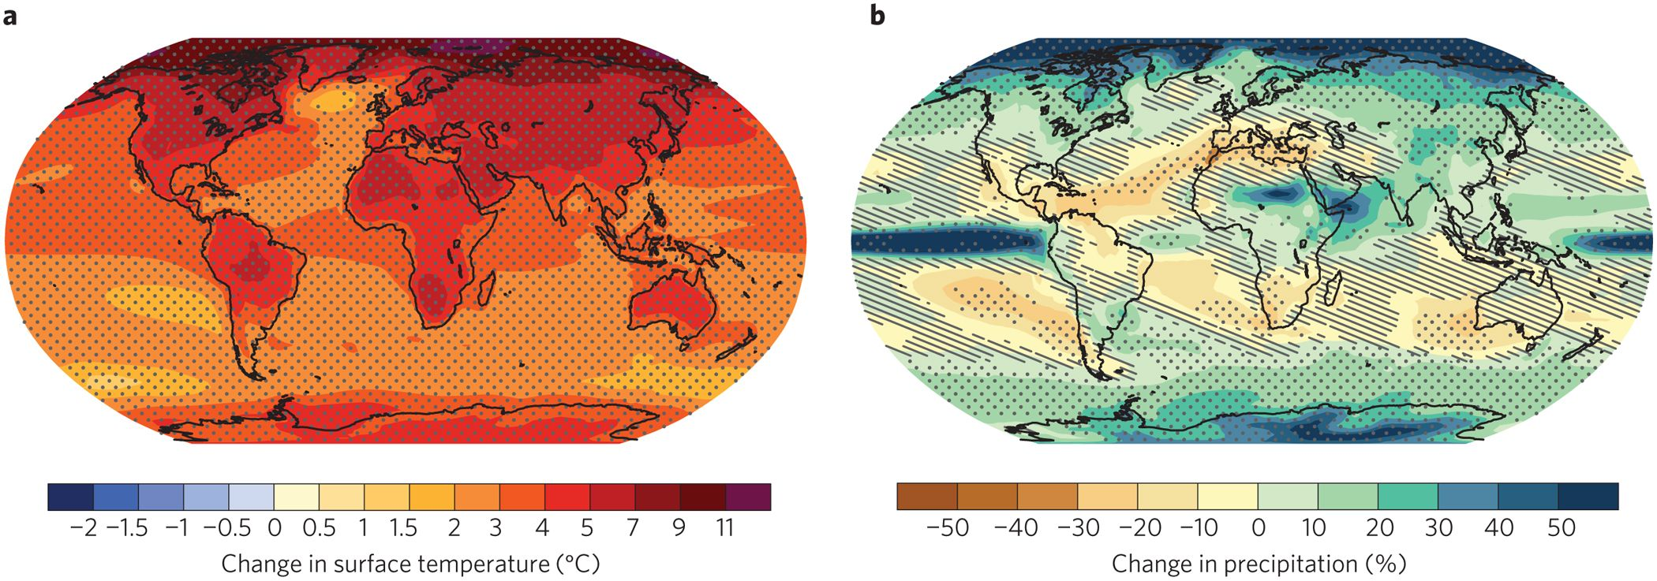
Motivation
Precipitation is controlled by both temperature (thermodynamics) and circulation (dynamics).
Compared with temperature, circulation-related changes in climate are not as robust in observations, theory or models.
GCMs are much less consistent in prediction of rainfall changes
Build on previous work (Polson et al. 2013, Polson and Hegerl, 2017) and analyse changes in rainfall in wet and dry regions
IPCC, 2013

Slide 4
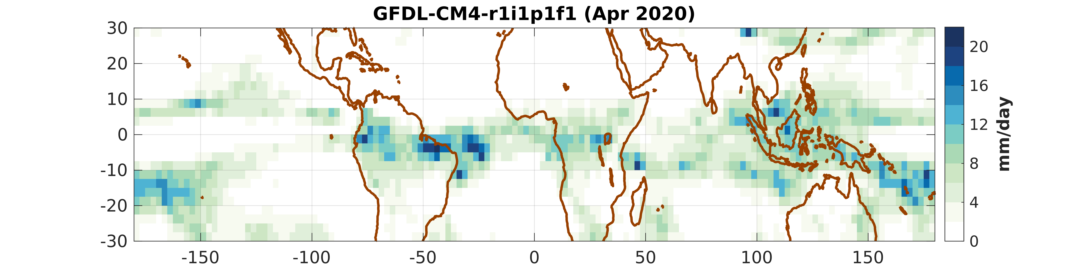
Tracking wet and dry region Rainfall
We analyse monthly rainfall over the tropical (30°S-30°N) region:
  For each individual GCM model ensemble member
  For each month separately

Slide 5
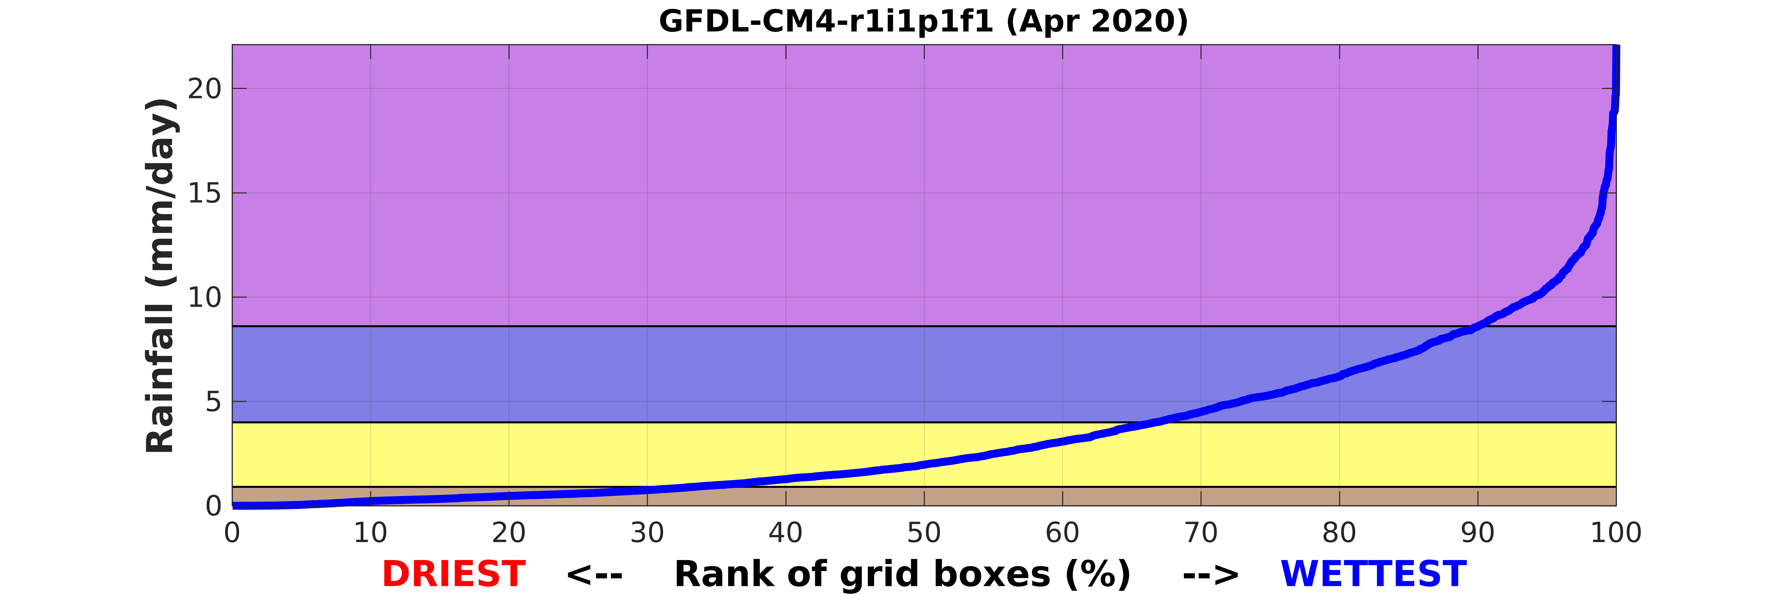
Tracking wet and dry region Rainfall
We analyse monthly rainfall over the tropical (30°S-30°N) region:
  For each individual GCM model ensemble member
  For each month separately
Rank all of the 2.5°x2.5° grid boxes (n=3456) from the least to most rainfall
Define wet/dry regions based on rank:
  Lowest tercile – “dry regions”
  Middle tercile – “moderate”
  Highest tercile – “wet regions”
  Highest decile – “wettest regions”

Slide 6
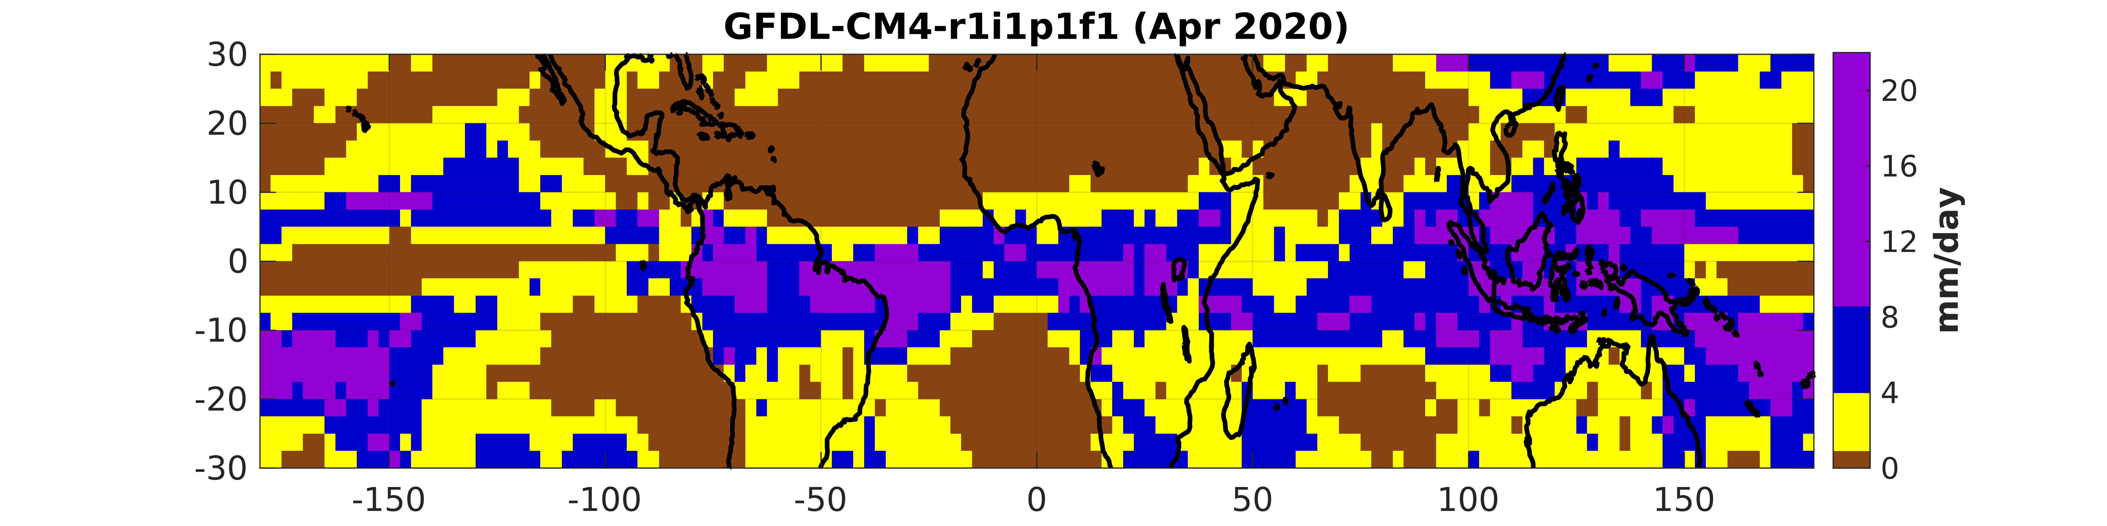
Tracking wet and dry region Rainfall
We analyse monthly rainfall over the tropical (30°S-30°N) region:
  For each individual GCM model ensemble member
  For each month separately
Rank all of the 2.5°x2.5° grid boxes (n=3456) from the least to most rainfall
Define wet/dry regions based on rank:
  Lowest tercile – “dry regions”
  Middle tercile – “moderate”
  Highest tercile – “wet regions”
  Highest decile – “wettest regions”

Slide 7
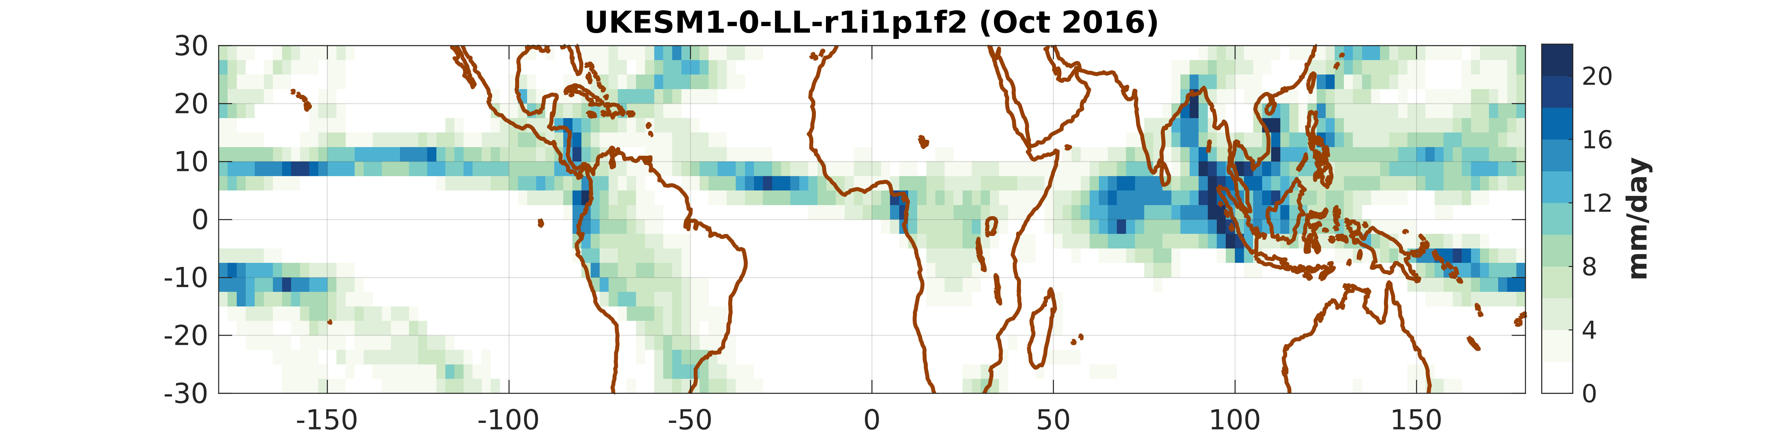
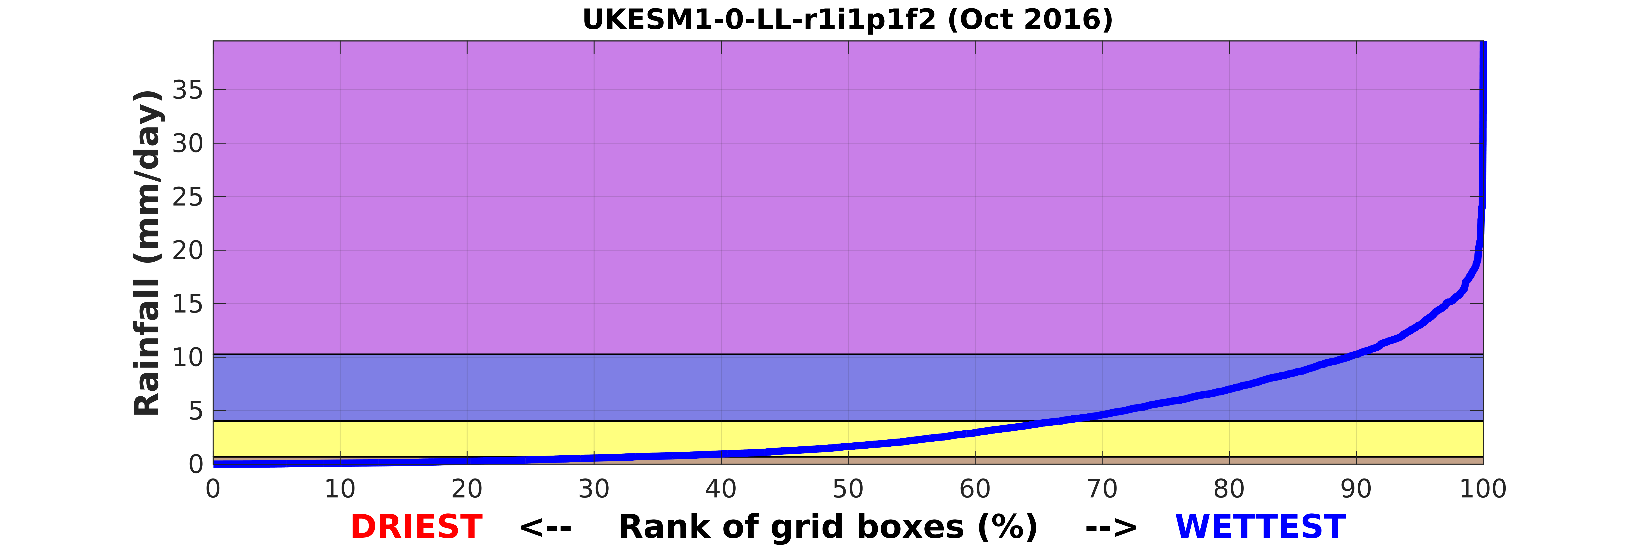
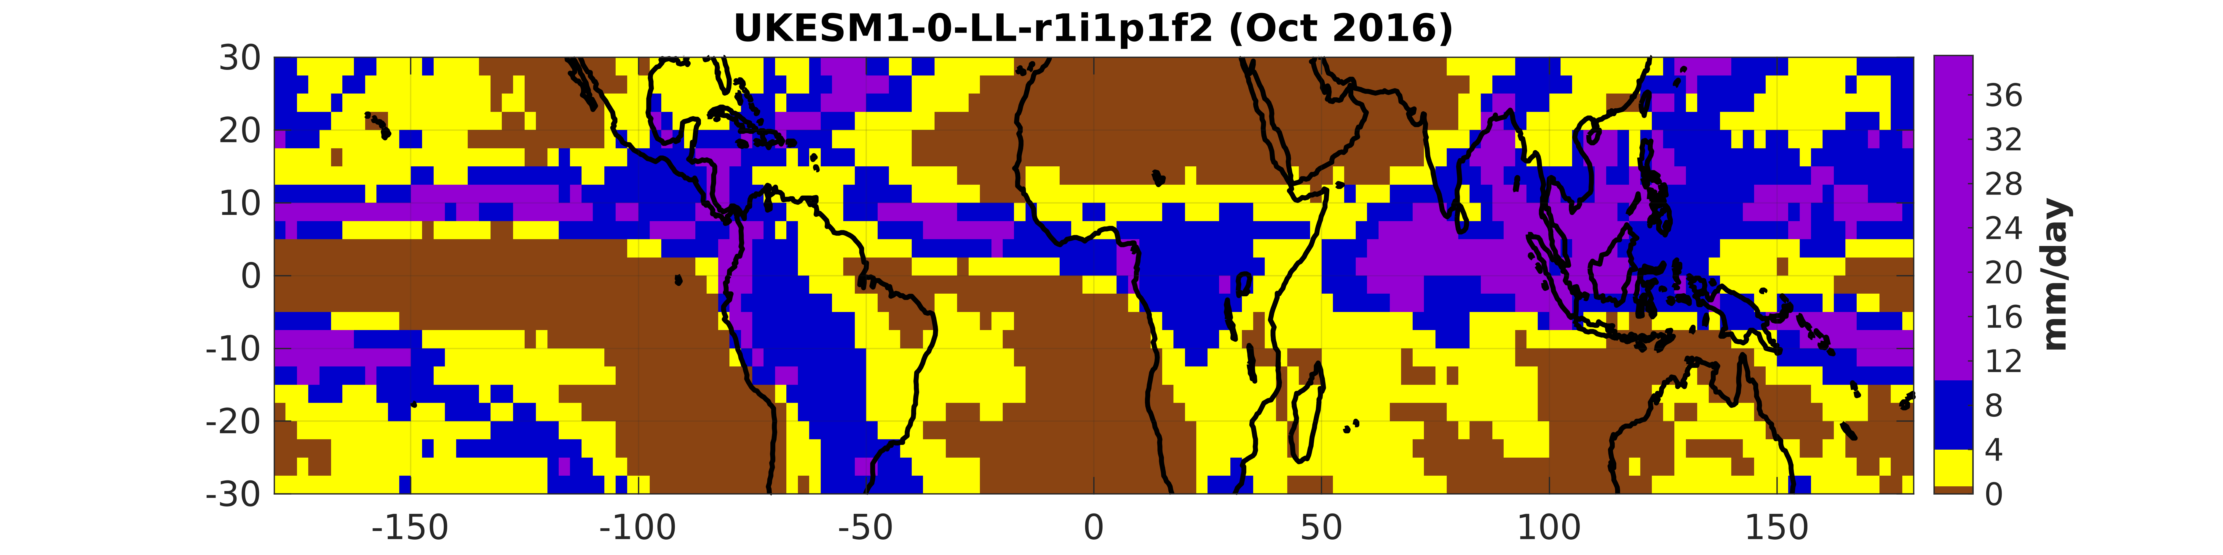
Tracking wet and dry region Rainfall
We analyse monthly rainfall over the tropical (30°S-30°N) region:
  For each individual GCM model ensemble member
  For each month separately
Define wet/dry regions based on rank:
  Lowest tercile – “dry regions”
  Middle tercile – “moderate”
  Highest tercile – “wet regions”
  Highest decile – “wettest regions”
Repeat for all models, obs, months, etc.

Slide 8
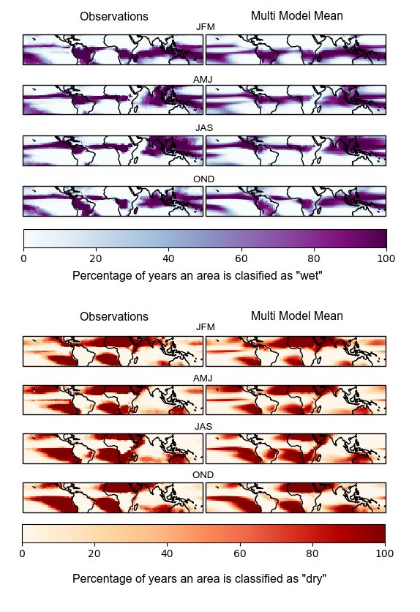
Tracking wet and dry region Rainfall
Define wet/dry regions based on rank:
  Lowest tercile – “dry regions”
  Middle tercile – “in-between”
  Highest tercile – “wet regions”
  Highest decile – “wettest regions”
General consistency in the wet- and dry-region patterns between the observations (GPCP) and the CMIP6 multi model mean

Slide 9
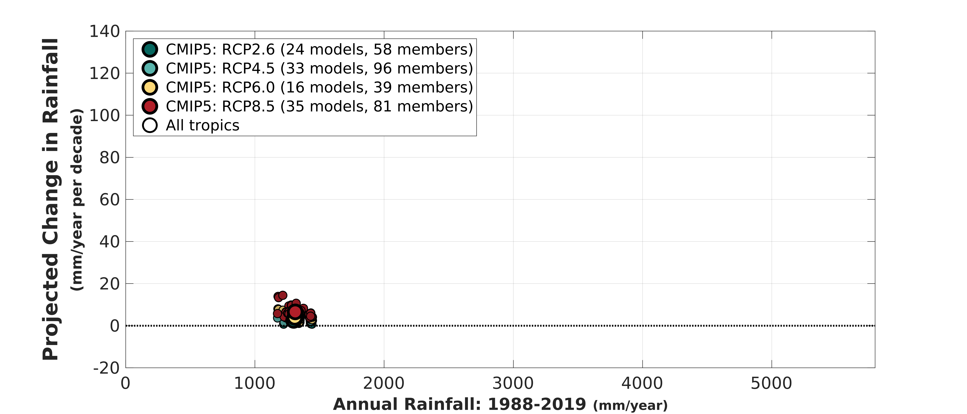
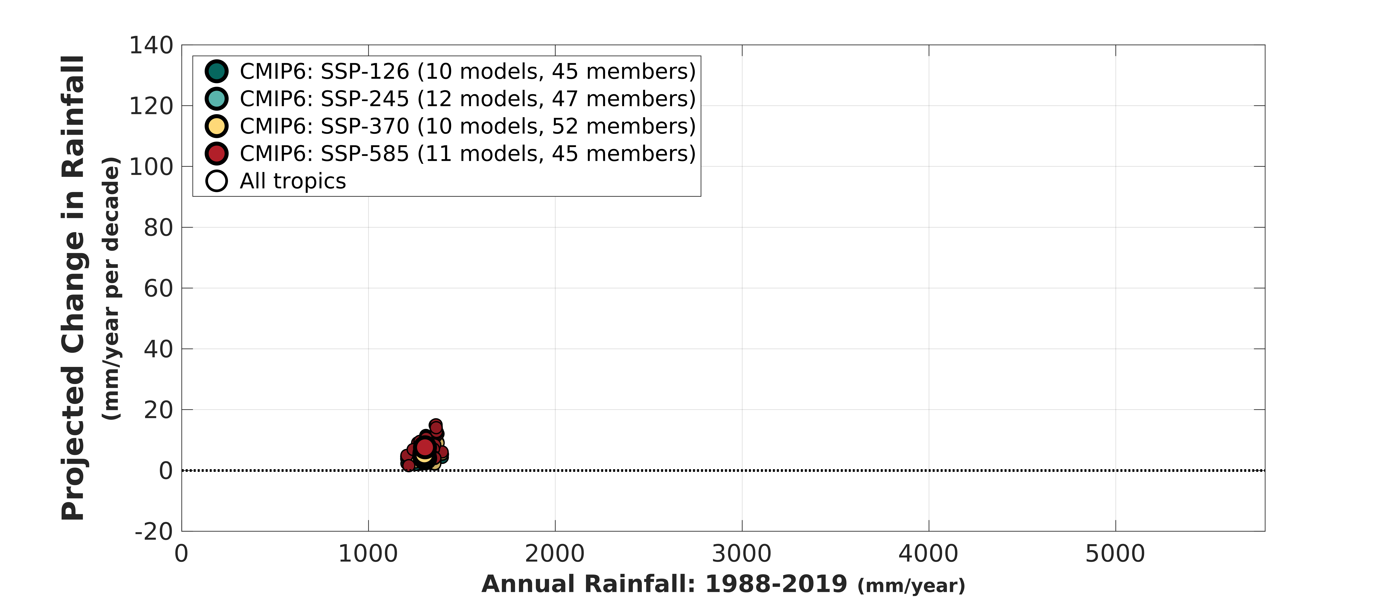
Projected Changes in Future rainfall (2068-2099)
CMIP5
CMIP6

Slide 10
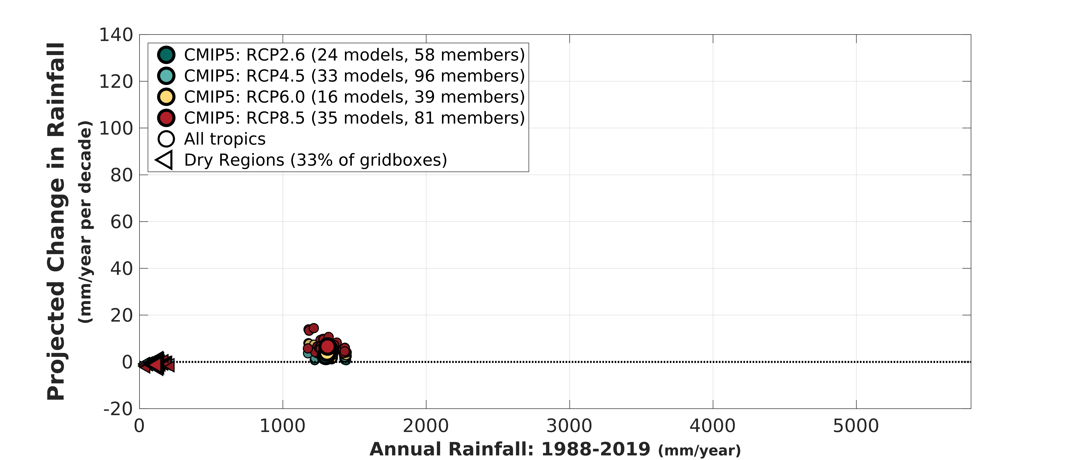
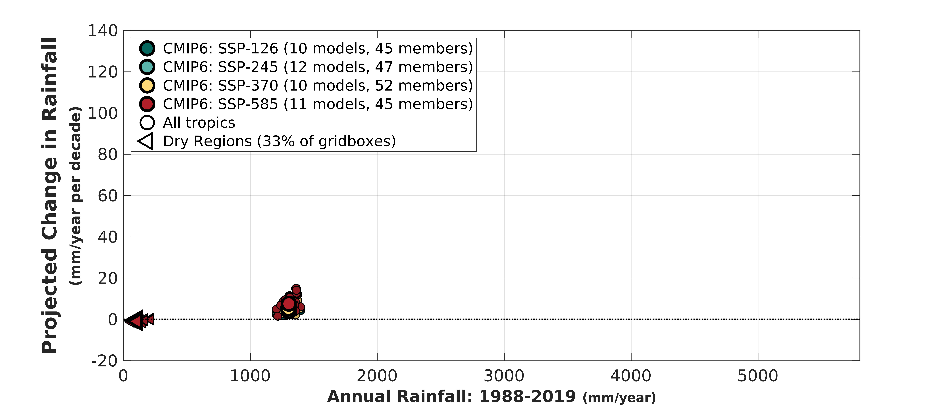
Projected Changes in Future rainfall (2068-2099)
CMIP5
CMIP6

Slide 11
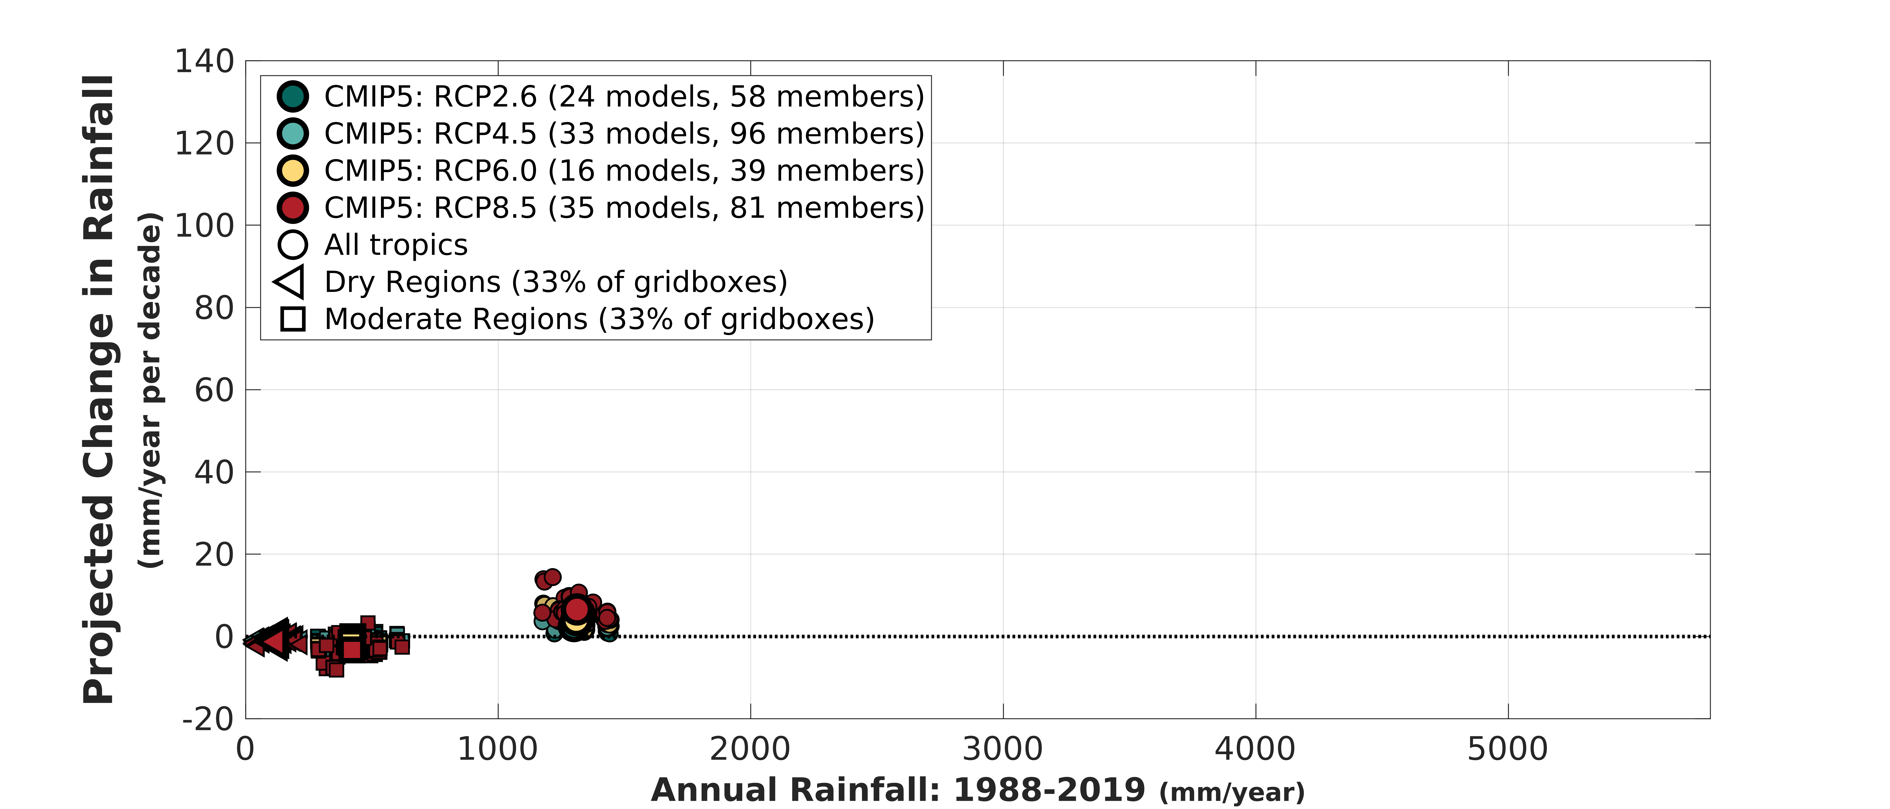
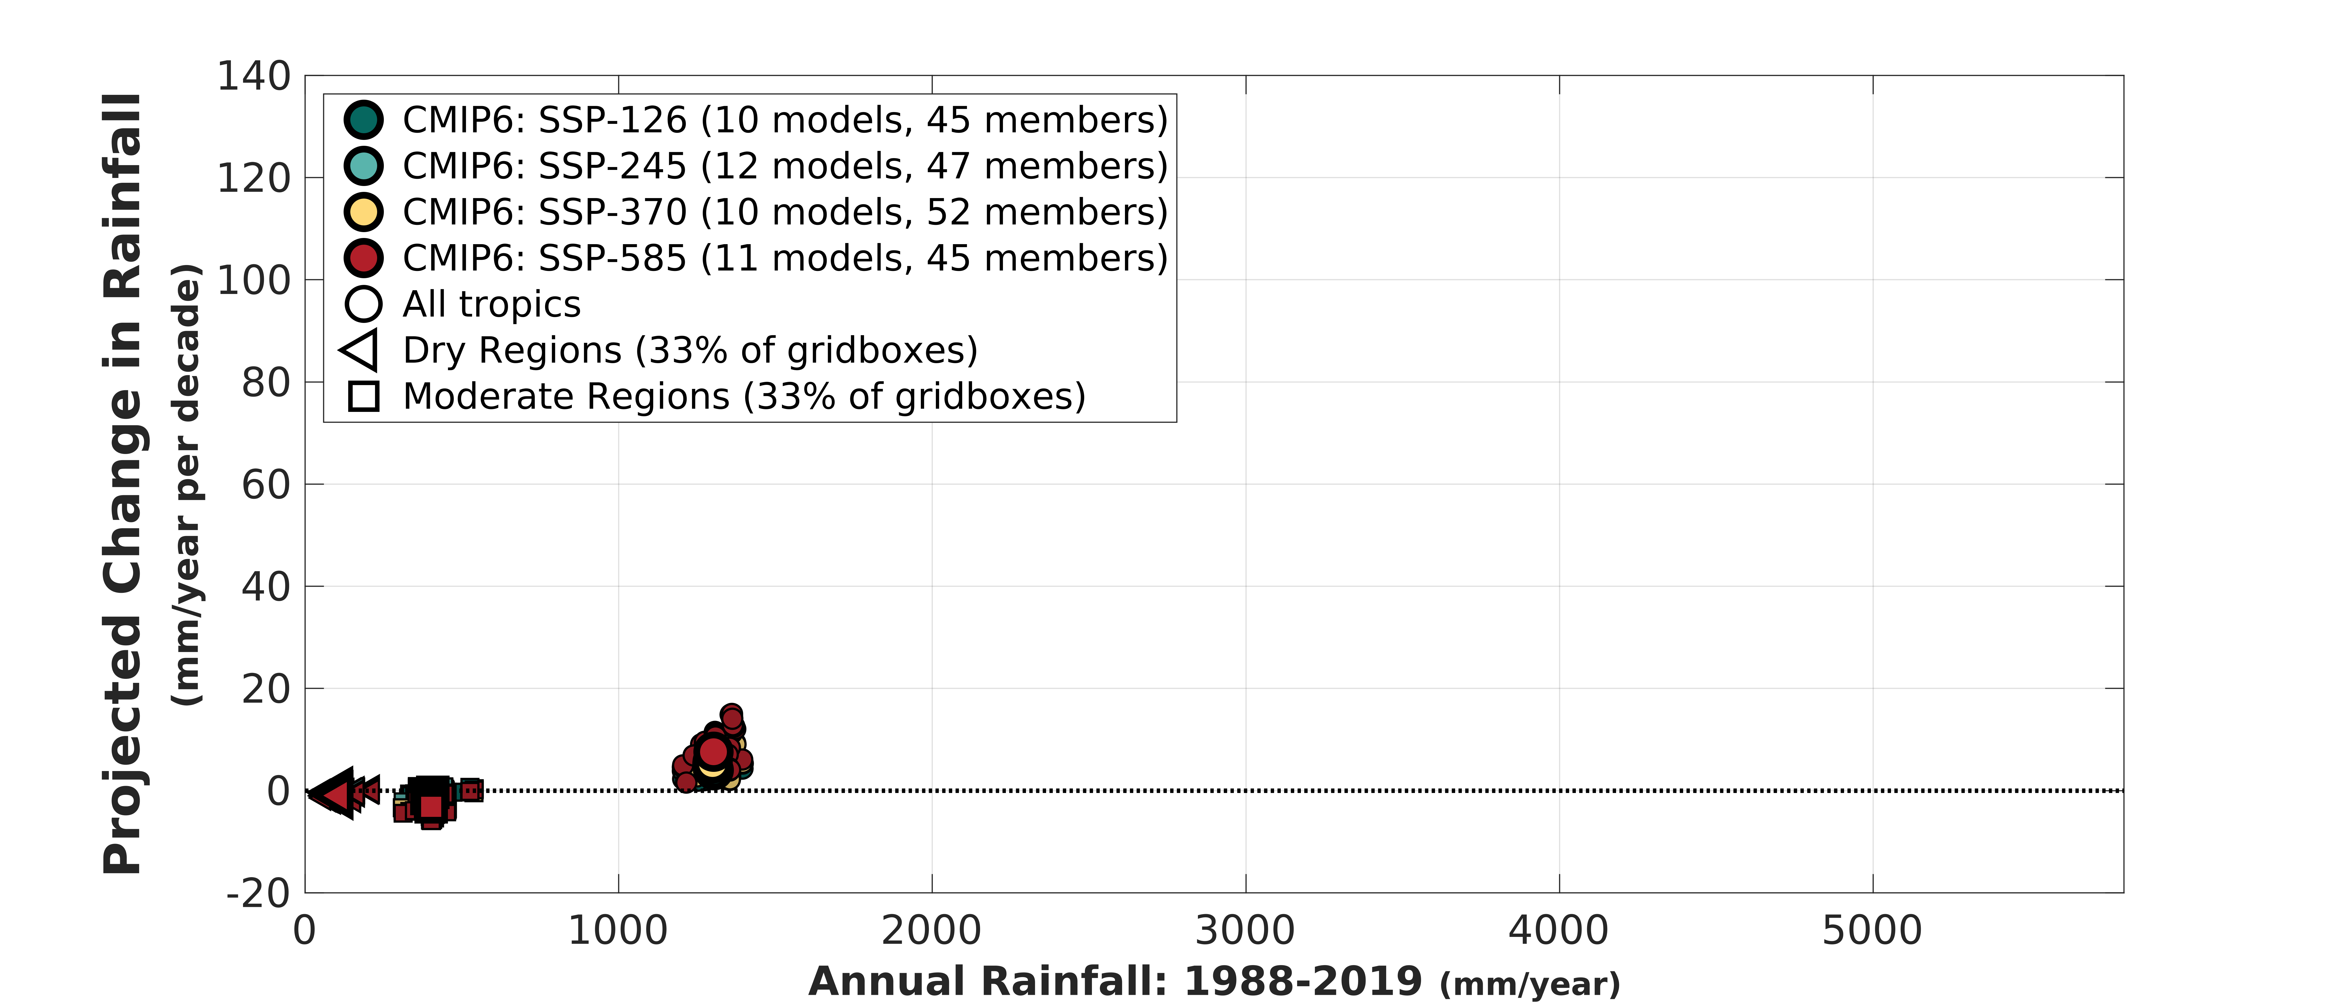
Projected Changes in Future rainfall (2068-2099)
CMIP5
CMIP6

Slide 12
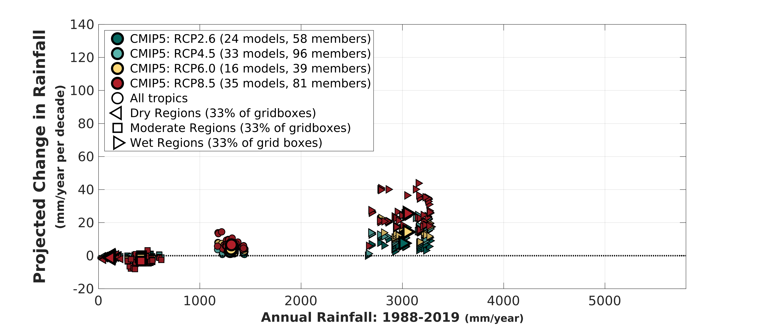
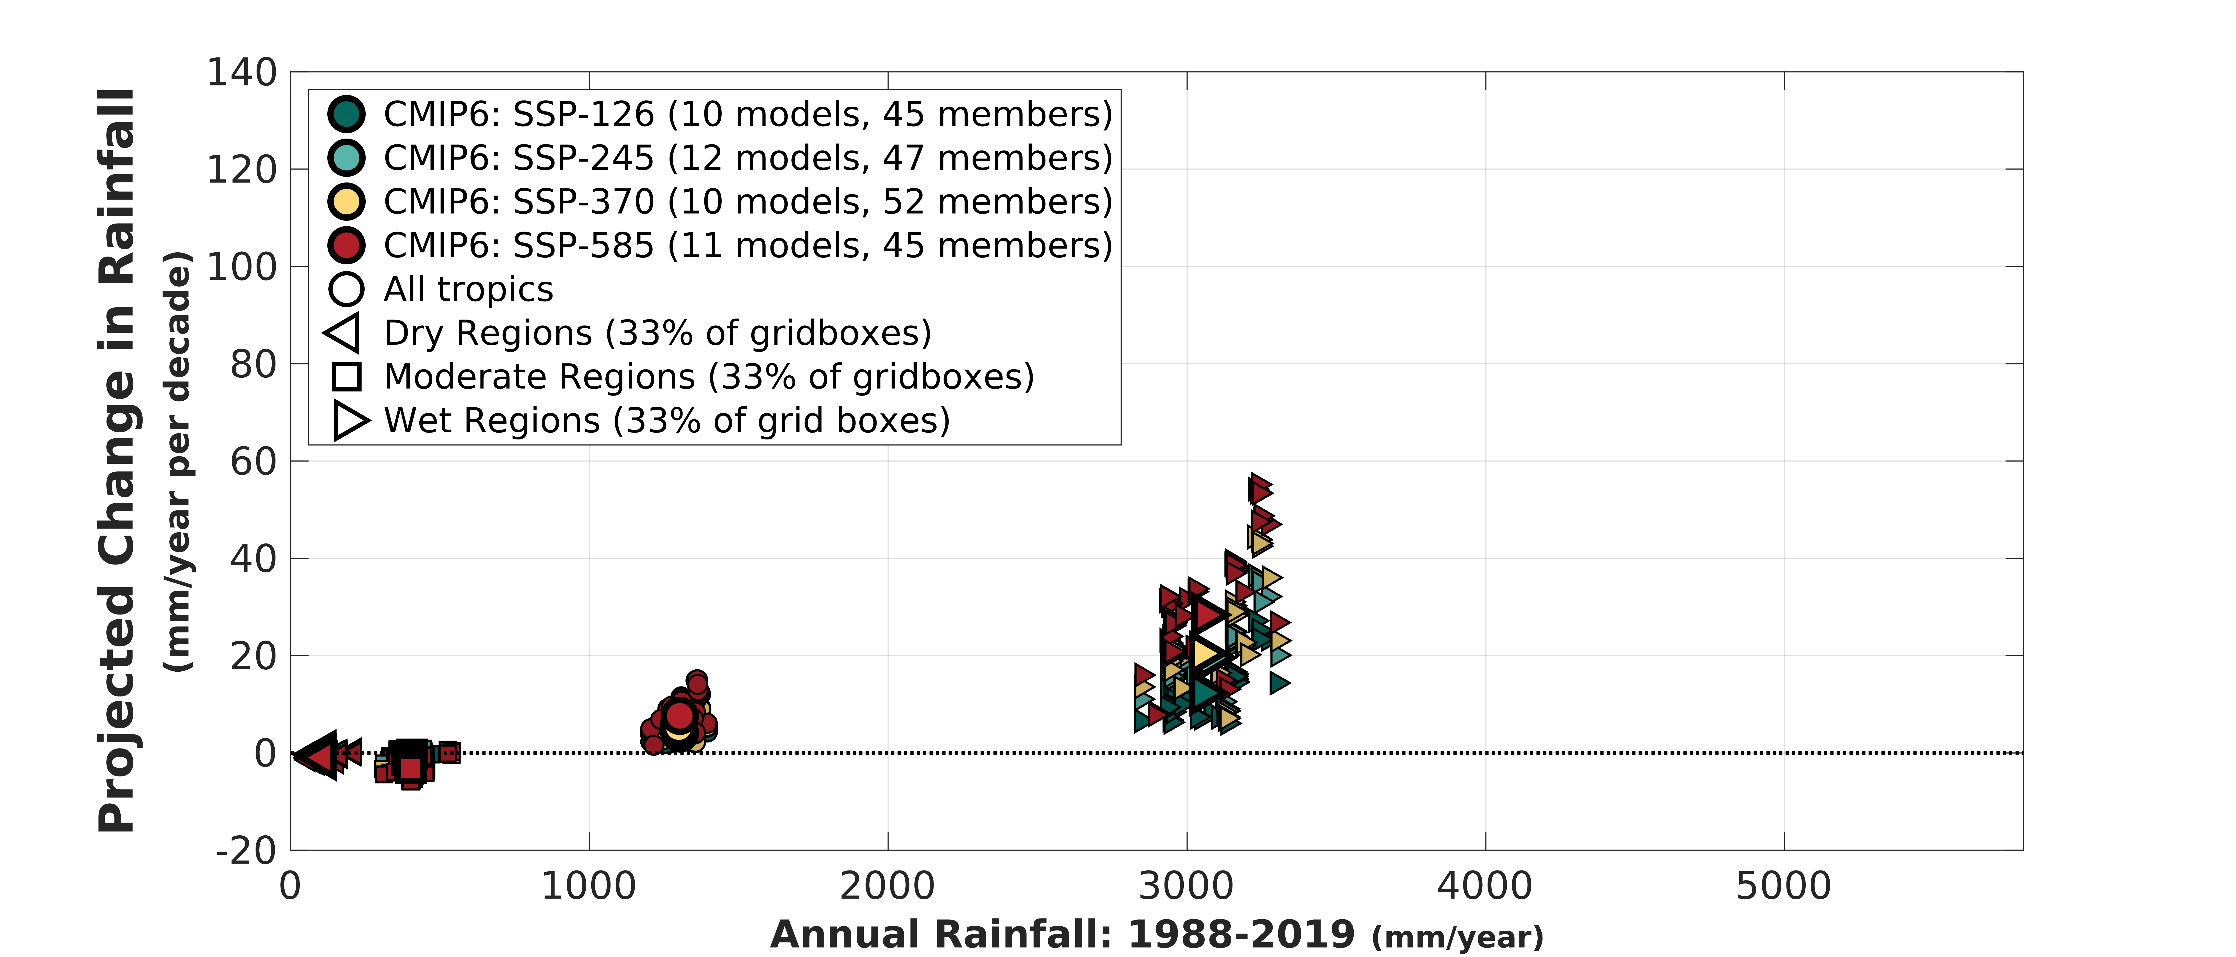
Projected Changes in Future rainfall (2068-2099)
CMIP5
CMIP6

Slide 13
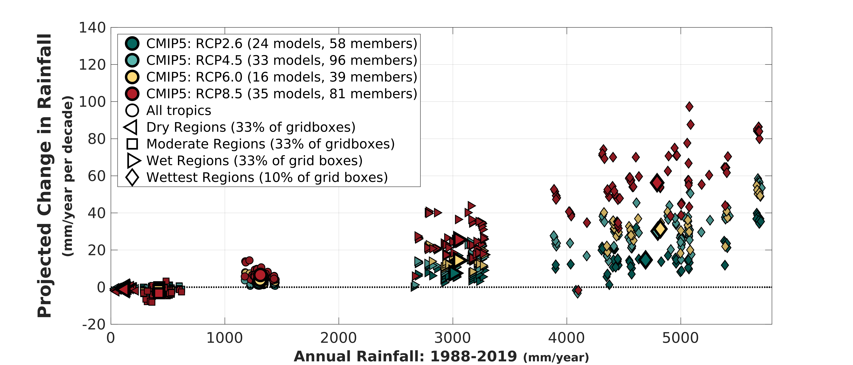
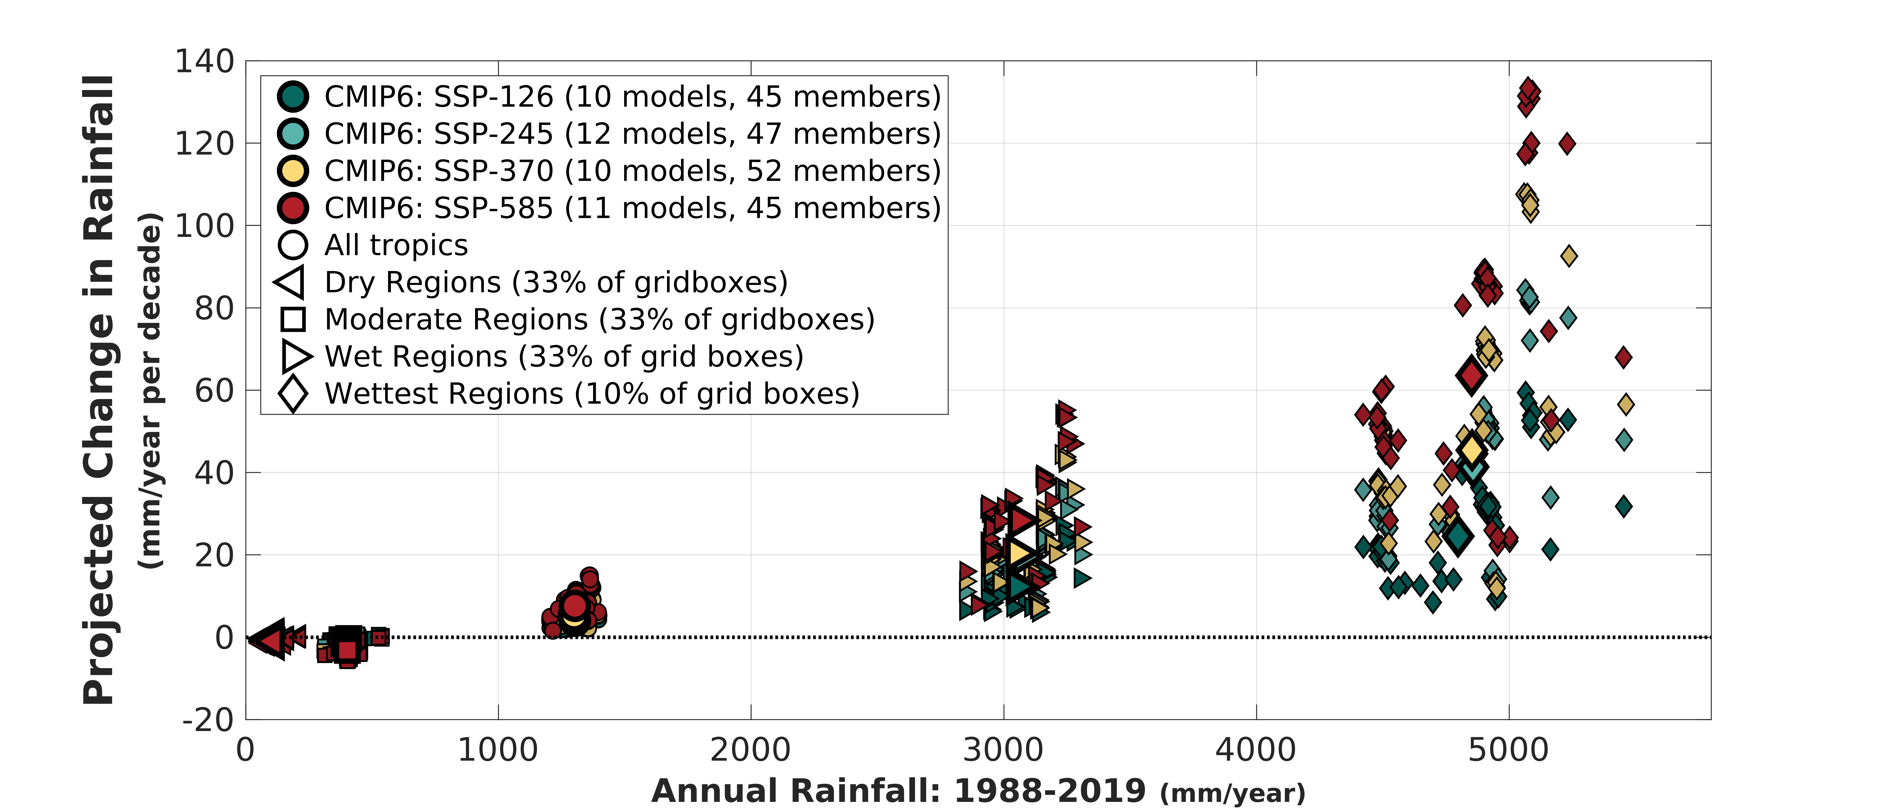
Projected Changes in Future rainfall (2068-2099)
CMIP5
CMIP6

Slide 14
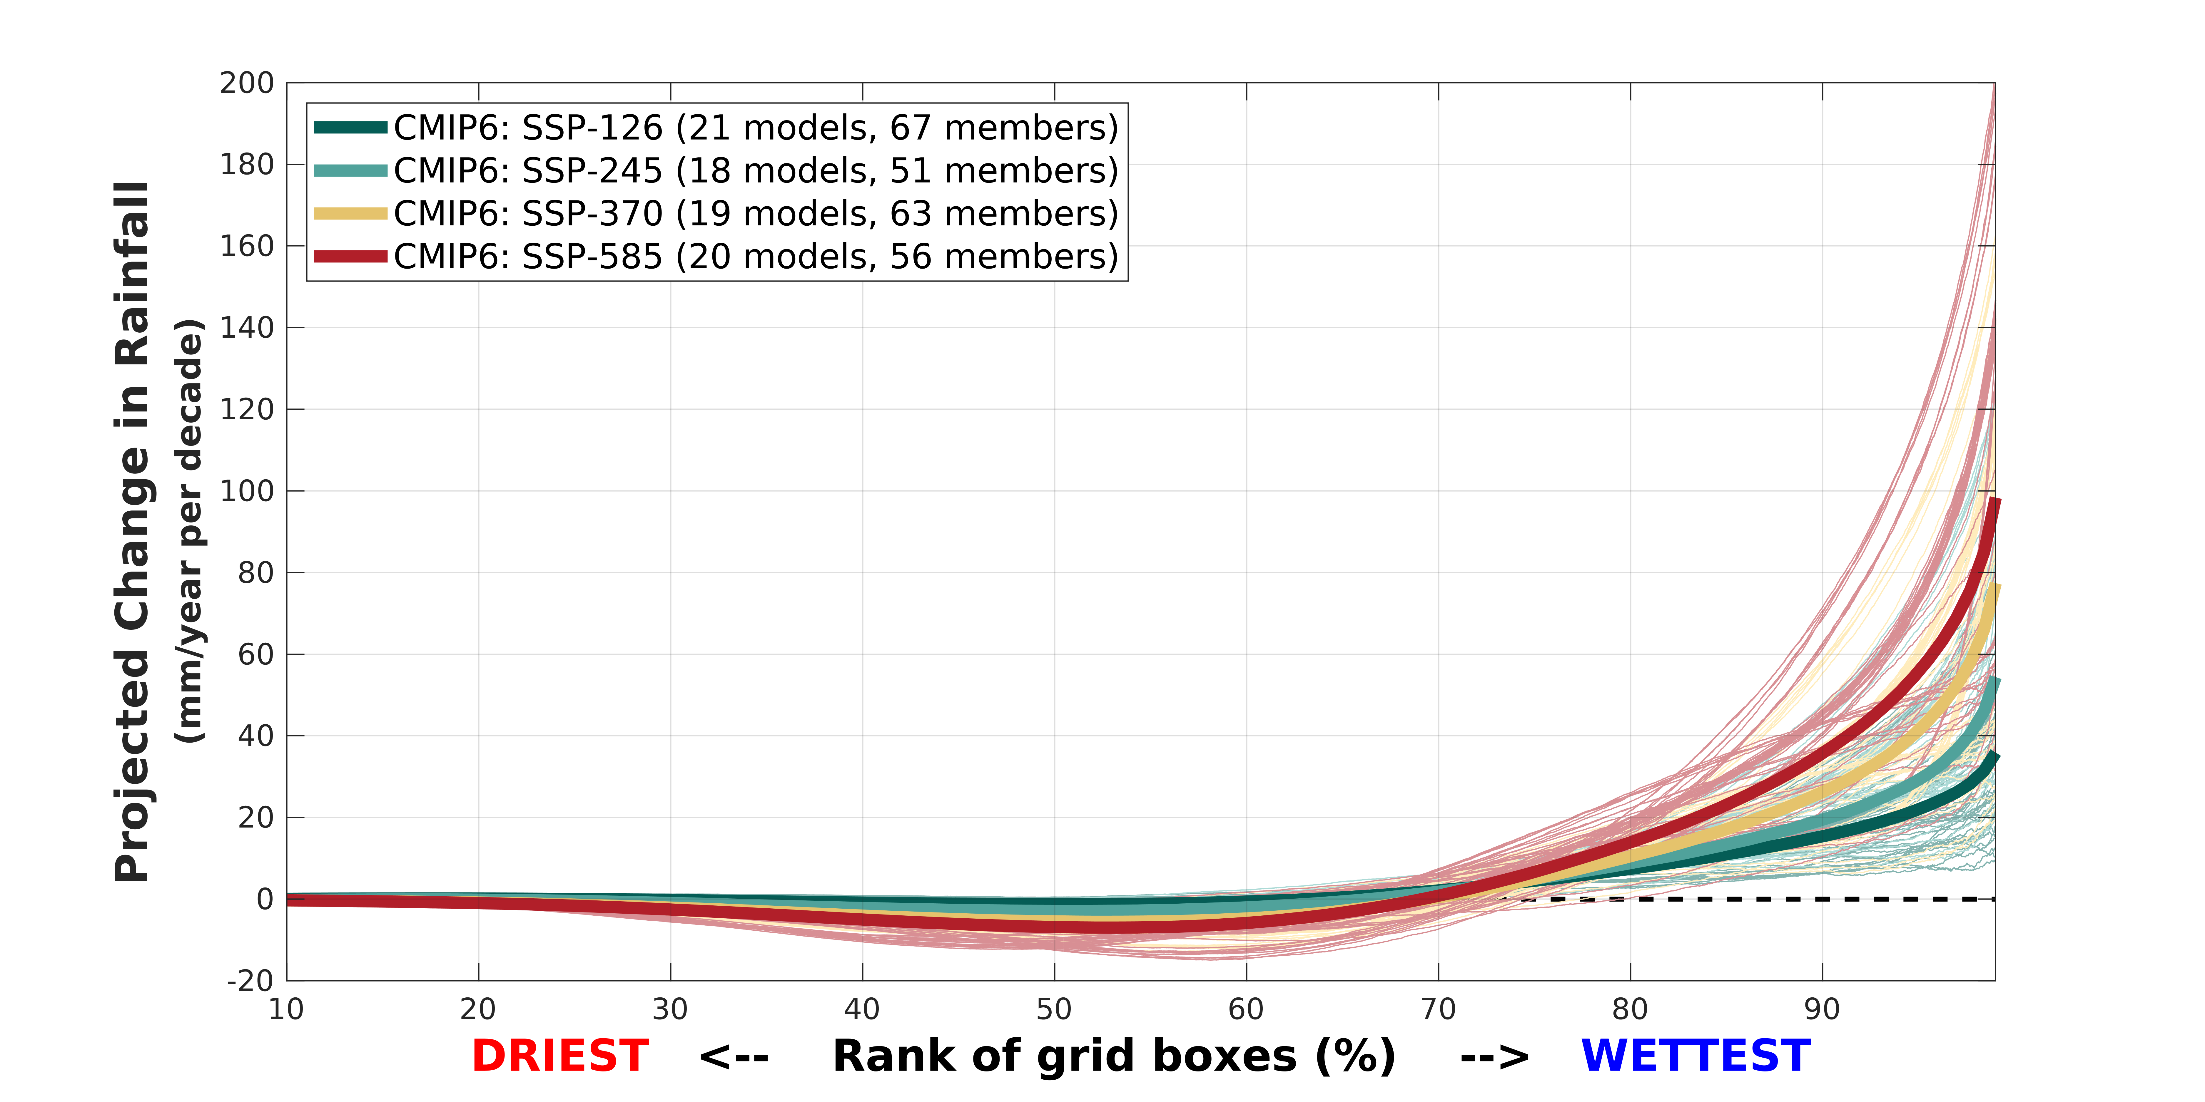
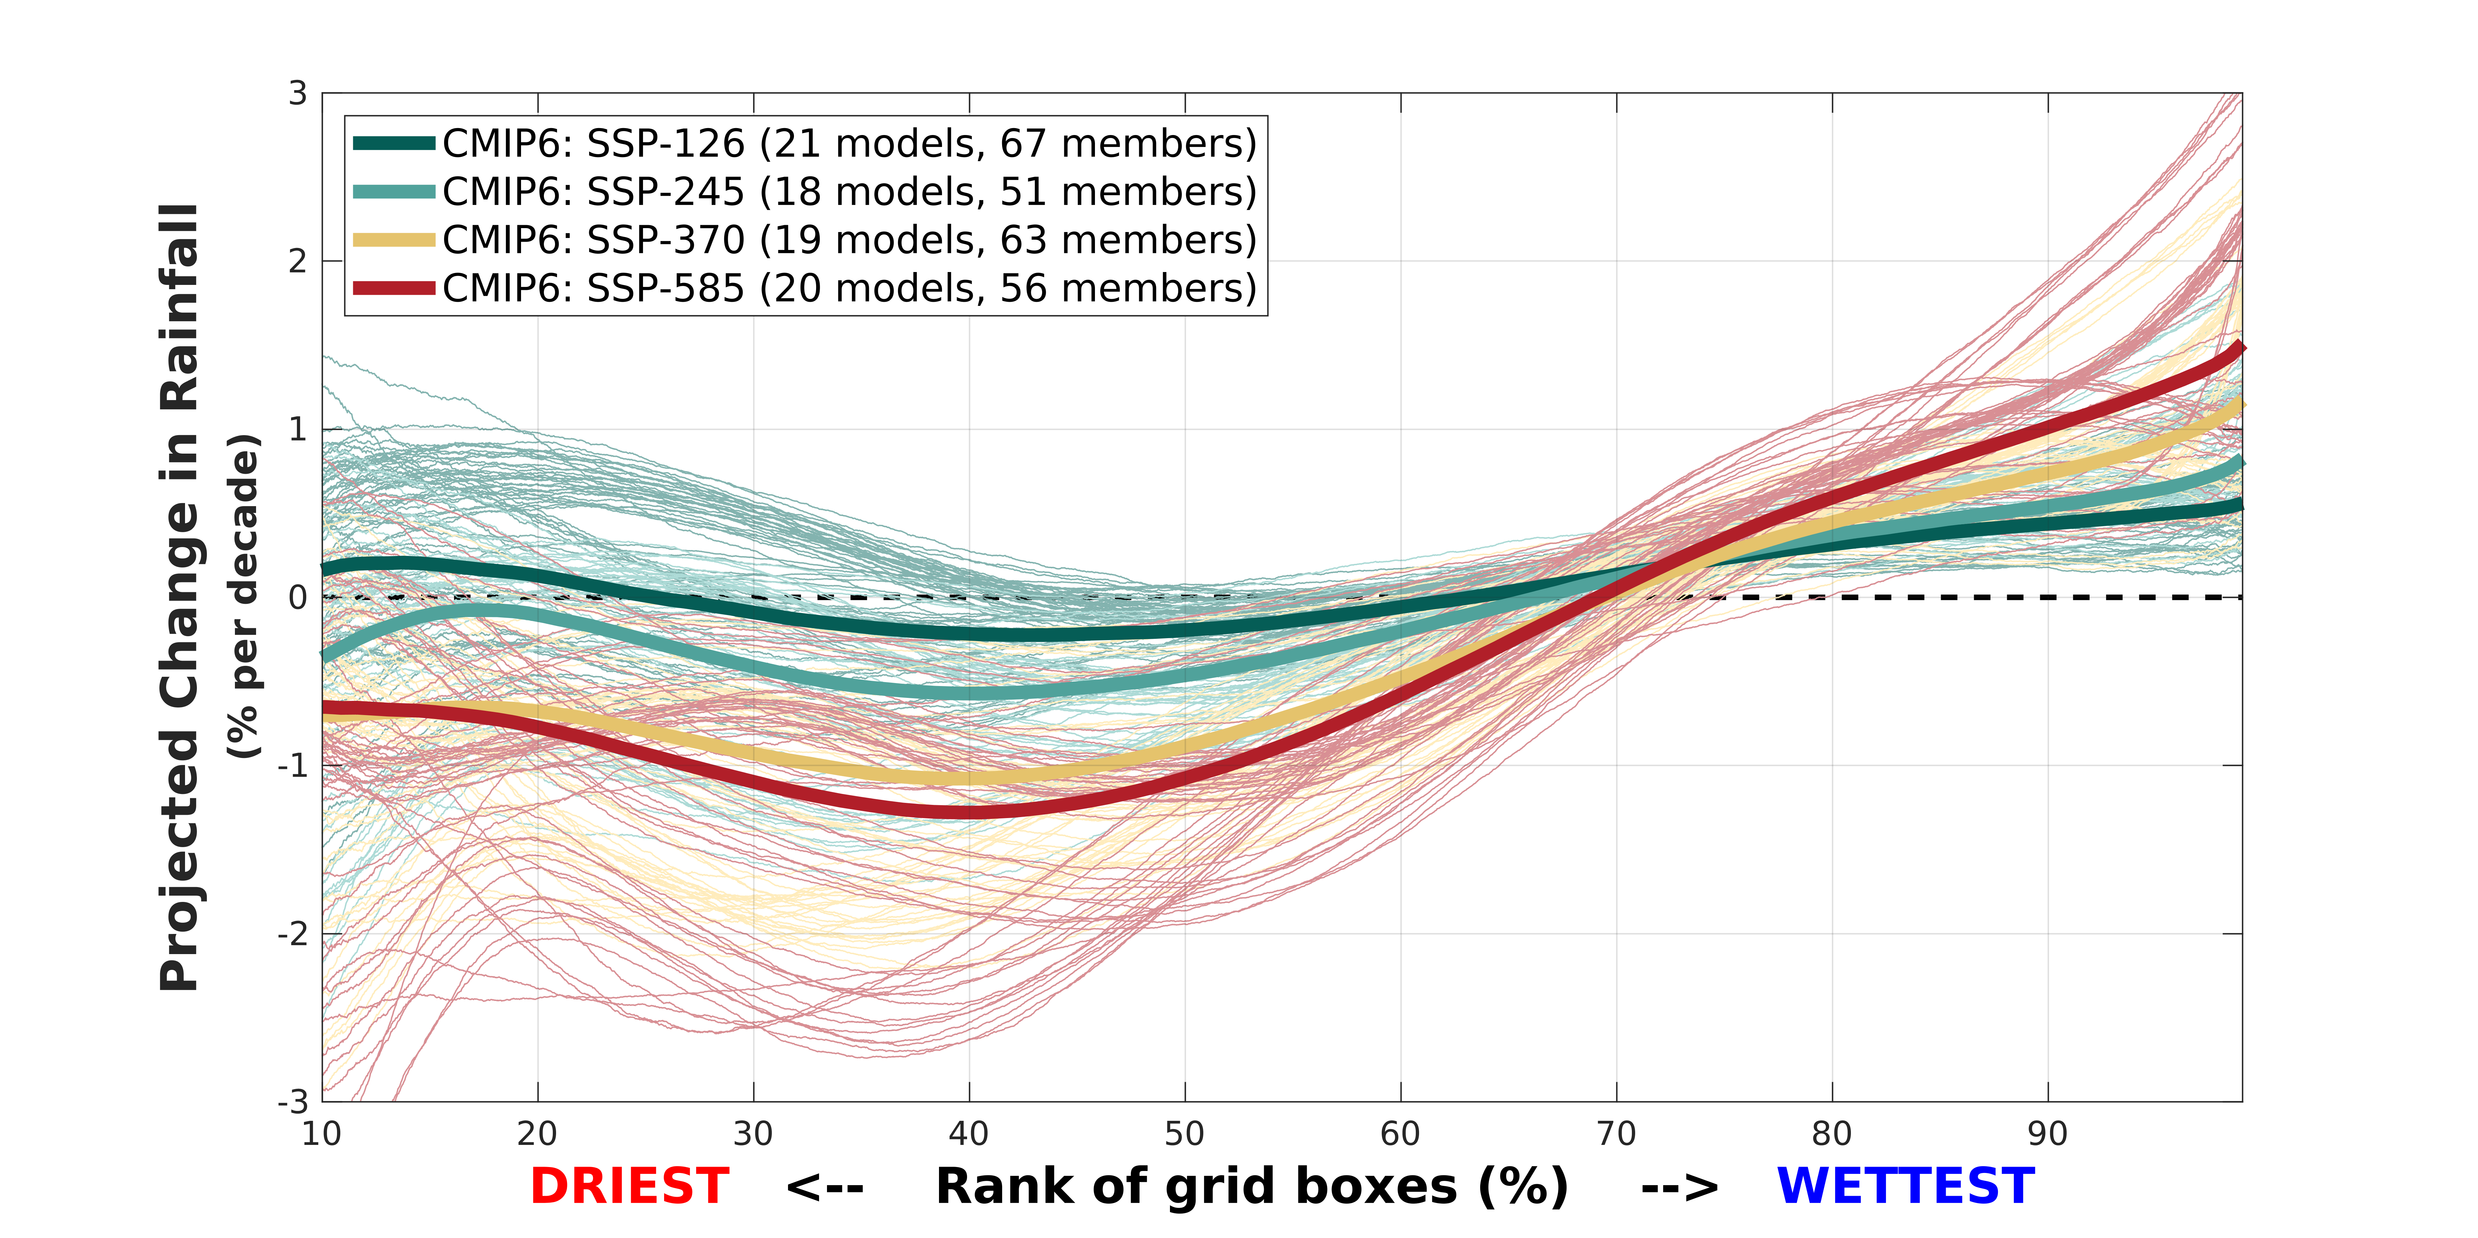
Projected Changes in Future rainfall: CMIP6
TOTAL Annual amount
Percentage Change

Slide 15
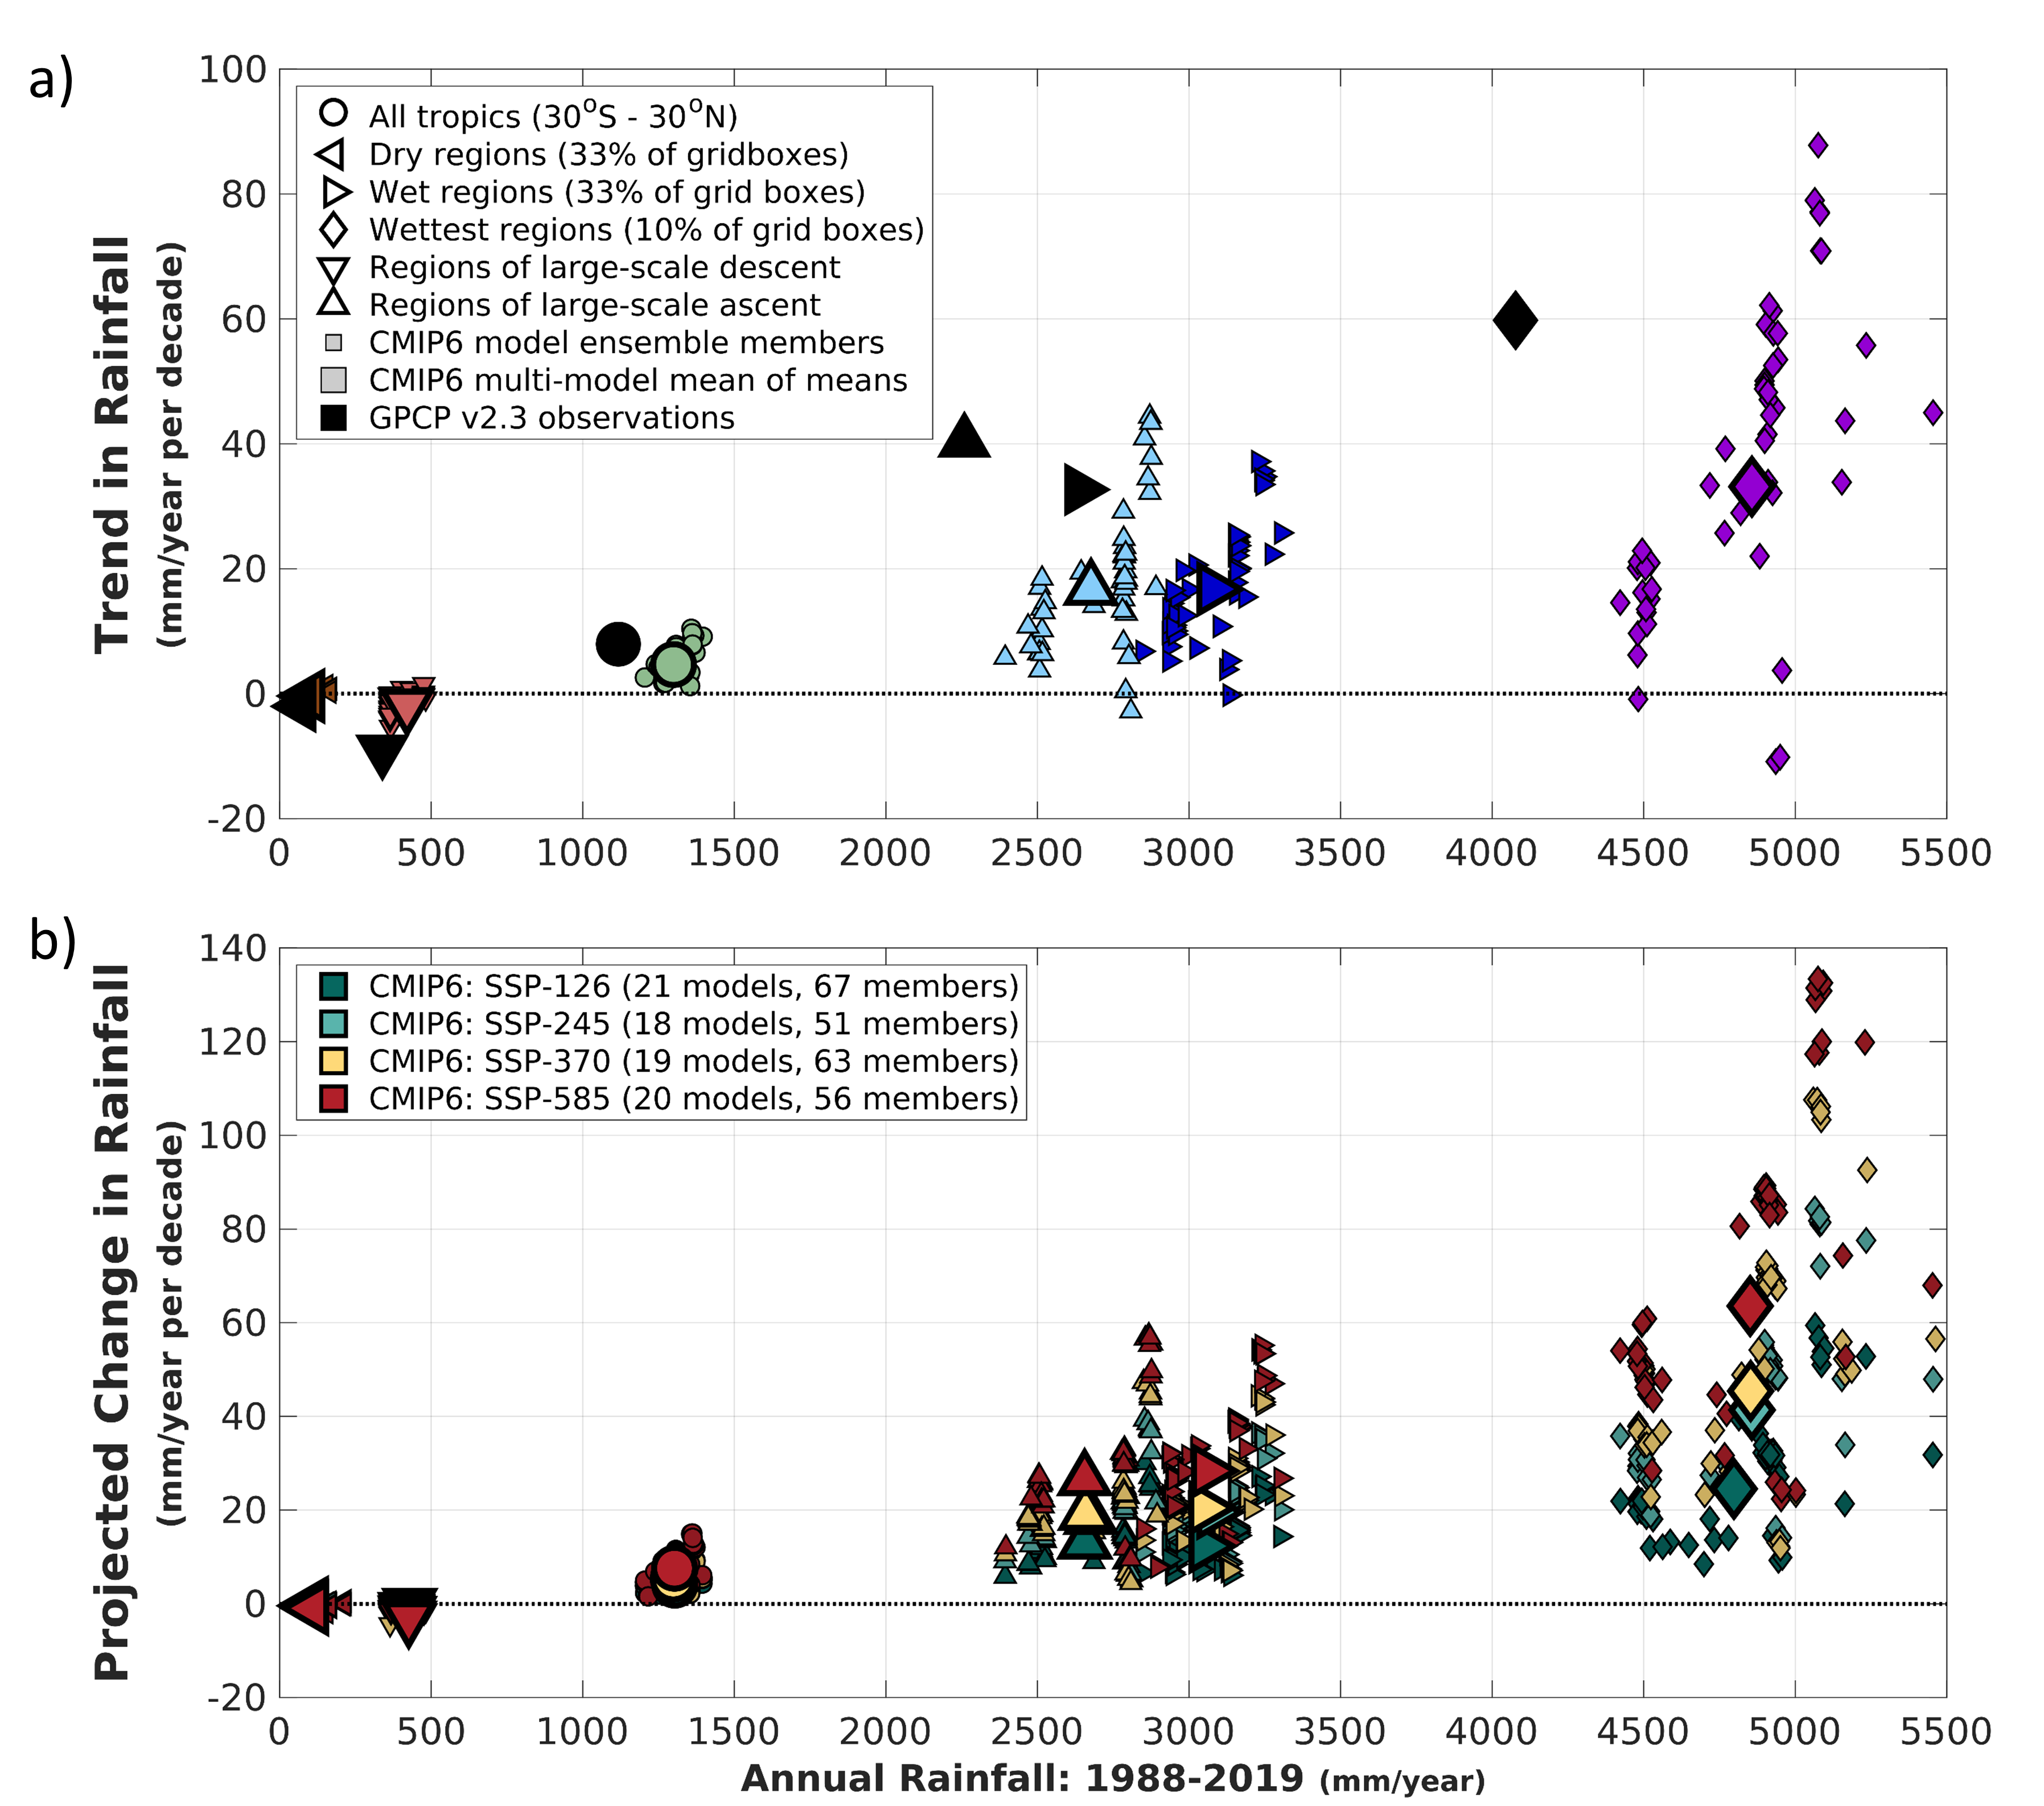
Tracking wet and dry region Rainfall
Change by 2068-2099
Projected changes in rainfall show that wet regions get wetter and dry regions get drier in all CMIP6 models by end of 21st century
Robust fingerprint of anthropogenic forcing

Slide 16
Tracking wet and dry region Rainfall
Change by 2068-2099
Projected changes in rainfall show that wet regions get wetter and dry regions get drier in all CMIP6 models by end of 21st century
Robust fingerprint of anthropogenic forcing
Observed trends (GPCP) over the past 32-years also show same signal
Trend 1988-2019

Slide 17
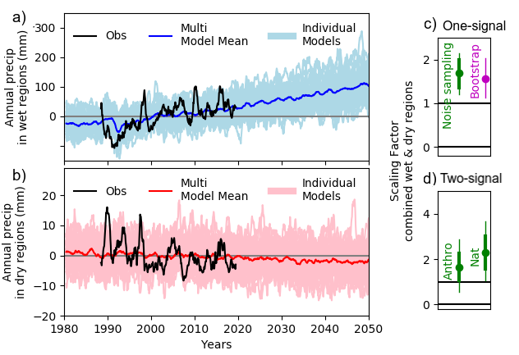
Tracking wet and dry region Rainfall
Time-series of seasonal rainfall anomalies over wet and dry regions in GPCP (black) and CMIP6 (colours)

Slide 18
Tracking wet and dry region Rainfall
Time-series of seasonal rainfall anomalies over wet and dry regions in GPCP (black) and CMIP6 (colours)
Detection and attribution by regressing the multi-model-mean onto the observations using TLS
The scaling factors show that the signal is clearly detected, but the magnitude is not consistent with the observations - needs to be scaled up!

Slide 19
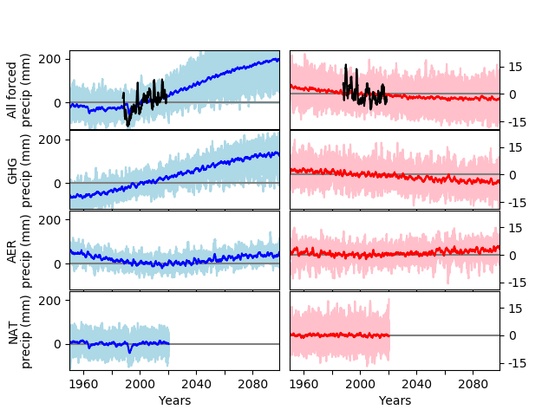
Tracking wet and dry region Rainfall
Time-series of seasonal rainfall anomalies over wet and dry regions in GPCP (black) and CMIP6 (colours)
Detection and attribution by regressing the multi-model-mean onto the observations using TLS
The scaling factors show that the signal is clearly detected, but the magnitude is not consistent with the observations - needs to be scaled up!
Anthropogenic attribution

Slide 20
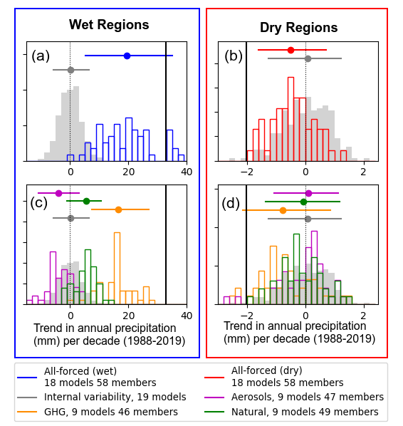
Tracking wet and dry region Rainfall
Normalised histograms of precipitation trends in wet and dry regions
Observed trends are outside what could be expected from internal variability alone (from piControl runs)
Further suggests that the observed change is larger than nearly all model simulations

Slide 21
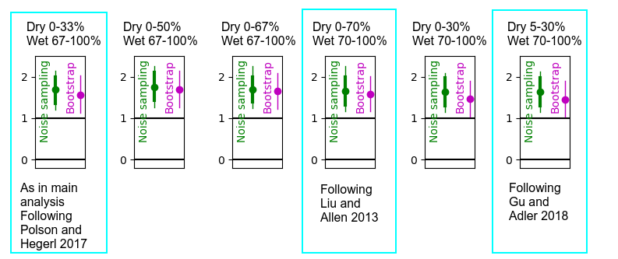
Not sensitive to wet/dry definition

Slide 22
SUMMARY
Analysed monthly rainfall over the tropical (30°S-30°N) region
Defined regions as wet and dry depending on amount of rainfall in any given month
Model projections show a robust pattern of wettest third getting wetter driest two thirds getting dryer
Observations (GPCP) of the last 32 years shows same pattern
This signal is clearly detectable, but the magnitude is not consistent with the observations - needs to be scaled up.
Can be attributed to anthropogenic forcing.

