Slide 1


Modelling the accumulation and transport of microplastics by Arctic sea ice
Miguel Ángel Morales Maqueda & Alethea Mountford
School of Natural and Environmental Sciences, Newcastle University, U.K.
Miguel.Morales-Maqueda@newcastle.ac.uk
Notes:
Motivation associated with two issues, namely.

Slide 2
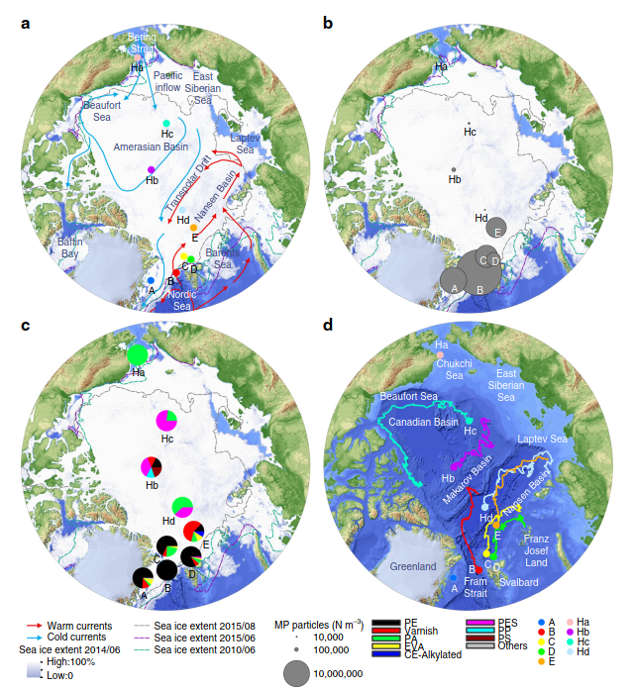
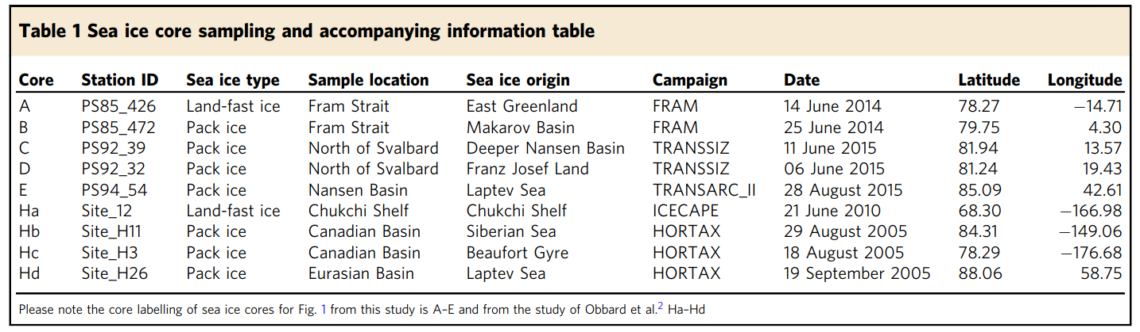
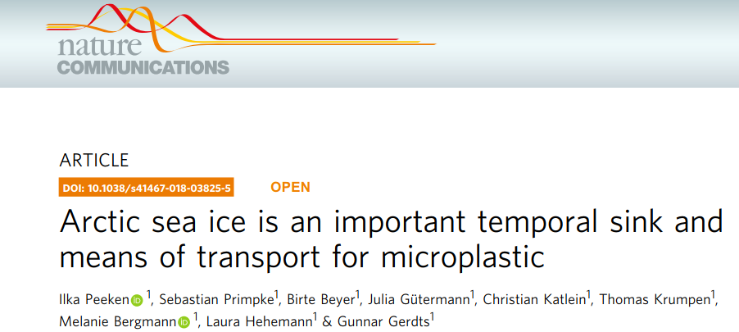
Notes:
Paper by Peeken et al. (2019) indicating sea ice is a temporal sink and a transport vehicle for plastics. Discuss panels a and b.

Slide 3
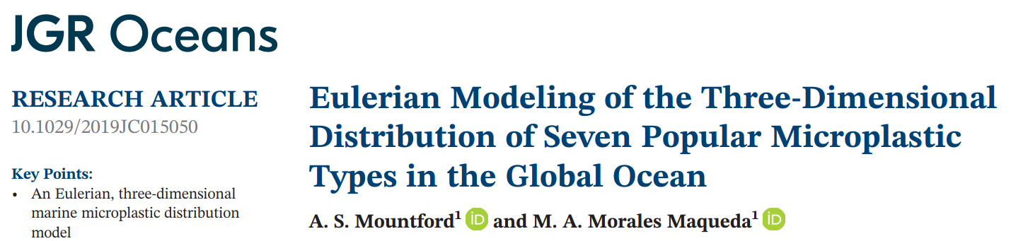
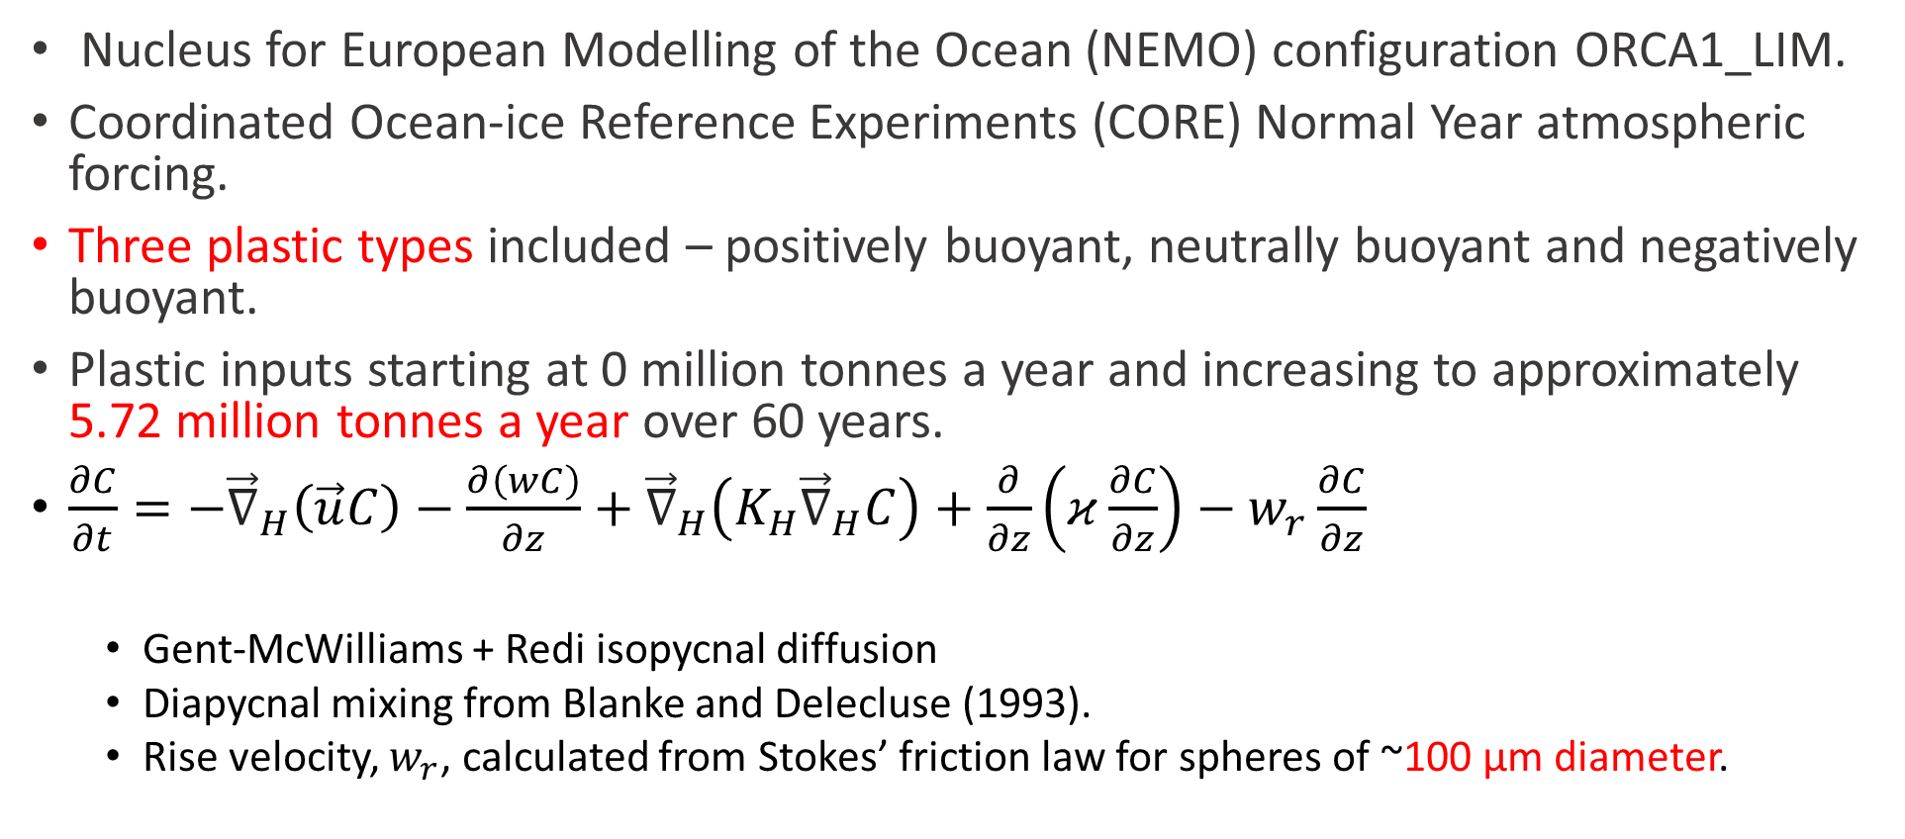
Model description
Nucleus for European Modelling of the Ocean (NEMO) configuration ORCA1_LIM.
Coordinated Ocean-ice Reference Experiments (CORE) Normal Year atmospheric forcing.
Three plastic types included – positively buoyant, neutrally buoyant and negatively buoyant.
Plastic inputs starting at 0 million tonnes a year and increasing to approximately 5.72 million tonnes a year over 60 years.
$\frac{∂C}{∂t}=−{\vec{∇}}_{H}\left(\vec{u}C\right)−\frac{∂\left(wC\right)}{∂z}+{\vec{∇}}_{H}\left(K_{H}{\vec{∇}}_{H}C\right)+\frac{∂}{∂z}\left(κ\frac{∂C}{∂z}\right)−w_{r}\frac{∂C}{∂z}$
  Gent-McWilliams + Redi isopycnal diffusion
  Diapycnal mixing from Blanke and Delecluse (1993).
  Rise velocity, $w_{r}$, calculated from Stokes’ friction law for spheres of ~100 μm diameter.
Notes:
Model of Mountford and Morales Maqueda describing an Eulerian formulation of global plastic dispersion.

Slide 4
Capture and release of plastic by sea ice
Surface melt
Snow ice formation
Sea surface
Snow
Sea ice
Water
Plastic
Basal accretion
Basal melt
Notes:
Three processes considered for the incorporation of plastic in suspension in the water column into the ice matrix. This is all rather crude but the hope is that it will provide a zero-order description of the processes. There is no airborne microplastic in the model and so snow is pristine.

Slide 5
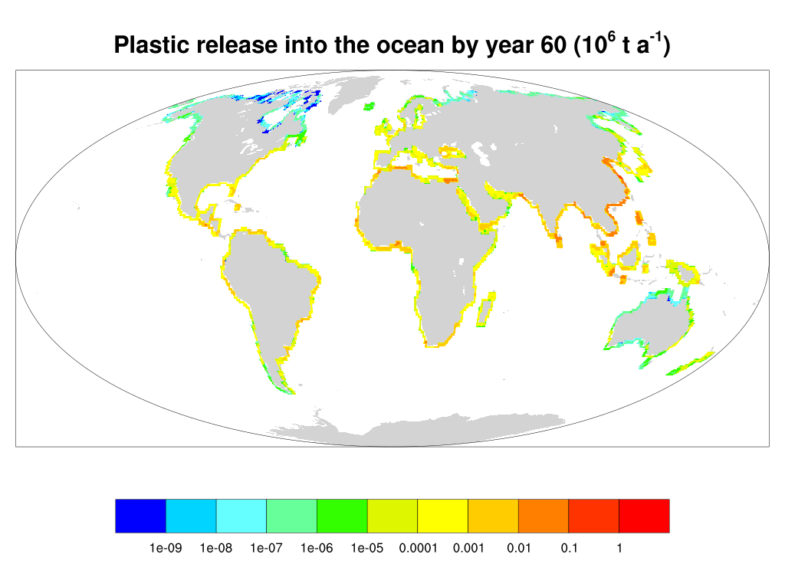
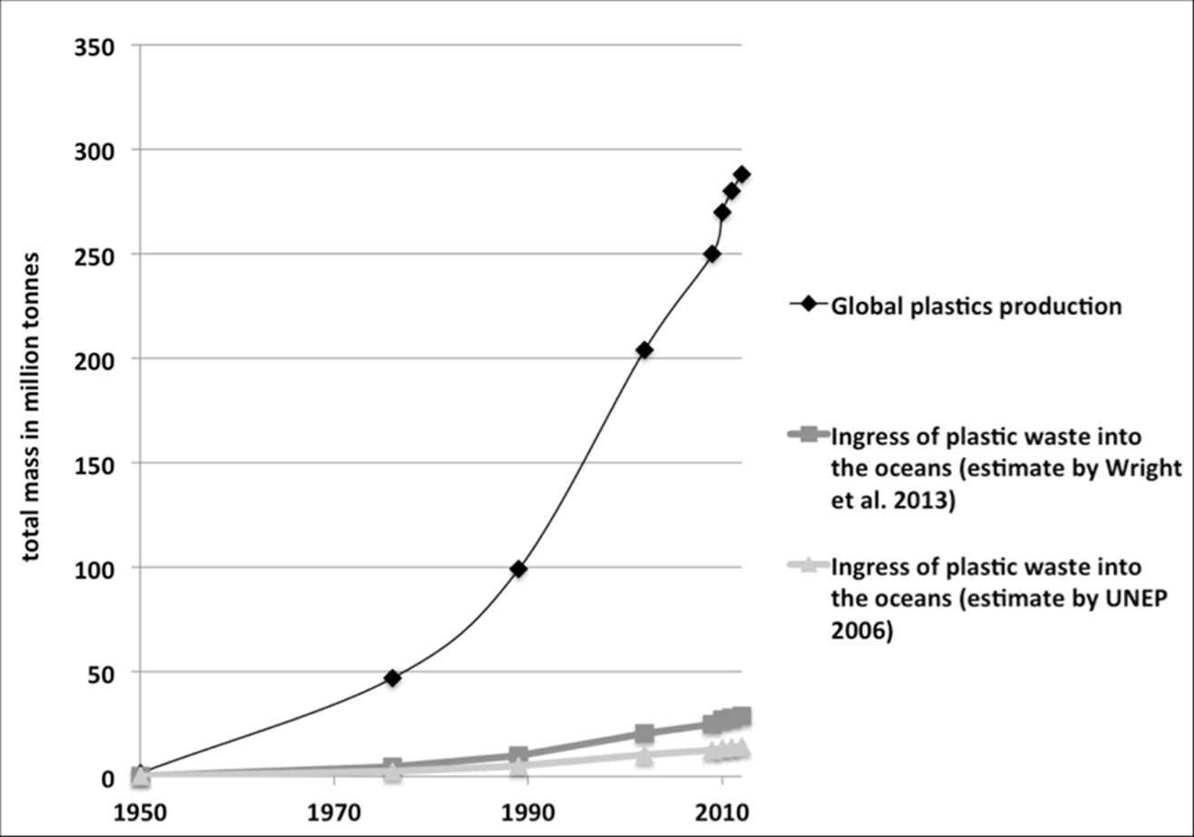

Global release of 5.72 million tonnes in year 60.
(PlasticsEurope 2013, UNEP 2006, Wright et al. 2013). http://news.bio-based.eu/microplastics-environment/
Jambeck et al. (2015).
Erik van Sebille
 | Fraction of total plastic released | Density (kg m⁻³) | Indicative rise velocity (m s⁻¹)
Buoyant | 0.491 | 926 | 0.0010
Neutrally buoyant | 0.190 | 1023 | 0.0001
Non-buoyant | 0.319 | 1217 | -0.0013
PlasticsEurope (2017) and Andrady & Neal (2009).
Notes:
This slides describes the plastic forcing of the model. The pattern of plastic input is from Jambeck et al. (2015). We thank Erik for providing the data. The data is ramped up globally from 0 on year 1 to 5.72 million tonnes on year 60 (we only do 50 year of simulation). The table describe the relative quantities and main properties of the three types of plastic we are using. Rise velocities are indicative.

Slide 6
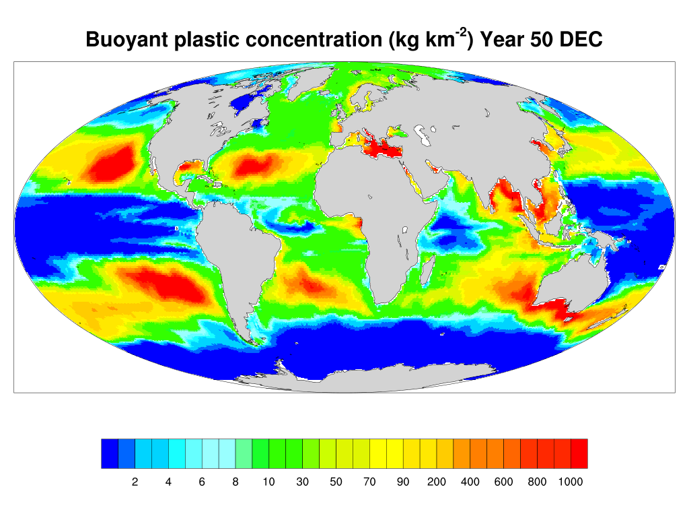
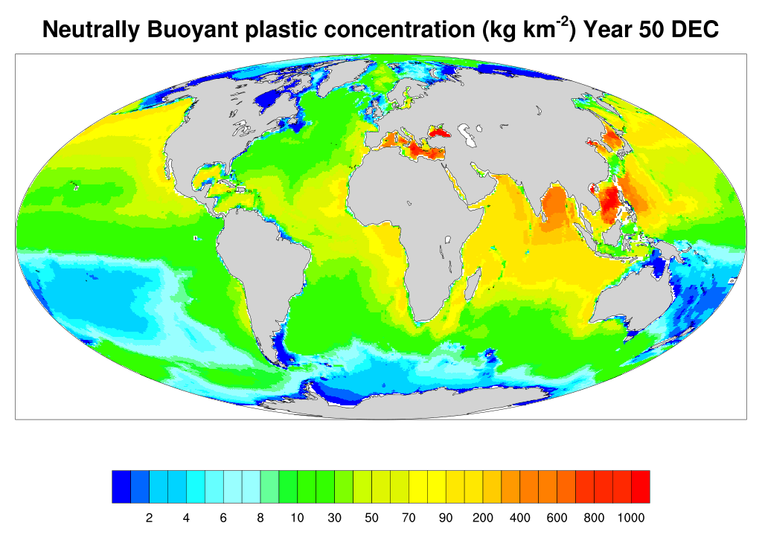
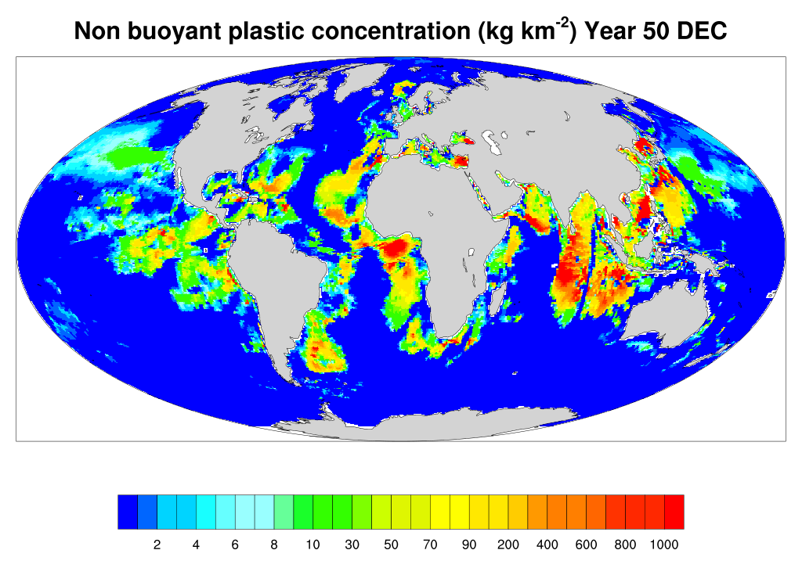
Notes:
Today we are going to focus on buoyant plastics in the Arctic but it is probably worthwhile to see what the model does globally. The three panels show the global distribution of the three types of plastic in December of year 50 in kg m⁻². Buoyant plastic shows the usual accumulations in garbage patches in the subtropics and an alarming inflow of plastics into the Arctic. Concentrations in tropical and equatorial regions and in the Southern Ocean are small. Neutrally buoyant plastics exhibit similar patterns to an extent but can spread downwards in 50 years down to the permanent thermocline and then horizontally at depth. They reach all parts of the world ocean, including the tropical-equatorial regions and the Southern Ocean. Non buoyant plastics invade the abyssal plains and abyssal and hadal trenches, the ultimate trash cans of the ocean as Guyu Peng put it yesterday in her

Slide 7
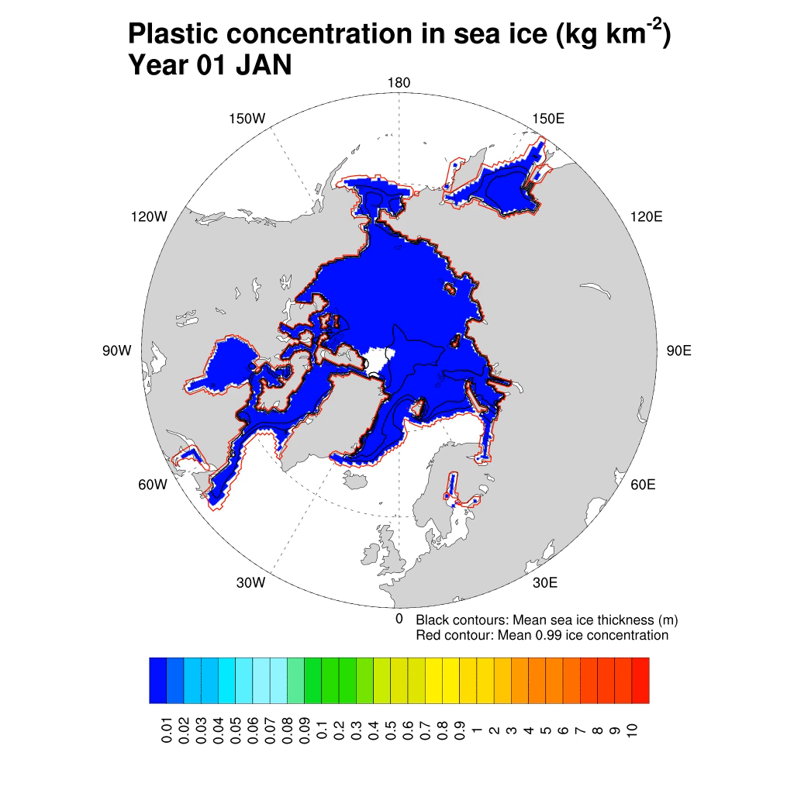
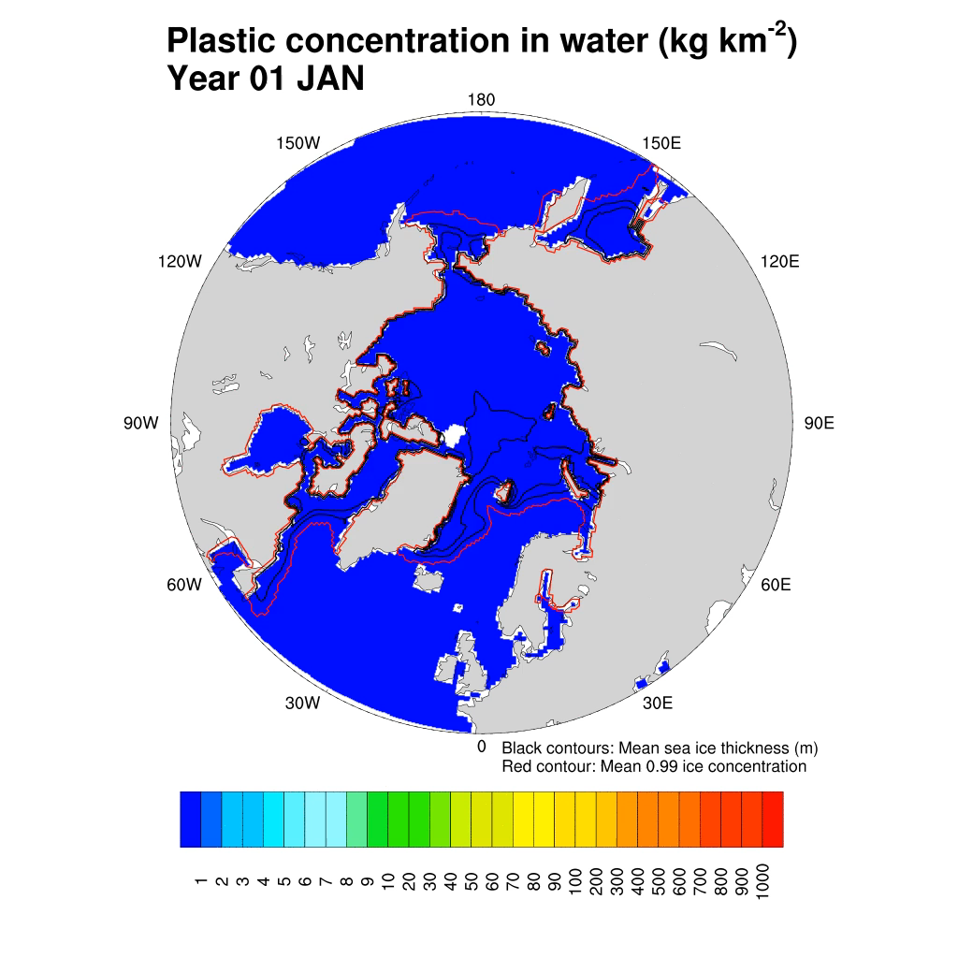
Notes:
This slide encapsulates the main results of this piece of research. What you are going to see is a monthly mean animation of buoyant plastic concentration in sea ice on the left and in the water column on the right, both in kg/km2, but note the different scale on the two charts. Say what the black lines and red lines are. The plastic that is scavenged by sea ice comes predominantly from the Atlantic via the Norwegian and Barents Sea and, therefore, it is the ice in the Eurasian basin that shows increasing levels of plastic. The circulation of the ice is such that ice that form in this half of the Arctic flows towards Greenland and Fram Strait, with little exchange toward the Canadian Basin. Accordingly, the largest plastic concentrations occur north of Greenland and along the Greenland eastern coast. The flow of ice through Nares Strait into Baffin Bay is too strong, and should be corrected by increasing the ice internal strength. This low ice strength also explain why the ice is somewhat too thin in the central Arctic. Notice that the concentration of plastic in sea ice partly maps that of plastic in the upper ocean. There is little inflow of plastic into the Arctic through Bering Strait, while the inflow from the Atlantic remains largely confined to the Eurasian Basin in the Nansen and Amundsen basins. It looks like only a fraction of the plastic in the water column is incorporated into the ice. How much?

Slide 8
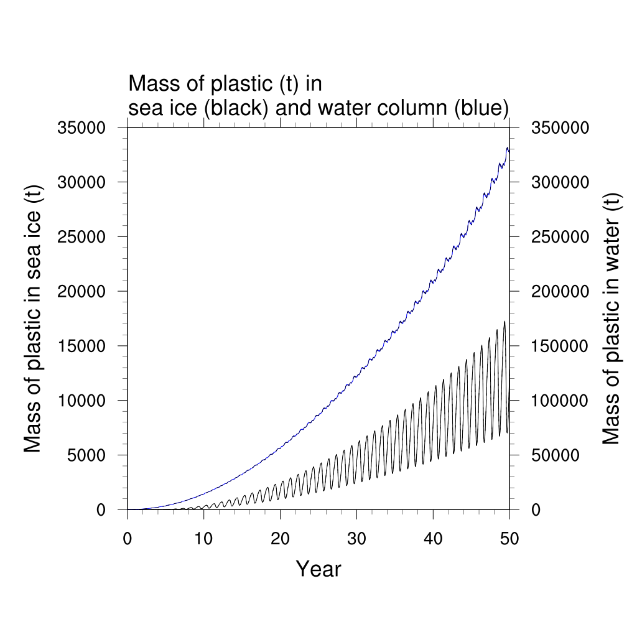
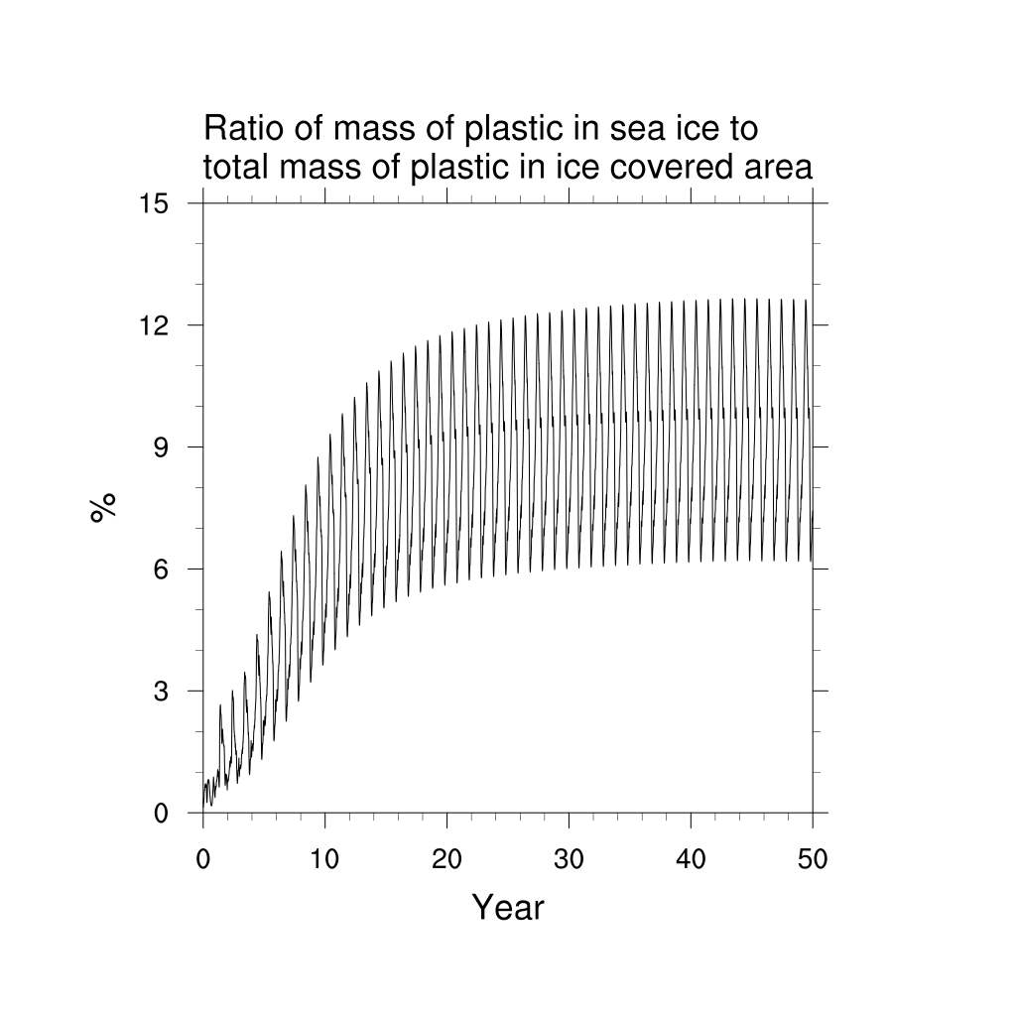
Mass of plastic in water (t)
Notes:
The left panel shows the time series of net amount of plastic in the water column north of 57N (in blue) and in Arctic sea ice (black). The latter is typically less than 5% percent of the total amount. Although, comparing sea ice plastic against the plastic content in the water column where there is sea ice, this percentage can go up to 10% or so.

Slide 9
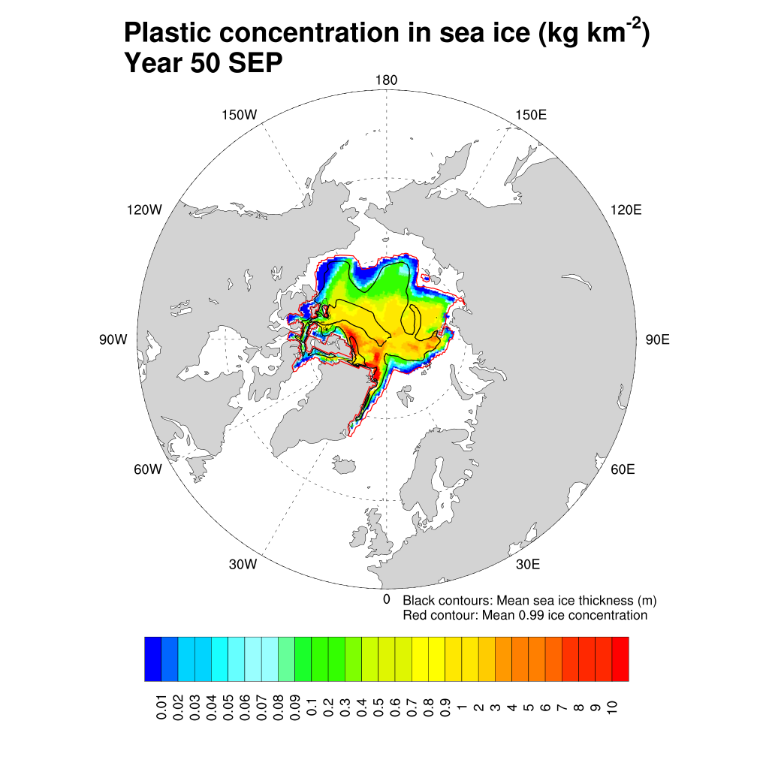
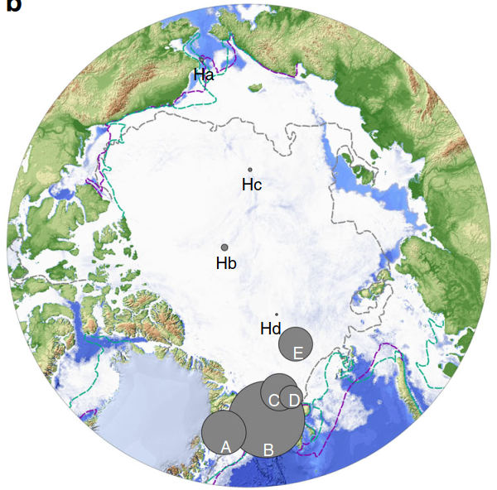
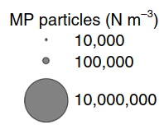
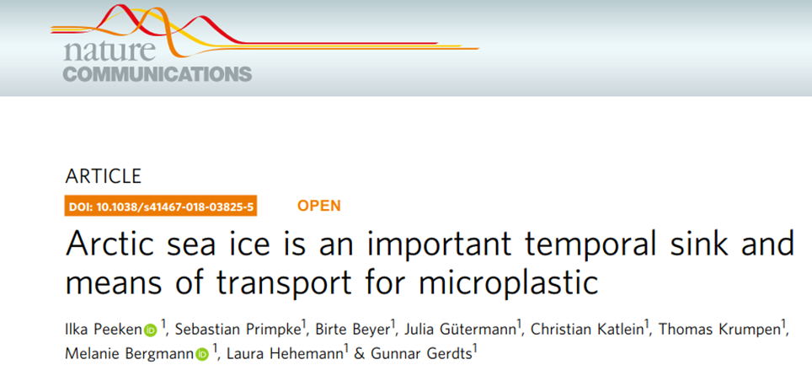
Notes:
The results are encouragingly comparable, qualitatively, with the findings of Peeken et al. (2018), with two orders of magnitude less plastic in the Canadian basin than in Fram Strait. Obviously it is not possible, nor sensible to compare absolute numbers, but a concentration of 1 kg km⁻² in our model would mean an abundance of about 250 million spheres per square kilometre.

Slide 10
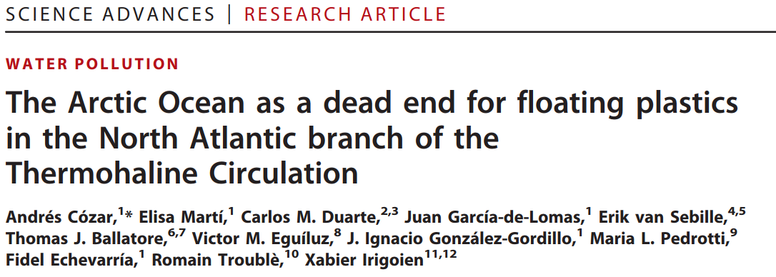
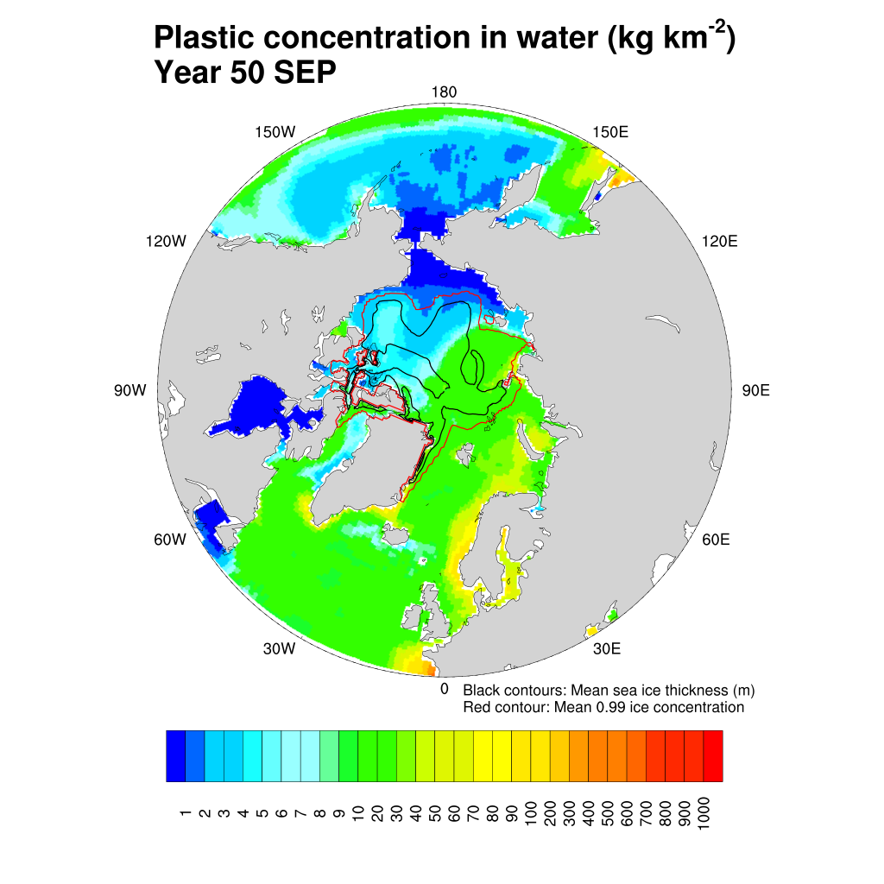
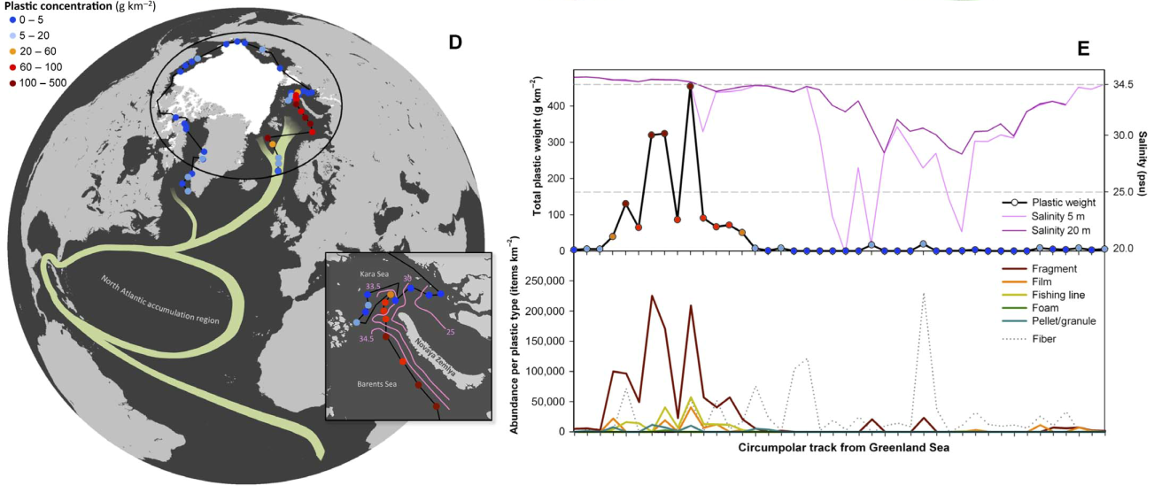
Notes:
The patterns of plastic in suspension are equally reasonable and agree well with the observation of Cozar et al. (2017) who looked at floating plastic in the Arctic based on data from the Tara Oceans expedition.

Slide 11
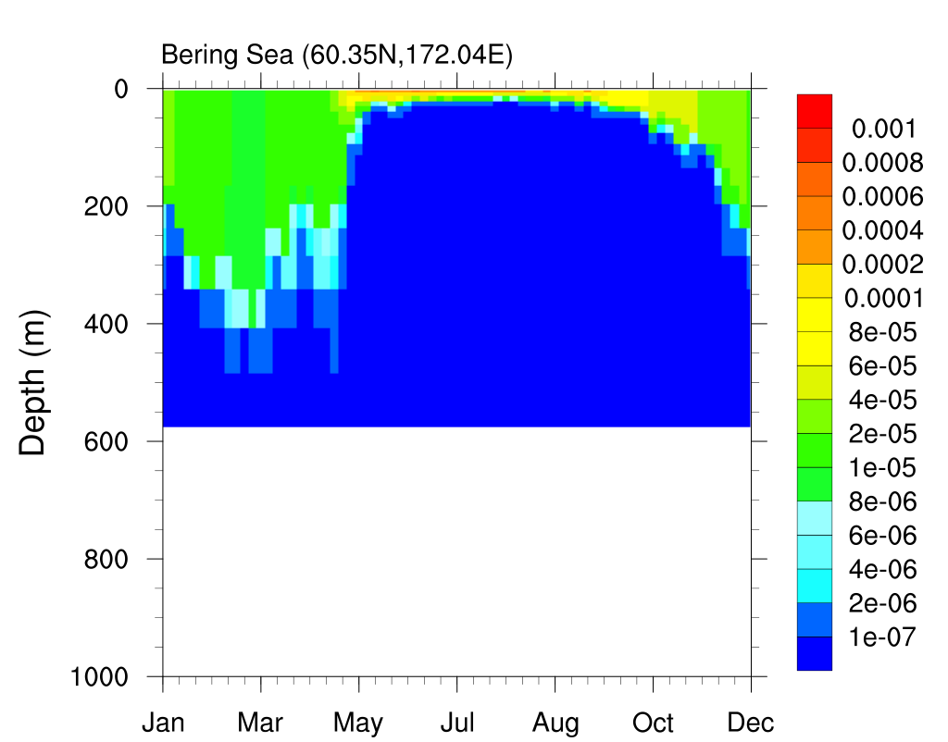
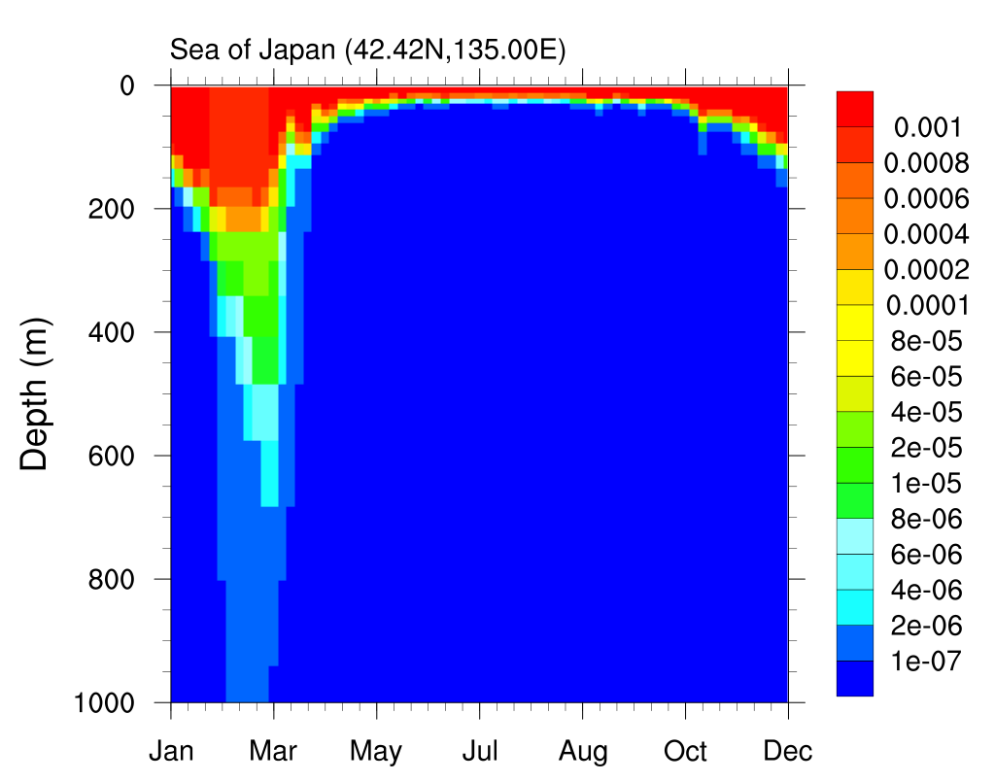
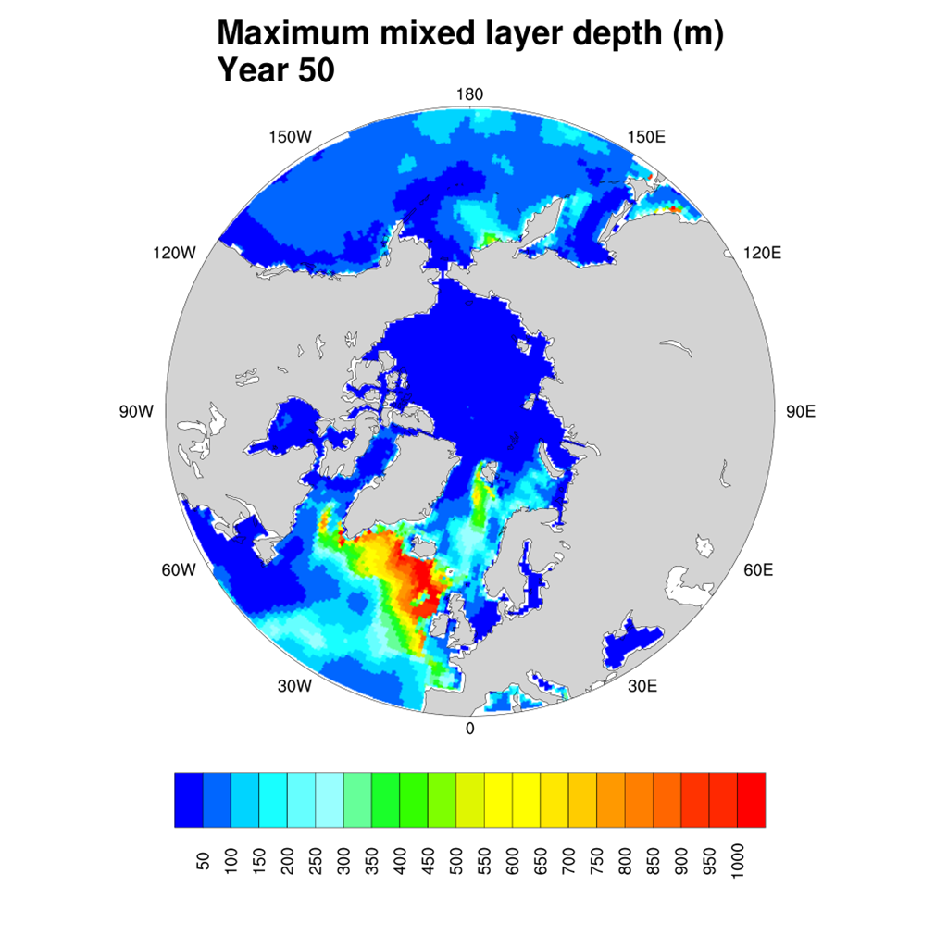
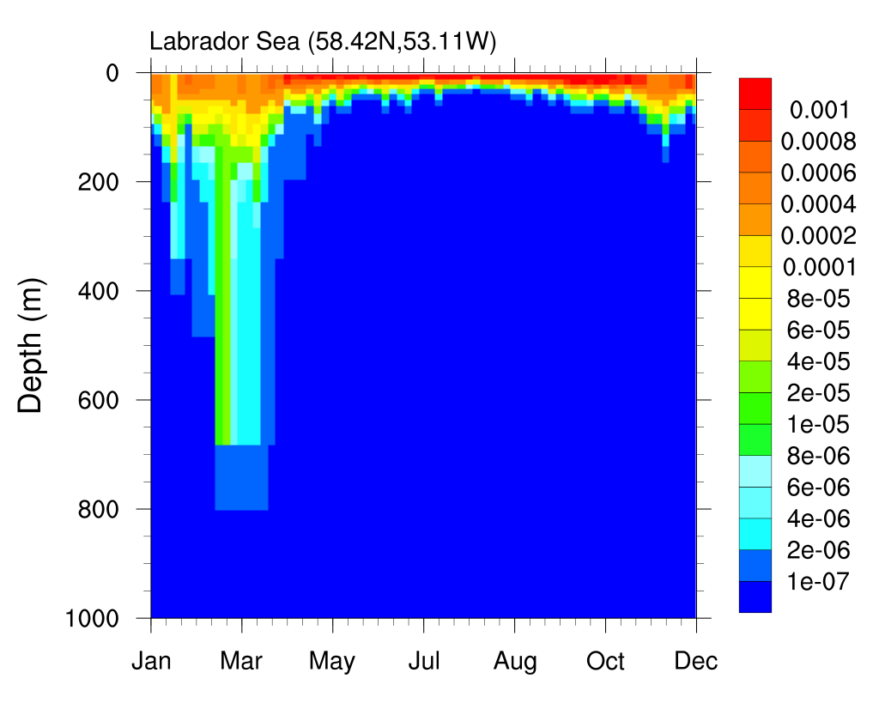
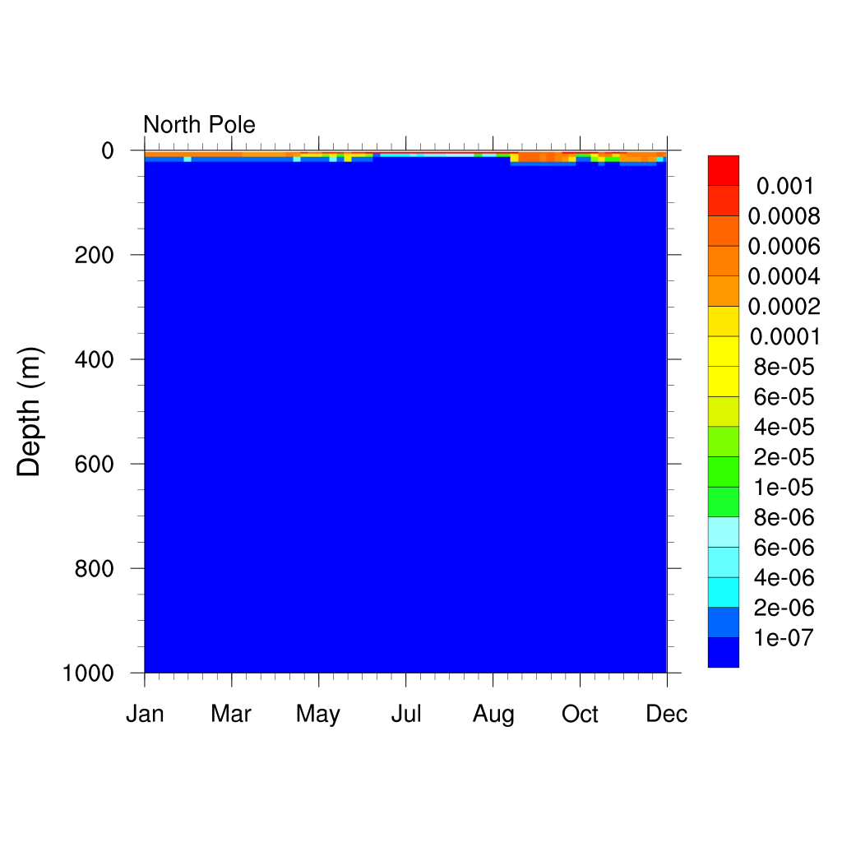
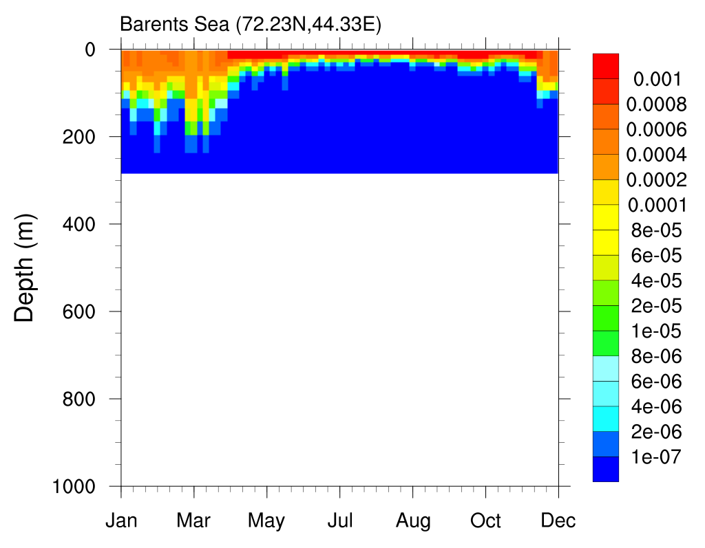

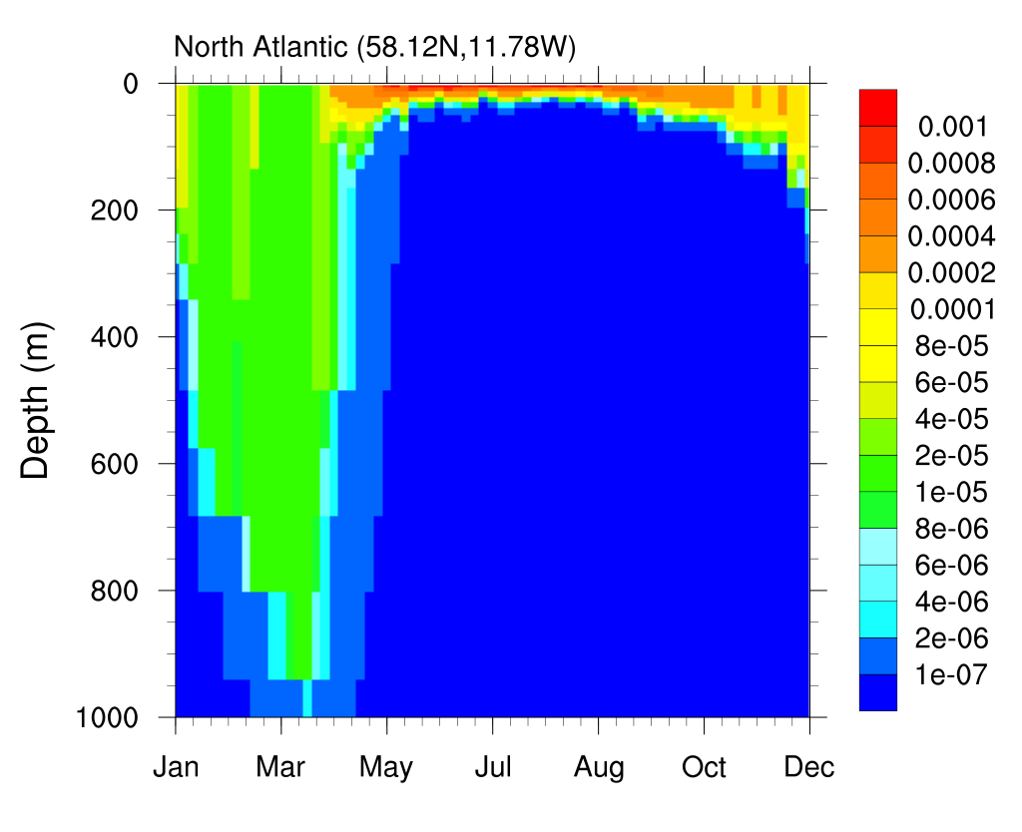
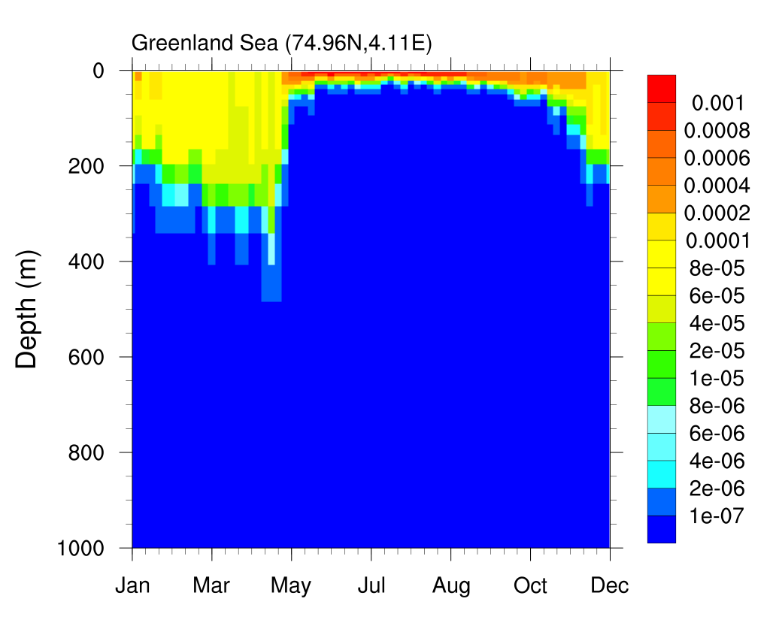
Plastic concentration (g m⁻³)
Year 50
Notes:
Finally, one of the interest of this study is that it is three-dimensional. Buoyant plastic is not just floating at the surface, but can be drawn down significantly by mixing and downwelling, specially, obviously in areas of deep winter convection. Chart of winter mixed layers. The various panels show the vertical distribution of buoyant plastic during year 50 in the corresponding areas of deep mixed layers. Contrast this with the distribution at the North Pole, which reaches only about 5 m or so below the surface.

Slide 12
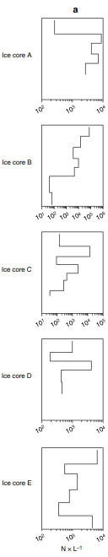
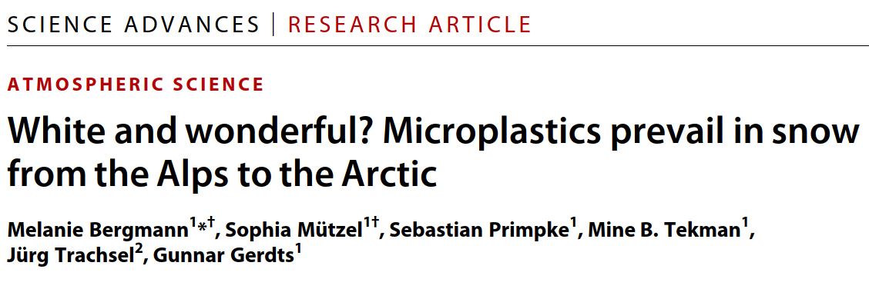
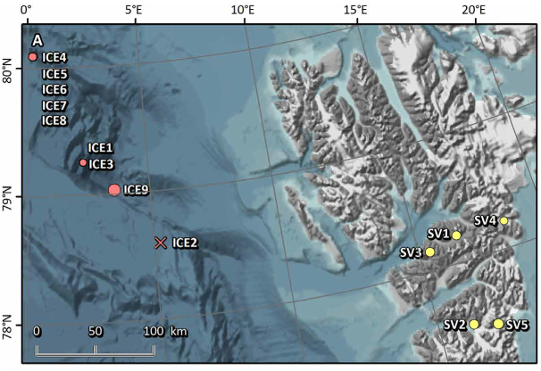
What next?
CORE atmospheric forcing: Inter-Annual Forcing Version 2.0
Snow samples from ice floes in Fram Strait.

Slide 13
Thank you

Slide 14
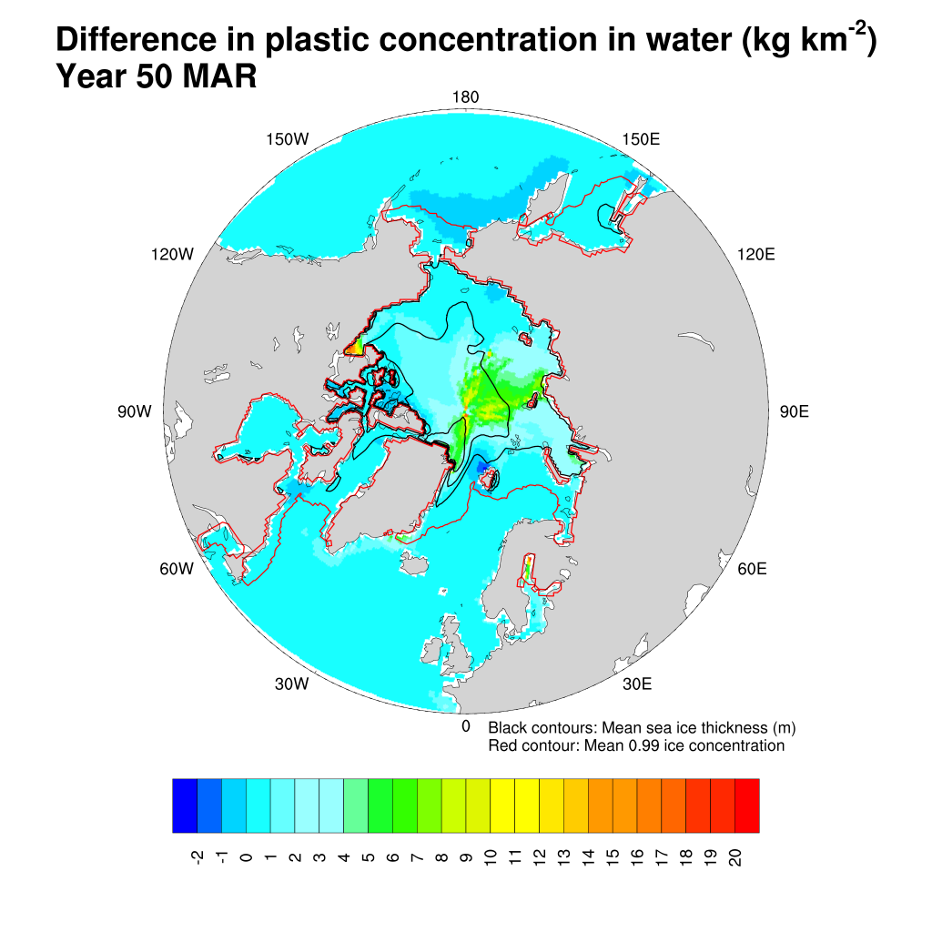
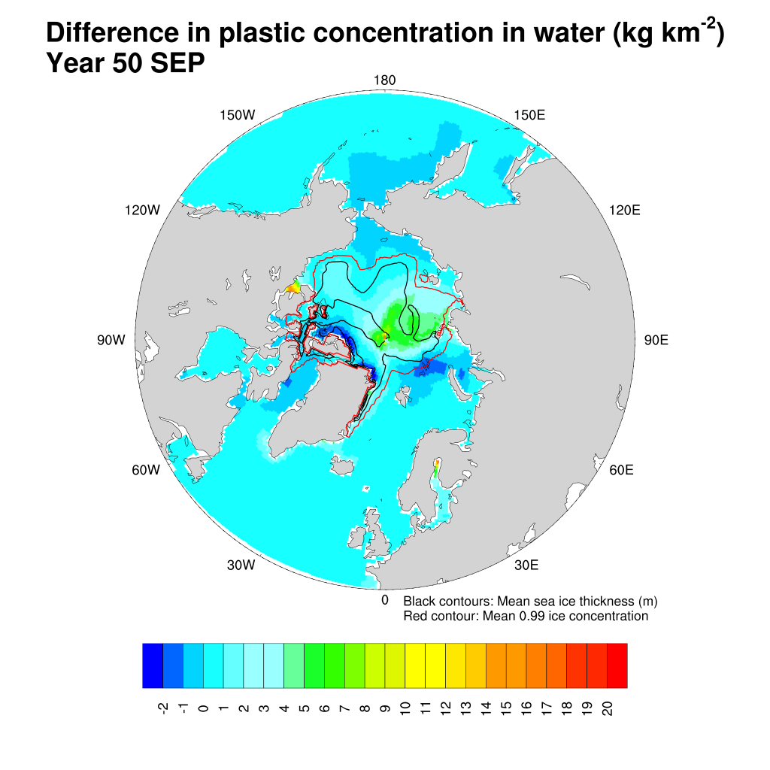
No cryoplastics simulation minus cryoplastics simulation

Slide 15
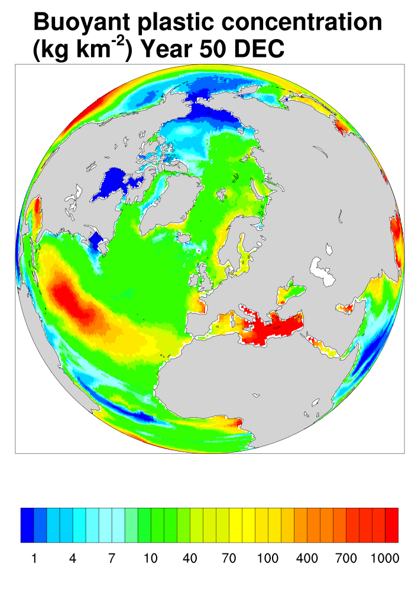
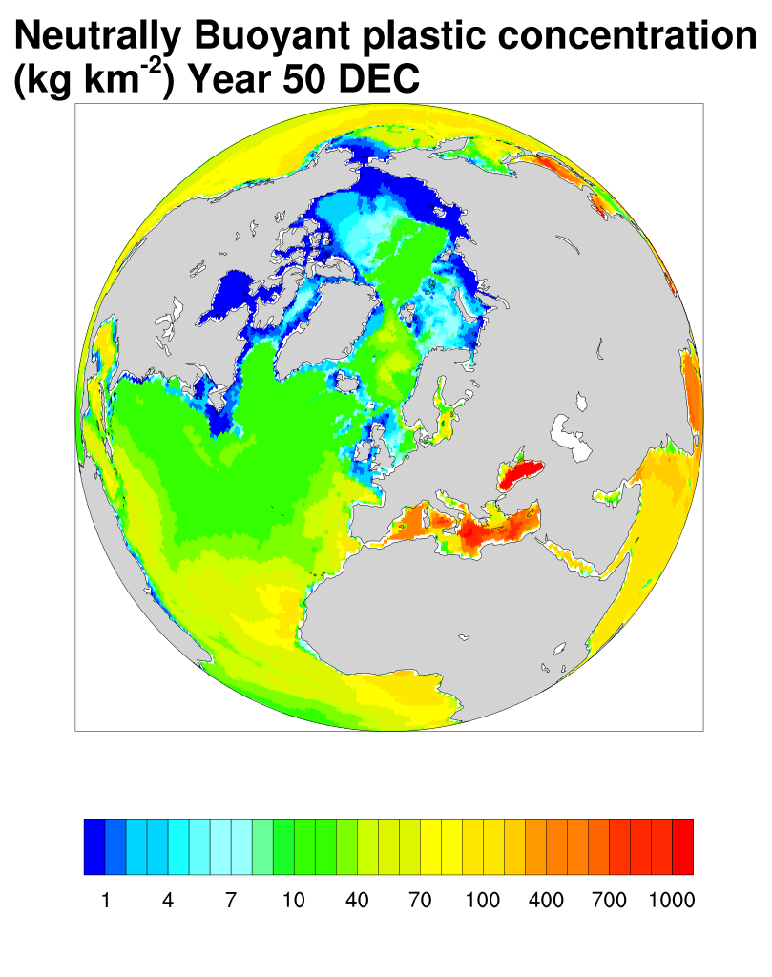
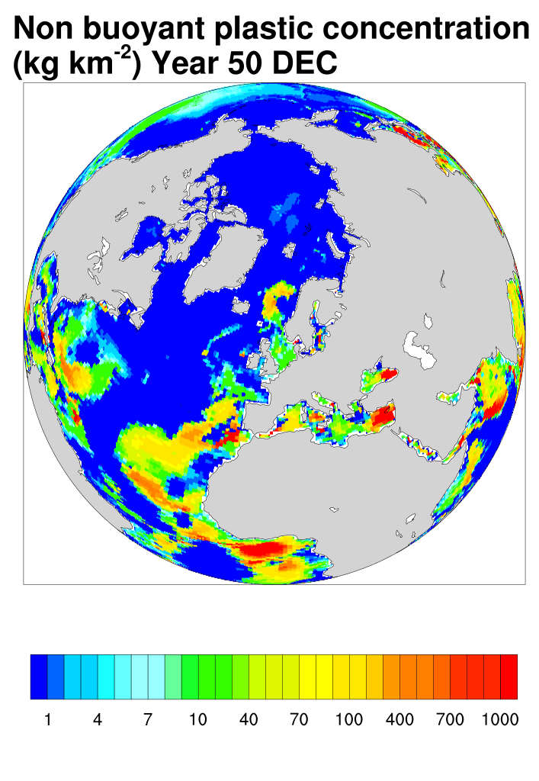

Slide 16
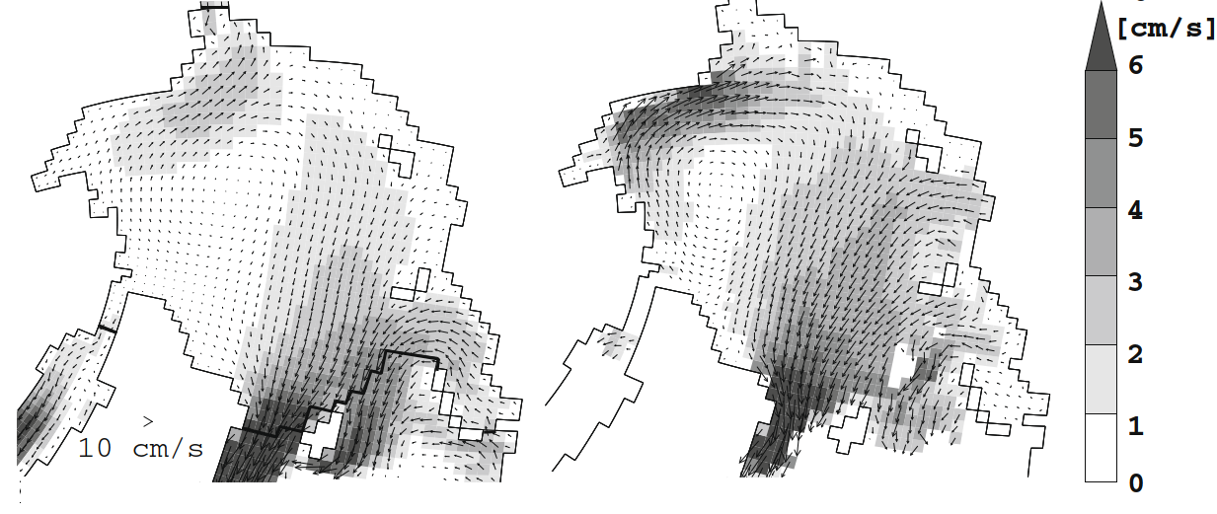
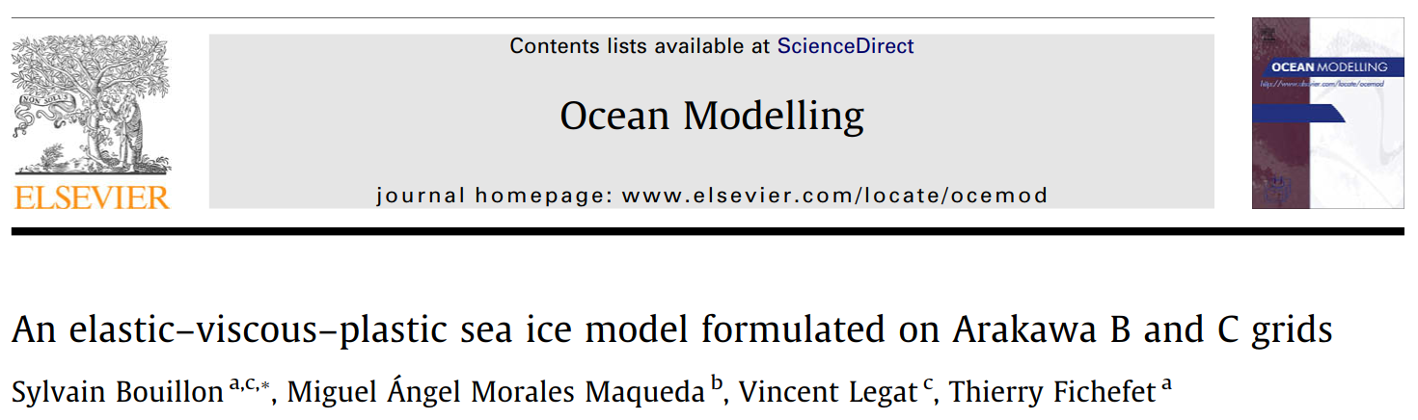
winter mean sea ice velocities (October to April) for the period 1992–2001 simulated by the model (bottom left) and from observations (bottom right). The black line in the third panel bounds the region used to calculate velocities distributions.

