Slide 1
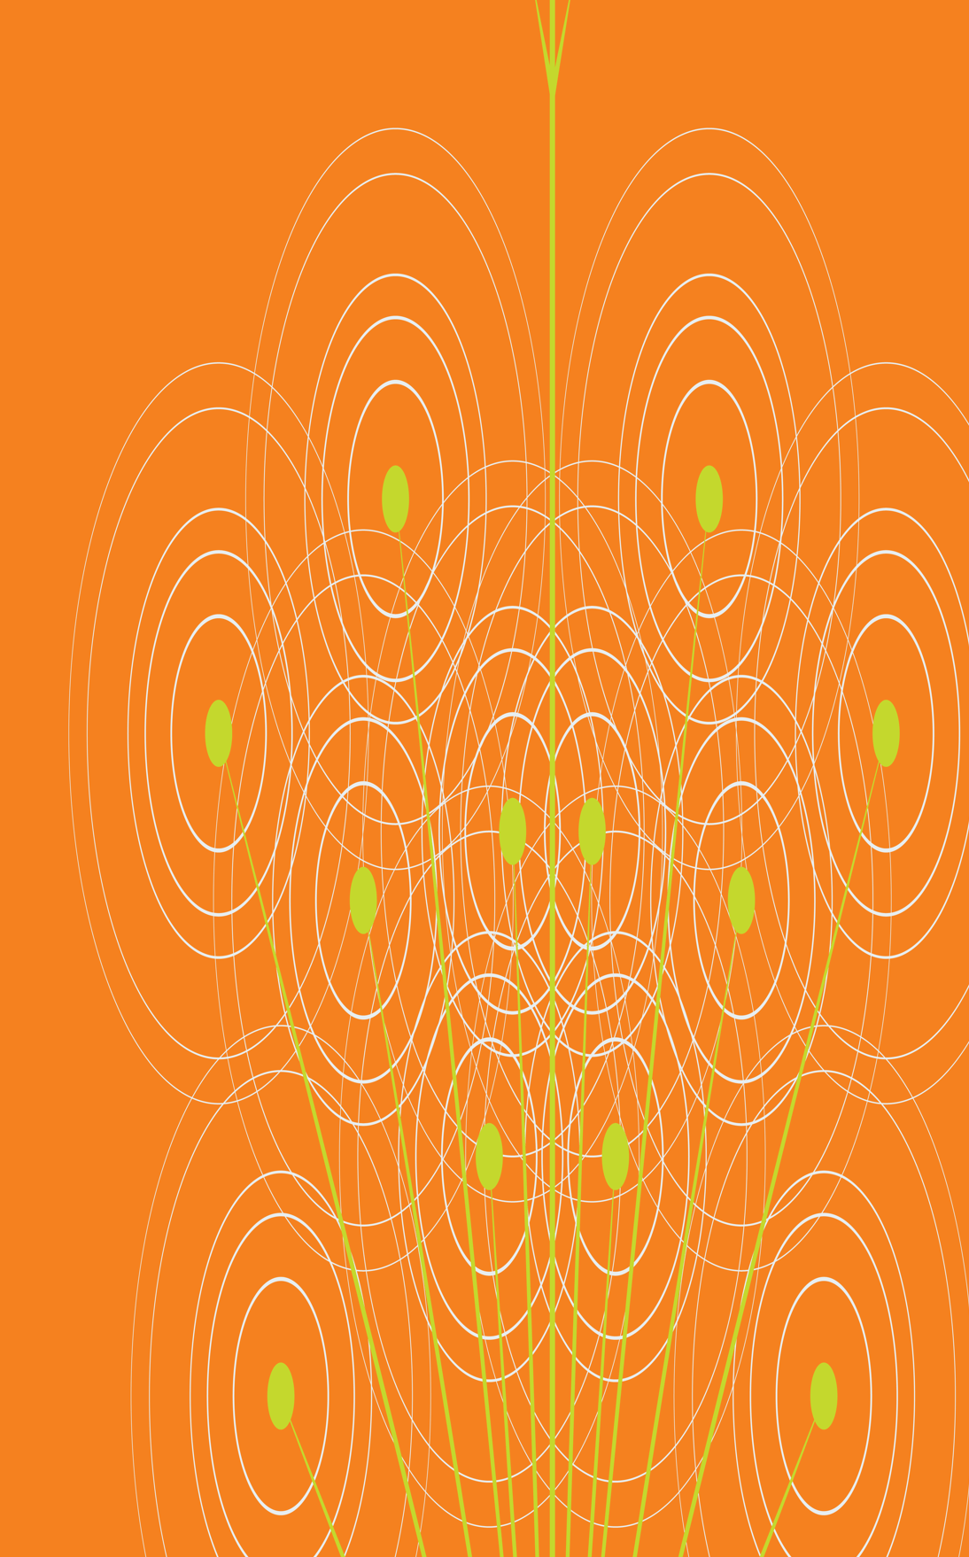
Cover image
Please select the cover image you require from the following selection:
5 x Discovery stories (SN)
5 X Transformer images (SN)
Once you have chosen the cover image move the associated Thank you page to the end of the presentation and delete all the other cover and thank you pages.
Printing
When printing the deck you can reduce ink use by selecting:
Ctrl p (print)
Change the option to greyscale
Beyond article publishing - support and opportunities for researchers in FAIR data sharing
Graham Smith & Andrew Hufton
Springer Nature
Illustration inspired by the work of Chien Shiung Wu

Slide 2
Talk data with Springer Nature at EGU 2020
As part of EGU 2020 online we are hosting an open office hour on Thursday May 7th at 11:00 CEST/ 10:00 BST: https://bit.ly/2SqldVP
Drop in to talk to us about anything in these slides or:
Publishing in data journals or articles, such as flagship data journal Scientific Data
Sharing data that support your research publications: requirements and best practice
Data curation (inc. our Research Data Support service), repositories and metadata
We are also participating in the
Virtual Data Help Desk throughout the
week (tweet #DataHelpDesk) and
look forward to hearing from you!

Slide 3
We are working to support FAIR data sharing across Springer Nature

Slide 4
Some of the ways we support FAIR data sharing in Earth Sciences
Commitments in Earth Sciences
Data journals & articles
Standardised data policies & initiatives
Support & services

Slide 5
but data sharing in scholarly publishing faces a key challenge

Slide 6
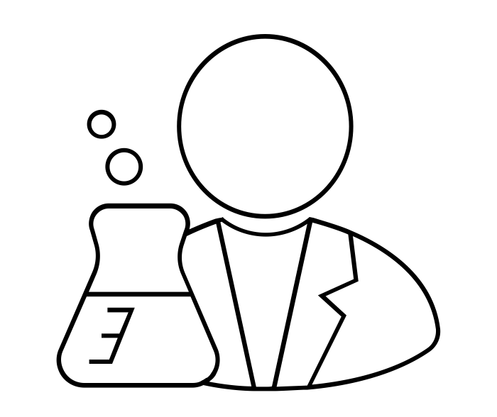
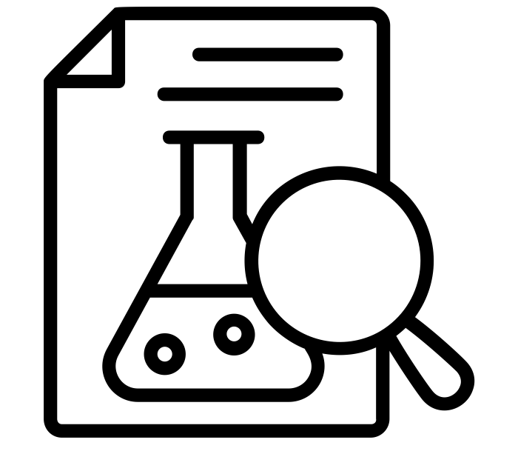
one challenge to embedding data sharing in publishing
Publishing a research article is an endpoint for a study and a means toward academic recognition, funding and further research.
credit
further funding
collaboration
Researcher
Article publication
In this context, data sharing requirements are encountered as a hurdle between the researcher and article publication.
This often results in underlying data being absent from the published work, or simply ‘available on request’.

Slide 7
data sharing is valuable in itself
We believe that research data are first class research outputs in their own right. Sharing research data is a way to drive research and collaboration as well as a credit mechanism separate to article publication.
credit
further funding
collaboration
Researcher
Data sharing
So the various challenges around sharing data also present opportunities for researchers beyond article publication.

Slide 8
sharing research data: the opportunities

Slide 9
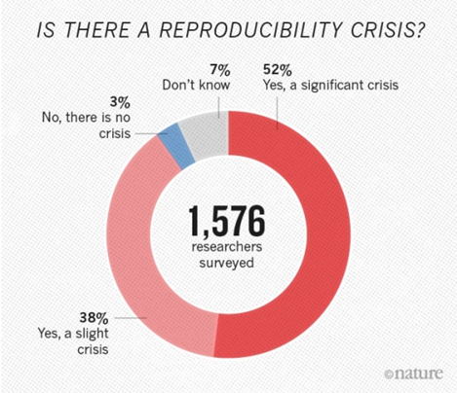
“We estimate the annual cost of not having FAIR data to a minimum of €10.2bn per year. “
Cost-benefit analysis for FAIR research data, 2018 report to the European Commission¹
Societal benefit
A Nature survey from 2015² highlights concern in the research community
>70% couldn’t reproduce the work of others
>50% couldn’t reproduce their own experiments

Slide 10
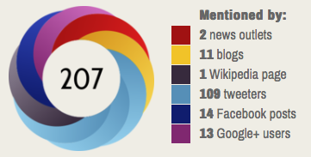
A recent study of over half a million articles found an average 25% more citations for papers with open data³
Credit mechanism
Data sharing also presents new opportunities for researchers to receive credit for their research outputs
Altmetrics present a range of interactions beyond citations alone

Slide 11
✔Funder data policies
Many major funders have data sharing requirements as a condition of ongoing funding, including UKRI councils, Wellcome, Bill & Melinda Gates Foundation
✔Journal data policies
Publishers increasingly require transparency around data availability, or data sharing, to publish in their journals.
Over 1,600 Springer Nature journals now have data policies
Policy compliance

Slide 12
how can publishers support researchers with these opportunities?

Slide 13
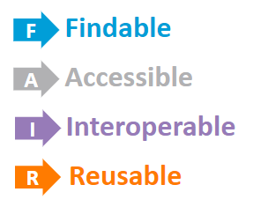
Societal benefit
Credit mechanism
Policy compliance

Slide 14
we’re putting FAIR data into practice across our journals, policies and services

Slide 15
Supporting FAIR data sharing at Springer Nature
Commitments in Earth Sciences
Data journals & articles
there are Springer Nature journals, like Scientific Data, that are glad to publish data articles from the Earth and climate sciences
Standardised data policies & initiatives
Support & services
Over 1,600 Springer Nature journals now have data policies, making data requirements easy to follow
4
5

Slide 16
and data sharing in Earth Sciences is growing at Springer Nature

Slide 17
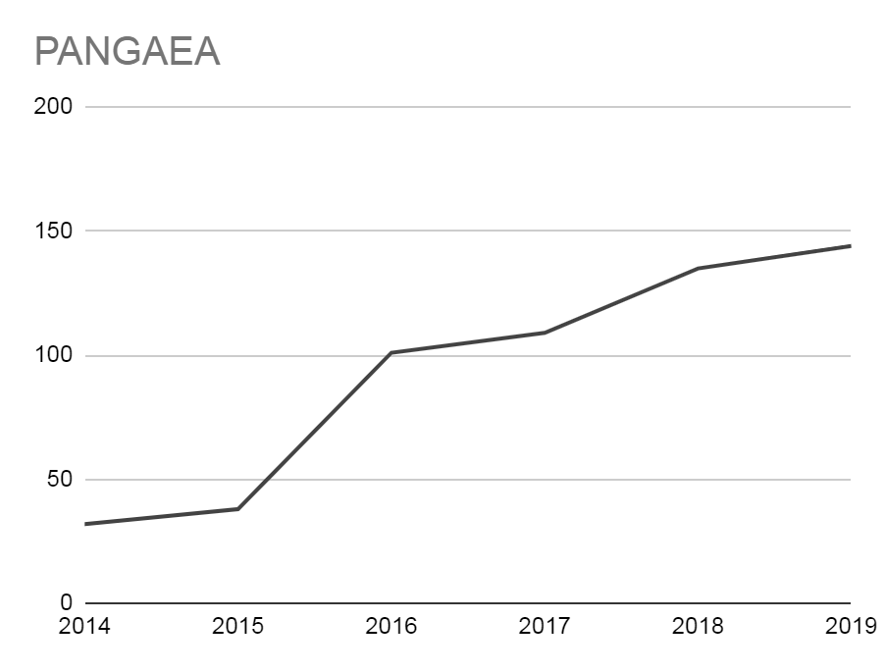
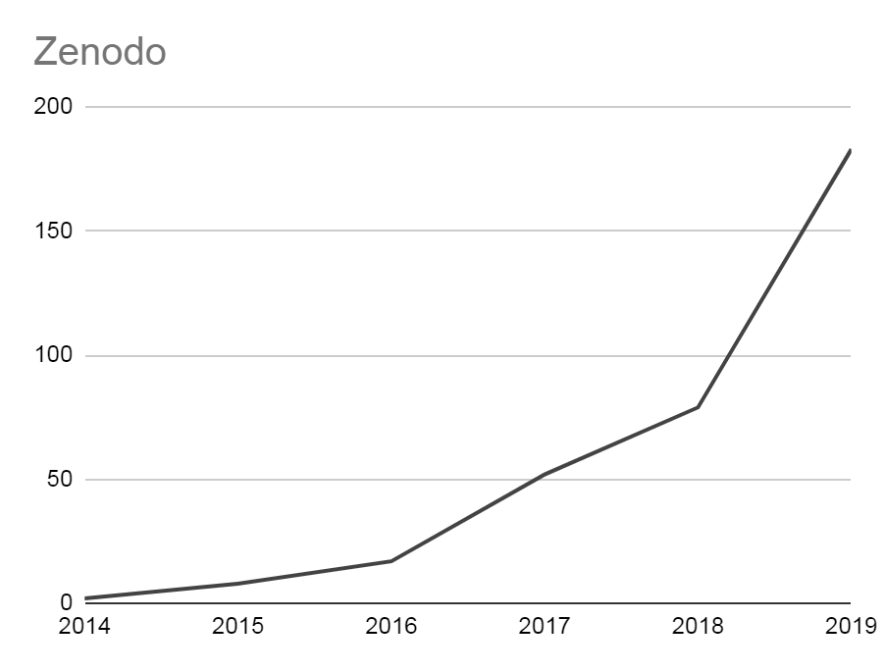
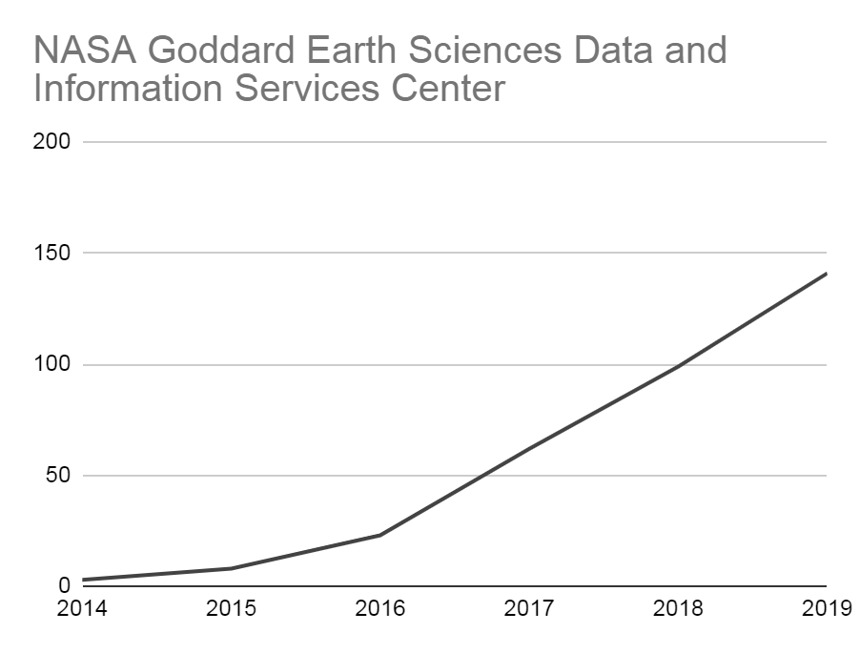
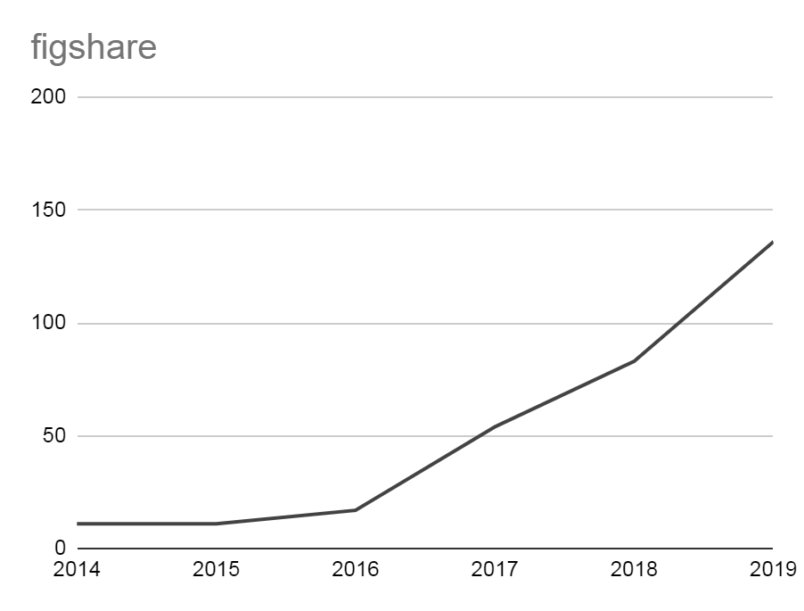
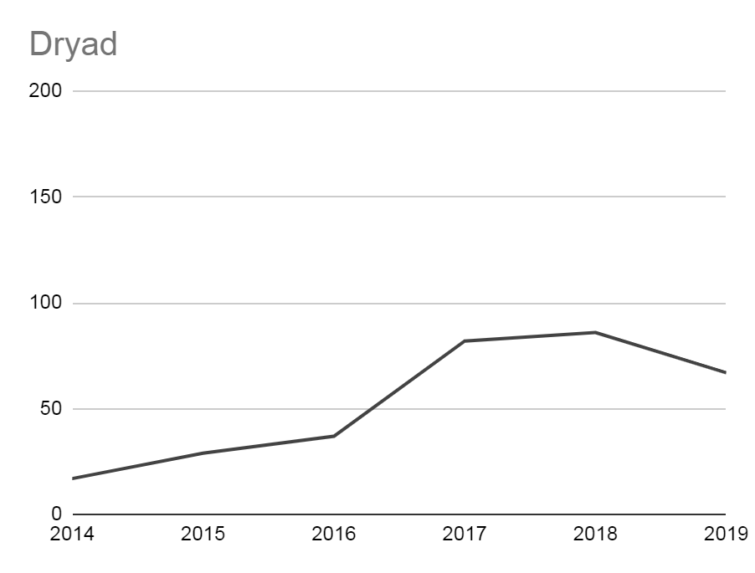
Earth Sciences articles declaring data in repositories
*
Springer Nature articles are increasingly citing and/or linking to data repositories for Earth, Environmental and Planetary Sciences
*links to generalist repositories included for these disciplines only (based on article FOR codes)
articles
*
*
articles
source: dimensions.ai

Slide 18
1. data sharing through community-led initiatives

Slide 19
Commitments to data sharing in Earth Sciences
Nature, Nature Geoscience, and Scientific Data endorse the Enabling FAIR Data initiative in the Earth, space and environmental sciences⁶.
Authors in these fields must make supporting data available to others through community repositories where available, and generalist repositories otherwise.
The project aims for:
easy discovery, recombination, reuse, and reliability testing of research data
generation of credit and recognition for researchers
increased public confidence in scientific research, and public access to digital research products

Slide 20
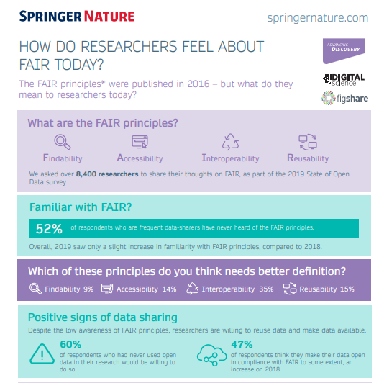
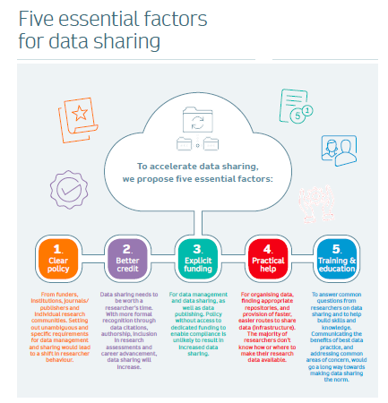
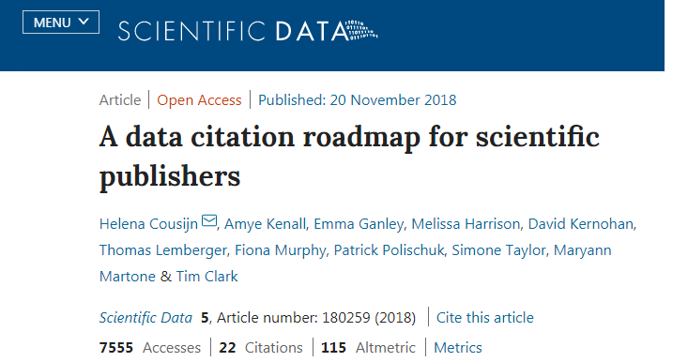
Assessing and outlining practical steps for data sharing across the scientific community

Slide 21
2. specialist data publications provide credit and best practice

Slide 22
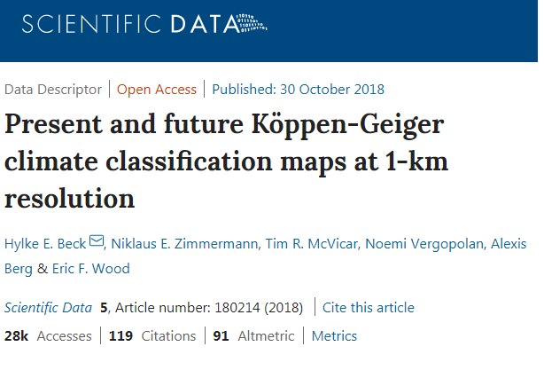
Data journals and articles: Scientific Data
A clear, peer-reviewed description of data, to maximize usage
Data are hosted in community repositories
Formal data citation robustly links the data paper to its data records
Data are previewable in-article when hosted at figshare
Explore online: https://doi.org/10.1038/sdata.2018.214

Slide 23
3. policies to standardise what’s expected from researchers

Slide 24
Standard research data policies at Springer Nature
Rolling out standard research data policies since 2016.
More than 1,600 (~65%) Springer Nature journals have one of these policies.
Approach is practical and pragmatic, enabling researchers to easily understand ‘what’, ‘where’ and ‘how’ of data sharing requirements

Slide 25
4. expert support for researchers submitting to our journals

Slide 26
Research Data Support: hands-on assistance
Check for presence of sensitive information and human identifiers and provide appropriate guidance
Researchers submit data for curation and sharing in our Springer Nature figshare repository.
Our curation team perform a series of checks and enhancements, taking on the legwork in curation and providing expert guidance.
Enhance metadata of dataset(s) to improve findability and encourage reuse
Apply DOIs to provide unique persistent links to dataset(s) and enable citation of them
Link data to their associated article(s) and coordinate publication with the article
Store data in the Springer Nature portal in the figshare repository
Notes:
Our process improves these elements, creates metadata, adds a PID, links data to articles, advises on sensitive or specialist elements - resulting in a comprehensive data record

Slide 27
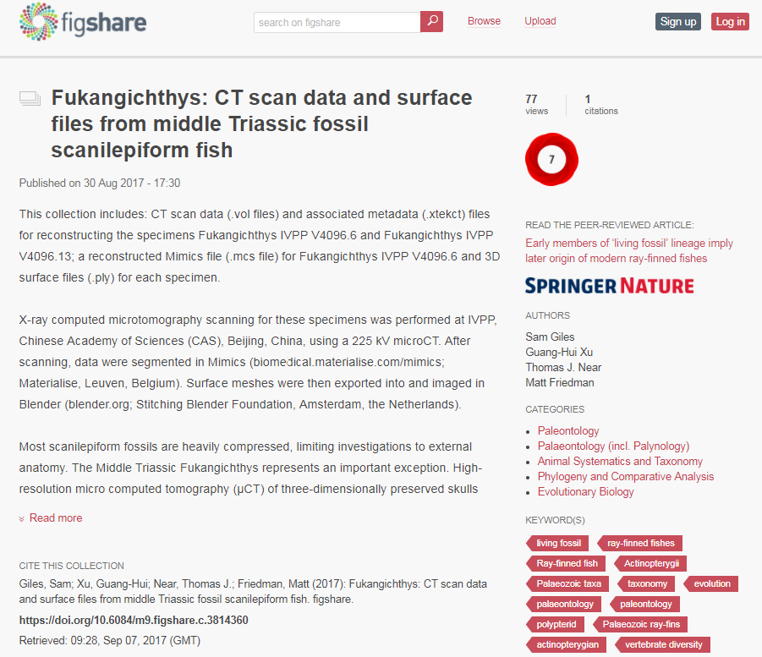
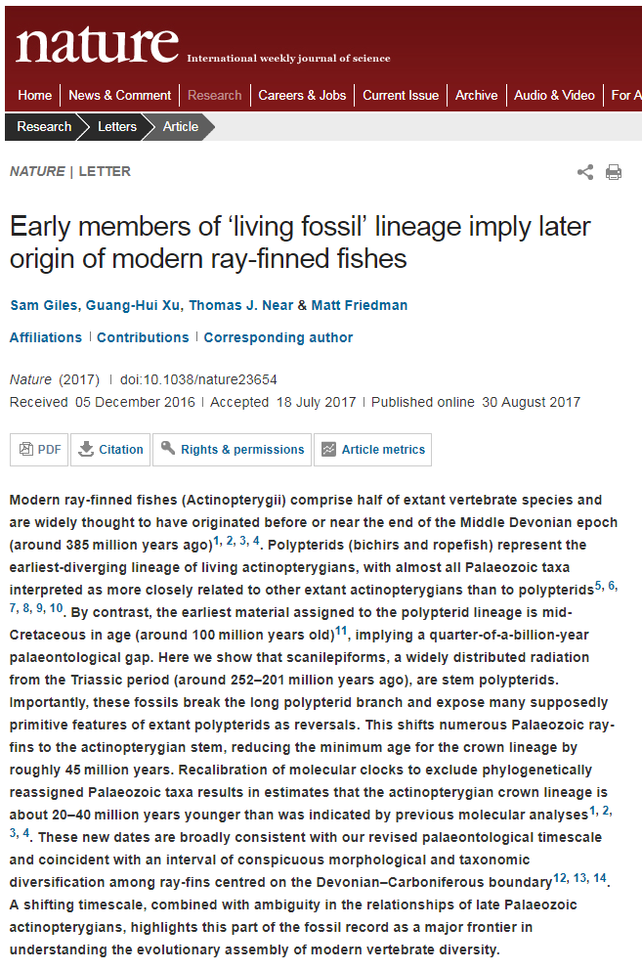
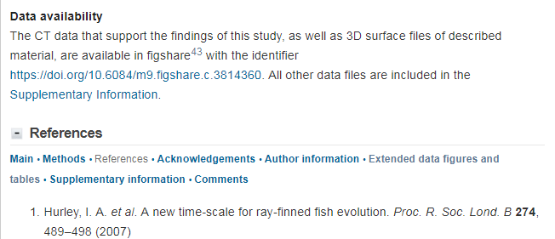
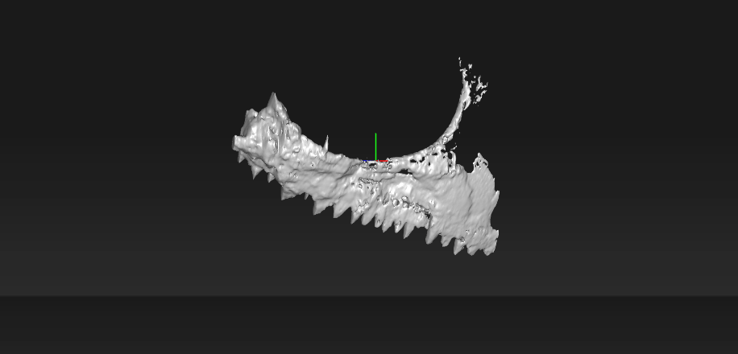
The result: data shared openly, previewable and linked to the research article
Dataset published in the Springer Nature figshare repository (https://doi.org/10.6084/m9.figshare.c.3814360)
Paper published in Nature (https://doi.org/ 10.1038/nature23654)
Data availability statement included with the paper
Notes:
Other benefits include file preview and handling large data submissions, facilitating data citation

Slide 28
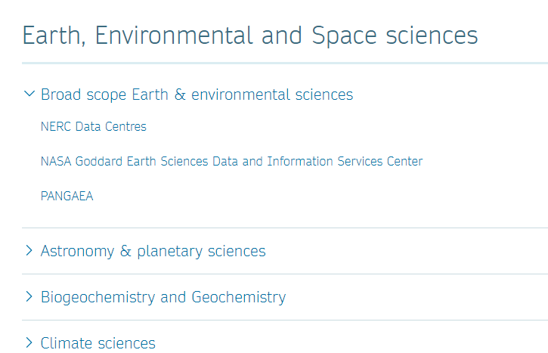
Guidance in data repositories, policies and sharing
Free Research Data Helpdesk
Queries are answered within two business days
Run by members of the Springer Nature Data Publishing team
Expertise in data curation and management, archiving and digital preservation, copyright and licensing, Open Access publishing
Always encourage best practices, e.g. the use of community repositories for specific data types

Slide 29
A FAIR-led data approach from publishers can help researchers in the Earth and environmental sciences to capitalise on new expectations around data sharing.
Reframing data as a first class research output, equal in stature to research articles, presents researchers with opportunities in generating credit, driving further research and addressing wider social and economic challenges.
References
https://doi.org/10.2777/02999
https://doi.org/10.1038/533452a
Colavizza G, Hrynaszkiewicz I, Staden I, Whitaker K, McGillivray B (2020) The citation advantage of linking publications to research data. PLoS ONE 15(4): e0230416. https://doi.org/10.1371/journal.pone.0230416
Lucraft, Mithu; Baynes, Grace; Allin, Katie; Hrynaszkiewicz, Iain; Khodiyar, Varsha (2019): Five Essential Factors for Data Sharing. figshare. Journal contribution. https://doi.org/10.6084/m9.figshare.7807949.v2
Cousijn, H., Kenall, A., Ganley, E. et al. A data citation roadmap for scientific publishers. Sci Data 5, 180259 (2018). https://doi.org/10.1038/sdata.2018.259
https://copdess.org/enabling-fair-data-project/commitment-statement-in-the-earth-space-and-environmental-sciences/

Slide 30
Thank you
Thank you page
Make sure you have the thank you page associated with the cover image you have chosen and move this slide to the end of your presentation
Updating the footer
To update the footer:
Go the slide master via View
Scroll to the first page
Change text in the footer
Close slide master
Scientific Data: http://www.nature.com/sdata/
Research Data Support: https://www.springernature.com/gp/authors/research-data/research-data-support
Recommended repositories: http://www.springernature.com/gp/group/data-policy/repositories
Graham Smith
graham.smith@springernature.com
Andrew Hufton
andrew.hufton@nature.com
Graphic credits:
Scientist by parkjisun
experimental research by ProSymbols
data from Priyanka
all from the Noun Project

