Slide 1
USING GAMMA-RAY AND X-RAY COMPUTED TOMOGRAPHY FOR POROSITY QUANTIFICATION OF RESERVOIR ANALOGUE ROCKS
#shareEGU20
ABRAÃO NOVA, FREDERICO RIBEIRO, PAMALLA OLIVEIRA, DANIEL AMANCIO, CÁSSIA MACHADO, ALEXANDRA CAROLINA, MARCIO PAIXÃO, ANTONIO ANTONINO, ENIVALDO BARBOSA, ANTONIO BARBOSA, MARIA LOURENÇO, MARCOS RODRIGUES, AND RICHARD HECK

Slide 2
1
Introduction
X-ray micro-computed tomography (µCT)
Characterization of rock properties
High-resolution 3D digital images.
Porous systems in reservoir rocks.
#shareEGU20

Slide 3
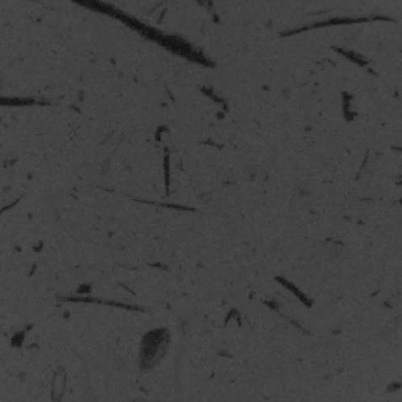
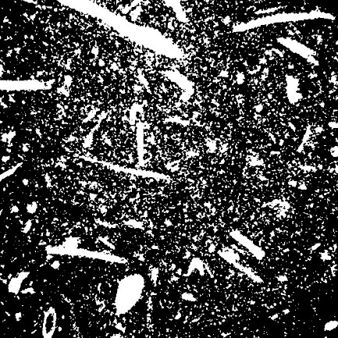
1
Introduction
The challenge:
Reliable quantification of porosity in rocks which present pore sizes ranging from centimeter to nanometer scale;
Intrinsic limits of the x-ray imaging method.
a) Imagem em HU
b) Huang
c) IsoData
d) Li
e) Moments
e) Otsu
e) PVE
#shareEGU20
#shareEGU20

Slide 4
1
Introduction
Problems that are related to the physical aspects of the µCT imagem Method:
Image artifacts;
Bam hardening effect.
Ring Artifact
Beam hardening effect
#shareEGU20
#shareEGU20

Slide 5
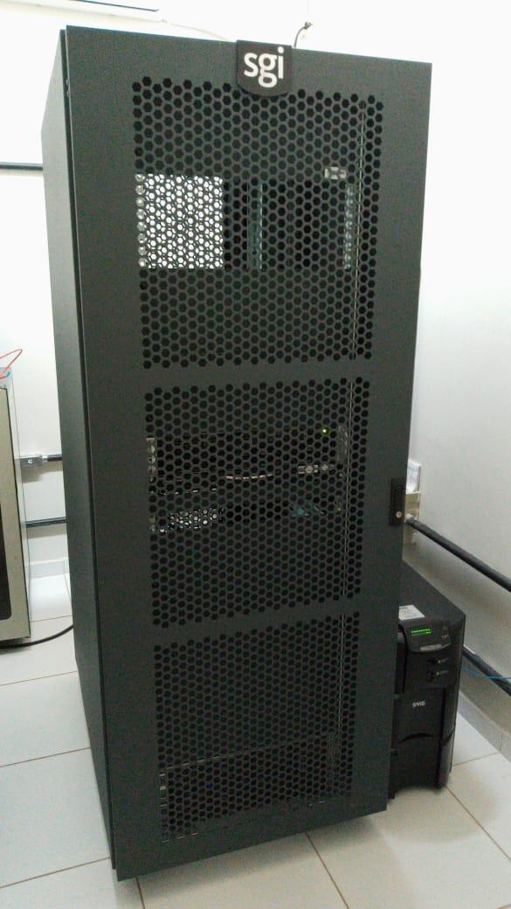
1
Introduction
The computational costs of processing for large image volumes, necessary for the reliable definition of some petrophysical characteristics of rock samples, like porosity and permeability.
#shareEGU20

Slide 6
2
Objective
A method is presented for quantification of porosity, based in data from gamma ray tomography. The objective was to create a protocol for core samples scanning in a gamma tomograph, in order to perform porosity calculation with reliable results within the minimum operational time.
The study was carried out in in sandstones and limestones samples (bioclastic mudstones and wackstones)
The results obtained was compared with the porosity quantification results produced with the application of traditional segmentation methods in µCT images of the same samples. Also, the results of gamma tomography and µCT images analyses were compared with porosity data obtained with a porosimeter for the same samples.
The traditional hard-data obtained with the porosimeter was used as a reference to compare with the other two sets of results.
#shareEGU20

Slide 7
3
Materials and Methods
These analyses were performed in core samples of limestones and sandstones analogous of Brazilian oil reservoirs.
Samples dimension
Sandstone cores from Botucatu Fm
Sample | Diametre (cm) | Length (cm)
B1 | 2.54 | 4.44
B2 | 2.54 | 4.19
C1 | 2.54 | 3.68
C2 | 2.54 | 4.04
Bioclastic limestones
(wacstones and packstones)
from Jandaira Fm
#shareEGU20

Slide 8
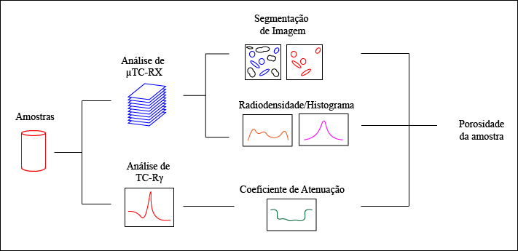
3
Materials and Methods
Image Segmentation
XR-µCT
Imaging
Radiodensity/Histogram evaluation
Core
Porosity
Rγ-CT
scaning
Attenuation Coefficient
Basic Workflow for Evaluation of Samples
#shareEGU20

Slide 9
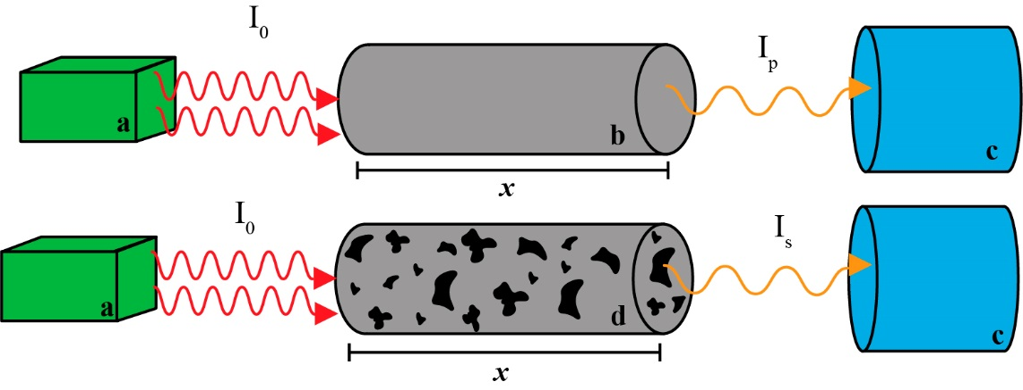
3
Materials and Methods
Gamma Ray attenuation method
Experimental procedure for determining porosity with the Gamma Ray attenuation method
(a) Radioactive source;
(b) Reference sample without pores;
(c) Detector;
(d) Porous rock sample.
#shareEGU20

Slide 10
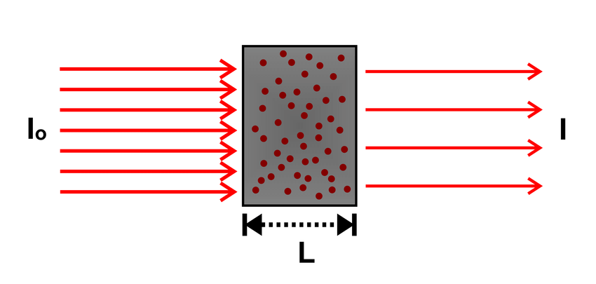
2
Materials and Methods
$$μ={μ }_{m}ρ$$
Mineral
Density
Data
Linear
Attenuation
Coefficient
of Minerals
NIST XCOM
Data
Porosity
$$φ(\%)=\frac{μ_{p}−μ_{s}}{μ_{p}}100$$
Linear
Attenuation coefficient of the Samples
γ-Ray CT
Sample
Thickness
$$I=I_{0}e^{−μL}$$
$$μ= \frac{1}{L}\ln{\frac{I_{o}}{I}}$$
#shareEGU20

Slide 11
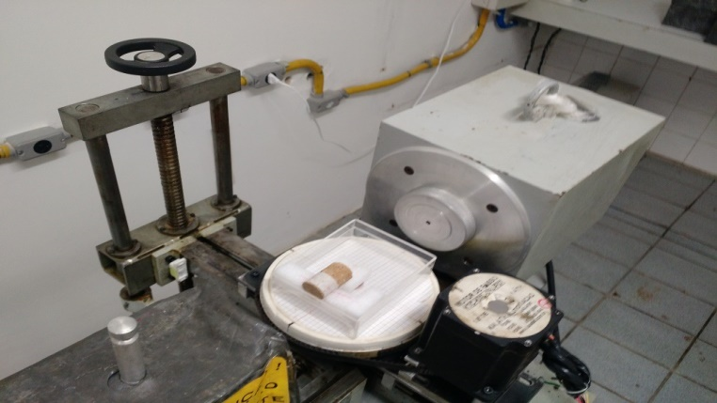
2
Materials and Methods
Gamma-Ray CT
Detector
Shielding and
collimator
Scan direction
Gamma radiation beam
Rock
Sample
Radiation Source: ¹³⁷Cs (662 keV);
Half-life: 30,1 years;
Radioactive activity: 3.70x10⁹ Bq;
NaI(Tl) Scintillation Crystal Detector
Lead collimator with circular hole 5.5 mm in diameter and length 73 mm.
Radiation Source
Shielding and
collimator
#shareEGU20

Slide 12
3
Materials and Methods
Axial view
Axial view
90º
135º
45º
0º
16 points in each plane
Distant by 1 mm
#shareEGU20

Slide 13
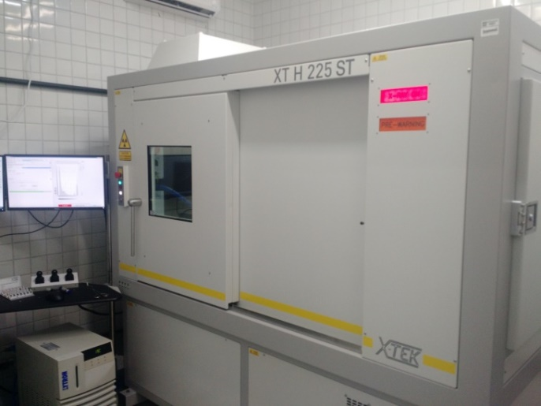
3
Materials and Methods
X-Ray CT
X-RAY µCT Scan Parameter
Scan Parameter | Value
Electric current (µA) | 70 µA
Maximal tension (kV) | 150 kV
Aluminum Filter | 0.25 mm
Voxel Resolution | 30 µm
Integration time | 500 ms
Grayscale image
#shareEGU20

Slide 14
3
Materials and Methods
X-RAY µCT image
Croped ROI
Binary image
PVE segmentation
Sample | Threshold
B1 | 1325
B2 | 1325
C1 | 2630
C2 | 2630
#shareEGU20

Slide 15
4
Results and Discussion
Sample | Porosity (%)
 | γR-CT | XR-µCT | He
B1 | 28.51 | 20.36 | 26.52
B2 | 27.83 | 20.13 | 24.15
C1 | 40.79 | 33.70 | 33.73
C2 | 40.79 | 32.15 | 35.80
B
C
#shareEGU20

Slide 16
4
Results and Discussion
Time required in each methodology
It Is an experimental approach
γR-CT | XR-µCT | He
30 min | 2-3 hour | 5 min
Scan time around 25 min
Volume reconstruction around 15 min
Image segmentation and porosity arond 60-120 min
What is important in this new approach is to test the possibility
of obtaining activated pore measurements, in less time and cost,
than in the extreme two methods
#shareEGU20

Slide 17
4
Conclusion
The results suggest that Industrial application of γ-ray CT for precise evaluation of large number of core samples can be highly effective. The method allows the porosity quantification of a larger number of cores, with less operational and computational costs.
Furthermore, the γ-ray data can be integrated with data provided by conventional X-ray µCT image processing to complement information regarding morphological aspects. This can be done for a fewer number of cores, due the higher complexity of this process and costs in terms of time and computation.
#shareEGU20

Slide 18
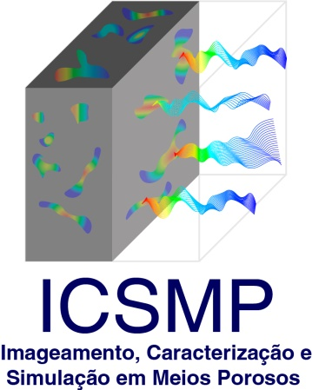
6
Acknowledgment
#shareEGU20

Slide 19
Thank you!
#shareEGU20
Abraão Alves Vila Nova
Department of Nuclear Energy - Federal University of Pernambuco – Brazil
abe.alves2@gmail.com

Slide 20
Using Gamma-Ray and X-Ray Computed Tomography for Porosity Quantification of Reservoir Analogue Rocks
#shareEGU20
Abraão Nova, Frederico Ribeiro, Pamalla Oliveira, Daniel Amancio, Cássia Machado, Alexandra Carolina, Marcio Paixão, Antonio Antonino, Enivaldo Barbosa, Antônio Barbosa, Maria Lourenço, Marcos Rodrigues, and Richard Heck

