Slide 1
Neanderthal extinction: the role of abrupt climate change, resource competition and interbreeding
Axel Timmermann, IBS Center for Climate Physics, South Korea

Slide 2
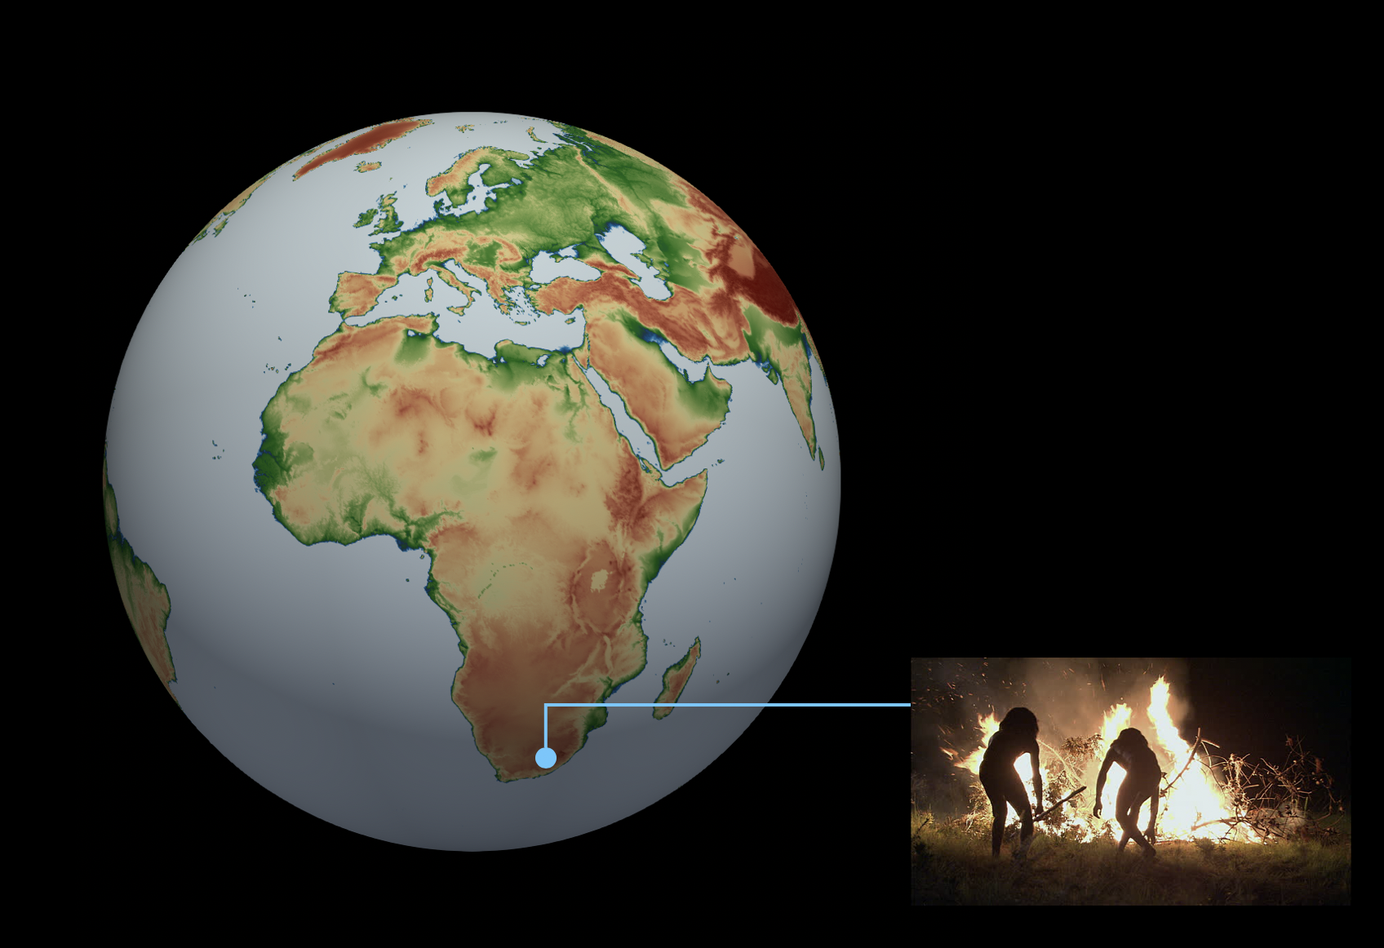
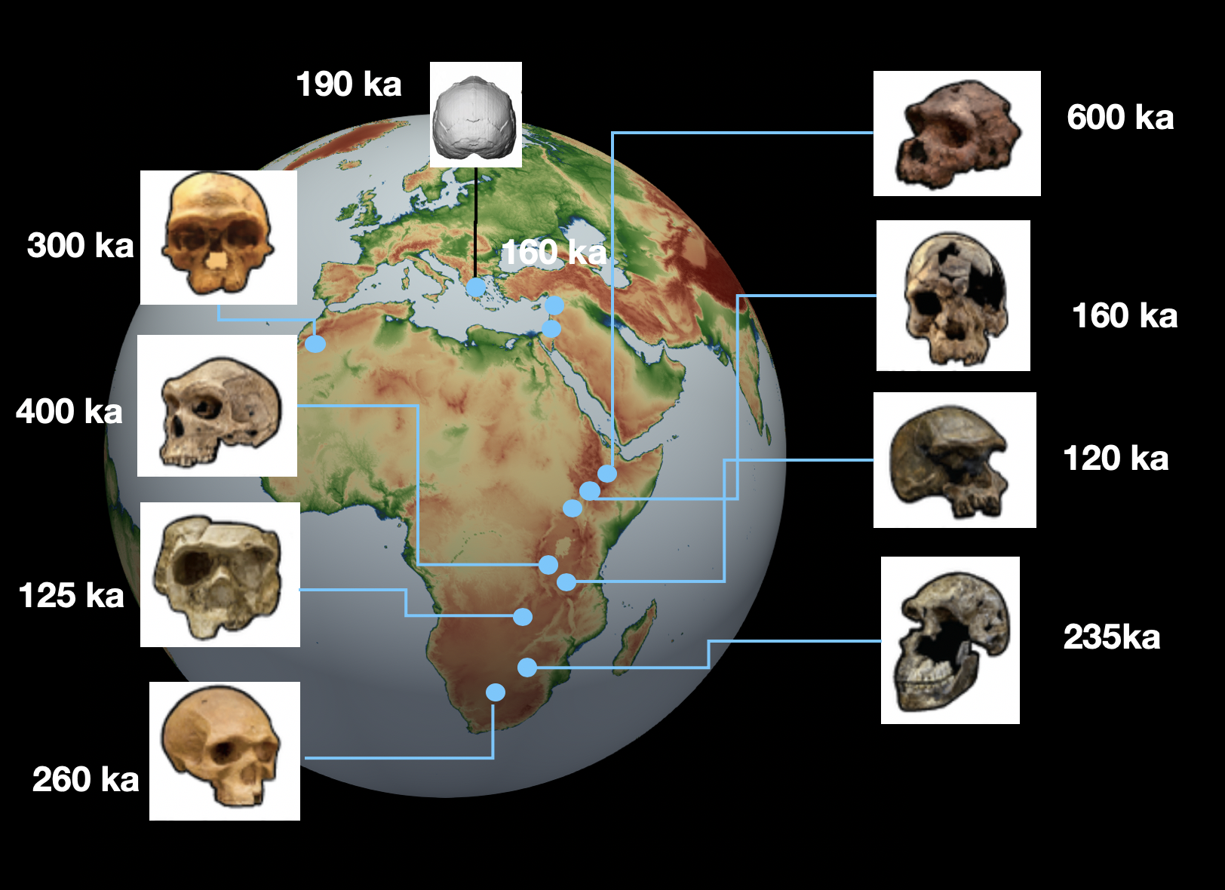
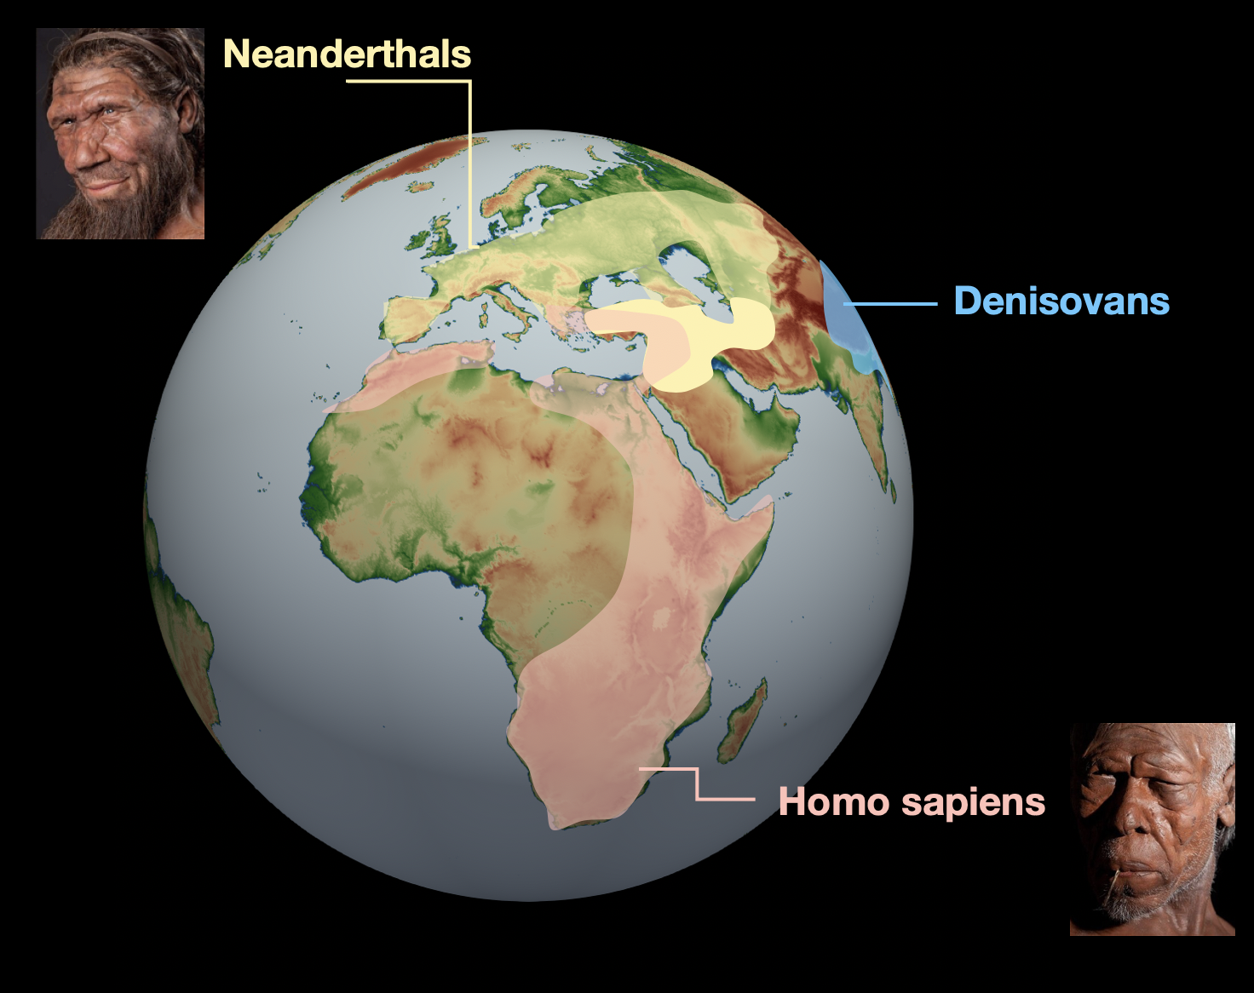
Once upon a time….

Slide 3
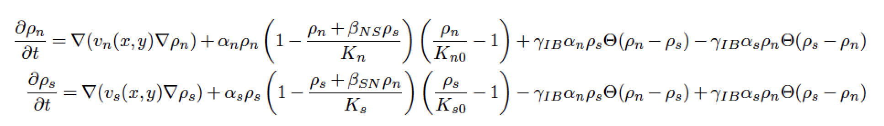





A Numerical model of Hominin interactions and dispersal
Hominin Dispersal Model 2
Parameter constraints
Parameter | Constraints
v _{s} | Hunter and gatherer populations
α_{s} | Demographic estimates and habitat
K_{s} | Global population estimates
γ_{iB} | Genetic data
K_{so} | Population dynamics
Model code available on: https://climatedata.ibs.re.kr/data/papers/timmermann-2020-qsr
Timmermann, QSR accepted (2020)

Slide 4
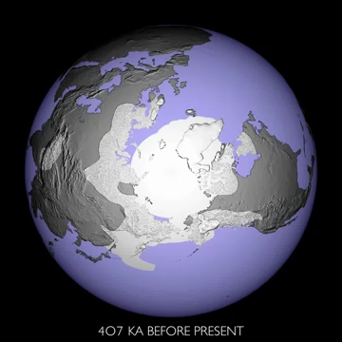
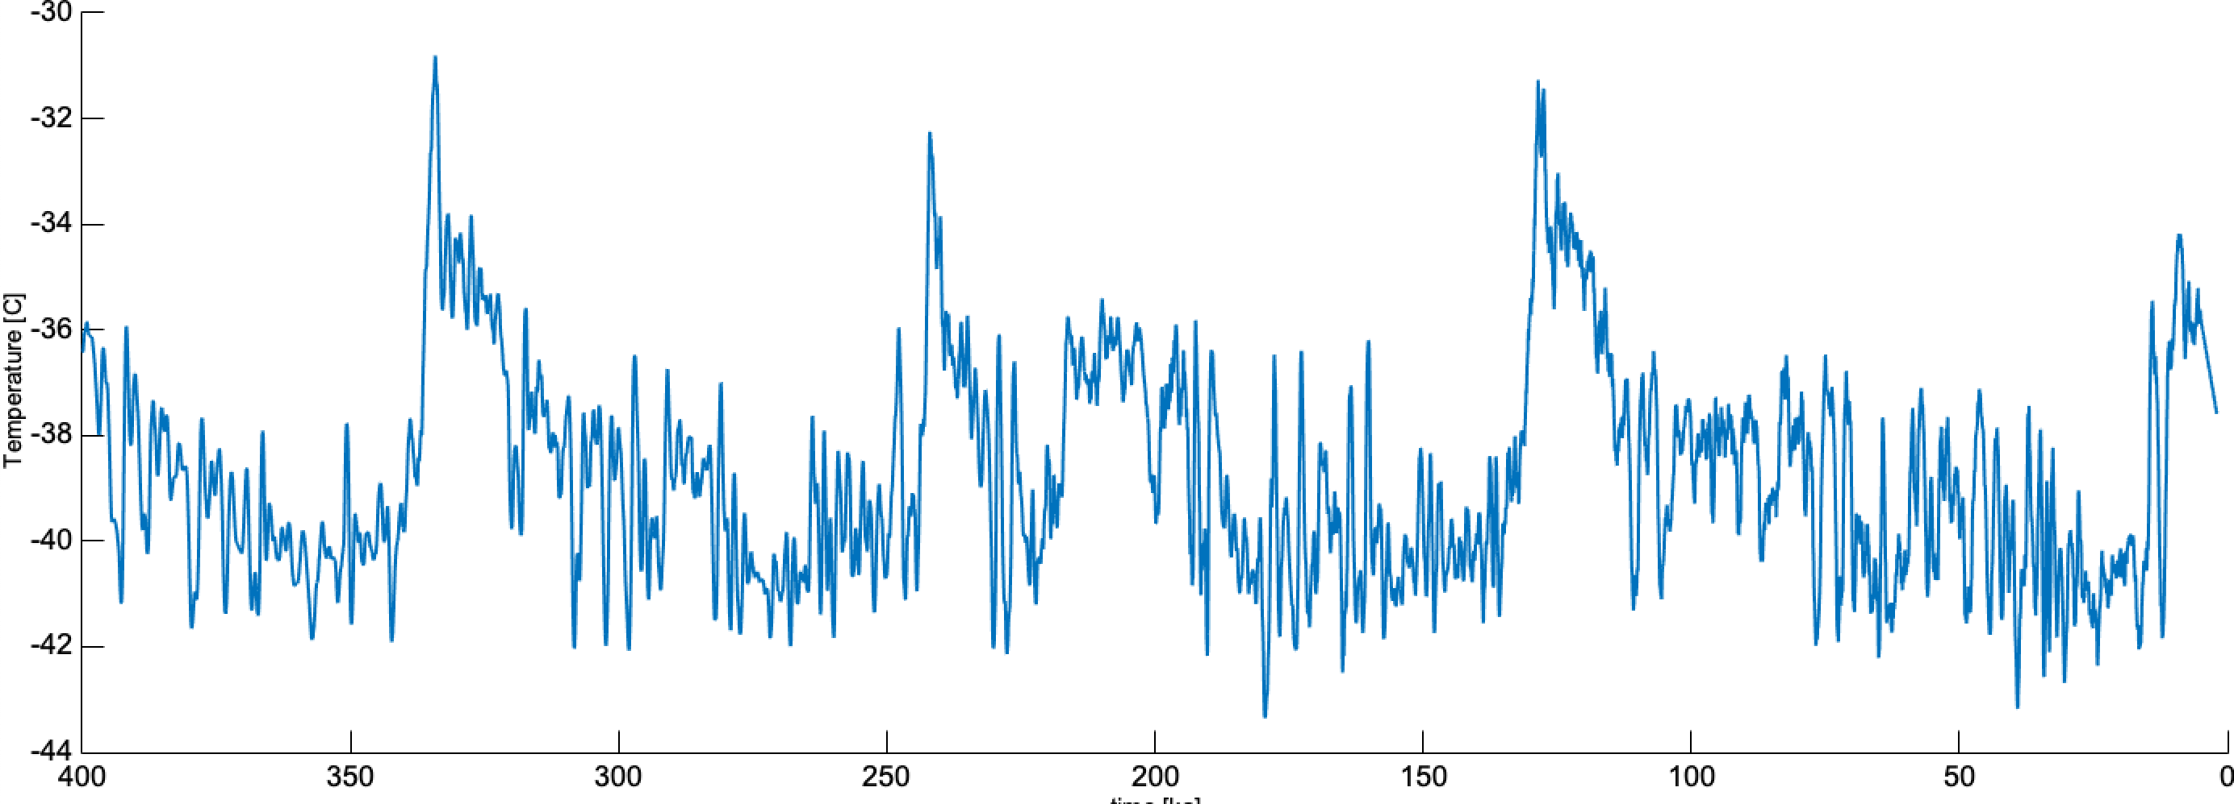
Animation, Tobias Friedrich
Neanderthals in Eurasia
38 ka
Homo sapiens sapiens
HS in Eurasia
The Climatic Context
Time [ka]

Slide 5
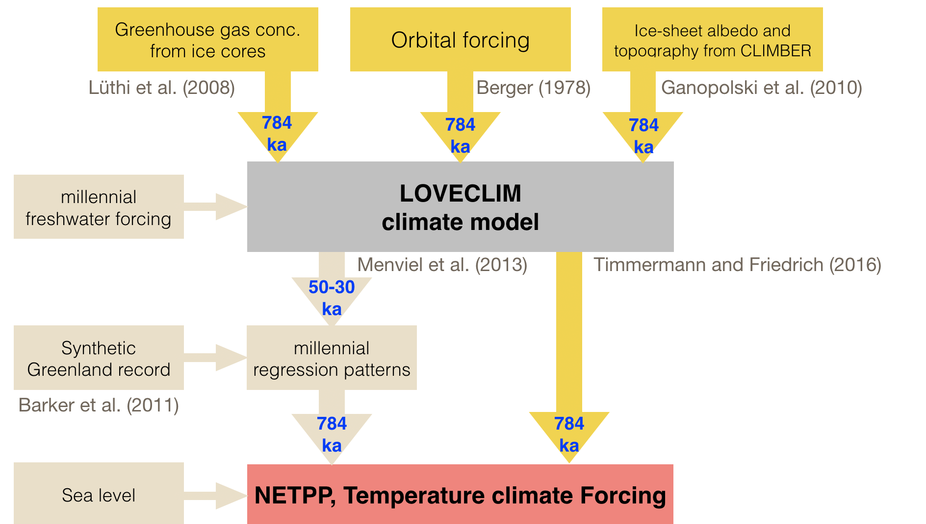
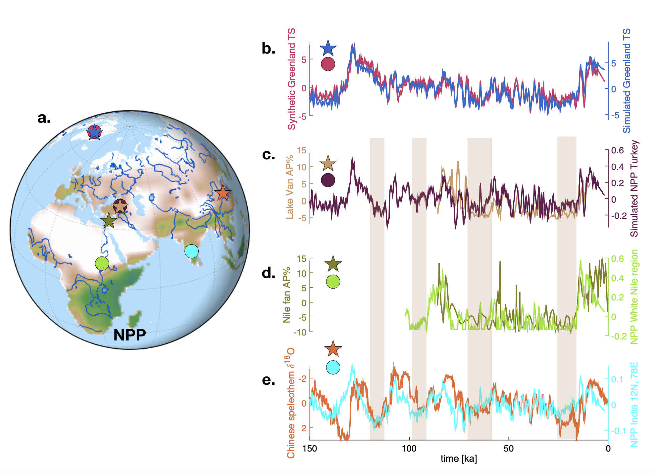
Climate Forcing
Comparison of forcing with proxy data

Slide 6
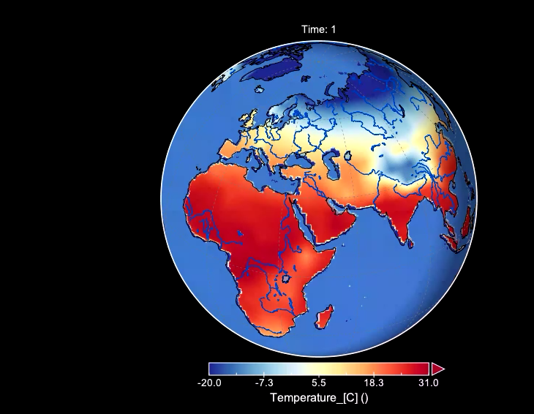
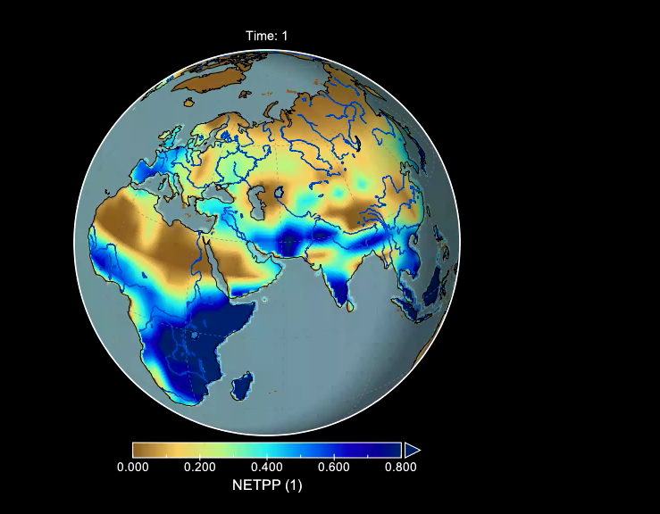
100 ka with Dansgaard-Oeschger and orbital variability
Net primary production
Temperature

Slide 7
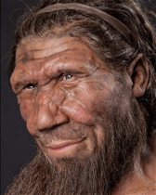
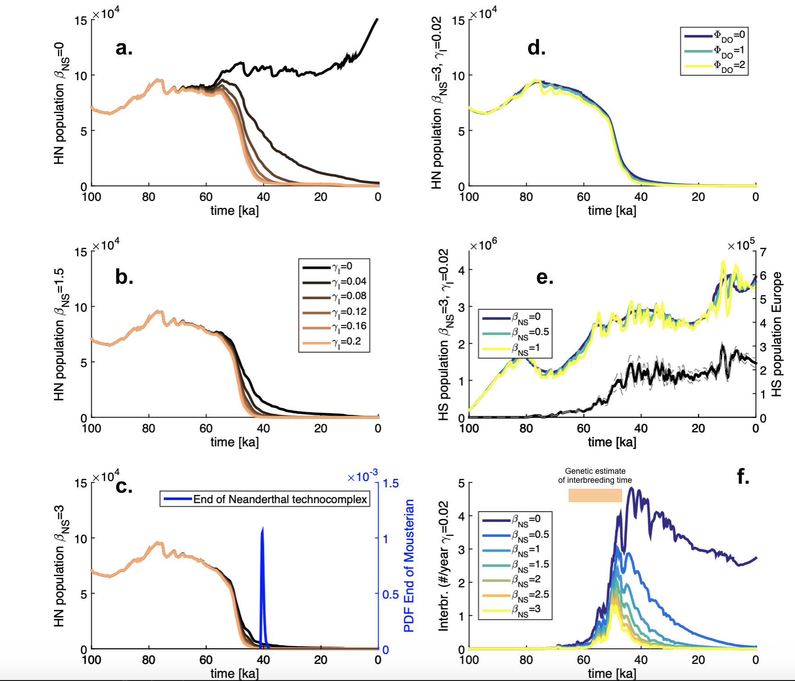
Effect of competition and interbreeding
Interbreeding
factor
Weak competition
Moderate competition
Strong competition
Timmermann, QSR accepted (2020)

Slide 8
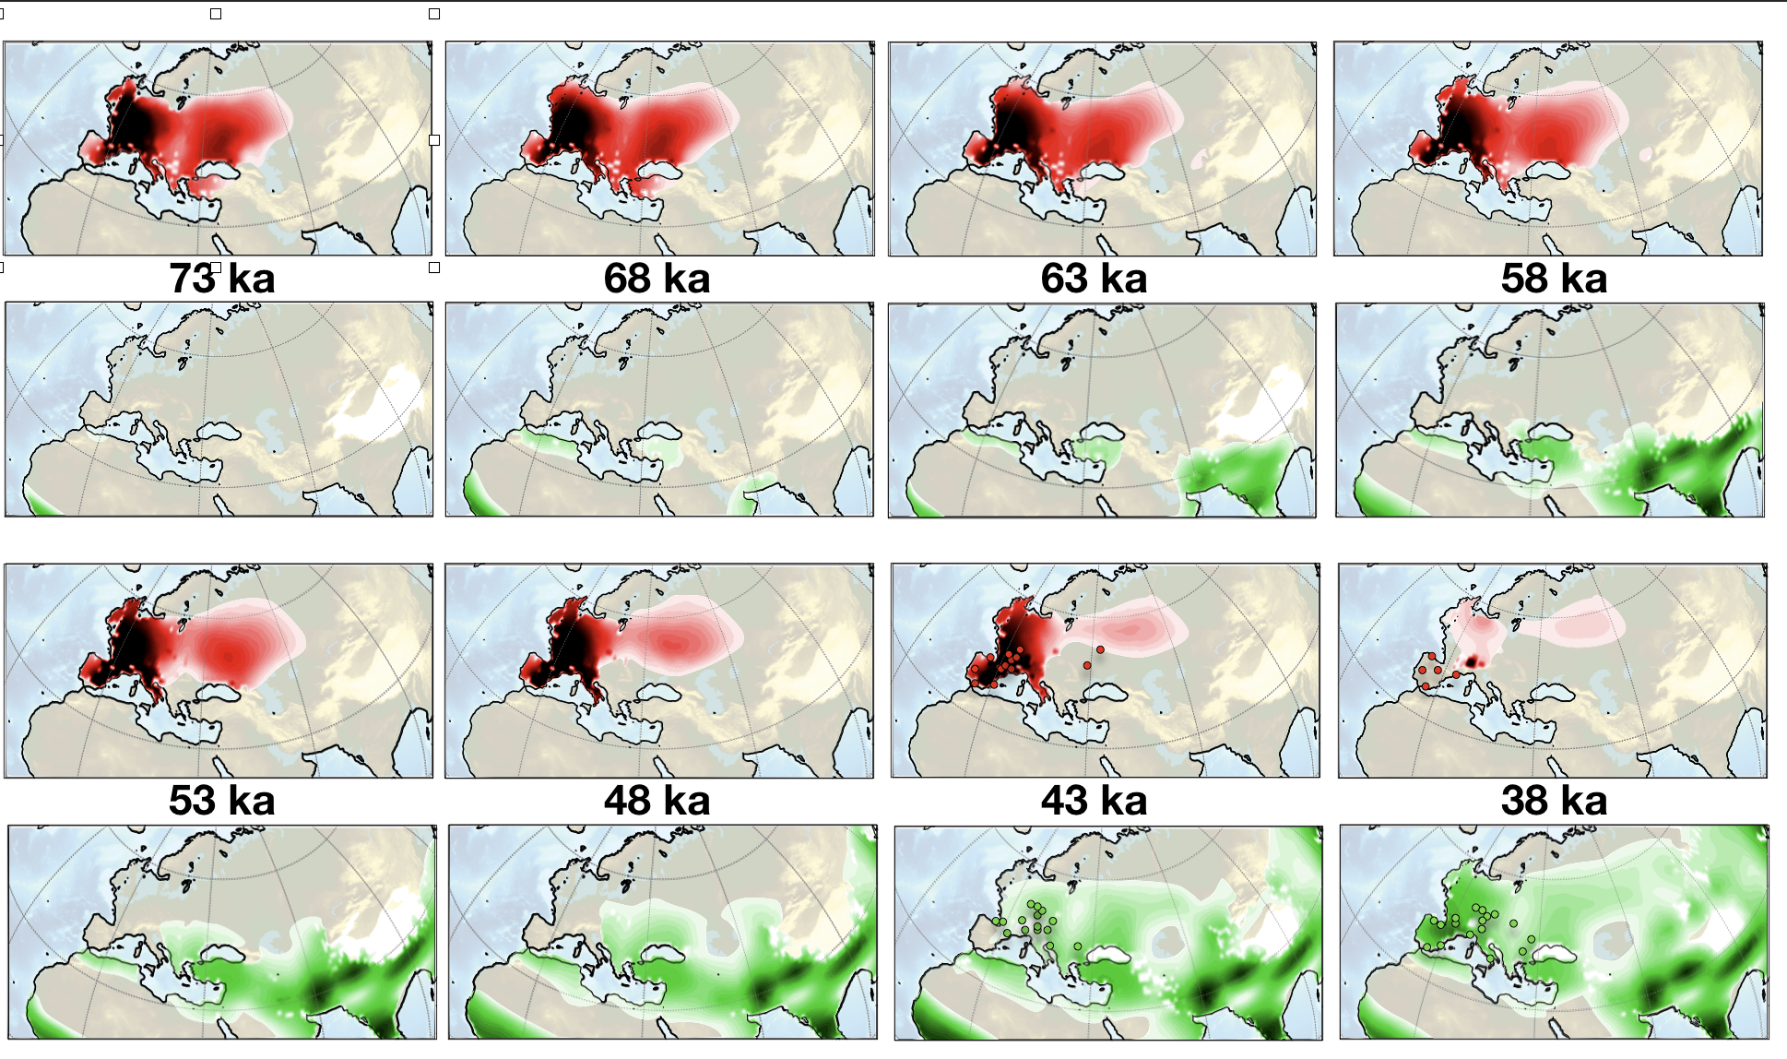
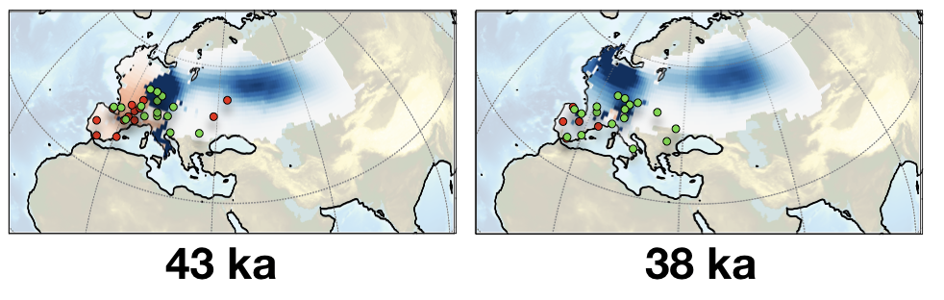
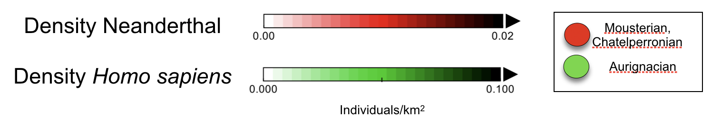
A gradual progression
Interbreeding rates
Timmermann, QSR accepted (2020)

Slide 9
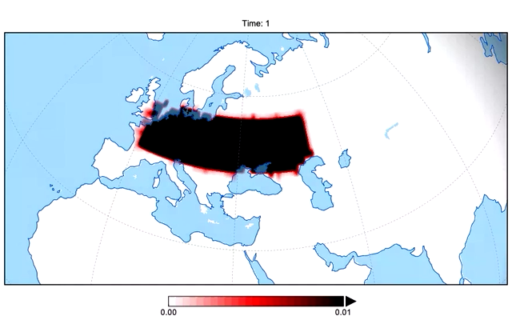
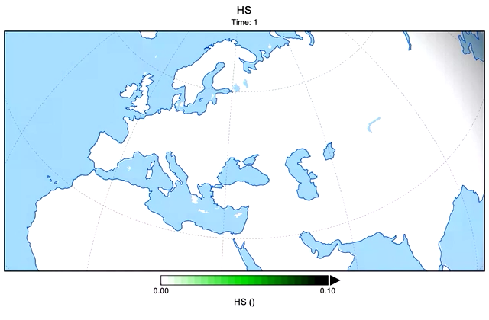
With competition and interbreeding
Last 100 kyrs

Slide 10
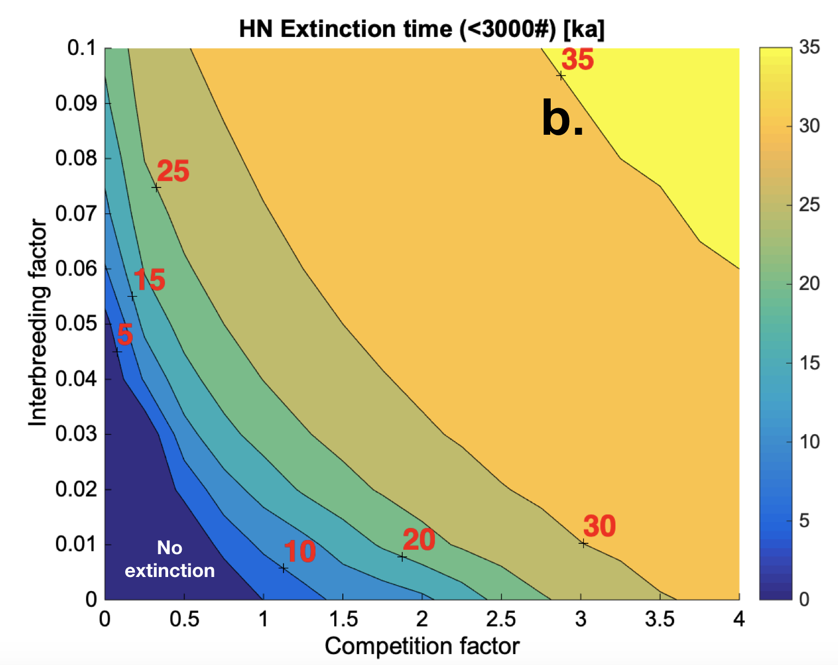
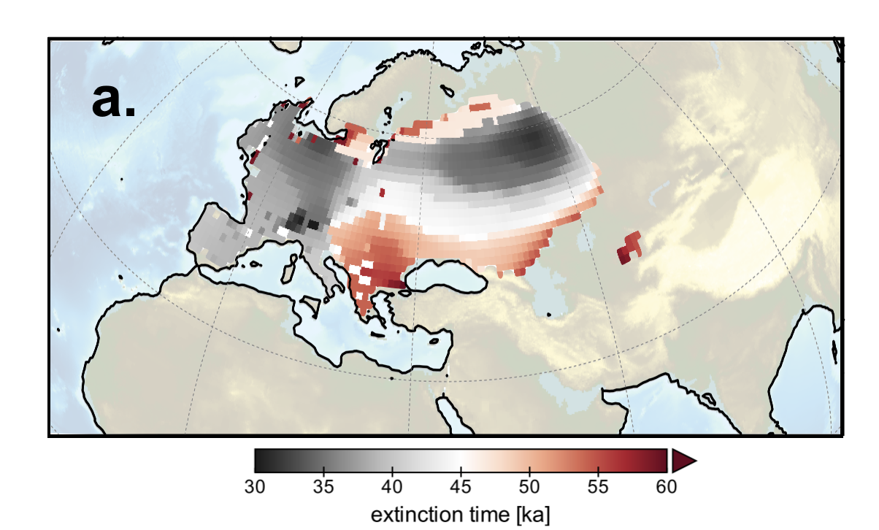
The global demise
Genetic constraints
Require interbreeding factor < 2%
=> Realistic extinction only possible for high competition values
Extinction time
Timmermann, QSR accepted (2020)

Slide 11
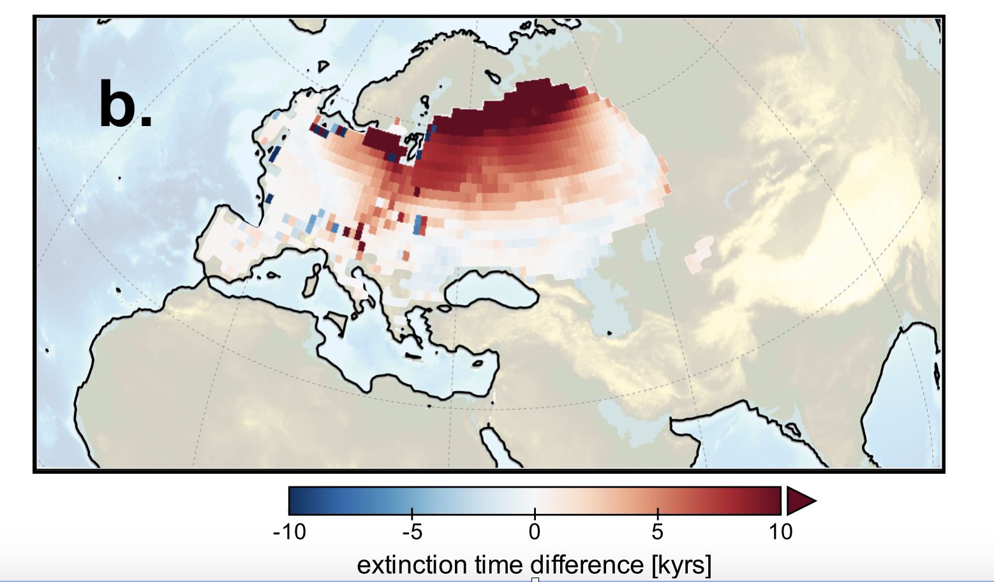
The role of Dansgaard Oeschger events: Not relevant for global extinction, but regionally
Extinction time difference with and
without DO variability in NPP, Temperature
Timmermann, QSR accepted (2020)

Slide 12



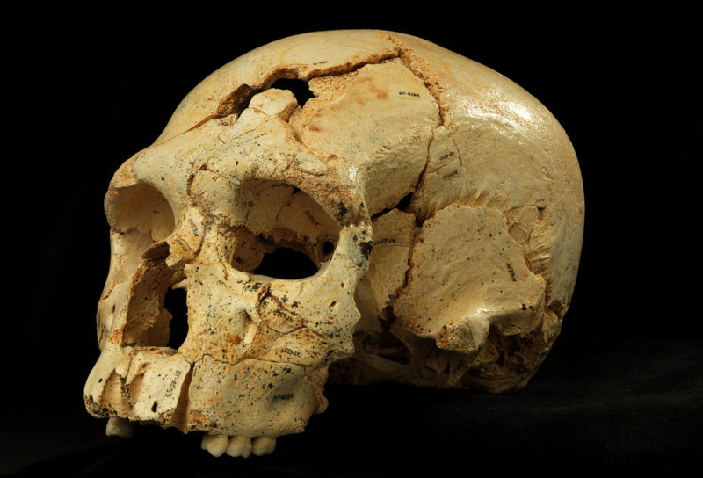
Research opportunities
Paleoclimate data
Archeology
Anthropology
Paleo-genetics
Preprint available on: https://www.biorxiv.org/content/10.1101/2020.04.19.049734v1.full.pdf
Climate models
Model code available on: https://climatedata.ibs.re.kr/data/papers/timmermann-2020-qsr
Migration models
Timmermann, QSR accepted (2020)
Better understanding of human migration and evolution

