Slide 1
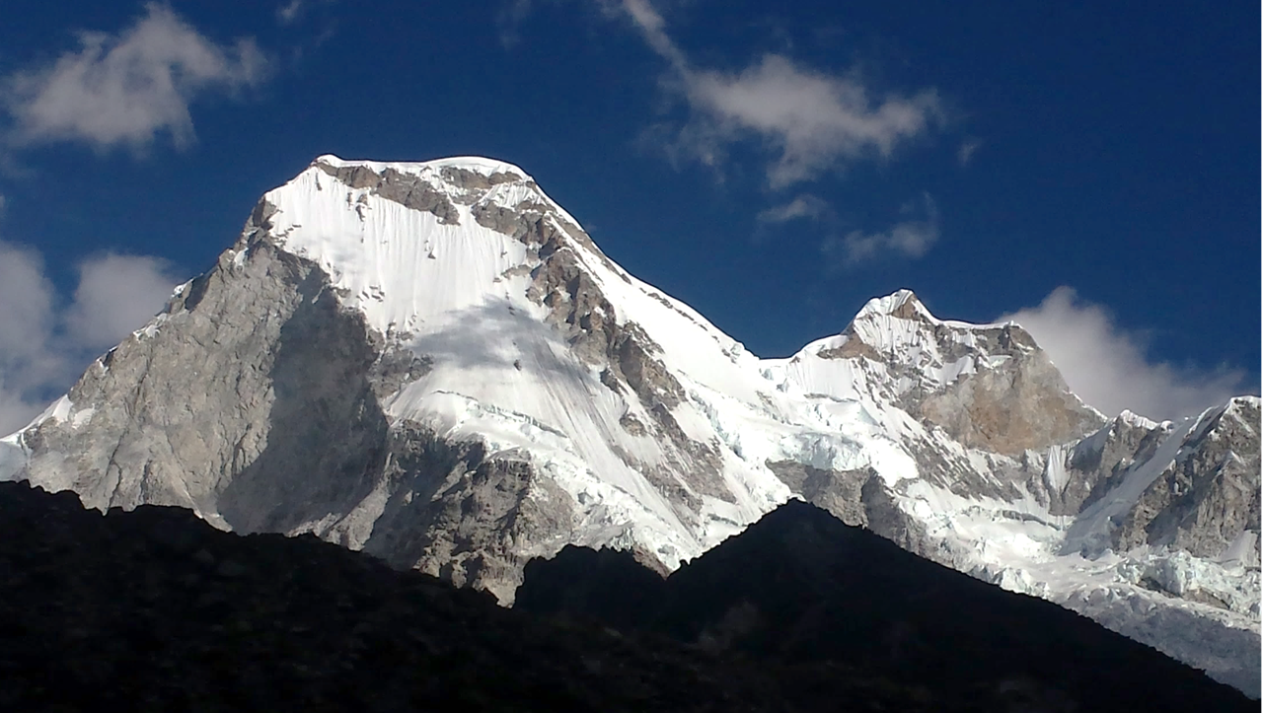






Paleoclimatic reconstruction during the Little Ice Age in the Llanganuco basin, Cordillera Blanca (Peru)
Joshua Iparraguirre¹, Jose Úbeda², Ronald Concha¹, Ramón Pellitero³, Javier de Marcos², Luzmila Dávila¹, Pool Vásquez⁴, Jesús Gómez¹ & Julia Araujo¹
¹Instituto Nacional de Investigación en Glaciares y Ecosistemas de Montaña (INAIGEM)
²Universidad Complutense de Madrid (UCM)
³Universidad de Educación a Distancia (UNED)
⁴Instituto Geológico, Minero y Metalúrgico (INGEMMET)

Slide 2
01
01
  Step one
  Development of a detailed geomorphogical map
  Delimitation of palaeoglaciers and current glacial extension
  Step one
  Development of a detailed geomorphogical map
  Delimitation of palaeoglaciers and current glacial extension
02
02
  Step two
  Glaciar bedrock Reconstruction – GLABTOP
  Step two
  Glaciar bedrock Reconstruction – GLABTOP
03
03
  Step three
  3D reconstruction of palaeoglaciers surface
  Step three
  3D reconstruction of palaeoglaciers surface
04
04
  Step four
  Calculation of Balance Ratio in a reference glacier
  Step four
  Calculation of Balance Ratio in a reference glacier
05
05
  Step five
  Automatic Equilibrium Line Altitud (ELA) reconstruction of glaciers and palaeoglaciers
  Step five
  Automatic Equilibrium Line Altitud (ELA) reconstruction of glaciers and palaeoglaciers
06
06
  Step six
  Estimation of palaeotemperature during LIA
  Step six
  Estimation of palaeotemperature during LIA

Slide 3
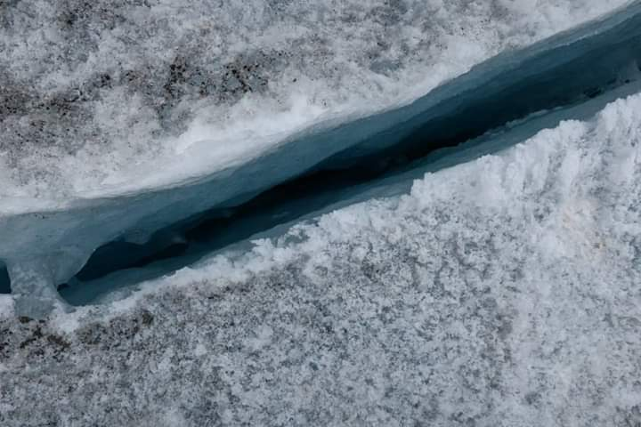
  Step one
  Development of a detailed geomorphogical map
  Delimitation of palaeoglaciers and current glacial extension

Slide 4
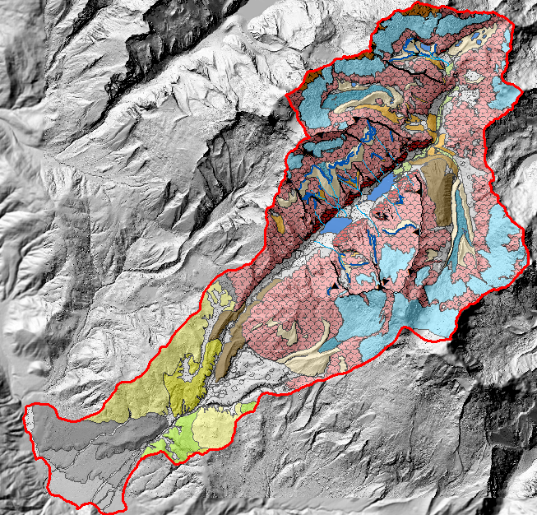
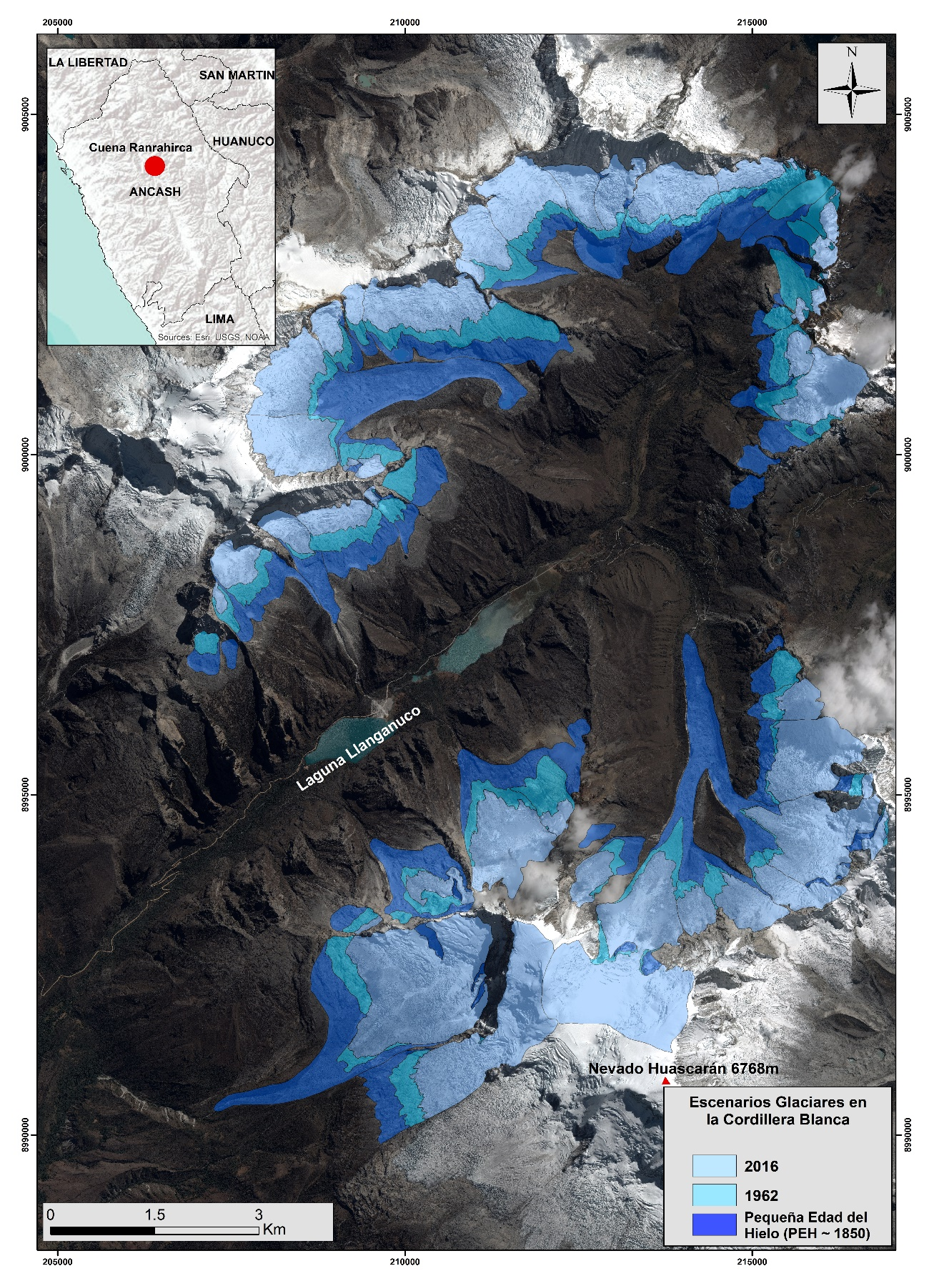
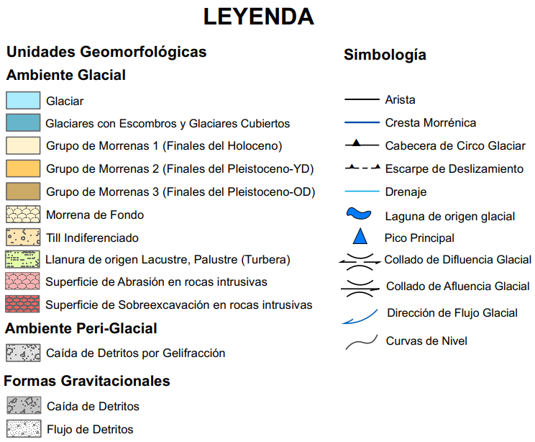

Slide 5
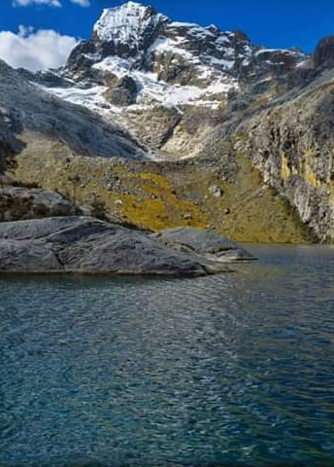
  Step two
  Glaciar bedrock Reconstruction – GLABTOP
  Step three
  3D reconstruction of palaeoglaciers surface

Slide 6
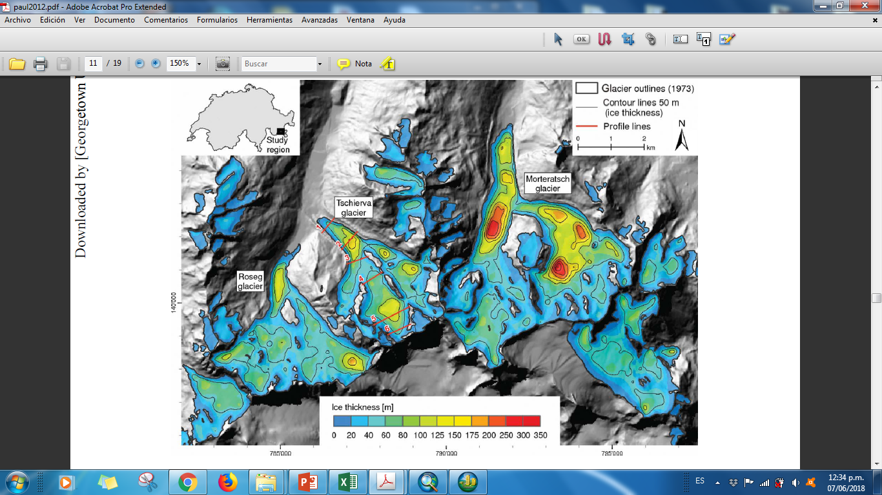

GLACIER BED TOPOGRAPHY

Slide 7
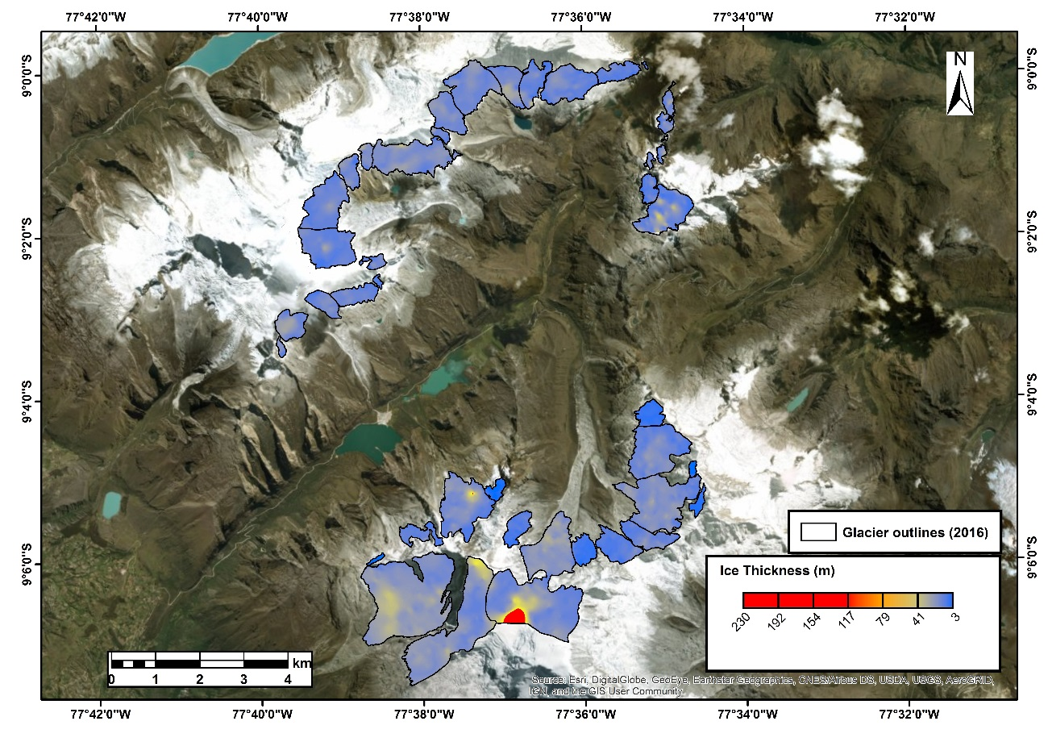

Slide 8
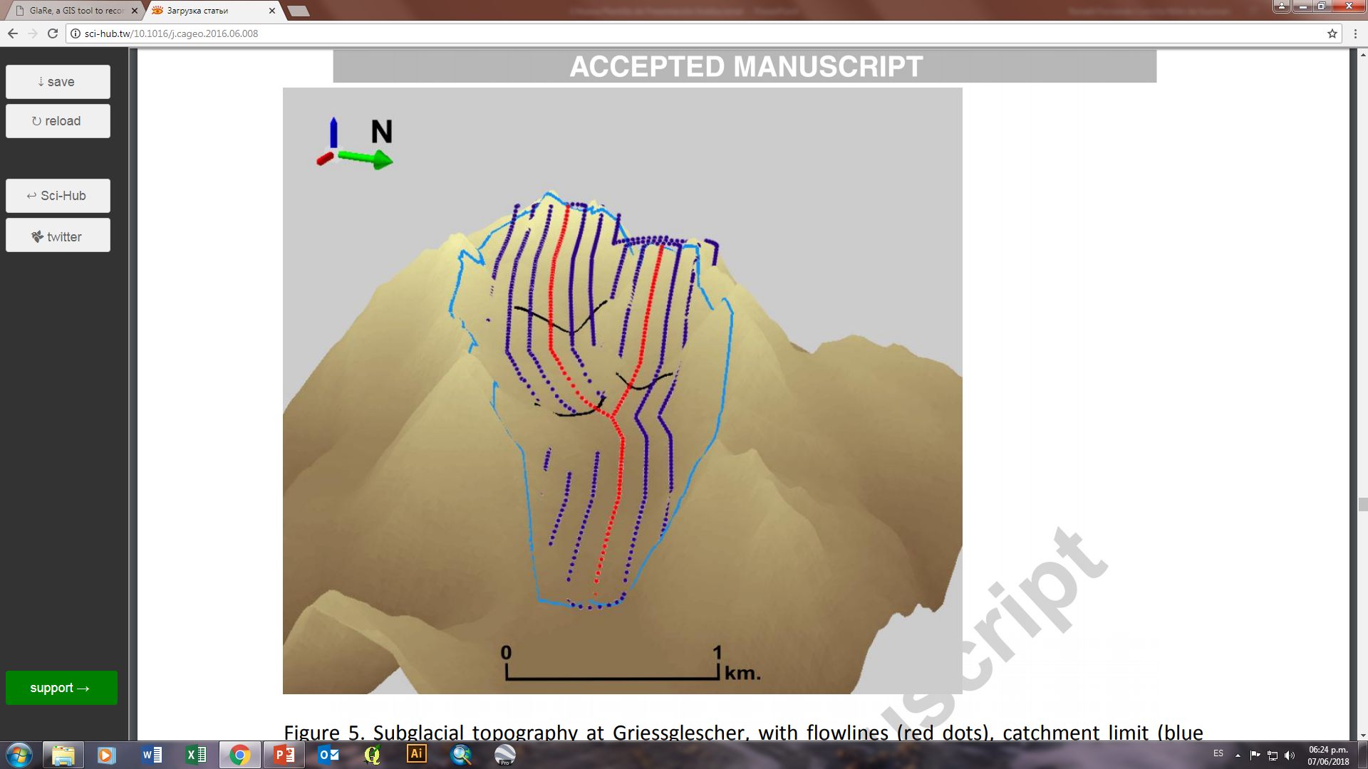
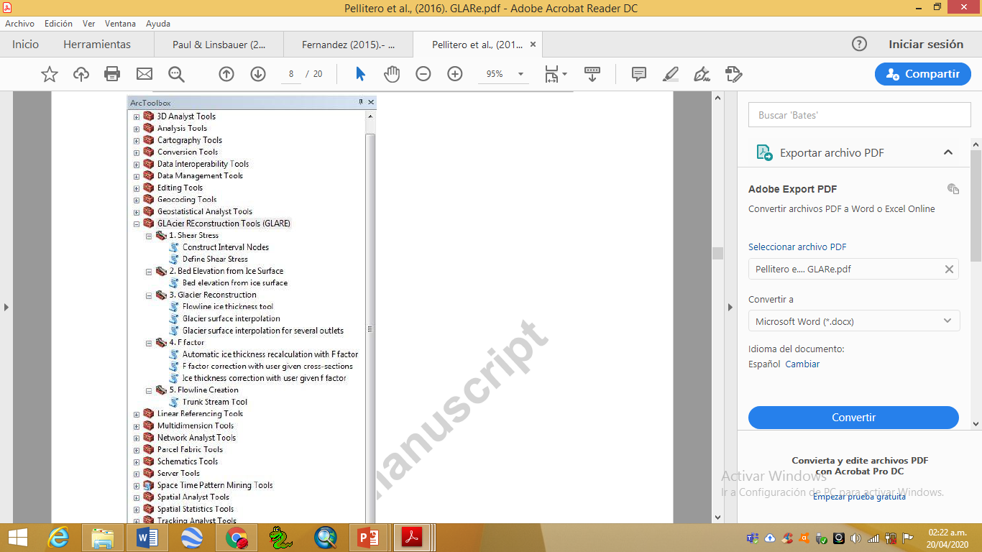
GLACIER RECONSTRUCTION (GLARE)

Slide 9
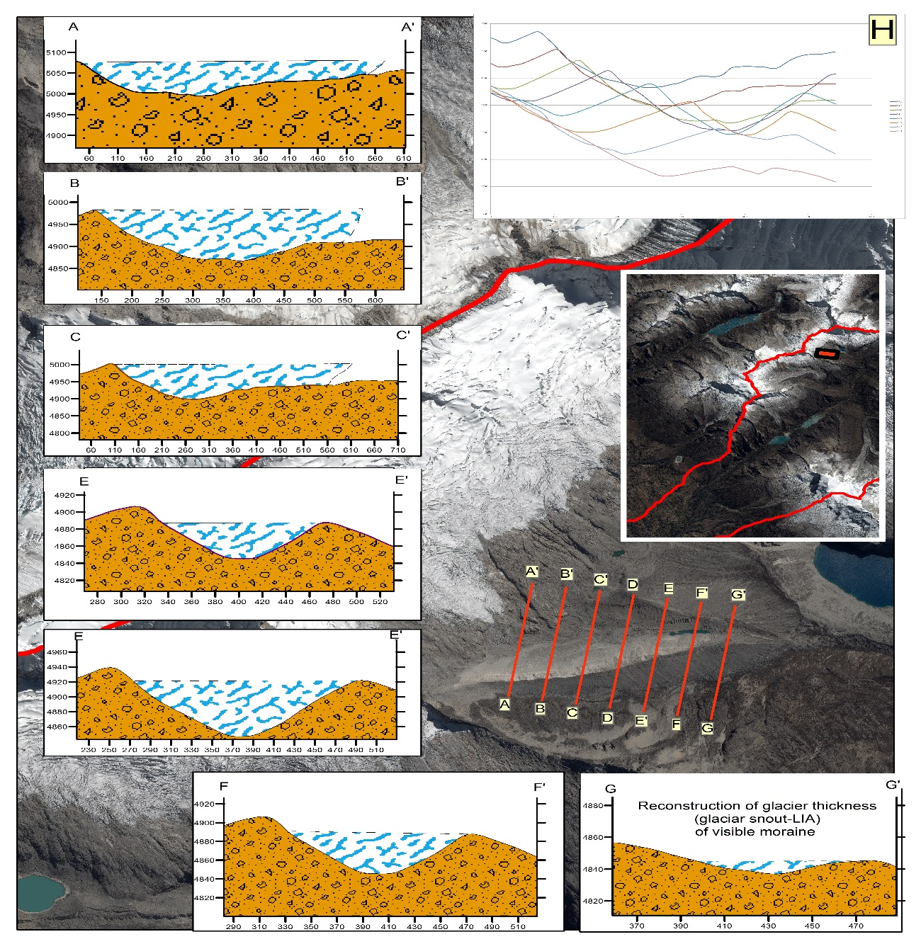
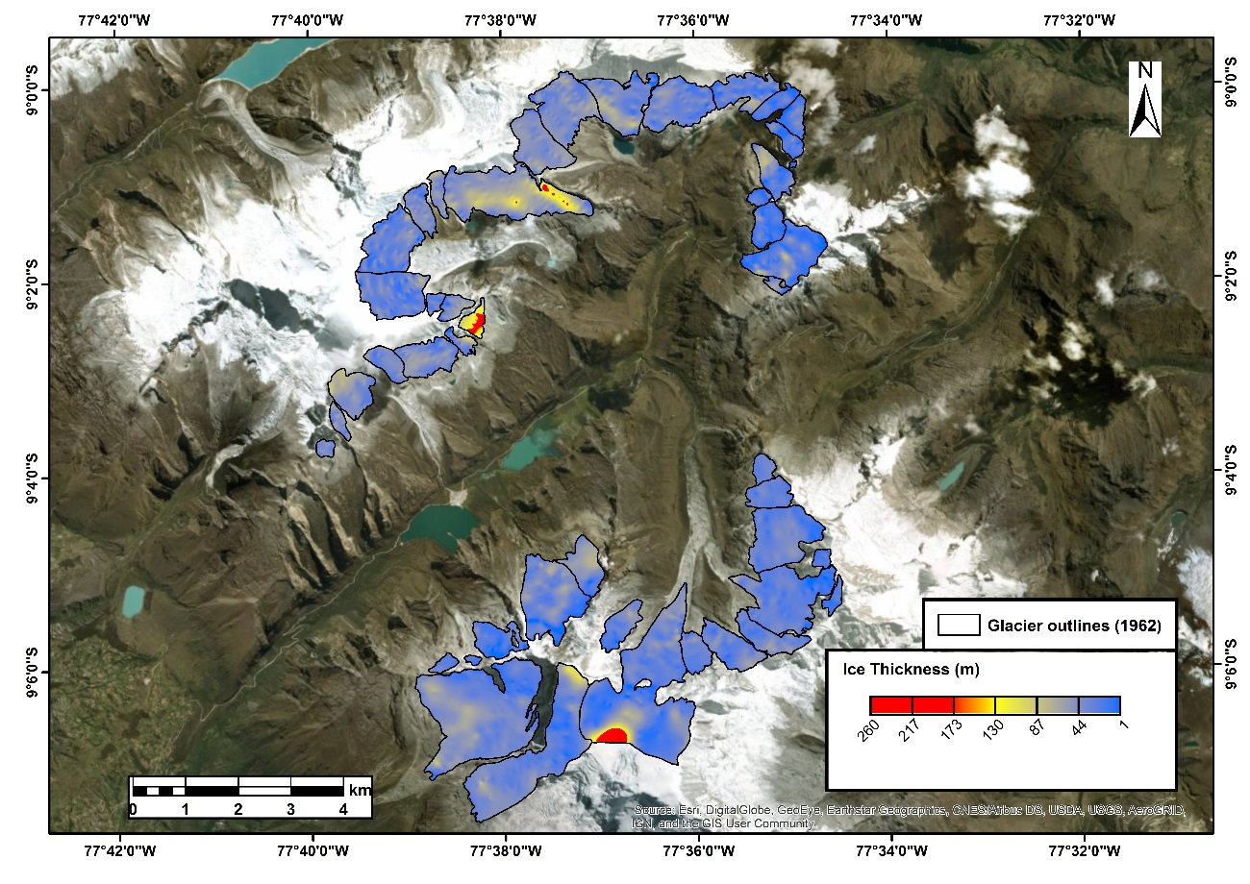
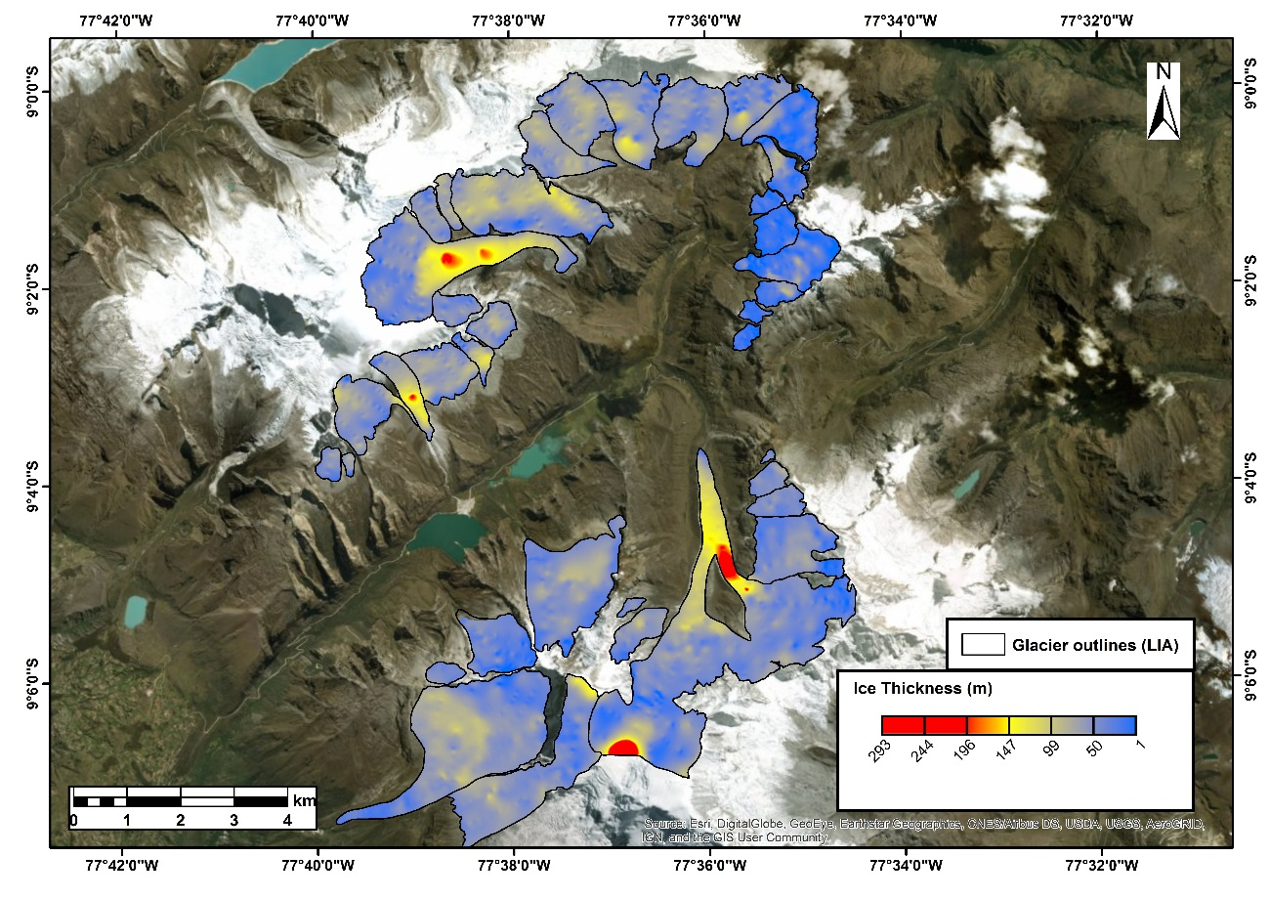

Slide 10
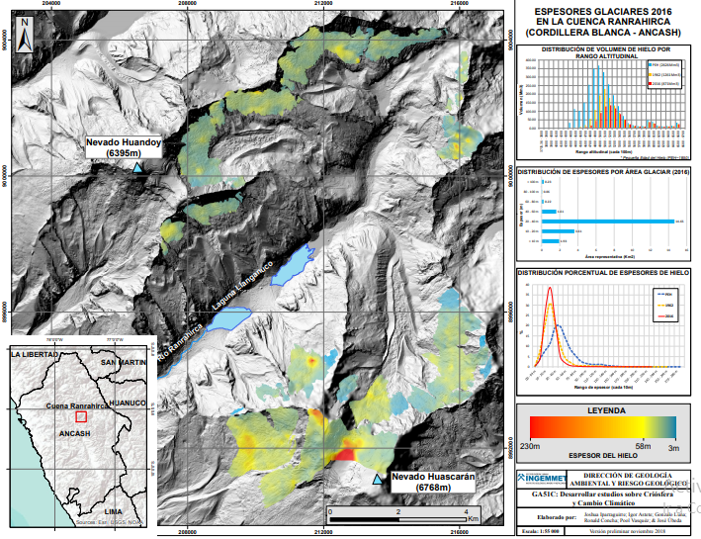
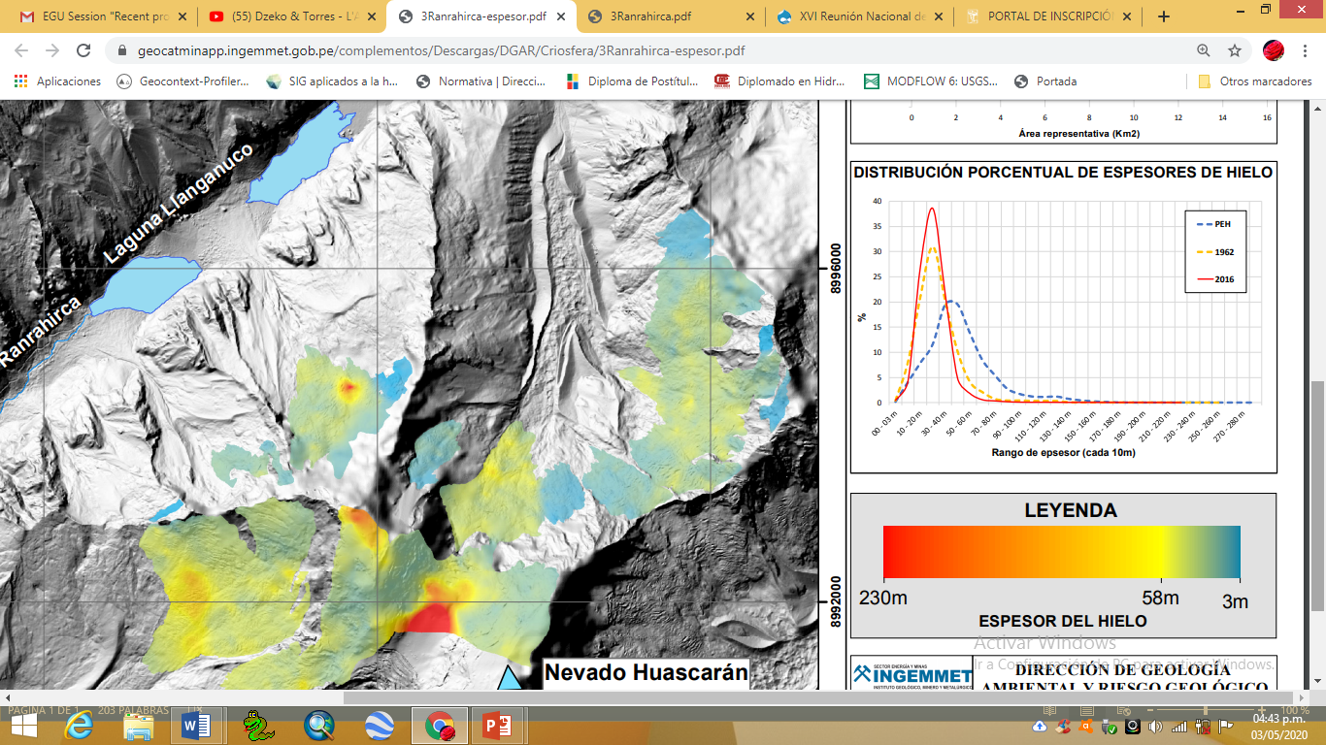
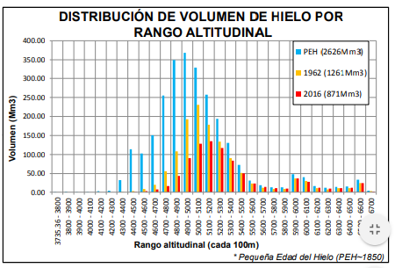

Slide 11
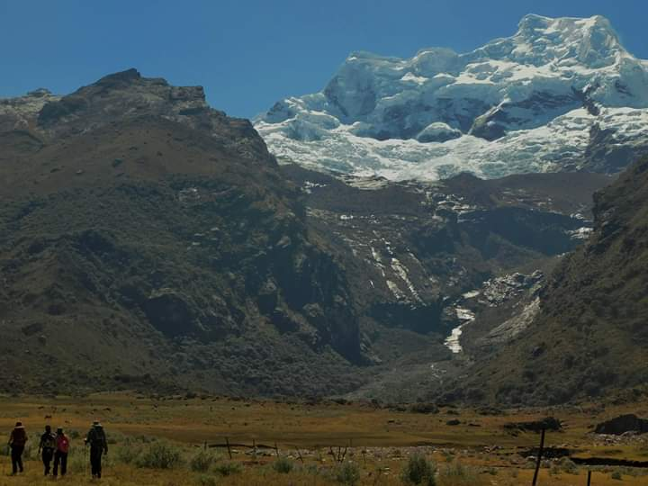
  Step four
  Calculation of Balance Ratio in a reference glacier

Slide 12
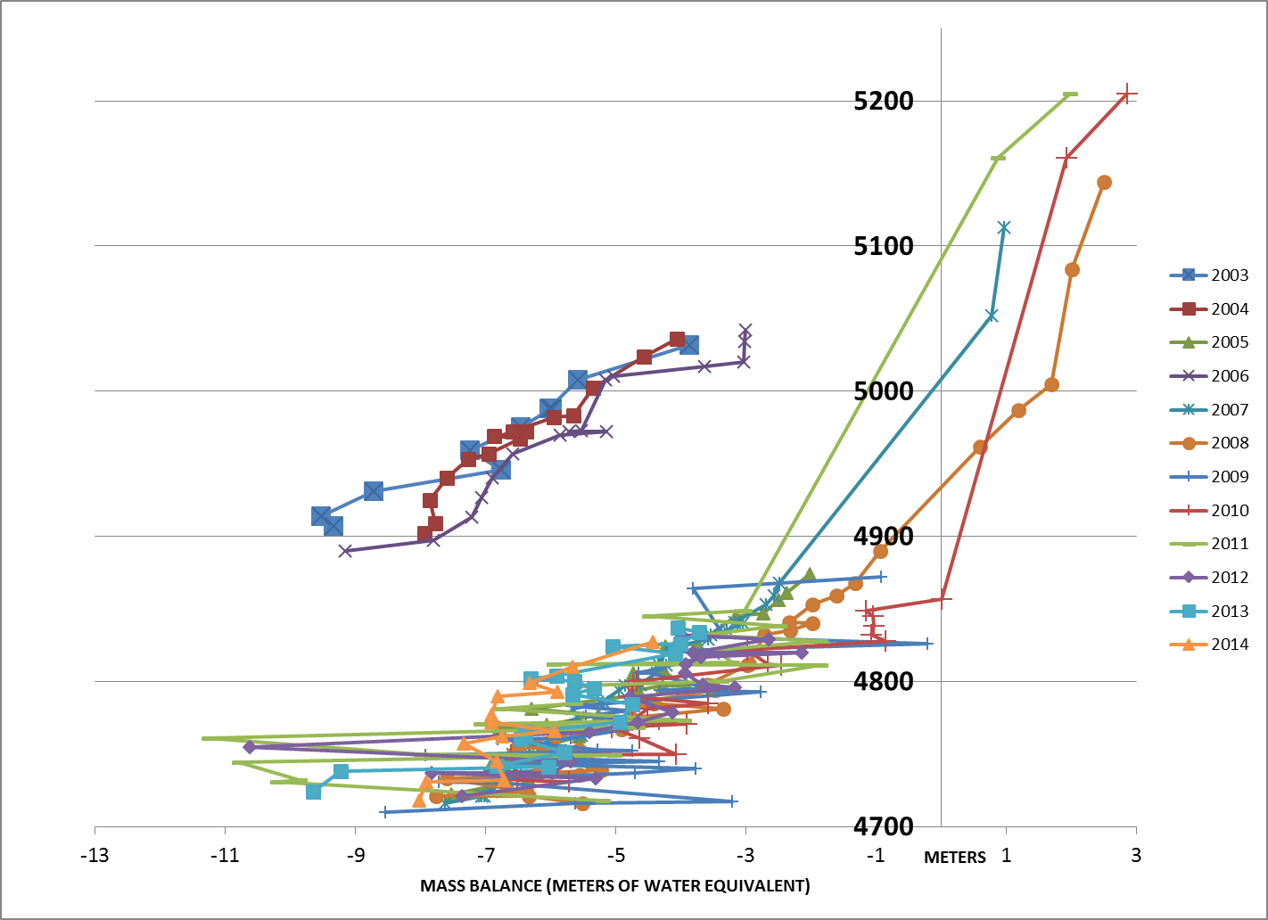
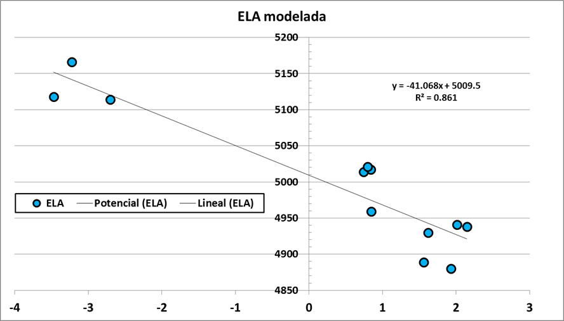
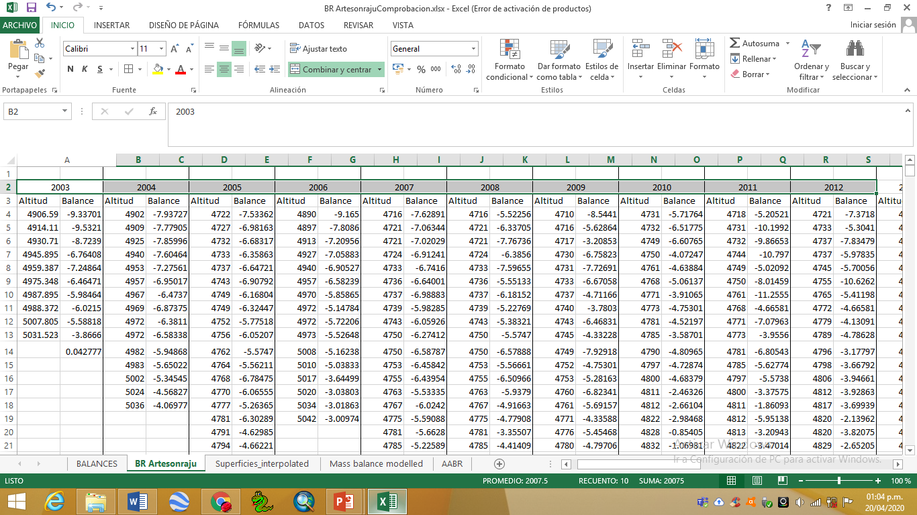

Slide 13
  Step five
  Automatic Equilibrium Line Altitud (ELA) reconstruction of glaciers and palaeoglaciers

Slide 14
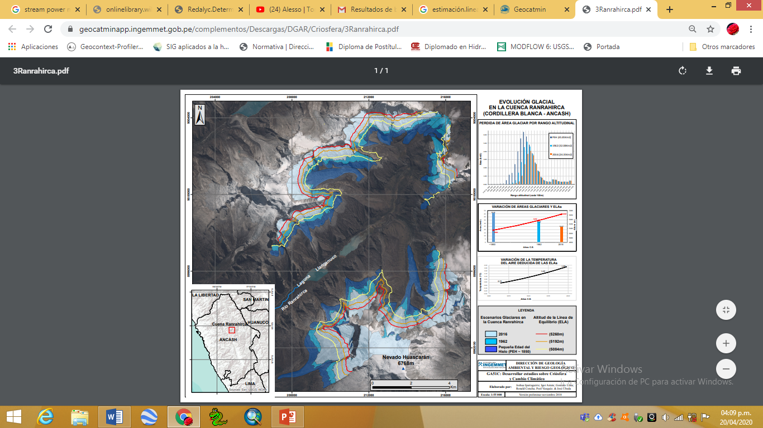
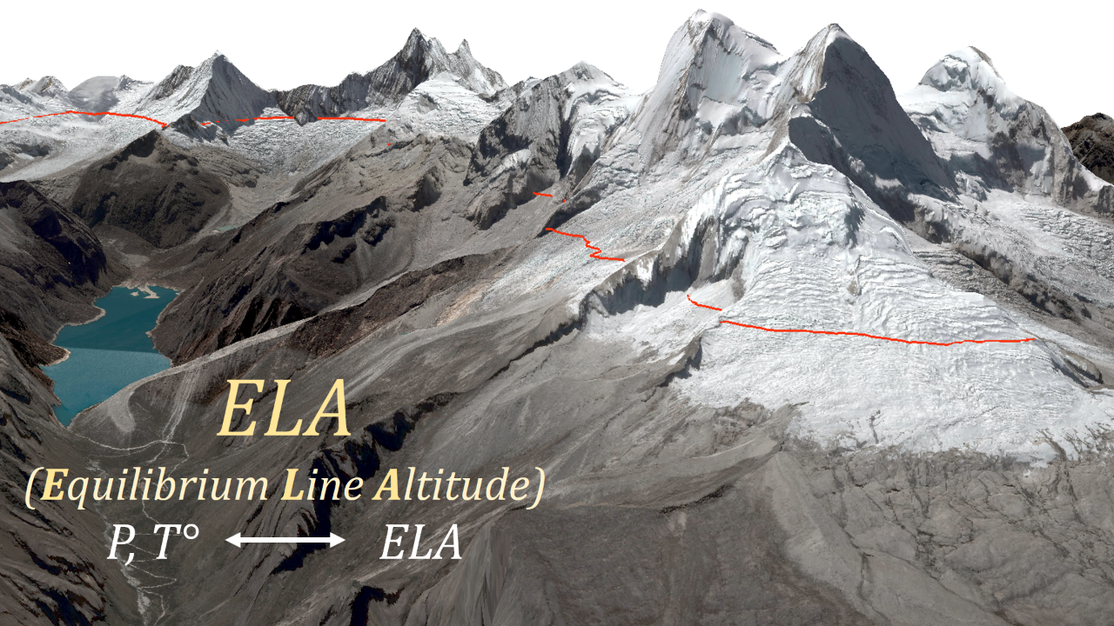
AABR
(Área x Altitud x Balance Ratio)
(Ahlmann, 1924, 1948, Loewe, 1971, Kotlyakov y Krenke, 1982, Braithwaite, 1985, 2008, Ohmura et al., 1992)

Slide 15
  Step six
  Estimation of palaeotemperature during LIA

Slide 16
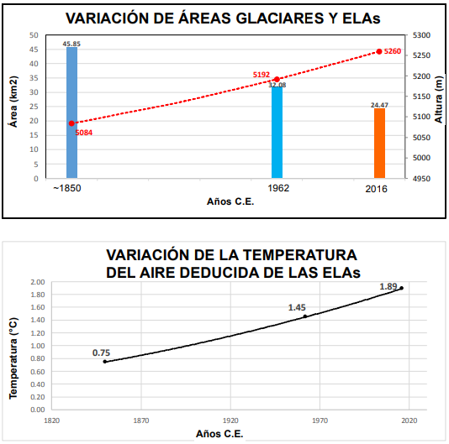
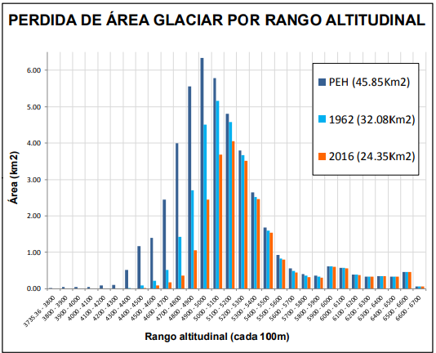

Slide 17
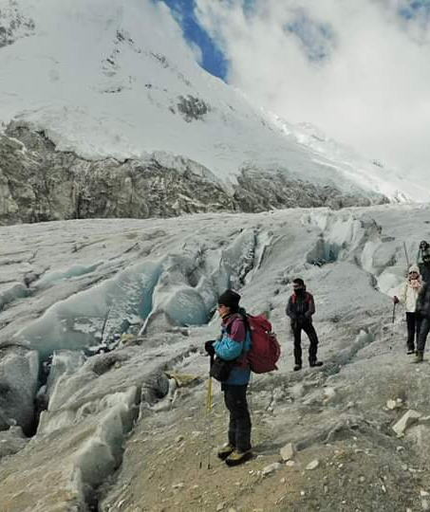
THANKS!
Does anyone have any questions?
iparraguirrea.joshua@gmail.com
+51 978 836 327

