Slide 1
Monitoring boulder movement using the Internet of Things:
towards a landslide early warning system
CLICK ON THE BUTTONS BELOW
STUDY AREA
OUR WIRELESS SENSOR NETWORK
THE BOULDER PROJECT
Bhote Koshi
Araniko
highway
N
BOULDER MOVEMENT MONSOON 2019
CONCLUSIONS AND OUTLOOK
2
N E P A L
AUDIO IN YELLOW CIRCLES
0 100 200 m
1
Benedetta Dini, b.dini@uea.ac.uk
Georgina Bennett, Aldina Franco, Michael Whitworth, Andreas Senn, Kristen Cook
Receiver
Landslide
No movement
Mov. onset in landslide
Boulders:
Debris flow channels
Moved in channel
May → Aug

Slide 2
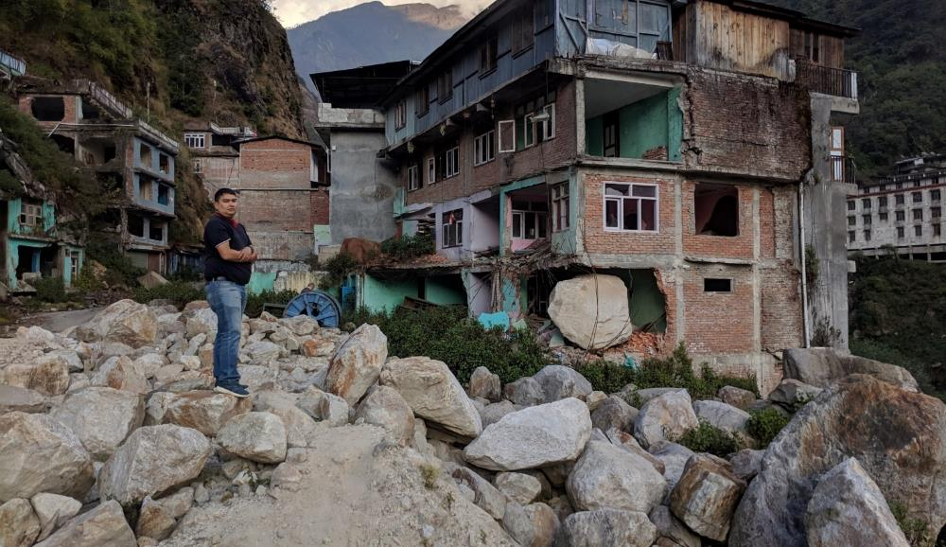
BACK
The BOULDER project
Develop a tracking system to observe boulders movement in landslides and floods
Set the basis for an early warning system
Increase resilience to landslide (and flood) hazard
BOULDER: Accounting for BOUlders in Landslide-flood Disaster Evaluation and Resilience.
Funded by NERC SHEAR Catalyst program.
PI: Georgina Bennett
CoI: Aldina Franco

Slide 3
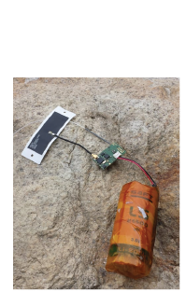
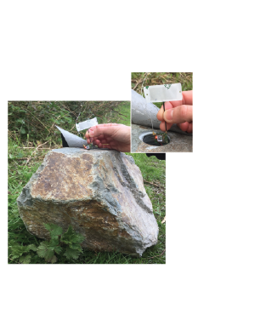
BACK
Our wireless sensor network
Sensors equipped with accelerometer
Powered by battery
Can activate on detecting movement
Real-time data transmission to a receiver via LoRa® (Long Range Wide Area Network)
GSM transmission from receiver to a server
Small angular variations
Large impact forces
GSM
LoRaWAN
Sensors
Receiver powered by solar system
Notes:
Map and assess boulder hazard across the landscape and produce boulder hazard maps to supplement existing landslide hazard maps
Integrate findings into landslide and flood hazard evaluation in collaboration with project partners to increase resilience to landslide and flood hazards.

Slide 4
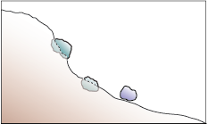
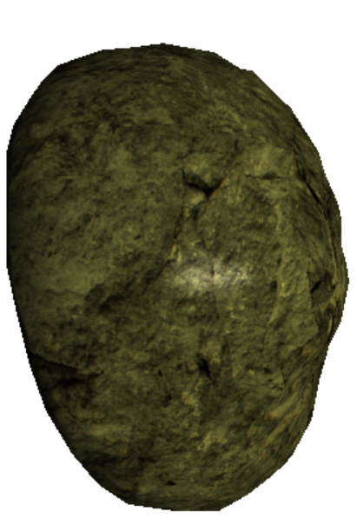
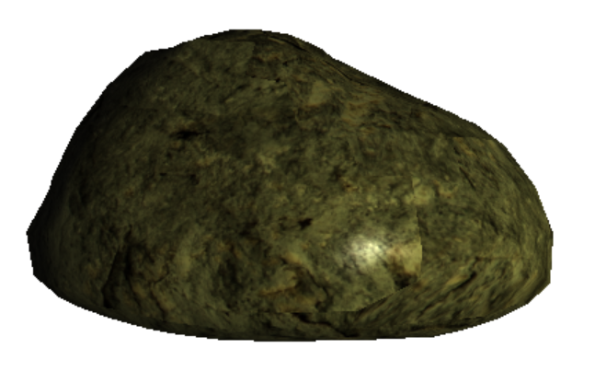
BACK
Boulder movement monsoon 2019
The sensors captured in real time:
1. Small angular variations within the landslide body
2. Sharp rotations in the debris flow channels
The graphs below are examples of bouders in position types 1 and 2.
The lines represent the variation of accelerometers values in x, y, and z from the initial position, in g ⁻³
1
g⁻³
+10²
1
2
0
-10²
+10³
2
g⁻³
0
x
y
-10³
z
1
2

Slide 5
BACK
Conclusions and Outlook
10 (possibly 11) of 23 tagged boulders in 2019 present patterns in the accelerometer data compatible with downslope movements.
Of these, 6 lying within the landslide body show small angular changes, indicating a reactivation during the monsoon and a movement consistent with the landslide mass. We observe a staggered onset of movement, starting from the scarp (May-Jun), then the centre (Jun-Jul), finally the southern flank (Aug-Sep). Moreover, field investigations and laser scan data show large displacements within the landslide mass.
5 located in a debris flow channel, show sharp changes in position, likely corresponding to larger free movements and rotations. The latter have not been found at their original location after the monsoon.
Boulders that moved in the channels are those with volume < 0.1 m³ (B axis from 0.3 to 0.45 m), whilst those with volume > 1 m³ did not move.
The data obtained show that the technology is promising for tracking boulders in real-time.
Improvements are being made ahead of the next tagging season (e.g. Improved accelerometer sampling frequency, improved receiver stability, improved programming settings, ability to retrieve and reuse tags after the monsoon season).
The concept of this cost-effective network created could be upscaled and applied to other regions/sites in the future.

