Slide 1
Reconstructing the climate of Ancient Babylonia
Climates of Conflict in Ancient Babylonia (CLICAB)
Rhonda McGovern*, Dr. Conor Kostick, Laura Farrelly, Andrew Hill, Dr. Francis Ludlow
Climates of Conflict in Ancient Babylonia (CLICAB)
Trinity Centre for Environmental Humanities, Trinity College Dublin.
*mcgoverh@tcd.ie
EGU 2020 Session CL1.20 Monday 4 May 16:15–18:00
Historical climatology and hydrology: the role of documentary evidence in the reconstruction of past (hydro)climate and its variabilities

Slide 2
About CLICAB
The project hypothesises that patterns of violence and conflict in the Ancient Near East are linked to climatic changes including periods of drought, flooding and other extreme weather.
Overall Project aims
Delineate the complex societal dynamics and pathways to assess for strategies used to mitigate violence and conflict.
Examine how the evolving historical context mediates any contributory role for climate in violence and conflict.
PhD Research aims
Develop a new climatic reconstruction of unprecedented detail (sub-daily resolution) using the Astronomical Diaries from Babylonia.
Assess climatic changes found in the climate reconstruction for veracity.

Slide 3
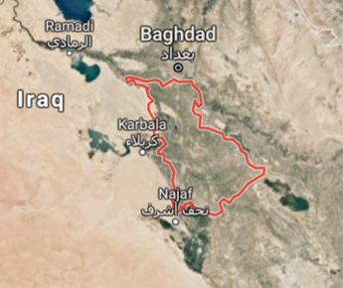
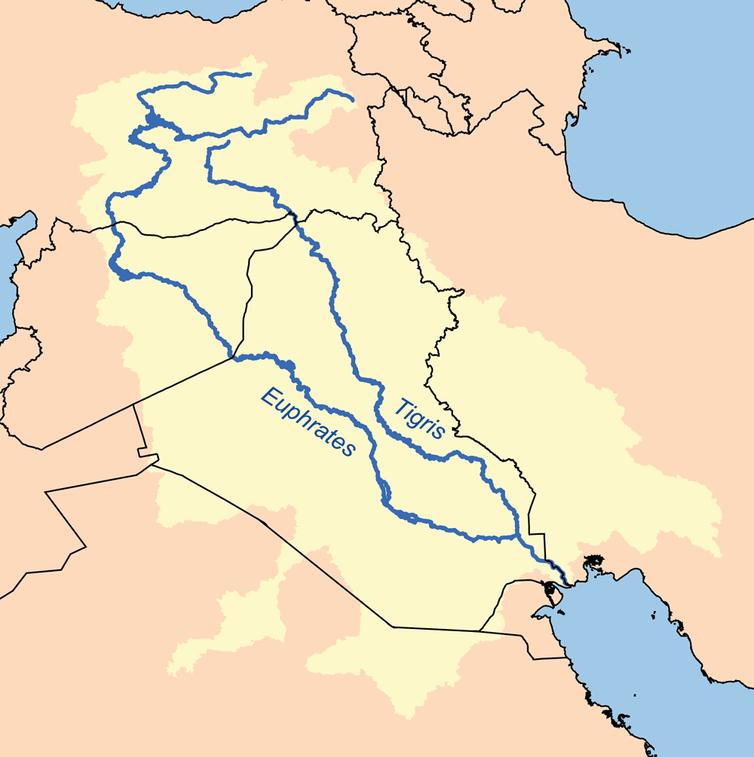
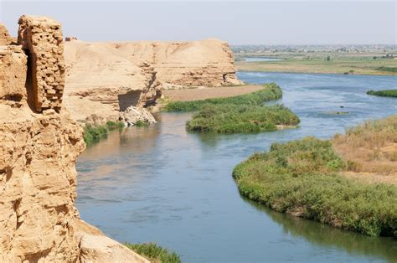
The Astronomical Diaries from Babylonia
Babylon is situated in Hillah, south of modern-day Baghdad, Iraq. The city and the kingdom went through many dynasties and social changes throughout its lifetime. Through a need to record administration data (ownership, taxes, historical events), as well as recording astronomical phenomena with the aim of successfully predicting the future, the Babylonian scribes used cuneiform writing on clay tablets, which were baked for preservation. It is because of this choice of a durable medium that we can still study this ancient language today.
Recording the diaries
The Astronomical Diaries are a collection of 209 precisely dated cuneiform tablets containing river levels, weather, price, historical and astronomical data, covering the period 652-62BC. Babylonian scribes spent years training to fulfil this role recording information systematically to predict future events. This sub-daily resolution of weather data is unprecedented in the world of historical climatology before the Early Modern Period.
Kingdom of Babylonia outlined in red on a map of modern day Iraq. Google Maps, 2019
Why study the region?
Babylonia is situated in Mesopotamia, the cradle of civilization. The city of Babylon sits between the Euphrates and the Tigris, both major world rivers.
This region is known for its fraught hydro-politics today and water scarcity is an issue incorporated into the balance sheets for agriculture in the Near East (FAO, 2020). Reconstructing the climate for Ancient Babylonia may provide some insights into how the Babylonians coped with water scarcity.
The Euphrates River
I-Stock.com, 2020
The Tigris and Euphrates rivers originating in Turkey, travelling through Syria and into Iraq. Wikipedia, 2020

Slide 4
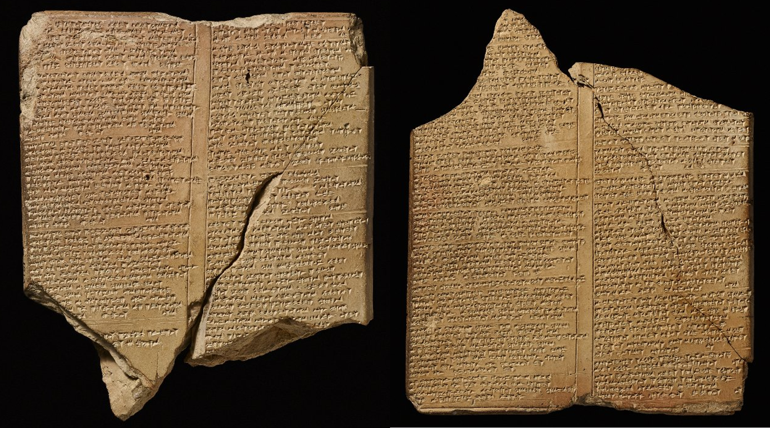
Cuneiform & the Astronomical Diaries
Cuneiform is a complex script constructed from a variety of wedge and line shapes produced by pressing the tip of a reed into wet clay. To understand this, the text must undergo a process of transliteration and translation.
Image 108548, British Museum, 2019
Finkel & Taylor, 2015
Sachs & Hunger
American Assyriologist Abraham Sachs (1915-1983) worked on the astronomical diaries for over thirty years. He passed along this work to Hermann Hunger before his death in 1983, who completed the transliterations and translations,
highlighting that there are more tablets in the British Museum probably belonging to this series, leaving it unfinished in its current form (1988). Sachs & Hunger have published six volumes of astronomical diaries (652-61 BC). The first three form the foundation of the CLICAB project.

Slide 5
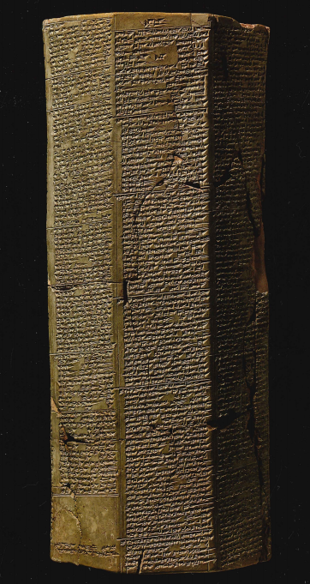
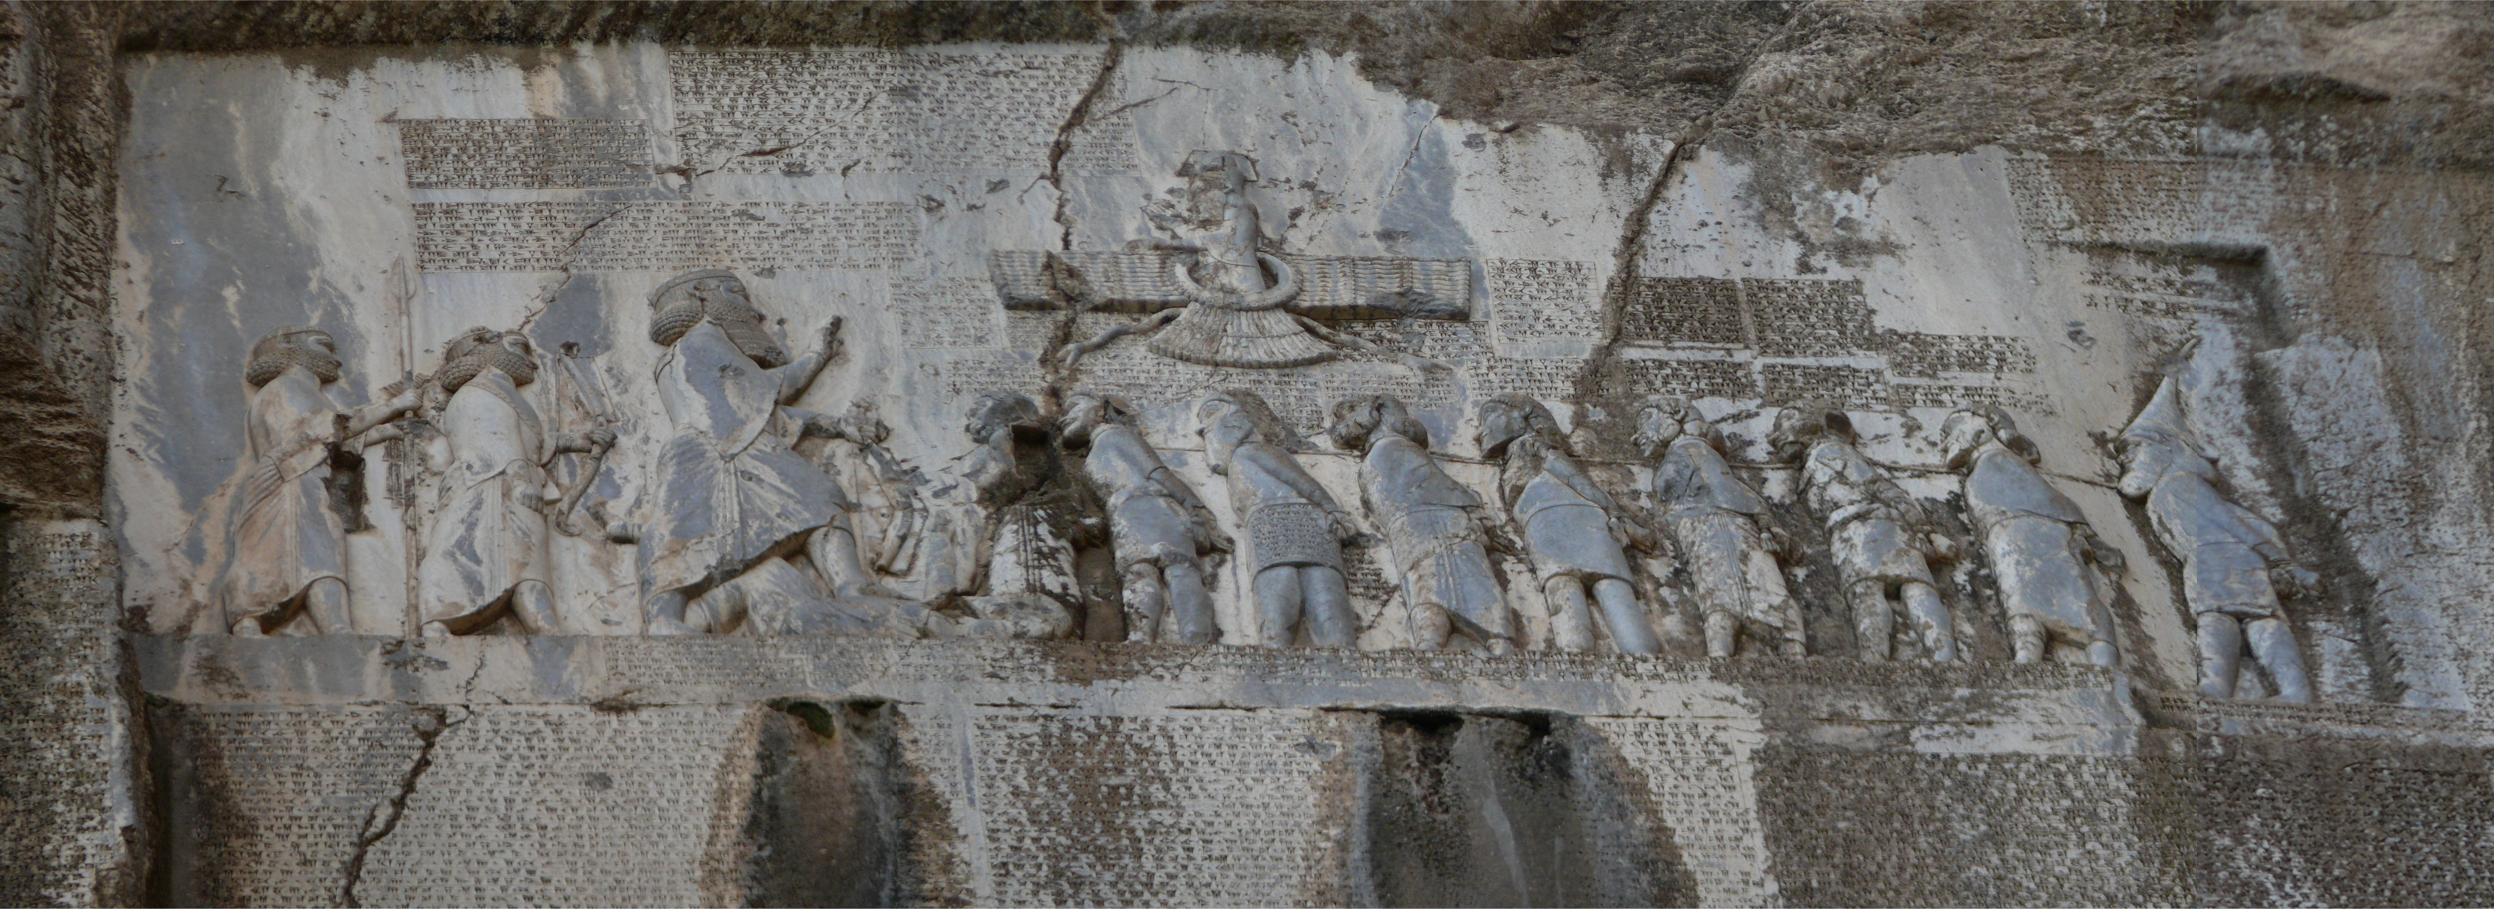
Behistun Inscription
Tiglath-Pileser I (1140-1076 BC)
Image 1621, BM 91035 British Museum, 2019
Length 40cm; Width 17.78cm
This trilingual inscription stone on Mount Behistun in Iran, contains Old Persian, Babylonian and the Elamite of the Persian King Darius. It is the Rosetta stone of cuneiform writing and was critical in cracking the code of Babylonian when decipherment began in the 1840s.
This octagonal prism stone contains the military campaigns of Tiglath-Pileser I. The Royal Asiatic Society ran a competition in 1857 where four leading scholars submitted independent translations of this stone. The success of the competition led to over 50,000 translations completed over the following century.
Behistun Inscription, Dynamosquito/Flickr, 2009

Slide 6
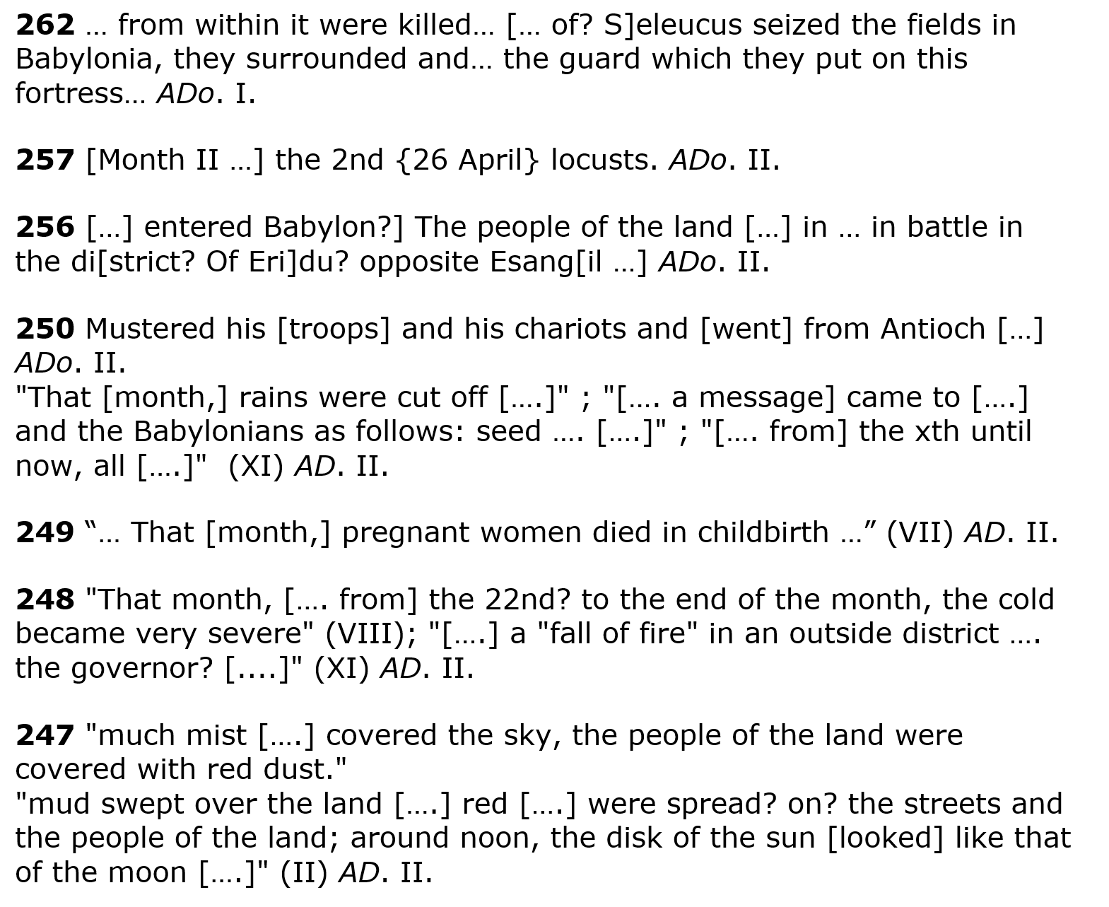
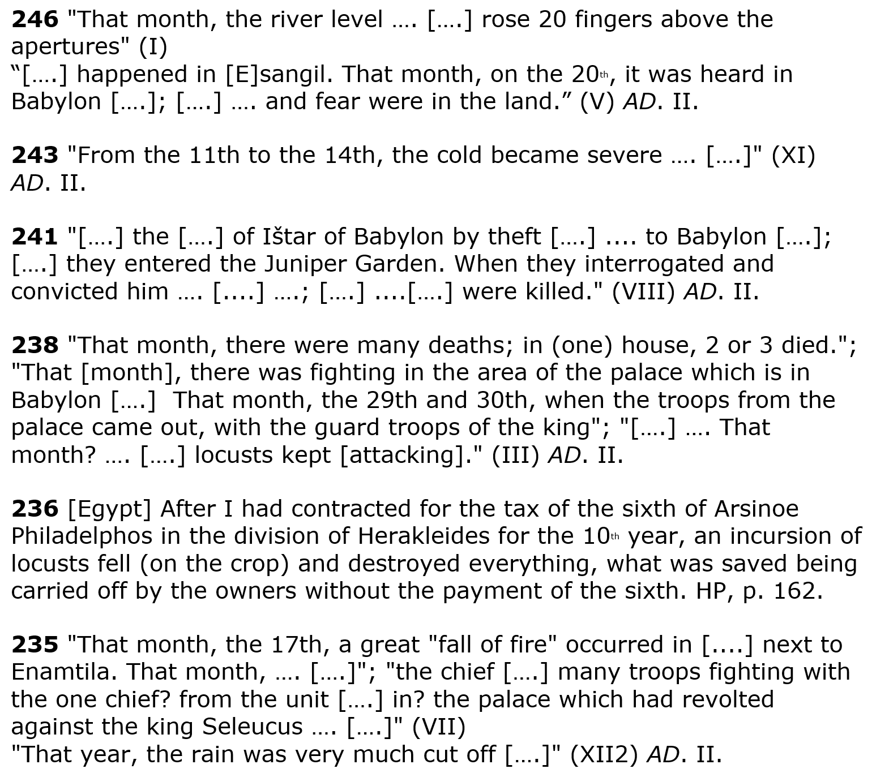
Diary Entries
Diary entries included river levels, historical information including unusual events, river heights, monthly price data, astronomical information & daily weather. References to red hazes, red rainbows stretching across the sky, the sun setting in a box, the disk of the sun looking like that of the moon are all recorded in the diaries. These may indicate volcanic sunsets and dust veils. The entry in 247, much mist, land covered in red dust, the disk of the sun looked like that of the moon, all indicate reduced visibility in the sky and debris (red dust) from a volcano, which occurs in the same year, as identified by Sigl, et al 2015 (DOI: 10.1038/nature14565).

Slide 7
Transliteration
(conversion of characters from one form of text into another)
Translation
(converting text from one language into another)
This is a sample of transliterated (above left) and translated (above right) text from Vol. 3 of the Astronomical Diaries. The cuneiform writing was first converted into characters and then this was translated to English. Using the keys below, the information is coded into excel sheets.
Keys
1 = overcast
2 = haze
3 = cold
4 = rain
5 = clouds
6 = fog
7 = sky (unspecific)
8 = rain shower
9 = wind
10 = mist
11 = rainbow
12 = thunder
13 = lightning
14 = bright
15 = halo / corona
16 = Sirius phenomenon
17 = Eclipse (L) / (S)
18 = meteor / comet
19 = missing data
20 = equinox / solstice
21 = Position stars / planets
22 = cloudburst
23 = disk
24 = hail
25 = earthshine
26 = dew
27 = storm
28 = famine
29 = cloudbank
30 = earthquake / quake
31 = ZI IR (no translation)
32 = PISAN DIB
33 = mud
34 = tornadoes
35 = fall of fire
36 = locusts
40 = river
….
49 = miscellaneous
PRICES
50 = barley
51 = dates
52 = mustard
53 = cress
54 = sesame
55 = wool
nn = no numbers

Slide 8
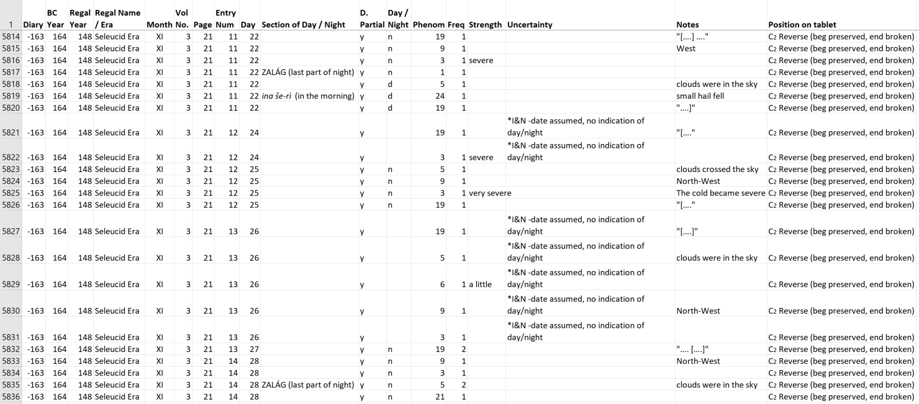
The excerpt from the above slide looks like this when coded.

Slide 9
The Coding Process
Line #11
Using the keys listed on slide #6, entries in the diary such as the excerpt on the right, are coded and entered into an excel worksheet. Each variable is keyed into the excel sheet under column P ‘phenomenon’ and all associated information is keyed into the appropriate cells. Line #11 is coded above and line #12 below, each with entry number 11 / 12 and the phenomenon highlighted.
Line #12

Slide 10
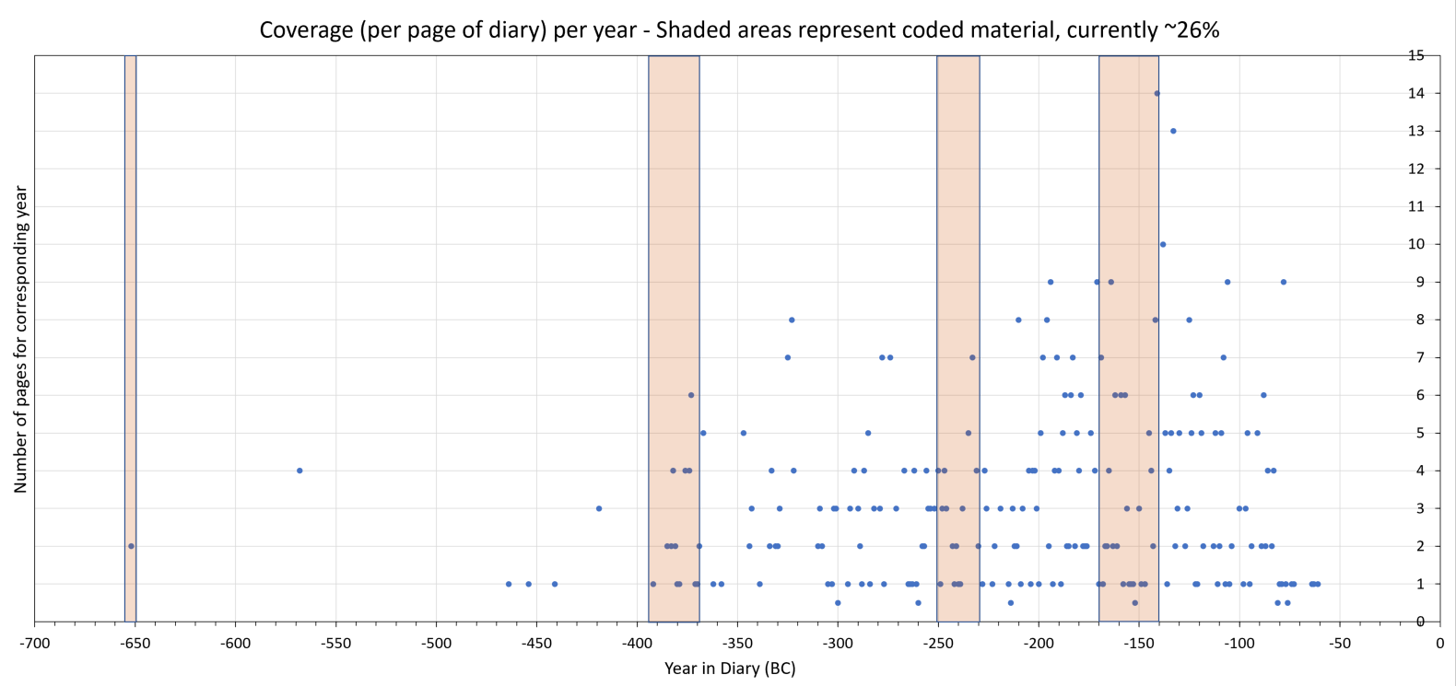
Coverage per year – Shaded areas represent coded material (~26%)
Each point represents the number of pages available for each year in the Astronomical Diaries. There are more tablets available between ~400BC and 61 BC. This may be due to higher levels of recording during this time, or there may be tablets yet to be translated that form part of this series, as indicated by Hunger (1988). The shaded areas show the sections of the diaries that have been coded to date, approximately 26%.

Slide 11
Frequency of variables through period -651 to -61 (where coded, ~26%)
We have excluded a few variables as they would skew the data further than shown here. E.g. the key ‘missing data’ provides 2864 hits and 2921 for ‘planetary information’.
This chart provides us with an indication of the variables we can reconstruct with confidence. Wind and clouds appear often in the diaries and tell us different things about the daily weather. For example, there are two main ways to indicate cloud cover, clouds crossing the sky or clouds in the sky. One inhibits observations, while the other represents clouds ‘taking their position in the sky’ (Sachs & Hunger, 1988).
11

Slide 12
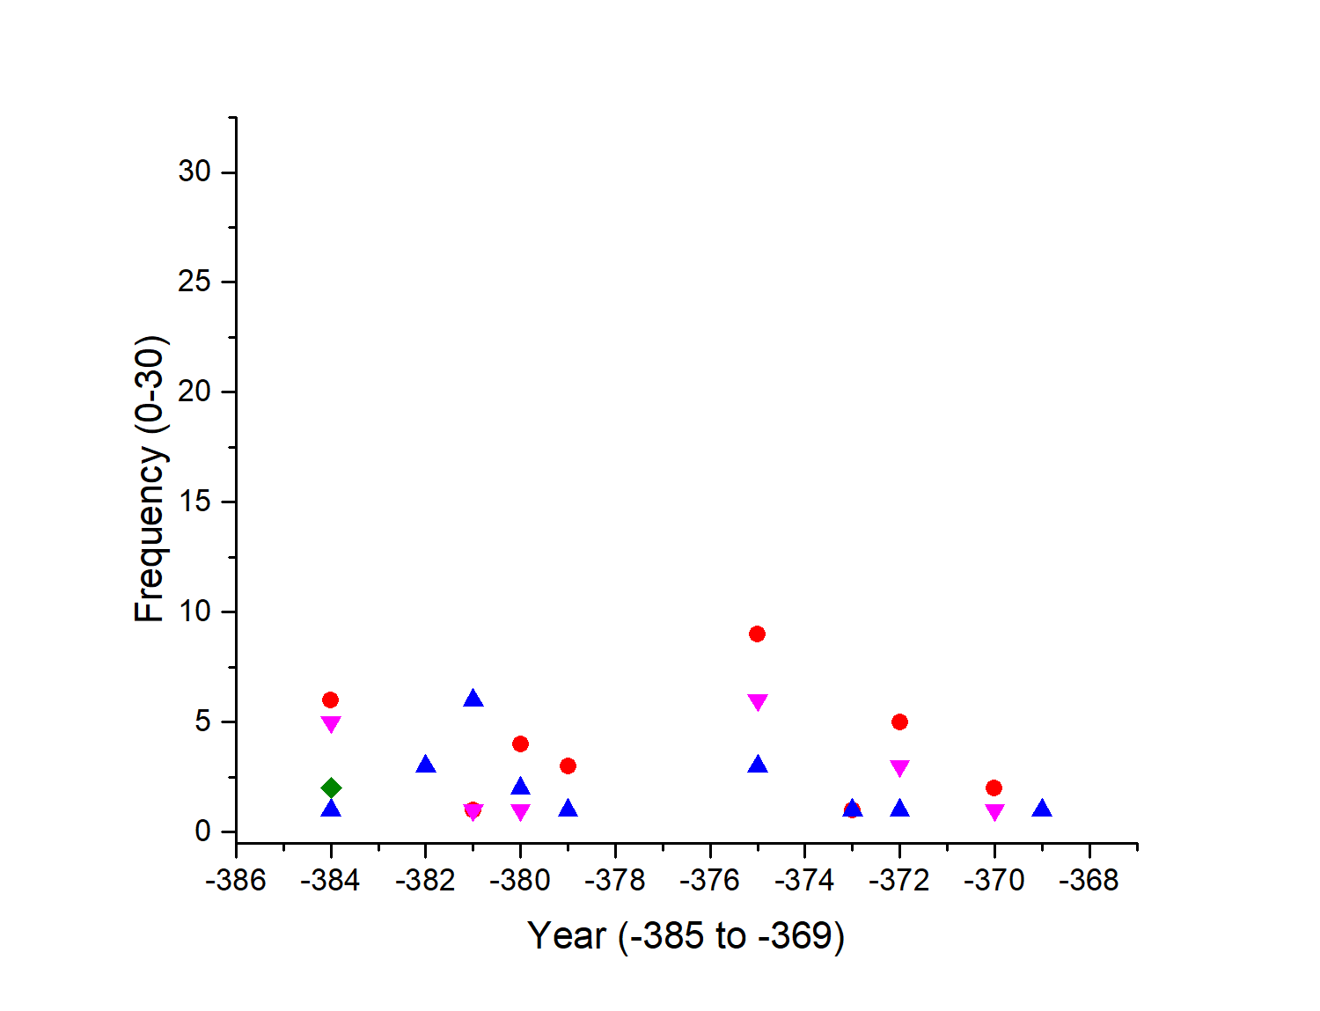
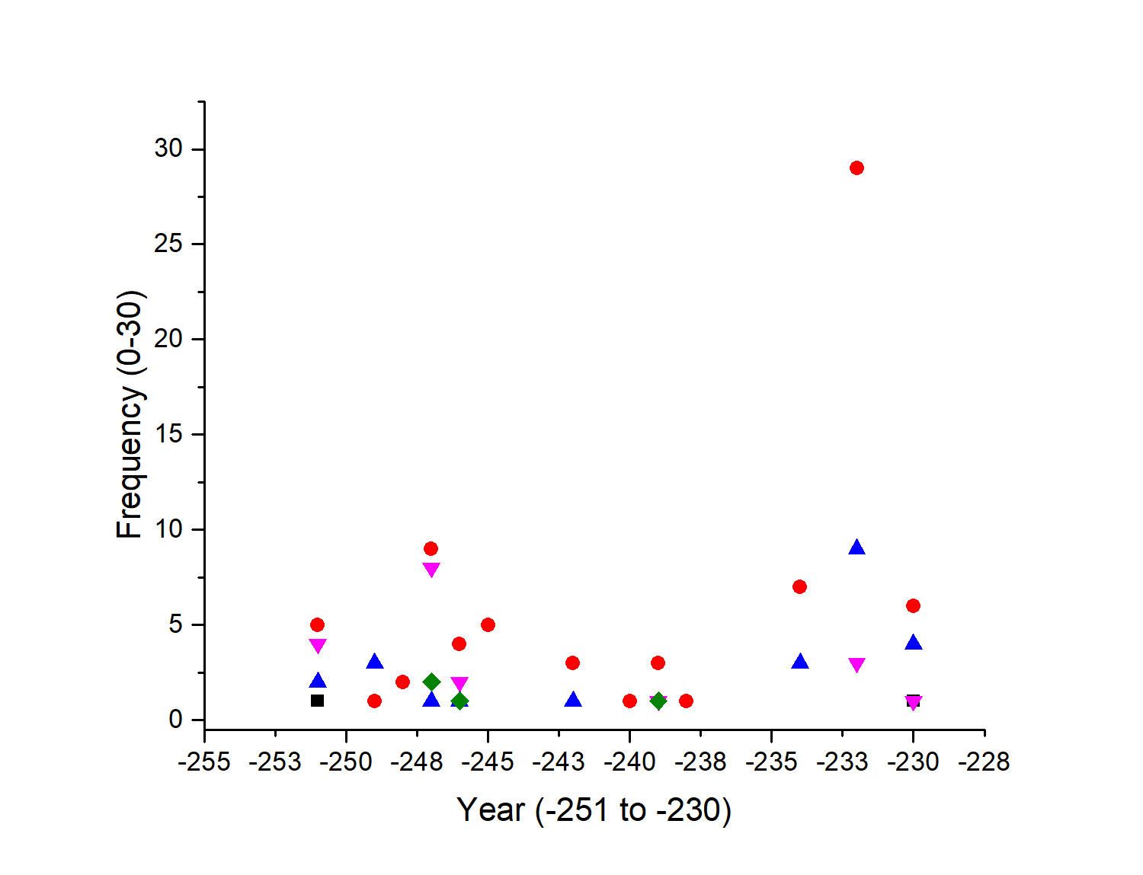
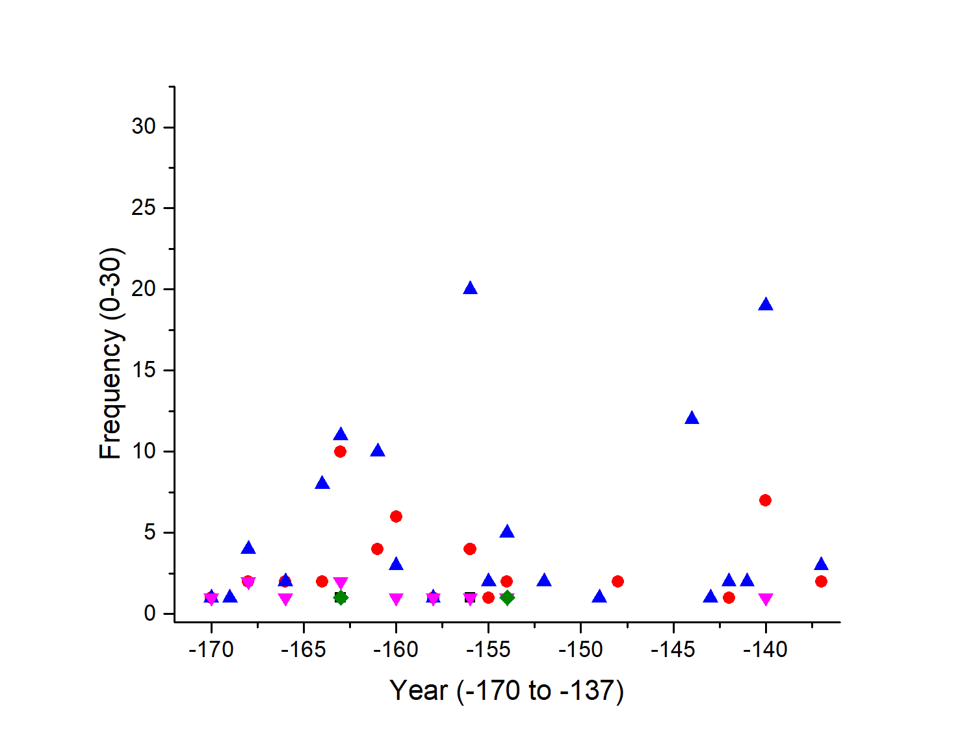
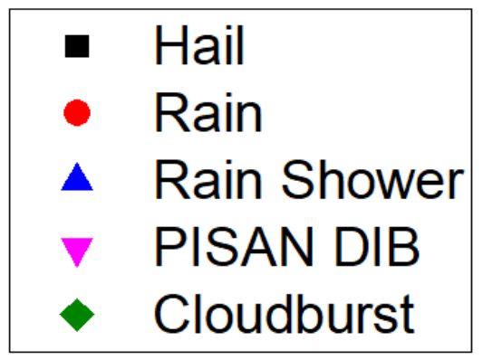
Frequency of references to precipitation recorded through the period (where coded, ~26%)
PISAN DIB – this variable was not translated by Hunger & Sachs. It is thought to relate to rain, from the word pisannu, “just as a (rain) shower from the sky does not return to its place, as water of a pisannu does not turn back”
“the weather became cloudy, but rain did not fall; rain fell, but it did not loosen the sandal” – Babylonian proverb, generally found in conjunction with the term rain, in the ~26% coded already, there are 11 variations of this phrase, where the sandal is, or is not removed.

Slide 13
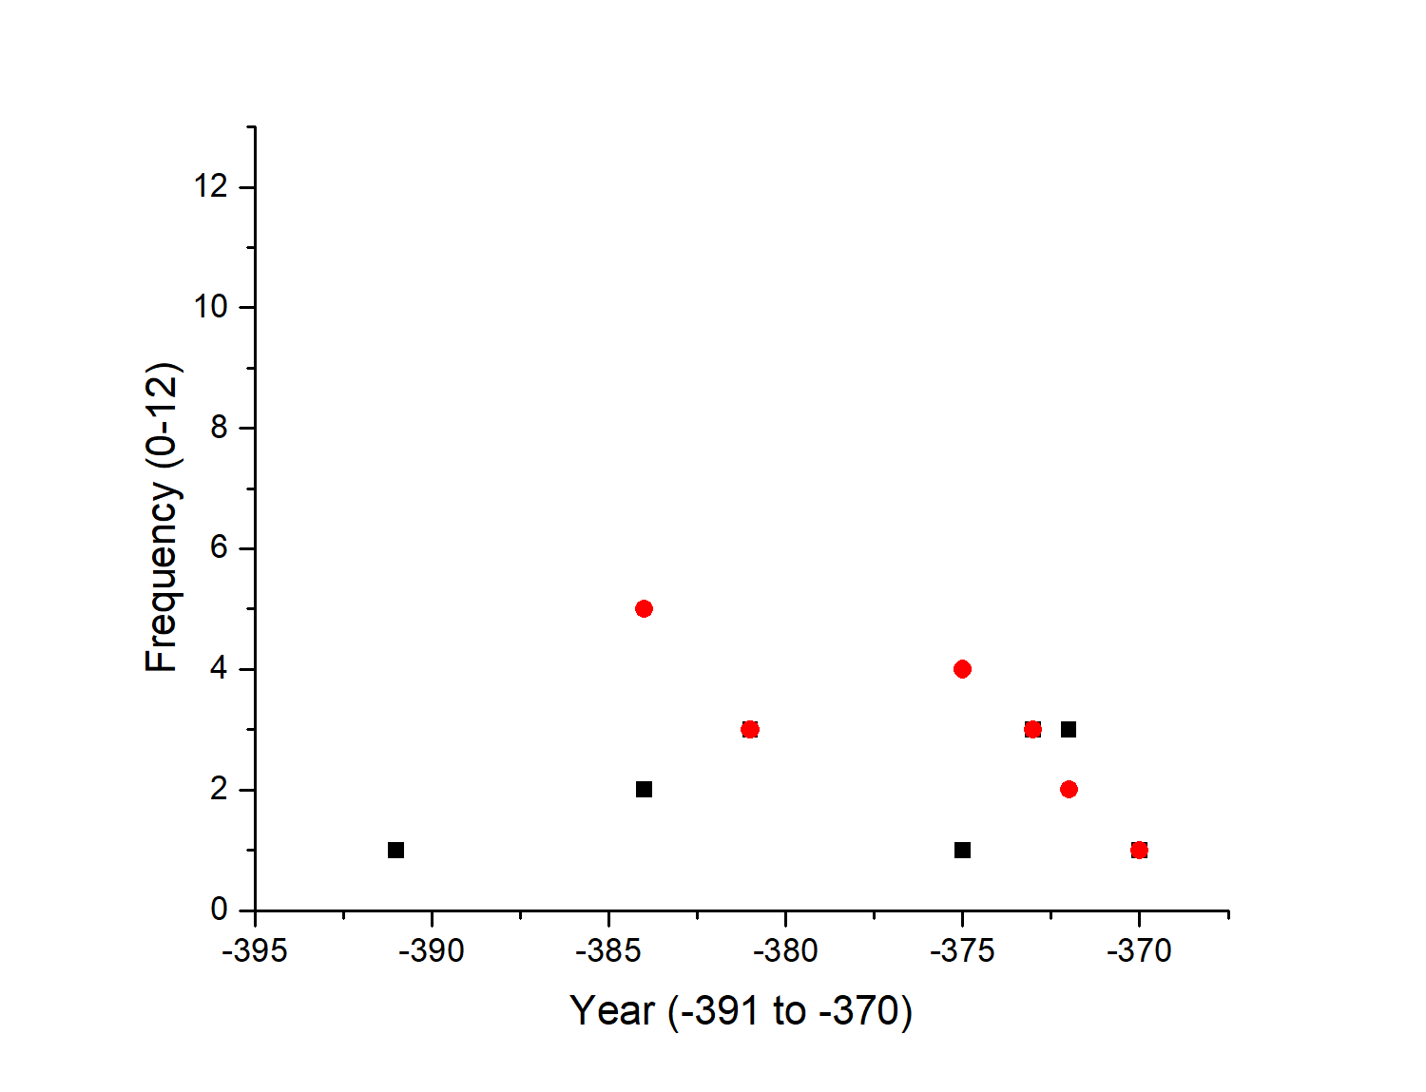
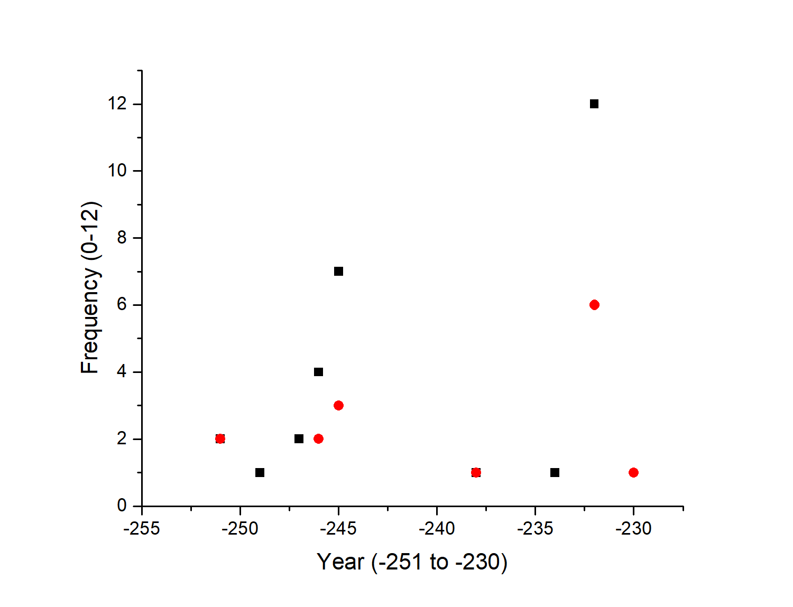
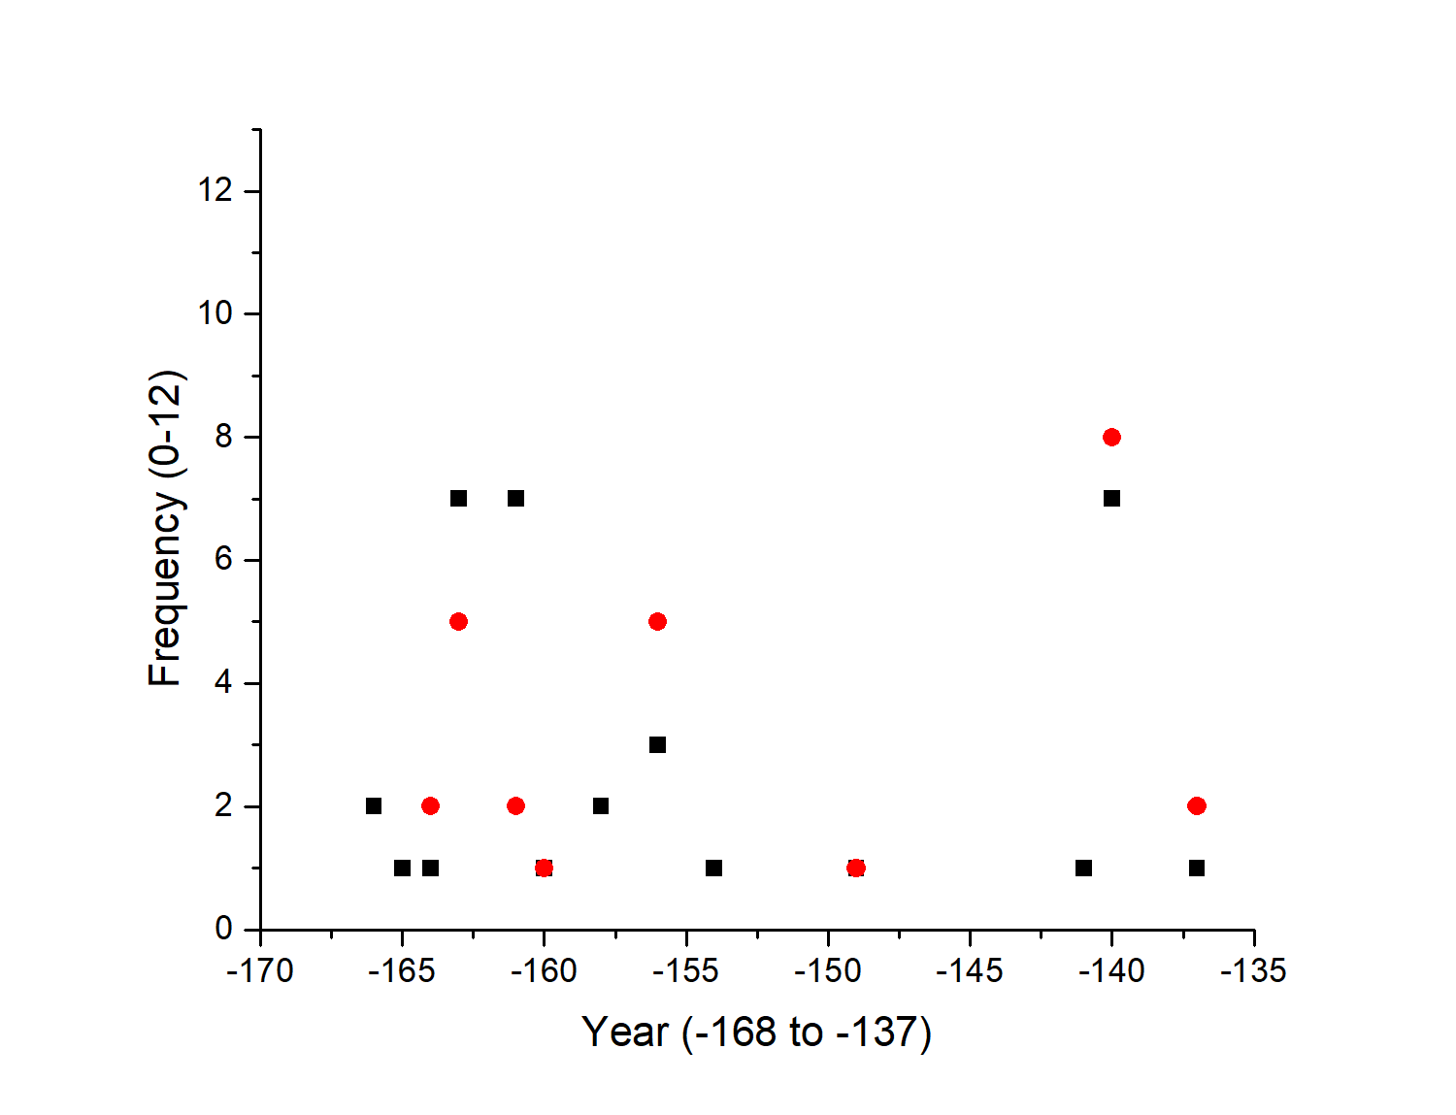
Frequency of references to thunder, lightning & storms recorded through the period (where coded, ~26%)
Thunder can be brief: ‘it thundered once’, or loud: ‘wailing thunder’ / ‘much wailing thunder’; it can be slow or strong.
Lightning is described alongside ‘flashed’, ‘flashed continuously’ or ‘much lightning’, sometimes a combination of all three.
Storms are predominately associated with south and east directional winds.

Slide 14
Wind Direction Frequencies recorded through the period (where coded, ~26%)
It is evident from the bar chart that there is a skew on the recording of wind directions in the diaries. We expect to see more distinctions like this through time. Some changes will align with change in regimes and dynasties, others might change with new scribes. We will chart these changes as we
find them.

Slide 15
What’s next?
CLICAB will continue to reach the project aims. I will continue to code the diaries to inform a climate reconstruction for the region, while my project colleagues will continue to interrogate the thesis that patterns of violence and conflict are linked to climatic changes. If you wish to know more about the project (beyond the EGU ‘chat’) please contact me (mcgoverh@tcd.ie).
If you are interested in finding out about the influence of volcanic events on the kingdom of Babylonia, please attend ‘Volcanic impacts on climate and society in First Millennium BCE Babylonia’ on Wednesday 6 May, 8.30-10.15 (CEST), more information here: https://meetingorganizer.copernicus.org/EGU2020/EGU2020-22127.html
Irish Research Council Laureate Starting Award Fund
Awarded to Dr. Francis Ludlow
Thank you for your interest & participation.

