Slide 1
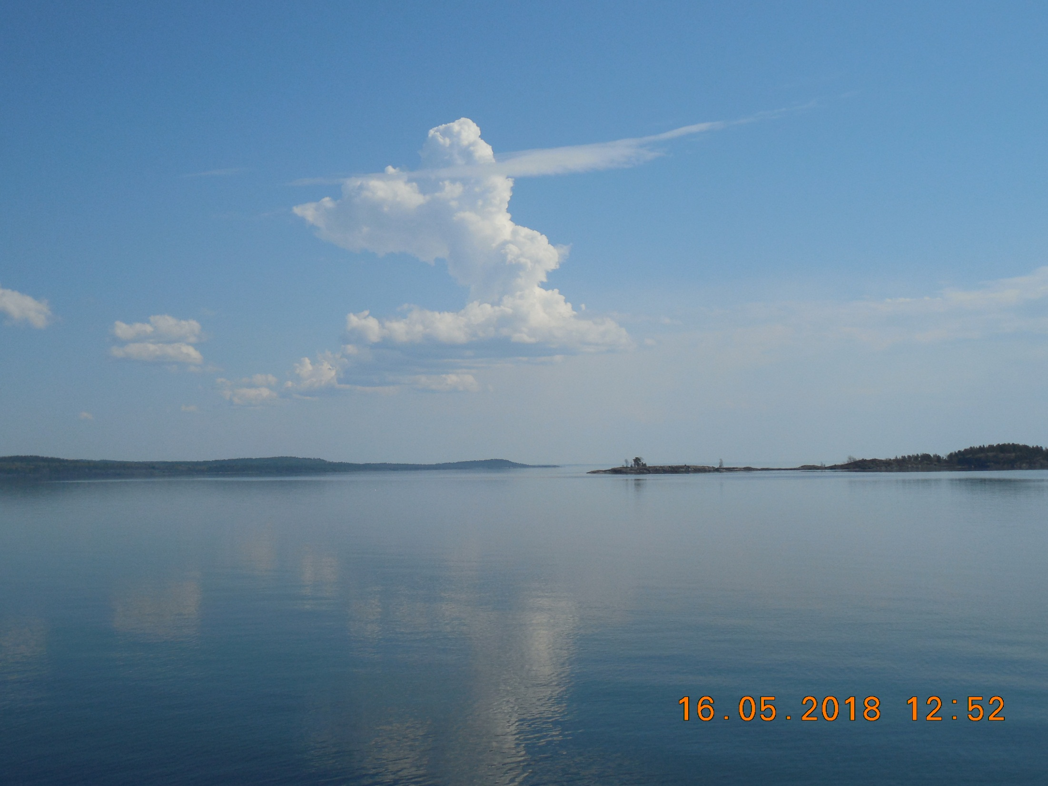





Studying the bottom landscapes of Lake Ladoga with use of underwater vehicles
Vladimir Anokhin (1,2,3) vladanokhin@yandex.ru
Dina Dudakova (1)
Mikhael Dudakov (1)
Institute of Limnology RAS, St. Petersburg, Russian Federation
St. Petersburg Research Centre RAS, St. Petersburg, Russian Federation,
3 Herzen State University, St. Petersburg, Russian Federation

Slide 2
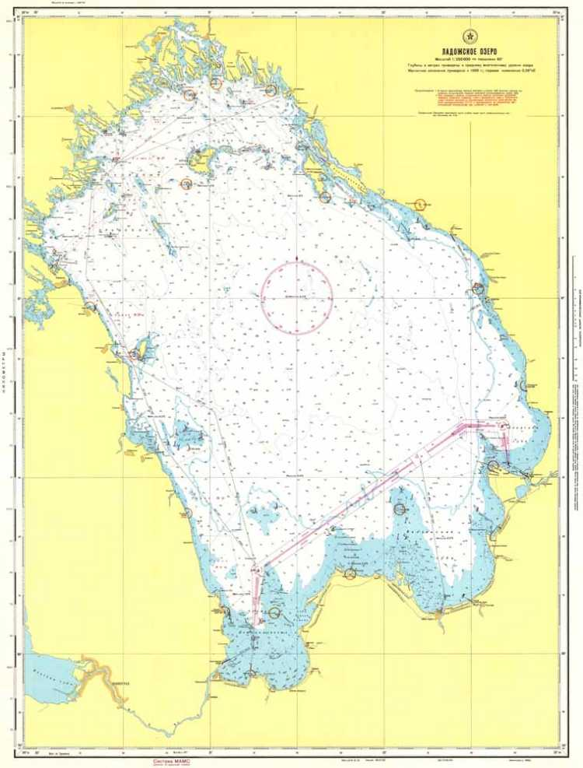
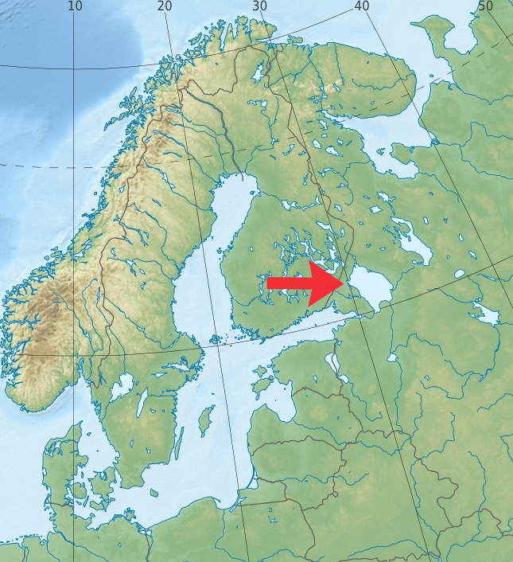
Lake Ladoga - the largest freshwater reservoir in Europe

Slide 3
General
In 2018-19, the Institute of Limnology of the Russian Academy of Sciences (IL RAS) carried out geological and geomorphological studies of the bottom and shores of Lake Ladoga within the framework of the State project of the IL RAS No. 0154-2018-0003 / 5. The research included the study of the bottom landscapes of Lake Ladoga with help of a series of underwater vehicles Limnoscout, designed and assembled at the IL RAS.
Underwater photo and video of the bottom in the coastal zone was carried out by the Limnoscout-230 vehicle from a boat. Each video filming polygon included 2 continuous video profiles of 1-2 km normal to the shore, and 1 connecting profile parallel to the shore of 200-400 m, in the deep part.
Underwater video filming of the bottom in the open water area of the lake was carried out by the Limnoscout-50 vehicle from the board of the r/v “Poseidon”, by point diving, in which the bottom was shot within a radius of 2-4 m from the dive point.
Maximal deep of studies was 117 m.
All underwater surveys were accompanied by echo-sounding surveys and GPS tracking.
In total, 24 underwater video filming polygons in the coastal zone and 23 underwater video filming points in the open water area of the northern part of Lake Ladoga were worked out.
The collected extensive photo and video materials made it possible to make preliminary typology of the bottom landscapes of Lake Ladoga and evaluate their condition.
Several new important facts of the structure of the bottom of Lake Ladoga and biota distribution were discovered, in particular:
- For the first time on the bottom of Lake Ladoga, an invasive species of mollusk Dreissena polymorpha was discovered, which in other large lakes has a significant impact on ecosystems.
- For the first time at the bottom in the northern part of the lake, outlets of presumably Riphean sandstones were discovered, which significantly complements the geological picture of the area.
- For the first time at the bottom in the northeastern part of the lake an abnormally deep occurrence of coarse deposits was discovered, which is likely to be associated with the intense activity of glaciers.

Slide 4

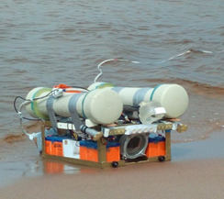
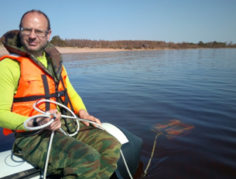
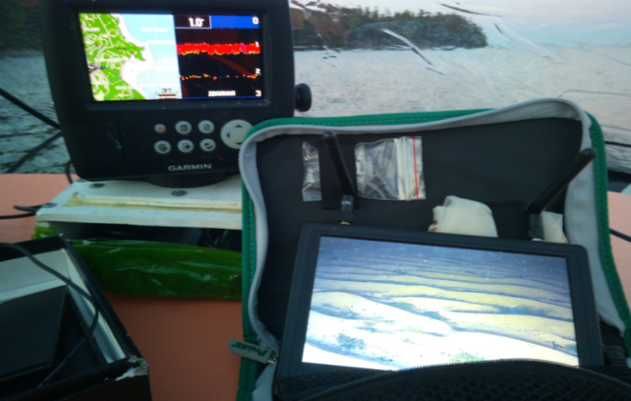
Given the acute shortage of fresh water in the modern world, the issue of preserving its natural sources, in particular Lake Ladoga, the largest freshwater reservoir in Europe, is particularly acute. Studying the quality of Ladoga’s water and the parameters that influence it, in particular, the state of bottom landscapes, is a critical task for the livelihoods of the vast territories.
Traditional point methods for the effective study of bottom landscapes are clearly not enough, and attempts to use underwater vehicles to study the bottom of Lake Ladoga have so far been unsuccessful.
Limnoscout-50
Limnoscout-230
In the Institute of Limnology RAS
created a series of underwater vehicles
Limnoscout, originally adapted to work in the conditions of Lake Ladoga.
This is the first successful experience of using underwater vehicles to study the bottom of Lake Ladoga.
Limnoscout features:
Estimated depth of immersion - 300 m or more;
It is possible to work from a ship, boat, or offline;
The devices are resistant to collision with the bottom, including with stones, rocks;
The backlight system is customizable and allows you to work with high turbidity of the water;
The high resolution of the cameras makes it possible to isolate small relief details, geological formations, biota elements, etc.
The equipment has high maintainability and mobility.

Slide 5
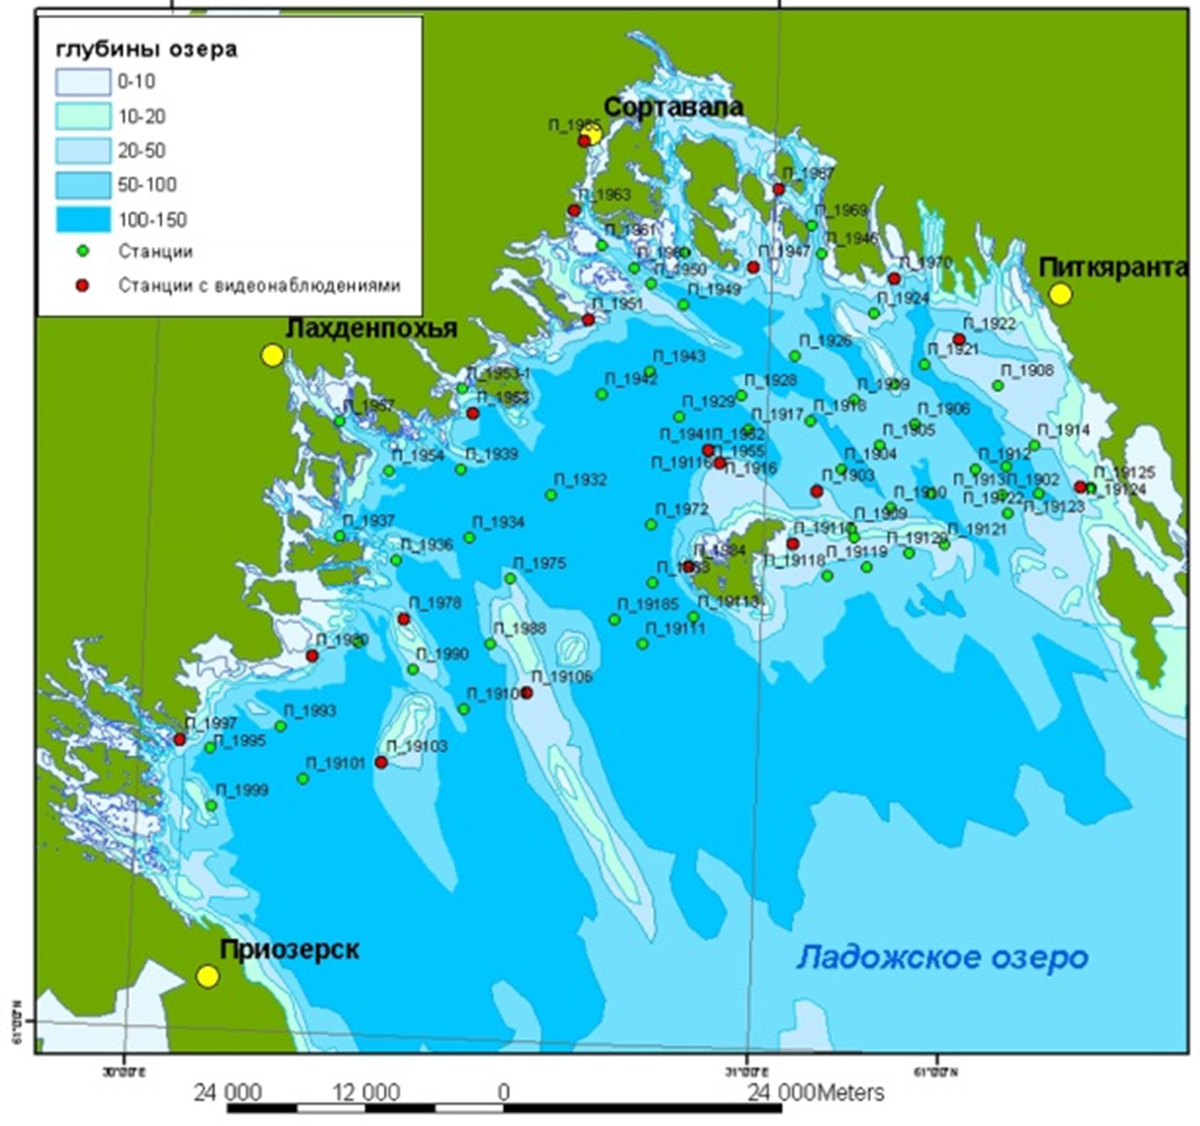
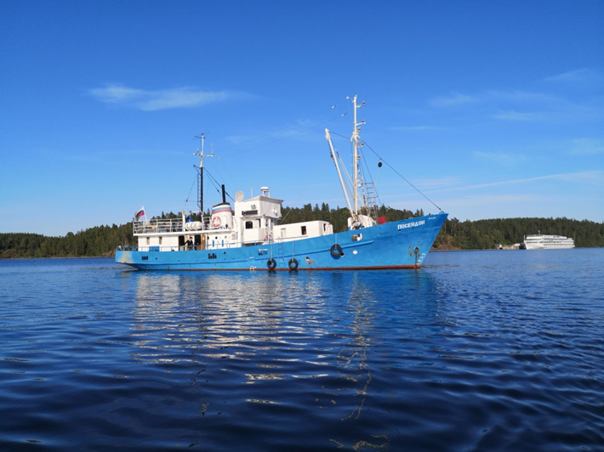
For the period 2018-2019
underwater video recording was carried out from the board of the R / V Poseidon at 23 stations in the northern part of the lake.
Numerous photo and video materials received
- depths
r/v Poseidon
Map of studies in 2019 in the north part of the Ladoga lake with r/v Poseidon
Green points – bottom samling
Red points – bottom videos

Slide 6
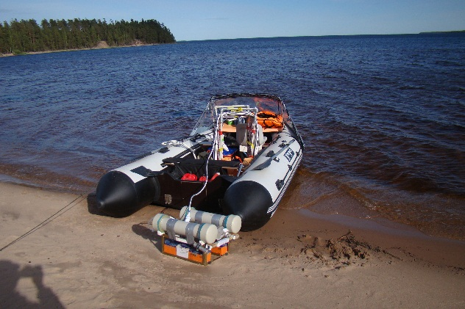
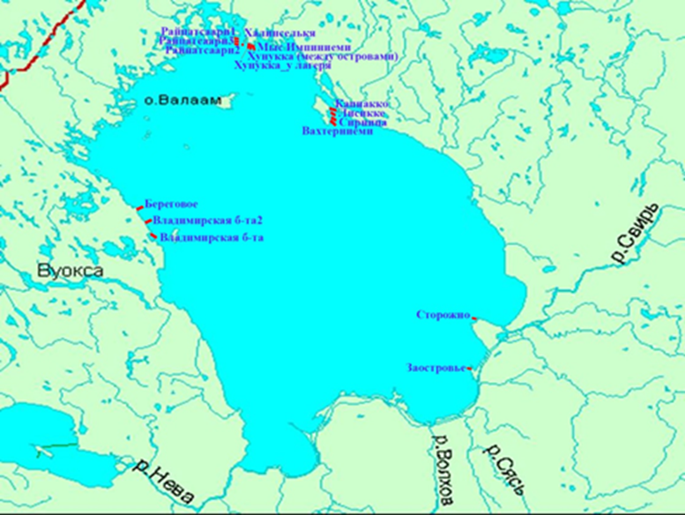


For the period 2018-2019
24 video profiles were worked out in different regions of Lake Ladoga
Boat for coast studies
LADOGA LAKE
Map of coast studies 2020
blue triangles - the location of the polygons
for the study of coastal bottom landscapes

Slide 7
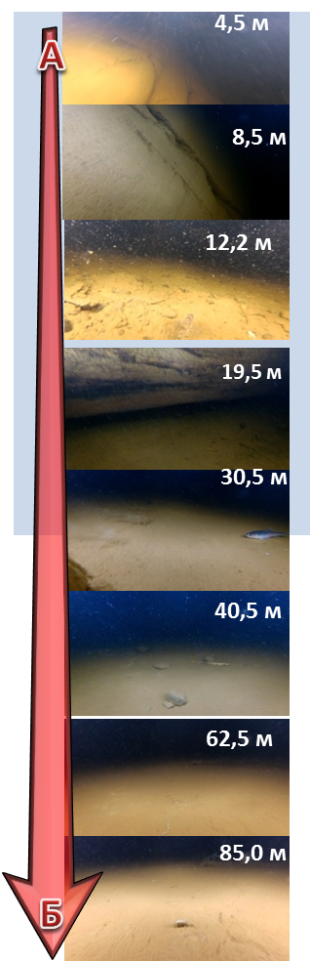
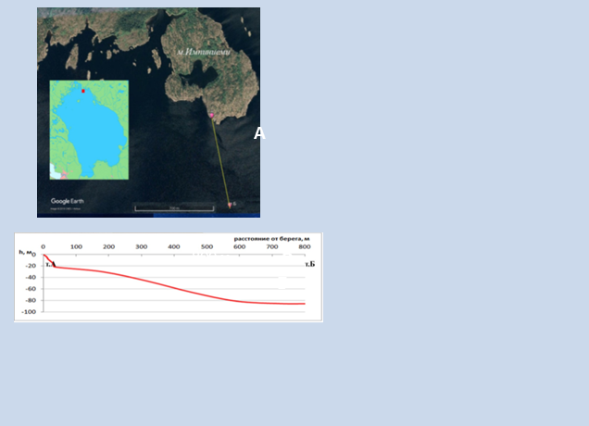
New facts on the structure of the bottom of Lake Ladoga, discovered only for the period 2018-19. using an underwater vehicle
Depths:
An example of an underwater video profile: distribution of bottom sediments and biota at different depths

Slide 8
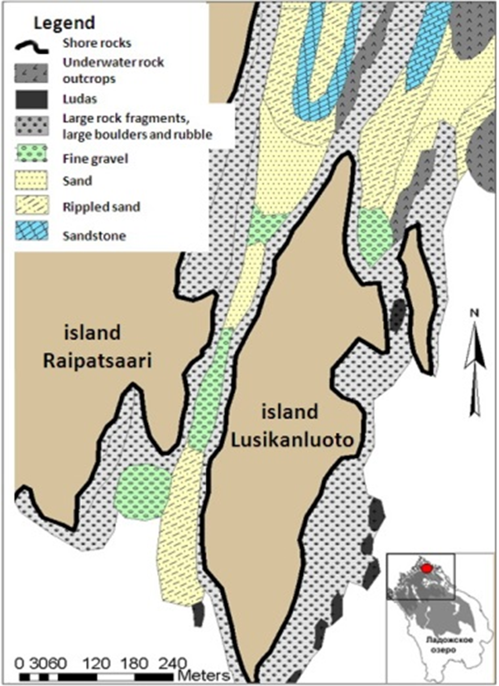
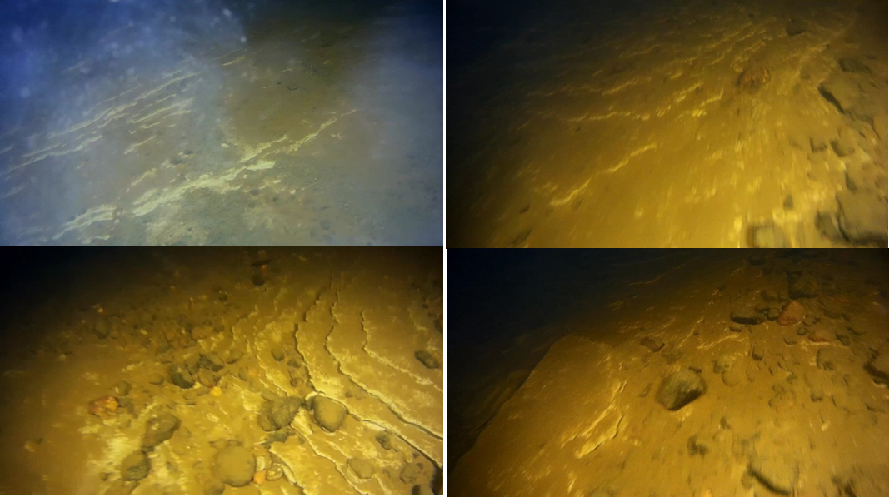
New facts on the structure of the bottom of Lake Ladoga, discovered only for the period 2018-19. using an underwater vehicle
An example of lakebed mapping is shown on the right figure. Large rock fragments, boulders and rubble occupy the largest part of the investigated lakebed.
Within the underwater rock outcrops in the northern part of the study area, sandstones of probably Riphean age are exposed on the lakebed (photos below).
The presence of such rocks far in the north of Ladoga is a new fact of the geological structure of this region.

Slide 9
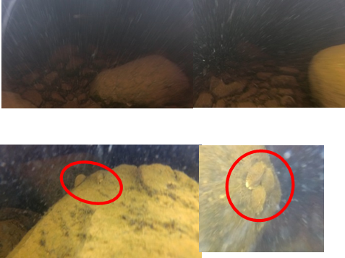

New facts on the structure of the bottom of Lake Ladoga, discovered only for the period 2018-19. using an underwater vehicle
An abnormally deep occurrence of coarse deposits in the eastern part of Lake Ladoga has been established
Detected
invasive species of bivalve mollusk Dreissena polymorpha

Slide 10
The use of underwater photo and video in combination with traditional methods for studying the bottom landscapes of Lake Ladoga has shown the high efficiency of these methods. The studies will be continued.
Directions for further work
Typification and characterization of the landscape zones of Lake Ladoga with the allocation of zones of anthropogenically altered landscapes;
Identification of the processes that formed the bottom landscapes;
Drawing up landscape maps of individual regions and the entire Lake Ladoga;
Compilation of the Atlas of landscapes of Lake Ladoga;
Compilation of a database of landscapes of Lake Ladoga
The publication was compiled with the support of the State Themes:
- Theme No. 0154-2019-0001 of the Institute of Limnology RAS, State Registration No. AAAA-A19-119031890106-5;
- State theme of the St. Petersburg Research Centre RAS No 82.1 FNI

Slide 11
