Slide 1
Changes of groundwater levels and land use with the introduction of canal system in Maheshwar block of Narmada basin (Central India)
Sakshi Shiradhonkar ^{*1} and Tomochika Tokunaga¹
¹Geosphere Environment Systems Laboratory,
Department of Environment Systems, Graduate School of Frontier Sciences,
The University of Tokyo, Japan
EGU 2020 Online Conference, May 04, 2020
Please consider these comment boxes as virtual narration.
*Corresponding author: Sakshi Shiradhonkar
E-mail address: sakshi_rs_gis@envsys.k.u-tokyo.ac.jp

Slide 2
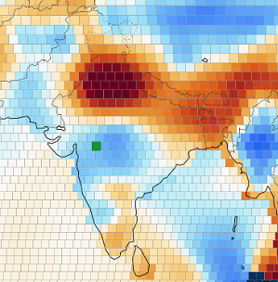
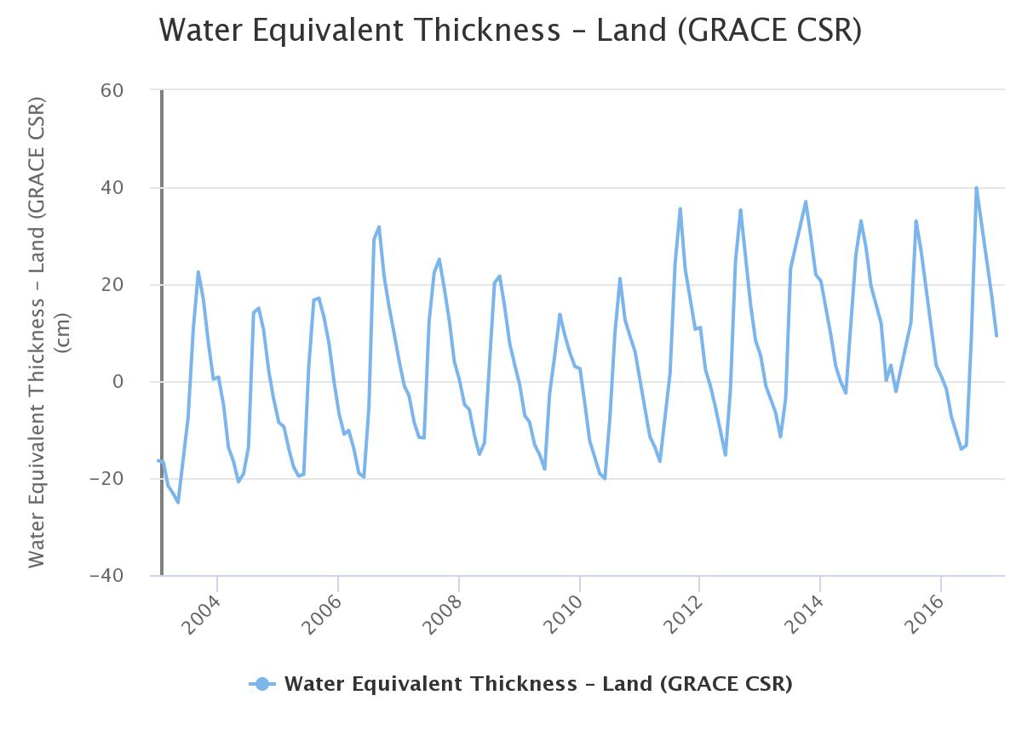
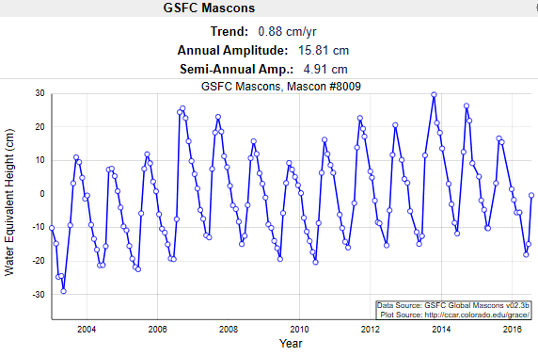

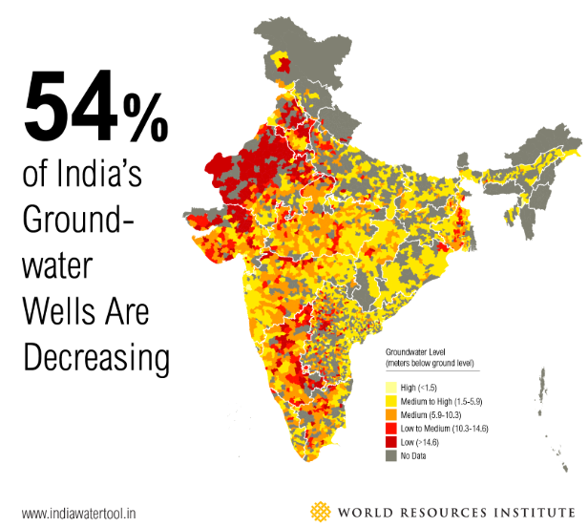
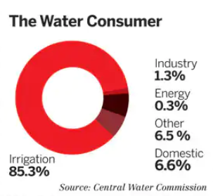
1. Background
Terrestrial Water Storage (TWS) increase indicated by GRACE satellite and previous studies in central India during 2003-2016.
Three possible reasons for TWS rise:
Increase of surface water (SW) storage
Increase in Groundwater (GW) storage
Increase in Soil moisture (SM) storage
Because TWS = SW + GW + SM
Surface water and soil moisture to be studied later.
Grid 8009 (highlighted in green) is the grid in which the study area is located..
0.88cm/year
As agriculture is the main occupation in India, groundwater utilized for irrigation is about 85% and is major concern since many studies claimed its severe decline in most regions of India.
Begin study focusing on Groundwater because,
Trend analysis by Mascon Visualization Tool showed an increase in TWS by 0.88cm/year (grid 8009).
Source: United Nations World Water Development report
Source: Central Water Commission
Source: www.indiawatertool.in
httpshttp://ccar.colorado.edu/grace/about.html
2

Slide 3
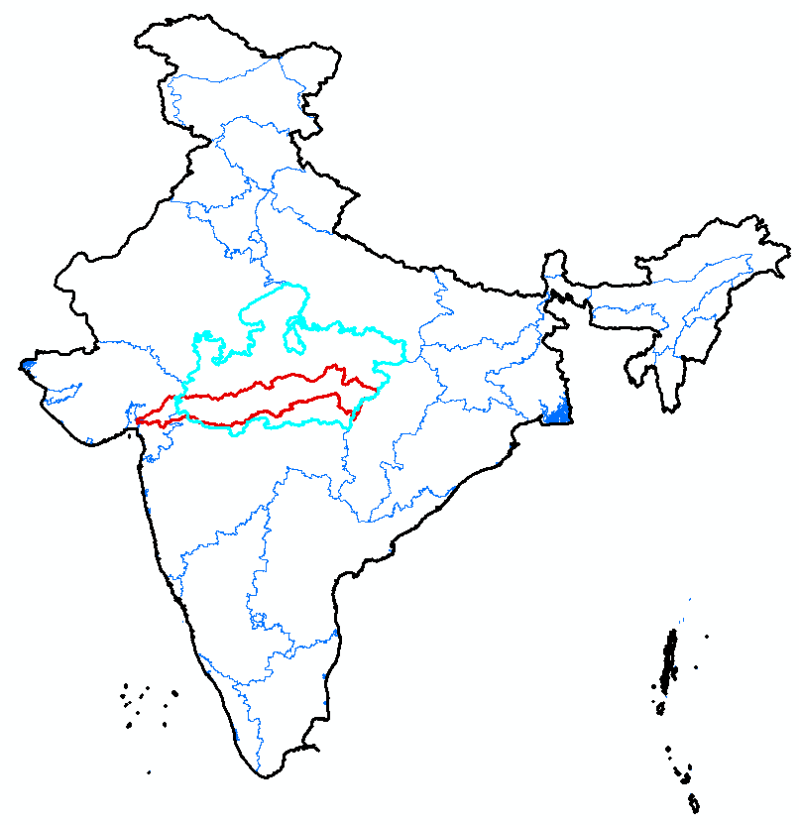
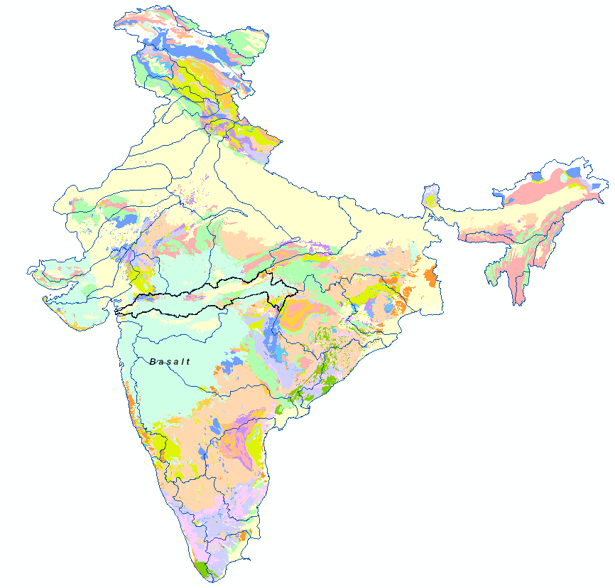
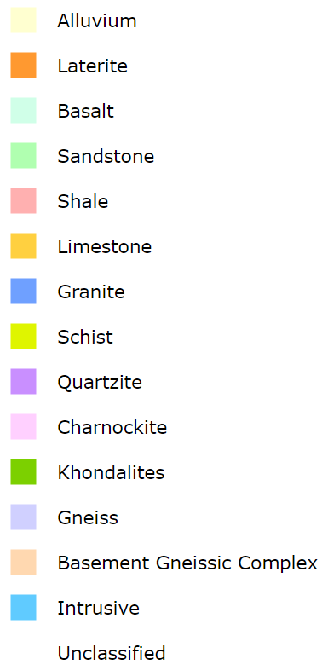
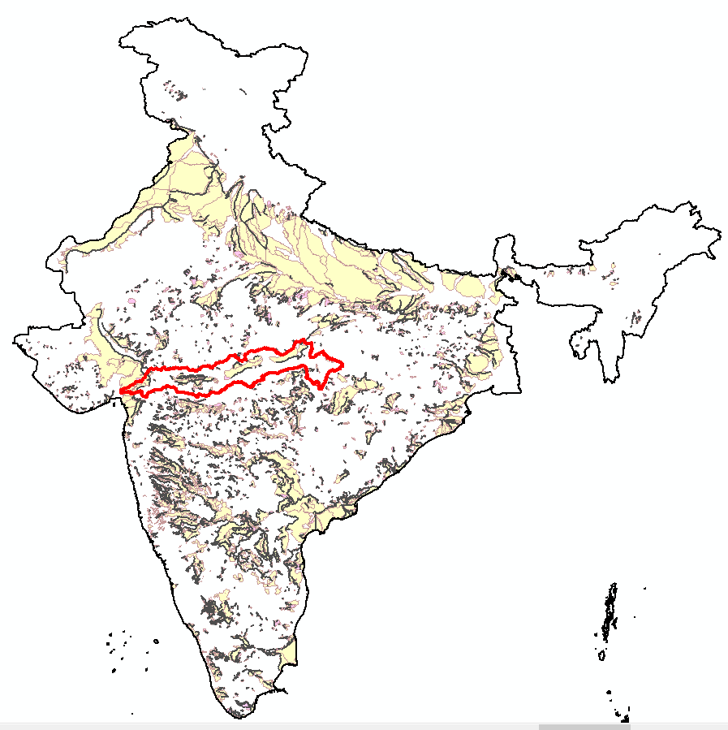
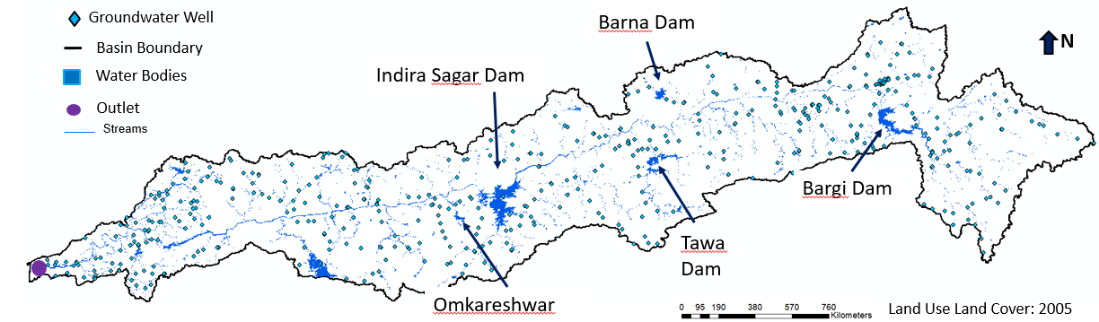
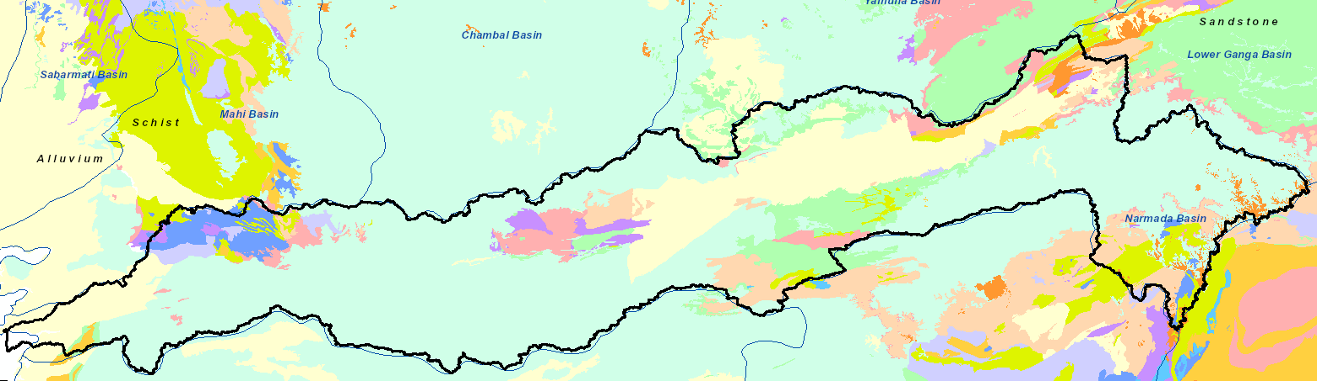
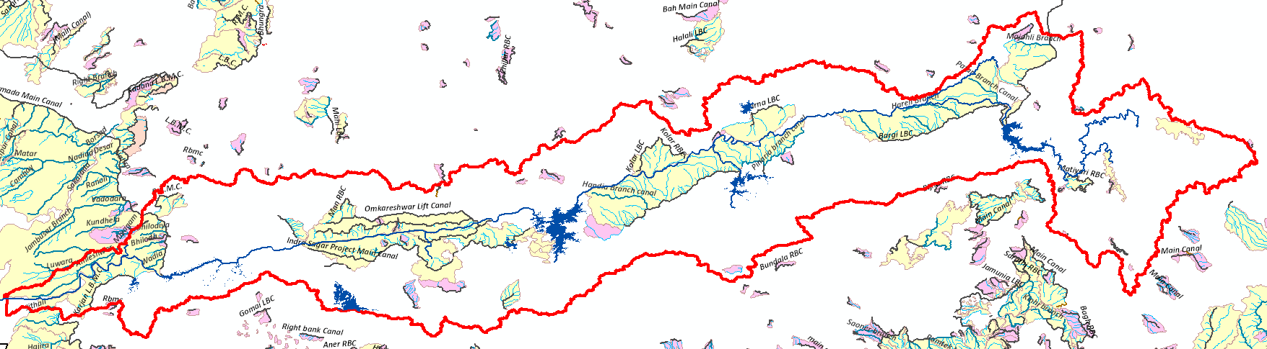
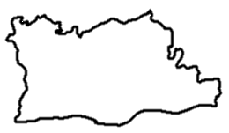
2. Study area: Narmada basin (Central India)
Canal Command Area (CCA) and Non-Canal Command Area (NCA) of the basin
INDIA
N
River length = 1312 km
River direction = West to East
Latest dam = Omkareshwar (2008)
Canal Operation (2010 ~)
Study site = Maheshwar block (simple canal network + single aquifer)
N
INDIA
Aquifer System of Narmada basin
Main CCA
Narmada river
Please use slide show to view the different maps of the study area.
Arabian Sea
Medium CCA
Arabian Sea
Bay of Bengal
Basin boundary
Bay of Bengal
Extension, Renovation & Modernization
Reservoirs
Maheshwar block
Maheshwar block
Maheshwar block
3

Slide 4
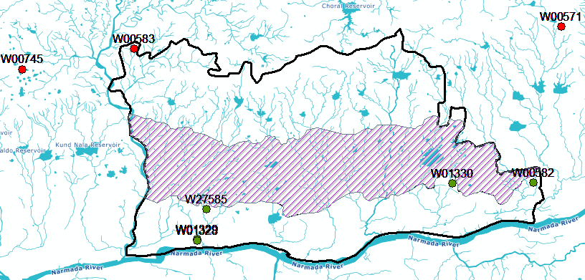
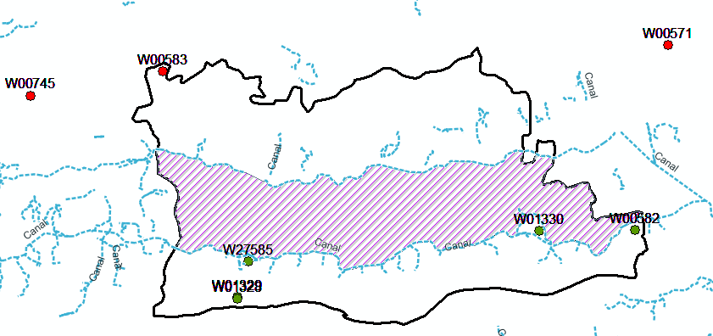
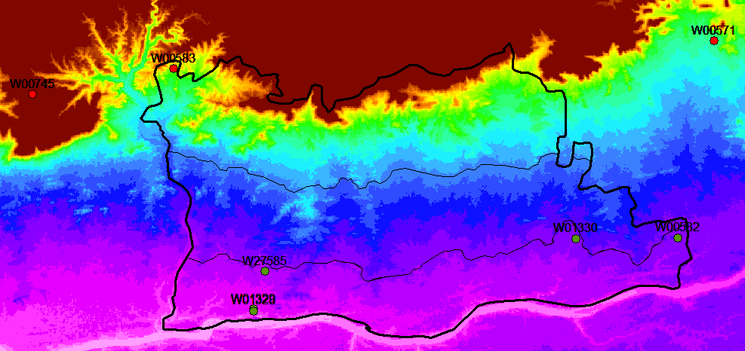
2. Study area: Maheshwar block
Please use slide show to view the elevation map, waterbody and canal network details of the study area.
River and other waterbody network
Canal Network
Elevation Map
Zone B
Zone B
Zone B
Zone A
High : 1317
Zone A
Zone A
W01328
W01328
W01328
Low : 0
Wells in Non-commanded area
Wells in Canal Command area
4

Slide 5
Please use slide show.
3. Methodology
4. Results
Choose study site -> Maheshwar block in Narmada basin due to single aquifer setting and simple canal layout.
Classification of wells based on location -> Wells in Command area (Zone A and B) and wells outside command area
Deriving statistics like Maximum/minimum depth, average, standard deviation of each well during pre-monsoon (dry) and monsoon (wet) season. This is calculated before (2003-10) and after (2011-16) the canal operation event.
Land use land cover (LULC) change detection by supervised classification method using Landsat series datasets. LULC change was studied between 2003 and 2016.
4.1 Statistics of Groundwater Wells located in the Omkareshwar Canal Command Area

Slide 6
Long-term trend of Groundwater well in Zone A (2003-2016)
Please use slide show to view the different groundwater well data.
There are no wells in Zone B
The well W27585 started operating since 2014
Due to insufficient data, such new wells were not accounted.
All data is taken from www.cgwb.gov.in

Slide 7
Groundwater Well Statistics (2003 - 2016)
As an example compare the before and after max. & min. depth for Well W00582. The water levels after the canal operation are higher as compared to the levels before the operation.
This can be an indication of water level rise due to less stress on groundwater (availability of surface water by canals)
Timeline | Well Code | Pre-monsoon |  |  |  |  | Monsoon |  |  |  |  | Annual
 |  | Slope | High | Low | Avg. | Std. Dev. | Slope | High | Low | Avg. | Std. Dev. | Slope | High | Low | Avg. | Std. Dev.
Before Canal System (2003 -2010) | W00582 | -0.24 | -8.20 | -10.50 | -9.62 | 1.10 | 0.05 | -3.07 | -5.83 | -4.56 | 0.97 | -0.01 | -2.12 | -10.50 | -6.47 | 2.11
 | W01328 | 0.16 | -4.81 | -6.70 | -5.67 | 0.67 | 0.00 | -3.49 | -4.70 | -4.26 | 0.51 | 0.01 | -3.49 | -6.70 | -4.83 | 0.75
 | W01329 | 1.39 | -7.31 | -14.07 | -11.17 | 2.95 | 1.03 | -5.80 | -7.65 | -6.65 | 0.93 | 0.24 | -5.80 | -14.07 | -8.32 | 2.76
 | W01330 | -0.08 | -3.91 | -7.25 | -5.95 | 1.50 | 0.31 | -2.17 | -6.00 | -4.06 | 1.32 | 0.00 | -2.17 | -7.60 | -4.58 | 1.56
After Canal system (2011-2016) | W00582 | 0.24 | -2.40 | -5.35 | -4.56 | 1.24 | -0.55 | -0.90 | -3.18 | -2.06 | 0.86 | 0.03 | -0.90 | -6.89 | -3.88 | 1.56
 | W01328 | 0.18 | -3.20 | -5.51 | -4.77 | 0.93 | -0.77 | -1.10 | -4.87 | -3.42 | 1.47 | 0.00 | -1.10 | -5.51 | -4.40 | 1.00
 | W01329 | 0.00 | -11.13 | -13.55 | -12.41 | 1.22 | -1.29 | -5.15 | -7.76 | -6.53 | 1.31 | 0.00 | -5.15 | -13.55 | -8.67 | 2.50
 | W01330 | 0.39 | -4.03 | -5.60 | -4.58 | 0.62 | -0.44 | -1.10 | -3.50 | -2.53 | 1.11 | 0.03 | -1.10 | -5.60 | -3.56 | 0.99
Longterm Trend (2003 -2016) | W00582 | 0.44 | -2.40 | -10.50 | -7.32 | 2.86 | 0.26 | -0.90 | -5.83 | -3.60 | 1.55 | 0.07 | -0.90 | -10.50 | -5.37 | 2.28
 | W01328 | 0.14 | -3.20 | -6.70 | -5.33 | 0.87 | 0.04 | -1.10 | -4.87 | -3.93 | 1.02 | 0.01 | -1.10 | -6.70 | -4.66 | 0.88
 | W01329 | 0.00 | -7.31 | -14.07 | -11.63 | 2.41 | 0.00 | -5.15 | -7.76 | -6.59 | 1.02 | 0.00 | -5.15 | -14.07 | -8.49 | 2.61
 | W01330 | 0.26 | -3.91 | -7.25 | -5.38 | 1.37 | 0.26 | -1.10 | -6.00 | -3.51 | 1.42 | 0.03 | -1.10 | -7.60 | -4.16 | 1.44
Increasing | Decreasing | Significant decrease | Significant increase | - No data | (Slope=mbgl/year)
High = highest water level below ground level |  |  | Low = lowest water level below ground level

Slide 8
Observation from the statistics table
Please use slide show to view the statistic table.
Statistics derived from the well existing in commanded area (Zone A) indicates the rise in water levels after the canal operation when compared to the water levels before the availability of surface water through canal networks. This change is more prominent in Pre-monsoon.
The statistic table indicates that the Pre-monsoon groundwater tables were lower before the canal operation compared with the ones after the operation. For eg. Well W00582 (highlighted in table), the highest water level in premonsoon (before) was 8.20 mbgl and lowest level was 10.50 mbgl while it elevated to 2.40 mbgl and 5.35 mbgl after the canal operation.
For seasonal changes, the average fluctuation in premonsoon before introduction of canal system was high as compared to the fluctuation after the introduction. Indicating a change (rise) in the lower water levels. Change in storage in Pre-monsoon, ∆Sp= 1.26m
In case of monsoon, the amplitude is more or less similar in before and after canal operation situation. This could be due to the variations in the amount of rainfall received during the study period. Change in storage in monsoon, ∆Sm = 0.35m
Before Canal System
Pre_high | Pre_low | Mon_high | Mon_low
-6.06 | -9.63 | -3.63 | -6.05
After Canal System
Pre_high | Pre_low | Mon_high | Mon_low
-5.19 | -7.50 | -2.06 | -4.83
Avg. Fluctuation amplitude in Premonsoon (before) | 3.57m | Avg. Fluctuation amplitude in Monsoon (before) | 2.41m
Avg. Fluctuation amplitude in Premonsoon (after) | 2.31m | Avg. Fluctuation amplitude in Monsoon (after) | 2.77m
For Premonsoon, Avg. Fluctuation amplitude (before) > Avg. Fluctuation amplitude (after)
For Monsoon, Avg. Fluctuation amplitude (before) ≈ Avg. Fluctuation amplitude (after)
Pre_high/Pre_low = highest/lowest water levels in pre-monsoon;
Mon_high/Mon_low = highest/lowest water levels in monsoon

Slide 9
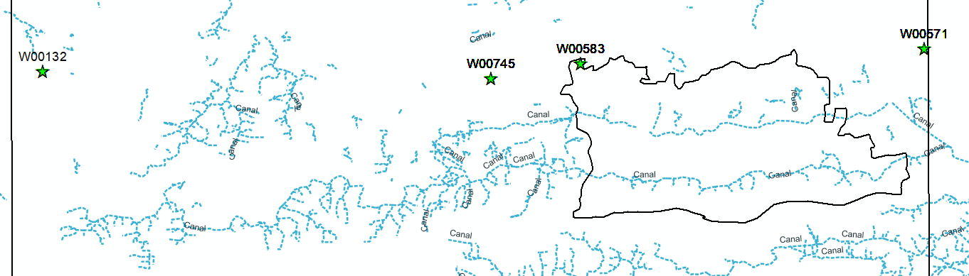
Long-term trend of Groundwater well in Non-commanded area
Please use slide show to view the different groundwater well data.
4.2 Statistics of Groundwater Wells located in the Non-Canal Command Area
2nd Canal Zone B
1st Canal (Zone A)

Slide 10
Groundwater Well Statistics (2003 - 2016)
Timeline | Well Code | Pre monsoon |  |  |  |  | Monsoon |  |  |  |  | Annual
 |  | Slope | High | Low | Avg. | Std. Dev. | Slope | High | Low | Avg. | Std. Dev. | Slope | High | Low | Avg. | Std. Dev.
Before Canal System (2003 -2010) | W00132 | 0.37 | -6.00 | -9.75 | -7.21 | 1.46 | 0.01 | -2.48 | -3.40 | -2.74 | 0.37 | 0.05 | -2.48 | -9.75 | -3.97 | 1.97
 | W00571 | 0.40 | -4.00 | -8.20 | -5.12 | 1.49 | 0.00 | -1.20 | -2.78 | -1.70 | 0.59 | 0.05 | -1.20 | -8.20 | -2.97 | 1.54
 | W00583 | 0.55 | -5.05 | -8.40 | -6.27 | 1.54 | 0.03 | -1.89 | -2.60 | -2.17 | 0.24 | 0.16 | -1.89 | -8.40 | -4.11 | 1.73
 | W00745 | -0.04 | -10.35 | -12.49 | -11.09 | 0.82 | 0.13 | -6.09 | -8.70 | -7.60 | 0.95 | -0.01 | -6.09 | -12.49 | -8.89 | 1.54
After Canal system (2011-2016) | W00132 | 0.37 | -6.77 | -10.15 | -8.46 | 2.39 | 0.01 | -2.65 | -2.65 | -2.65 | nodata | 0.00 | -2.65 | -10.15 | -4.81 | 2.54
 | W00571 | 0.40 | -3.10 | -9.20 | -5.53 | 2.96 | 0.00 | -1.65 | -4.20 | -2.63 | 1.22 | 0.00 | -1.65 | -9.20 | -4.01 | 2.47
 | W00583 | 0.55 | - | - | - | - | 0.03 | - | - | - | - | 0.00 | -4.70 | -5.90 | -5.30 | 0.85
 | W00745 | -0.04 | -9.55 | -11.25 | -10.50 | 0.63 | 0.13 | -7.15 | -8.03 | -7.67 | 0.41 | 0.05 | -7.15 | -11.25 | -8.86 | 1.12
Longterm Trend (2003 -2016) | W00132 | 0.00 | -6.00 | -10.15 | -7.57 | 1.65 | -0.01 | -2.48 | -3.40 | -2.73 | 0.33 | 0.06 | -2.48 | -10.15 | -4.17 | 2.11
 | W00571 | 0.18 | -3.10 | -9.20 | -5.29 | 2.11 | -0.04 | -1.20 | -4.20 | -2.07 | 0.96 | 0.00 | -1.20 | -9.20 | -3.41 | 2.02
 | W00583 | 0.55 | -5.05 | -8.40 | -6.27 | 1.54 | 0.03 | -1.89 | -2.60 | -2.17 | 0.24 | 0.08 | -1.89 | -8.40 | -4.20 | 1.70
 | W00745 | 0.05 | -9.55 | -12.49 | -10.86 | 0.79 | 0.03 | -6.09 | -8.70 | -7.63 | 0.77 | 0.00 | -6.09 | -12.49 | -8.87 | 1.37
Let’s consider well W00132, the water levels after the canal operation are lower as compared to the levels before the operation.
Here, 2010 is assumed to the event year.
In case of wells located in non-Commanded area, no particular rise in water levels is observed as shown by the well levels in commanded area.
This dissimilarity between results highlights the importance of the event (Canal operation)
Increasing | Decreasing | Significant decrease | Significant increase | - No data | (Slope=mbgl/year)
High = highest water level below ground level |  |  | Low = lowest water level below ground level

Slide 11
Please use slide show.
Analysis of groundwater wells in the Non-Command area
Similar analysis was performed for the wells not located in the Commanded area. (Assuming that the canal operation started in 2010 same as in commanded area)
The wells were selected on following conditions,
No large water bodies/Canal near by
Similar topography
All wells are located to the North of the Zone A & B (timeline could be more or less similar)
Following were the observations,
The statistic table indicates that the Pre-monsoon groundwater tables were lowered after the canal operation compared with the ones before the operation. For eg. Well W00582 (highlighted in table), the highest water level in premonsoon (before) was 6.00 mbgl and lowest level was 9.75 mbgl while it decreased to 6.77 mbgl and 10.15 mbgl after the canal operation.
The highest and lowest values vary within the same range for pre-monsoon and monsoon season.
Overall, no major change was visible in before-after the canal operation.
Before Canal System
Pre_high | Pre_low | Mon_high | Mon_low
-6.78 | -10.15 | -3.26 | -4.96
After Canal System
Pre_high | Pre_low | Mon_high | Mon_low
-6.47 | -10.20 | -3.82 | -4.96
Avg. Fluctuation amplitude in Premonsoon (before) | 3.36m | Avg. Fluctuation amplitude in Monsoon (before) | 1.70m
Avg. Fluctuation amplitude in Premonsoon (after) | 3.73m | Avg. Fluctuation amplitude in Monsoon (after) | 1.14m
For Premonsoon, Avg. Fluctuation amplitude (before) < Avg. Fluctuation amplitude (after)
For Monsoon, Avg. Fluctuation amplitude (before) ≈ Avg. Fluctuation amplitude (after)

Slide 12
Please use slide show.
Derivations from Landsat series data
Supervised classification: This method was adopted to obtain the land use land cover map for the study area using Landsat 7 ETM+ and 8 OLI datasets.
NDVI (Normalized Difference Vegetation Index): NDVI maps were generated in order to calculate the vegetation cover changes in the study site.
Extraction of land use class: Land use class like the Agriculture and fallow land were extracted for a better visualization of the LULC changes during 2003-2016.
NDVI value description: The value range of an NDVI is -1 to 1. Negative values of NDVI (values approaching -1) correspond to water. Values close to zero (-0.1 to 0.1) generally correspond to barren areas of rock, sand, or snow. Low, positive values represent shrub and grassland (approximately 0.2 to 0.4), while high values indicate temperate and tropical rainforests (values approaching 1).
4.3 Land Use Land Cover (LULC) Changes observed in Maheshwar block
Source: https://www.sentinel-hub.com/eoproducts/ndvi-normalized-difference-vegetation-index

Slide 13
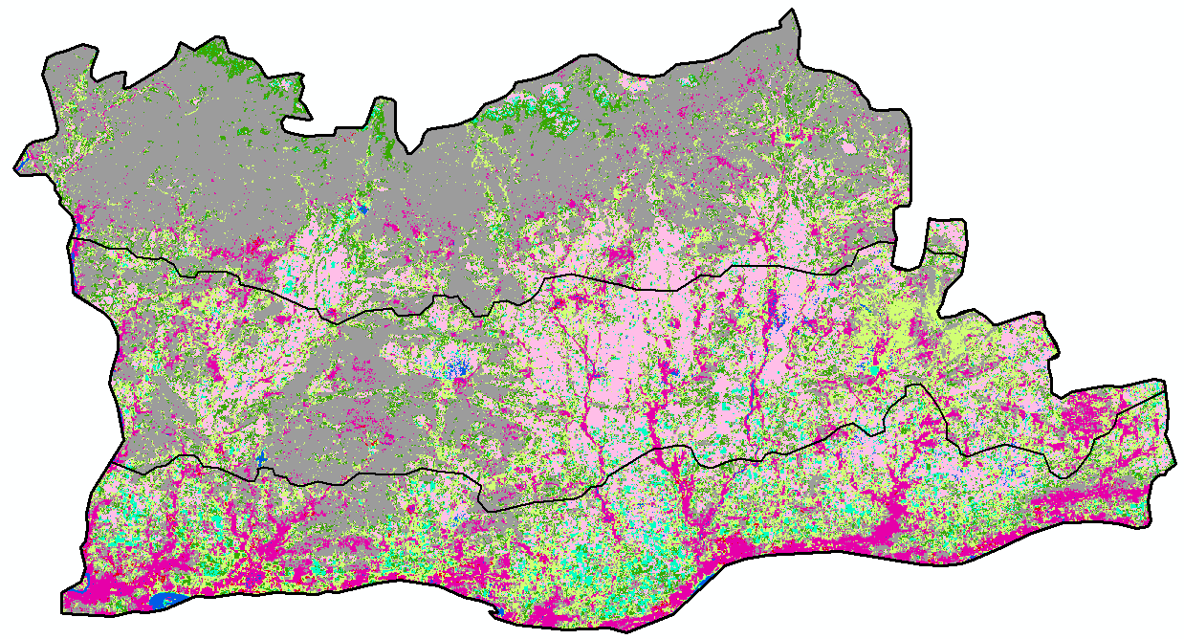
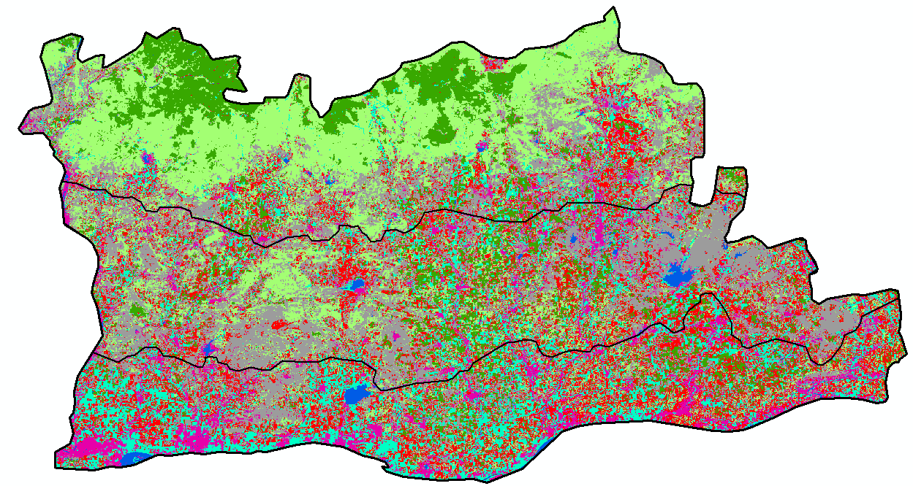
Supervised classification LULC maps (2003 & 2016)
Legend
Please use slide show to view the change in land use in zone A and B
Forest
2013
2003
Built up
Water
Barren
Agriculture
Fallow/DC/TC
Grasslands/Vegetation
ZoneB
ZoneB
ZoneA
ZoneA
Based on Landsat 7 data, April 2003

Slide 14
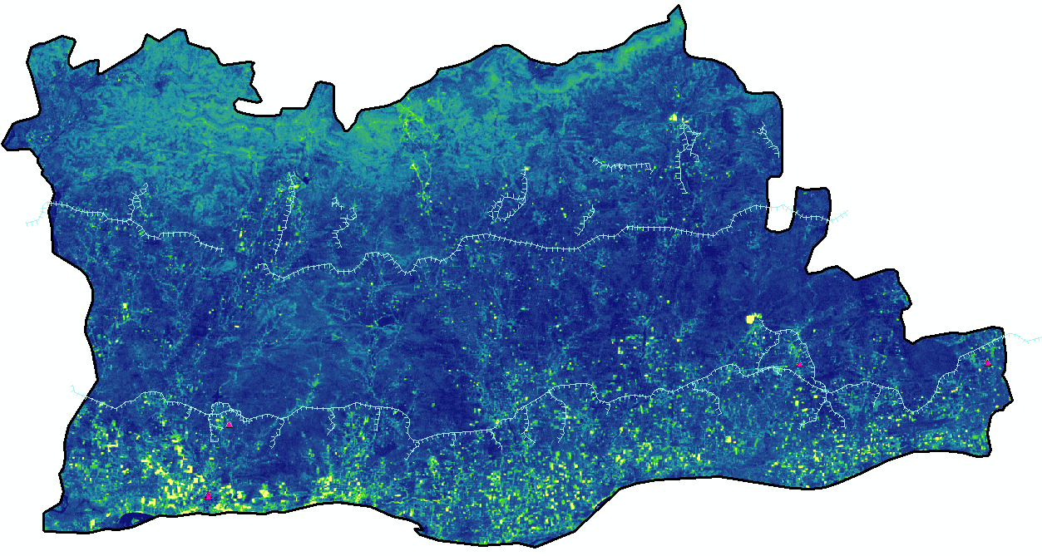
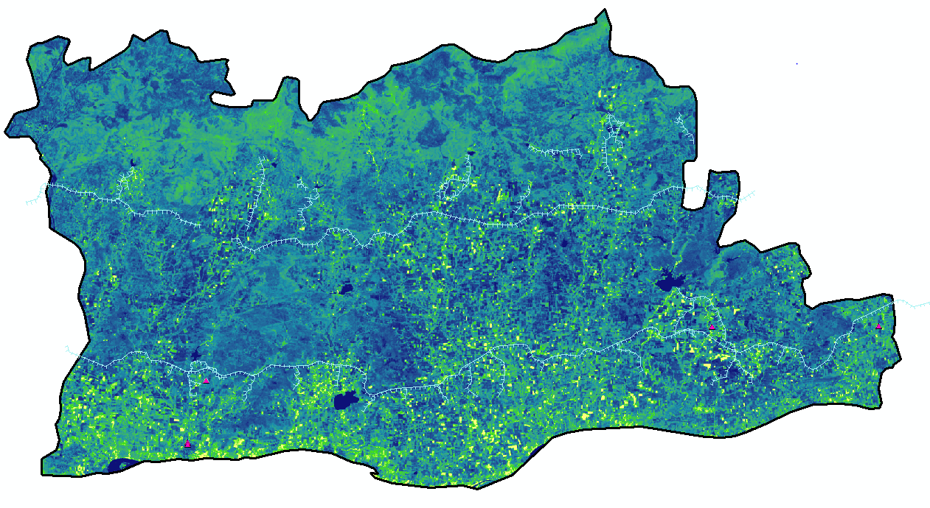

NDVI map of Maheshwar Block (2003 & 2016)
Legend
Legend
2013
Groundwater well
2003
Groundwater well
Please use slide show to view the change in NDVI values in zone A and B
Canal
Canal
Boundary
Boundary
NDVI
NDVI
0.36
0.50
-0.48
-0.11
ZoneB
ZoneB
ZoneA
ZoneA
NDVI: Normalized Difference Vegetation Index

Slide 15
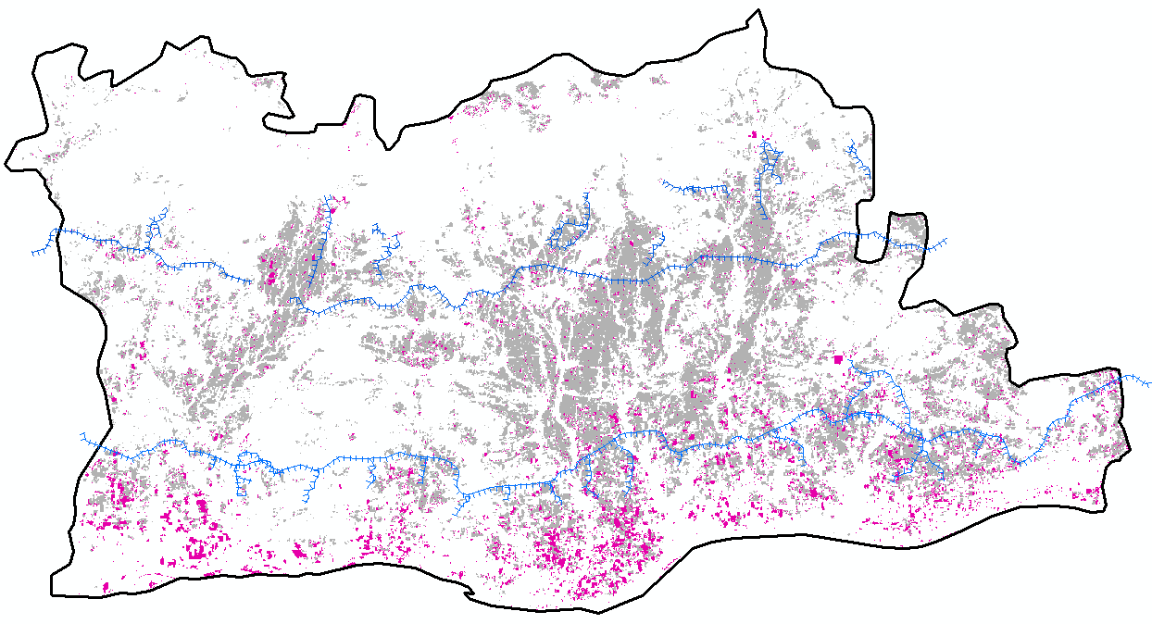
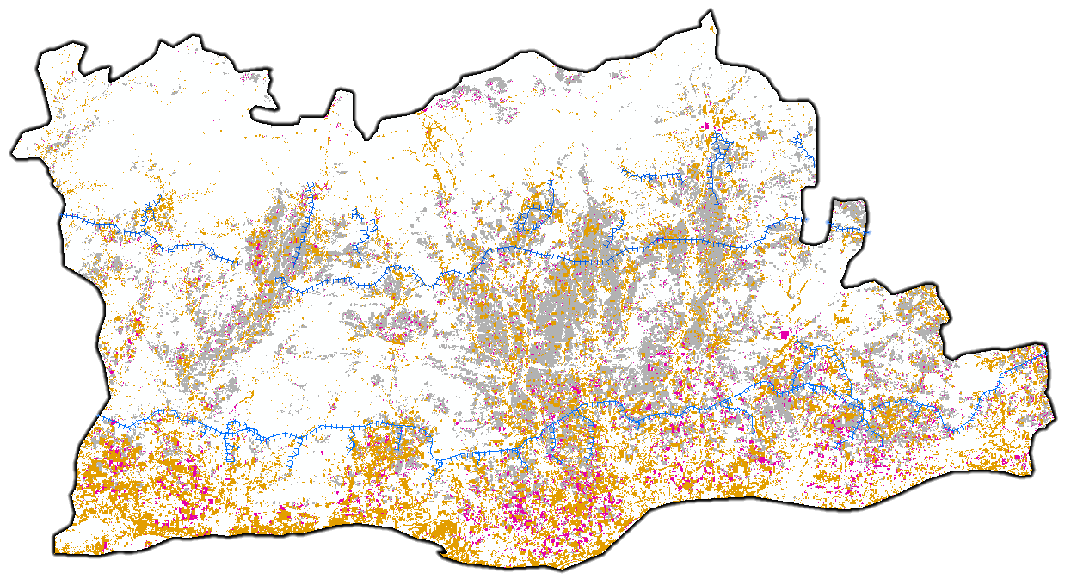
Please use slide show to view the change in land use in zone A and B
Extracting only the Agriculture / Fallow type land use
Legend
Agriculture (2003)
Fallow/DC/TC
2013
2003
Agriculture (2016)
Canal
Boundary
The Agriculture land use increased in Zone A and Zone B as calculated in the LULC change matrix.
Change in cropping pattern from single to double/triple cropping was observed as well.
ZoneB
ZoneA

Slide 16
LULC Analysis
5. Conclusions
According to the estimation of GRACE satellite dataset, central India showed an increase in TWS during 2003-2016. Thus, Narmada basin was chosen as the study region. And further due to single aquifer system and simple layout of canal network Maheshwar block was decided as the study site.
After the canal construction, on an average, about 1 m rise was observed in the well water levels, that is, about 1.26 m in pre-monsoon while 0.35 m in monsoon seasons, respectively.
Expansion in Agriculture class of land use was observed in Zone A and in Zone B. Change in cropping pattern from single to double/triple cropping was observed as well. This implies availability of water even during pre-monsoon (dry) season through the canals. Thus, less stress on groundwater resources due to availability of surface water resulting in increase of groundwater storage.
Based on the observations, available amount of water and the groundwater storage have increased after the canal operation compared with before the operation, and this may at least partly explain the reason why TWS has increased in this area.
After supervised classification, overall accuracy, error matrix and user accuracy was calculated for the validation of LULC detection.
On observing NDVI, positive pixel values (>0.1), it is quite clear indication of vegetation existence. Zone A shows more development in vegetation as compared to Zone B during 2003-2016.
The classified LULC images were cross-checked with original Landsat data and google earth images with specific year for identifying the pixels correctly and as the ground truth. Major land use change observed was agriculture class and fallow land class.
Therefore, features like the agriculture land use area and Fallow land area were extracted and it was noticed that not only the fallow land use changed to cultivation but the cropping pattern shifted from single cropping to double/triple cropping as well.

Slide 17


THANK YOU

