Slide 1
Towards the production of a high-resolution regional dust reanalysis for Northern Africa, the Middle East and Europe
Enza Di Tomaso (enza.ditomaso@bsc.es), Sara Basart (sara.basart@bsc.es), Jerónimo Escribano, Oriol Jorba, Francesca Macchia, Carlos Pérez García-Pando and Paul Ginoux
Barcelona Supercomputer Center; NOAA-GFDL
EGU2020, online, 8th May 2020

Slide 2
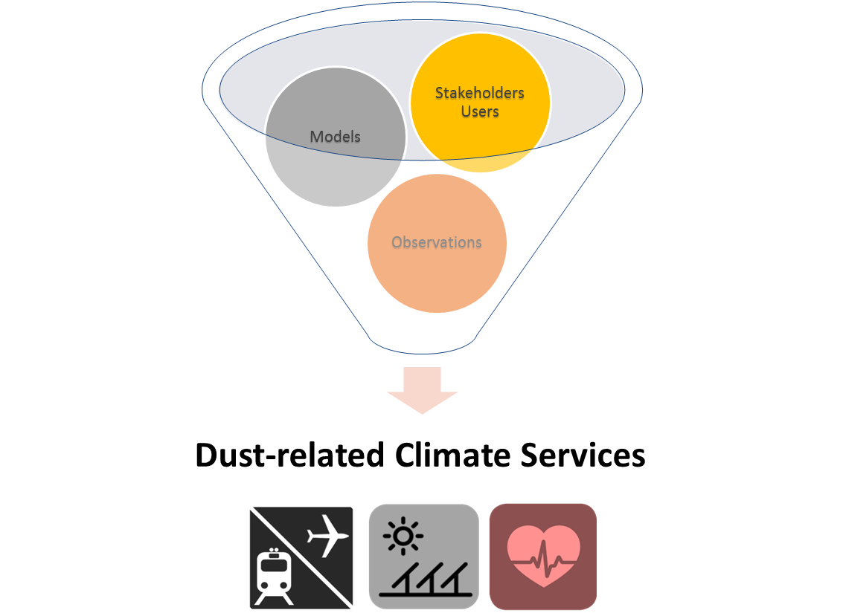
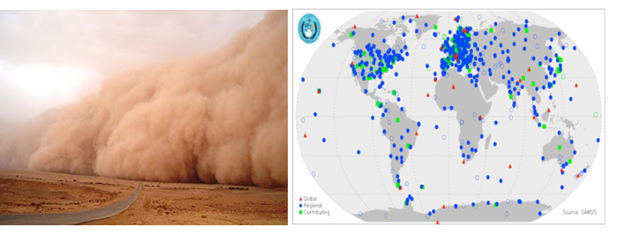
Dust Storms Assessment for the development of user-oriented Climate Services in Northern Africa, Middle East and Europe
SDS is a serious hazard for life, health, environment and economy
Lack of dust observations (past trends and current conditions)
GOAL: Develop dust-related services to specific socio-economic sectors based on an advanced dust reanalysis for the NAMEE region
2
Notes:
Sand and dust storms (SDS) are an important threat to life, health, property, environment and economy in many countries, and play a significant role in different aspects of weather, climate and atmospheric chemistry. There is an increasing need for SDS accurate information and predictions to support early warning systems, and preparedness and mitigation plans.
In alignment with the mission of the WMO Sand and Dust Storm Warning Advisory and Assessment System, the Dust Storms Assessment for the development of user-oriented Climate services in Northern Africa, the Middle East and Europe“ (DustClim) will make a major step forward in the way SDS affects society by producing and delivering an advanced dust regional model reanalysis for Northern Africa, Middle East and Europe covering the satellite era of quantitative aerosol information, and by developing dust-related services tailored to specific socio-economic sectors.
The novelties of the DustClim reanalysis include its unprecedented high-resolution, the assimilation of satellite products over dust source regions with specific dust observational constraints, and a thorough evaluation using a wide variety of observations and data from experimental campaigns. There is currently a very limited integration of dust information into practice and policy. In this context, DustClim will not only provide reliable information on SDS trends and current conditions, but will also develop dust impact assessment pilot studies for three key economic sectors (air quality, aviation and solar energy). Since the beginning of the project, there will be a continuous exchange between the scientific teams (from observational and modelling communities) and the main user communities. This collaboration is fundamental for better defining the dust parameters to be investigated and to design and optimise the future provision of dust services.
2

Slide 3
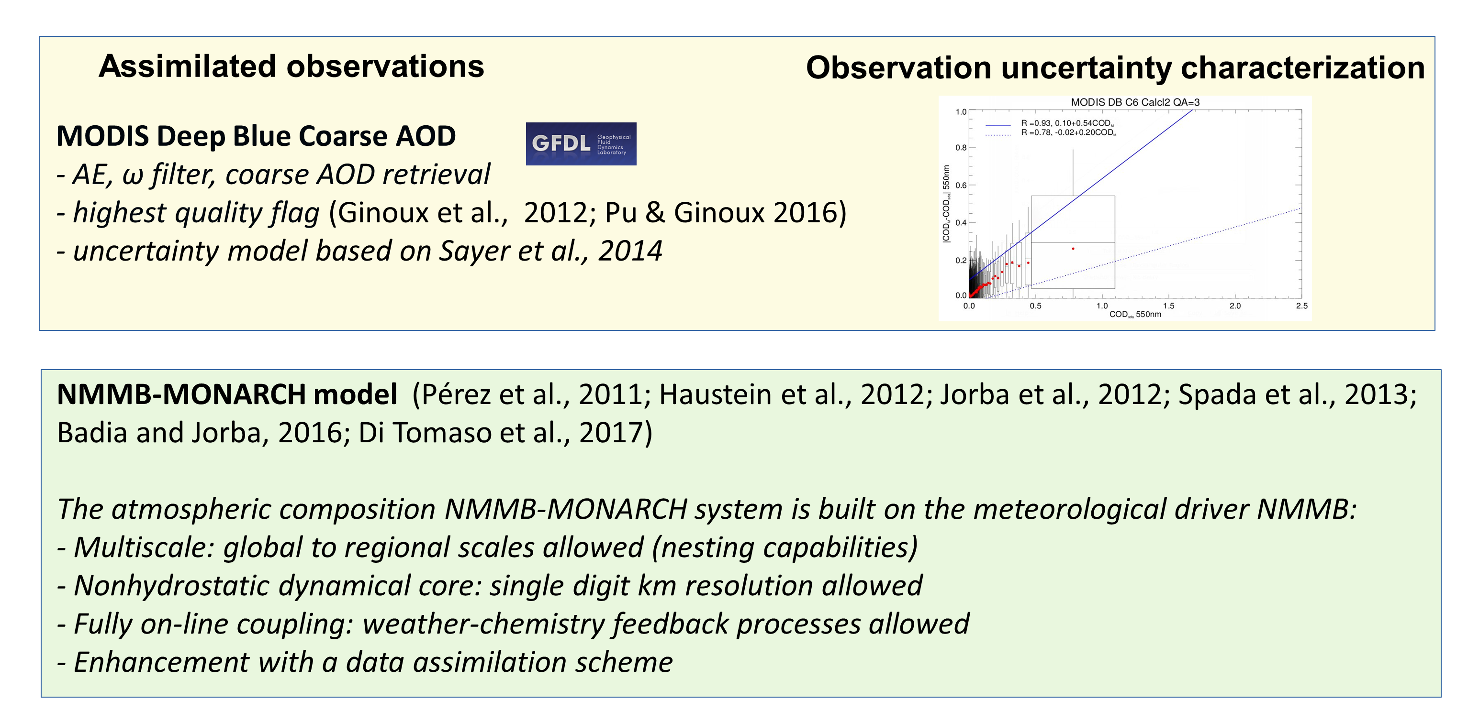
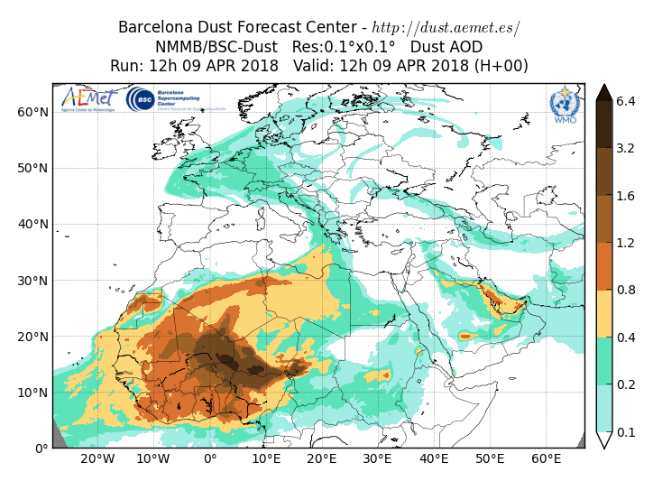
Dust reanalysis

Slide 4
Dust ensemble forecasts

Slide 5
Evaluation results - AERONET

Slide 6
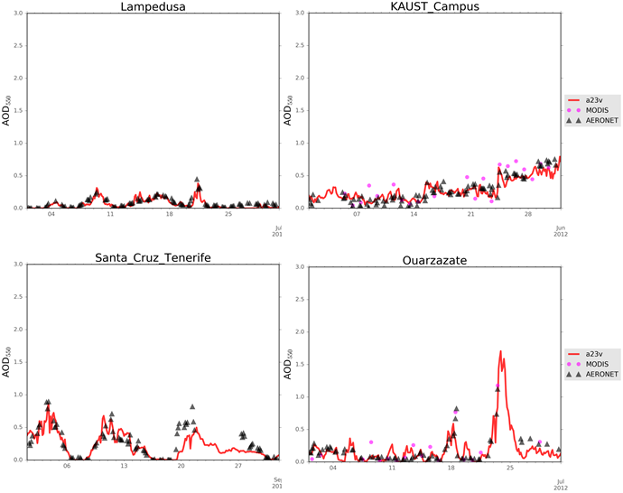
Evaluation results - AERONET

Slide 7
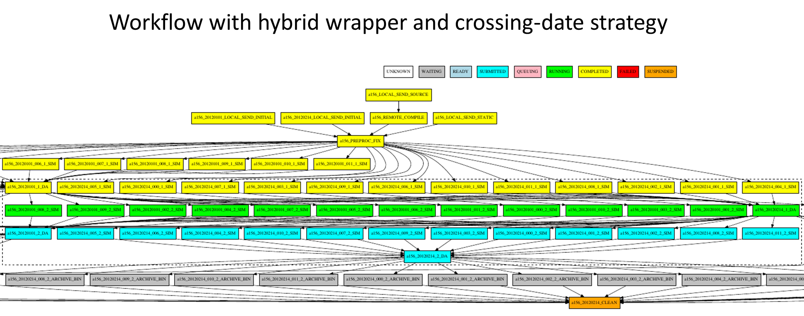
Optimised workflow execution

Slide 8
Thanks!
This work counts on the support of the DustClim project of the ERA4CS (GA 690462) and of the InDust COST Action (CA16202). Carlos Pérez García-Pando acknowledges long-term support from the AXA Research Fund, as well as the support received through the Ramón y Cajal programme (grant RYC-2015-18690) of the Spanish Ministry of Economy and Competitiveness. This project has also received funding from the European Union’s Horizon 2020 research and innovation programme under the Marie Skłodowska-Curie grant agreement H2020-MSCA-COFUND-2016-754433. The authors thank all the Principal Investigators and their staff for establishing and maintaining the AERONET sites, and thankfully acknowledge the computer resources at Marenostrum4, provided through the PRACE Project Access (proposal 2018184470), as well as the technical support provided by the Barcelona Supercomputing Center.
enza.ditomaso@bsc.es

