Slide 1

flow regime variation of arctic river
Nasim Fazel, Ali Torabi Haghighi, Kabir Rasouli, Björn Klöve
Water, Energy and Environmental Engineering Research Unit, University of Oulu, Oulu, Finland

Slide 2
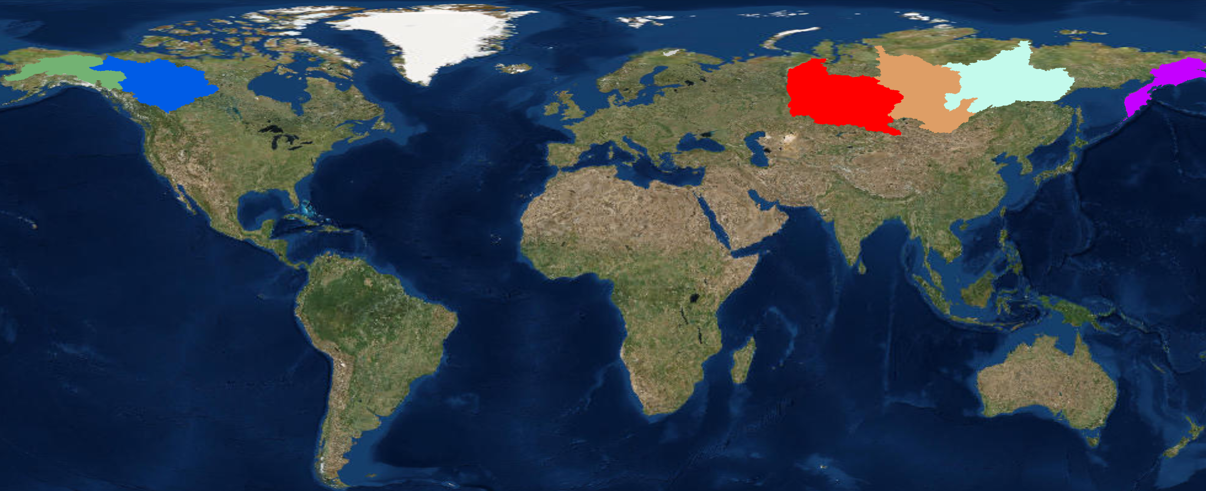
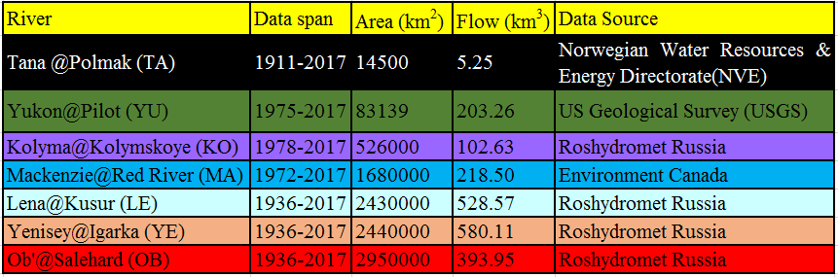
flow regime variation of Major arctic river (MARS)
YE
LE
YU
MA
OB
KO
TA
How the Flow regime has been changed at outlet of MARs?
What is the impact of Major Dams and hydropower on MARs?
How the starting time of Ice-Breakup in MARs has been Changed?
Research Questions

Slide 3
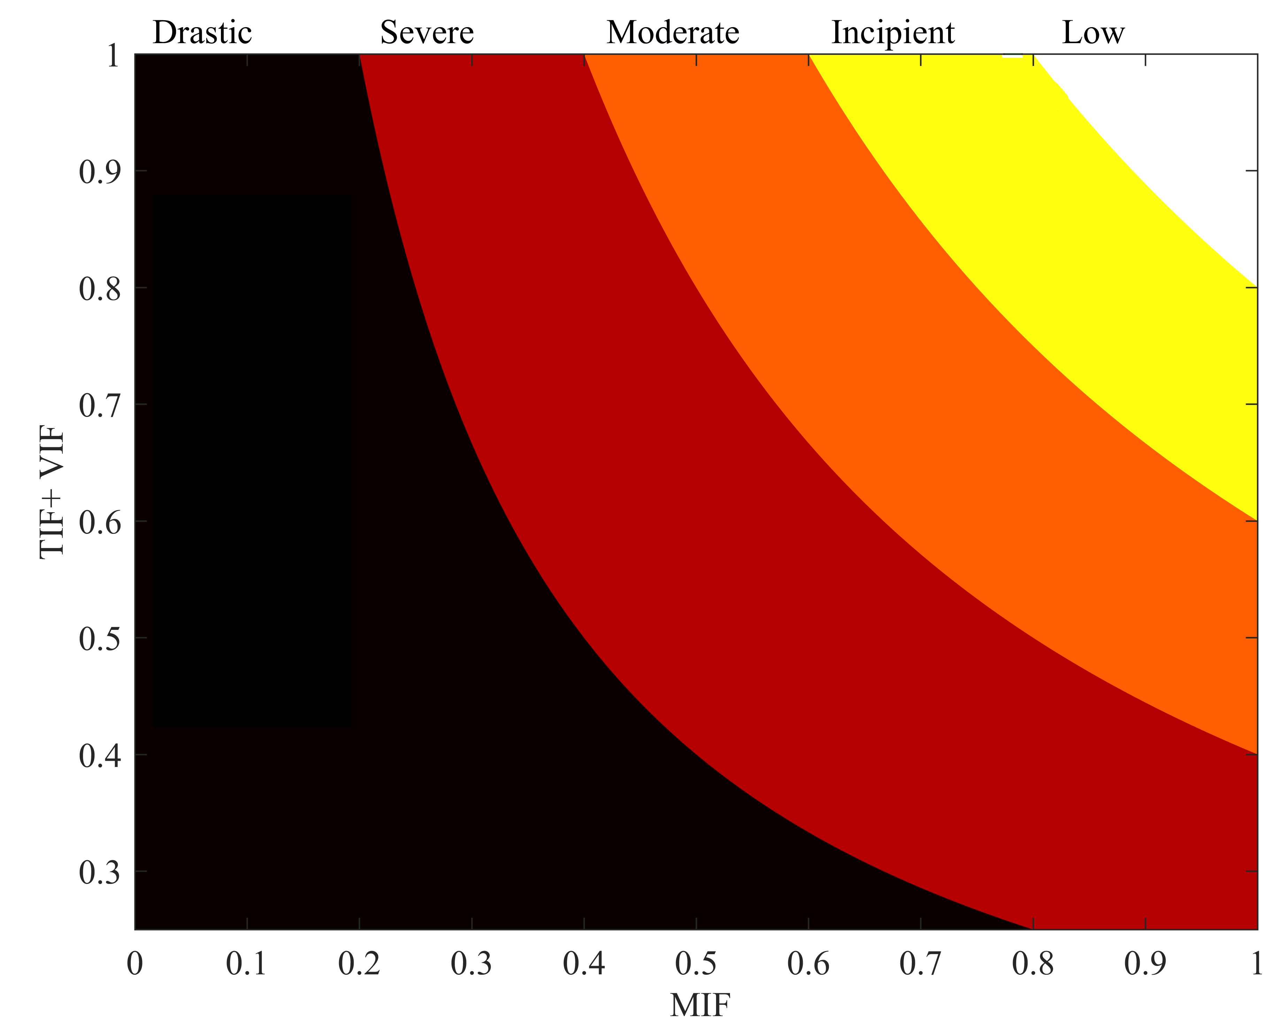

How the Flow regime has been changed at outlet of MARs?
MIF represents flow magnitude impact factor,
TIF signifies timing impact factor,
VIF denotes flow variability impact factor
RI = MIF $×$ (TIF + VIF)
Low: RI>0.8,
Incipient: 0.6<RI<0.8,
Moderate: 0.4<RI<0.6,
Severe: 0.2<RI<0.4 and
Drastic: 0<RI<0.2
Torabi Haghighi A, Marttila H, Kløve B. Development of a new index to assess river regime impacts after dam construction. Global Planet Change. 2014;122(0):186-196.

Slide 4
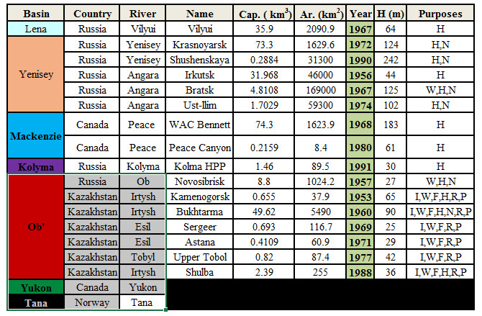
What is the impact of Major Dams and hydropower on MARs?
The impact of 16 dams were evaluated
The Kolyma hydropower shows lowest impact (Low impact)
Of these,
The Shushenskaya Dam on Yenisey shows highest impact (Severe Impact class)
(a): Vilyuy HPP on Vilyuy (Lena) Before1968 & (1967 - 1980), (b): Vilyuy on Vilyuy (Lena) Before1968 & (1979 - 1995), (c): Krasnoyarsk Dam on Yenisey at Bazaikha Before1970 & (1970 - 2000), (d): Shushenskaya Dam on Yenisey Before1989 & (1990 - 2000), (e): Bratsk HPP on Angara (Yenisey) Before1968 & (1969 - 1990), (f): Below Bratsk and Ust-ilim dam on Angra at Boguchany (Yenisey) Before1956 & (1974 - 2010), (g): WAC Bennett on Peace (Mackenzie) Before1969 & (1968 - 1981), (h): WAC Bennett on Peace (Mackenzie) Before1969 & (1981 - 2010), (i): Kolyma HPP on Kolyma Before1982 & (1981 - 2000).

Slide 5
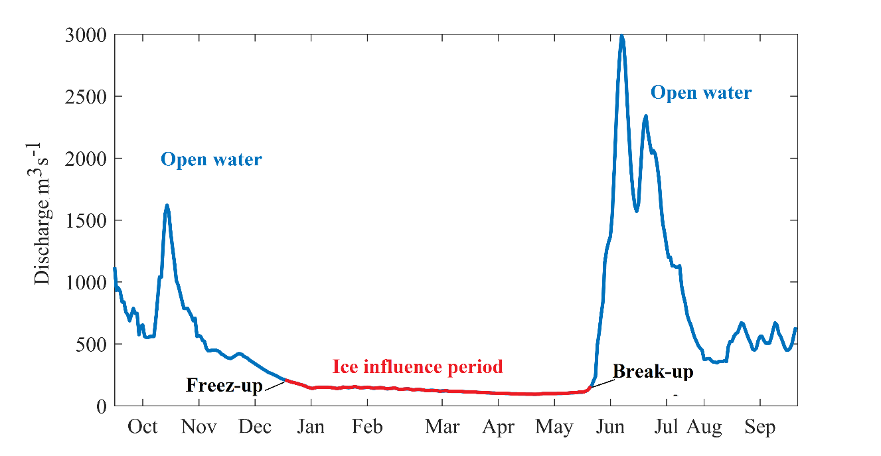
How the starting time of Ice-Breakup in MARs has been Changed?
To assess the change in start time of open water we used the “findchangepts” function in MATLAB and for each year we find abrupt changes in daily flow.

