Slide 1


The ADAM platform
EGU General Assembly 2020 - ITS4.8/ESSI4.1
Data science, Analytics and Visualization: The challenges and opportunities for Earth and Space Science
www.meeo.it
Simone Mantovani^{1*}, S. Natali², M. Folegani¹, M. Cavicch¹, D. Barboni¹, and S. Ferraresi¹
*mantovani@meeo.it
¹MEEO, Ferrara (Italy)
²SISTEMA, Vienna (Austria)

Slide 2

ADAM – Advanced geospatial Data Management platform
Seamless full data cycle management experience
Explore spatial distribution and temporal evolution of various geophysical and geospatial information
Find insights from data
Integrate and execute data processing functionalities at scale

Slide 3
ADAM – Advanced geospatial Data Management platform
Global
Regional
Local
Pixel

Slide 4
ADAM – Advanced geospatial Data Management platform
Pixel
Local
Regional
Global

Slide 5
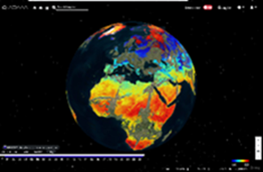






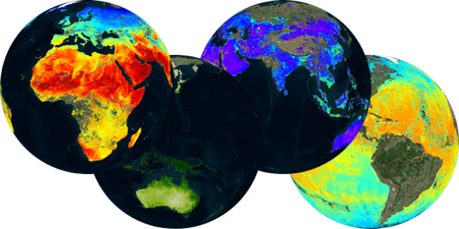

ADAM in one slide
Web based GUI
(including third-party applications)
Jupyter Notebook
CLI / API / PLUGINS
Presentation layer
Standardised data access interfaces allow connecting a wide range of user interfaces
Data(cube) layer
The deployment of DAS in front of each data source enables effective access services
Data layer
Data remain at their own location (multiple data centers) with the original data format
Mission-specific data
Thematic data
Other geospatial data
Infrastructure layer
Interoperability and federation between multiple centers

Slide 6
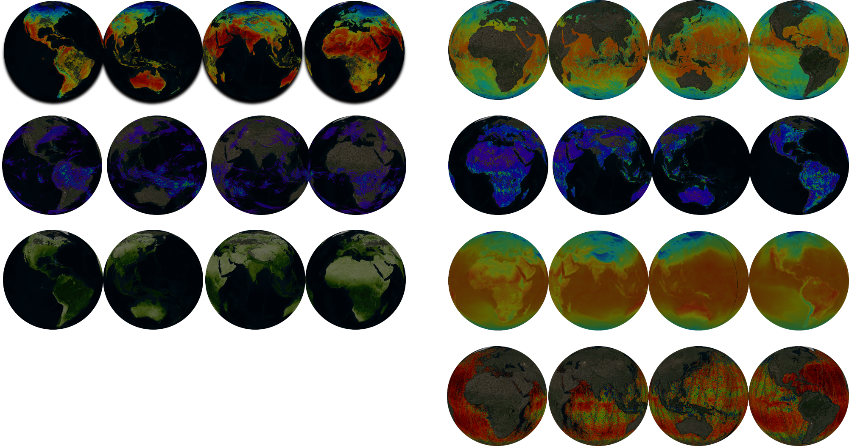
ADAM Data offer
Land surface temperature: Sentinel 3, MODIS
Vegetation information: MODIS, Sentinel 2, Landsat
Precipitation: Hydro Estimator, imerg (rain, snow)
Pollution: Sentinel 5P NO2 SO2 CH4 O3 CO
Sea Level anomaly
True/false color images: Sentinel 2 LandsaT
High Resolution optical / SAR data
Sentinel 1 , Sentinel 2, Landsat 4 to 8
Land Products
Vegetation Indexes, Land Surface TempERATURE, Soil Moisture, Land Cover type
Atmospheric products
Air Temperature, Precipitation, Atmospheric parameters
Ocean products
Sea Surface TEMPERATURE, OCEAN Salinity, Chlorophyll, Sea Level Anomalies, Sea Surface Velocity
Numerical models
Re-analyses, projections
Notes:
LST: 09/2017 - 09/2018 (monthy mean)
NDVI (africa): 09/2017 - 09/2018 (15 days)
HYDRO: 09/2018 - 11/2018 (daily)
NO2: 07/2018 - 10-2018 (daily)
CCI: 01/1997 - 01/1999 (monthly))
L8 (istanbul): 07/2013 - 04/2018 (34 frames)
S2 (istanbul): 06/2015 - 10/2018 (69 frames)

Slide 7


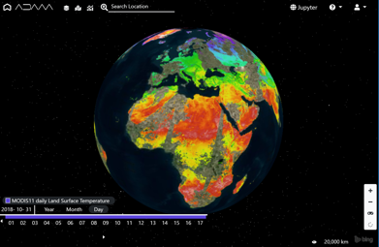

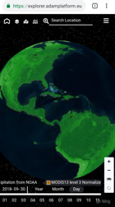
#askADAM
explorer
Jupyter
APIs
Plugin
User centric
Data access
E-collaboration
For scientist
Coding environment
Processing resources
Results publication and / or download
For developers
APIs
OGC interfaces
For GIS users
Notes:
Gui
For generic users
User centric
Data access
E-collaboration

Slide 8












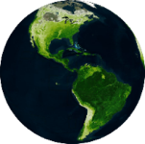
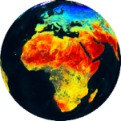
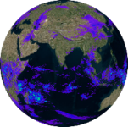
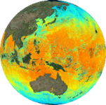
Application domains
Agriculture
Urban
Environment
Atmospheric applications
Marine applications
Education
Planetary Science
Public Health
Climate
Change
Forestry
Cultural heritage
Infrastructure monitoring
Data infrastructure and Security
Ask ADAM

Slide 9
Atmospheric applications
Map mosaicking
  Conventional approach
  On-demand mosaicking
  Access to Level 3 product
Monthly averaged map
  Explorer
  adamapi
Notes:
Gui
For generic users
User centric
Data access
E-collaboration

Slide 10
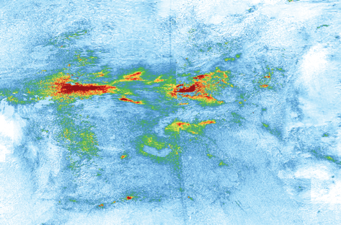

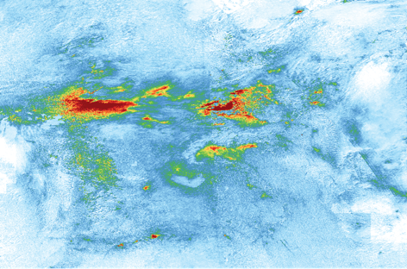


Atmospheric applications
map mosaicking
Conventional approach
Access to single granules
  need of ”large” local storage
Local processing to create the mosaic
  need of local computational resources
On-demand mosaicking
Remote access to single granules
Remote processing of single granules
Access to the mosaic
  need of “small” local storage
Access to Level 3 product

Slide 11
Atmospheric applications
Monthly averaged map: using Explorer
Submit your processing request

Slide 12
Atmospheric applications
Monthly averaged map: using Explorer
Check the status of your processing request
Load / download your results

Slide 13
Atmospheric applications
Monthly averaged map: using adamapi
Install adamapi
  pip install adamapi
Get your API Key

Slide 14
Atmospheric applications
Monthly averaged map: using adamapi
Use the adamapi
  Auth, to configure the environmental variables and a method to manage the authorization

Slide 15
Atmospheric applications
Monthly averaged map: using adamapi
Use the adamapi
  Datasets, to discover the datasets available in the ADAM instance, including all properties (e.g. description, start/end date, spatial coverage)

Slide 16
Atmospheric applications
Monthly averaged map: using adamapi
Use the adamapi
  Search, to discover the products available for a specific dataset, including filters (e.g. geometry, attributes, tile, …)

Slide 17
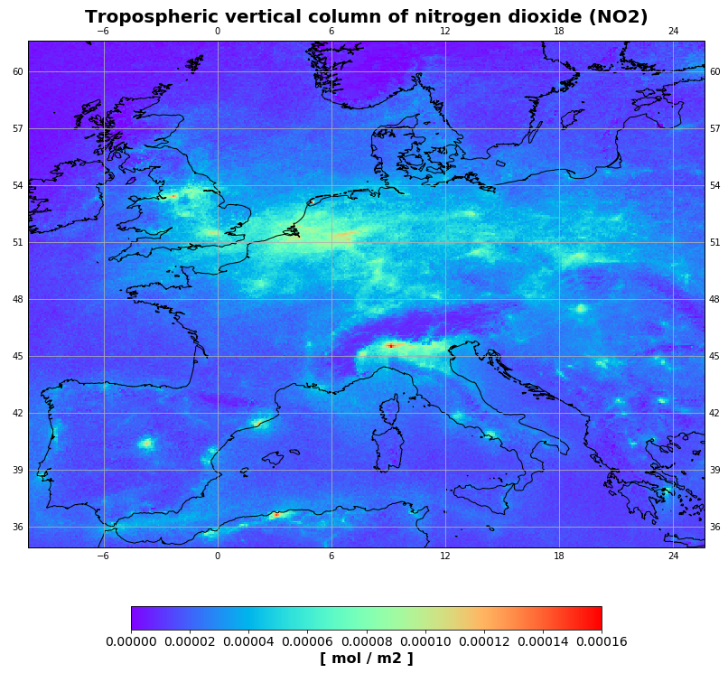
Atmospheric applications
Monthly averaged map: using adamapi
Use the adamapi
  GetData, the module to access a product or a timeseries of products, up to pixel granularity, including the support of different encodings (json, tif, png, gif)
  Process and visualize the data with Python functionalities
  (in the Jupyter environment)

Slide 18
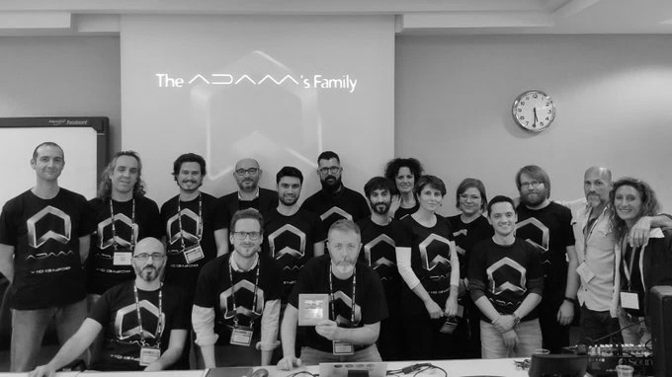
https://adamplatform.eu
New way of handling data
Simple services to use
Data become a commodity
Join the ADAM´s Family!
@platformAdam
@platformAdam
www.meeo.it

