Slide 1
1 2 3 4
Session ERE 4.2
EGU2020-17712
Impacts of changing conditions on far-field radionuclide evolution:
background and goals of a newly funded DFG-RFBR project [INFRA].
Fabien Magri^{1,2}, Thomas Nagel³, Axel Liebscher¹, and
Victor Malkovsky⁴
¹Federal Office for the Safety of Nuclear Waste Management (BASE), FA2, Germany (fabiano.magri@bfe.bund.de)
²Freie Universität Berlin, Hydrogeology, Germany
³Technical University Bergakademie Freiberg, Geotechnical Institute, Germany.
⁴Institute of Geology of Ore Deposits, Petrography, Mineralogy, and Geochemistry, Russian Academy of Sciences, Russia

Slide 2
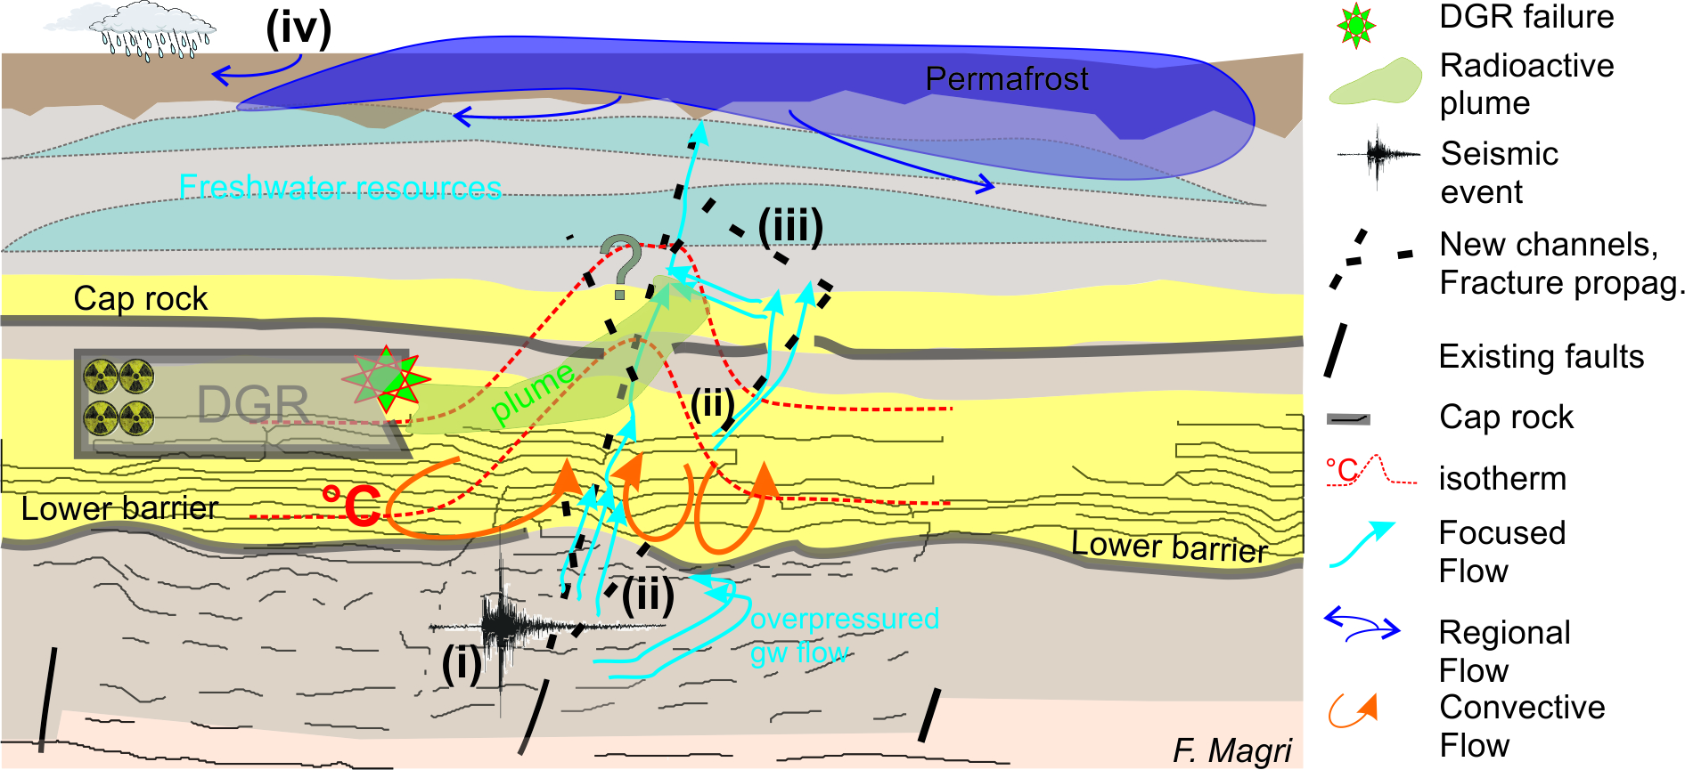
Major goal: improving our understanding of far-field evolution of radionuclides under changing conditions
Cap-rock failure due to seismic events (but also slower tectonic processes)
focused flow escapes from the aquifer (driving forces, flow field?)
flow-induced fractures propagate generating a heterogeneous porosity-permeability field
Changing climate/permafrost impacts

Slide 3
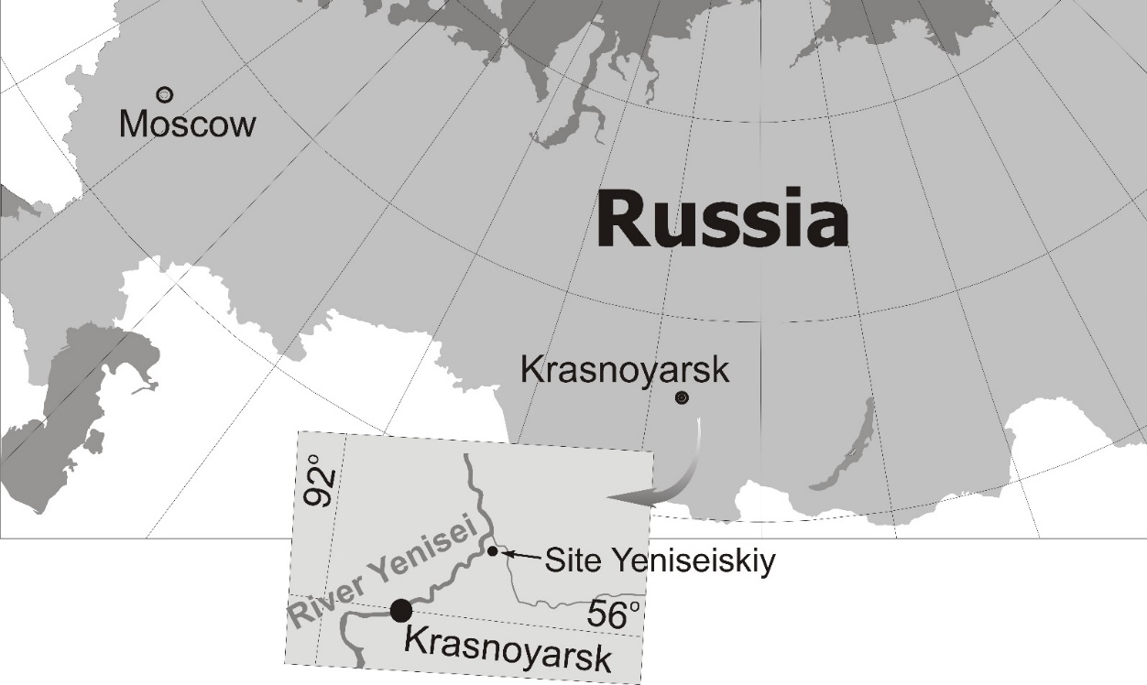
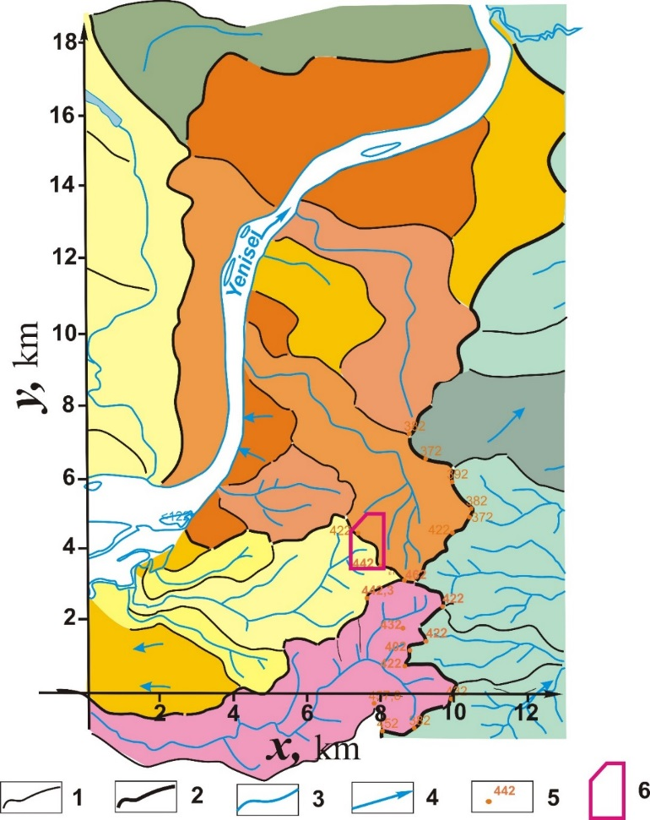
Study area: the Yeniseisky Site, Russia
Archean granite-gneiss massif in the Krasnoyarsk region
in metamorphic rocks of the Atamanovskaya group
(1) local water divides; (2) Regional water divide; (3) Tributaries of Yenisei
(4) Directions of groundwater flow; (5) Absolute elevations; (6) Repository site
Notes:
The Yeniseiskiy site is located in the northern part of the Archean granite-gneiss Nizhnekansky massif in the Krasnoyarsk region (Siberia, Russia) in metamorphic rocks of the Atamanovskaya group. The rock mass is dissected by tectonic perturbations into tectonic blocks. The site is located in one of these blocks. The block is confined from East and West by Atamanovskiy and Right-bank submeridional faults. Fractures within the block are filled with secondary minerals and do not exert a significant influence on bulk permeability of the rocks. The water table reflects in a smoothed form the relief. The depth of the watertable is 20–50 m at water divides and 2–10 m at depressions of the valleys.

Slide 4
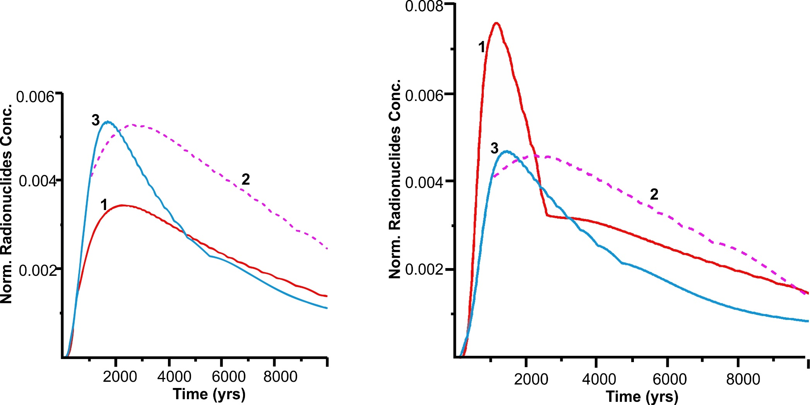
Preliminary results: Temperature and fault impacts on radionuclides concentration at the surface
Malkovsky et al. (in prep.)
No heat generation
With heat generation
Time interval between waste loading and fault formation: (1) zero; (2) 1000 years; (3) 5000 years

