Slide 1

Numerical simulation of chemical reactions occurring in fog droplets
Gabriella Schmeller
István Geresdi
University of Pécs, Insitute of Geography and Earth Sciences
EGU Sharing Geoscience Online
Session AS3.1 Aerosol Chemistry and Physics
05.05.2020

Slide 2
Description of the model
Time dependent box model
Formation of fog by radiative cooling (- 0,0001 K/s)
CCN activization (hygroscopic particles), measured size distribution of particles from a rural site (measurements done by colleagues at University of Pannonia)
Condensation growth of drops
Use of bin microphysics and chemistry scheme (moving bin boundaries)
Absorption and desorption of the following gases: CO₂, SO₂, NH₃, H₂O₂, O₃, HNO₃
Organics: HCHO, HCOOH, CH₃COOH
Chemical reactions:
1, S(IV) and H₂O₂, O₃
2, S(IV) and HCHO

Slide 3
In fog droplets:
Absorption and desorption of gases
Change in pH
Chemical reactions
  S(IV)+H₂O₂ and O₃ → formation of S(VI)
  S(IV)+HCHO → HMSA (hydroxymethanesulfonic acid)
  Question: What is the correlation between these two chemical reactions concerning the amount of S(VI)?

Slide 4
Chemical reactions
1, S(IV) + H₂O₂ → S(VI) + H₂O
S(IV) + O₃ → S(VI) + O₂
2, HCHO + HSO₃⁻ → CH₂(OH)SO₃⁻ k₁= 7,9∙10² M⁻¹s⁻¹ „HMSA1”
HCHO + SO₃²⁻ → CH₂(O⁻)SO₃⁻ k₁= 2,5∙10⁷ M⁻¹s⁻¹ „HMSA2”
HMSA = hydroxymethanesulfonic acid (CH₂(OH)SO₃H) is also S(IV)!
HMSA formation is significant between pH 5 and 6.5. Strong acid, but does not oxidized (as an S(IV) form, HMSA is co-existing with H₂O₂ and O₃). HMSA is an important compound in fog- and cloud water.

Slide 5
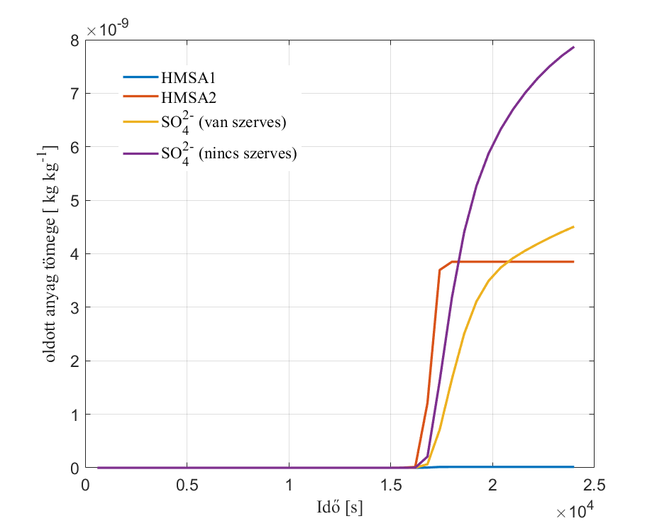
(HCHO is present)
(HCHO is not present)
Mass of solute [ kg kg⁻¹]
Time [s]

Slide 6
Summary
Chemical reactions led to formation of S(VI) and HMSA in fog droplets.
Due to the formation of HMSA, the amount of S(IV)
– which could have been oxidized by H₂O₂ and O₃ –
is decreased.
If the reaction of HCHO and S(IV) takes place, then the amount of S(VI) is decreasing (this statement is valid for the chemical reactions investigated in this research).
Formation of HMSA affects the chemical composition of the aerosol residues after evaporation of drops.

Slide 7
Thank you for your interest!

