Slide 1
Climatology of relative humidity in the Carpathian Valley
Anikó Cséplő¹
István Geresdi²
Ákos Horváth³
EGU2020: Sharing Geoscience Online
4-8 May 2020
Vienna
¹ Doctoral School of Earth Sciences , Faculty of Sciences, University of Pécs
² Geology and Meteorology Department, Faculty of Sciences, University of Pécs
³ Storm Warming Observatory, Hungarian Meteorological Service, Siófok

Slide 2
Why the relative humidity?
Relative humidity (RH) in the atmosphere:
Characteristic of the moisture content of the air mass
The role of RH: cloud and fog formation
The trend of RH could be uncertain in changing climate (Researches assess fixed or changing trend of RH)
The daily mean values of RH could be derived from different ways
During a day: RH versus specific humidity (q)
changes remains

Slide 3
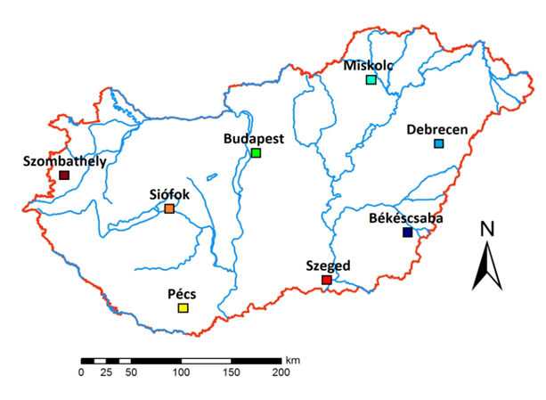
Database: CarpatClim (1961-2010): 8 stations (on the image) – homogenized data Station data (1956-2018) from the same 8 stations – raw data
Method: Long-term humidity trends: between 1961-2010 Compare homogenized and raw database

Slide 4
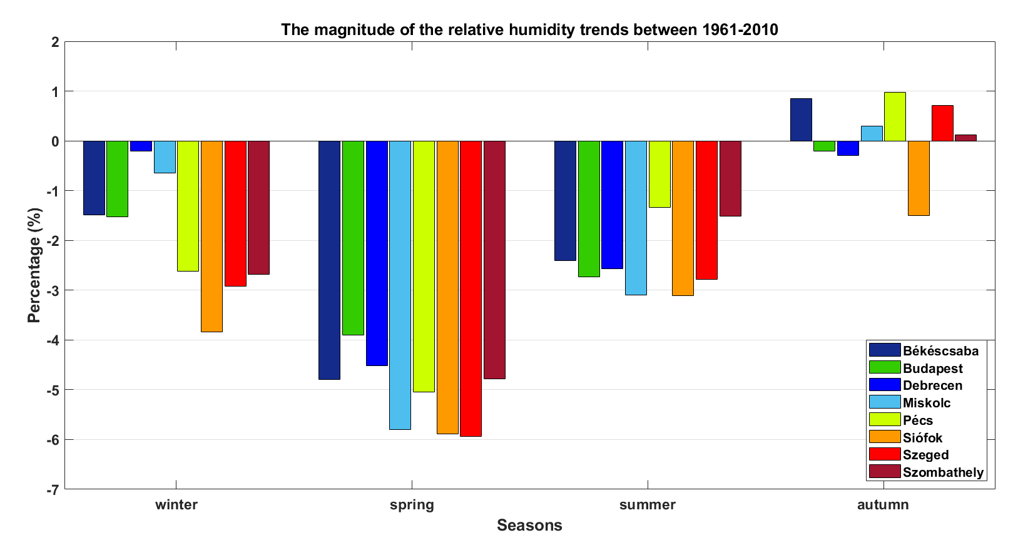
RH trend from CarpatClim

Slide 5
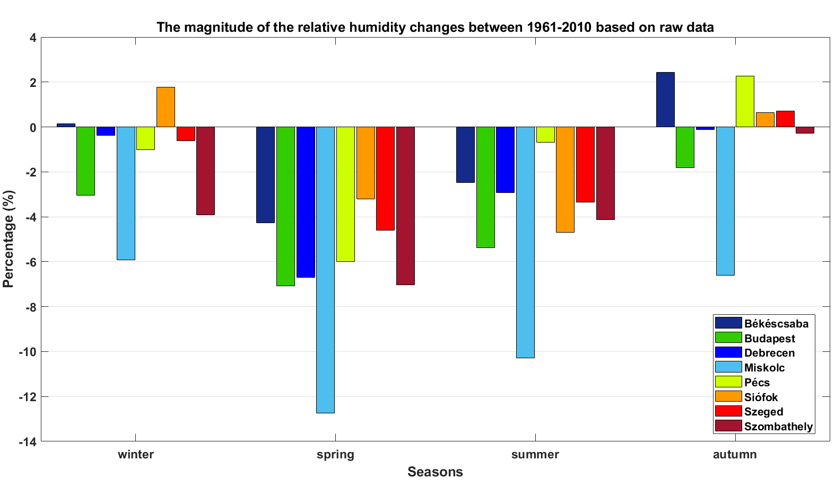
RH trend from station data

