Slide 1
Transferring Geo-/Mineralogical Information to THM Simulations of HLW Storage in Claystone Formations (BASTION II)
Vinay Kumar, Tilo Kneuker, Jobst Maßmann
EGU 2020
04.05.2020

Slide 2
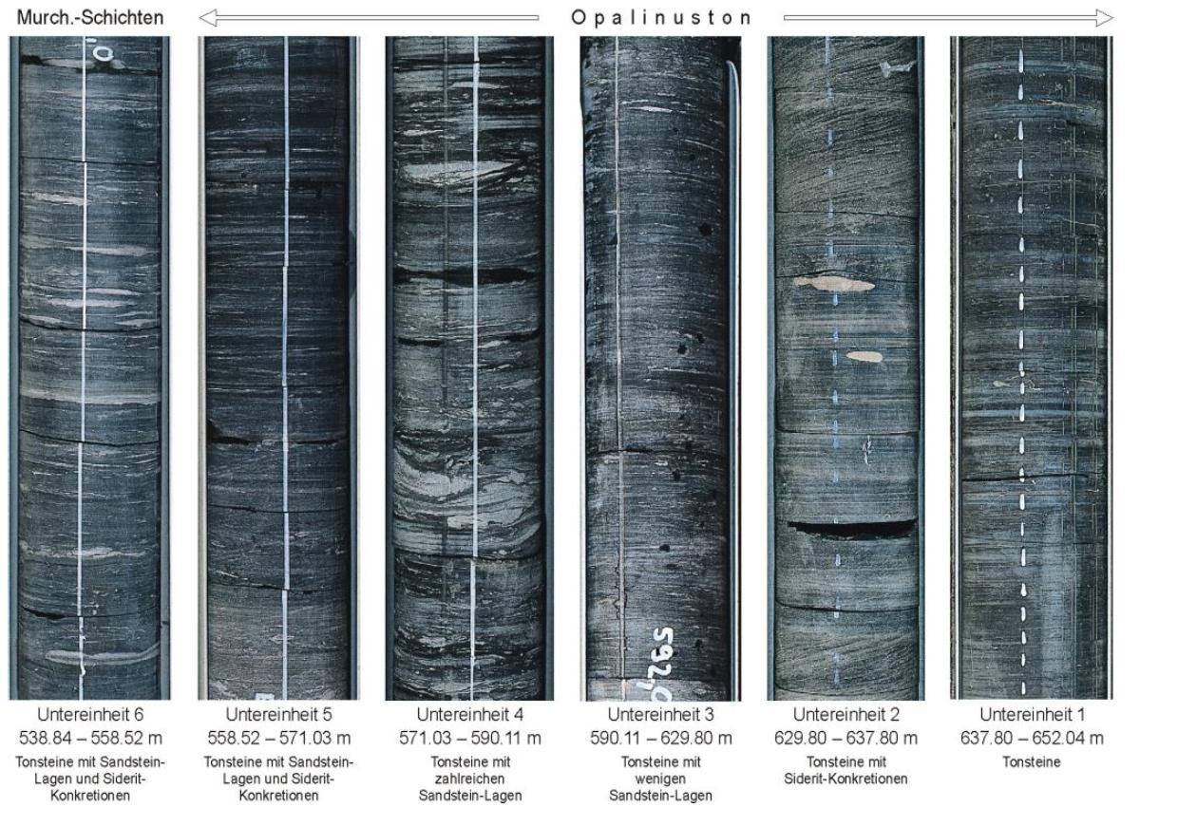
Introduction & Motivation
There are different scales of variability in claystone
End members of Opalinus Clay (OPA):
  Shaly facies: homogeneous (clay minerals)
  Sandy facies: heterogeneous (quartz)
  Carbonate-rich sandy facies: heterogeneous (quartz, carbonate)
Q: How to incorporate this information in this detail in numerical THM simulations?
A: Gather information, transfer to parameters, apply to THM-models
TN 2012-45
TN 2012-45
Nagra NTB 02-03
Increasing spatial scale
geology
simulation

Slide 3
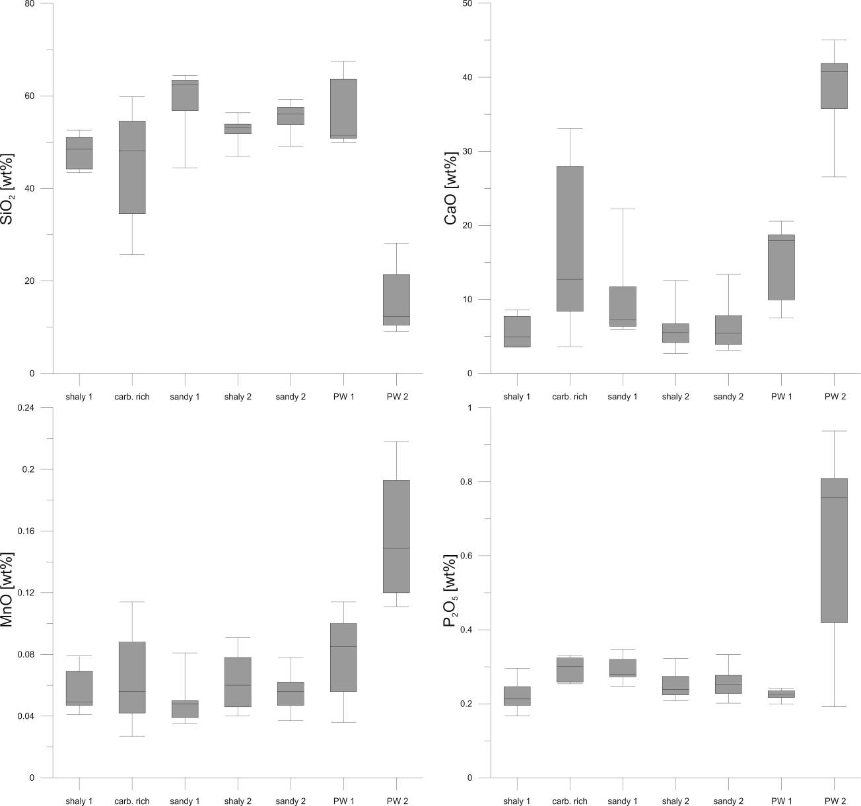
Gather: The (sub) facies concept for OPA
by Lauper et al. (2018) for OPA (Mt. Terri); to capture intra-formation heterogeneity
5 subfacies types based on texture and mineralogy
Additional measurements are foreseen (for calibration model)
n = 7 6 8 10 19 6 5
shaly 1
carb.-rich
sandy 1
shaly 2
sandy 2
PW 1
PW 2
Lauper et al. (2018)
Kneuker et al. (2020)

Slide 4
Transfer: The correlation model
Geology → simulation parameters
Identify relevant parameters
(e.g. indicator mineral SiO₂)
shaly 1
carb.-rich
sandy 1
shaly 2
sandy 2
PW 1
n = 7 6 8 10 19 6 5
PW 2
shaly 1
carb.-rich
sandy 1
shaly 2
sandy 2
PW 1
PW 2
Kneuker et al. (2020)

Slide 5
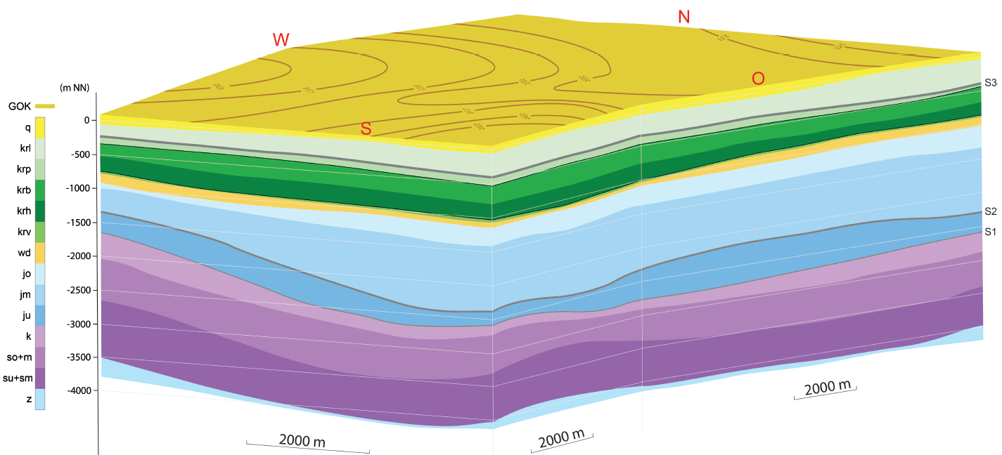
The Workflow
Step 1: Gather (geology)
Identify thermal simulation-relevant parameters based on mineralogy and composition of (sub)facies types
Step 2: Transfer (geology → simulation)
Correlate parameters with mineralogy and (sub)facies composition
Measure (sub)facies thermal conductivity
Step 3: Apply (simulation)
Upscale to formation-scale models
Apply appropriate upscaling
Compare upscaled results to discrete case
Step 3: Simulations
Increasing spatial scale
TN 2012-45
Reinhold, K. et al. (2013)

