Slide 1
A new project to monitor the Ocean Heat Content and the Earth Energy imbalance from space: MOHeaCAN
Michaël Ablain(1) , Marti Florence (1), Rémi Jugier (1),
Benoit Meyssignac (2) , Alejandro Blazquez (2), Jérôme Benveniste (3)
(1) Magellium, France ; (2) LEGOS, France ; (3) ESA/ESRIN, Italy
1, rue Ariane 31520 Ramonville Saint-Agne, France
+33 5 62 24 70 00
info@magellium.fr
https://www.magellium.com
https://www.linkedin.com/company/magellium

Slide 2
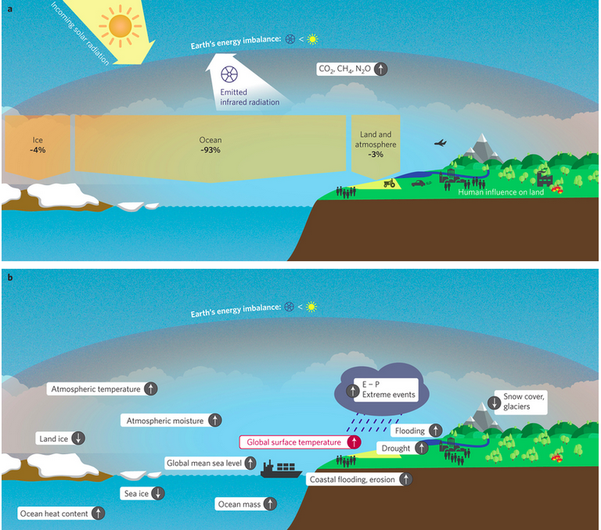
MOHeaCAN
Overview
Earth energy imbalance (EEI) indicator provides a quantitative estimate of climate change. Recent studies suggest that the EEI response to anthropogenic greenhouse gases and aerosols emissions is 0.5-1 W.m⁻² (<< 340 W.m⁻² incoming solar radiation).
An accuracy of 0.3 W.m⁻² (ideally 0.1 W.m⁻²) is necessary to assess the long-term mean EEI due to anthropogenic forcing at decadal time scales.
The ocean heat content (OHC) is a very good proxy to estimate EEI as ocean is the major heat reservoir (93% EEI)

Slide 3
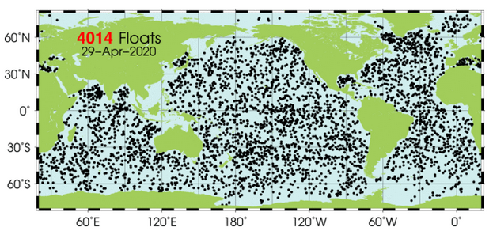
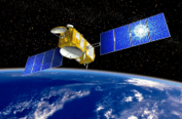
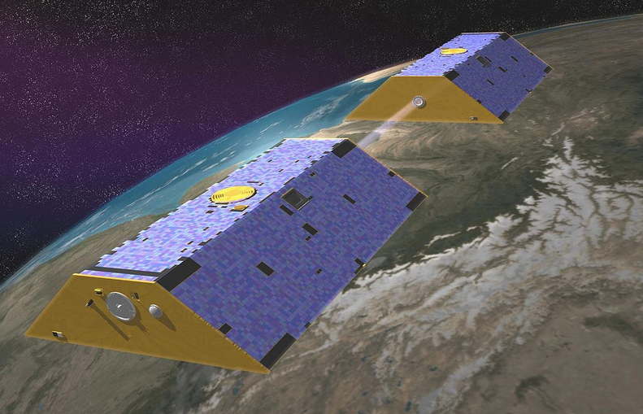
MOHeaCAN
Objectives
OHC can be derived from different approaches:
the direct measurement of in situ temperature based on temperature/Salinity profiles (e.g. ARGO floats),
the measurement of the net ocean surface heat fluxes from space (CERES),
the estimate from ocean reanalyses that assimilate observations from both satellite and in situ instruments,
the measurement of the thermal expansion of the ocean from space based on differences between the total sea-level content derived from altimetry measurements and the mass content derived from GRACE data (noted “Altimetry-GRACE”).

Slide 4
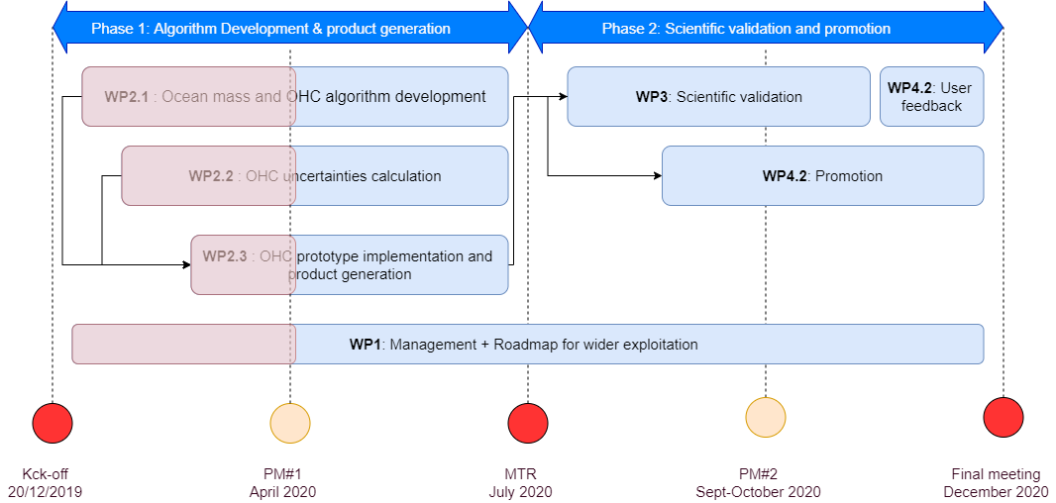
MOHeaCAN
Objectives
Objectives of the MOHeaCAN project:
to develop novel algorithms to reach the target of 0.3 W.m⁻² for the EEI uncertainty estimation
to estimate more realistic uncertainties for OHC
to develop a software prototype to perform sensitivity studies through ensemble approach
to validate OHC against other means of measurements (ARGO for example)
Project Schedule:
The project will be completed by the end of 2020
MOHeaCAN OHC/EEI products will be available in September
Feedback from users expected by the end of the year

Slide 5
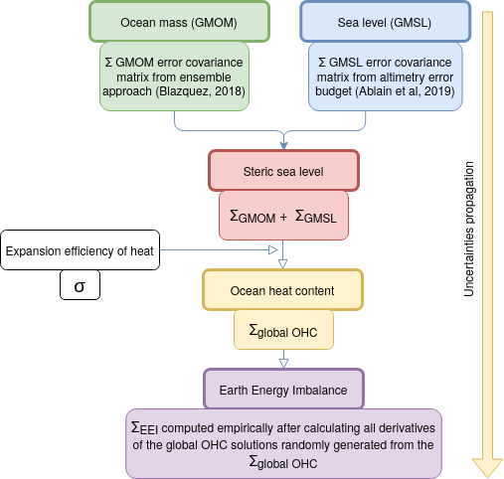
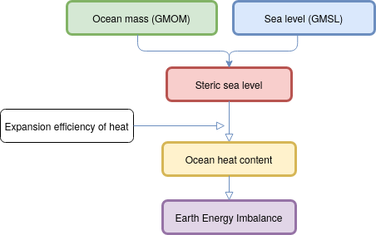
MOHeaCAN
On-going work at global scale
The processing chain is being developed:
product generation
validation against Argo-based data and CMEMS Ocean Monitoring Indicator (0-700 m)
The uncertainties propagation has been specified :
using matrix covariance error
Altimetry-GRACE approach provides an independent estimate of the steric sea level representative of the full ocean column.
Error covariance matrix (∑) provides a full description of errors allowing the calculation of 1) trend uncertainties and 2) error envelop, etc.

Slide 6
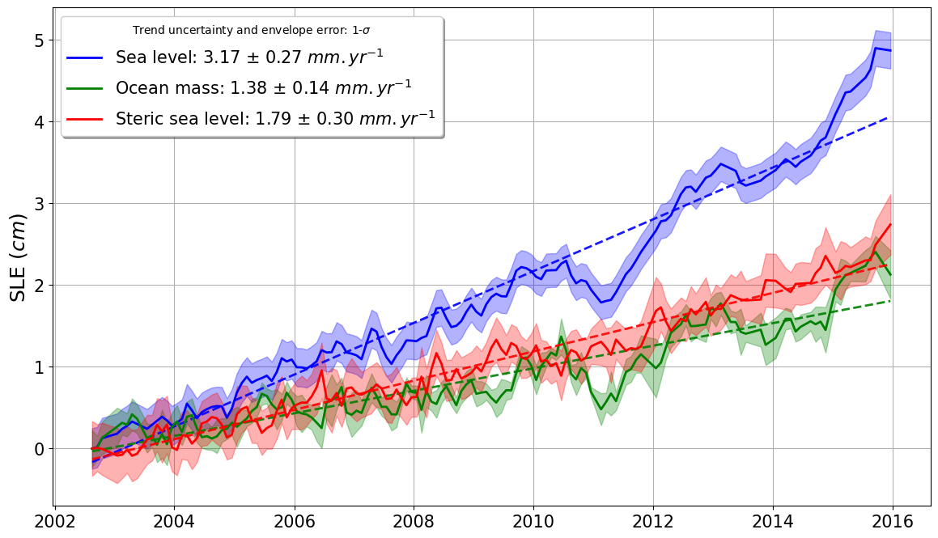
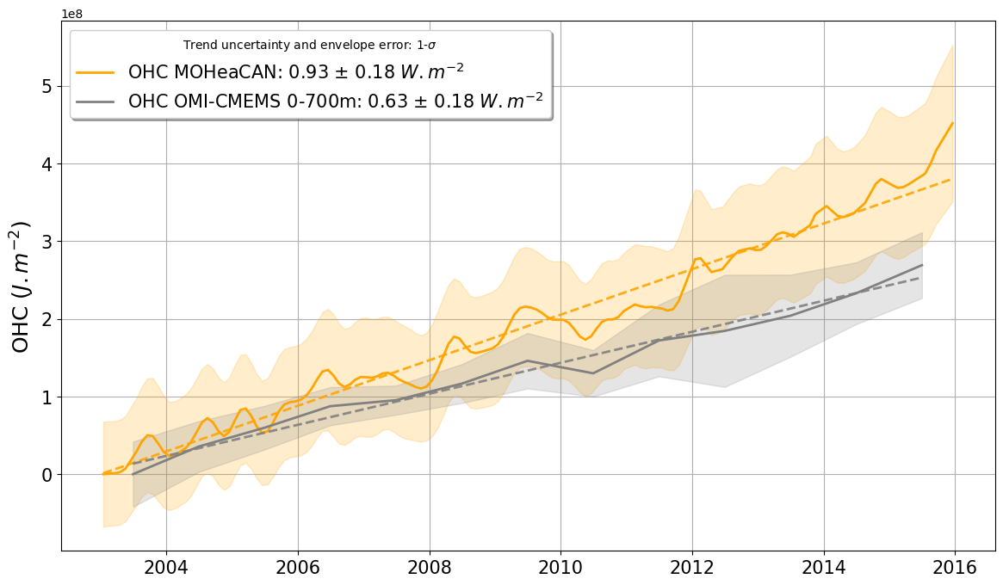
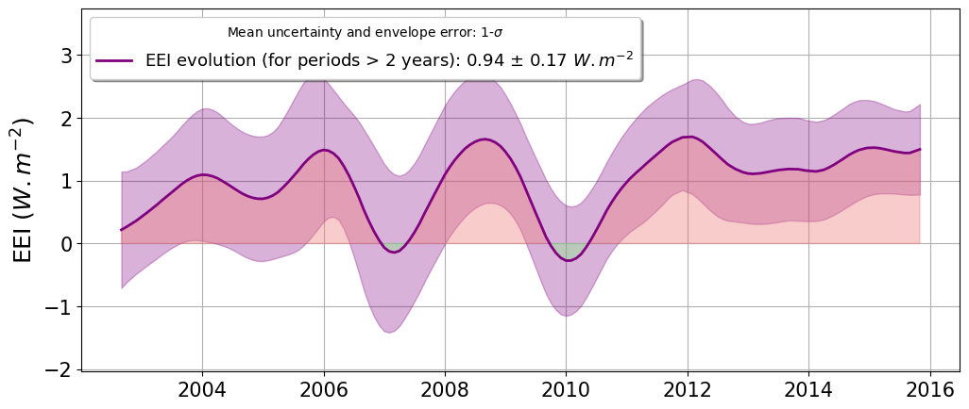
MOHeaCAN
Preliminary results
at global scale
Global Mean Steric Sea Level (red curve) inferred from Altimetry Sea level (blue curve) and Ocean Mass from Grace data (green curve)
OHC from MOHeaCAN (orange curve) and Ocean Monitoring Indicator (OMI) from E.U. Copernicus Marine Service Information. (0-700 m)
OHC
Evolution of EEI from MOHeaCAN for periods higher than 2 years:
error envelop superimposed
Positive mean value (0.94) is in line with scientific litterature
Uncertainty is 0.17 w.m⁻² (1-σ): objective is to reduce this uncertainty level.
EEI

Slide 7
MOHeaCAN
Future work and perspective
Improving the processing chain and input data in order to prepare MOHeaCAN OHC/EEI products:
to extend temporal time series (e.g GRACE time series (mid-2016) with GRACE-FO mission)
to improve uncertainties characterization
to provide OHC regional grids
Providing a Product User Manual describing MOHeaCAN OHC/EEI products
Providing scientific analyses with regards to other OHC/EEI products based on in-situ data (e.g. ARGO), models or other spatial data (e.g. CERES)

Slide 8
MOHeaCAN
References
Ablain, M., Meyssignac, B., Zawadzki, L., Jugier, R., Ribes, A., Spada, G., Benveniste, J., Cazenave, A., and Picot, N.: Uncertainty in satellite estimates of global mean sea-level changes, trend and acceleration, Earth Syst. Sci. Data, 11, 2019, 1189–1202, https://doi.org/10.5194/essd-11-1189-2019
Blazquez A, Meyssignac B, Lemoine JM, Berthier E, Ribes A, Cazenave A, Exploring the uncertainty in GRACE estimates of the mass redistributions at the Earth surface: implications for the global water and sea level budgets, Geophysical Journal International, Volume 215, Issue 1, 1 October 2018, Pages 415–430, https://doi.org/10.1093/gji/ggy293
Meyssignac B, Boyer T, Zhao Z, Hakuba MZ, Landerer FW, Stammer D, Köhl A, Kato S, L’Ecuyer T, Ablain M, Abraham JP, Blazquez A, Cazenave A, Church JA, Cowley R, Cheng L, Domingues CM, Giglio D, Gouretski V, Ishii M, Johnson GC, Killick RE, Legler D, Llovel W, Lyman J, Palmer MD, Piotrowicz S, Purkey SG, Roemmich D, Roca R, Savita A, von Schuckmann K, Speich S, Stephens G, Wang G, Wijffels SE and Zilberman N (2019) Measuring Global Ocean Heat Content to Estimate the Earth Energy Imbalance. Front. Mar. Sci. 6:432. https://doi.org/10.3389/fmars.2019.00432
von Schuckmann, K., Palmer, M., Trenberth, K. et al. An imperative to monitor Earth's energy imbalance. Nature Clim Change 6, 138–144 (2016). https://doi.org/10.1038/nclimate2876

