Slide 1
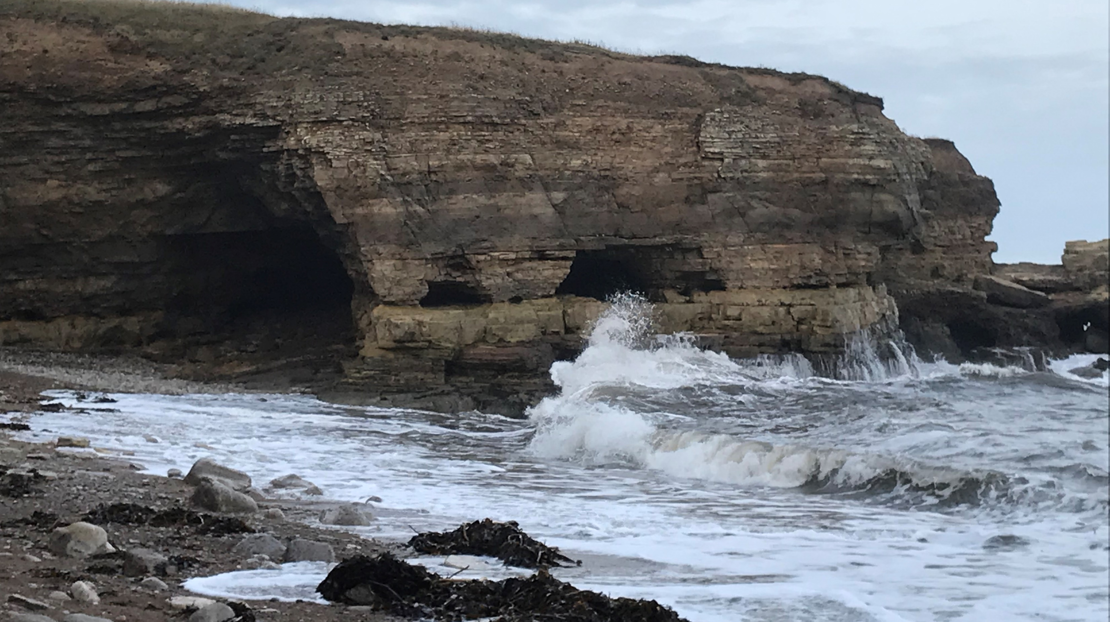
Erosion monitoring of coastal cliffs of geoheritage significance – an example from north east England.
Lesley Dunlop, Matthew J. Westoby and Michael Lim
Northumbria University, Newcastle upon Tyne, NE1 8ST
lesley.dunlop@northumbria.ac.uk

Slide 2
Geological setting and significance
cliff and foreshore exposures dolomites and limestones of late Permian age
also known as the Magnesian Limestone
deposited in the Zechstein Sea in a relatively shallow landlocked sea
straddling latitude 30° north during Late Permian times, the Zechstein Sea was subjected to high evaporation rates
Permian concretionary limestone and breccias are most common in the headlands, stacks and arches, whereas the bays are cut into a weaker dolomite
faults cross the coastline increasing erosion and causing pinch points which threaten the road line
Marsden Bay includes beach, rock and cliff features and is a classic locality for beach process studies (King, 1953)
the coastline is covered by multiple designations ranging from being a Site of Special Scientific Interest for geological factors to other forms of national and international protection
Important terrestrial example of North Sea deposits

Slide 3
Monitoring and results – Marsden Bay
To capture 3D cliff topography a Riegl LMS-Z620 time-of-flight terrestrial laser scanner, set to acquire ~11,000 points per second at a 3D point spacing of 0.05 m at 100 m distance was used.
TLS data acquisition settings remained identical for all surveys
24 survey visits at an approximately monthly return interval (mean 33.5 days) between February 2015 and March 2017
Each survey comprised three overlapping scans (Figure 1), which were georegistered using iterative closest point matching in RiSCAN Pro software (version 1.5.9) to within ±0.02 m and achieved a mean 3D point spacing of 0.03 m
Field photographs showing the three main cliff lithologies, and large-scale failure. A: Dolomitic and secondary limestones. B: Dolomitic and brecciated limestones. C: Erosion of the entire cliff face (volume ~175 m3), affecting a section immediately outside of our survey area, and which occurred within 6 months of the end of our monitoring period. The cliff is 20-25 m-high in all both photographs. Black dashes show lithological boundaries. Red dashes in C show cliff-scale erosion scar outline, which includes both the scar and debris deposit (1.5 column figure).
From: Decoding complex erosion responses of limestone coastal cliffs using repeat terrestrial LiDAR 2 . (2020) Matthew J. Westoby , Michael Lim, Michelle Hogg, Lesley Dunlop, Matthew Pound, Mateusz C. Strzelecki and John Woodward (in press)

Slide 4
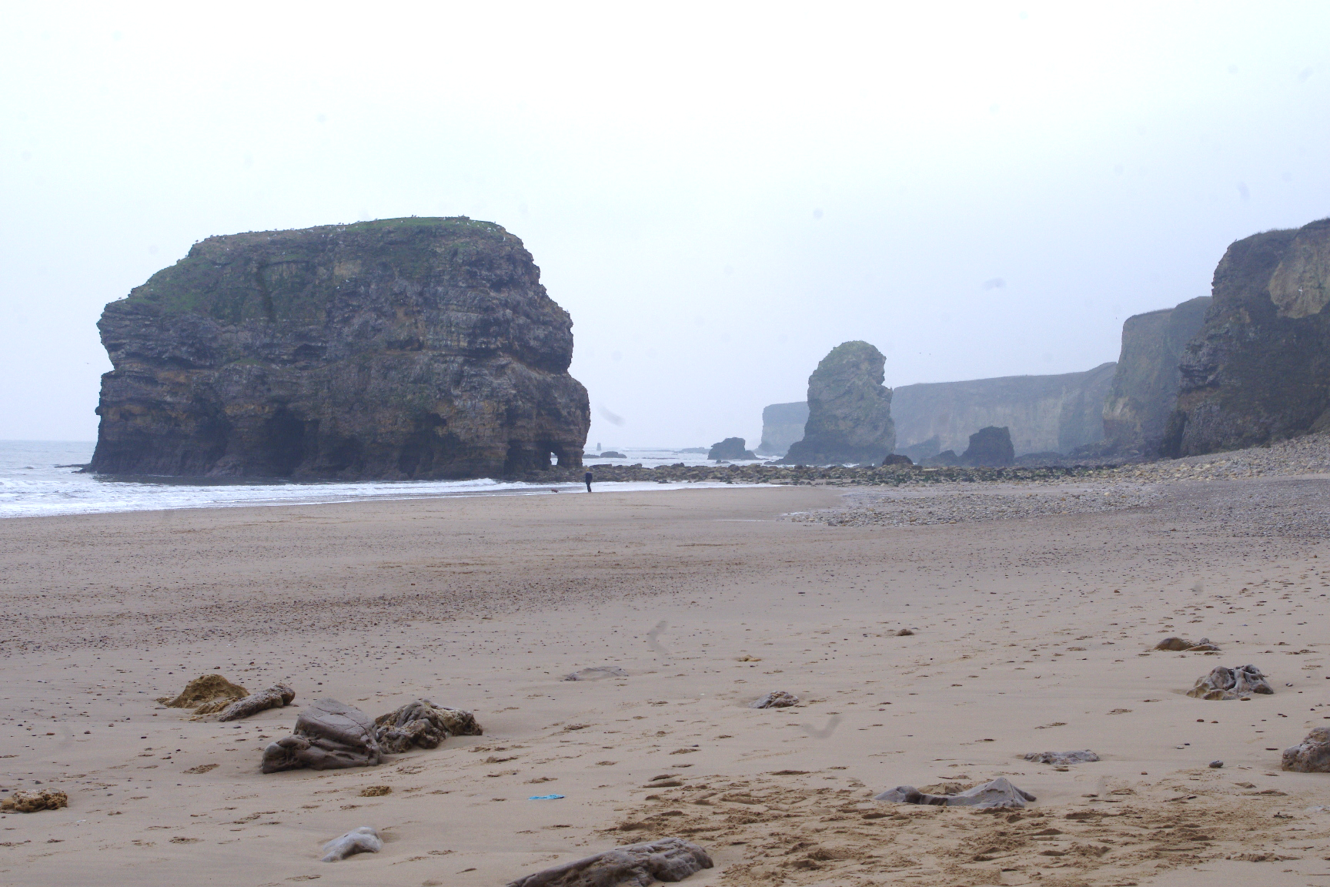
Monitoring and results – Marsden Bay
a monitoring programme using terrestrial laser scanning, photogrammetry and geophysical techniques has been taking place in order to characterise the erosion, recognise points of issue and recommend potential action
large, episodic failures generate localised erosion rates exceeding the site-wide mean erosion rate (0.032 m a⁻¹) by over an order of magnitude
rockfalls >1 m³ and >10 m³ occur approximately every 2 and 9.5 months, respectively
internal system controls, such as cliff material characteristics and foreshore geometry, dictate rockfall characteristics and background patterns of activity.
the influence of external environmental controls, notably storm activity, is detectable through regression analysis
Top left – typical stack and arch formations, Marsden
Top right – brecciated areas are more resistant to erosion
Right – view of cliff showing variability in erosion linked to lithological variation

Slide 5
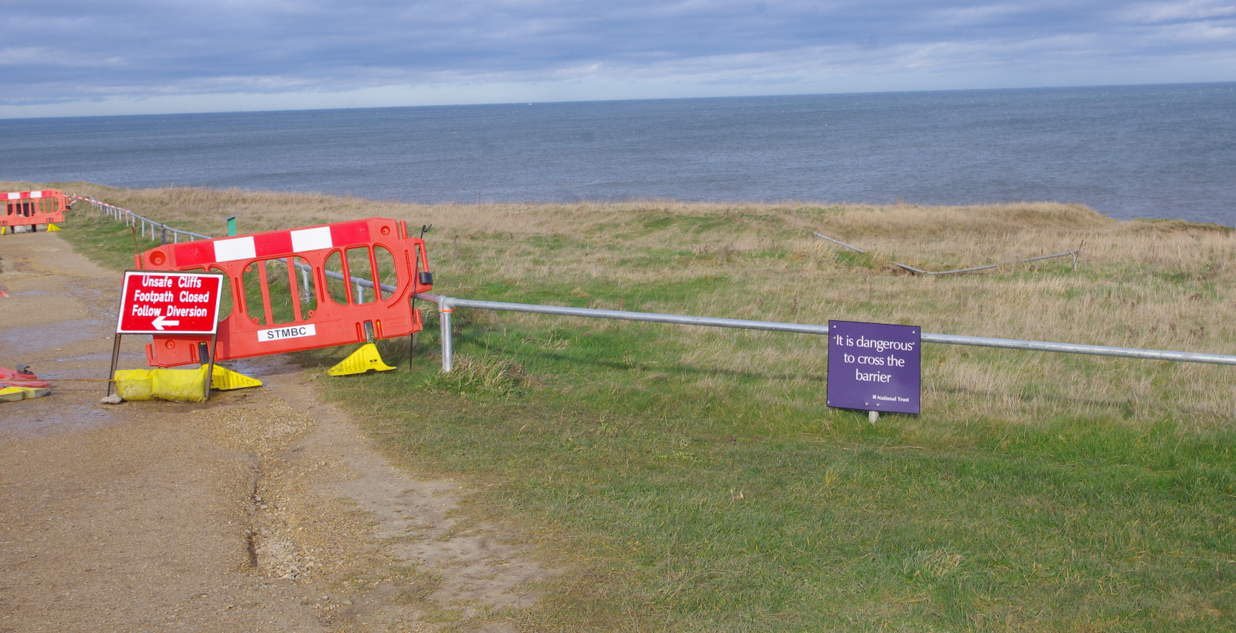
Whitburn
Whitburn was formerly a quarry and coal mine, later infilled and now subject to erosion, undercutting and sink hole appearance
Geophysical surveys using seismic and ground penetrating radar methods demonstrate undercutting is occurring over a much wider area than previously believed
A new sink hole appeared in 2019 in an area not previously quarried or disturbed
This is due to increased erosion at the cliff base which exploits natural fissures
Top right - Sink hole on cliff at Whitburn
Middle – historic image showing mine and quarry. Yellow star shows position of sink hole
Bottom right – ‘new’ sink hole marked by red star

Slide 6
Conclusions
it is possible to quantify links between environmental variables
in this case offshore wave heights, and erosion prediction
from a hazard and geosite management perspective this finding and framework is significant because it represents an effective new tool for quantifying temporal convergence in rockfall dynamics at lithologically complex rocky coasts over timescales that are relevant for hazard assessment
with knowledge then decisions can be made about protection, recording and future management
important for maintaining access
King, C.A.M. (1953) The relationship between wave incidence, wind direction and beach changes at Marsden Bay, County Durham. Transactions of the Institute of British Geographers, 19, 13–23.
Westoby, M.J., Brasington, J., Glasser, N.F., Hambrey, M.J., and Reynolds, J.M., 2012, ‘Structure-from-Motion’ photogrammetry: A low-cost, effective tool for geoscience applications: Geomorphology, v. 179, p. 300-314, https://doi.org/10.1016/j.geomorph.2012.08.021 .
Westoby, M.J., Lim, M., Hogg, M., Pound, M.J., Dunlop, L., and Woodward, J., 2018, Cost-effective erosion monitoring of coastal cliffs: Coastal Engineering, v. 138, p. 152-164, https://doi.org/10.1016/j.coastaleng.2018.04.008.

