Slide 1
Ulyssys Water Quality Viewer: a satellite-based near real-time water quality visualization
András Zlinszky @azlinszky, Gergely Padányi-Gulyás @fegyi001
zlinszky.andras@ulyssys.hu
Ulyssys Software Development Ltd.
Budapest, Hungary

Slide 2
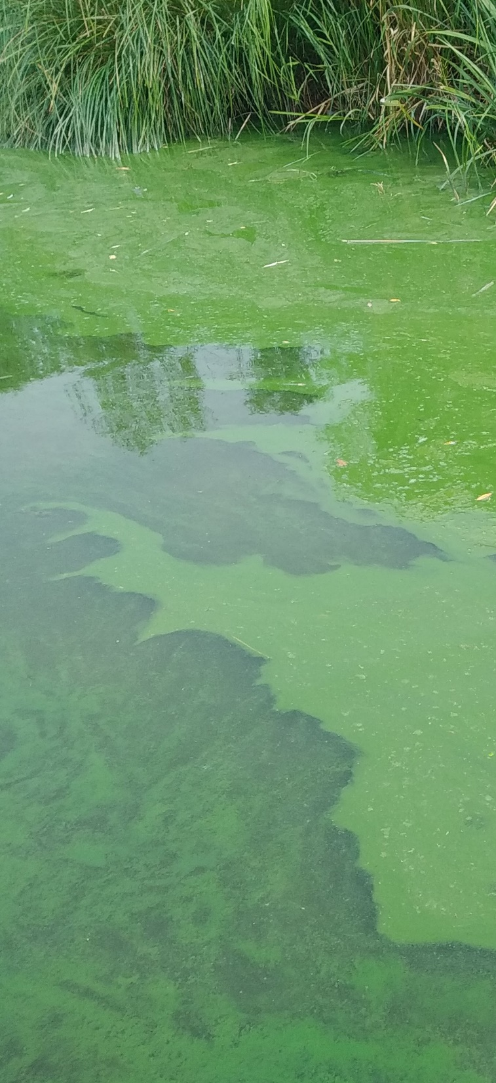
How does satellite imagery relate to water quality?
Chlorophyll ← related to nutrient inflow
Suspended Sediment ← related to mixing of the water column
Coloured Dissolved Organic Matter
Temperature
These parameters have optical signals in water, so they can be „seen” on satellite imagery
Accuracies depend on local calibration from sample data
This is why we „visualize” and not „map” with this method

Slide 3
Why a new visualization?
Satellite imagery products already exist
Eg. Copernicus Lake Water Quality product
But they are difficult to access and use even for remote sensing scientists
Water quality scientists – who uses them?
Aquatic Ecologists?
Water Quality related decisionmakers?
Teachers?
Interested public?
Why not? They don’t know about these products? Complicated access, download and visualization? Which product to choose?

Slide 4
Our goal: make global satellite Water Quality data accessible for everyone
So we have to make a product that is
Easy to handle
Easy to understand and interpret
Provides high spatial and temporal resolution
Works globally
Our first try was Global Lake Watch in Google Earth Engine
Simple visualization, difficult to use and maintain, but it worked
Recurring gaps in functioning, would have needed professional maintenance
Not working any more
What we need is a system that takes care of image hosting, search and visualization – that we can use as a basis for our own script

Slide 5
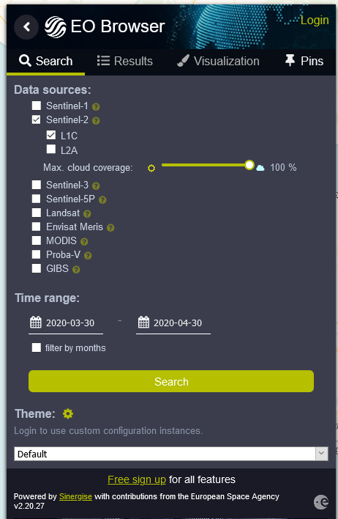
EO Brower: an easy entry point to satellite data
Global Coverage, search based on location, time and cloud coverage
Vast archive of satellite data, updated in near real time (Landsat 5,7,8, Sentinel 1,2,3,5p, MERIS, MODIS, PROBA-V
Visualization and basic analysis (time series)
Custom scripting based on JavaScript, with large GitHub script repository
Free for non-commercial users
https://apps.sentinel-hub.com/eo-browser/

Slide 6
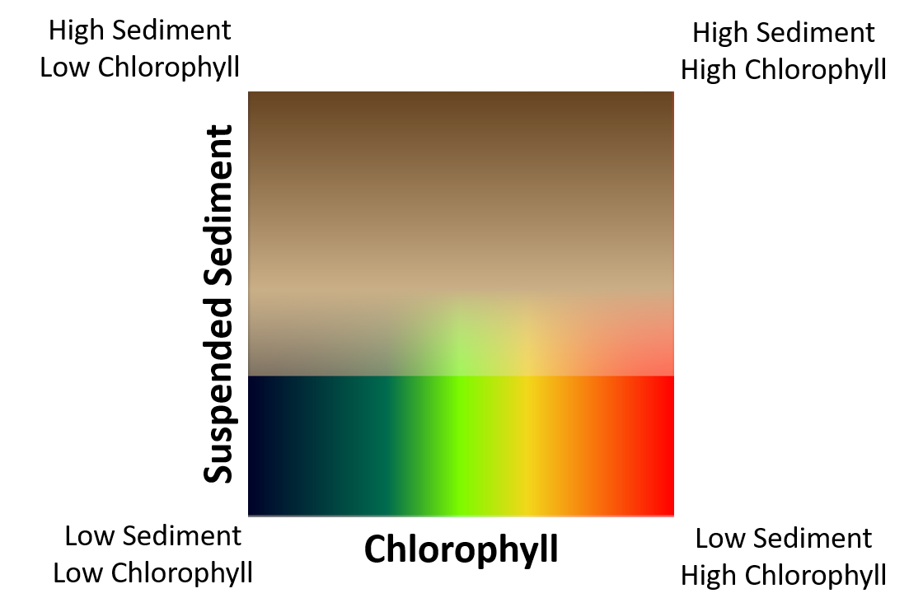
Ulyssys Water Quality Viewer: methods
Data sources: Sentinel 2 (5 days 10 m) and Sentinel 3 (2 days 300 m)
Cloud masking
Based on two custom scripts: Braaten et al 2015 and Hollstein et al 2016
Water masking
Based on the NDWI index (McFeeters 1996)
Suspended sediment visualization
620 or 700 nm band radiance (Nechad 2010)
Chlorophyll visualization
Fluorescence Line Height Algorithms (Gower 2005)
Common palette

Slide 7
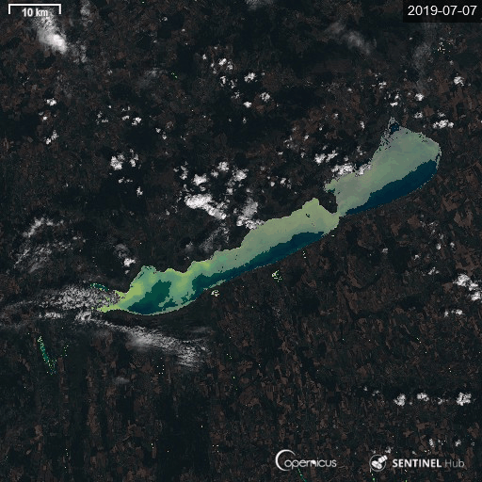
UWQV case study
Lake Eutrophication: Balaton, Hungary
Sudden and unexpected algae bloom in a lake of high ecological and economical importance
Peak chl 300 mg/m³, September 2019
Bi-weekly field monitoring was insufficient for early detection
Satellite monitoring showed progress of bloom (in retrospect…)

Slide 8
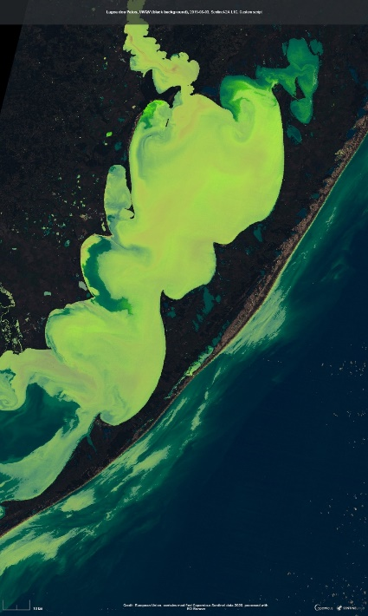
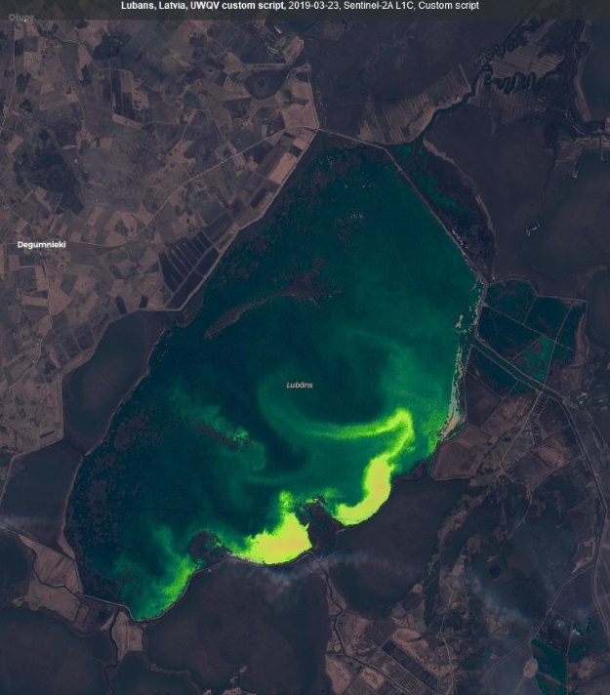
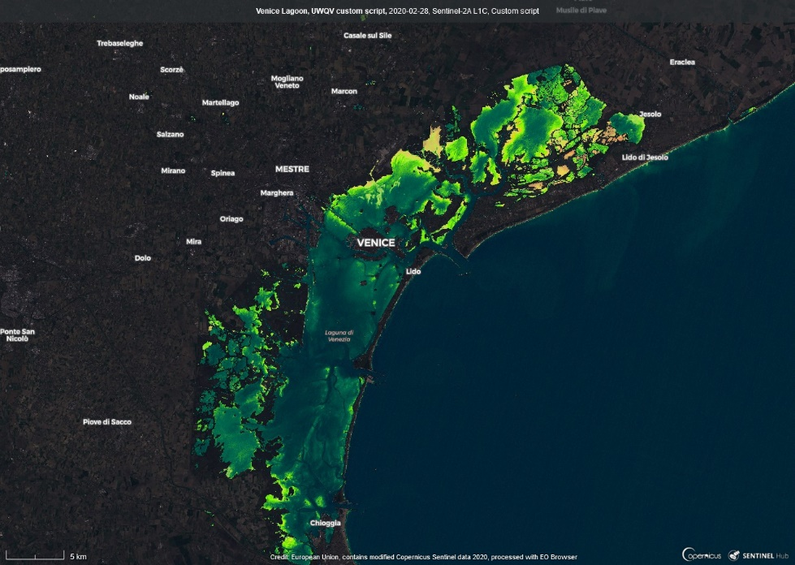
Impact
EO Browser Custom Script Contest 1st Prize
Widespread interest all over the world (based on twitter…)
Now embedded in „educational mode” in EO Browser → even easier to operate, no coding needed

Slide 9
Where to find – check it out!
An interactive example:
www.tinyurl.com/UWQV-example
Code and readme on github
https://github.com/sentinel-hub/custom-scripts/tree/master/sentinel-2/ulyssys_water_quality_viewer
Background documentation (citeable)
https://www.preprints.org/manuscript/202001.0386/v1

