Slide 1
Investigation of global atmospheric carbonyl sulphide between 2004 and 2018: an observational and modelling study
Author:
Michael Cartwright Supervision:
Dr. Jeremy J Harrison^{[1]}
Prof. John J Remedios^{[1]}
Prof. Martyn P Chipperfield^{[2]}
Dr. David P Moore^{[1]}
Funding provided by LISEO with an additional CASE award from the NCEO
^{[1]} NCEO & University of Leicester ^{[2]} NCEO & University of Leeds

Slide 2
Introduction – Carbonyl Sulfide (OCS)
Can be used as a proxy for photosynthetic uptake of carbon dioxide (CO₂) by vegetation:
$OCS+H_{2}O\underset{→}{CA}CO_{2}+H_{2}S$ $GPP=F_{OCS}\frac{[OCS]}{[{CO}_{2}]}\frac{1}{LRU}$
Global average atmospheric mixing ratio of ~500 pptv and a negligible trend – therefore a closed budget.
Sources | Sinks
Oceanic Emission | Vegetation
Biomass Burning | Soil
Anthropogenic Emissions | Photochemical loss

Slide 3
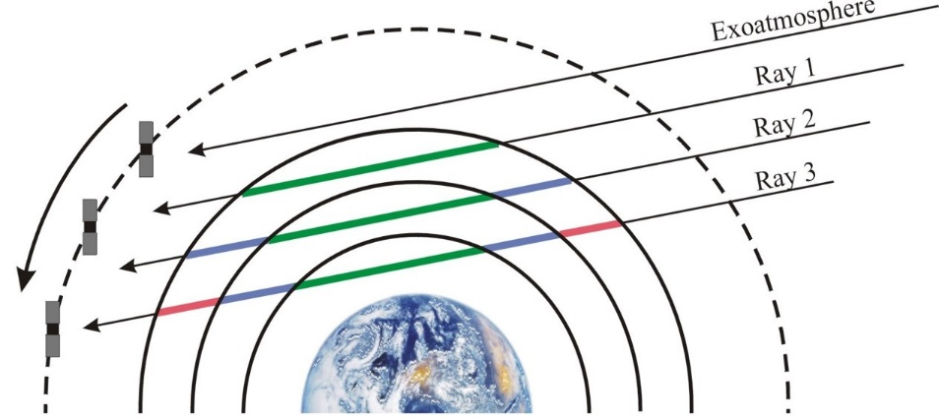
Introduction – Tools and Data
TOMCAT:
3D-CTM driven by ECMWF meteorological reanalyses and by OCS fluxes from the literature + amendments.
Horizontal resolution of 1.2°x1.2° from surface to 10 hPa.
ACE-FTS:
Limb sounding FTS, with approximately 87k profiles.
Being used to validate TOMCAT output spatially and temporally.
ACE-FTS viewing configuration.

Slide 4
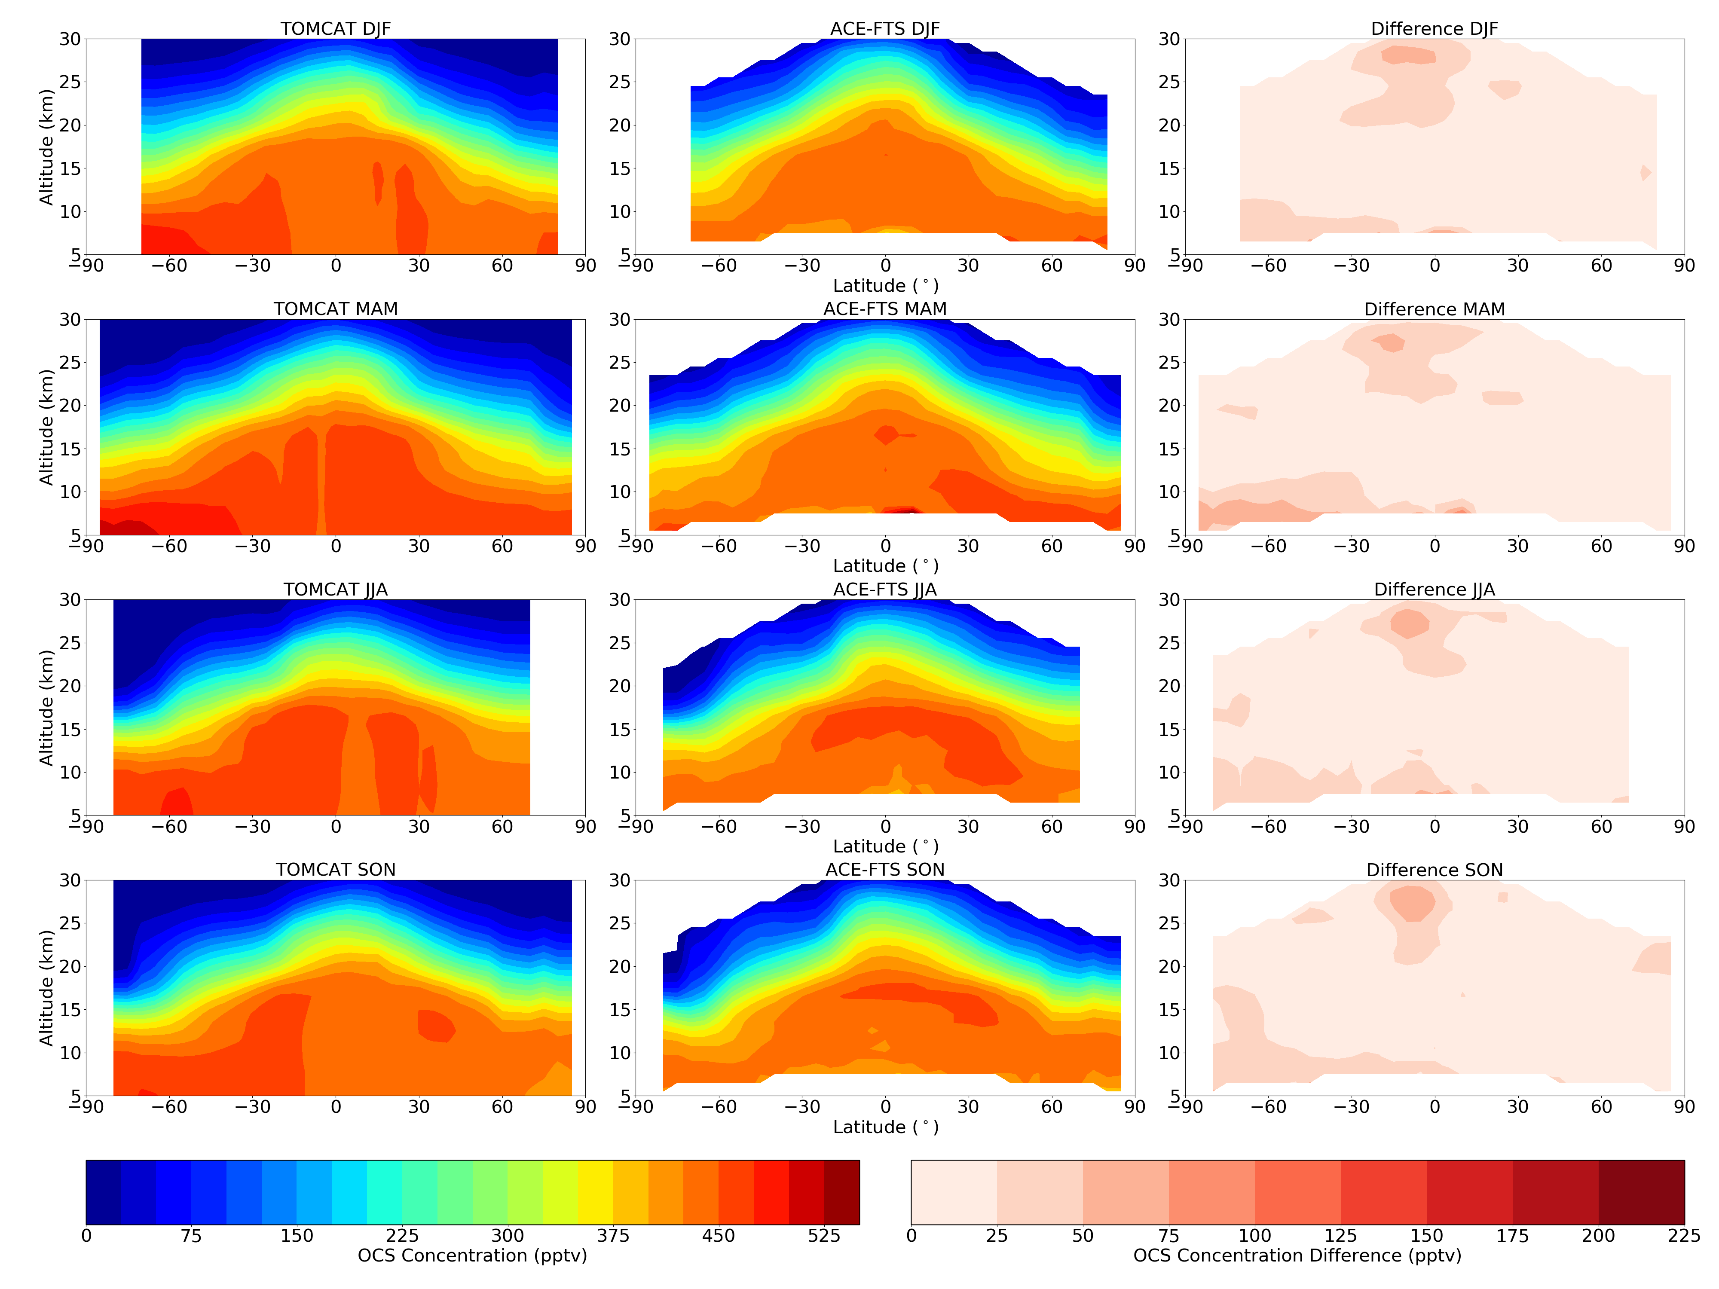
TOMCAT Results – Spatial Distribution
The model captures the vertical gradient of OCS, even into the stratosphere.
Absolute difference (right) generally within ±25 pptv throughout the troposphere.
Profiles of TOMCAT (not shown) are within the standard deviation of ACE-FTS measurements.
Data averaged between 2004 and 2018.

Slide 5
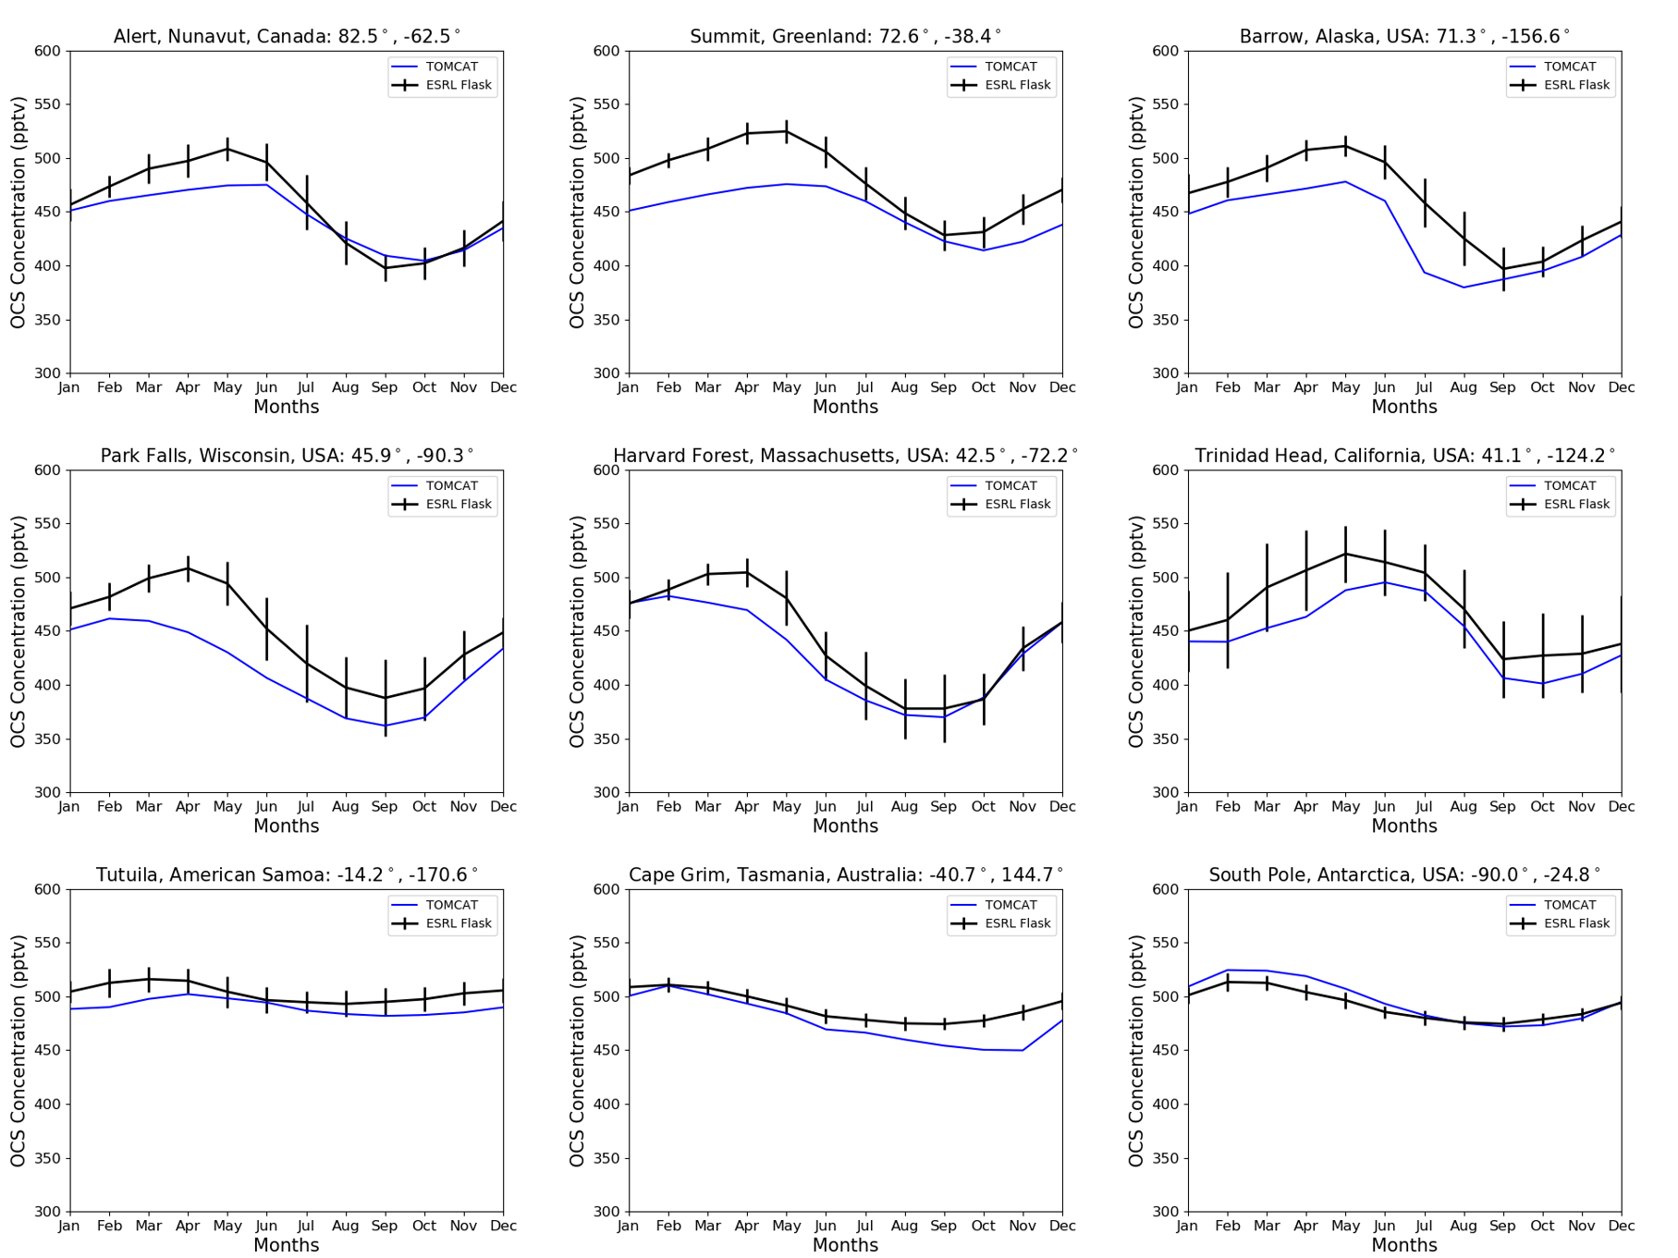
TOMCAT Results – Surface Comparison
TOMCAT (blue) captures the seasonal cycle successfully at most NOAA-ESRL flask sites (black).
The seasonal cycle in the Northern Hemisphere dominated by vegetative uptake and driven more by oceanic emissions in the South.
Data averaged between 2004 and 2018. Error bars represent standard deviation.

Slide 6
Summary and Future Work
TOMCAT has been configured to model OCS using multiple input fluxes.
OCS vegetative flux was calculated by scaling the JULES GPP product.
When compared to ACE-FTS, TOMCAT simulates OCS to within ±50 pptv throughout most of the atmosphere, with particularly good results in the troposphere.
The model captures an appropriate seasonal cycle at most of the NOAA-ESRL surface site locations.

