Slide 1
Numerical models of sheath fold development in rheologically heterogeneous rocks of the Cima Lunga-Adula shear zone (Central Alps)
Filippo Luca Schenker ⁽¹⁾, Marta Adamuszek ⁽²⁾, Matteo Maino ⁽³⁾ and Marcin Dabrowski ⁽²⁾
(1) University of Applied Sciences and Arts of Southern Switzerland (SUPSI), Institute of Earth Sciences, 6952 Canobbio, Switzerland (filippo.schenker@supsi.ch)
(2) Computational Geology Laboratory, Polish Geological Institute – National Research Institute, Wrocław, Poland
(3) Università degli Studi di Pavia, Dipartimento Scienze della Terra, Via ferrata, 1, 27100 (PV), Italy

Slide 2
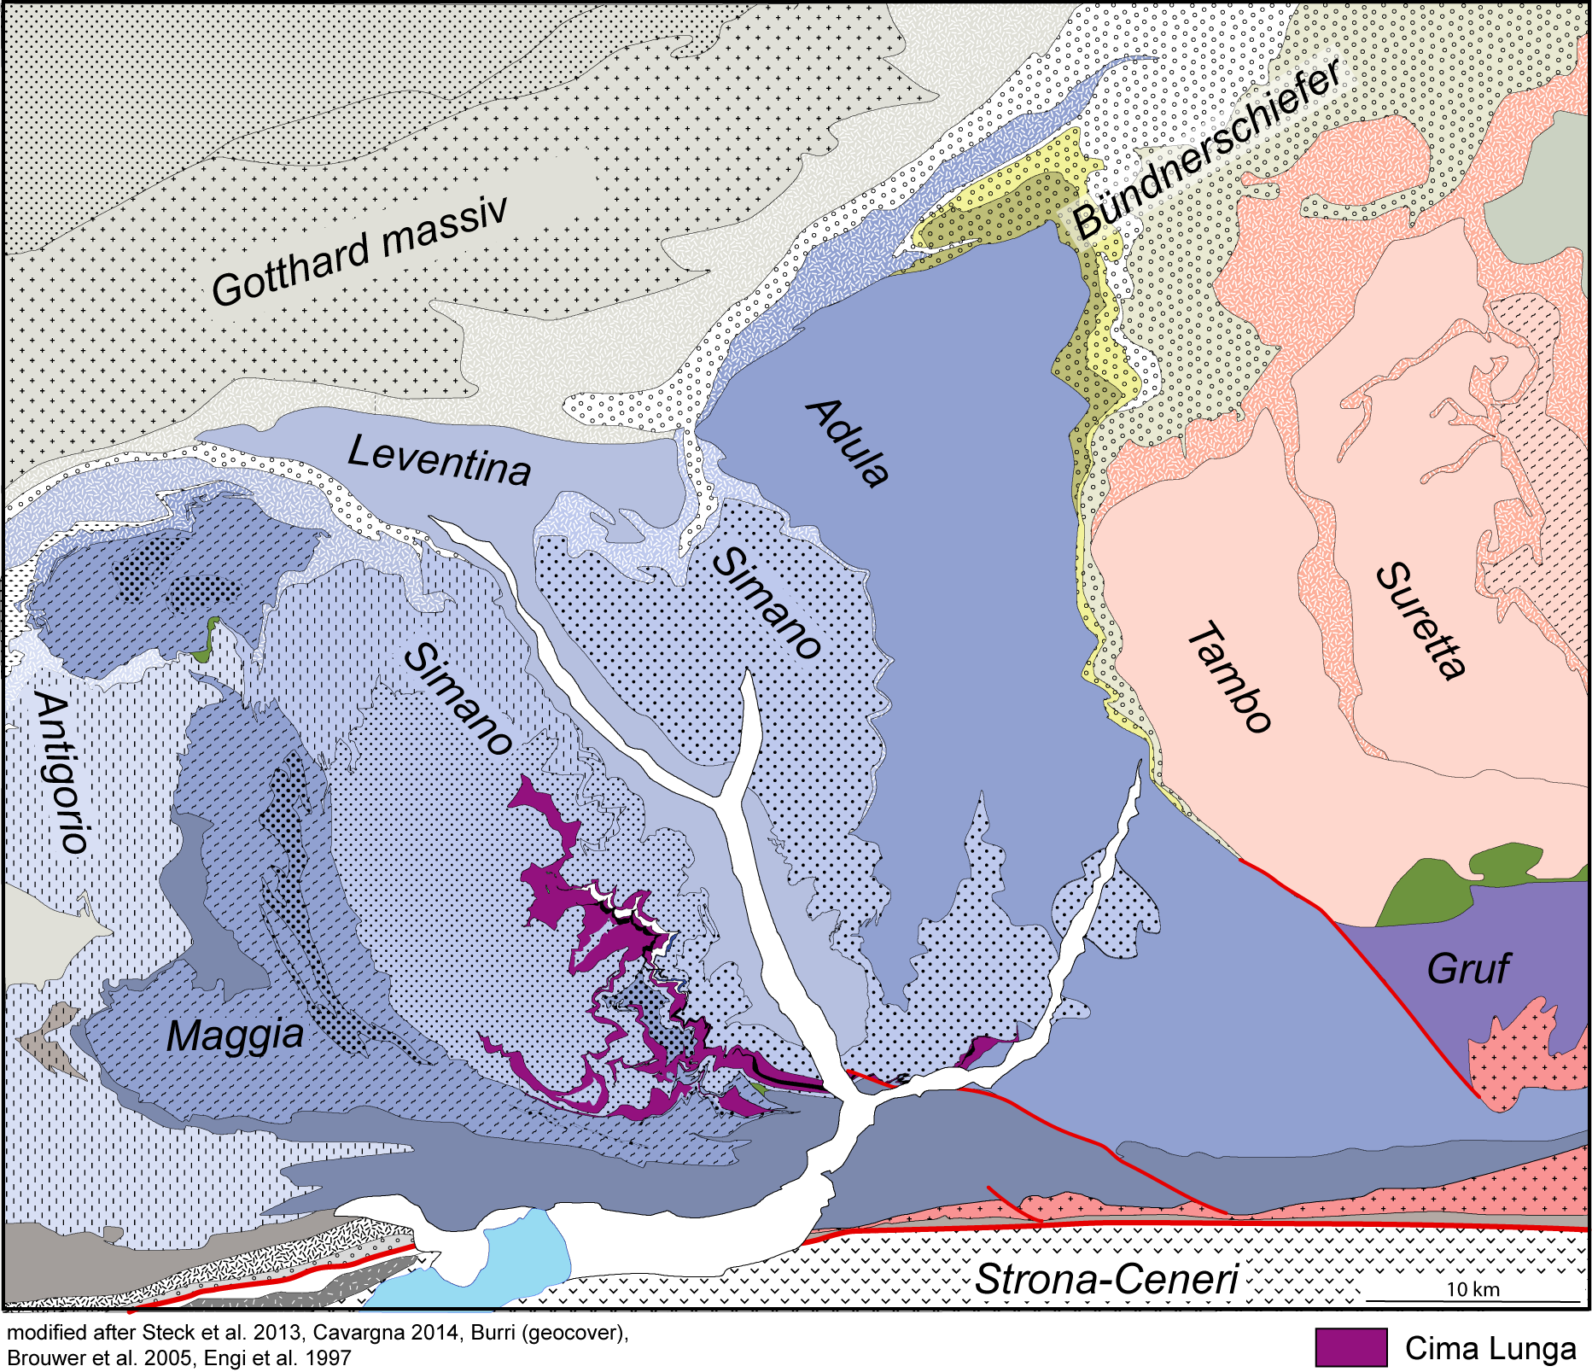
Geological setting
Brouwer et al 2005

Slide 3
Geological setting
Adula profile (East)
10
0
Schmid et. al. 2004
Cima Lunga profile (West)
Brouwer et al 2005
Own unpublished data

Slide 4
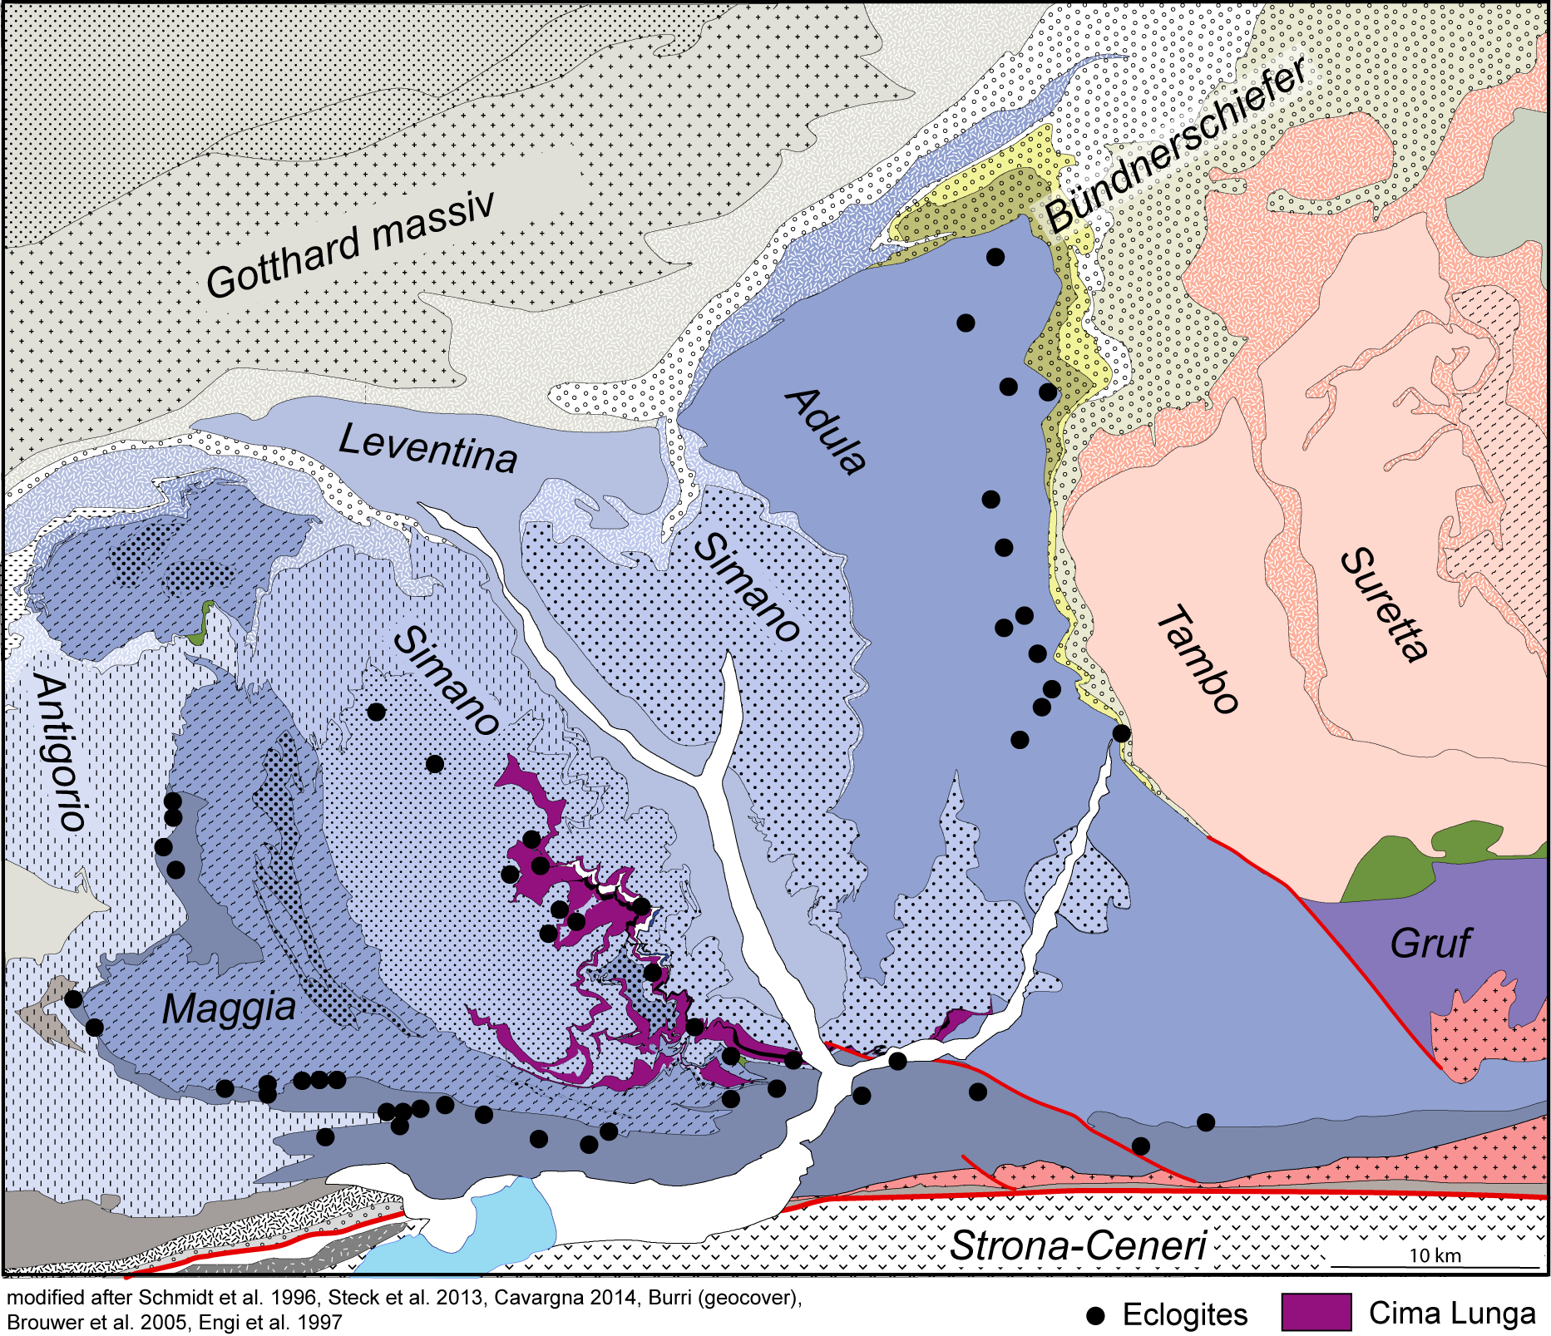
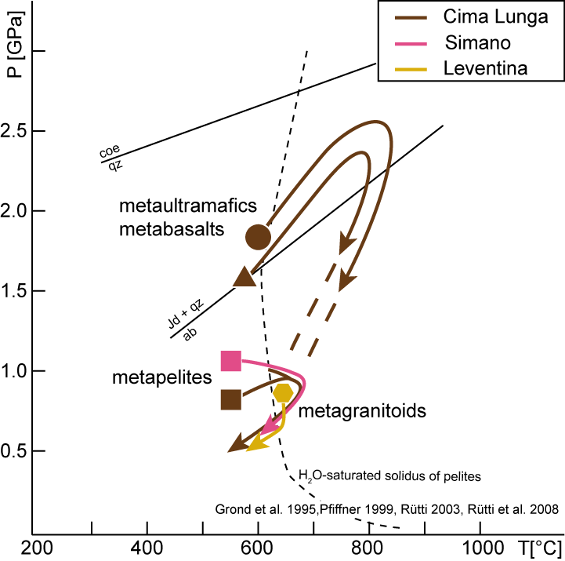
Geological setting
HP metamorphism Cima Lunga:
ca. 750 C and 2.5 GPa
(e.g. Evans et al. 1979, Heinrich 1982)
at 40.2 ± 4.2 Ma
(Sm/Nd dating on Garnet peridotite, Becker 1993).
Brouwer et al 2005

Slide 5
Geological setting
Barrovian metamorphism Cima Lunga:
ca. 650 C and 0.8 GPa
(e.g. Grond et al. 1995, Rütti et al. 2003 1982)
at 33.0 ± 0.6 Ma
(U-Pb dating on zircons, Gebauer 1994)
Southern Steep
Belt
Brouwer et al 2005
Rubatto et al. 2009

Slide 6
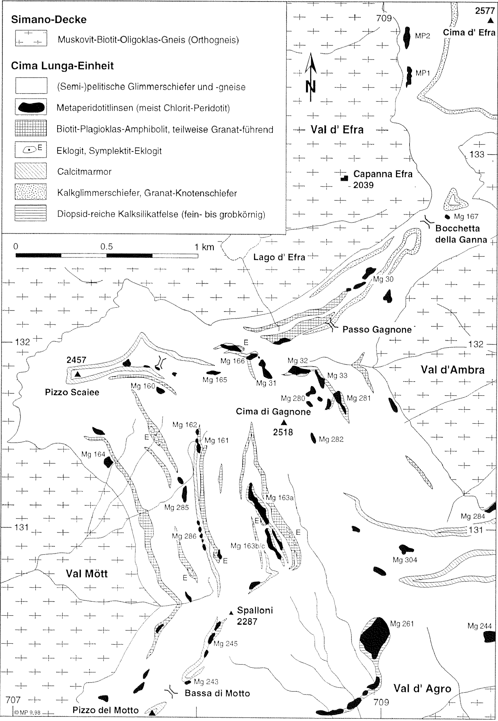
Geological setting – the Cima Lunga unit
Schenker, unpublished data
The Cima Lunga unit is a highly sheared nappe constituted of micaschists, paragneisses and minor orthogneisses and metacarbonates, locally enclosing lenses of garnet peridotite and chlorite harzburgite, partially talc bearing. Within the ultramafites, metarodingites demonstrate that, before Alpine deformation, ultramafics were metasomatised on the seafloor and serpentinized (Evans and Trommsdorff, 1978).
The elongated high-pressure ultramafic bodies are surrounded by folded amphibolite-facies paragneisses and meta-carbonates that locally form sheath folds. The internal structures of the ultramafic bodies are characterized by recumbent, sub-isoclinal folds, folded boudinaged mafic layers and boudinaged fold hinges.
Pfiffner, 1999

Slide 7
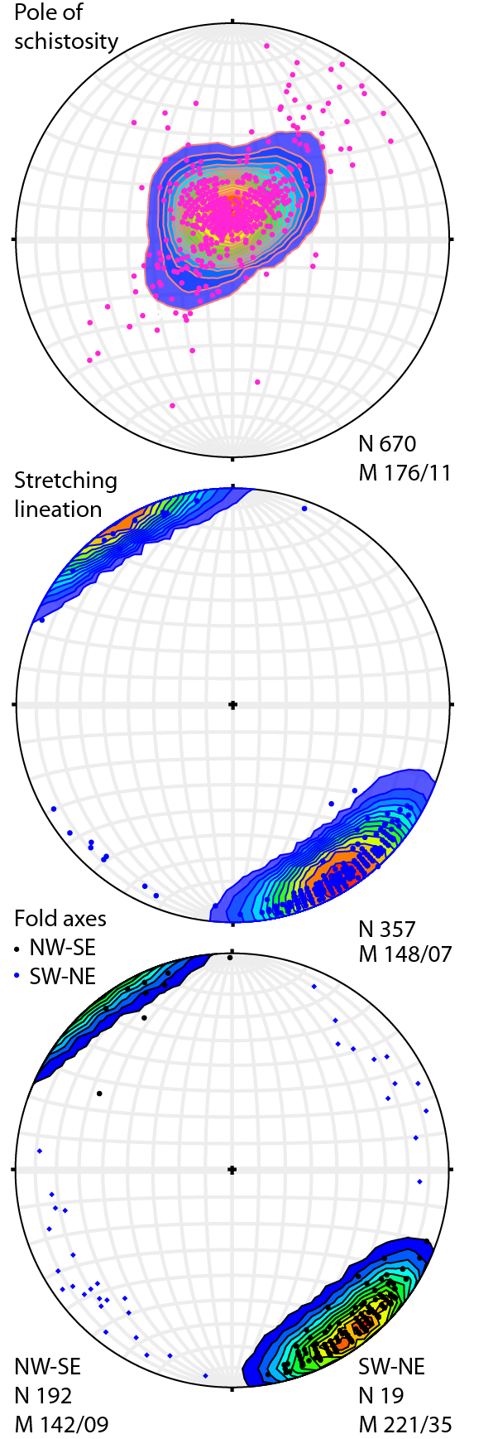
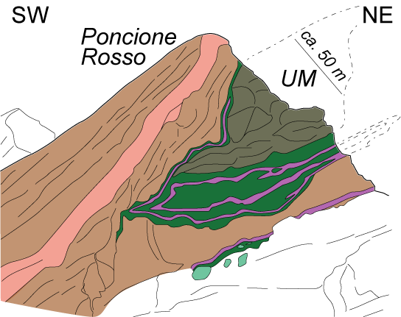
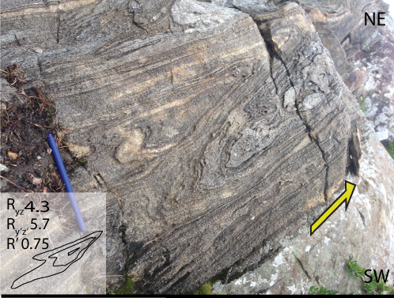
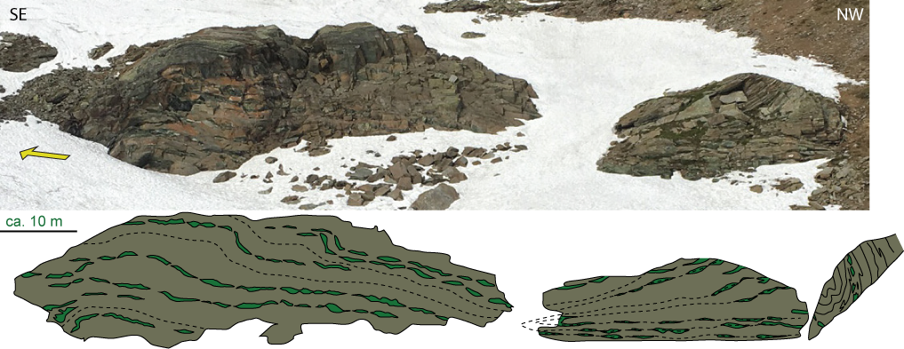
Geological setting– main structural features of the Cima Lunga
Sheath folds within micaschists, gneisses
and metacarbonates at all scales.
Penetrative stretching
lineation
Sheath folds are associated with ultramafic elliptical inclusions that have a complex poly-phase internal deformation.
after Kuhn 2000

Slide 8
Scientific questions
How to reconcile different deformation styles within matrix and inclusion of the Cima Lunga unit?
- Gneissic matrix: penetrative amphibolite facies mineral/stretching lineation and foliation that locally depicts sheath folds. The deformation pattern suggests a continuous simple shear dominated deformational regime.
- Peridotitic inclusion: contains folded boudinaged mafic layers and boudinaged fold hinges that hint to changes in the stress field.
These spatial differences in deformation style and the superimposed structures are traditionally attributed to distinct deformation phases that reflect a varying stress field during subsequent tectono-metamorphic stages of the Cima Lunga nappe (e.g. Grond et al. 1995). However, we propose that the contrasting deformation styles occur during a continuous simple shear deformation within a heterogeneous rock media consisting of a weak matrix and a relatively hard but deformable inclusion.
2) In the inclusion-matrix deformation system, two end-member regimes have already been investigated: (i) a weak ellipsoidal inclusion that acts as a slip surface over which sheath folds develop and (ii) a rigid ellipsoidal inclusion that rotates within the matrix generating sheath folds in the back of the rotating ellipse in direction of the shearing. Between these two end-members, the understanding of the clast-matrix deformational regime is not trivial and the genesis of sheath folds is unexplored.

Slide 9
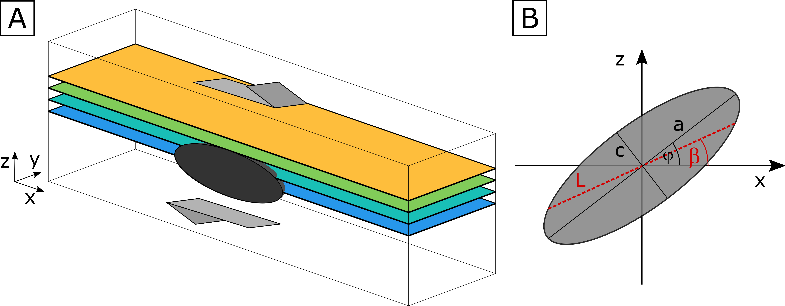
Numerical setup
We use a three-dimensional model of ductile deformation around an ellipsoidal inclusion under simple shear. We analyse the structure development around a deformable inclusion with the Eshelby solution by varying:
1) Initial inclusion aspect ratio (a/c and b/c)
2) Viscosity ratio between inclusion and matrix (m)
3) Strain (γ)
Linear viscous behaviour
Longest ellipse axis parallel to the x-direction
Simple shear acts in the x-direction
Horizontal layers act as passive markers

Slide 10
Numerical results – deformational regimes
The regime diagram as a function of different initial inclusion aspect ratios (a₀/c₀) and viscosity ratios (m).
The diagram shows only regimes of the inclusion behaviour but not their evolution!
The diagram is applicable only for the case of initially horizontal orientation of the longest ellipse semi axes φ=0!

Slide 11
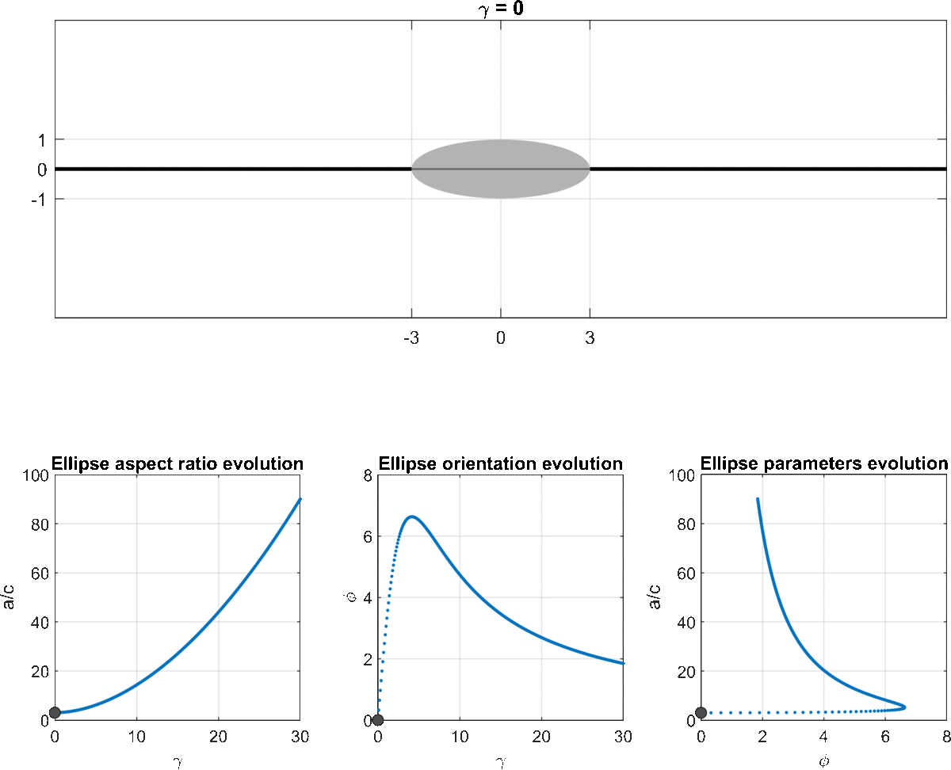
Numerical results – regime I: stretching

Slide 12
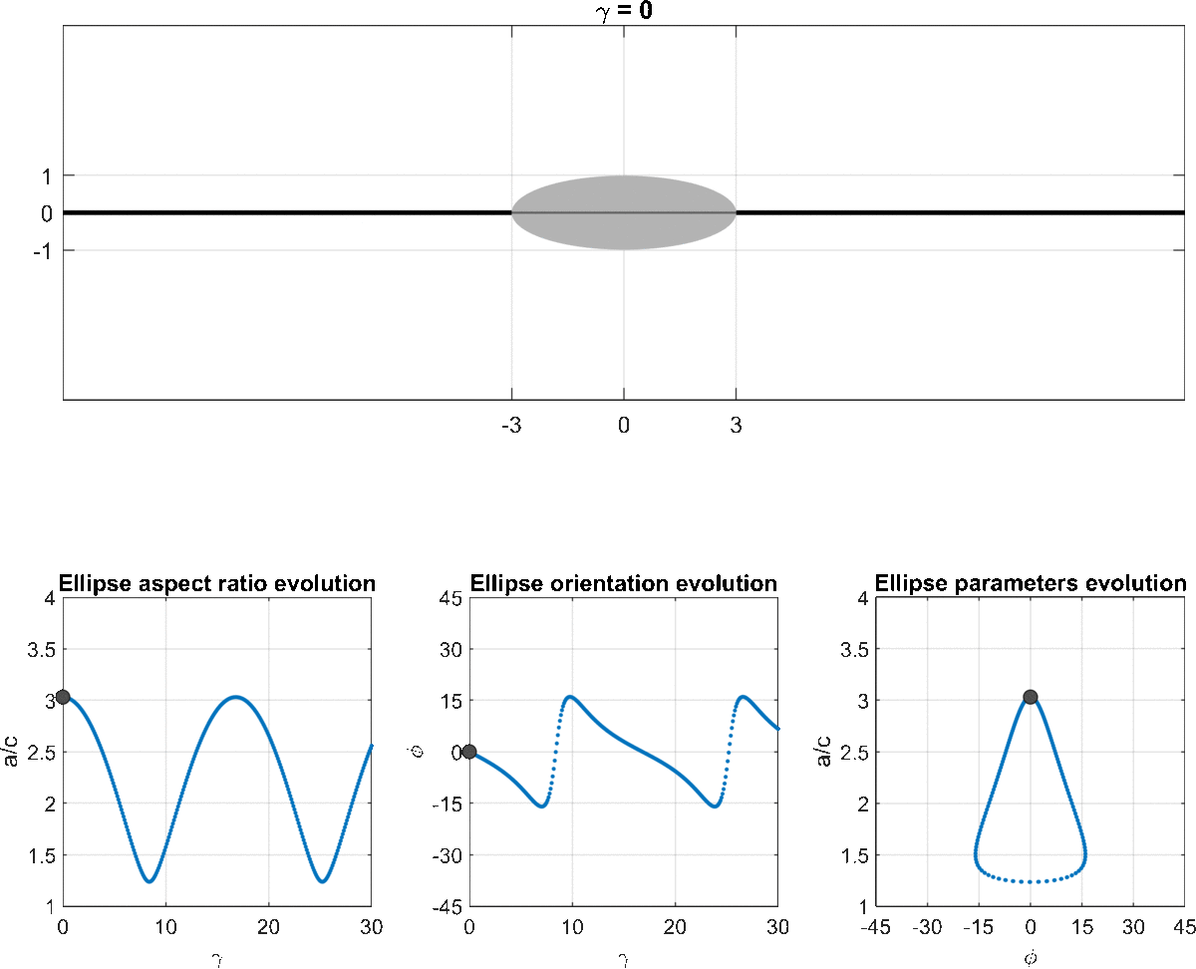
Numerical results – regime II: oscillation

Slide 13
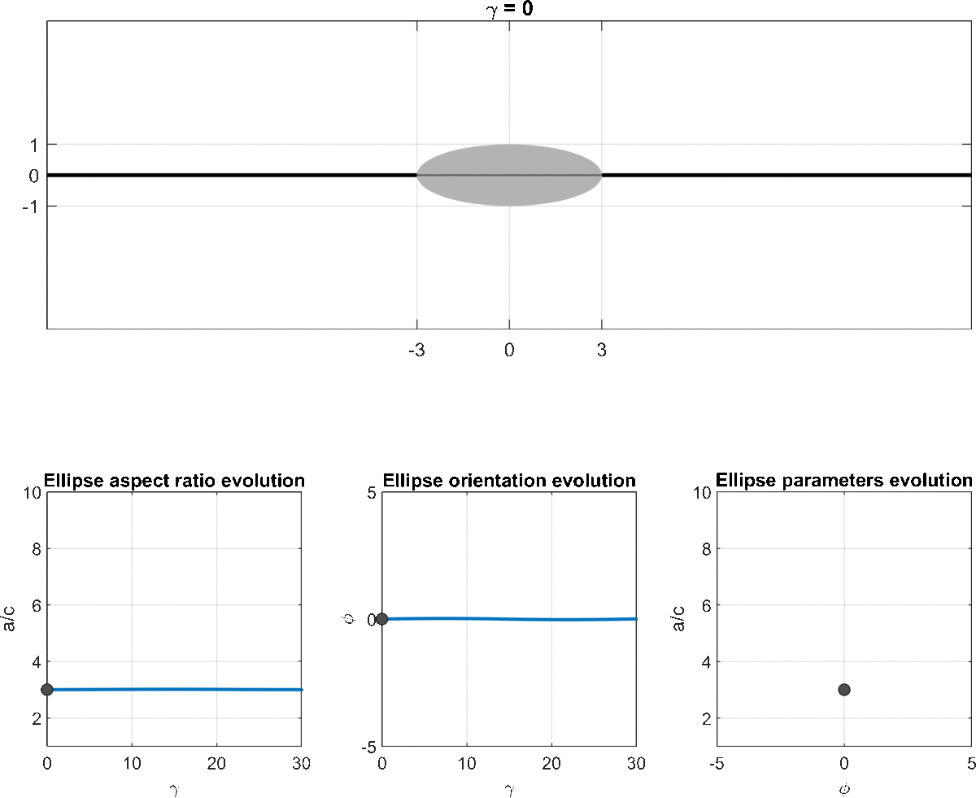
Numerical results – regime IIA: stationary

Slide 14
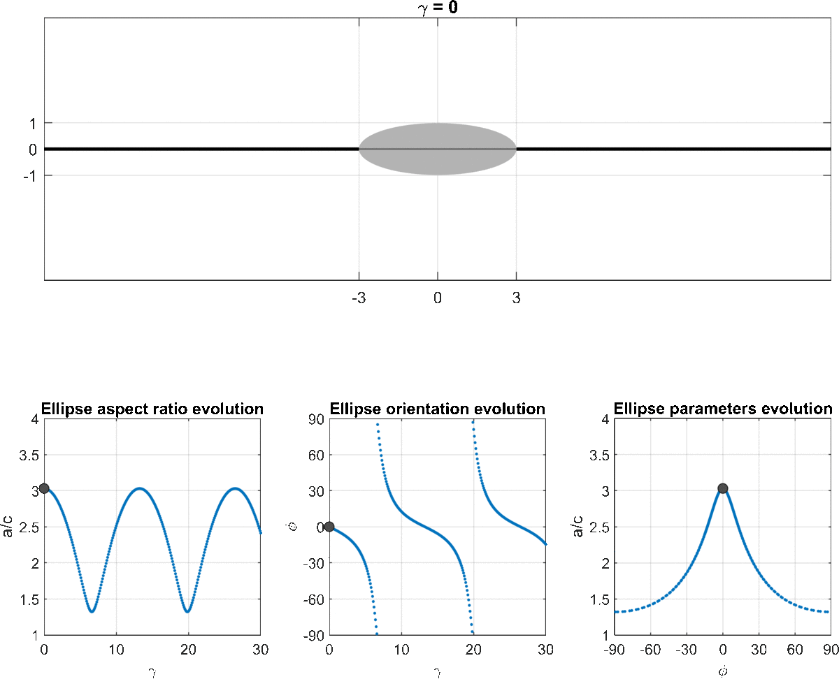
Numerical results – regime III: rotating

Slide 15
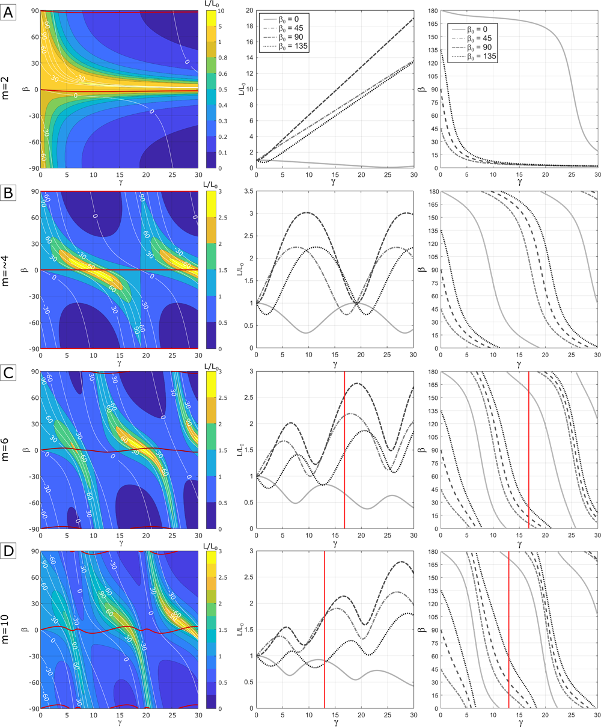
Numerical results – analysis of the deformation of the internal lines
Figure caption:
The length and orientation of the material lines intercepting the inclusion centre for varying viscosity ratios. The evolution of the material line lengths normalized by their initial length L/L₀ is color-coded. The evolution of selected initial material line orientation are plotted using white curves. Red curves separate fields of instantaneous shortening and stretching. Vertical red lines in C and D indicate strain at the end of the first cycle of inclusion deformation.
Regime I
Except for the end-member cases (weak and not deformable inclusion), the internal lines alternate stages of stretching and shortening (or vice versa) during continuous deformation.
The intensity of deformation (L/L₀) and the cyclicity of the internal layers depend on the viscosity contrast (m), the total bulk strain (γ) and the orientation of the layers.
Regime IIa
Regime II
Hence, by constraining in the field (i) the final aspect ratio and (ii) the angle of the inclusion, (iii) the number of switches in the deformation regimes of the inclusion, (iv) the final angle of the internal layer, (v) the estimate of the total shortening and the total stretching of the internal layer, it is possible to estimate the viscosity contrast and the total strain!
-> we performed backward modelling
Regime III

Slide 16
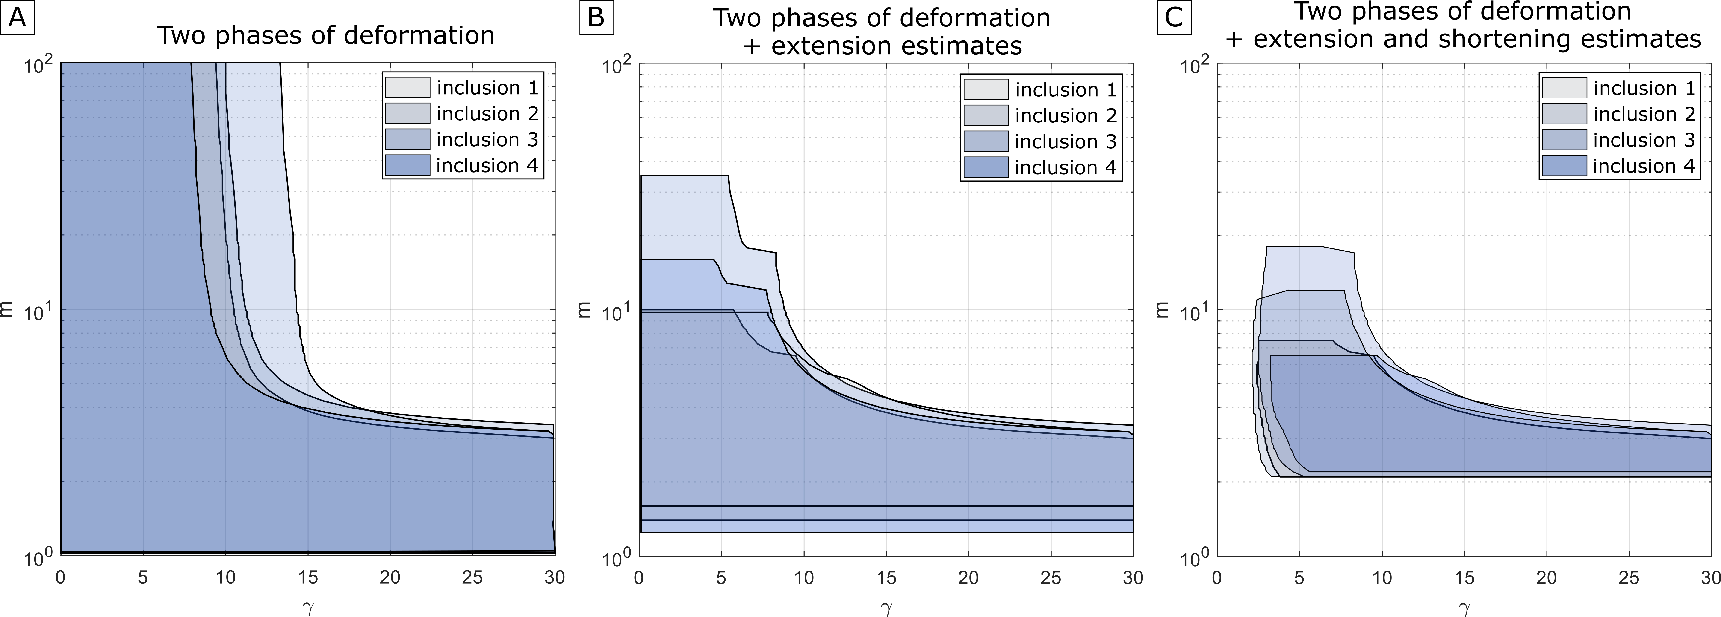
Numerical results – backward modelling
Field data.
Input parameters to constrain the numerical models.
inclusion | sizes (m) | a/c | b/c | φ | β | altern. of E-extension S-shortening) | min. total E (L/L0) | min. total S (L/L0)
1 | 45x30x15 | 3.0 | 2.0 | 0 | 0 | E-S-?E? | 1.4 | 0.48
2 | 50x20x18 | 2.8 | 1.1 | 0 | 0 | E-S-?E? | 1.15 | 0.52
3 | 60x20x15 | 4 | 1.3 | 0 | 0 | E-S-?E? | 1.7 | 0.46
4 | 50x50x25 | 2 | 2 | 0 | 0 | E-S-?E? | 1.2 | 0.4-0.5
Backward modelling.
Range of possible viscosity ratios (m) and strains (γ) when we consider Extension-Shortening phases of deform. within the inclusion
No estimate on L/L₀
For a given inclusion shape (field data), the method tests different m in the backward models. In each model, it analysed all the possible material line orientations within the inclusion and track their length change. Based on the number of deformation switches (from E to S or from S to E) and the estimates of L/L₀ of the lines in E and in S (field data) the method further limits the possible ranges of m and γ needed to reproduce the observed shape and deformation history of the inclusion.

Slide 17
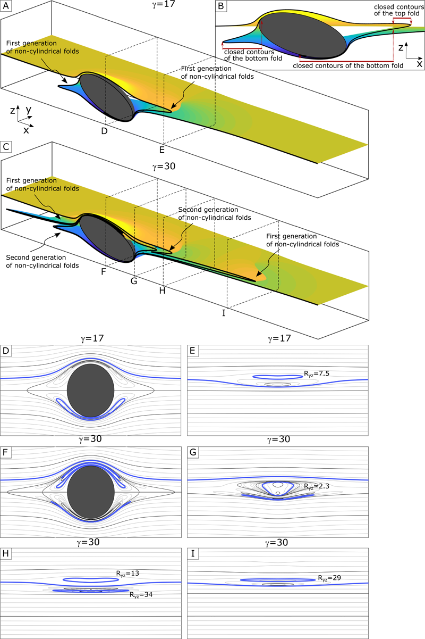
Conclusions
The structural evolution of the regime II of the matrix-inclusion numerical simulations reproduced the main features of the contrasting deformation pattern of the Cima Lunga unit (sheath folds in the gneissic matrix and poly-phase deformation within the peridotitic inclusions).
-> Spatial changes in the deformation style and the overprinted structural patterns may be comprehensively explained by the overall progressive simple shear deformation rather than a regional poly-phase evolution.
With the backward modelling, a first attempt of quantification of the physical parameters in the system permitted to estimate m = 2-7 and γ>3 for 2 deformation phases of the inclusion. However, the implementation of the onset of sheath folds in the backward modelling and a more detailed structural analysis on different inclusions are needed to further constrain the physical parameters.
-> each inclusion with a similar viscosity ratio may record its own structural history that depends on its initial aspect ratio and orientation of the internal layer. Therefore, any attempt of grouping structures in deformational phases between the different inclusions with similar rheology may be misleading.

