Slide 1
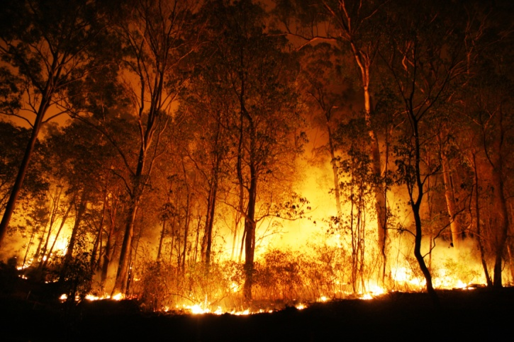
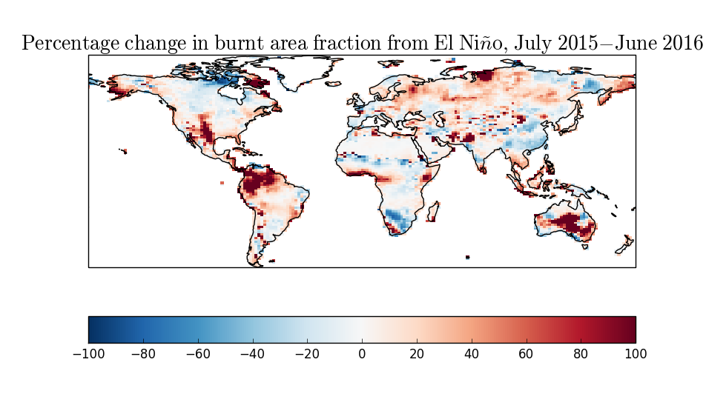
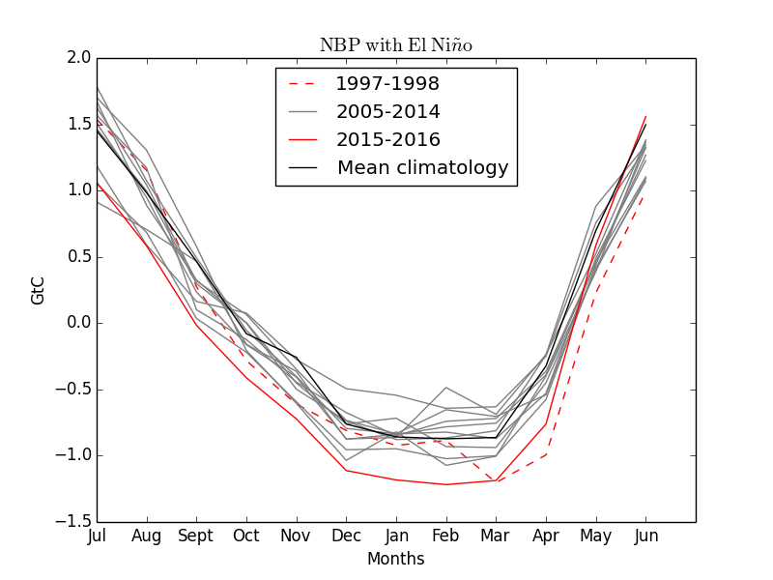
Fire-vegetation feedbacks in JULES-INFERNO
C. Burton¹, R. Betts^{1,2}, C. D. Jones¹, D. I. Kelley³
¹Met Office Hadley Centre, Exeter, UK. EX1 3PB, UK
²College of Life and Environmental Science, University of Exeter, Exeter. EX4 4SB. UK
³ UK Centre for Ecology & Hydrology, Wallingford. OX10 8BB. UK
Introduction and Aims
Introduction
There is high confidence that forest fire severity and frequency is increasing through the interaction between severe droughts and land use, with land-use change often increasing ignition sources in tropical landscapes (IPCC AR5, WGII, Chapter 4). With climate change, we may face increasing threat of fire, but globally burned area is decreasing due to fragmented and declining fuel loads in managed agricultural areas. There is still much uncertainty about how fire risk will change in the future. Yet fire is an important aspect of the Earth System, affecting the land surface, the carbon cycle, atmospheric chemistry and the hydrological cycle.
Research aims
Couple the fire model INFERNO to dynamic vegetation in JULES
Investigate the impact of fire and land-use change on the land surface in the historical period
Understand the impact of modes of variability such as El Niño on fire and the terrestrial carbon cycle
Explore fire risks in future scenarios of climate and land-use change for Brazilian ecosystems
Methods
Results
Disturbance is important for the accurate simulation of vegetation cover within JULES
Fire is important for the representation of the Cerrado in Brazil within JULES, and improves the simulation of land-use emissions from this region
El Niño events can increase fire risk in some areas, as was the case with the 2015-16 El Niño in South America due to hotter and (in some areas) drier conditions.
The Amazon biome has the potential to change from a sink to a source of carbon in hot, dry years
Fire risk is projected to increase in the future due to hotter and drier conditions, but not homogeneously
The pathway taken to specific levels of warming has different regional impacts, with hotter temperatures and higher burnt area projected in NE Brazil in scenario RCP8.5 at global mean temperatures of 2.0˚C compared to other RCP scenarios, leading to reduced evapotranspiration (ET) and higher albedo
Fires may reduce dry season resilience of tropical ecosystems and bring them closer to a tipping point in the future
Fire risk is reduced at lower temperatures, but not homogeneously due to changing patterns of temperature and moisture availability
INFERNO
INteractive Fire and Emission algoRithm for Natural envirOnments
Fire weather conditions
Precipitation
Temperature
Relative Humidity
Ignition Mode
Constant
Lightning
Population and lightning
Summary of change in evapotranspiration from present day for each RCP scenario and level of warming (with fire and land-use change). Colours indicate temperature above pre-industrial (ºC)
Ignition
+
Fuel Density
Flammability
Goff-Gratch saturation vapour pressure
Burnt Area
Soil Moisture
Change in 90th percentile of McArthur fire danger with Solar Radiation Management, calculated as change in RCP2.6+SRM (2061-2070) from Present Day (2006-2015) minus change in RCP2.6 (2061-2070) from Present Day (2006-2015).
(Burton et al., 2018. GRL)
Emissions
Change in burnt area due to El Niño July 2015 – June 2016 simulated by JULES-INFERNO
Research questions
What impact does fire and land use have on the simulation of vegetation cover in JULES?
What was the impact of the 2015/16 El Niño on fire and the carbon sink in Brazil and globally?
How could fire risks change in the future with different land use and climate change scenarios?
What impact will changes in the fire regime have on vegetation across Brazil, and could this lead to a change of state from tropical forest to seasonal forest / savannah?
This research uses the fire model INFERNO in the land surface model JULES (Joint UK Land Environment Simulator), driven by CRU-NCEP meteorological forcing data for the historical period and by HadGEM2-ES model data for the future period. INFERNO is an empirical model designed for large scale simulations on decadal to centennial timescales.
Burnt area fraction observations from GFED4.1s (left) and as modelled by coupled JULES-INFERNO (right), annual mean 2012-2016 (Burton et al., 2019. GMD)
Conclusions
We can now represent fire mortality for the first time in JULES, and use this capability to assess the impact of fire on the carbon cycle. This is particularly relevant to understand in the context of future climate change scenarios, where fire risk may increase with hotter, drier conditions but not homogenously across the world. The Amazon rainforest is an important global store of carbon and regulator of climate and hydrology, yet this biome is at risk from future changes in climate, land use and fire. Keeping temperature rise below 2ºC could mitigate some of these potential impacts but the method of temperature reduction is also an important factor.
Global terrestrial Net Biome Productivity (GtC/month) for time series of 10 years from July – June. 2005-2014 shown in grey, large El Niño years shown in red (1997-1998 dashed; 2015-2016 solid), 10 year-mean climatology (‘No El Niño’) shown in black simulated by JULES-INFERNO
(Burton et al., in review, Frontiers
Met Office FitzRoy Road, Exeter, Devon, EX1 3PB United Kingdom Email: chantelle.burton@metoffice.gov.uk
© Crown copyright | Met Office and the Met Office logo are registered trademarks
This work was supported by the Newton Fund through the Met Office Climate Science for Service Partnership Brazil (CSSP Brazil), and the European Commission’s 7th Framework Programme (EU/FP7) under Grant Agreement 603864

