Slide 1
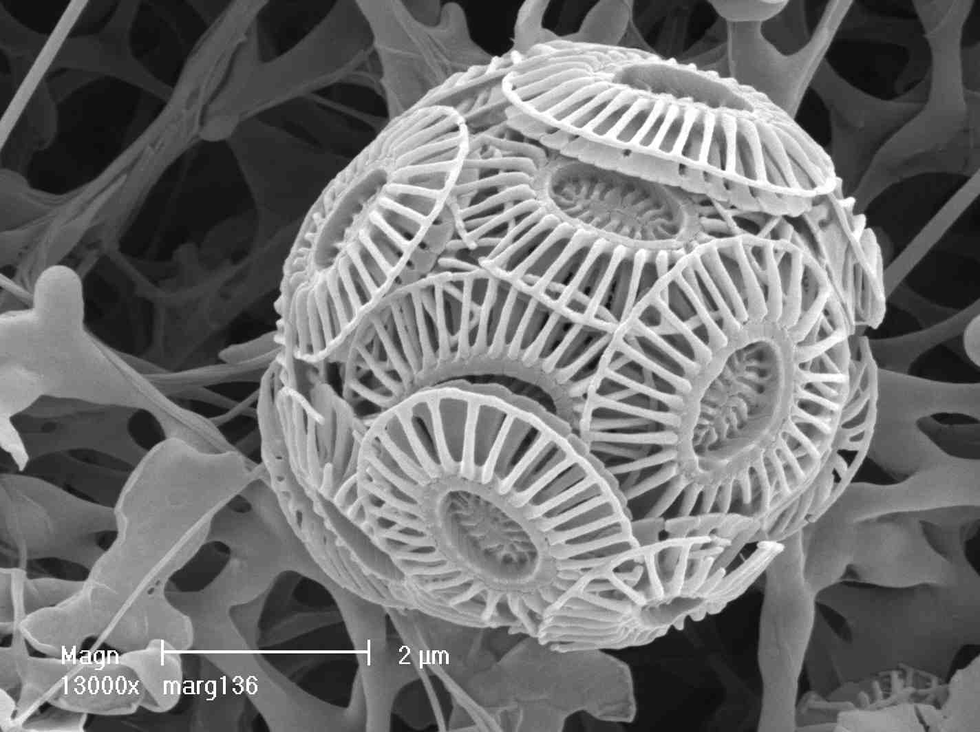




EGU2020-18410
Reconstructing ocean temperatures using coccolith clumped isotopes
Luz Maria Mejia, Alvaro Fernandez, Hongrui Zhang, Jose Guitian-Bermejo, Madalina Jaggi, Alberto Perez-Huerta, Stefano Bernasconi, and Heather Stoll

Slide 2


1. Why coccolith clumped isotopes?
Watch the presentation using the slide show option. It helps to follow the story.
Widely used ocean temperature proxies:
Foraminifera Mg/Ca or δ¹⁸O
Organic based proxies
Alkenones Uk37 (prod. by coccolithophores)
TEX86 (prod. by archaea)
Require assumptions on seawater Mg/Ca or δ¹⁸O
Insensitive > 28-29 C
Unclear depth of production
Independent of seawater chemistry
Warm tropical oceans over the Cenozoic?
??????
Coccolith clumped isotopes (∆₄₇)
Photic zone signal
No vital effects?
e.g. Drury and John, 2016; Katz et al., 2017

Slide 3
2. Samples
a) Iceland Sea bloom sediment trap
Monospecific
C. pelagicus
No T° bias due to ≠ habitats of ≠ species.
Well-constrained T°
Depth: surf.
July 1999
No diagenetic CaCO₃
b) ODP Site 982
2-16 Ma
<11, 2-10 and <2 µm size fractions
Sed. trap
ODP Site 982
Comparison to Uk37 record
Image from WoodsHole Oceanographic Institition, 2001 Annual Report

Slide 4
3. Sed. trap coccolith ∆₄₇: optimism for photic zone T° reconstructions
Satellite AVHRR surface July 1999 temperature:
6.74 °C
C. pelagicus ∆₄₇ -derived temperature:
7.1 ± 3.9 °C (95% CI)
SeaWiFS satellite image showing C. pelagicus bloom.
Image from WoodsHole Oceanographic Institition, 2001 Annual Report
C. pelagicus shows no vital effects in accordance with Katz et al. (2017)
Bernasconi et al., 2018
calibration
∆₄₇ C. pelagicus good tracer of production T°

Slide 5

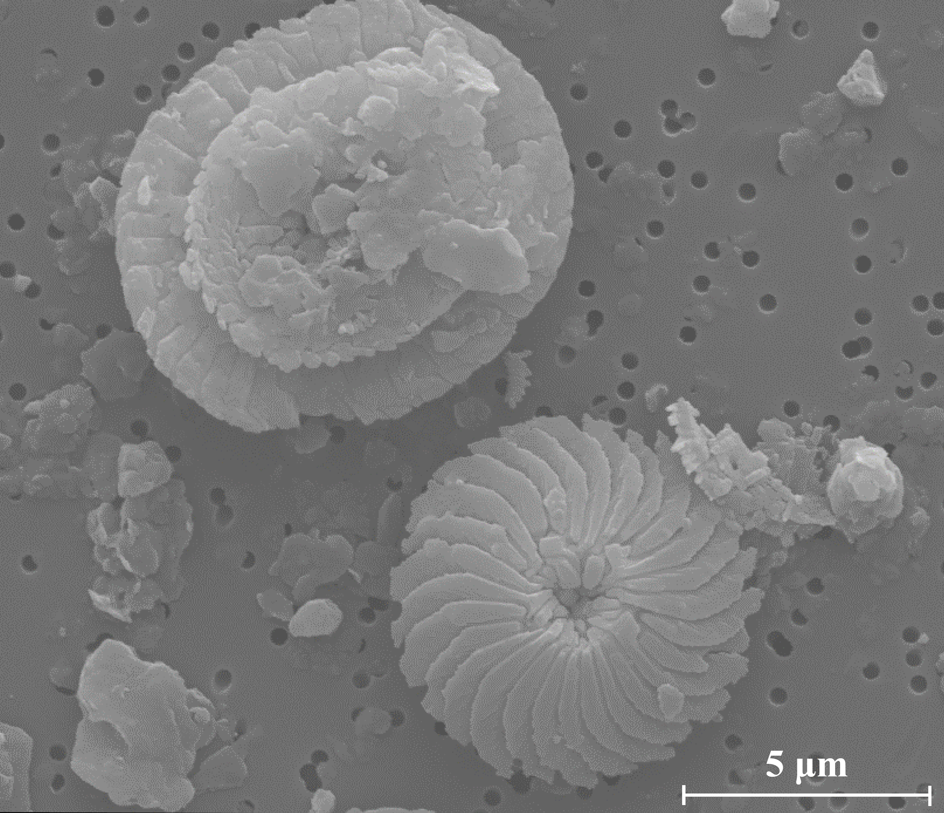
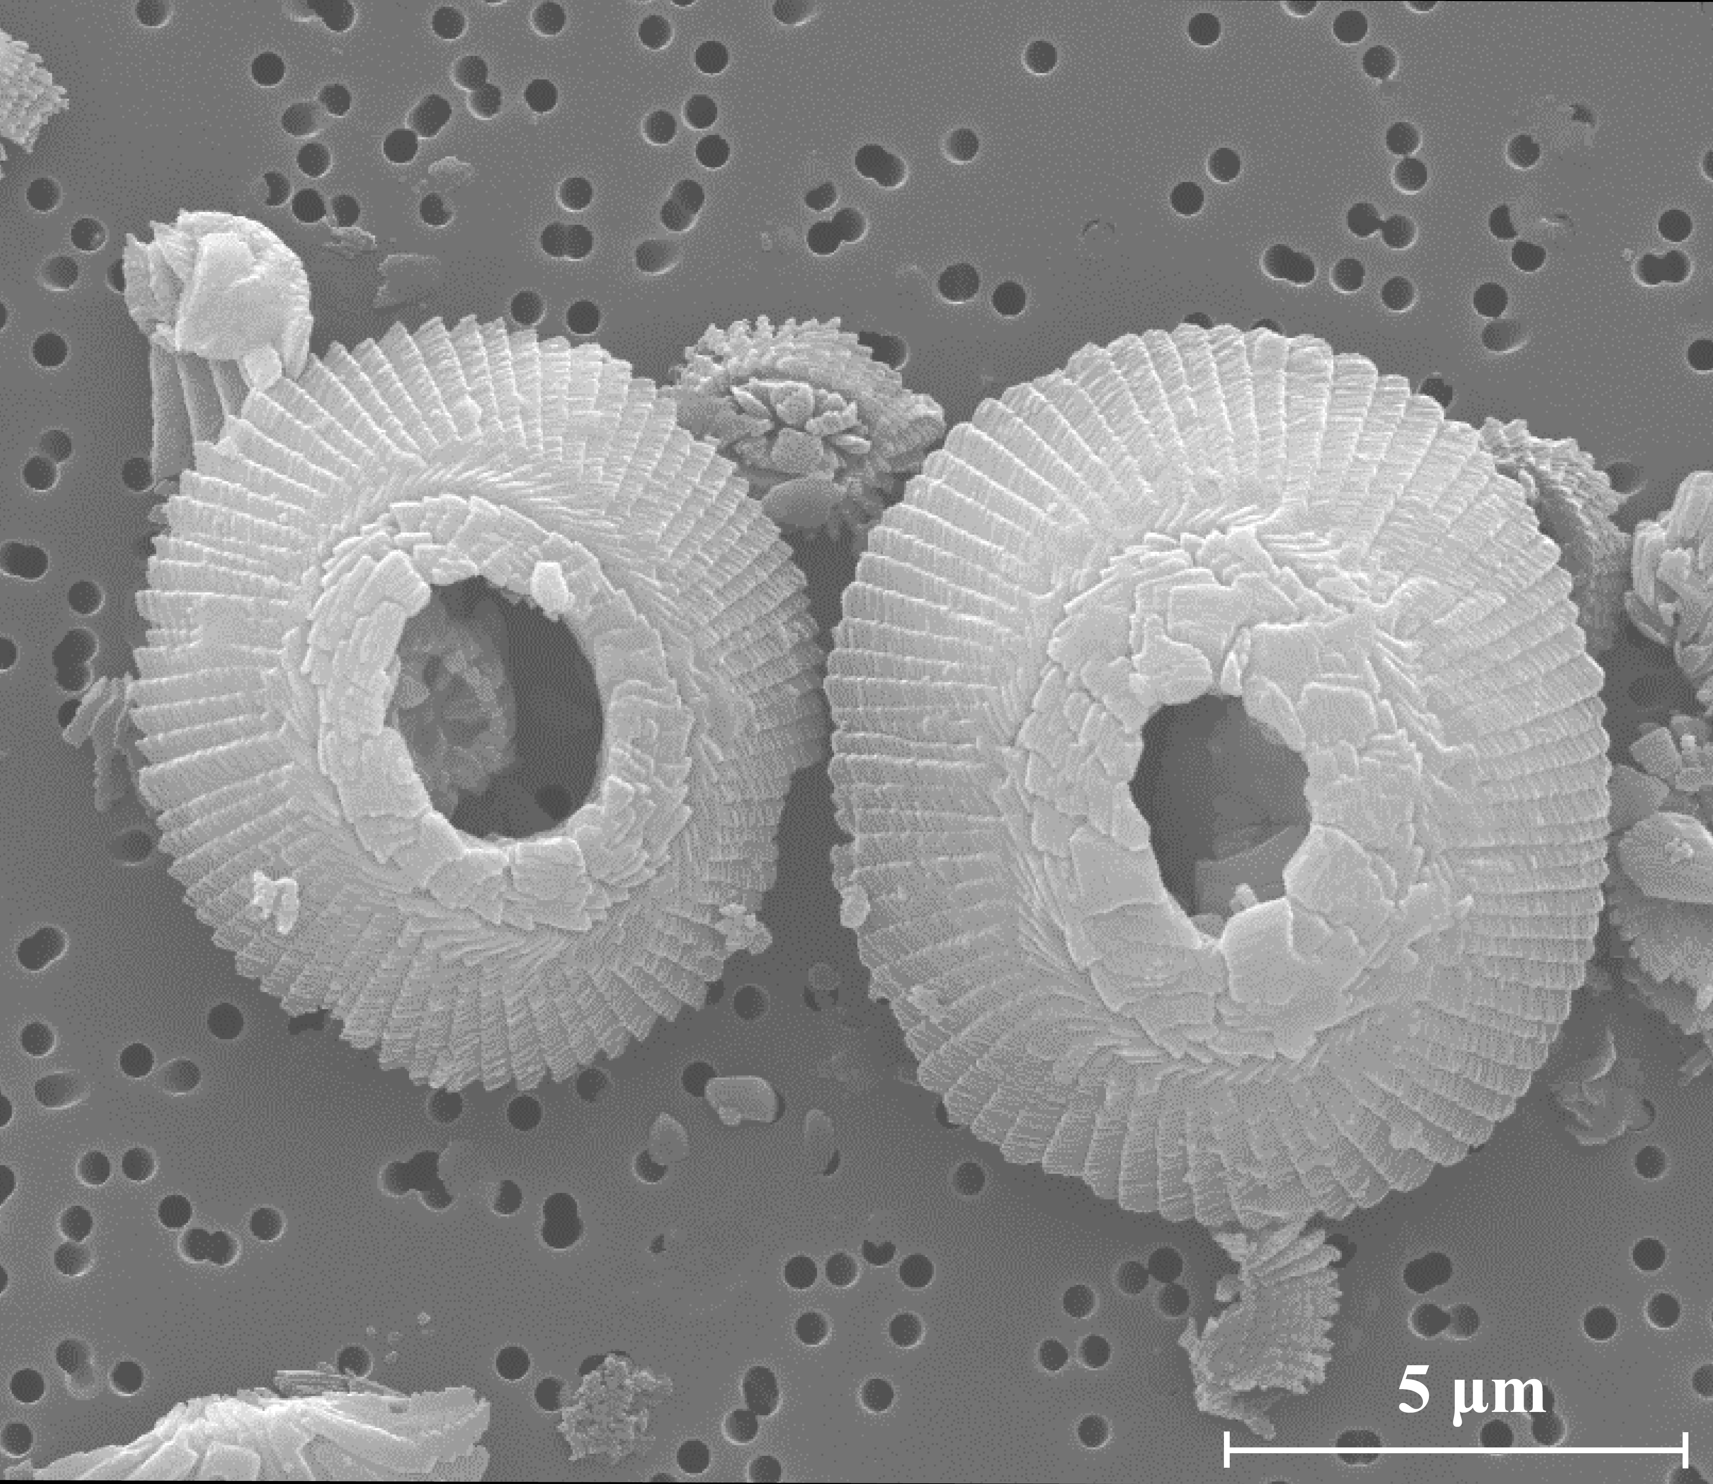
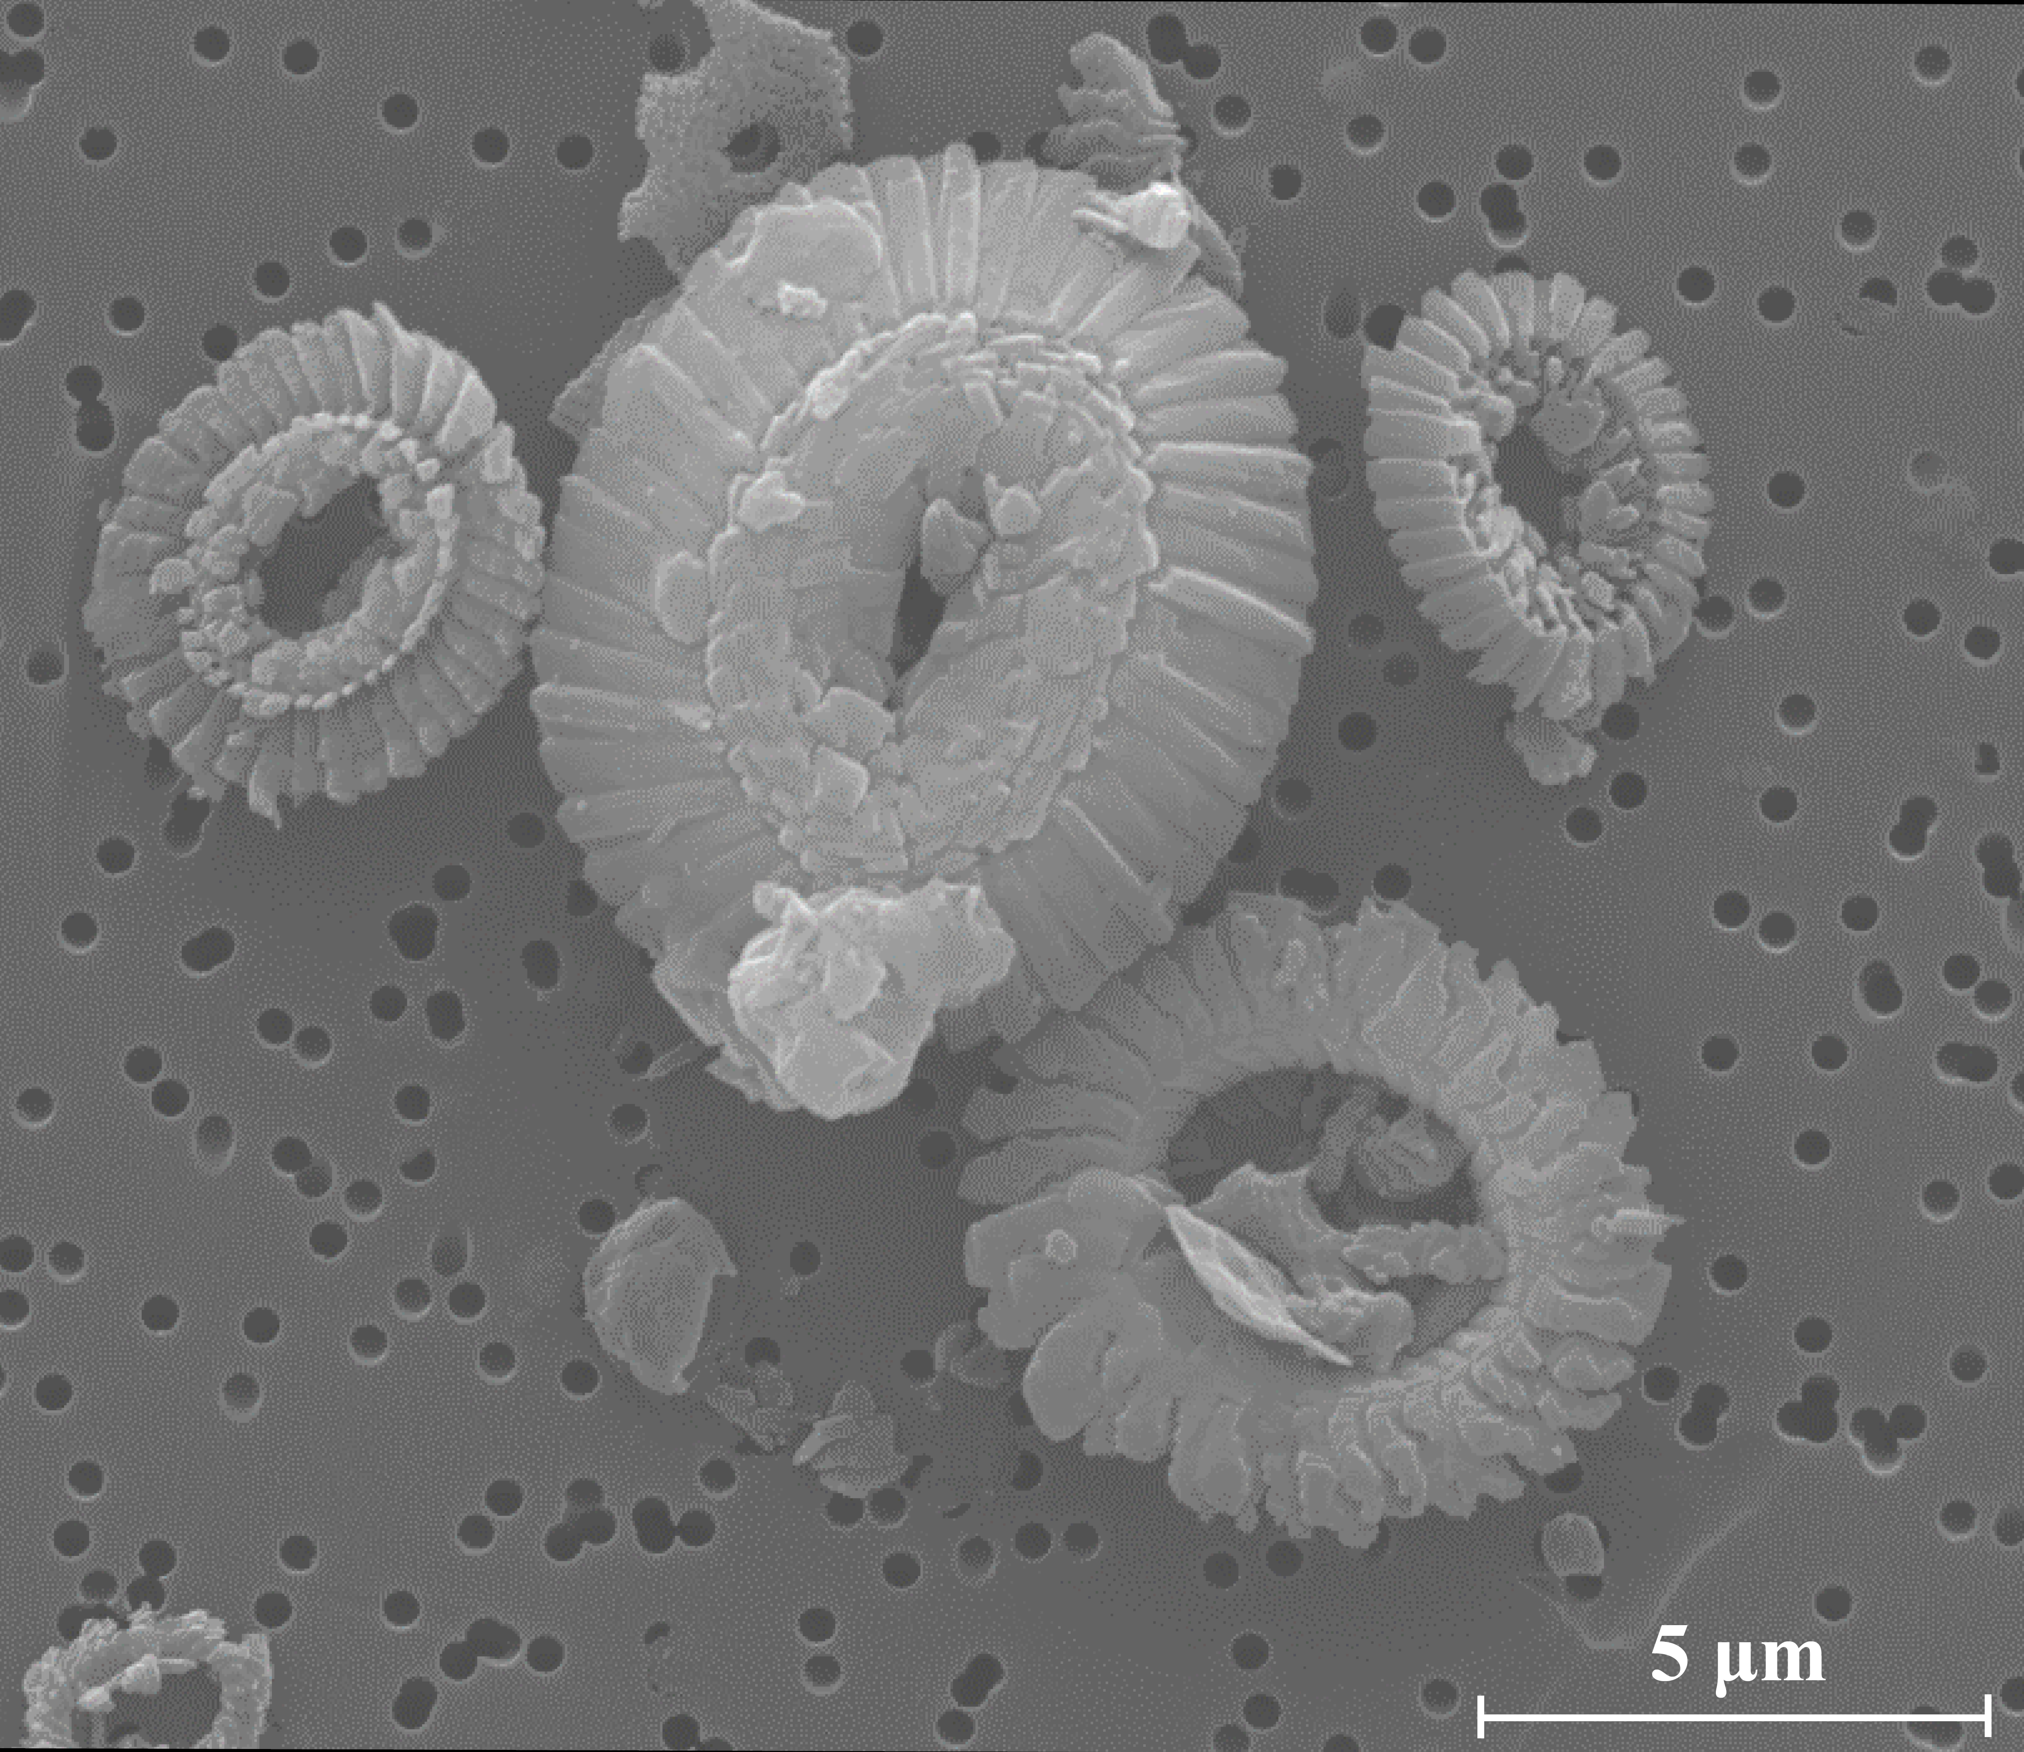
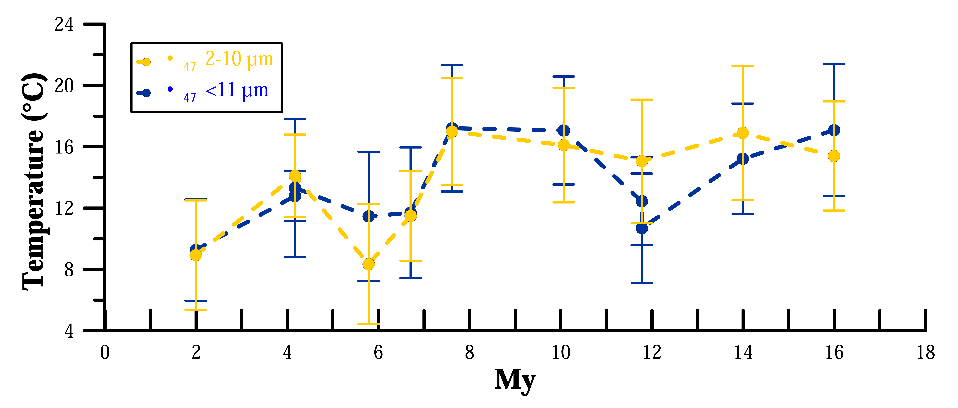
4. Site 982 coccolith ∆₄₇: 16 Ma cooling
1) Diagenesis does not have a big effect in absolute ∆₄₇T° or trends
SEM → overall good preservation
Bottom T° are colder than production T° potentially leading to a cold bias in ∆₄₇T°
BUT
2 My
6.7 My
14 My
If diagenesis increased with time, it could lead to underestimations of the cooling trend
No obvious ≠ between young and old samples so diagenesis likely didn’t affect a lot cooling trend
Cooling trend
Similar ∆₄₇ <11, 2-10, 2 µm (not shown)
∆₄₇
∆₄₇
Micarb not diagenetic→ No need to remove it for this Site.

Slide 6

5. Coccolith ∆₄₇ vs. U^{k’}₃₇ temperatures
1) Similar cooling trends
We can trust trends, what about absolute values?
Reliable 16 Ma cooling!
2) ∆₄₇ average 10 °C colder than U^{k’}₃₇
∆
Coccolith assemblage variations?
Alkenone non-thermal effects?
Alkenone calibration?
Prod. depth
Prod. season

Slide 7
5. Coccolith ∆₄₇ vs. U^{k’}₃₇ temperatures
Coccolith assemblage variations cannot explain T° ≠ of ∆₄₇ vs. U^{k’}₃₇
2 My
6.7 My
Prod. Depth T
Most coccoliths (Reticulofenestrids) → alkenone producers
No expected ≠ of calcite & alkenone production T°
Similar
Prod. Season T
14 My

Slide 8
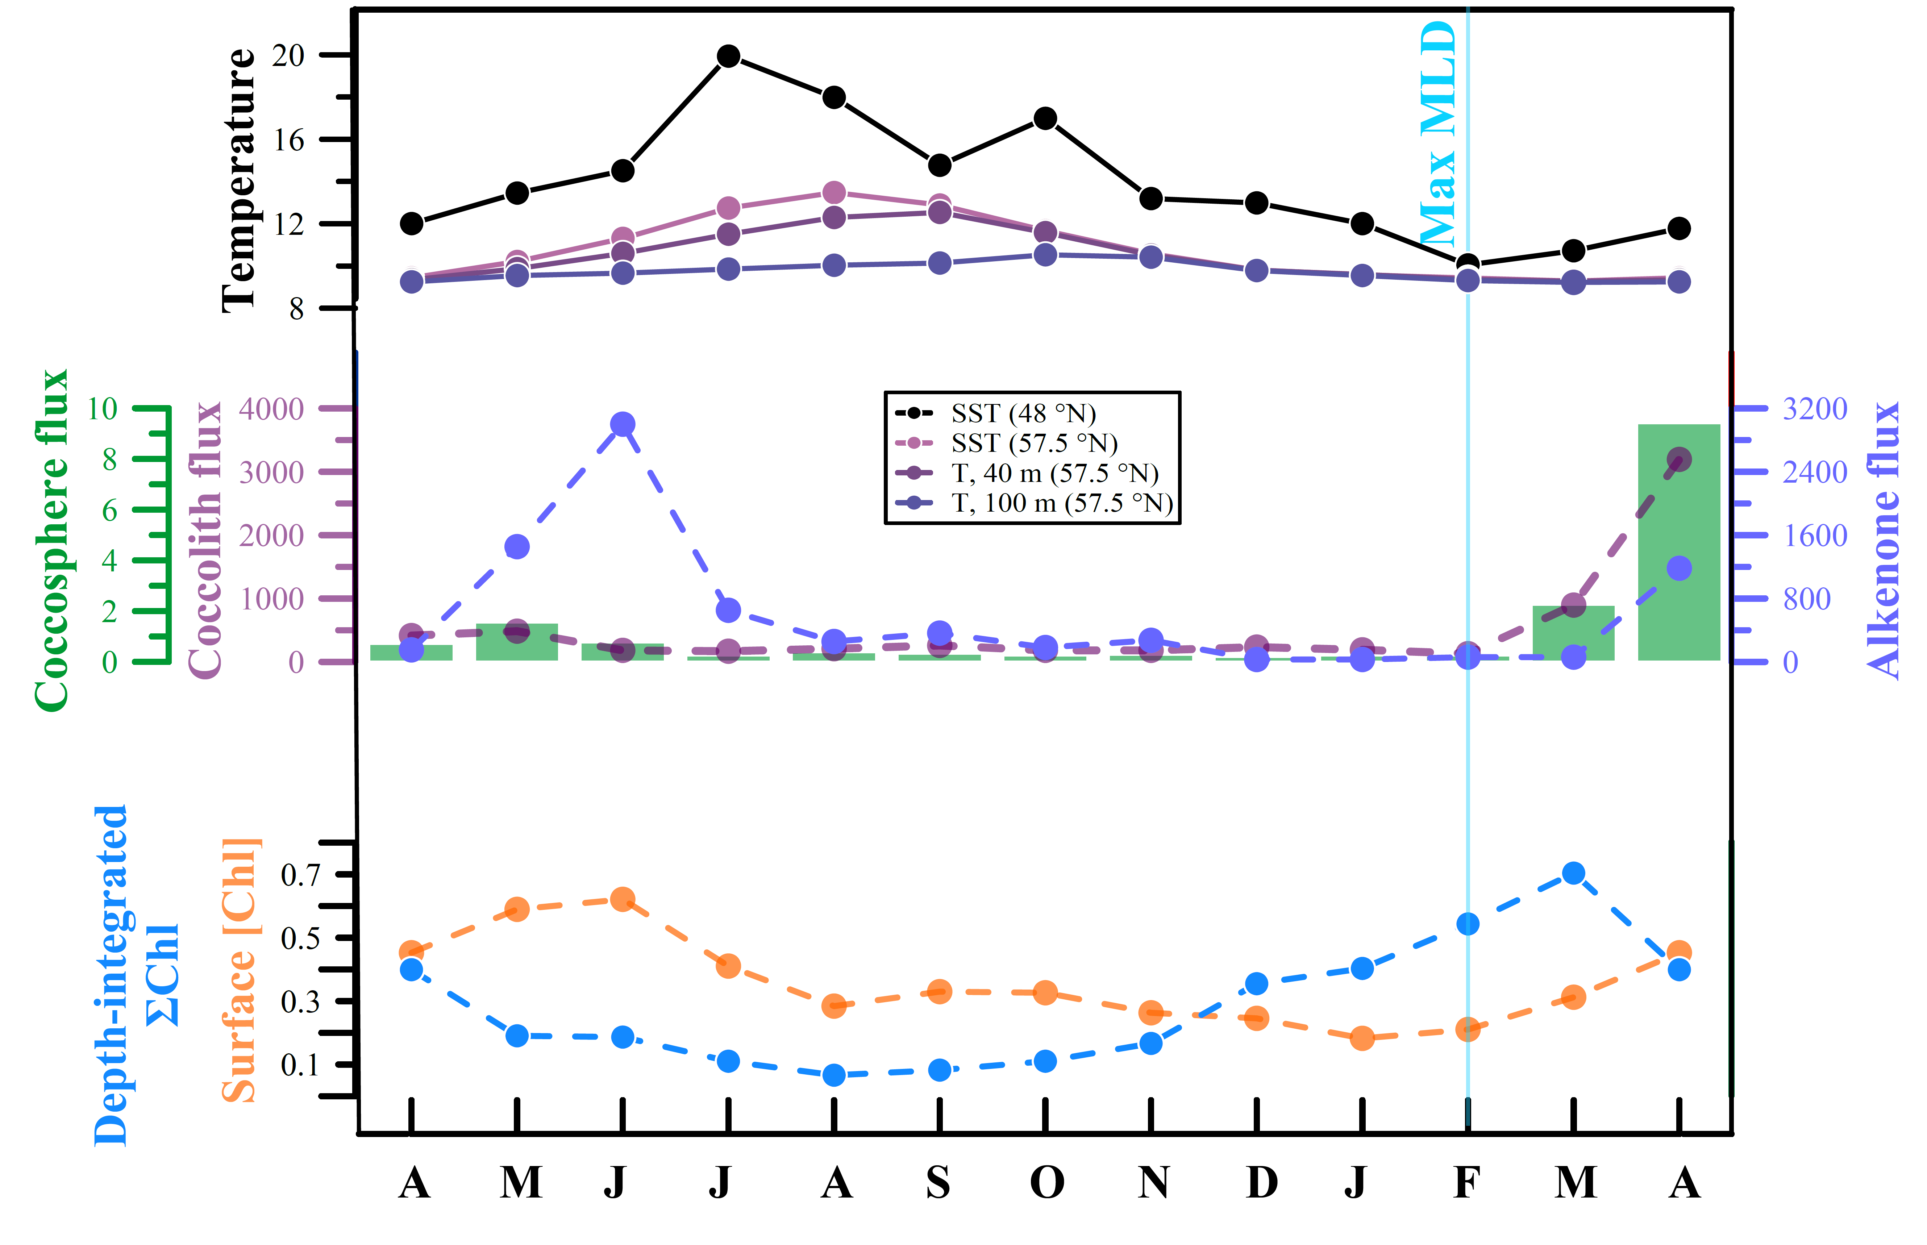

5. Coccolith ∆₄₇ vs. U^{k’}₃₇ temperatures
Alkenone (bayspline & coretop) v.s clumped isotope calibration approach?
Depth of production
Data from NABE 48
Broerse et al., 2000; Rosell-Melé et al., 2000; Behrenfeld et al., 2013
Season of production
∆₄₇→ calcification T°
Cold
Warm
Cold
U^{k’}₃₇ → SST°
Tierney and Tingley (2018)
Müller et al. (1998)
If calcification prod. occurs deeper than surface...
≠ of ∆₄₇ vs. U^{k’}₃₇ may indicate coccolithophore habitat depth?
Average SST used by bayspline/ coretop calibr.
Average T°, 100 m highest prod. months
Bayspline calibr. (Aug-Oct)
Max surf. Prod. (Mar-Jun)
Max surf. Prod. (Mar-Jun)
Max. 1.6 °C
ONLY
16% ∆₄₇ vs. U^{k’}₃₇ T° diff.
Max. 3 °C
30% ∆₄₇ vs. U^{k’}₃₇
T° diff.

Slide 9
5. Coccolith ∆₄₇ vs. U^{k’}₃₇ temperatures
Alkenone non-thermal effects?
Preferential degradation C_{37:3}
Light limitation
Top-down PP control
Growth phase
High → Overest.
O₂ SST°
Batch culture U^{k’}₃₇ calibr. (Prahl et al., 1988)
Deep, light-limited, nutrient-rich alkenone prod.
Grazing eff. follow PP abundances
Applied to chemostat U^{k’}₃₇ (Popp et al., 1998)
Less surface prim. prod. exported
Grazing focused on surface
3 °C Overestimation
30% ∆₄₇ vs. U^{k’}₃₇
T° diff.
9 °C Overestimation
90% ∆₄₇ vs. U^{k’}₃₇
T° diff.

Slide 10

6. Concluding remarks: Optimism for temperature reconstruction using coccolith ∆₄₇ and guidelines
1. ∆₄₇ C. pelagicus sed trap show real CaCO₃ production temperature
5. Absolute coccolith ∆₄₇ (colder) likely closer than U^{k’}₃₇ (warmer) to real production T°
2. Choose carefully Site Diagenesis→cold bias
≠ can be explained:
≠ cannot be explained:
Max 1.6 °C diff. Depth of production
Diagenesis
Especially for warm oceans with large Surface-bottom T° gradients
Evaluate coccolith preservation. May be necessary to separate micarb from coccoliths
∆₄₇ vital effects
Assemblage variations
U^{k’}₃₇ calibr. →SST
∆₄₇ calibr. →calcif. T°
3. Further evidence for negligible or small vital effects in coccolith ∆₄₇
Max 3 °C diff. Season of production
4. Cooling trends from 16 to 2 Ma similar between U^{k’}₃₇ and coccolith ∆₄₇ proxies
Preservation
Non thermal effects in alkenones (3+9 °C max diff. )
Coccolith ∆₄₇ reliable for reconstructing T° trends
Light limit.
Growth phase

