Slide 1
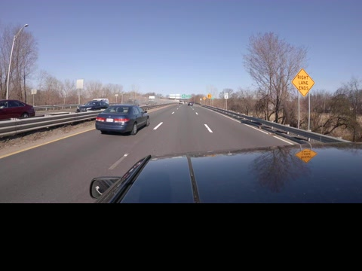
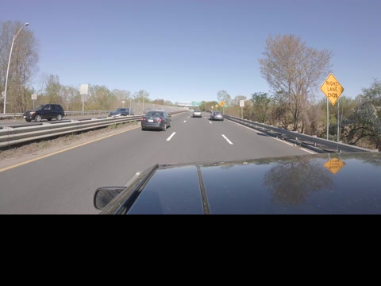
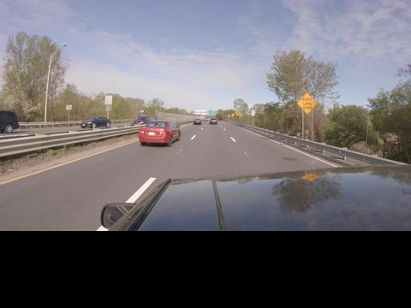
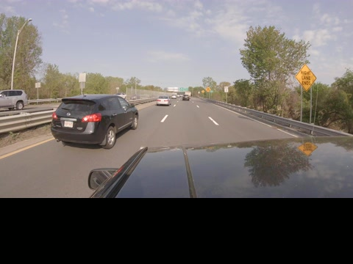
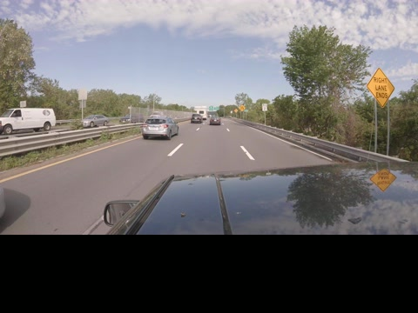
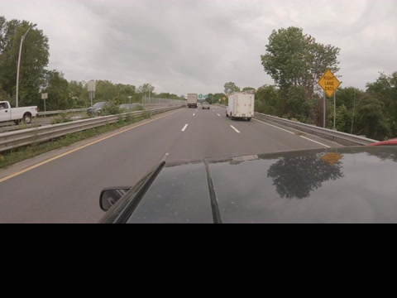
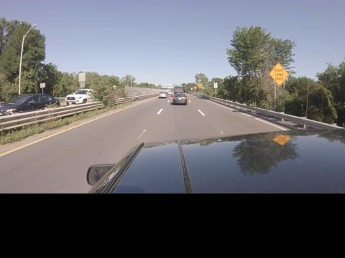
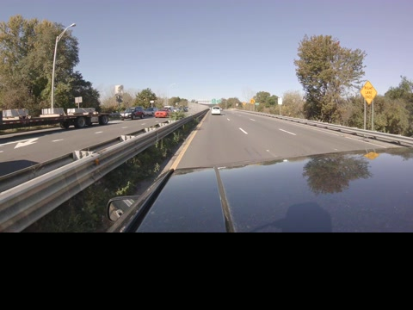
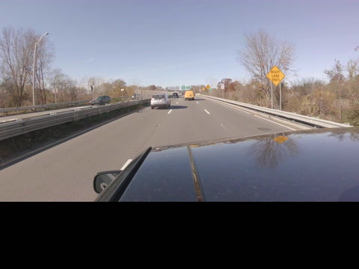
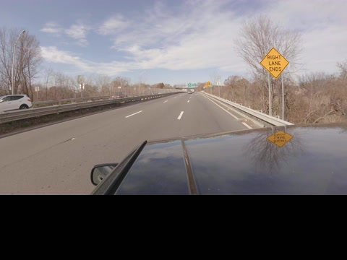



PhenoCar: Phenology of thousands of roadside trees along an environmental gradient
David Basler and Andrew D. Richardson
EGU General Assembly 2020, Online presentation May 8, 2020

Slide 2
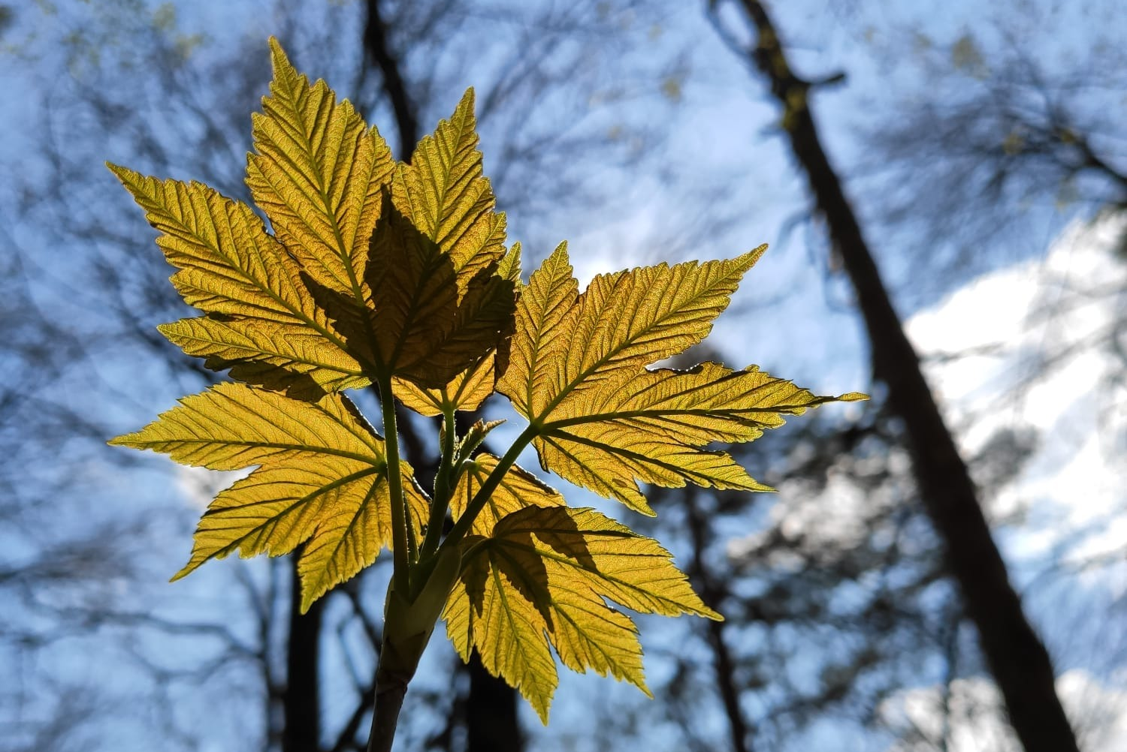
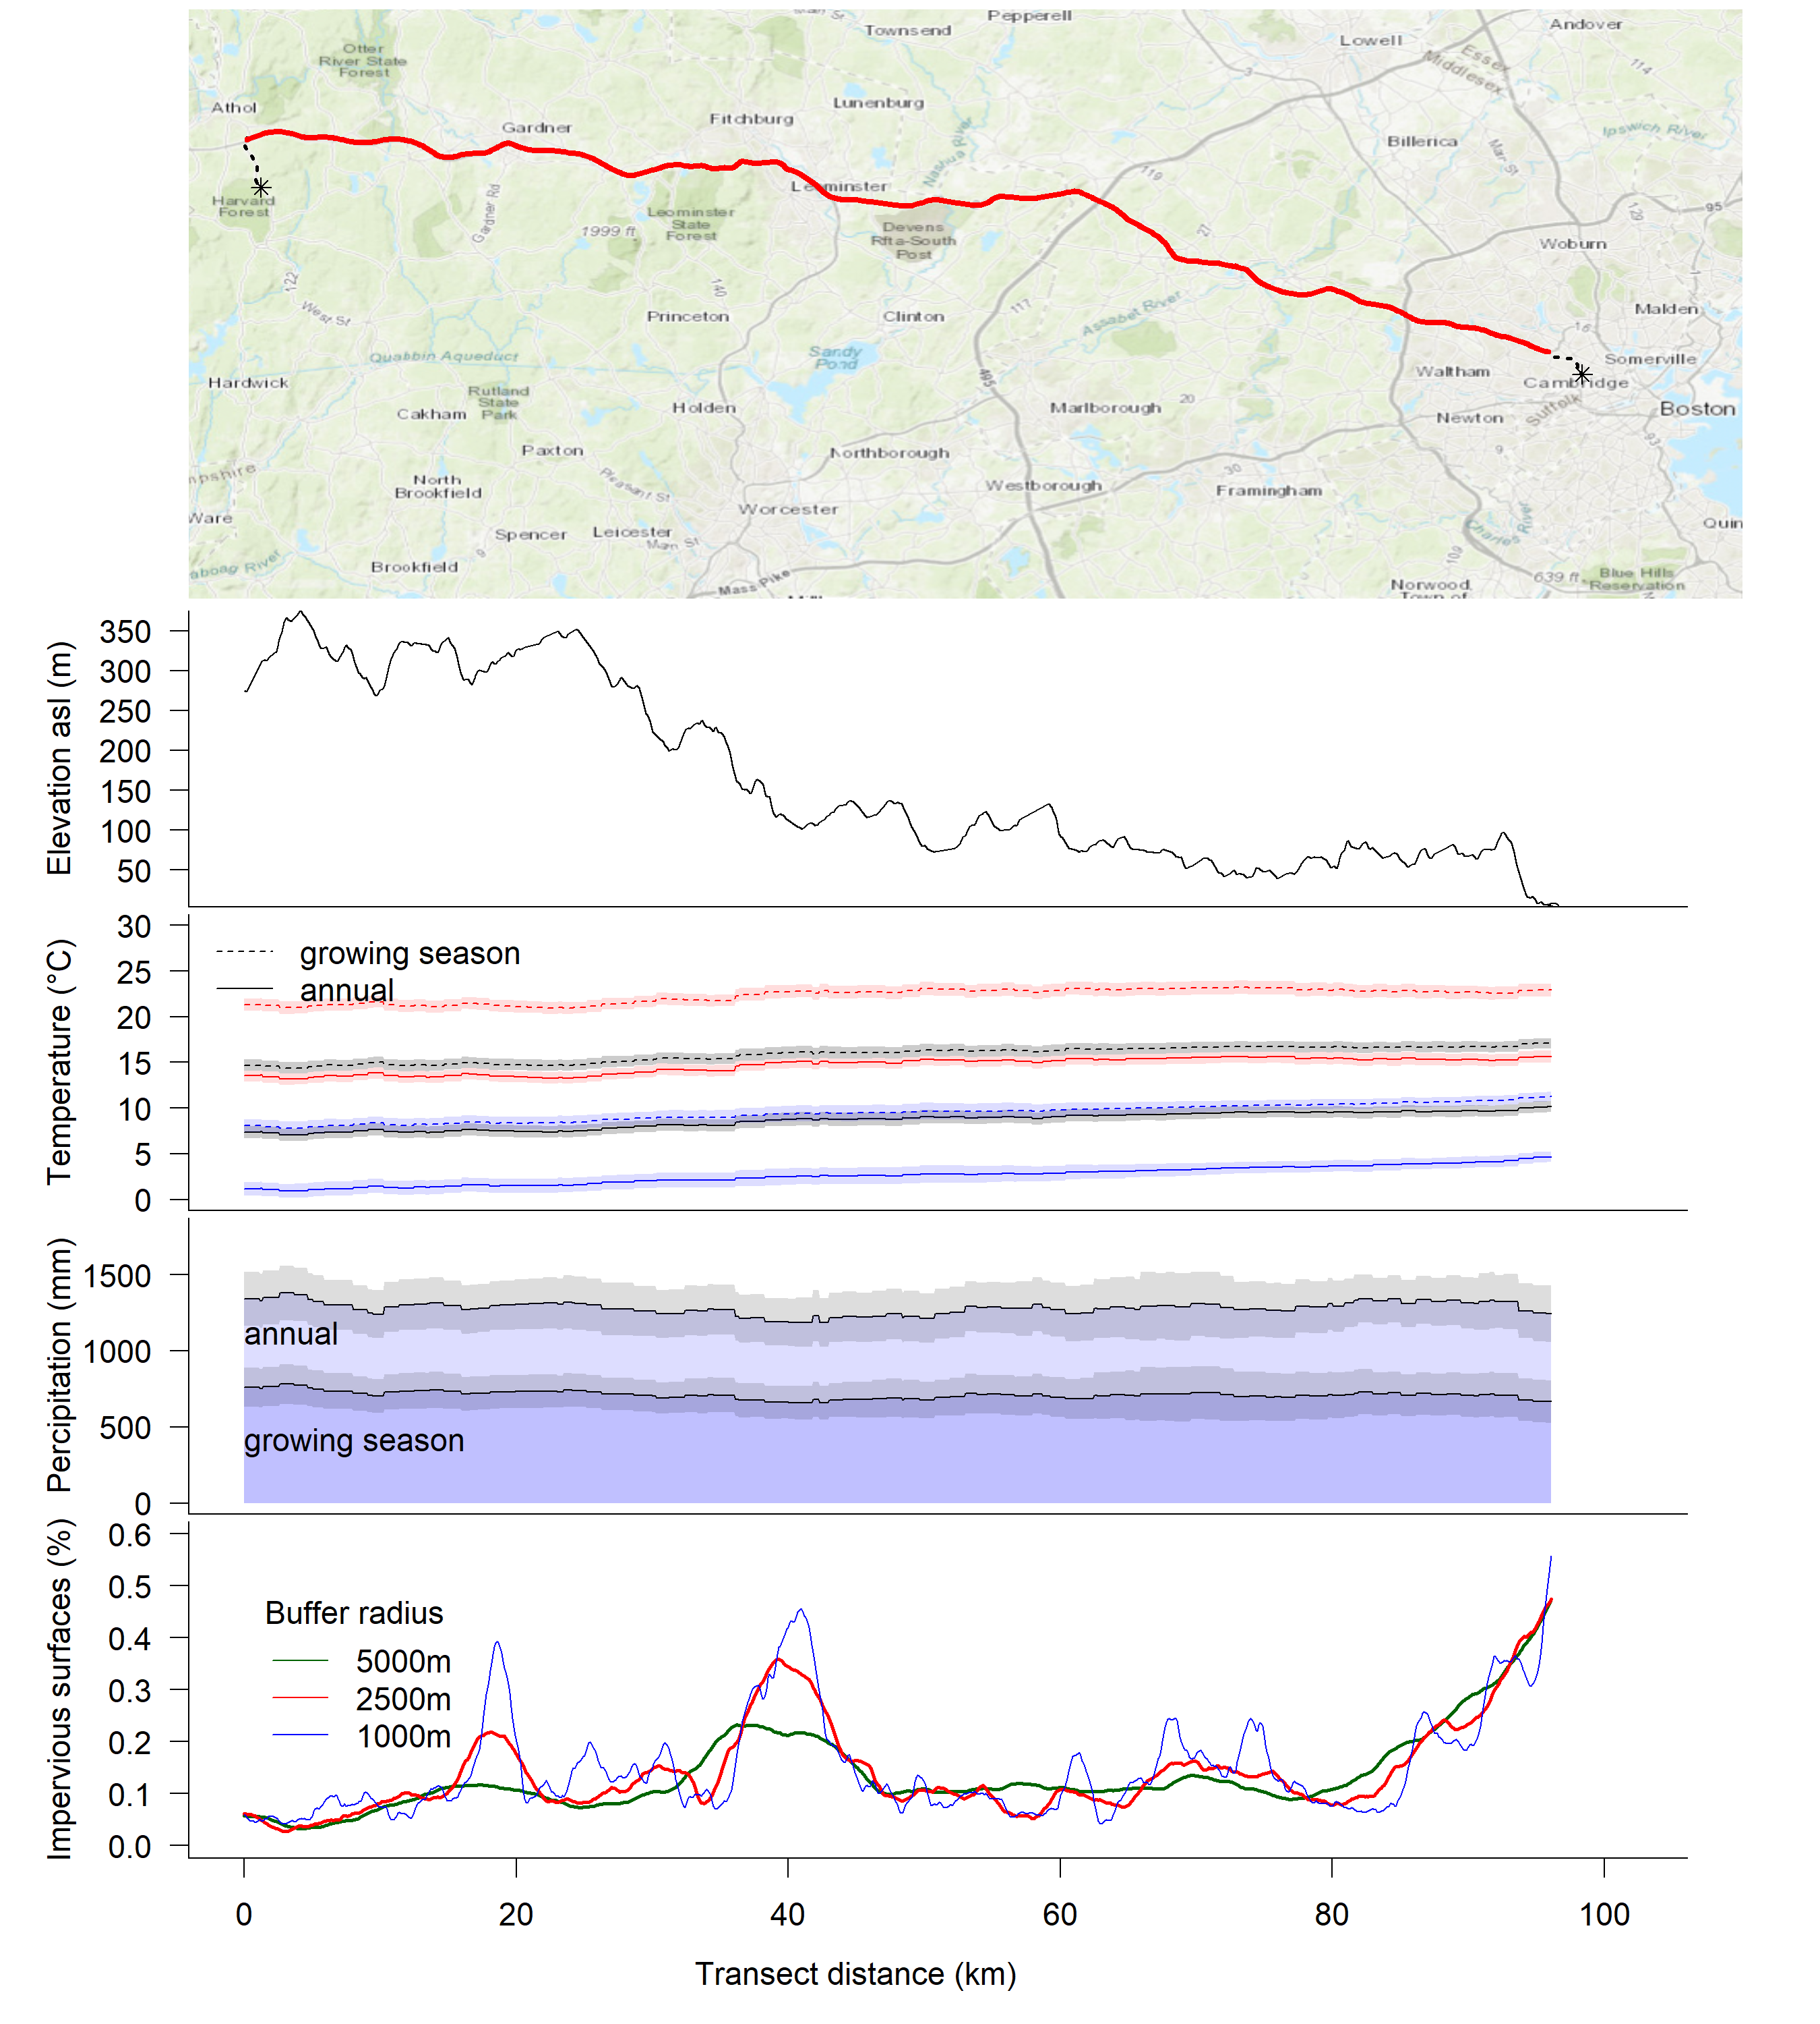
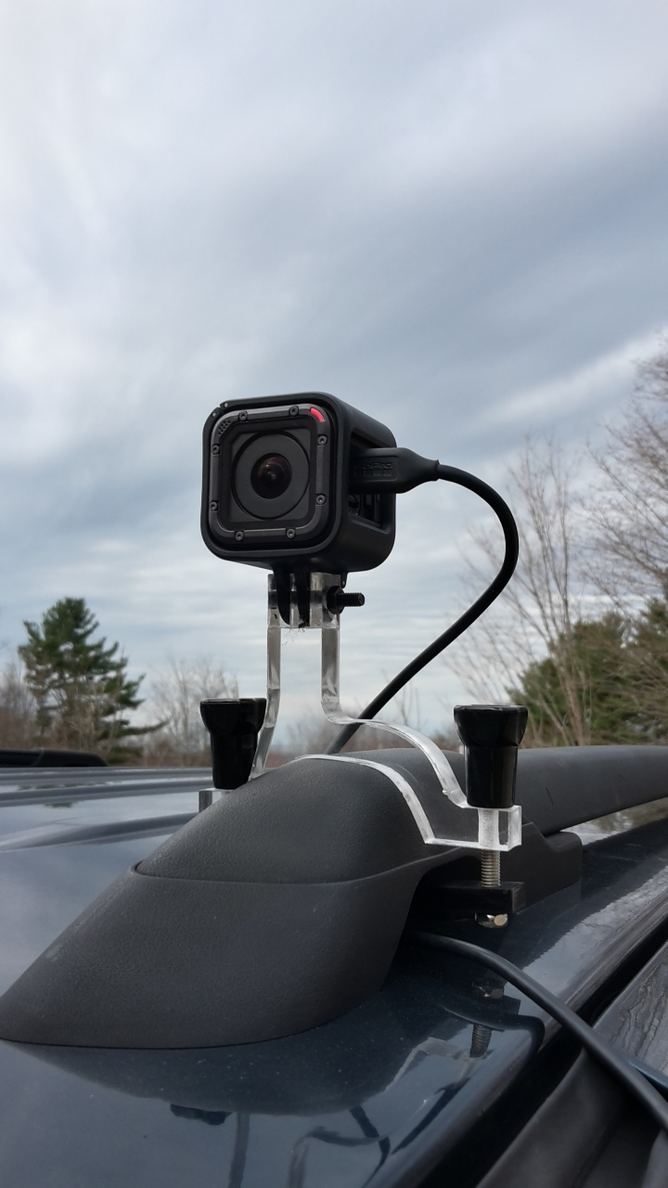

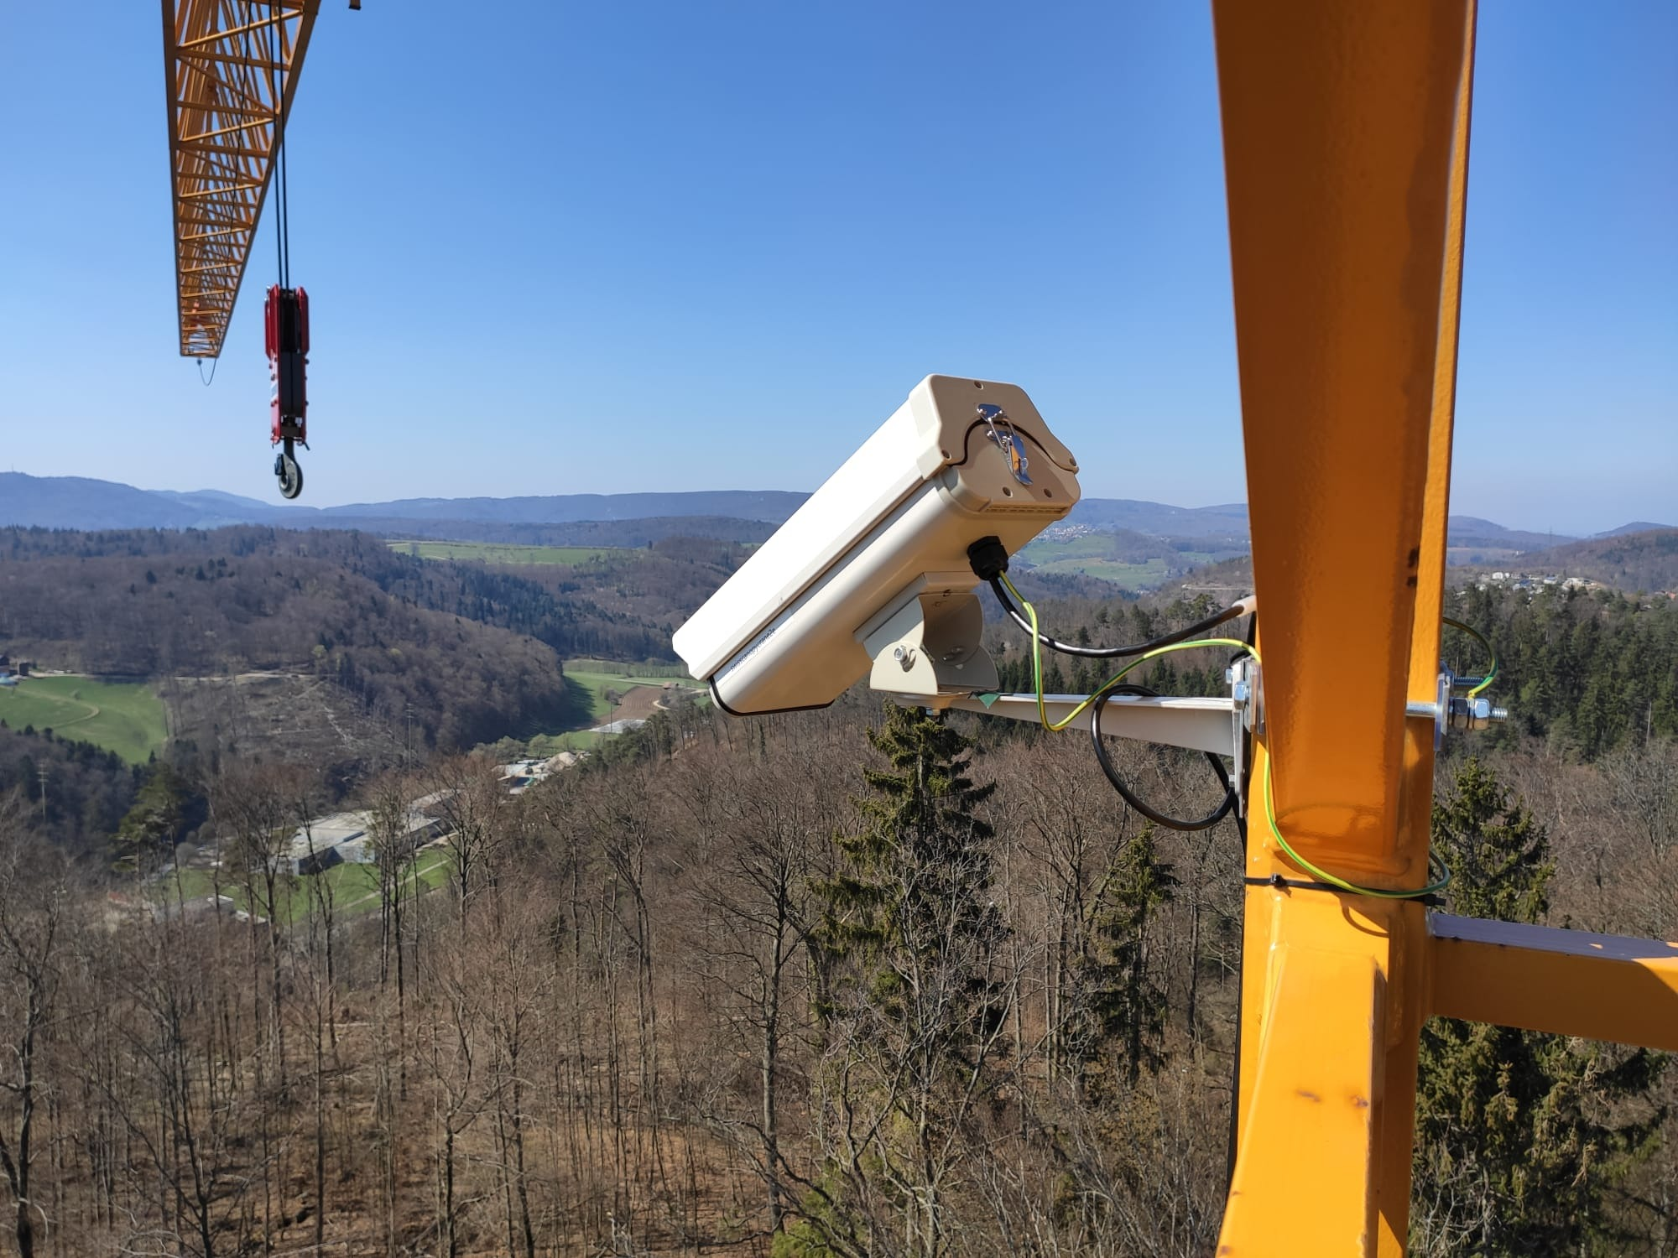
Car-mounted PhenoCam (‘PhenoCar’) to track vegetation
Human observer
Mobile, low-frequency, highly accurate
direct observations
PhenoCam
Automated Stationary high-frequency observations
Vegetation index based
… or a PhenoCam at every meter along a 96 km transect
(although with less temporal resolution)
D.Basler EGU General Assembly 2020, Online presentation

Slide 3
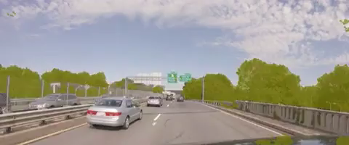
Extraction of Vegetation
Frame segmentation and vegetation mask generation using SegNet
(A Deep Convolutional Encoder-Decoder Architecture for Robust Semantic Pixel-Wise Labelling)
http://mi.eng.cam.ac.uk/projects/segnet/
Vegetation status using GCC (green chromatic coordinate)
D.Basler EGU General Assembly 2020, Online presentation

Slide 4
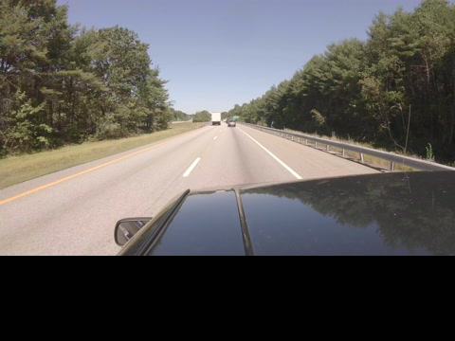
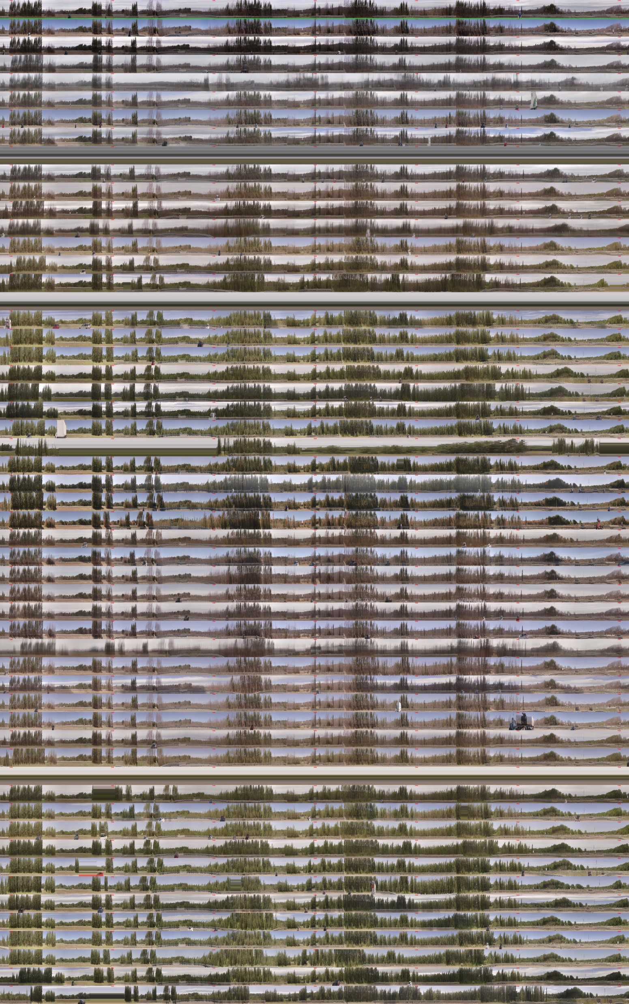
Spatiotemporal processing: Sequence Alignment
t
GPS and feature-based slice matching to extract frame correspondence between videos
(sampling to ~ 1 m / line)
spring
fall
spring
1000m
D.Basler EGU General Assembly 2020, Online presentation

Slide 5
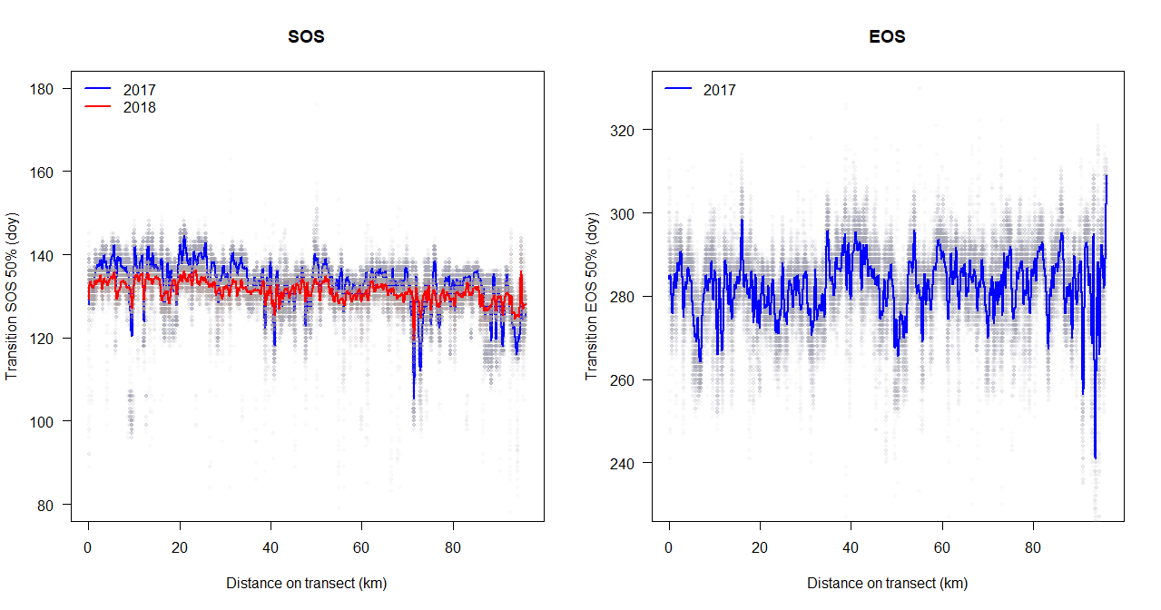
Phenological transitions along transect
D.Basler EGU General Assembly 2020, Online presentation

Slide 6
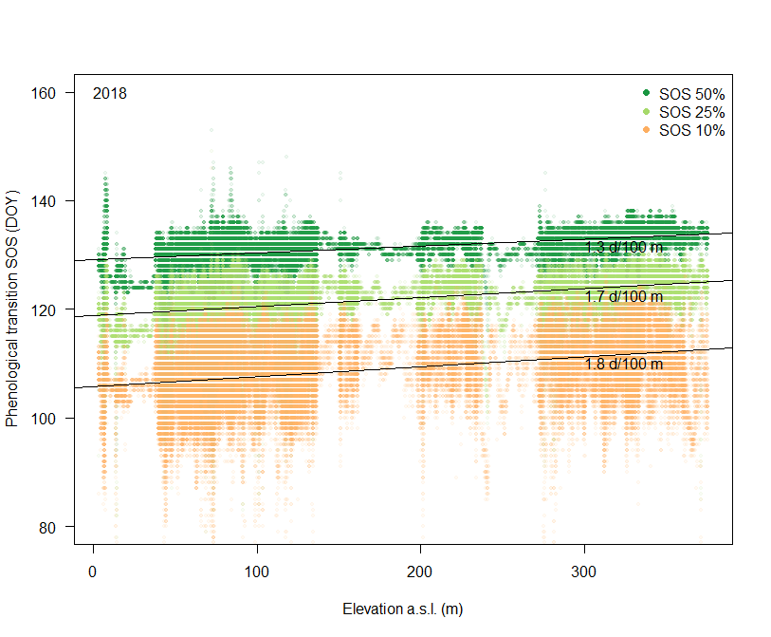
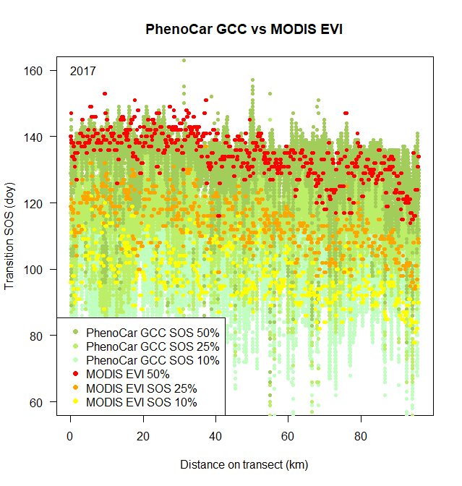
1.2 d/100m
D.Basler EGU General Assembly 2020, Online presentation

Slide 7


Conclusions
Near-surface remote sensing using moving cameras are efficient methods for the collection of high-resolution, individual tree phenology data
Simultaneous collection of additional vegetation parameters
Aligns well with other remote sensed phenology metrics
Great potential to train and use machine-learning
Requires high-resolution complementary data
Data collection and analysis still semi-automated
Contact: david.basler@unibas.ch
This research was funded by
Harvard Forest Charles Bullard Fellowship
Swiss National Science Foundation
EGU General Assembly 2020, Online presentation May 8, 2020

