Slide 1
The overwhelming jungle of climate information and the role of climate services.
Carlo Buontempo

Slide 2
Act 1

Slide 3
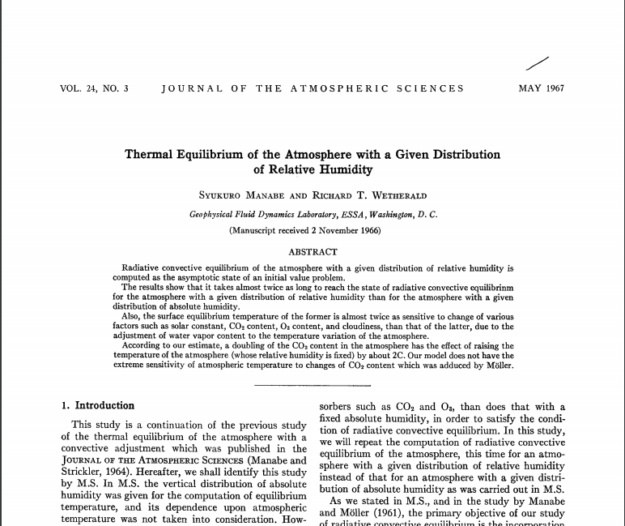
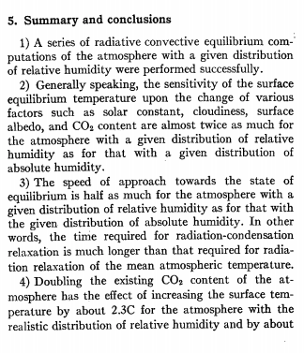
How did it start?
https://www.carbonbrief.org/the-most-influential-climate-change-papers-of-all-time

Slide 4
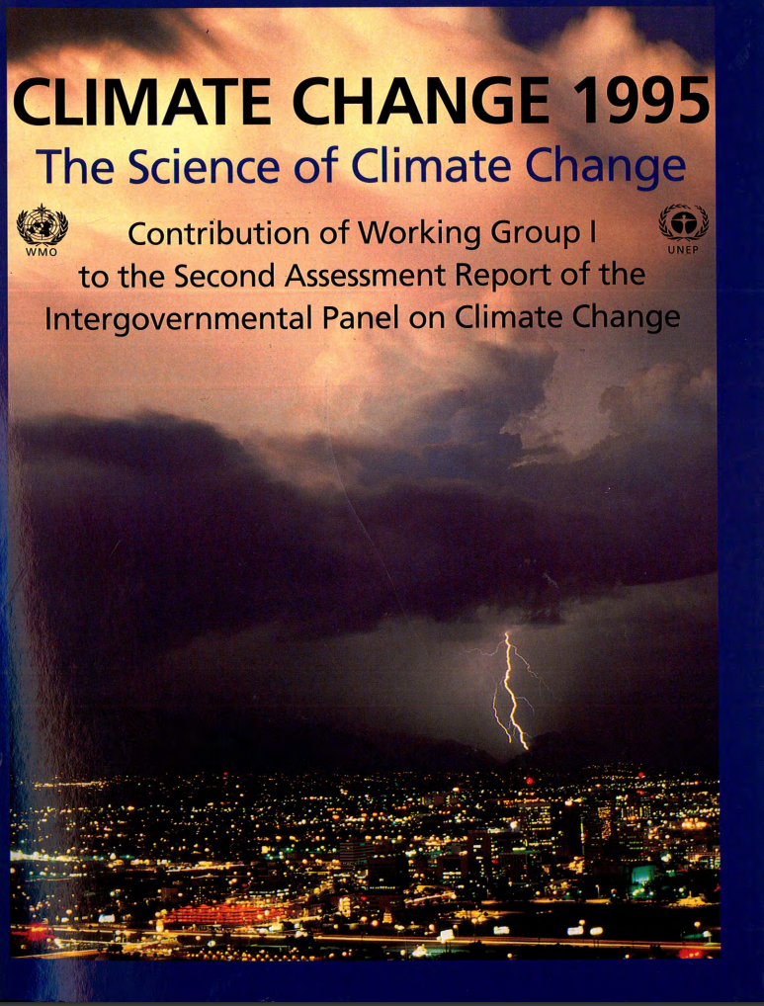
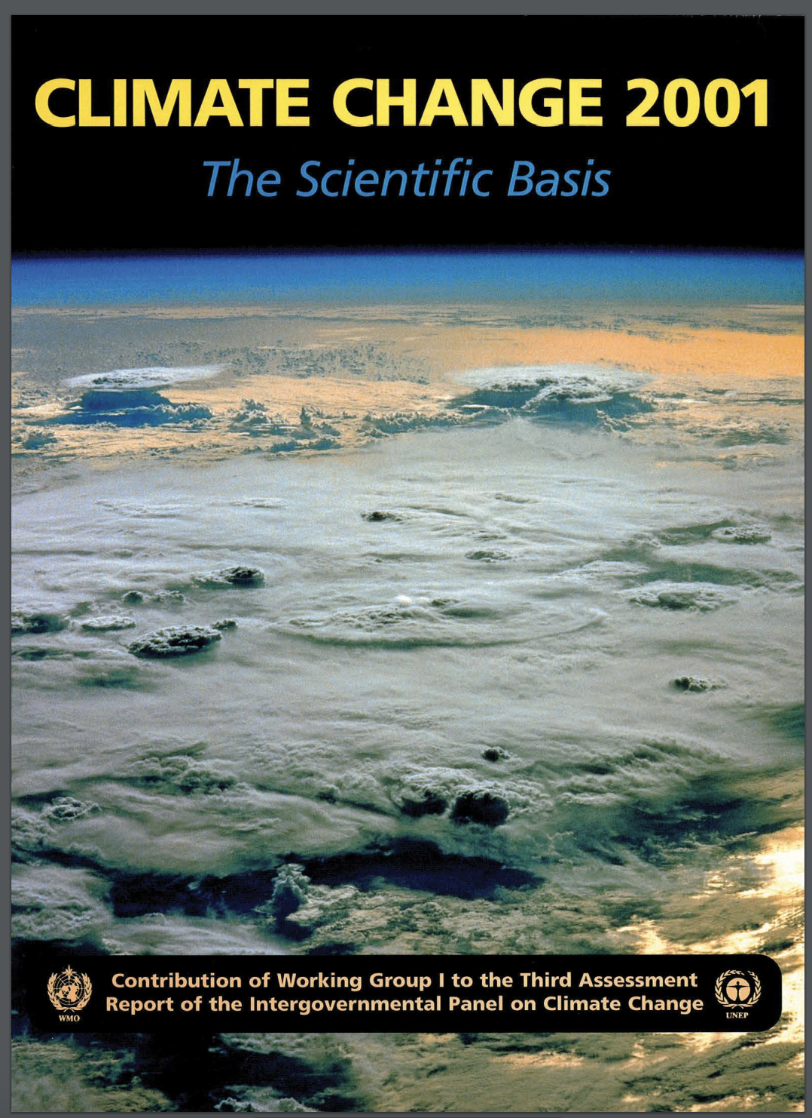
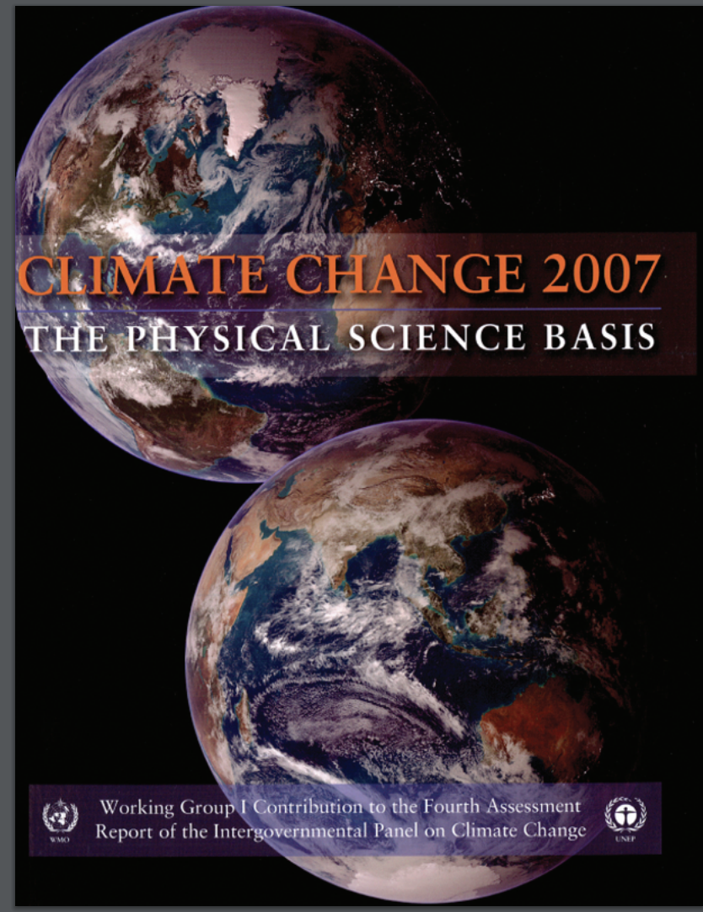
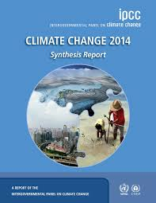
Over the following 50 years the climate community has shown not only that learning about global climate was important for society but also that the data provided by models and instruments were essential to inform policies.

Slide 5
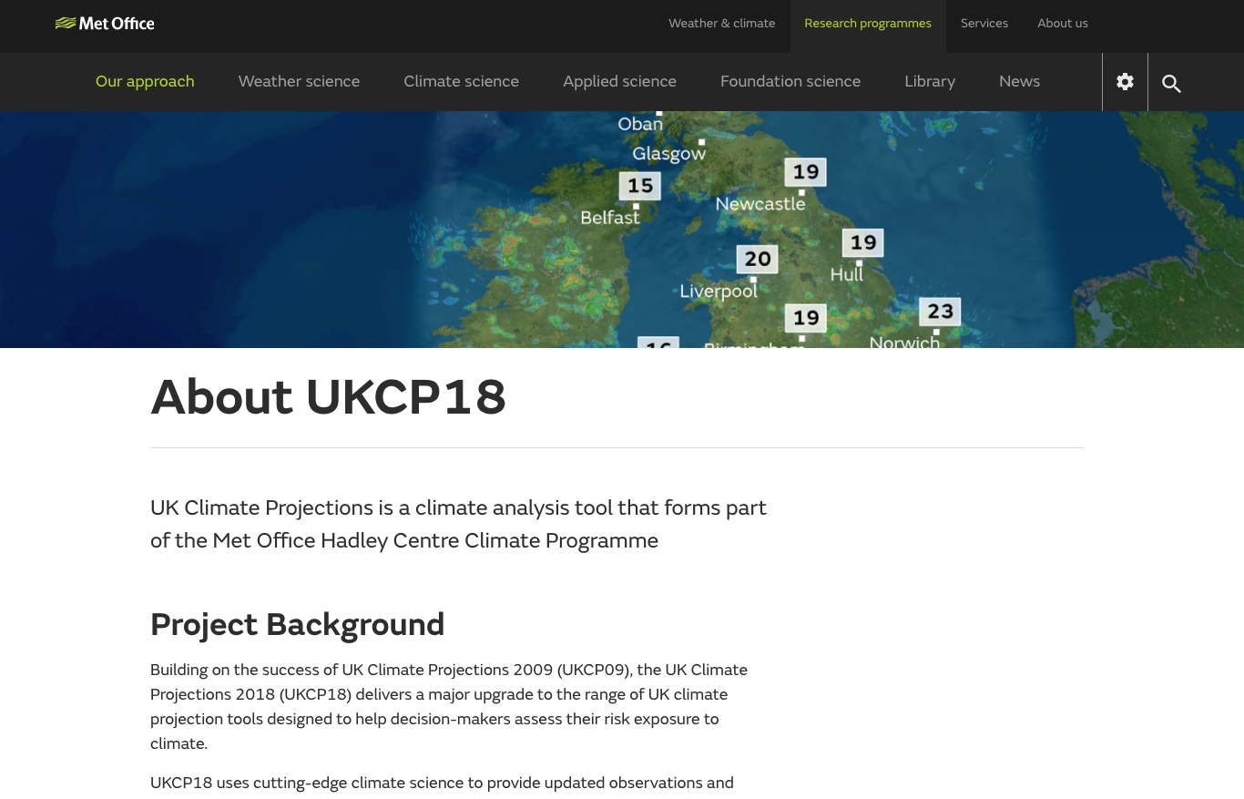
Climate date for applications

Slide 6
The jungle
https://na-cordex.org/simulation-matrix.html

Slide 7
Act 2

Slide 8
Operational climate services
Globally, last month was on a par with the previous warmest April in our record (2016). In Europe, well above average in some western countries, but below average in the northeast
https://bit.ly/2YvIcTi

Slide 9
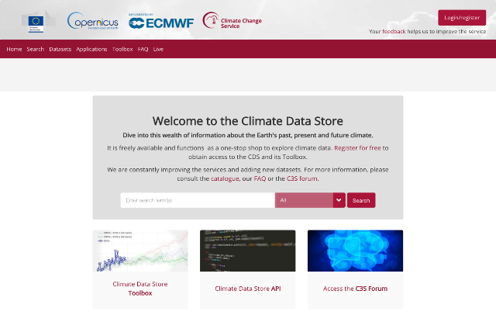
The Climate Data Store
Registered users: 41 751+
TB/day: ~50 (30-60)
Datasets: 64
23000+
registered users
Status on 4th May 2020 at 06h00 CET
The number of users increased by 5000+ in the last couple of months.
Notes:
9

Slide 10
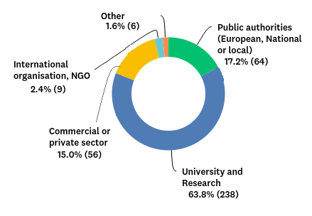
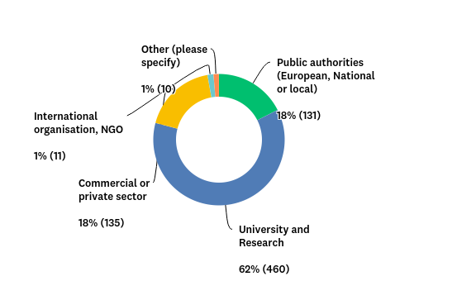
User profile
2018
2019
A significant majority of survey participants (70%) works in academia and research, followed by 14% in the public sector, and 11% in the commercial sector.
Within the EU-based responses we see a more even distribution than elsewhere (see plots above), with public sector and commercial entities having 18% each.
The sectoral distribution shows how C3S products continue to find significant uptake among commercial and public-sector users. The fraction of users from these sectors is increasing both in absolute and relative terms.

Slide 11
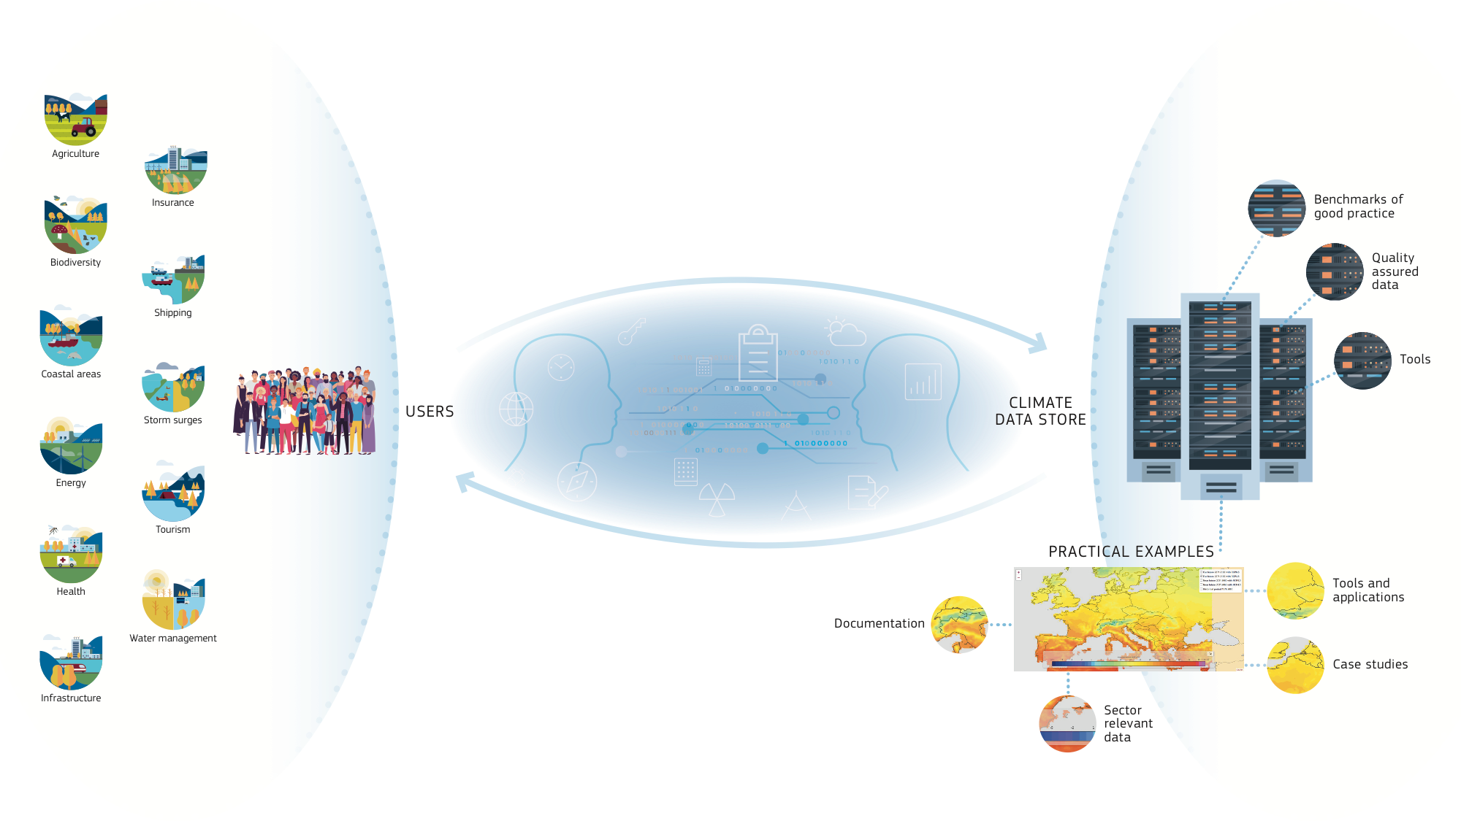
All sectors addressed
Notes:
To provide practical examples of how C3S in general and CDS in particular could deliver information of relevance to specific sectors.
To act as benchmarks of good practice.
To document users needs, and whenever possible address those.
In particular SIS contracts should develop and make available
sector-relevant indicators and tools that were either unavailable or inaccessible before.

Slide 12
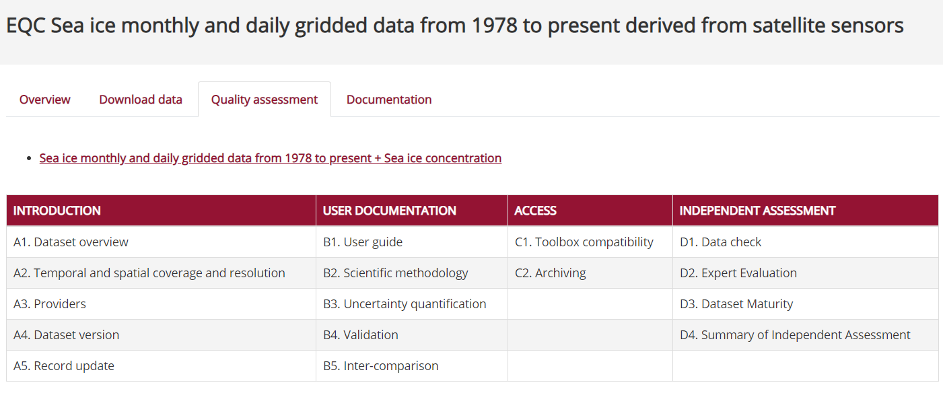
Evaluation and Quality Control
EQC function is pre-operational
Content Management System integrated into the CDS
100+ Quality Assurance Reports produced
EQC tab with synthesis table in CDS-test
Ready to go live in Q2 2020
Analysis of User Requirements underway
Operational URDB holding 3000+ requirements
First URADs on data, toolbox and sectors produced
Internal EQC Review Board established to address issues reported by EQC
Mechanism put in place to inform service evolution

Slide 13
Emerging requirements
CEN – European Committee for Standardization CENELEC – European Committee for Electrotechnical Standardization
ISO 14090 https://www.iso.org/standard/68507.html
ISO 14091 https://www.iso.org/standard/68508.html

Slide 14
Act 3

Slide 15
An incomplete journey from research to services
ESGF Future Architecture Workshop November 5-7, 2019 in Abingdon
“[..] any of the ESGF nodes now have other functions beyond CMIP and there has also been changing landscape of data repository and science needs.”
WMO Resolution 67
CMIP to enhance Research-Operation linkages
https://esgf.llnl.gov/2019-Future-Arch-Workshop.html

Slide 16
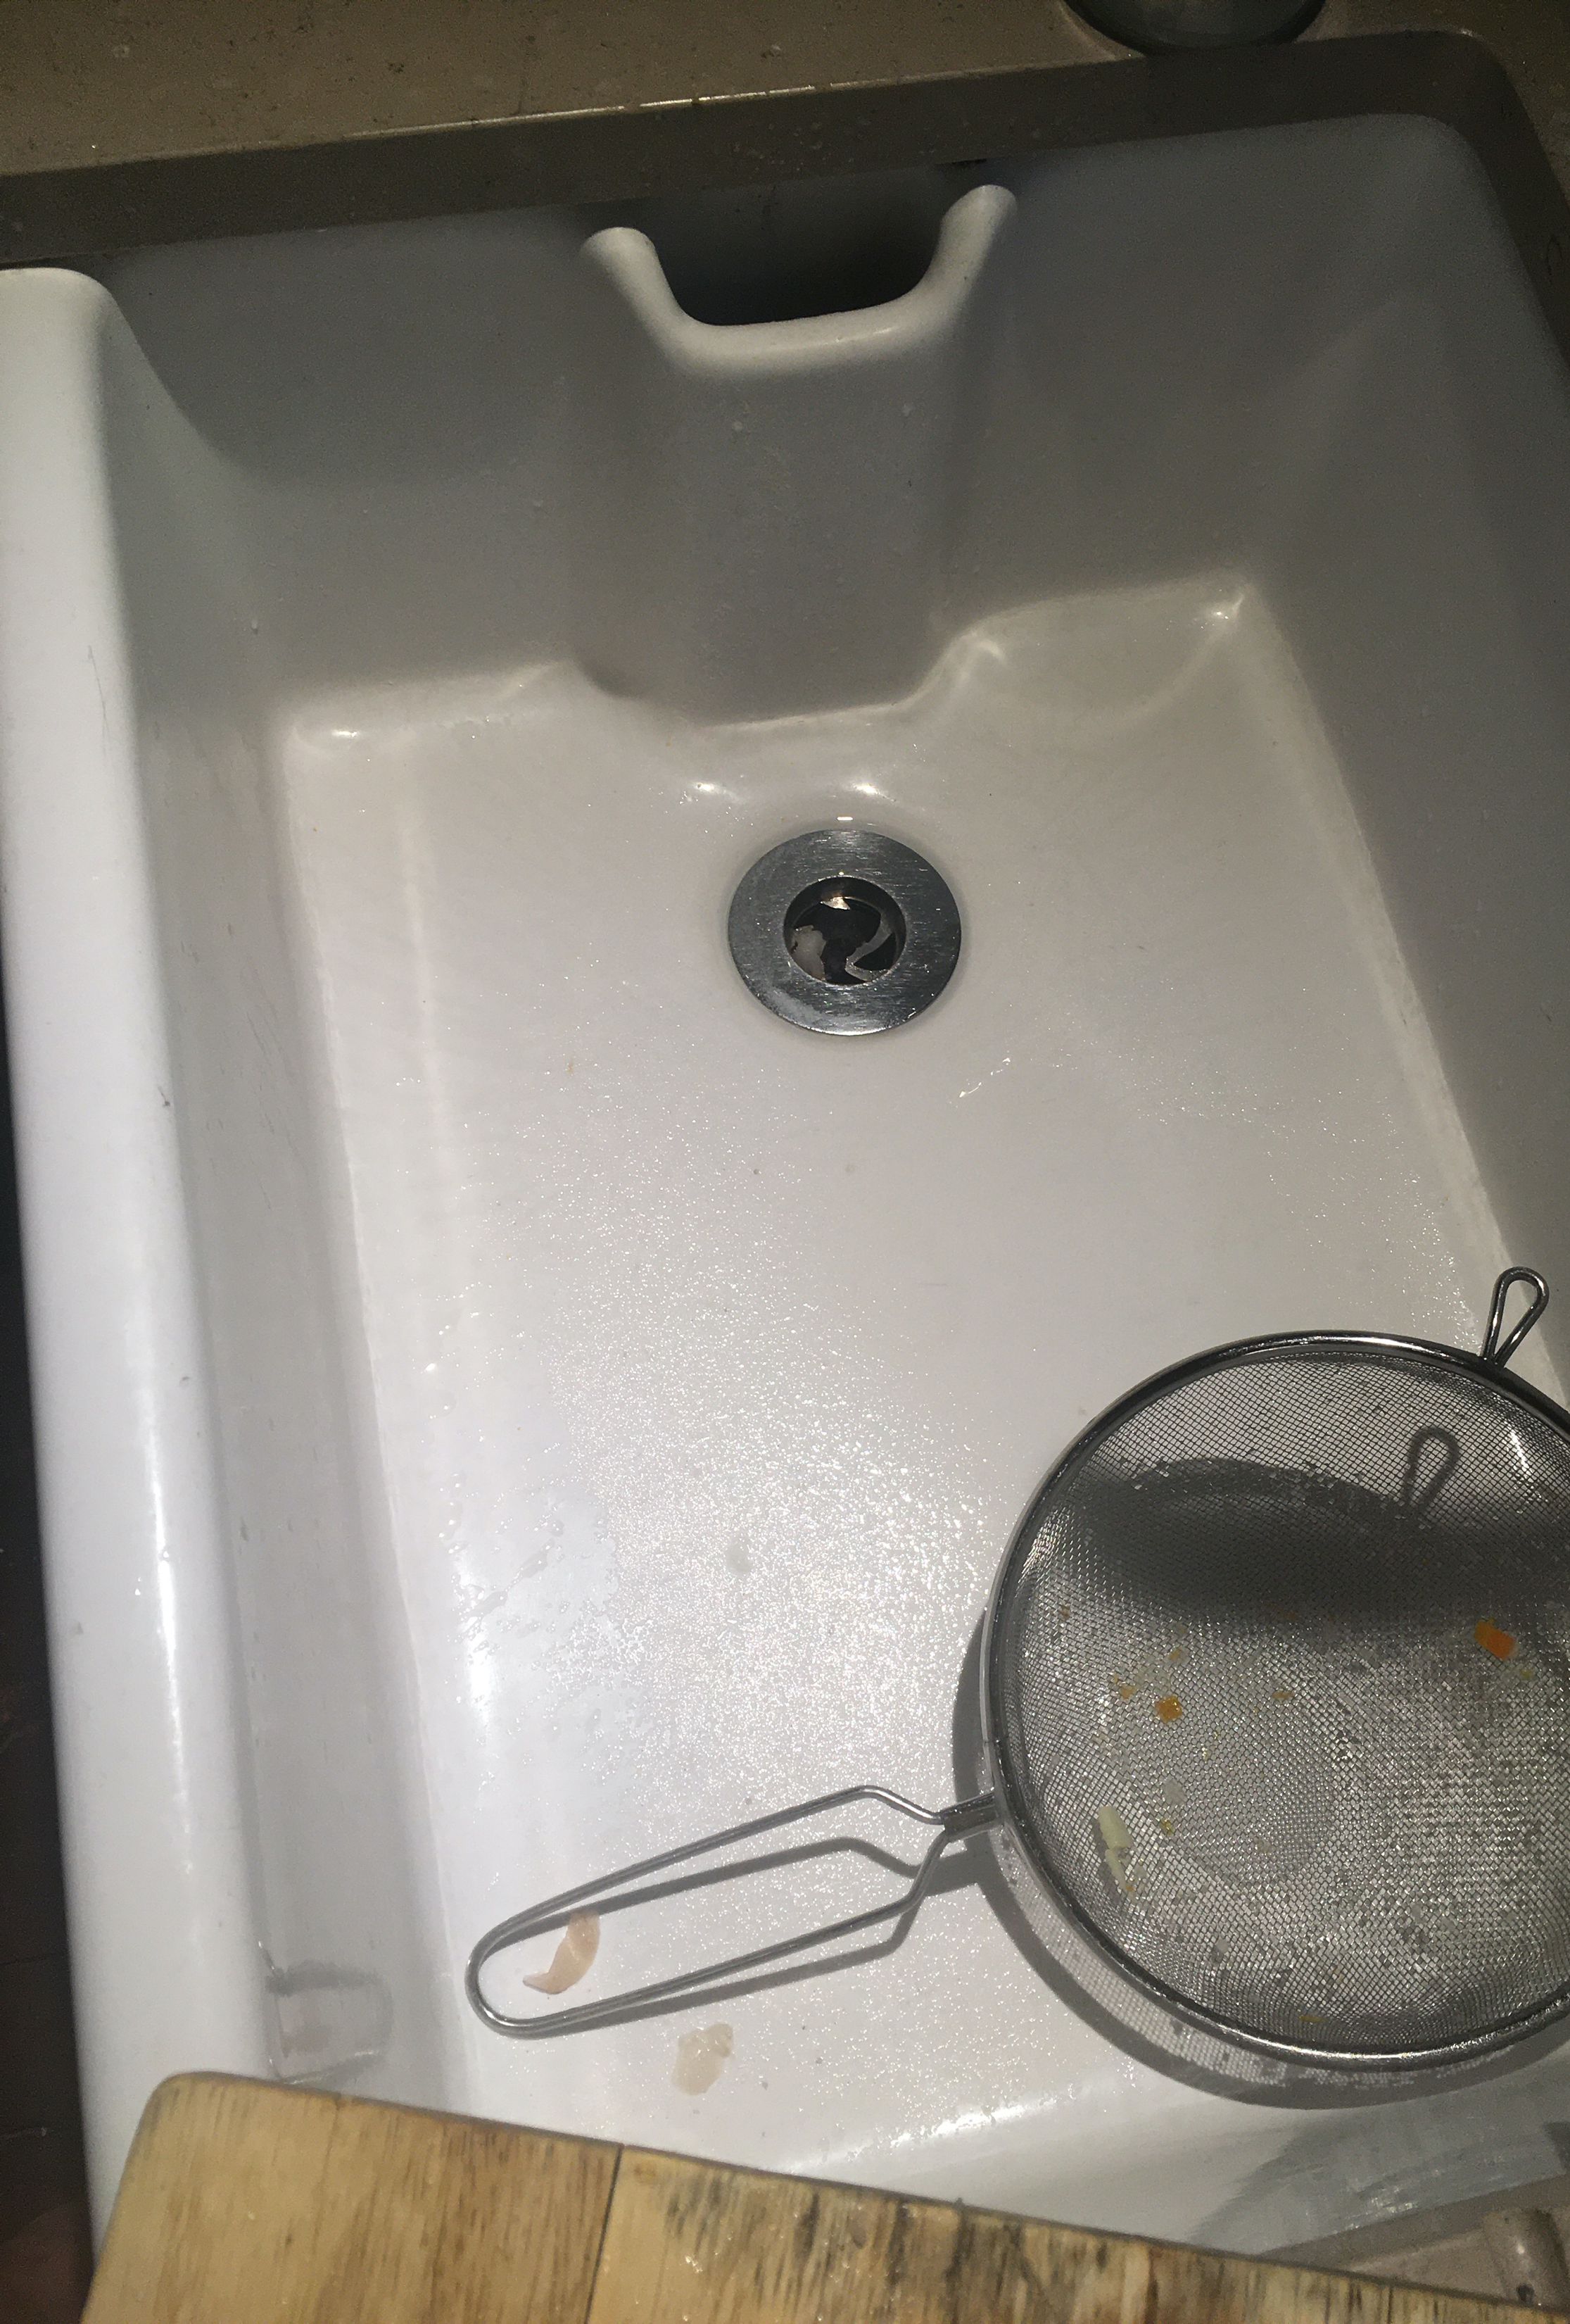
Beyond the kitchen sink
Society needs and deserve something better than the kitchen sink
If the needs for data are changing shouldn’t change also the way in which such data is generated and distributed?
Can we improve our mapping of the new and emerging user-requirements and let this influence the experimental design and/or observational strategy ?

Slide 17
Epilogue
I argue that we need a different data governance and data infrastructure which takes better account for the rapidly growing non-academic use of the data.
The issue is not only how to make 10s of PBs usable by, and useful to a large set of users. The issue is also how to generate such data in the first place.
I believe we are not far from the moment when divide between a research layer (which is essential and needs to be properly resourced) and an operational service layer (which should be largely driven by user requirements) will become inevitable. It is now urgent to reflect on how to best make such a transition.

