Slide 1
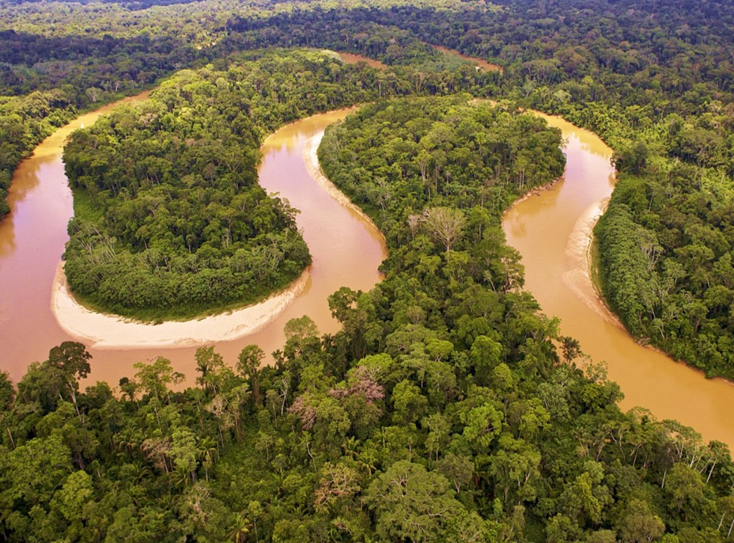

Changing Sediment Yield of the Amazon
Safaa Naffaa Rens van Beek , Frances Dunn & Steven M. de Jong

Slide 2
Objective: To assess the impacts of future changes including climate and land use changes at the rate of sediment supply of the Amazon River and its variability for the Surinam coast
Dry season
Deforestation
Climate change
Accelerate soil erosion
weathering of rocks and detachment rate of soil
stream discharge
Rainy season
Sediment yield and transport in Amazon river

Slide 3
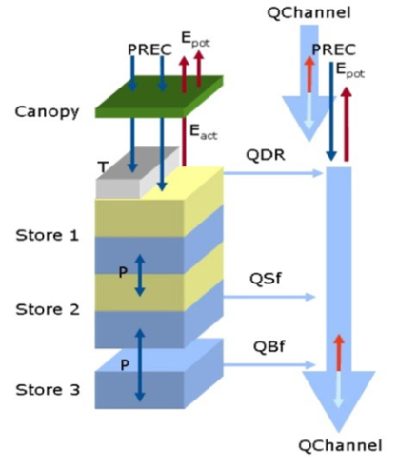
Methods
PCRGLOB_SET¹
Assess the local sediment supply
Include the effects of land cover changes
PCRGLOB-WB²
Add the trapping efficiency of the reservoirs.
Simulate the hydrological response under climate change and land use change
¹https://essay.utwente.nl/66330/
²https://www.hydrol-earth-syst-sci.net/19/823/2015/

Slide 4
Sediment Transport - Model RESULTS

Slide 5
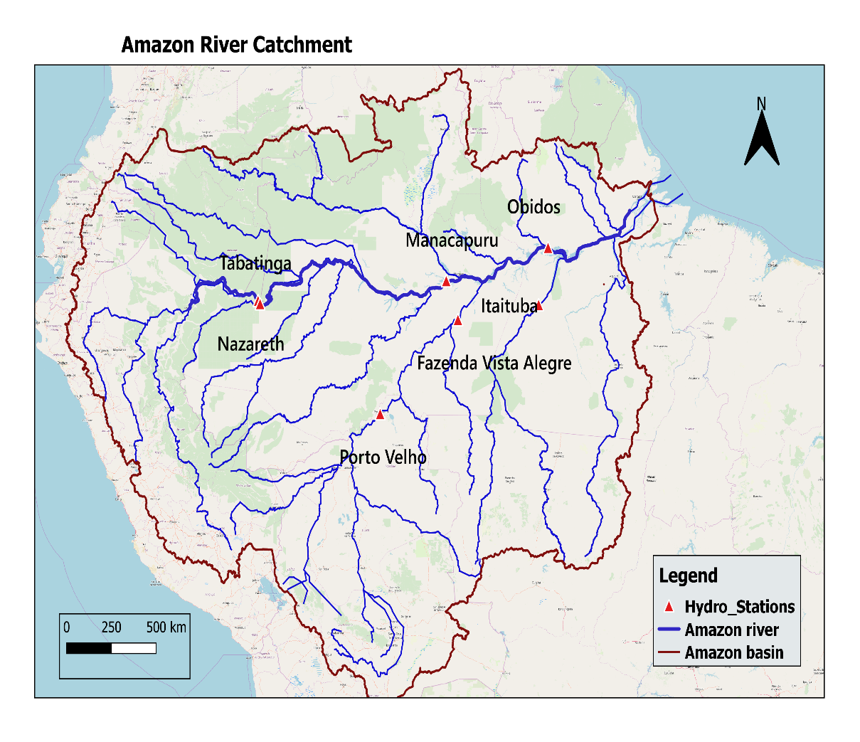
Validation of the model
Seven stations along the Amazon river have been defined based on the observation data(OS-Hybam³)
³https://hybam.obs-mip.fr/data/
Notes:
Add the map for the stations and delete the names. Add the validation graph for the model and observations

Slide 6
Validation of the model

Slide 7
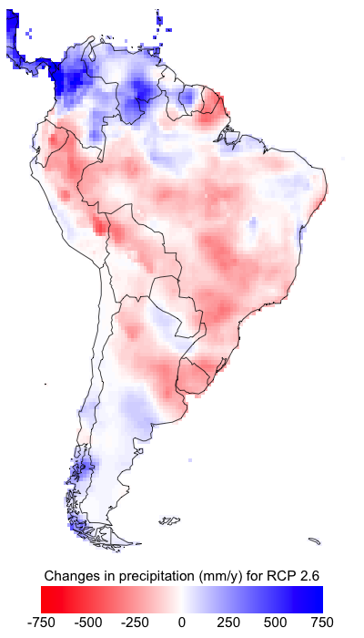
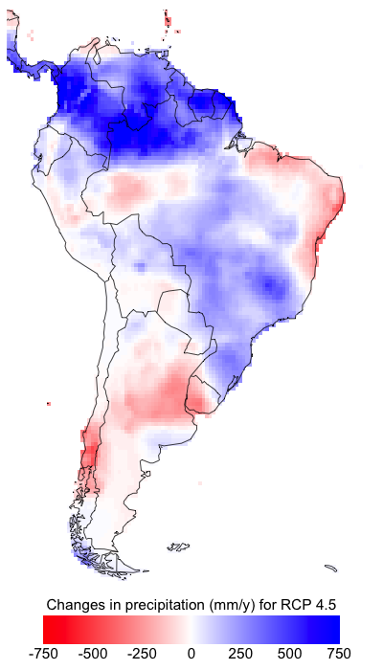
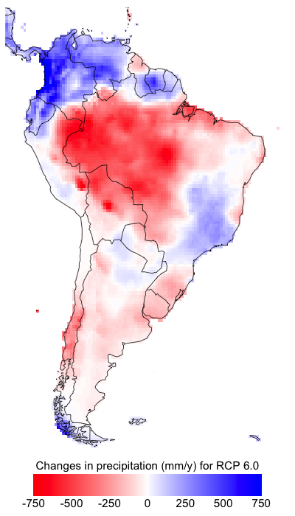
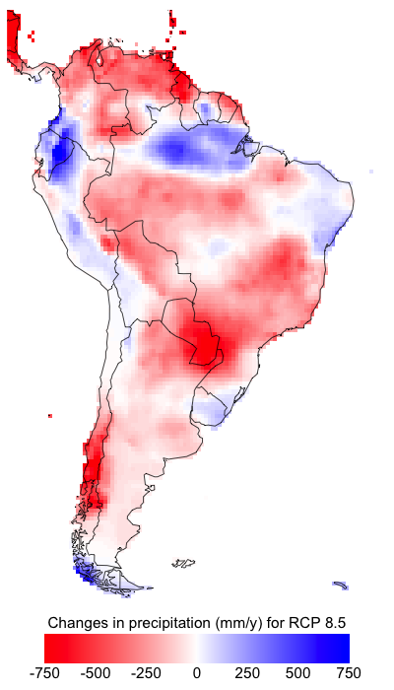
Changing precipitation
Climate change scenarios

Slide 8
Deforestation scenarios- IMAGE
Future scenarios (IMAGE scenarios- Vegetation fraction 2011-2100 )
Sediment delivery ratio ton/month
Sediment delivery ratio ton/year
Notes:
Image scenarios (2011-2100)

Slide 9
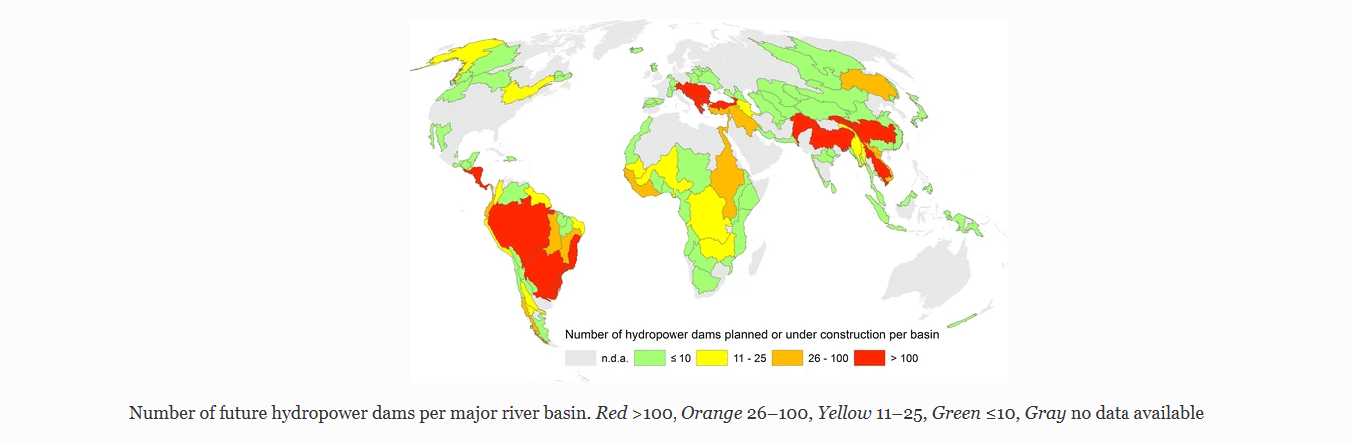
Future Dam Projection:
Future dam projection
Trapped sediment in reservoirs (1994-1999)
source: Zarfl, C.et al.2015. A global boom in hydropower dam construction

Slide 10
Conclusion:
We used PCRGLOB-SET and PCRGLOB-WB for estimation of sediment yield.
The model is not calibrated but applied directly using data from global datasets
Comparing the Model output with observations yields a coefficient of correlation of r=0.5, r=0.6 for discharge and sediment flux respectively.
next step, applying climate change, land use scenarios to the model to estimate their impacts on sediment flux in the Amazon and its variability at the Suriname coast.

Slide 11
References:
Christiane Zarfl, Alexander E. Lumsdon, J urgen Berlekamp, Laura Ty-decks, and Klement Tockner. “A global boom in hydropower dam con-struction”. In: Aquatic Sciences77.1 (2015), pp. 161–170.issn: 1420-9055.doi:10.1007/s00027-014-0377-0.url:https://doi.org/10.1007/s00027-014-0377-0
Jannis Hoch. “PCR-GLOBSET - Development and verification of a globalsediment supply model”. MA thesis. University of Twente, Nov. 2014
L Van beek and M. F. Bierkens. “The global hydrological model pcr-globwb:conceptualization, parameterization and verification. Utrecht Uni-versity”. In:International Association of Hydrological Sciences(2009).

Slide 12
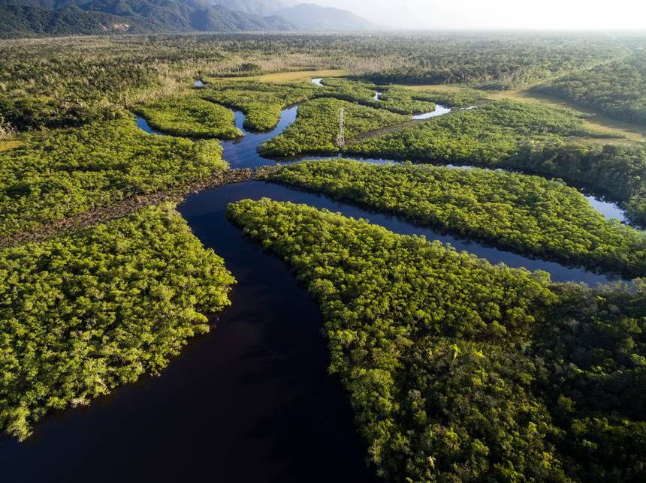
Thank you for your attention
Notes:
Put this photos at the beginning to show what I want to do?

