Slide 1
Change in Mt. Elbrus nival-glacial system in the last century
Sergey Sokratov , Yuri Seliverstov , Alla Turchaniniva , Evgenii Kharkovets , Heitor Evangelista da Silva
Lomonosov Moscow State University, Faculty of Geography, Moscow, Russian Federation
Universidade do Estado do Rio de Janeiro / LARAMG, Rio de Janeiro, Brazil

Slide 2
Why Elbrus?
Climate record without melt distortion in Eurasia
Long-term (since 18th century) observations of different resolution and accuracy
Site of especially extensive investigations since IGY 1957/58 with detailed maps
New detailed data during the last 15 years, including drilling, echo-sounding and mapping
Contradictions in published results of existent data analysis

Slide 3
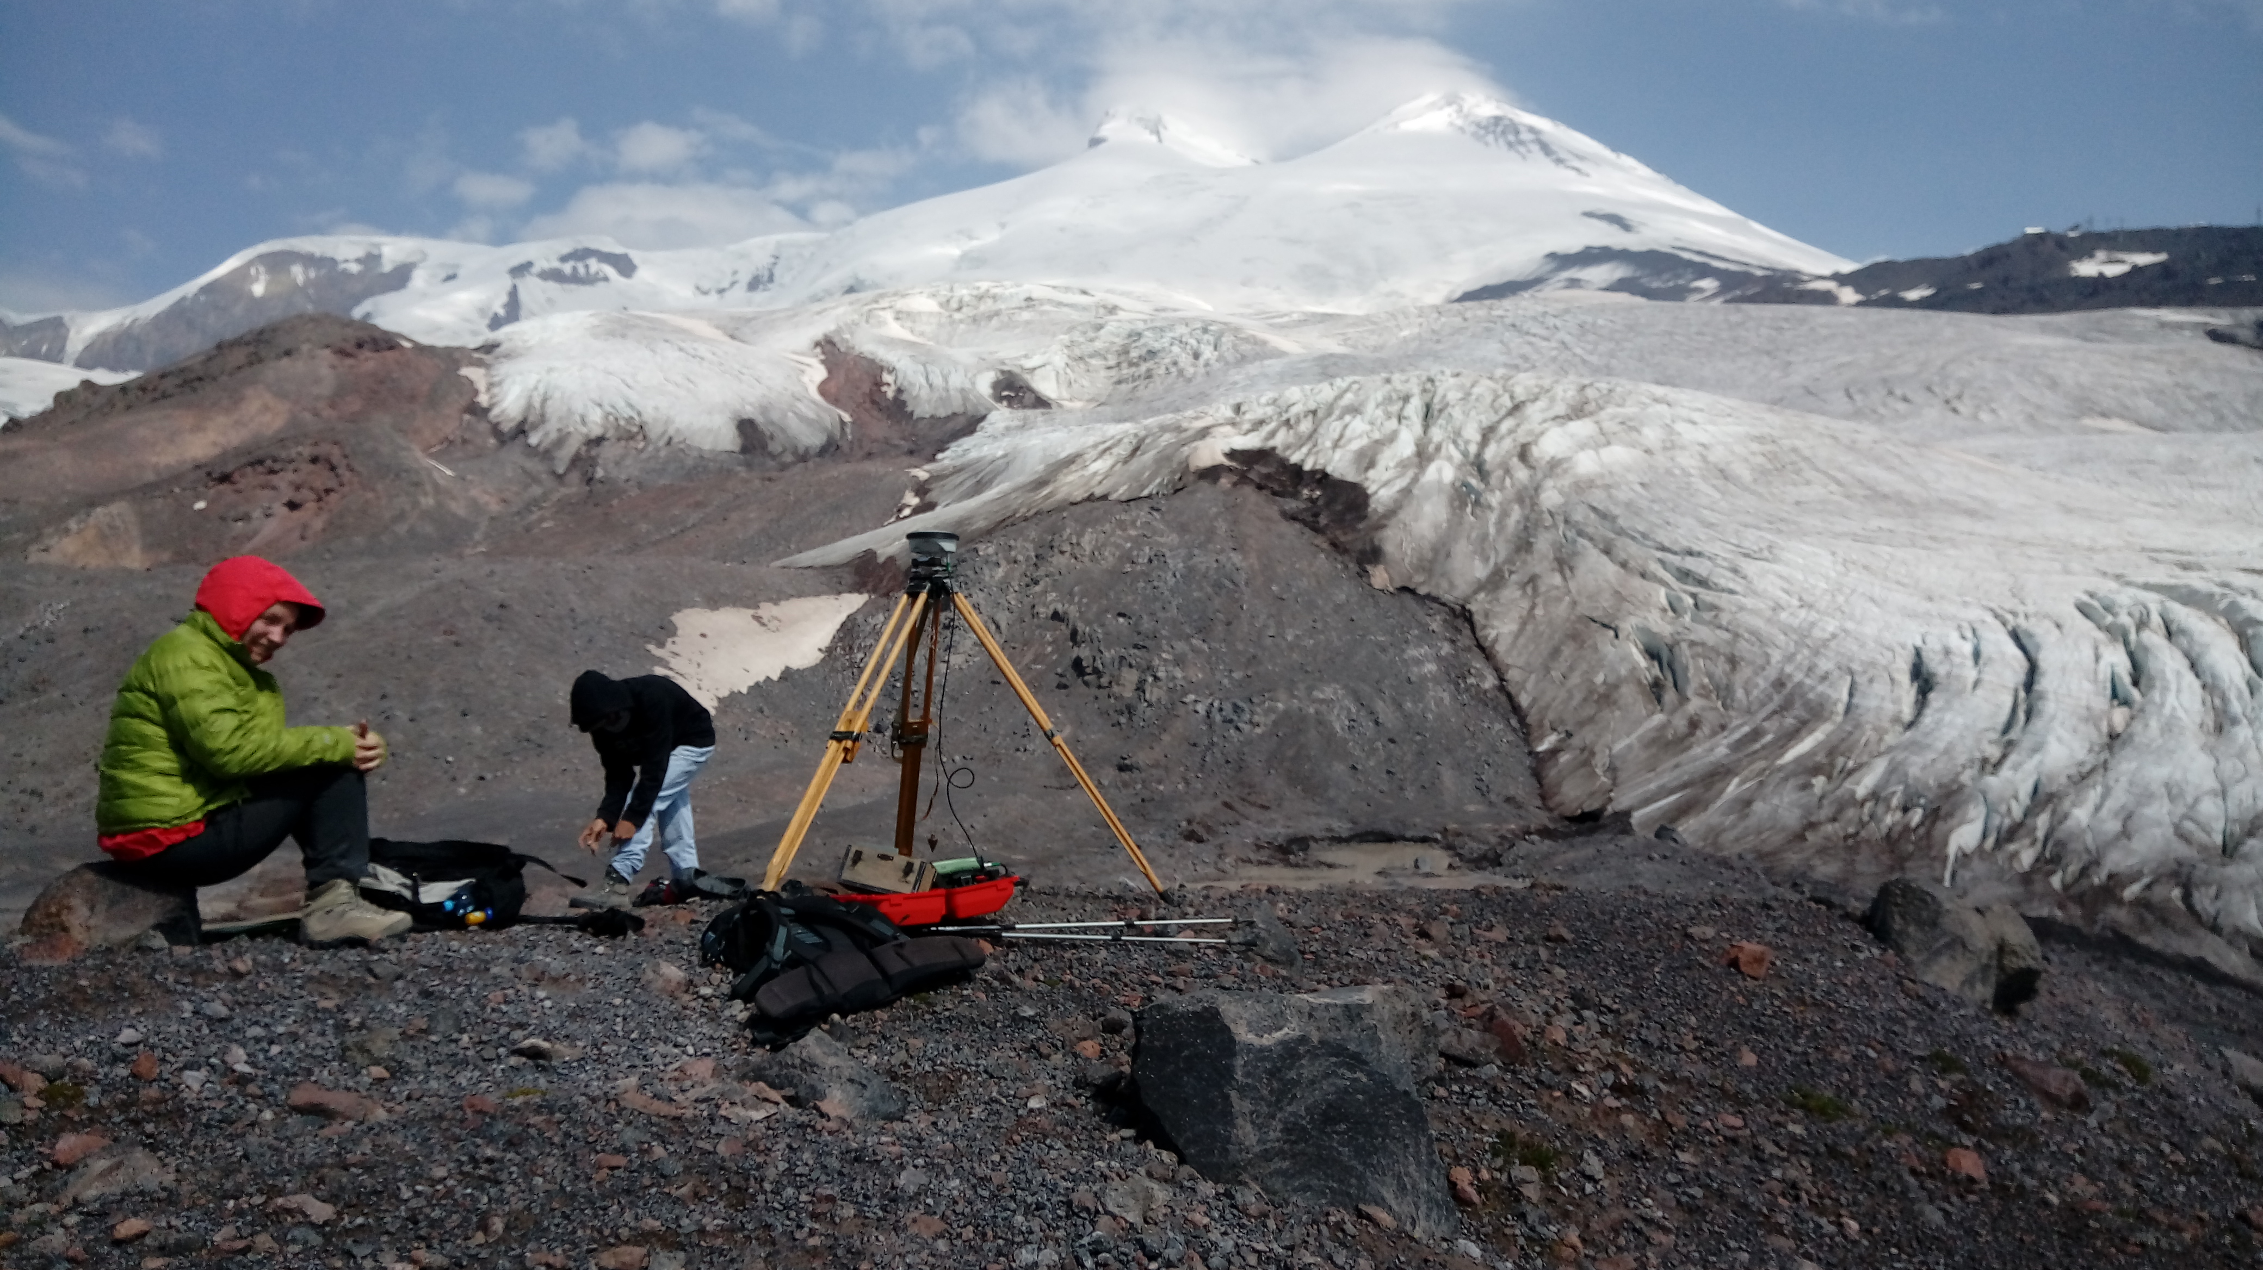
Campaign of 2017
Lakes sediments cores
Mapping from ground (South slope) and with UAV (the edges of South Slope glaciers)
Pléiades stereo image of the same time
Recalculation of previous cartographic material (1957, 1997) – just finished

Slide 4
Lakes sediments
The lake formed close to 1957

Slide 5
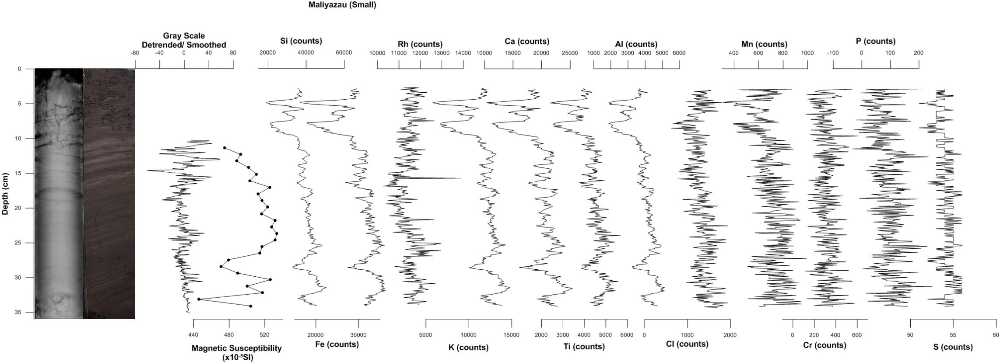
Lakes sediments
The lake formed close to 1957

Slide 6
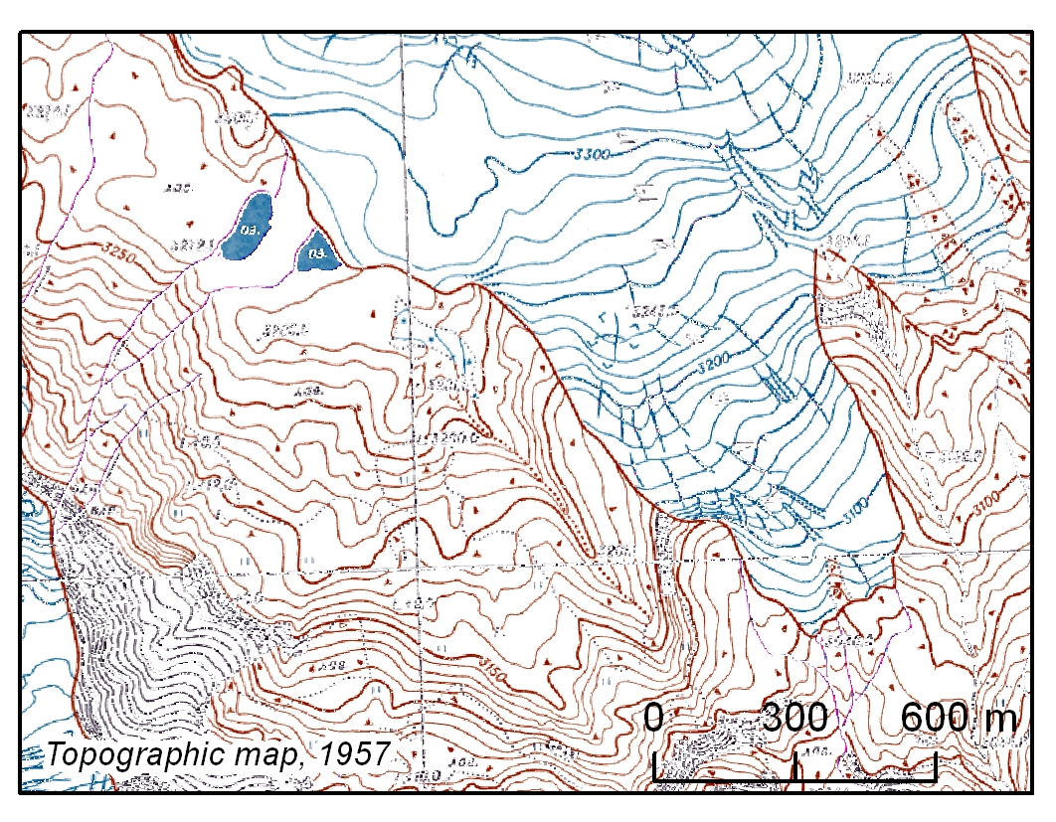
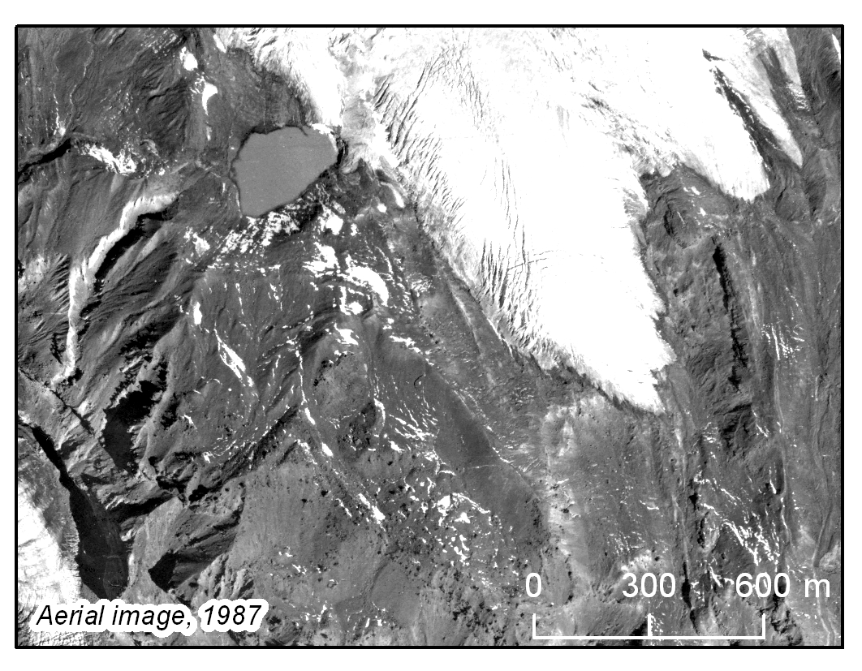
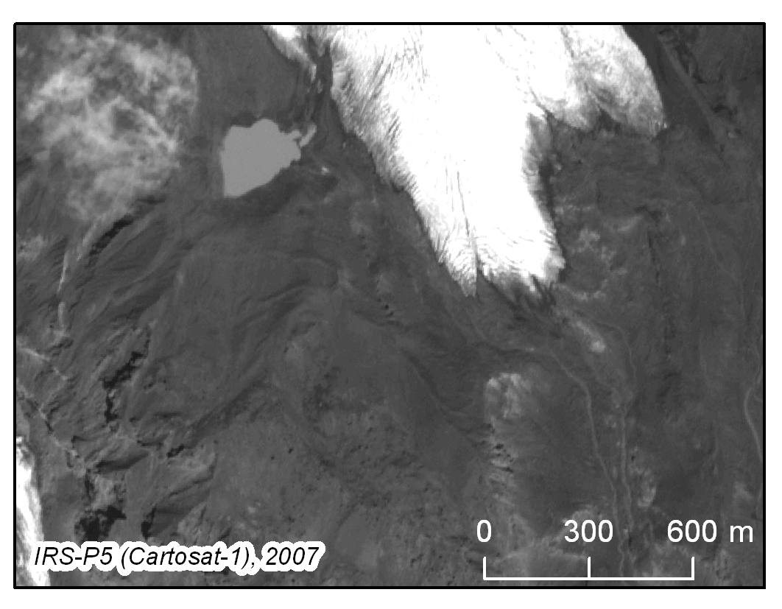
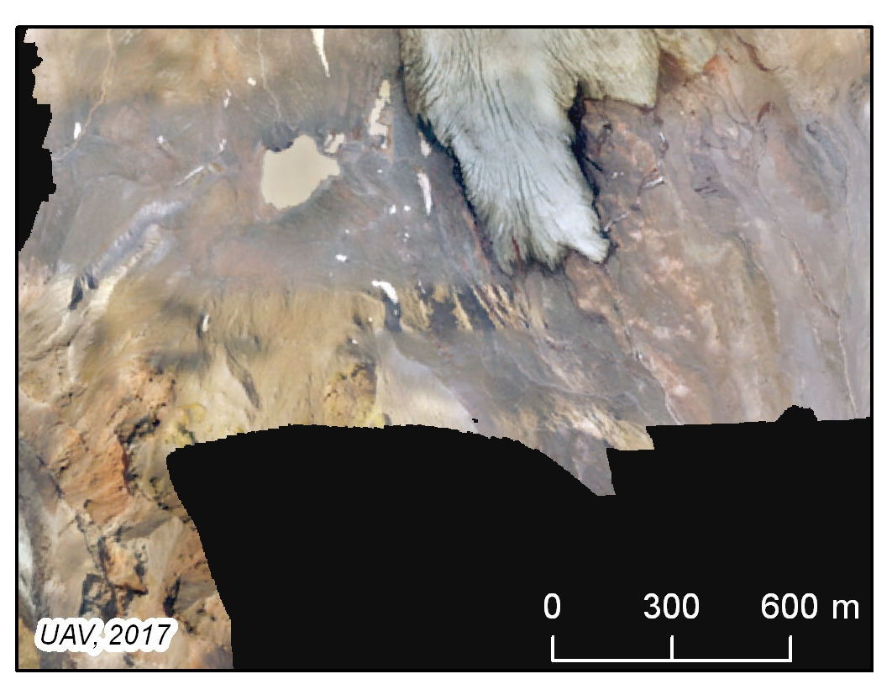
Lakes sediments

Slide 7
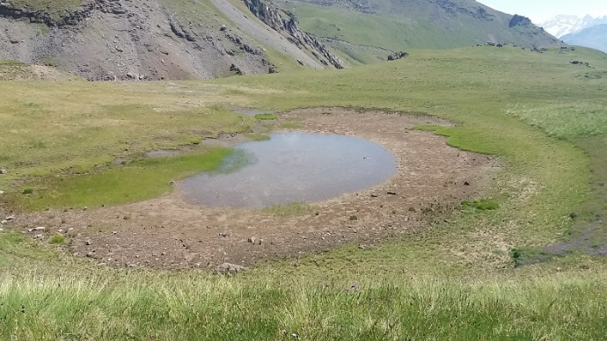
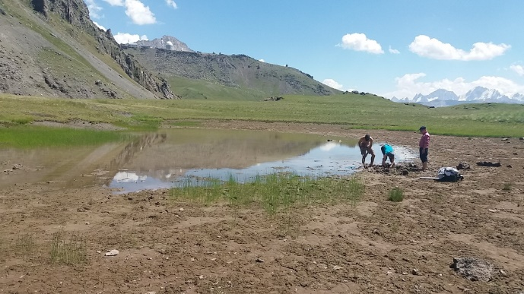
Lakes sediments
The lake of unknown age – bottom of former glacier?

Slide 8
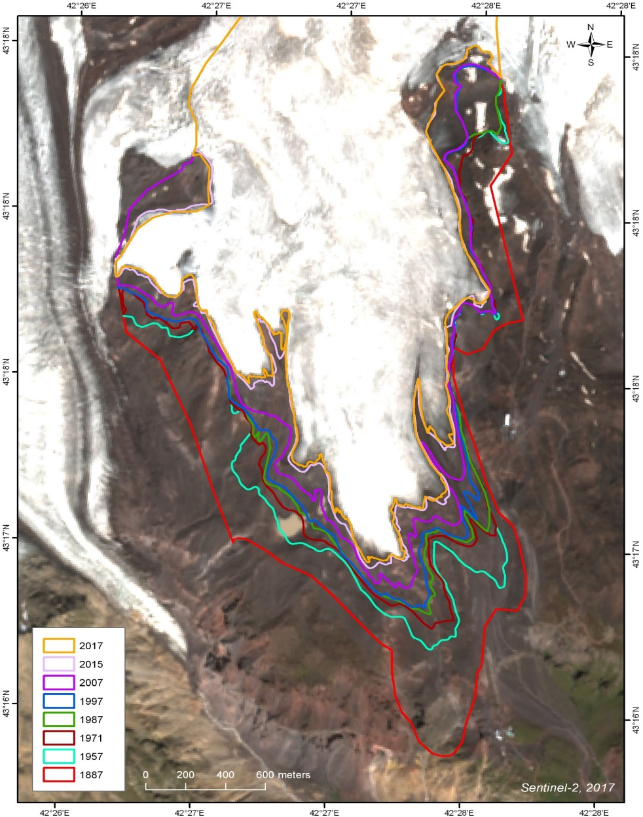
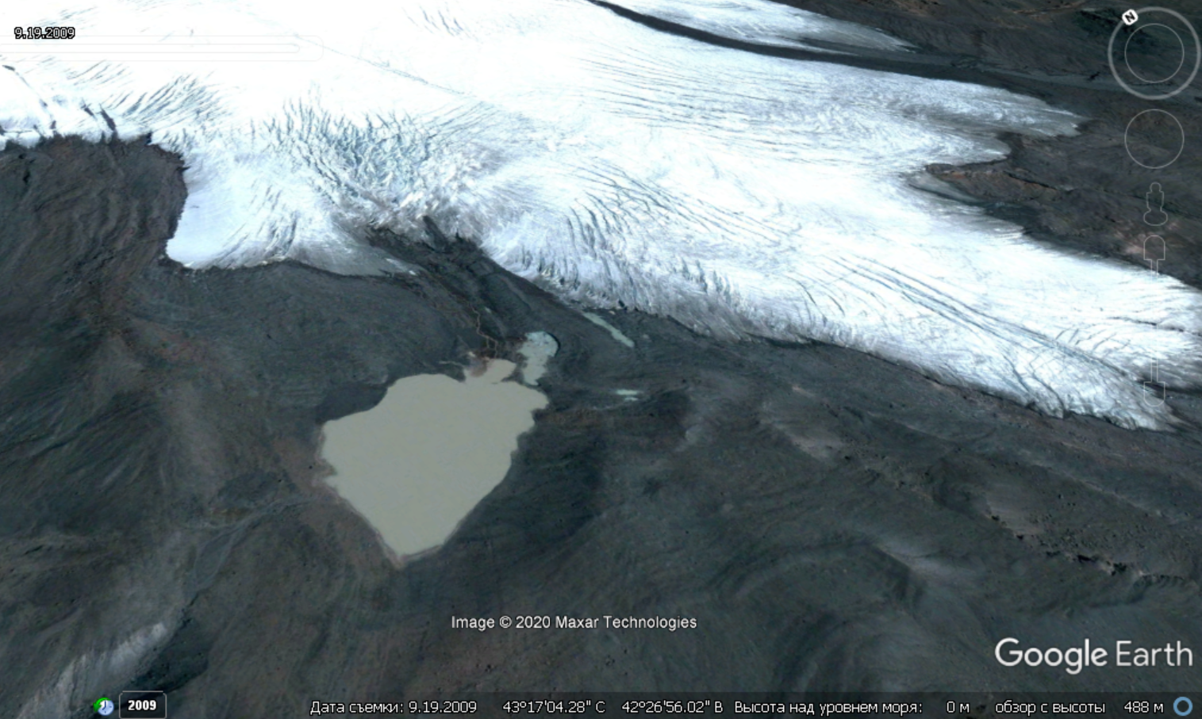
Glaciers retreat
Retreat lines survey:
1887 Topographic map
1957 Topographic map
1971 Corona
1987 Aerial photography
1997 Aerial photography
2007 Cartosat-1 (IRS P5)
2015 Pleiades
2017 Sentinel-2/UAV survey
19.09.2009

Slide 9
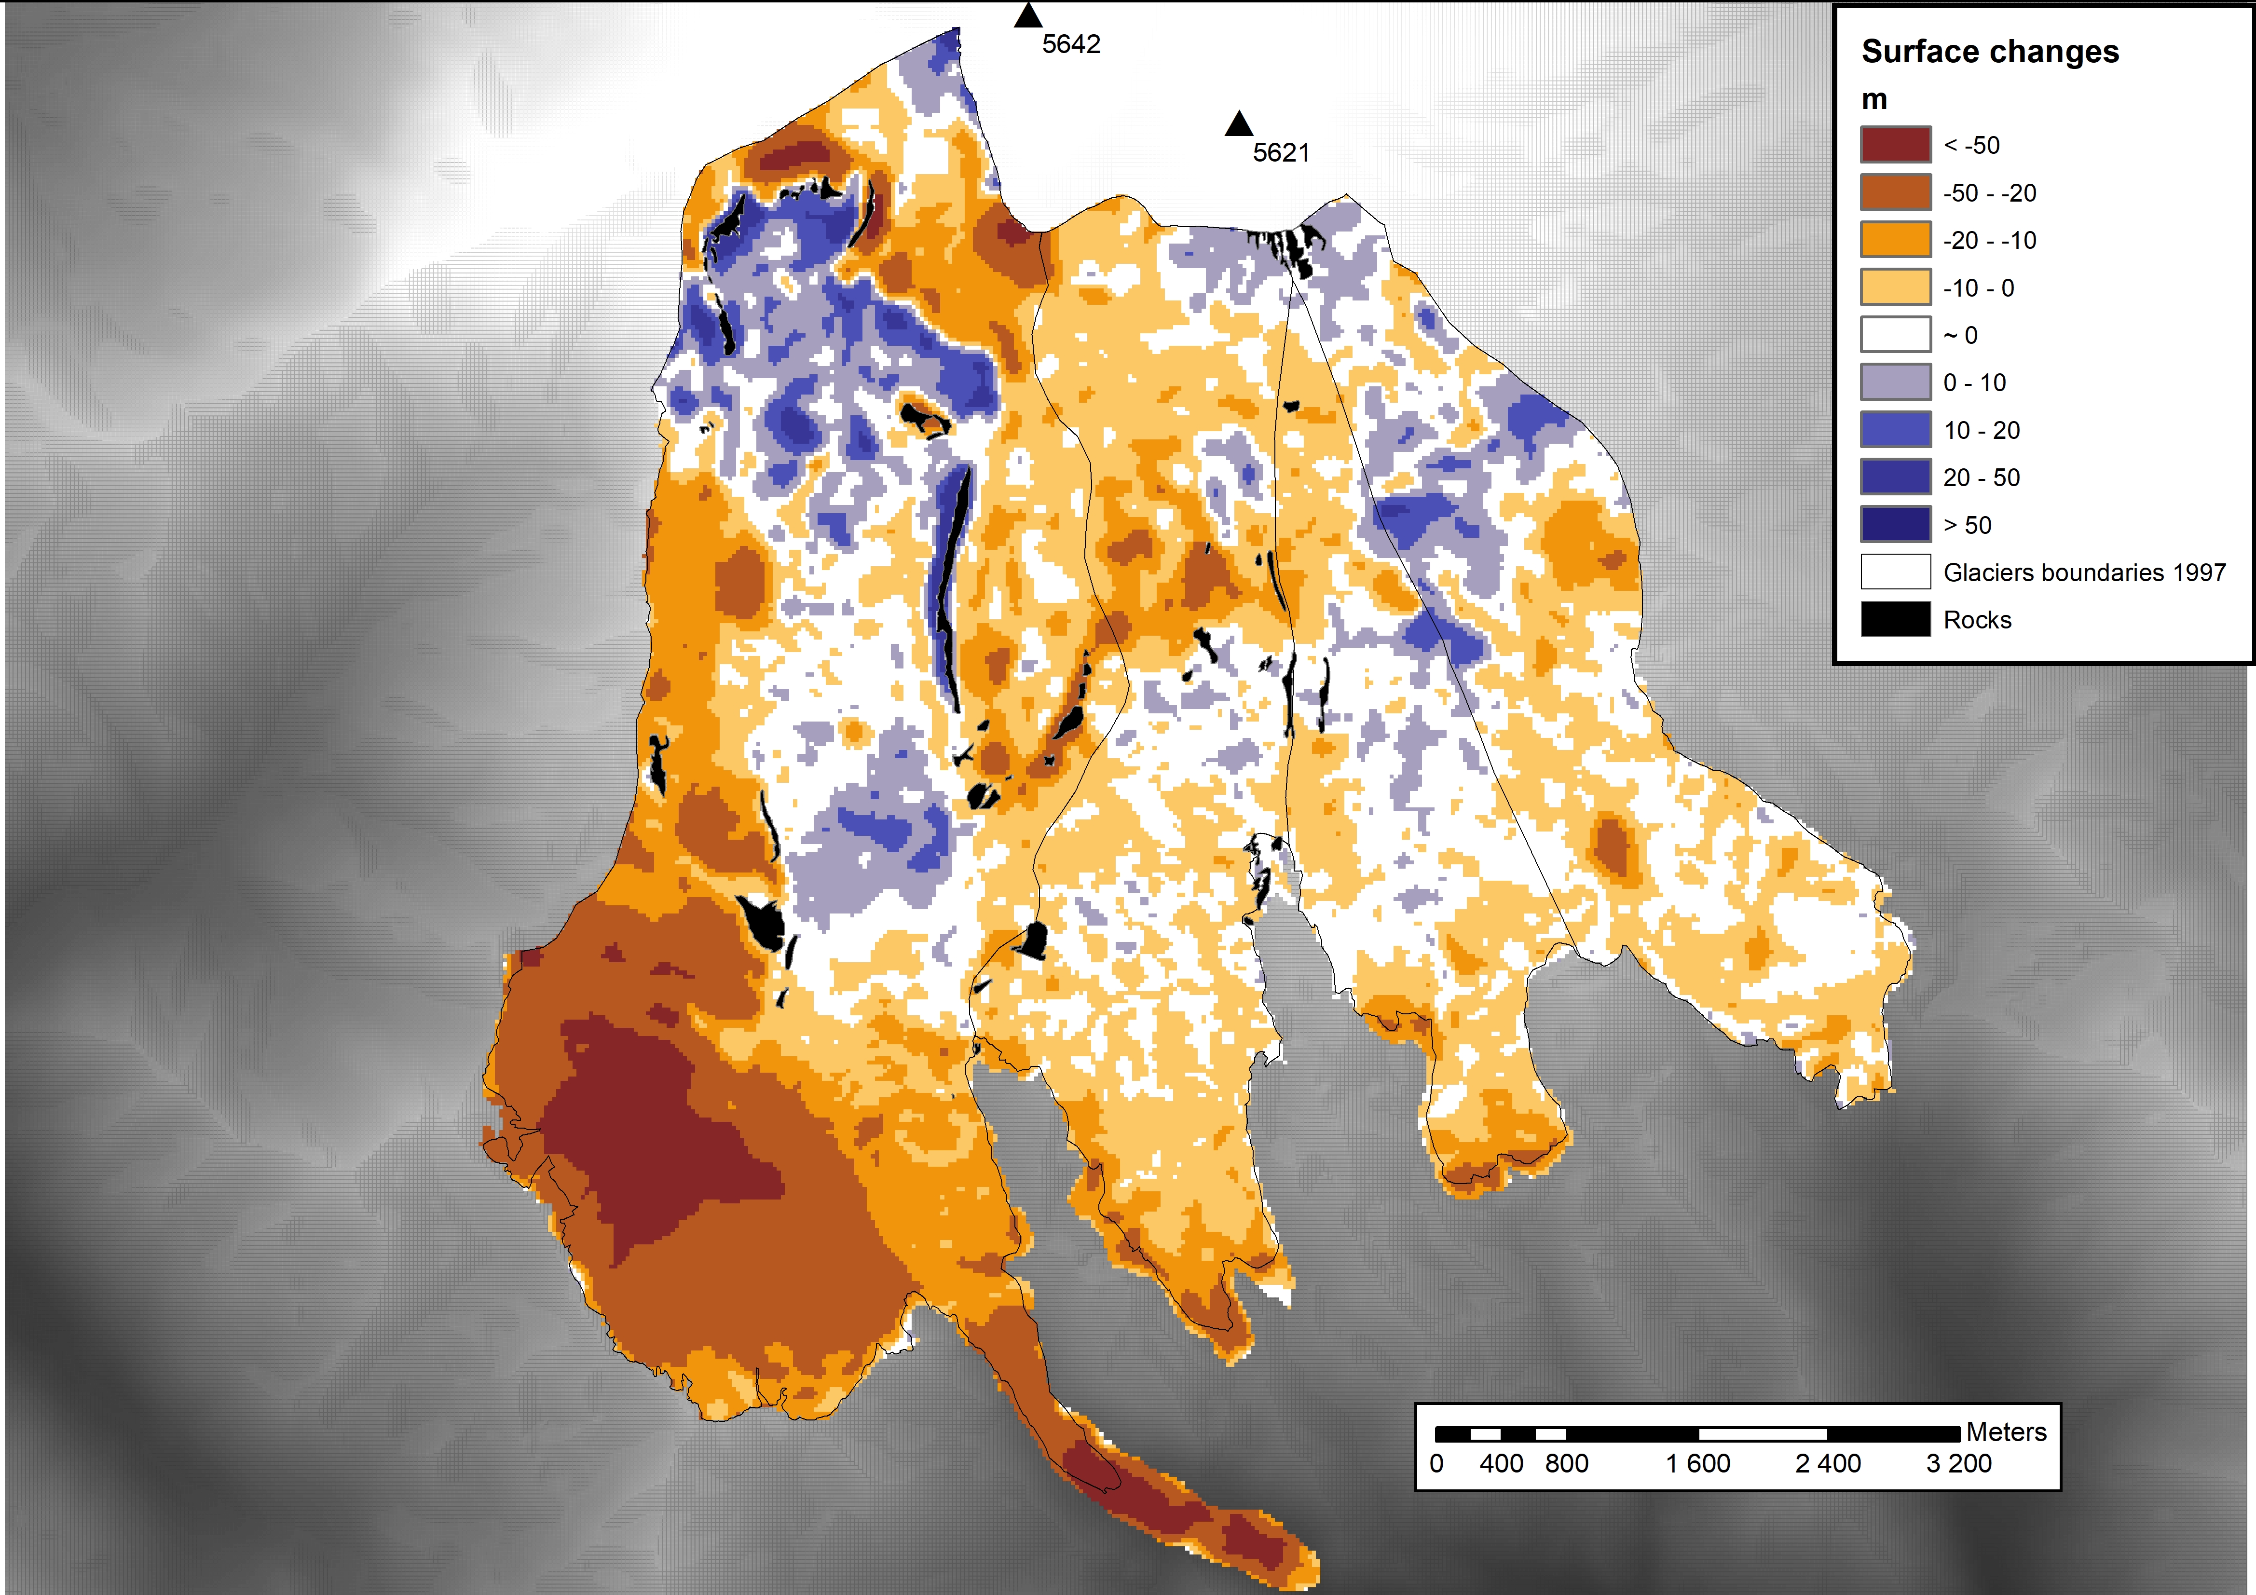
The change in the surface elevation between 1957 and 1997

Slide 10
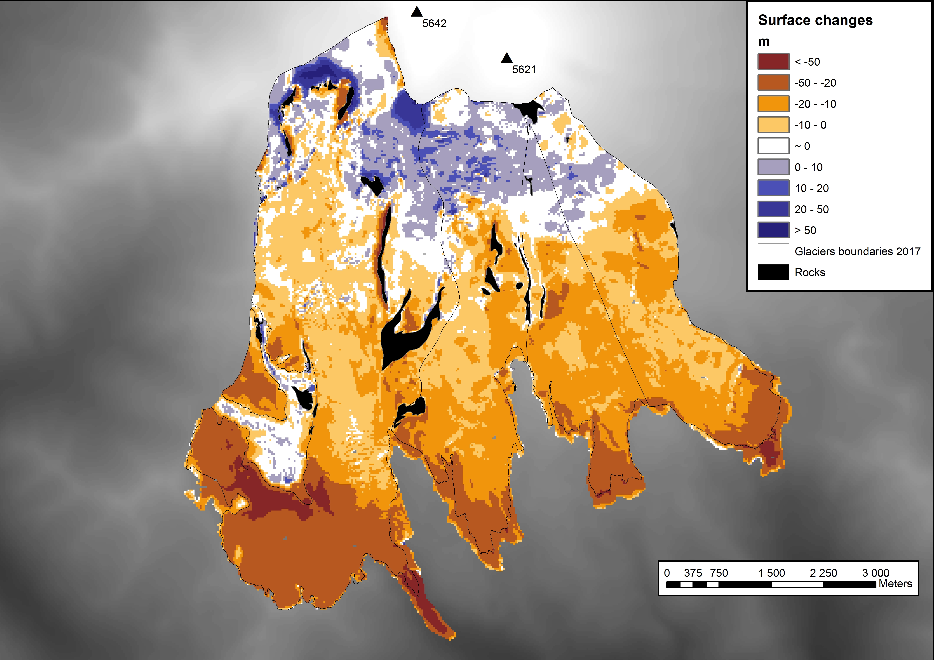
The change in the surface elevation between 1997 and 2017

Slide 11
Schematic comparison 1997-2019 with the latest Kutuzov et al., Front. Earth Sci. 7:153

Slide 12
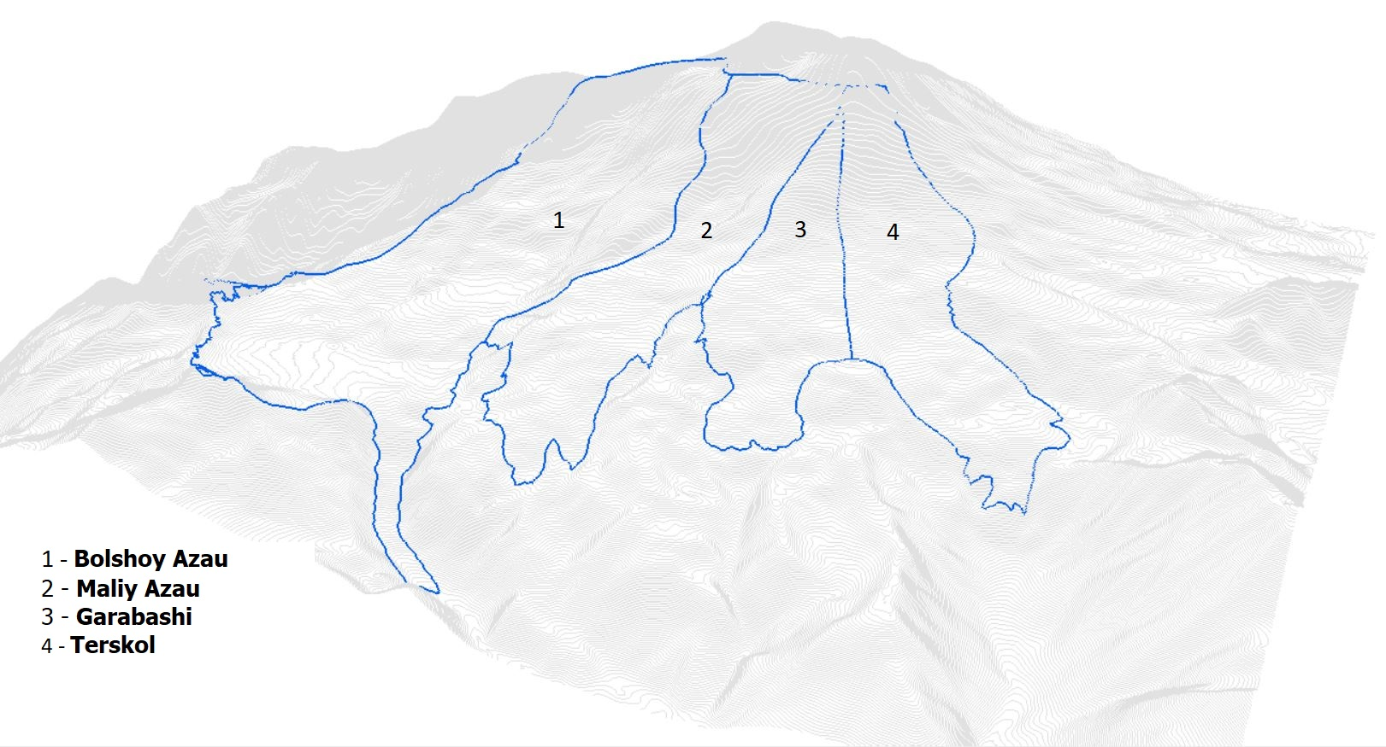
The glaciers separation

Slide 13
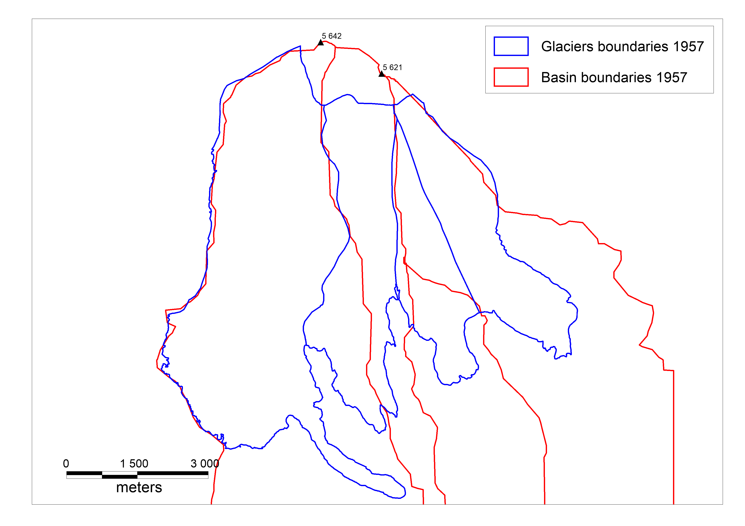
The glaciers and glacier basins boundaries, 1957

Slide 14
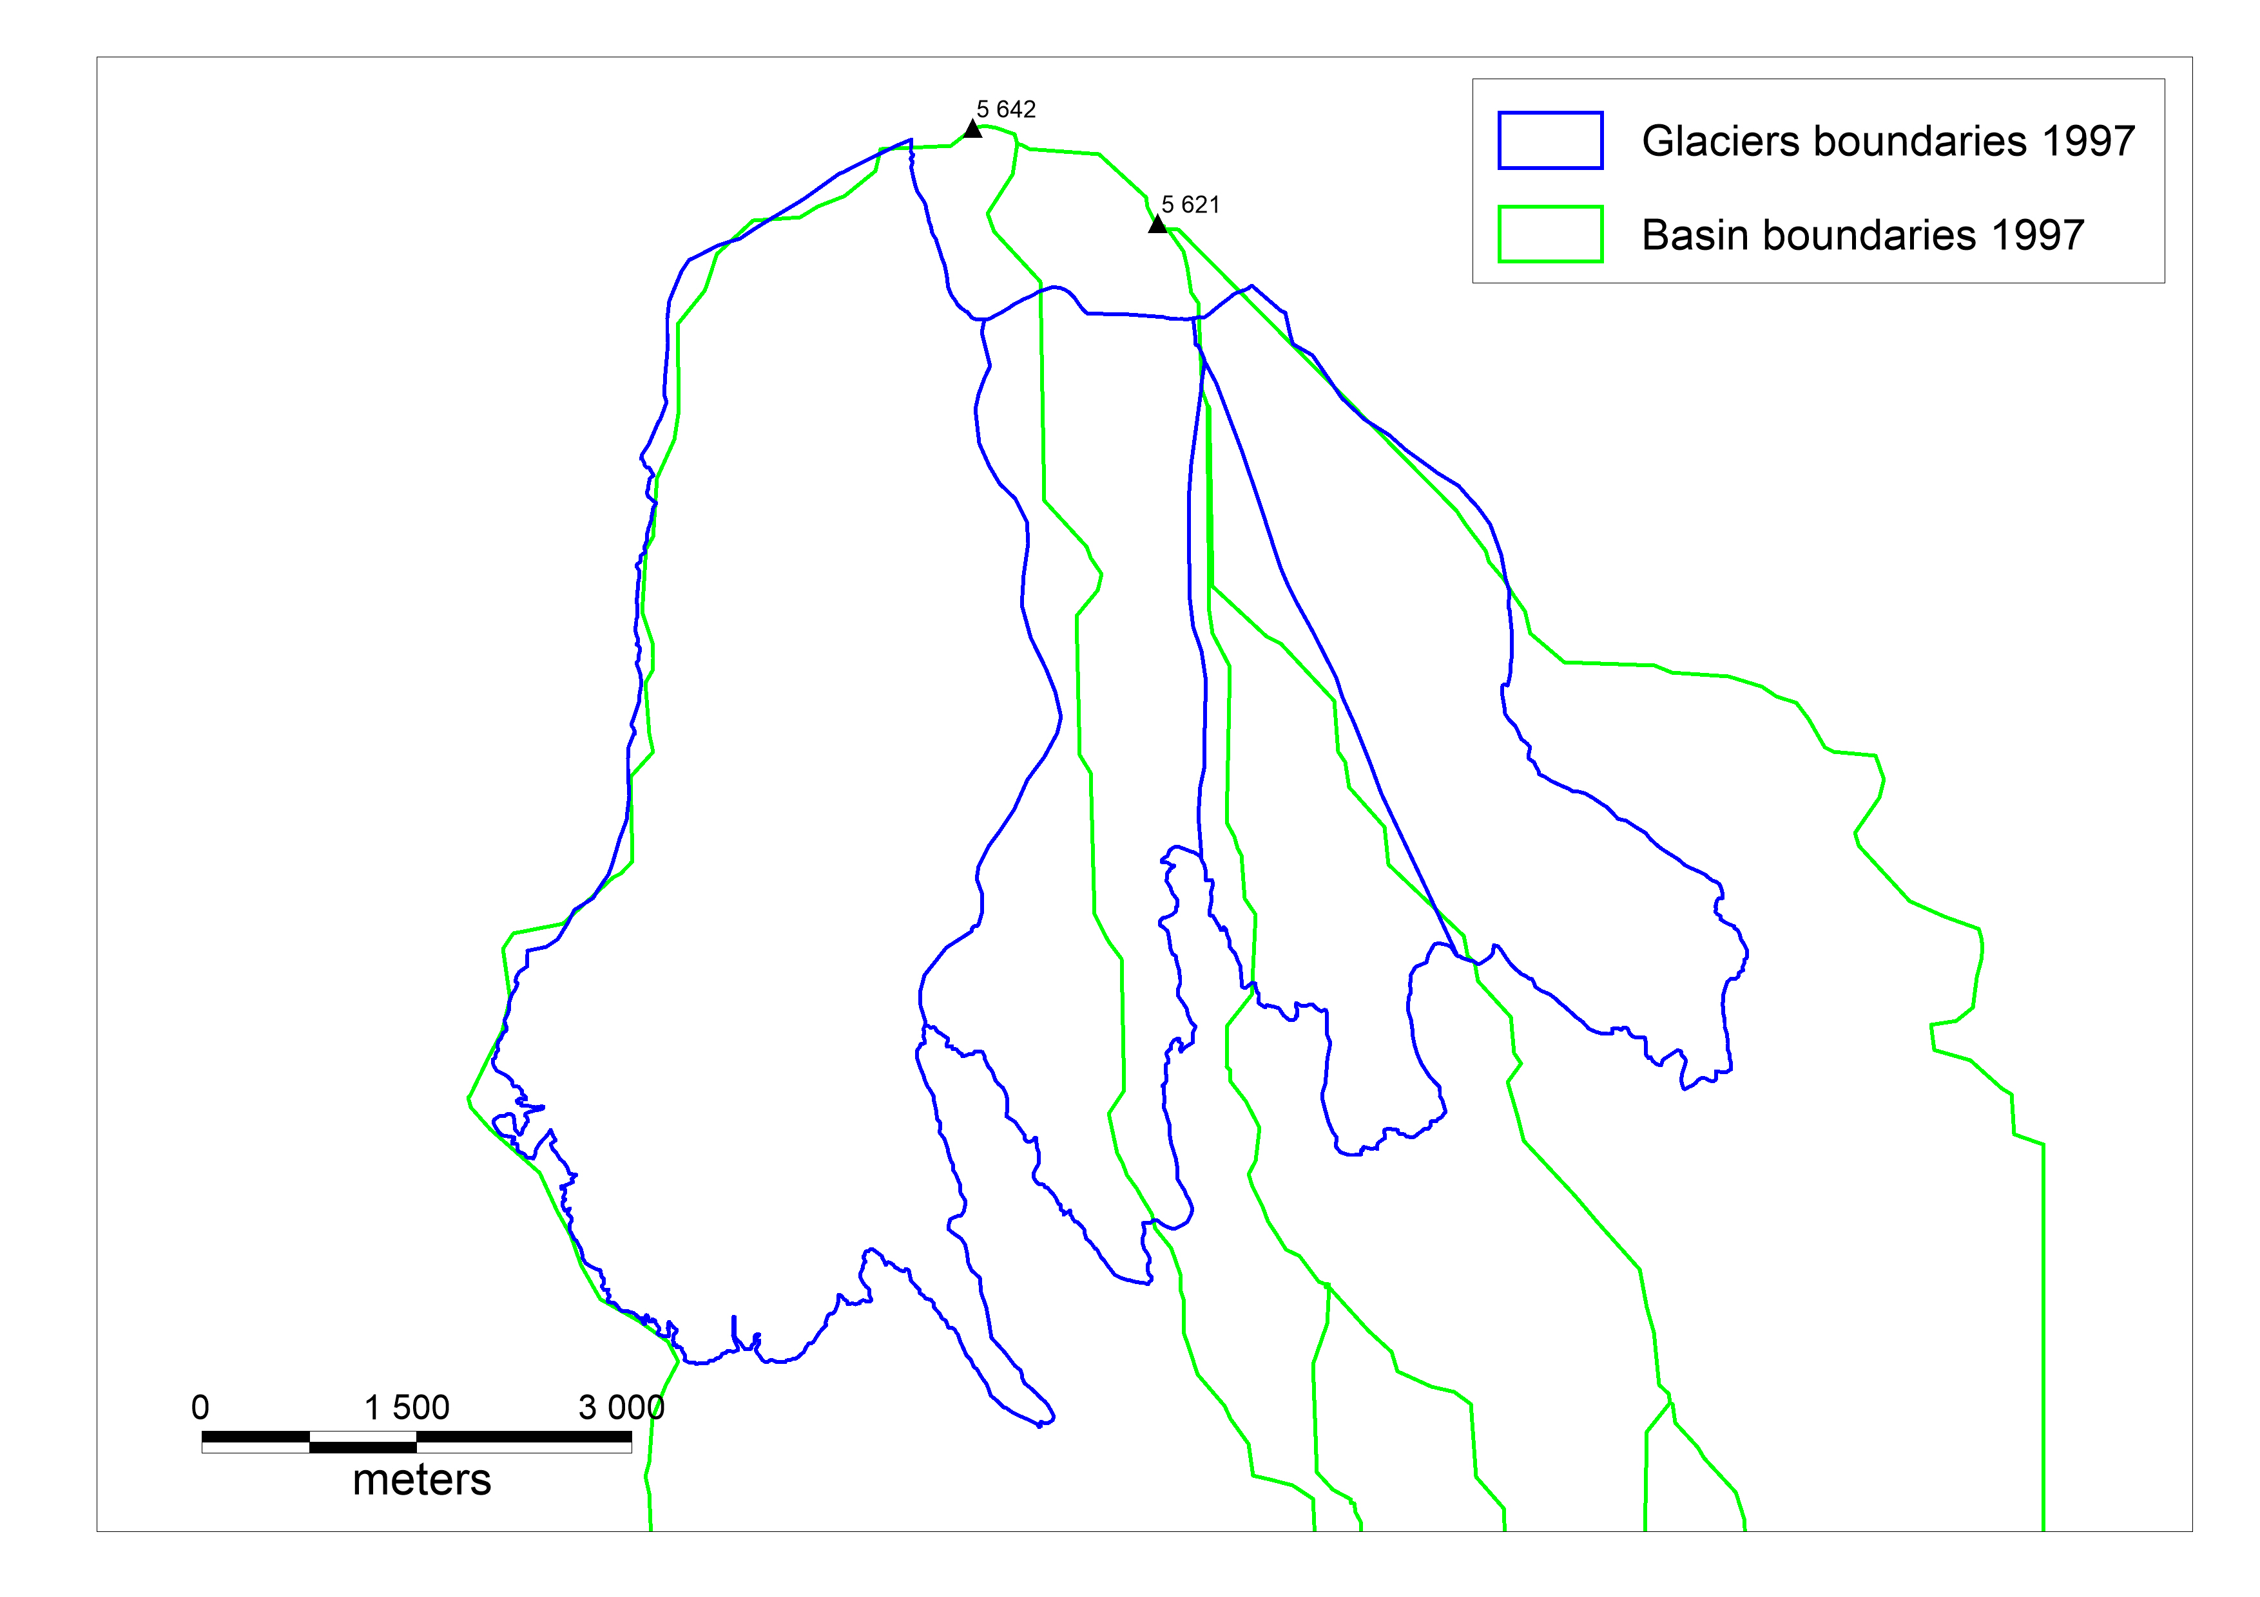
The glaciers and glacier basins boundaries, 1957

Slide 15
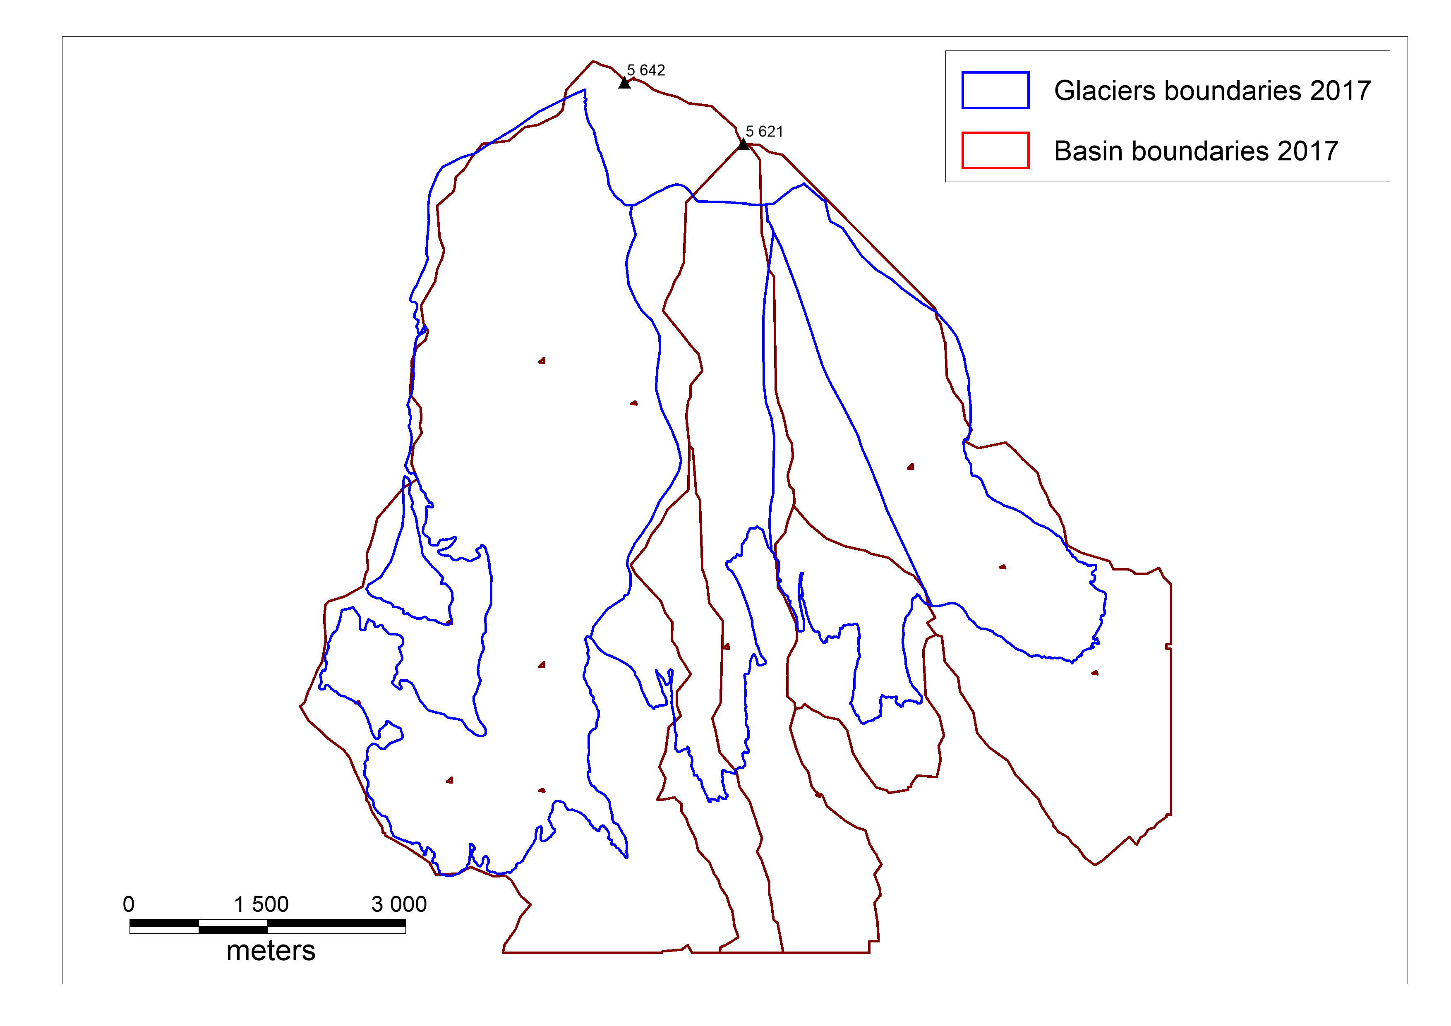
The glaciers and glacier basins boundaries, 1957

Slide 16
What now?
Surface elevation data collected and is under evaluation for 1979 and 1987
The data on elevation/aspect of slop/slope angle for each ”pixel” in each ”year” to be related to their changes
The core from lake with known age to be used as a reference for other cores

