Slide 1
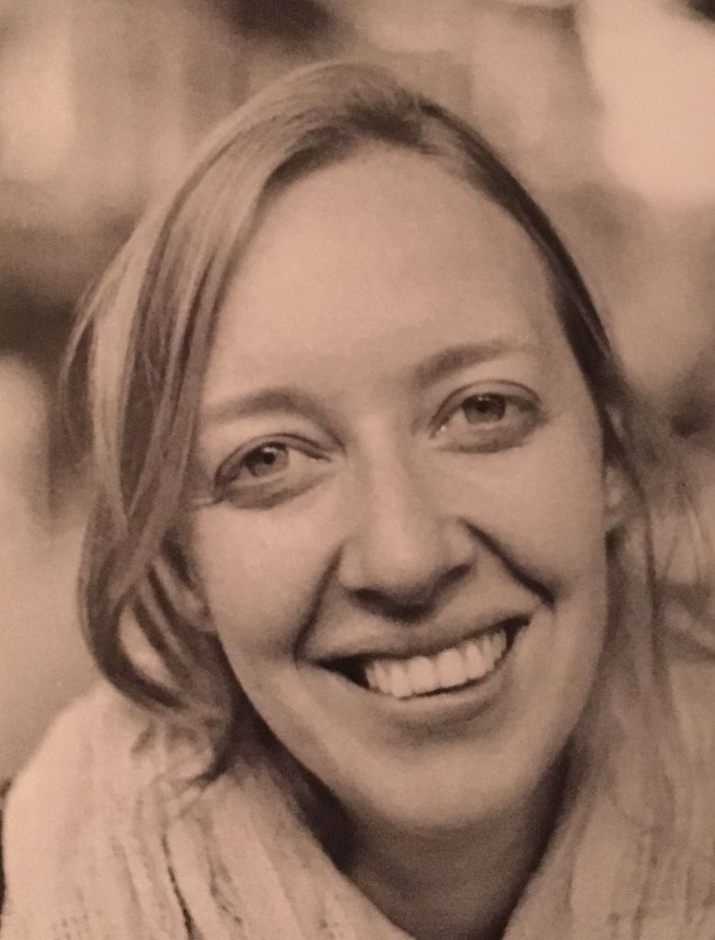
Global scenarios of competition for water between energy, food and nature
Lotte de Vos^{1,2}
In collaboration with: Hester Biemans², Jonathan Doelman¹ and Elke Stehfest¹
¹PBL Netherlands Environmental Assessment Agency
²Wageningen Environmental Research

Slide 2
IMAGE-LPJmL framework
Integrated Model to Assess the Global Environment
Global response strategies
Effects of different scenarios on
Land use
Energy
Water availability
Biodiversity
Nutrients

Slide 3
IMAGE-LPJmL framework
Integrated Model to Assess the Global Environment
Global response strategies
Effects of different scenarios on
Land use
Energy
Water availability
Biodiversity
Nutrients

Slide 4
Nexus water-food-energy-nature
Nature
Food
Energy

Slide 5
Nexus water-food-energy-nature
LPJmL
Variable monthly flow method as developed in Pastor et al. (2014)
Environmental flow requirements
Water demand for industries, households and electricity
Water demand for irrigation
LPJmL
IMAGE

Slide 6
Nexus water-food-energy-nature

Slide 7
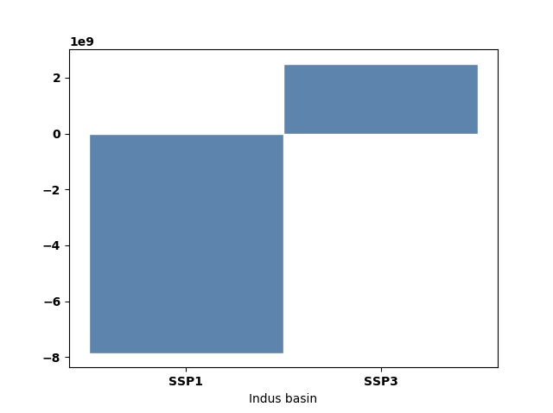
Nexus water-food-energy-nature
Notes:
.

Slide 8
Thank you
For any questions/suggestions, please reach out to:
Lotte.deVos@pbl.nl

