Slide 1
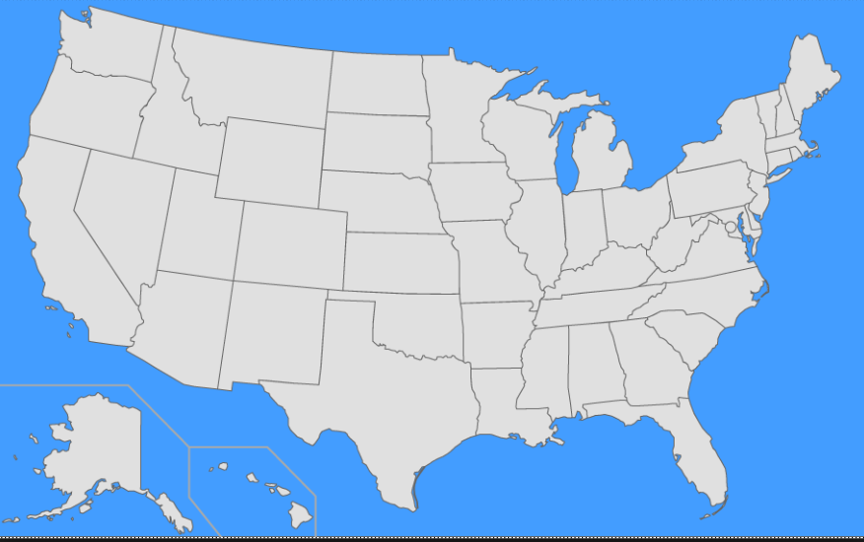
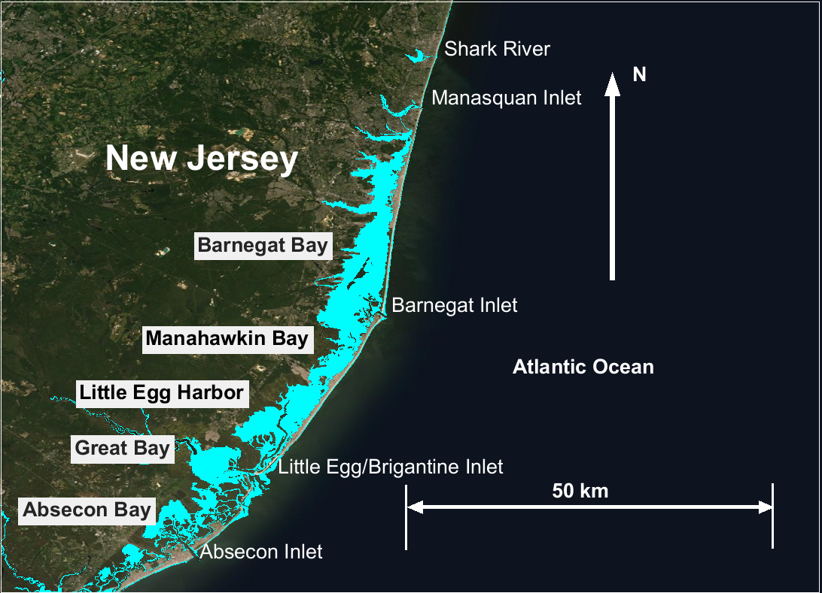
The role of coastal wetlands in reducing back bay flooding: New Jersey Back Bays case study
Gregory Slusarczyk and Mary A. Cialone
US Army Corps of Engineers (USACE) Engineer Research & Development Center (ERDC)
United States
US Army Corps
Of Engineers ®
European Geophysical Union Vienna, Austria 8 May 2020

Slide 2
Overview
The goal of the project was to determine effectiveness of large-scale Natural and Nature Based Features (NNBF) measures for reducing storm surge water levels in portions of New Jersey Back Bay (NJBB) domain
The Approach was to numerically simulate the Designed large-scale NNBF concepts with use of
coupled Two-dimensional, depth averaged ADCIRC hydrodynamic model and Steady-State Spectral Wave Model STWAVE
Standalone ADCIRC model
forcing from synthetic tropical cyclone events generated jointly by OceanWeather Inc. (OWI)/ERDC as part of the North Atlantic COAST COMPRIHENSIVE STUDY (NACCS)
Simulations did NOT include the effects of tides

Slide 3
Modeling scenario 1 (Configuration 5: Brigantine area)
Coupled ADCIRC and STWAVE
Configuration 5: grid with NNBF measures (with-project-conditions)
Configuration 3: grid without NNBF measures (without-project-conditions)
Storm surge barriers at Great Egg Inlet and Absecon Inlet (Configuration 5 & 3)

Slide 4
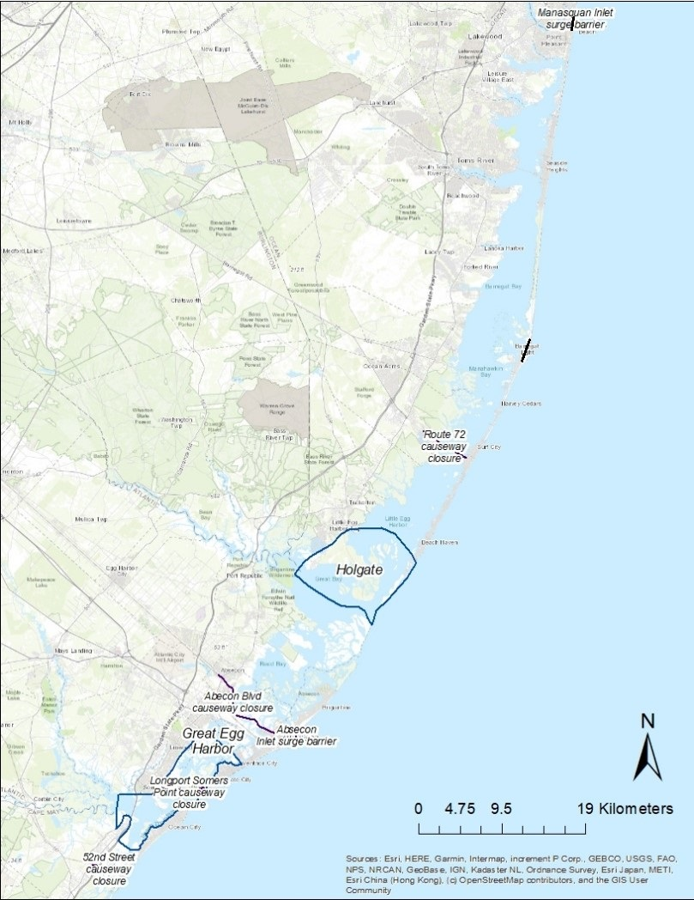
Modeling scenario 2 (Configuration 8: Holgate and Great Egg Harbor areas)
ADCIRC standalone (no waves)
Configuration 8: grid with NNBF measures (with-project-conditions)
North: grid without NNBF measures (without-project-conditions)
Storm surge barriers at Manasquan Inlet and Barnegat Inlet (Configuration 8 & North)

Slide 5
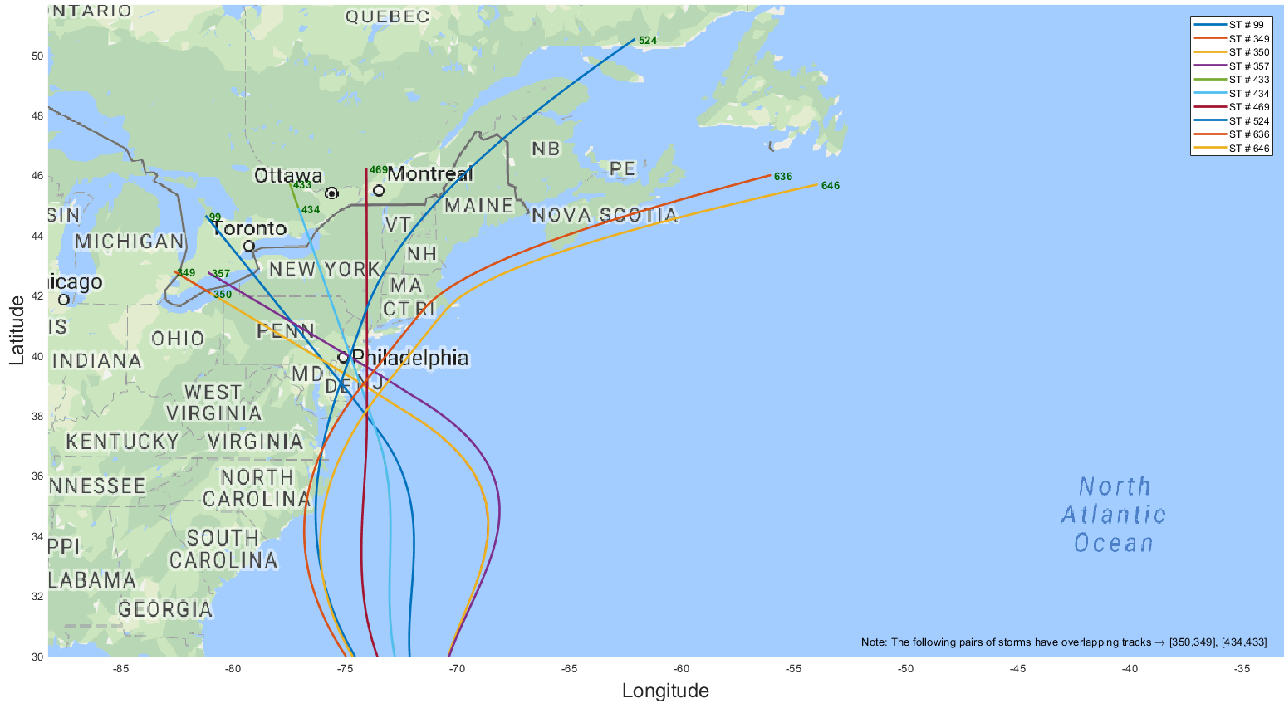
Selected Storms
NJBB Storms | Landfall Angle (deg N) | Central Pressure Deficit (hPa) | Rmax (km) | Forward Speed (km/hr)
1 | -40 | 88 | 65 | 16
2 | -60 | 78 | 125 | 65
3=350 | -60 | 68 | 52 | 26
4 | -60 | 58 | 88 | 28
5 | -20 | 88 | 55 | 62
6 | -20 | 78 | 82 | 27
7 | 0 | 78 | 74 | 38
8 | 20 | 78 | 73 | 38
9=636 | 40 | 78 | 47 | 14
10 | 40 | 83 | 67 | 59
Ten synthetic tropical storms from NACCS selected to minimally cover the range of
Storm size
Direction
Intensity
for the NJ coastal region and demonstrate the varying surge response in this region

Slide 6
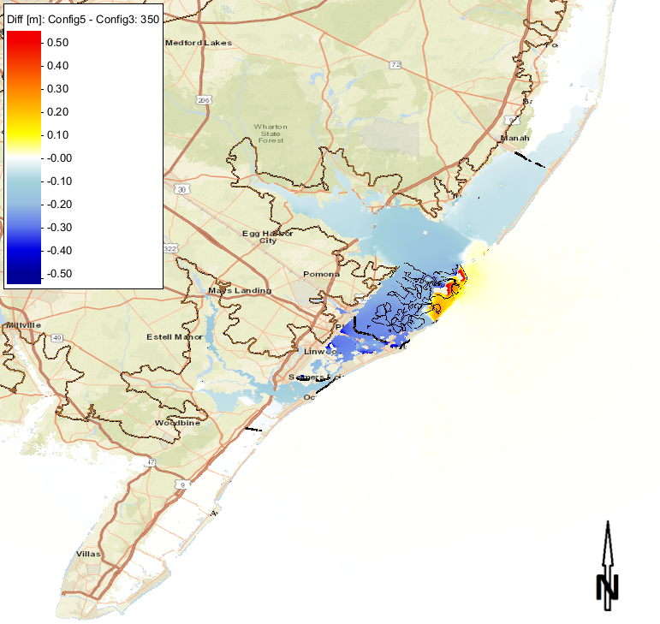
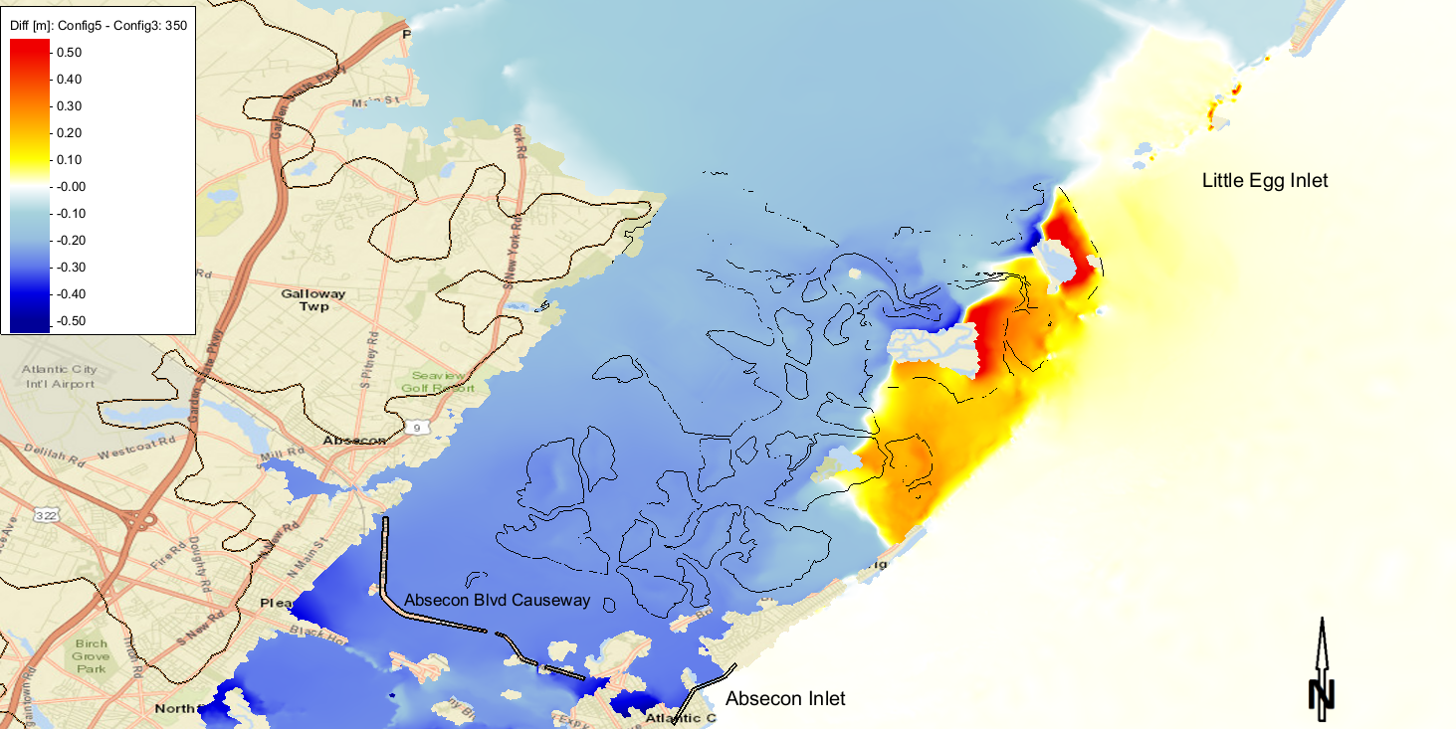
Storm 350 Scenario 1 Brigantine
Maximum Surge Envelope
Difference (Config5-Config3)
(m)
Zoom of Difference (Config5-Config3)
(m)

Slide 7
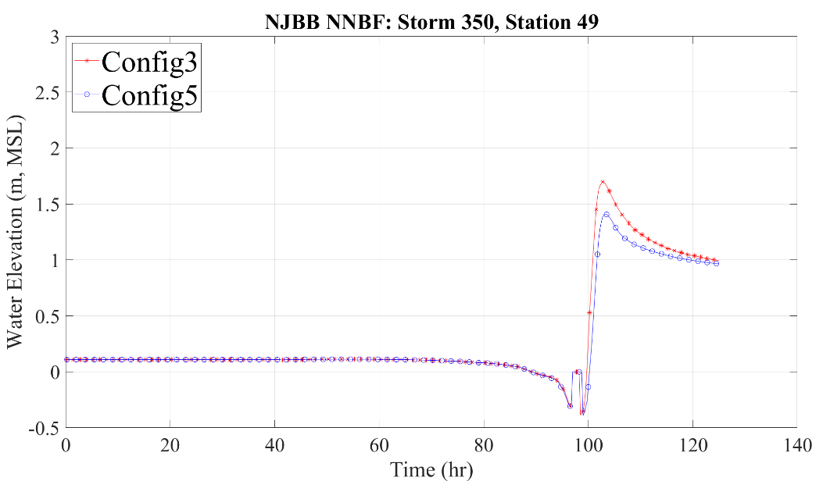
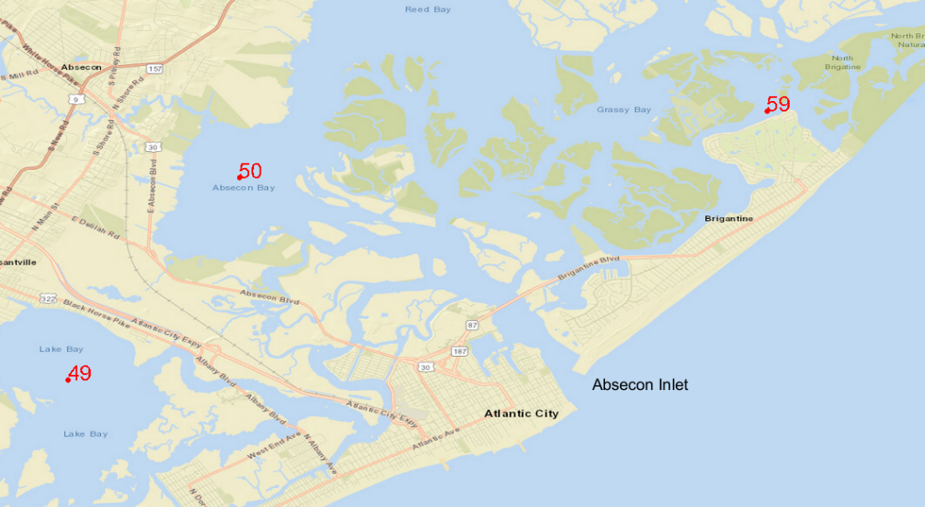
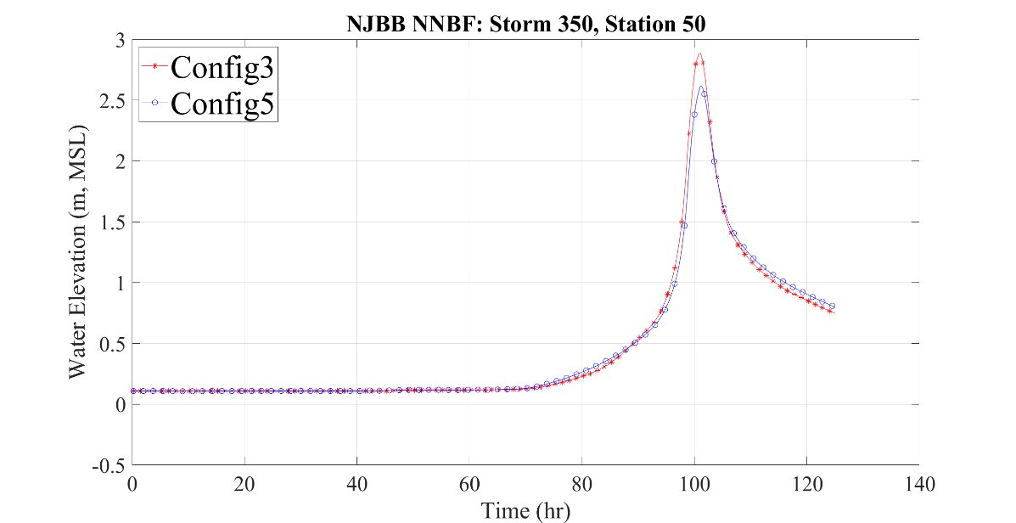
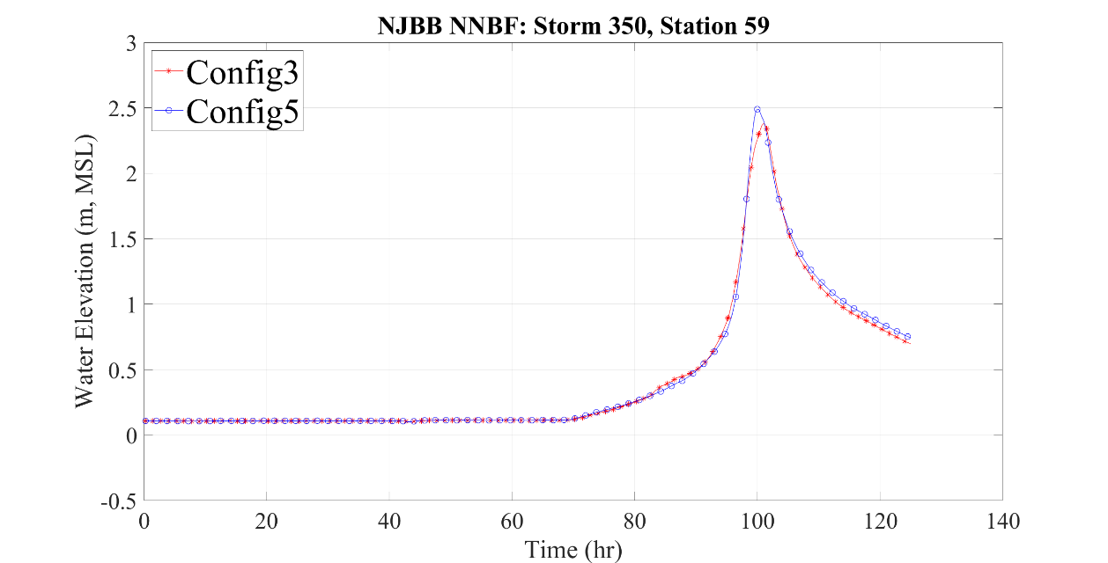
Storm 350 - Scenario 1 brigantine
Base and Config5 time-series map showing point 49, 50, and 59 and the time-series for these 3 points

Slide 8
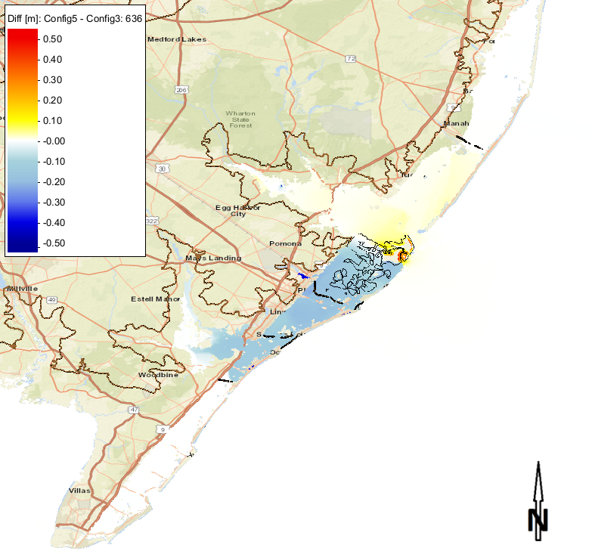
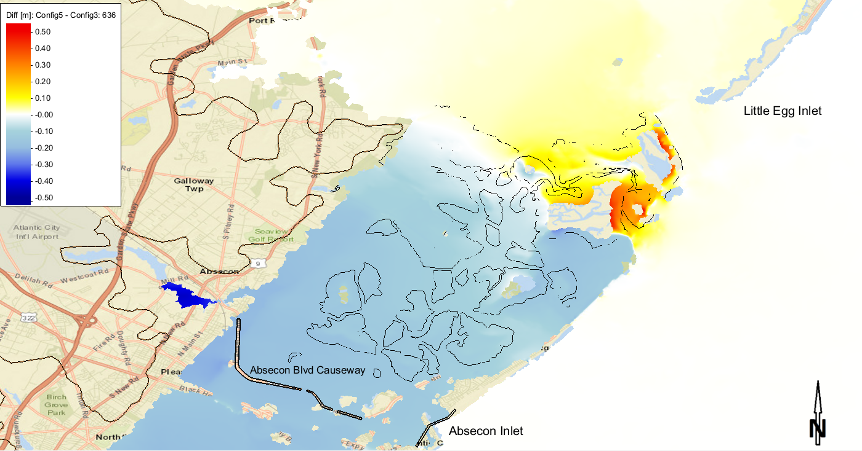
Storm 636 Scenario 1 brigantine
Maximum Surge Envelope
Difference (Config5-Config3)
(m)
Zoom of Difference (Config5-Config3)
(m)

Slide 9
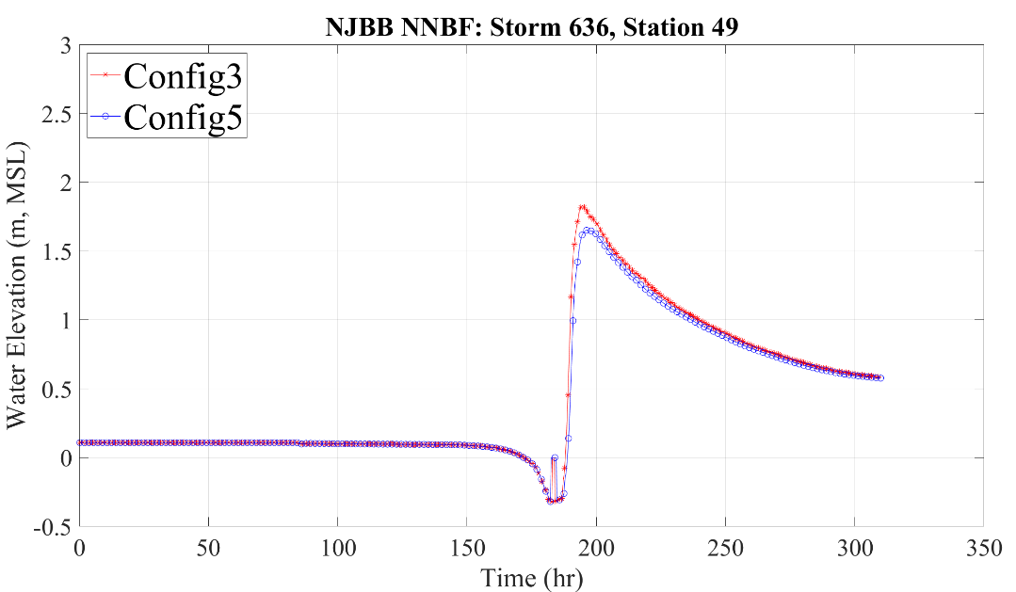
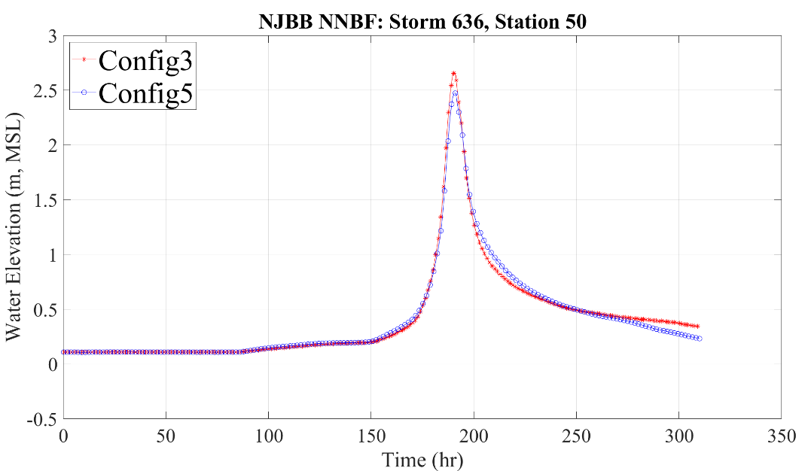
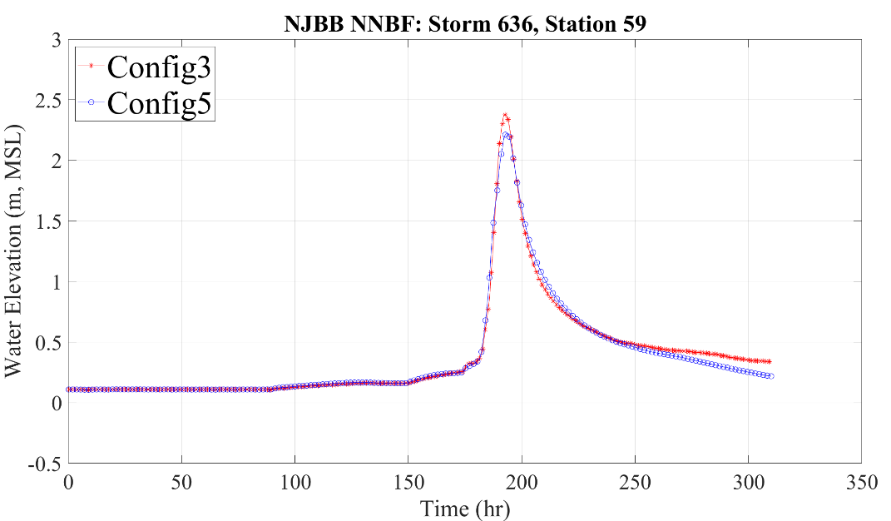
Storm 636 – Scenario 1 Brigantine
Base and Config5 Time series map showing point 49, 50, and 59 and the time-series for these 3 points

Slide 10
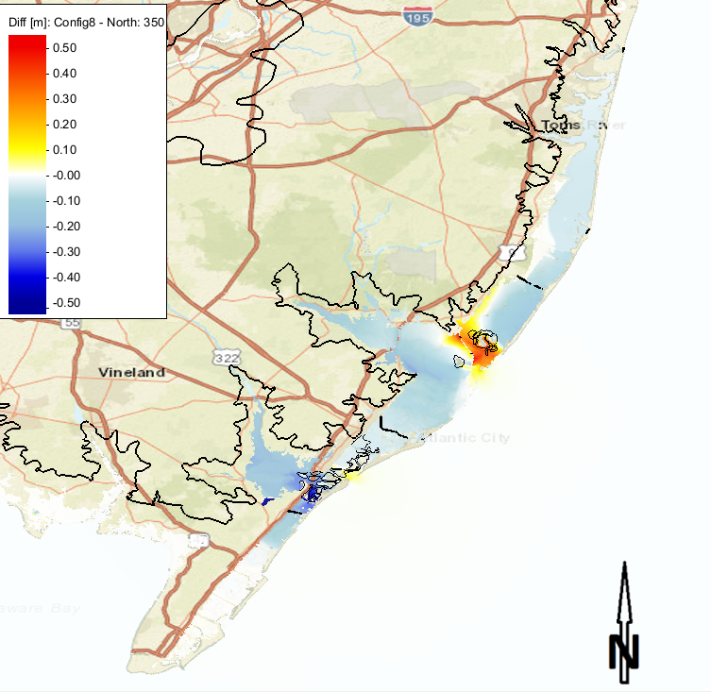
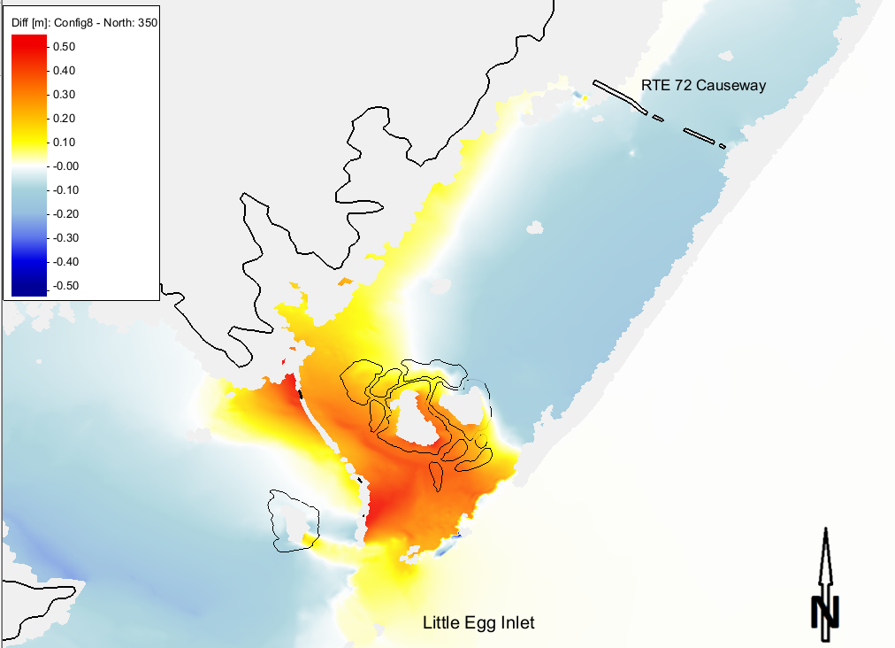
Storm 350 Scenario 2 Holgate
Maximum Surge Envelope
Difference (Config8-North)
(m)
Zoom of Difference (Config8-North)
(m)

Slide 11
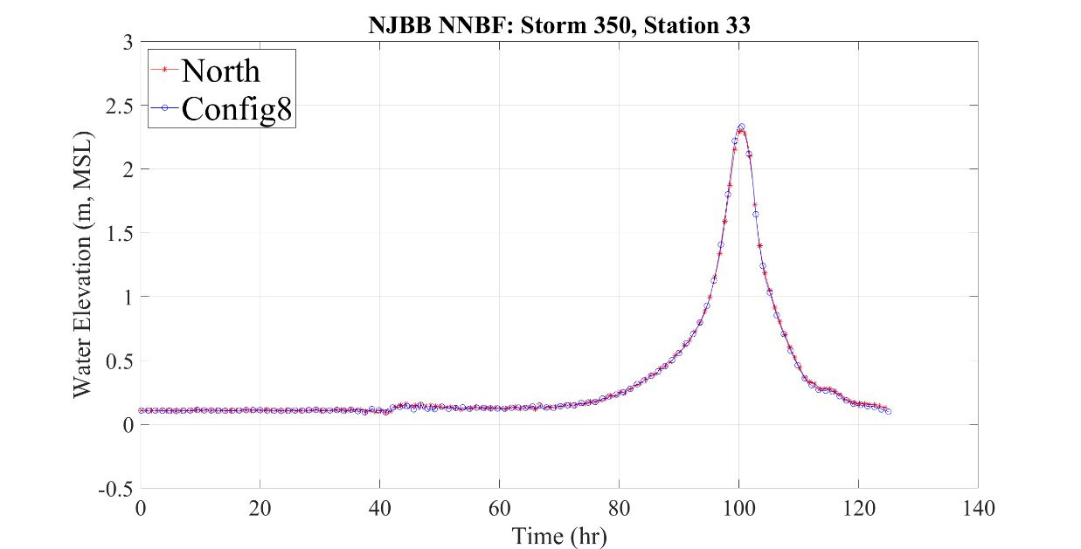
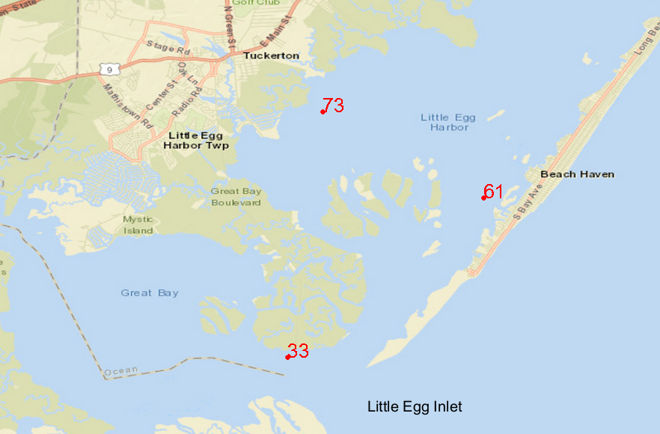
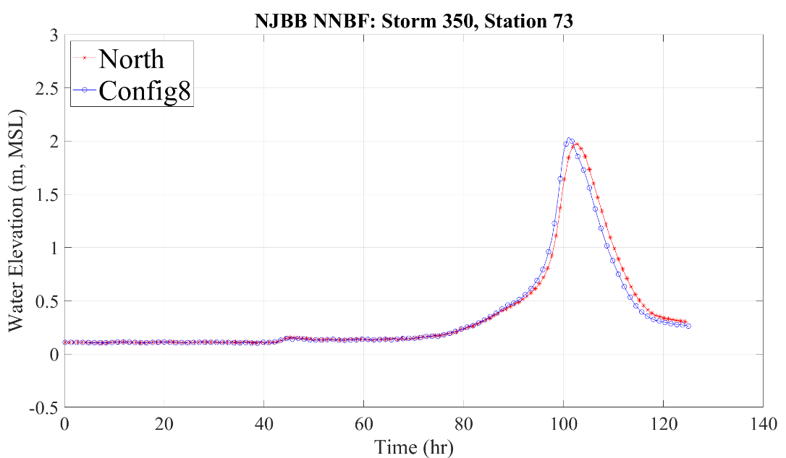
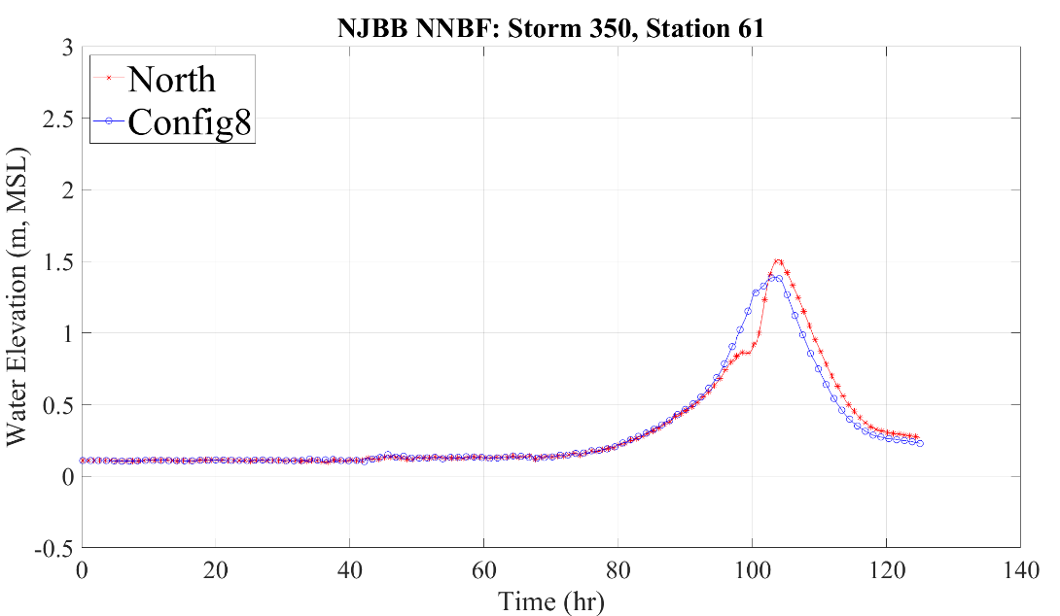
Storm 350 – scenario 2 near Holgate
Base and Config8 time-series map showing point 33, 73, and 61 and the time-series for these 3 points

Slide 12
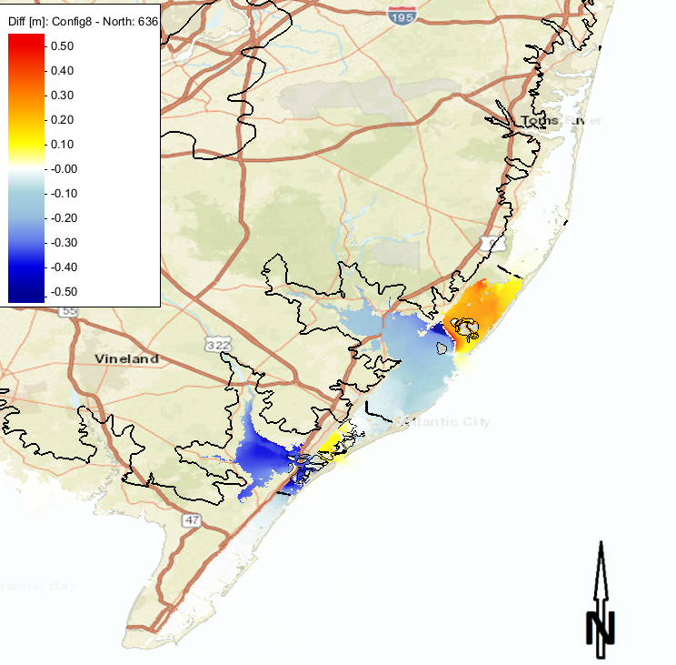
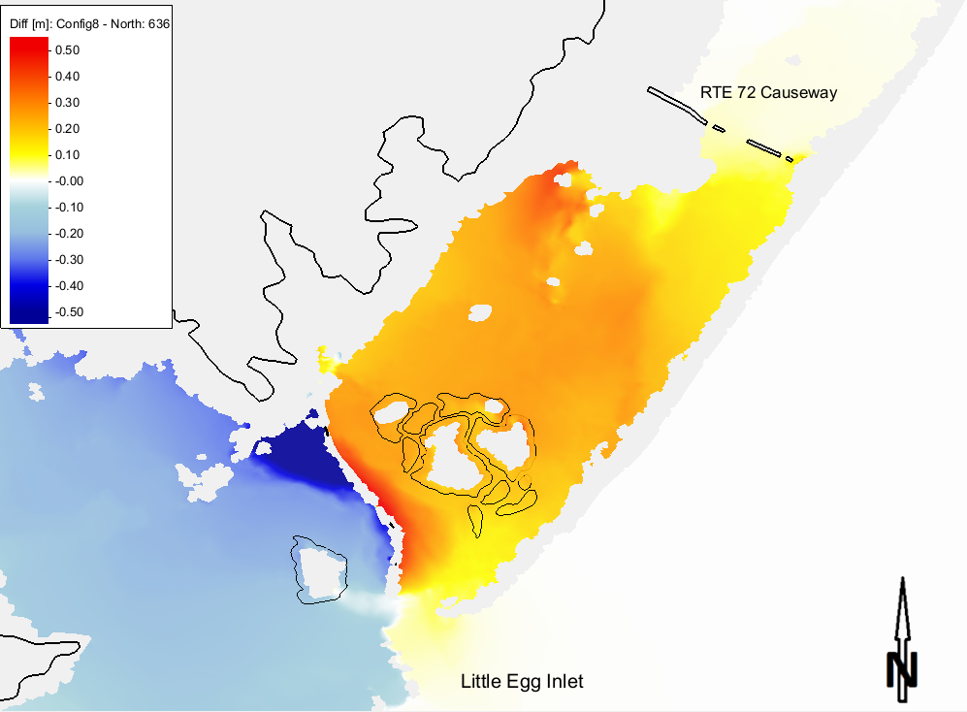
Storm 636 scenario 2 Holgate
Maximum Surge Envelope
Difference (Config8-North)
(m)
Zoom of Difference (Config8-North)
(m)

Slide 13
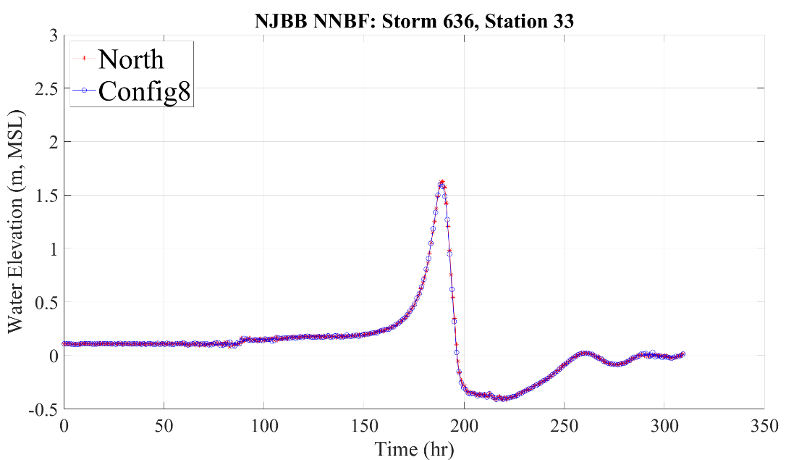
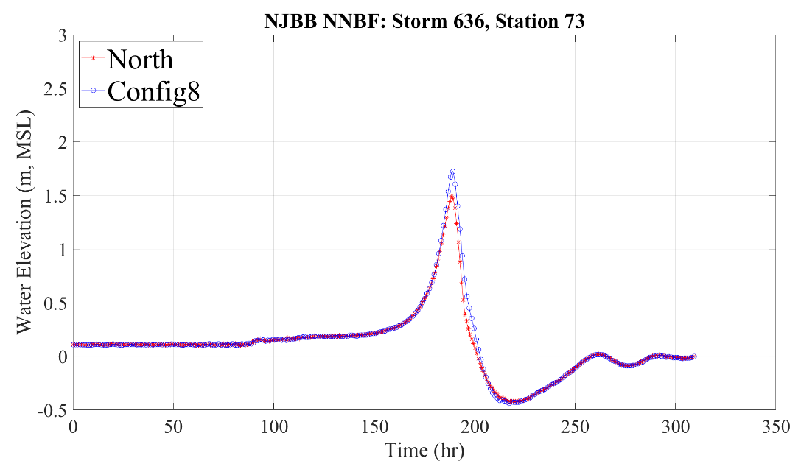
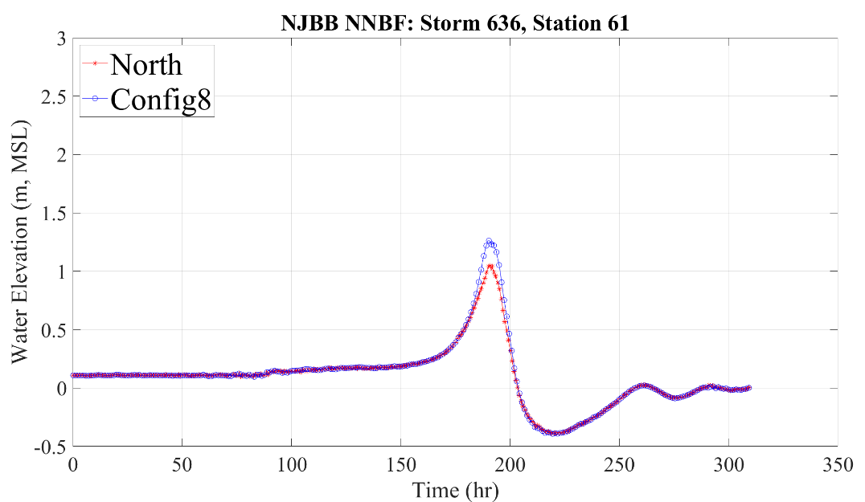
Storm 636 – scenario 2 near Holgate
Base and Config8 time-series map showing point 33, 73, and 61 and the time-series for these 3 points

Slide 14
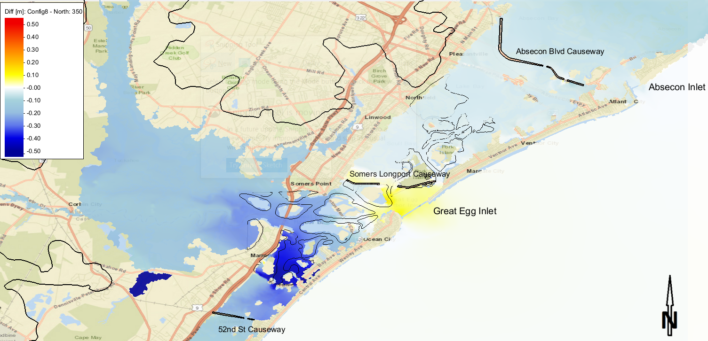
Storm 350 scenario 2 Great Egg Harbor
Maximum Surge Envelope
Difference (Config8-North)
(m)
(Config8-BaseNorth)
(m)

Slide 15
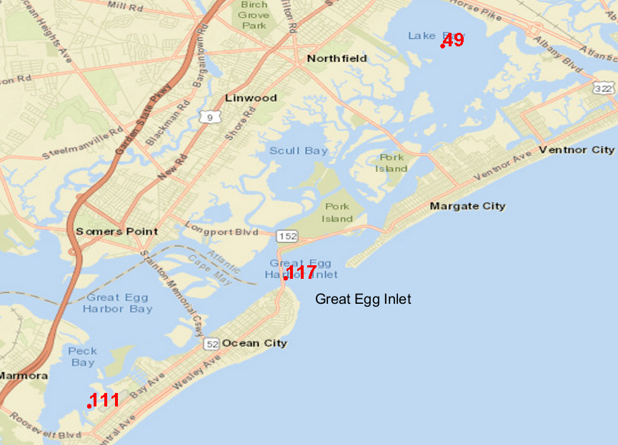
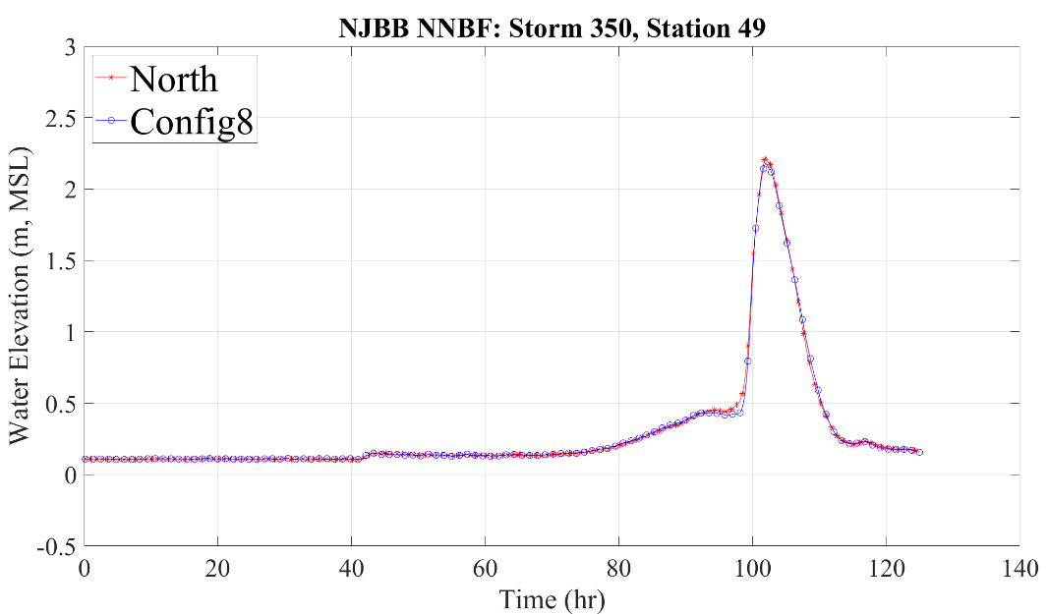
Storm 350 – scenario 2 near Great Egg Harbor
Base and Config8 time-series map showing point 111, 117, and 49 and the time-series for these points

Slide 16
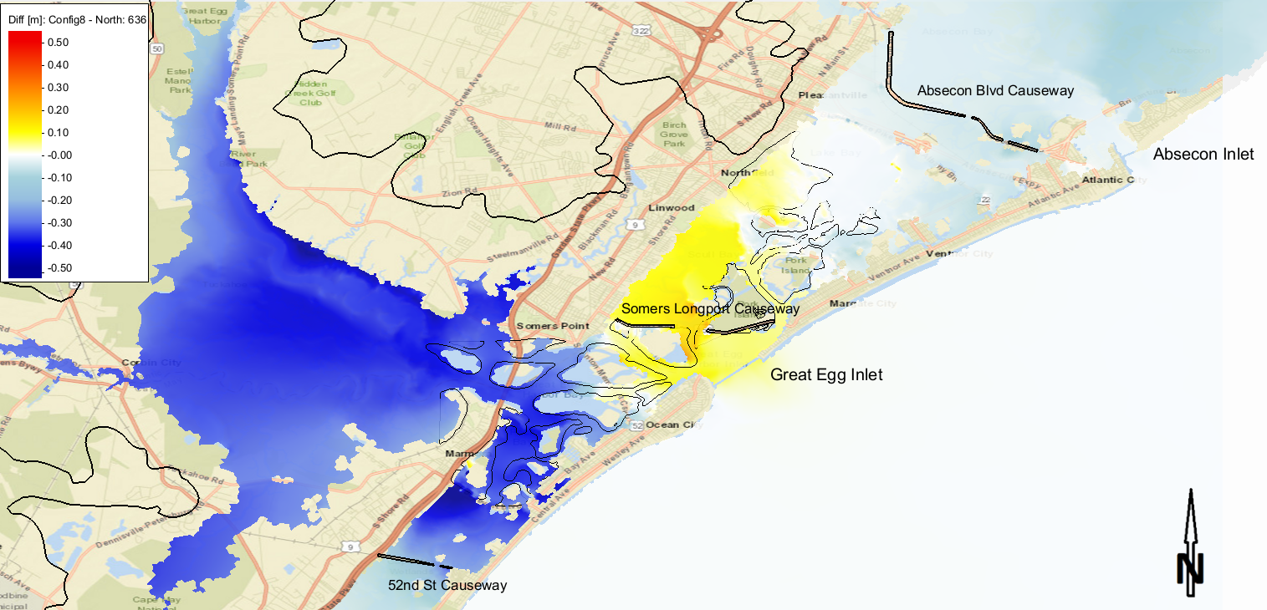
Storm 636 scenario 2 Great Egg Harbor
Maximum Surge Envelope
Difference (Config8-North)

Slide 17
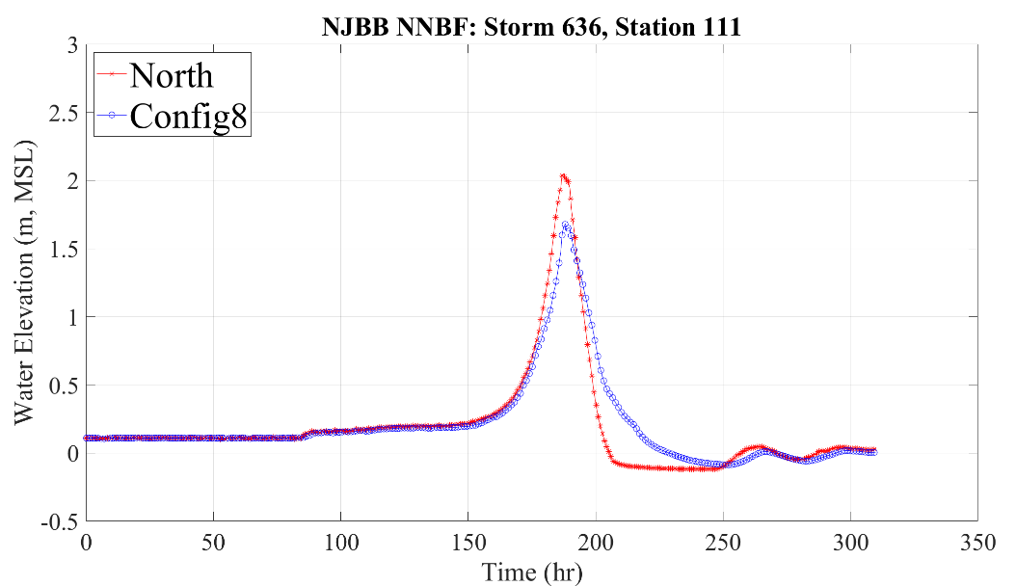
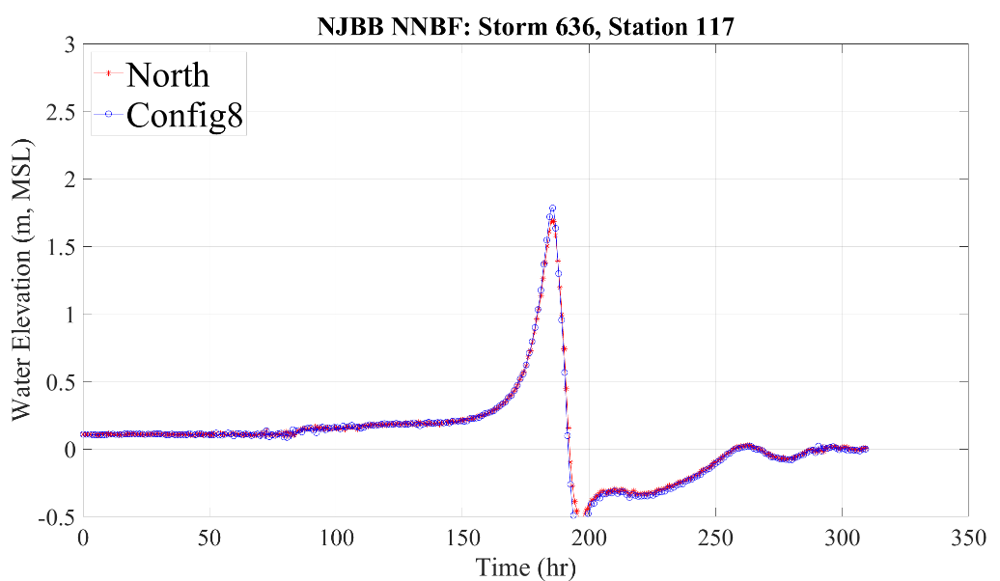
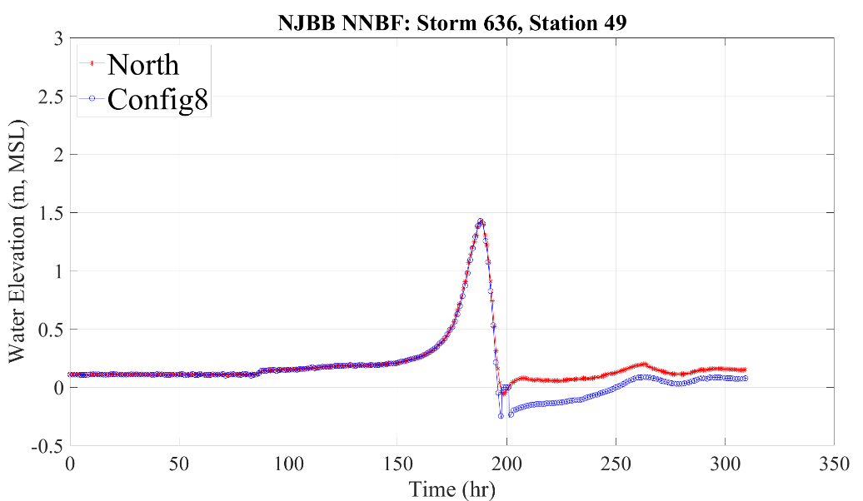
Storm 636 – scenario 2 near Great Egg Harbor
Base and Config8 time-series map showing point 111, 117, and 49 and the time-series for these points

Slide 18
Summary
Pros
Most of the area of interest experienced storm surge reduction by 10-30 cm due to NNBF measures
The reduction occurred over long period of time (~10 hrs)
Cons
Some areas (Holgate) experienced water level increase due to north-to-south wind direction (Storm 636)

