Slide 1



ROmanian Methane Emissions from Oil&gas
Thomas Röckmann and the The ROMEO team
PI of ROMEO project, coordination of Marie Curie training network MEMO²
Professor for Atmospheric Physics and Chemistry, Utrecht University, The Netherlands

Slide 2

Outline
    Objectives and campaign overview
    Participants and methods employed
    First results

Slide 3
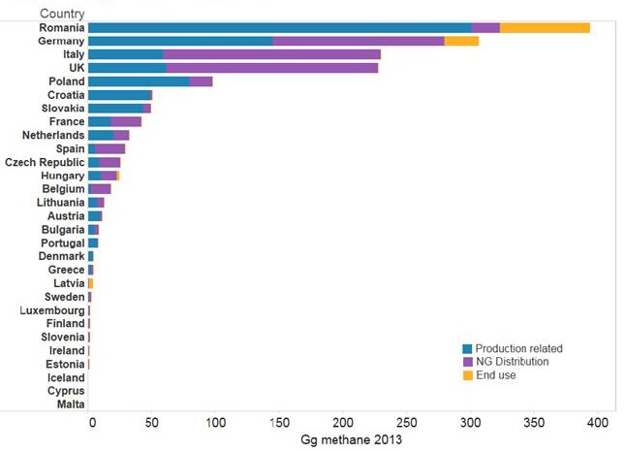
Why Romania?
Reported emissions from oil & gas from EU countries
Romania: relatively large onshore oil and gas reservoirs within EU
high production
high emissions reported
very few measurements
UNFCCC statistics

Slide 4
ROMEO: Emission quantification at 3 scales:
30 sept – 20 oct
30 sept – 20 oct
(component scale)
17 aug – 31 aug
Basin scale: 2 aircraft
Well scale: 6 vehicle teams
2 drone teams
1 leak detection team
City scale (Bucharest):
3 vehicle teams

Slide 5
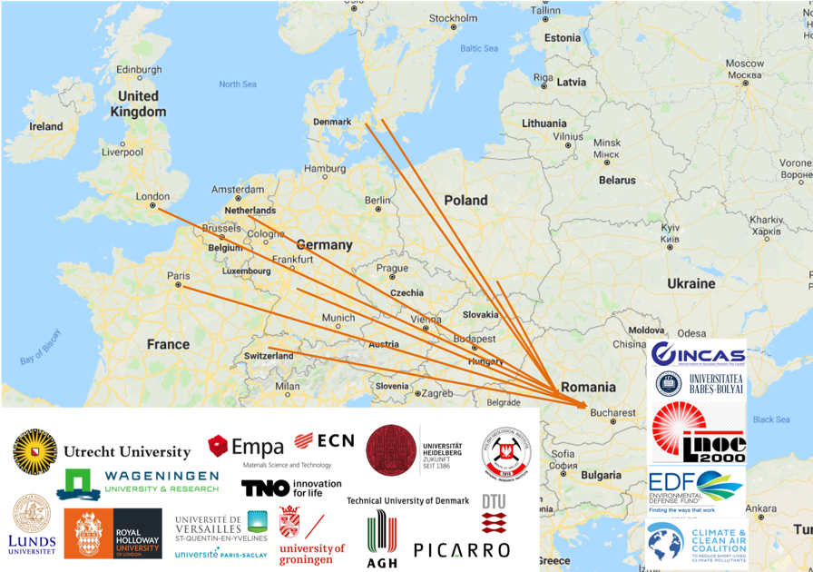





ROMEO Participants
Additionally, two major O&G producers (OMV Petrom and Romgaz) provide activity data to the project and learn from the science.

Slide 6
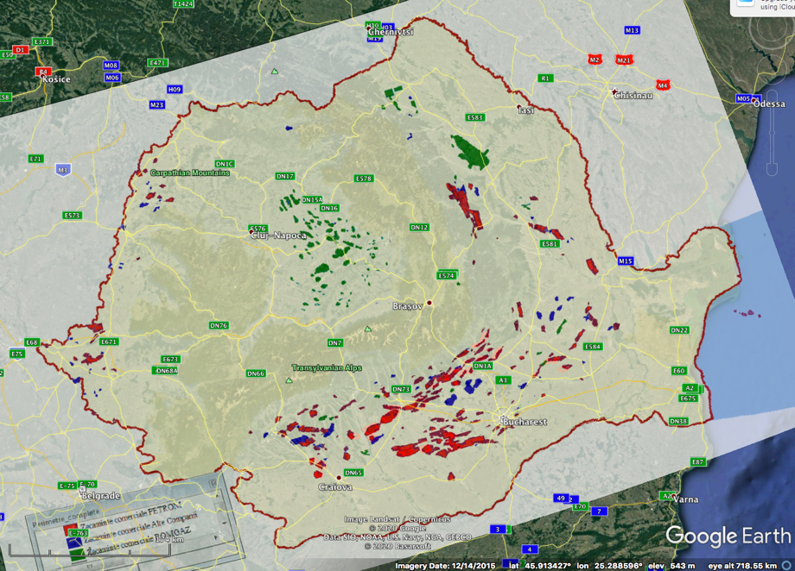
Romanian O&G reservoirs

Slide 7
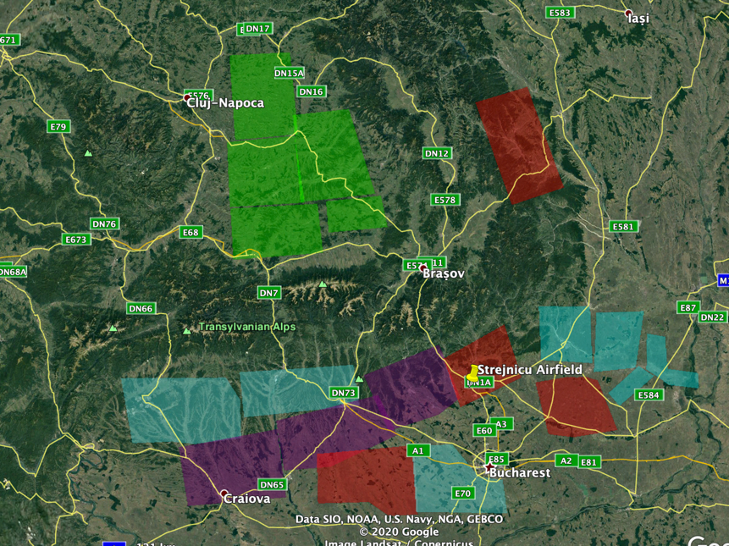
ROMEO focus areas

Slide 8
The ROMEO team

Slide 9
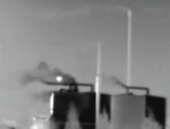
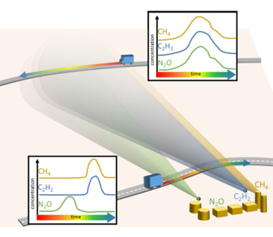
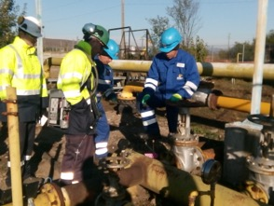
Approaches used during ROMEO
Component-
level
Facility-
level
Basin-
level
100s of m
Focus on total emissions
Requires scientific experts
Quantify all facility emissions
Requires scientific experts
Detect leaks and facilitate immediate repair
Notes:
CH4 emissions can be detected using an infrared camera
It visualizes the radiation properties of hydrocarbon and other gases
This is what you can see here. But you can also miss plumes.
Why potentially miss plumes?
Strong winds dilute the signal
Emitting component not in line of sight, large plume could look like background
Approach focuses on leaks, not other intended emissions
The magnitude of the emissions can then be quantified using a high flow sampler
It measures the flow rate of the gas directly at the source and the CH4 concentration
Advantage is that it can measure individual component-level emissions accurately
These are traditionally used to generate EFs for inventories
Disadvantage is that it quantifies only what you measure. This is really important
If you fail to detect the plume, you can’t measure it.
Even if emissions are detected from the distance, it may be difficult to access (if need a manlift) or may be unsafe if the leak is very large.
No matter the reason, if it isn’t quantified, it won’t appear in an inventory.

Slide 10
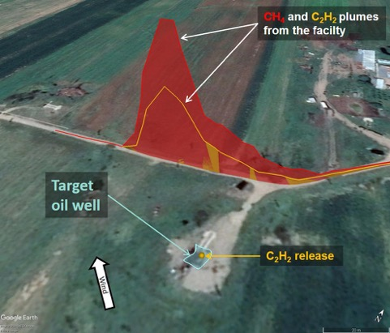
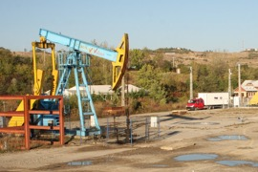


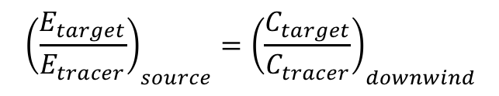
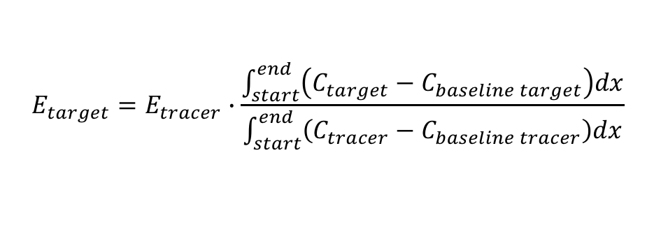
Reliable quantification: Tracer release measurements
Release an artificial gas (tracer) at the target site
Observe plumes of tracer and target
Analytical instrument w. high resolution
Global Navigation Satellite System
$${\left(\frac{E_{target}}{E_{tracer}}\right)}_{source}={\left(\frac{C_{target}}{C_{tracer}}\right)}_{downwind}$$
Principle
More detailed math
Plume traverese recorded at 17:10 on October 17th, at oil well. DTU Environment, 2020
$$E_{target}=E_{tracer}∙\frac{\int_{start}^{end}{\left(C_{target}−C_{baseline target}\right)dx}}{\int_{start}^{end}{\left(C_{tracer}−C_{baseline tracer}\right)dx}}$$
Charlotte Scheutz, Antonio Delre, Technical University of Denmark
Notes:
CH4 emissions can be detected using an infrared camera
It visualizes the radiation properties of hydrocarbon and other gases
This is what you can see here. But you can also miss plumes.
Why potentially miss plumes?
Strong winds dilute the signal
Emitting component not in line of sight, large plume could look like background
Approach focuses on leaks, not other intended emissions
The magnitude of the emissions can then be quantified using a high flow sampler
It measures the flow rate of the gas directly at the source and the CH4 concentration
Advantage is that it can measure individual component-level emissions accurately
These are traditionally used to generate EFs for inventories
Disadvantage is that it quantifies only what you measure. This is really important
If you fail to detect the plume, you can’t measure it.
Even if emissions are detected from the distance, it may be difficult to access (if need a manlift) or may be unsafe if the leak is very large.
No matter the reason, if it isn’t quantified, it won’t appear in an inventory.

Slide 11
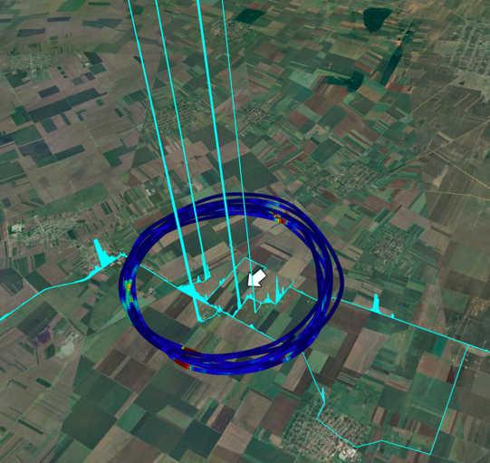
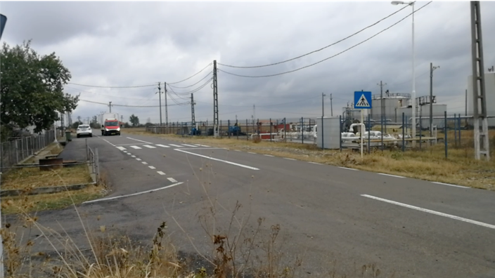
Example applications
Drive-by
Combination ground-based and aircraft measurements

Slide 12
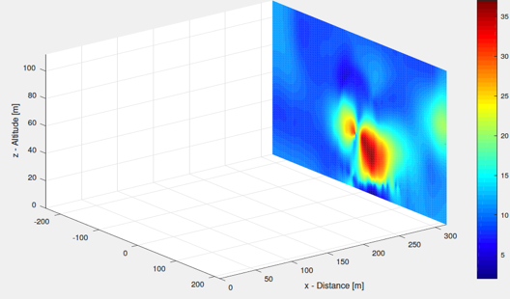
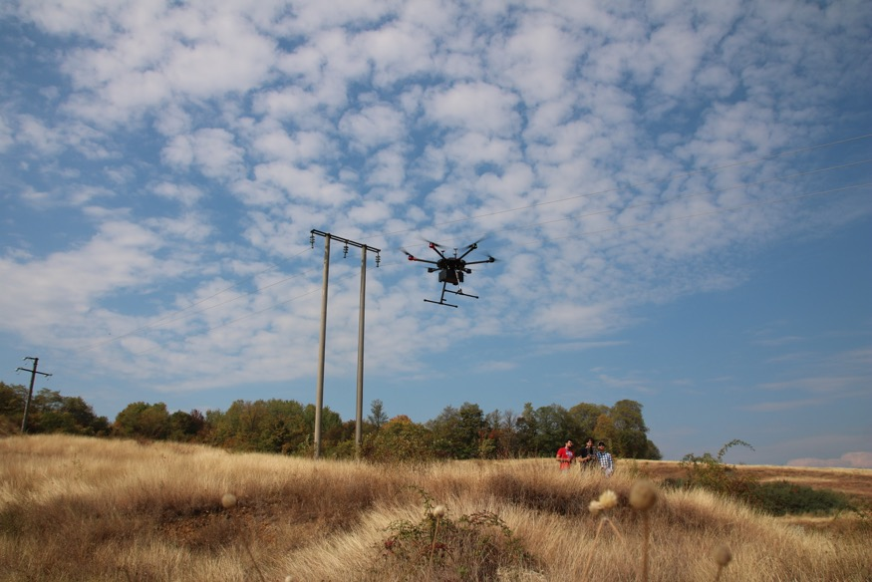
Mass balance from drone flights

Slide 13
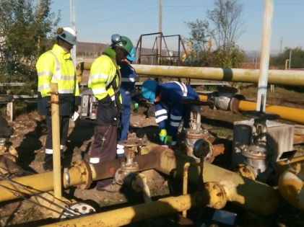
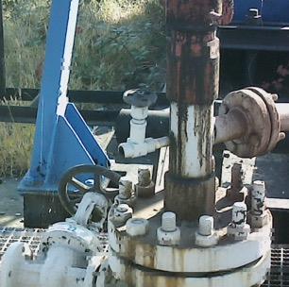
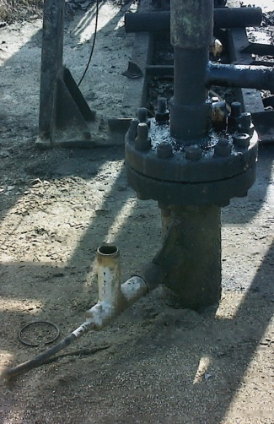
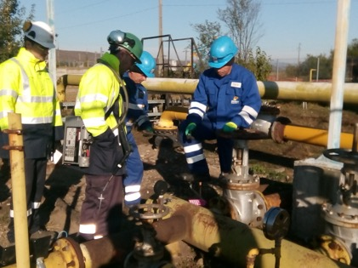
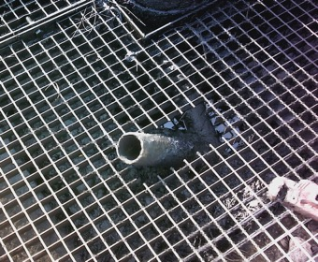
Leak detection with FLIR camera
Wells: Often open vents/valves
Compressor station: Many detected leaks fixed in short period

Slide 14
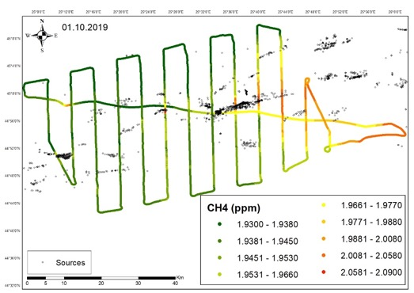
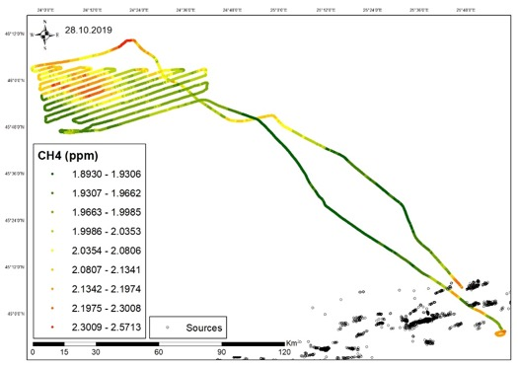
Example raster flights (INCAS aircraft)
South of Transylvanian Alps
North of Transylvanian Alps
Wind
Black dots:
Facilities
Quantitative evaluation will be performed with atmospheric models

Slide 15
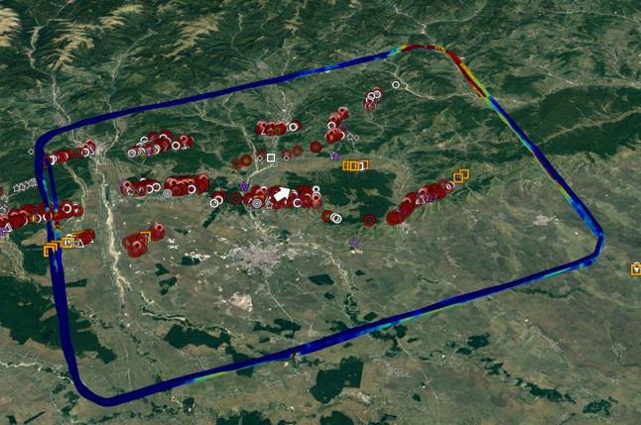
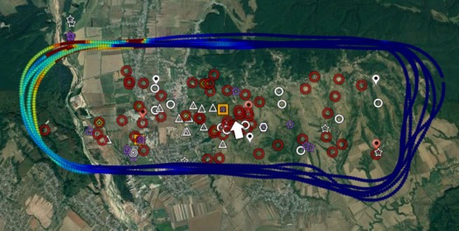
Example mass balance flight (SA aircraft)
Region including Ploiesti (downstream, non-O&G)
Individual cluster
Quantifying and reconciling 2 individual regional flights on different days with additional flights at cluster-scale

Slide 16
Limitations
  Low winds during campaign period complicated/precluded quantification on many days
    Both ground-based and aircraft-based work affected
        still > 150 ground-based and ≈ 20 aerial quantifications
    No problem for component level (FLIR camera) measurements

Slide 17
Summary aircraft work
9 regions surveyed
15 raster measurements (including repeats)
21 cluster quantification attempts (including repeats)
6 region quantification attempts (including repeats)
1 large venting source quantification attempt

Slide 18
Summary ground-based work
7 regions surveyed
> 1200 wells and facilities screened
  Vehicles, drones and aircraft, using different methods
> 150 wells and facilities quantified

Slide 19
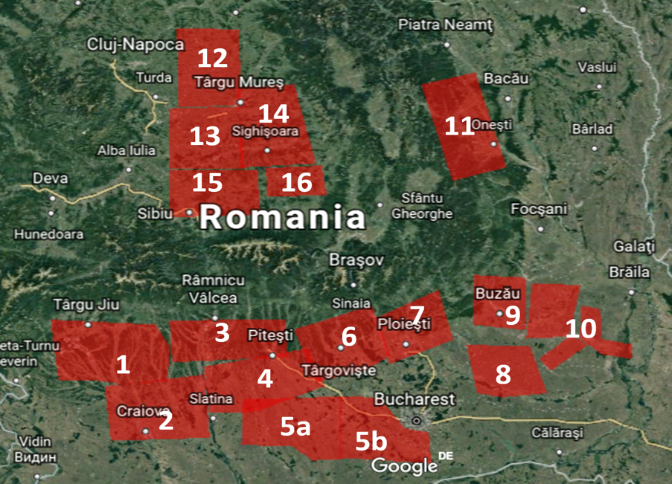
ROMEO phase A summary
Aerial quantifications
(whole box)
Target area
Phase B
Aerial quantifications
(cluster)
Same flux on 2 days
5 Clusters
1 Cluster
Clusters 3
Gas
blind
spot
5 Clusters + vent + facility

Slide 20
ROMEO phase A summary
Aerial quantifications
(whole box)
Target area
Phase B
Aerial quantifications
(cluster)
Ground quantifications
20 ground
42 ground
10 ground
19 ground
12 ground
29 ground

Slide 21
Preliminary results
Methane emissions detected from (very roughly) half of screened facilities
  Consistent between vehicle and on-site measurements (FLIR camera)
  CH₄ enhancements 1- 2,000 ppm (1000 * background) at distances 10-100m away from facility
  Aircraft sees ≈ 100 ppb CH₄ enhancements at ≈ 100 meters altitude close to production clusters
Emission rates between <10⁻² g/s and 10² g/s for individual facilities
Almost no gas flaring in the surveyed regions
Limited gas collection from oil wells
Visually, maintenance conditions appear highly variable across Romania

Slide 22
Preliminary results
  Oil wells: emissions mostly due to facility design/state (e.g. open pipes), operational procedures (e.g. not properly closed valves). Only partly due to leaking equipment (e.g. flanges, pressure gauges).
  Oil wells with H₂S emissions are much better maintained and emit much less.
  Gas wells: Generally lower emissions but large measured CH₄ concentrations due to improperly closed valves/vents and (less often) leaking equipment.

Slide 23
Preliminary results
  Compressor stations: high numbers of leakages at individual flanges, valves, vents, pressure regulators etc. Considered easily fixable by LDAR team.
  Storage facilities (different types): storage tanks often require maintenance (holes in tanks), but many facilities are also designed to vent (no gas collection), especially older facilities.
  Collection manifolds: generally in good state and few leaks

Slide 24
Outlook
  Continue evaluation:
    Finish and integrate all quantifications
    Add data from 1200 “screenings”
    Derive final emission distributions
    Up-scaling to national scale
    Compare ground-based and aircraft – derived emissions
    Compare to inventories and reported emissions
    Report and publish data
  ROMEO phase B in planning (2020 or 2021)
    Mostly in Transylvania, plus revisits in southern part planned (gas areas)

Slide 25
ROMEO impact
  Improved emissions estimates for industry and policy
  Optimize mitigation strategies

Slide 26
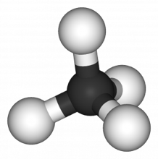

Thanks for your attention

