Slide 1
Interactive Jupyter Notebooks for the visual analysis of critical choices in Global Sensitivity Analysis
Follow this link to access our Jupyter Notebook:
https://uob-my.sharepoint.com/:f:/g/personal/vn1197_bristol_ac_uk/Eg9njuaaUDJJiuLlfuPNMd8BIZjNFJJ9EWpUtxmA9GtYmQ?e=syO2ge
Valentina Noacco (NERC Knowledge Exchange Fellow)
Andres Peñuela-Fernandez (Research Associate in in Water Resource Management)
Francesca Pianosi (Lecturer in Water and Environmental Engineering)
Thorsten Wagener (Professor of Water and Environmental Engineering)
Department of Civil Engineering, University of Bristol
[KE Fellowship: NE/R003734/1]

Slide 2
Take home message
Interactive visualisations and the use of Jupyter Notebooks, which combine text, code and figures, can be great tools for increasing the understanding of complex modelling concepts.
One such example is the use of interactive visualisations to interrogate in real time the impact of user choices on the results of Global Sensitivity Analysis.

Slide 3
Global Sensitivity Analysis (GSA) is a set of mathematical techniques which investigate how the uncertainty in the model inputs influences the variability of the model outputs

Slide 4
But Global Sensitivity Analysis requires the users to make a number of choices to set-up their application
Noacco et al. (2019) MethodsX

Slide 5
Here Global Sensitivity Analysis will be applied to a Rainfall-Runoff model (HyMod)
 |  | Input factors
1 | S_{M} | maximum storage capacity (mm)
2 | beta | degree of spatial varibility of the SM (-)
3 | alfa | factor distributing slow and quick flows (-)
4 | R_{S} | fractional discharge of the slow release reservoir(1/dd)
5 | R_{F} | fractional discharge of the fast release reservoir (1/dd)
Boyle 2001
Wagener et al. 2001

Slide 6
With interactive visualisations we can easily assess the impact of changing the range of variability of the input factors on the sensitivity analysis results

Slide 7
Here we show the sensitivity indices estimated with Global Sensitivity Analysis for the default parametrisation

Slide 8
Here we change the range of variability of some inputs, which varies the sensitivity indices of the input factors

Slide 9
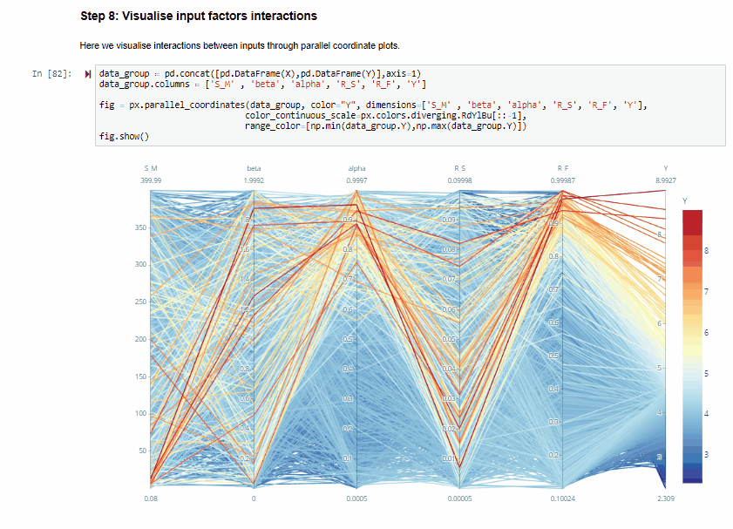
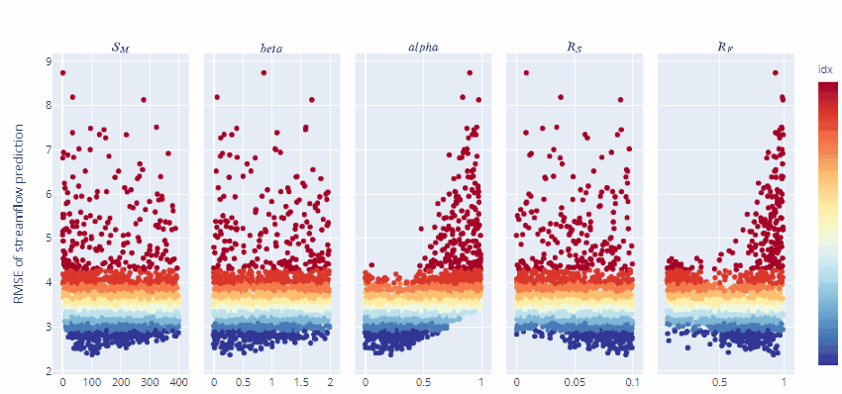
For more features go to the link below
https://uob-my.sharepoint.com/:f:/g/personal/vn1197_bristol_ac_uk/Eg9njuaaUDJJiuLlfuPNMd8BIZjNFJJ9EWpUtxmA9GtYmQ?e=syO2ge

Slide 10
References
SAFE Toolbox Website https://www.safetoolbox.info/
Pianosi et al. 2015. A Matlab toolbox for Global Sensitivity Analysis. Environmental Modelling and Software. 70. https://doi.org/10.1016/j.envsoft.2015.04.009
Pianosi et al. 2016. Sensitivity analysis of environmental models: A systematic review with practical workflow. Environmental Modelling and Software, 79. https://doi.org/10.1016/j.envsoft.2016.02.008
Wagener, T. and Pianosi, F. 2019. What has Global Sensitivity Analysis every done for us? … Earth-Science Reviews https://doi.org/10.1016/j.earscirev.2019.04.006
Noacco et al. 2019. Matlab/R workflows to assess critical choices in Global Sensitivity Analysis using the SAFE toolbox. MethodsX https://doi.org/10.1016/j.mex.2019.09.033

