Slide 1

Welcome to my presentation!
This work is part of my PhD at the University of Liverpool, where I am in my 3rd year studying ocean sciences with Professor Ric Williams.
On the next slide, each box is interactive- clicking on a box will direct you to that part of the presentation. The home button on the upper right of each slide will return you to this main slide. I have created hyperlinks for all cited materials within the presentation
If you have any questions or comments outside of the chat time, please feel free to leave a comment and I will answer as soon as I can. I look forward to our discussion!

Slide 2






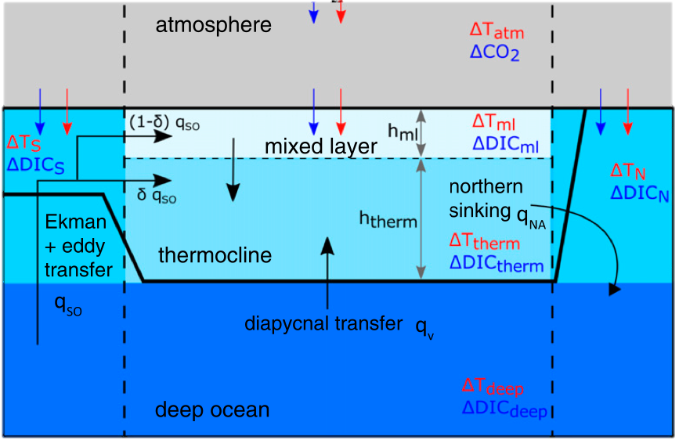
Sensitivity of climate mitigation signals to climate engineering implementation
K. E. Turner, R. G. Williams, A. Katavouta, D. J. Beerling
Differences in the timing of oceanic adjustment to CO₂ emissions and climate engineering make prolonged or delayed climate engineering less effective at mitigating peak temperatures
Motivation:
Are there emergent “optimal conditions” for implementing climate engineering?
Methods: the Gnanadesikan ocean-atmosphere model
Climate engineering results:

Slide 3
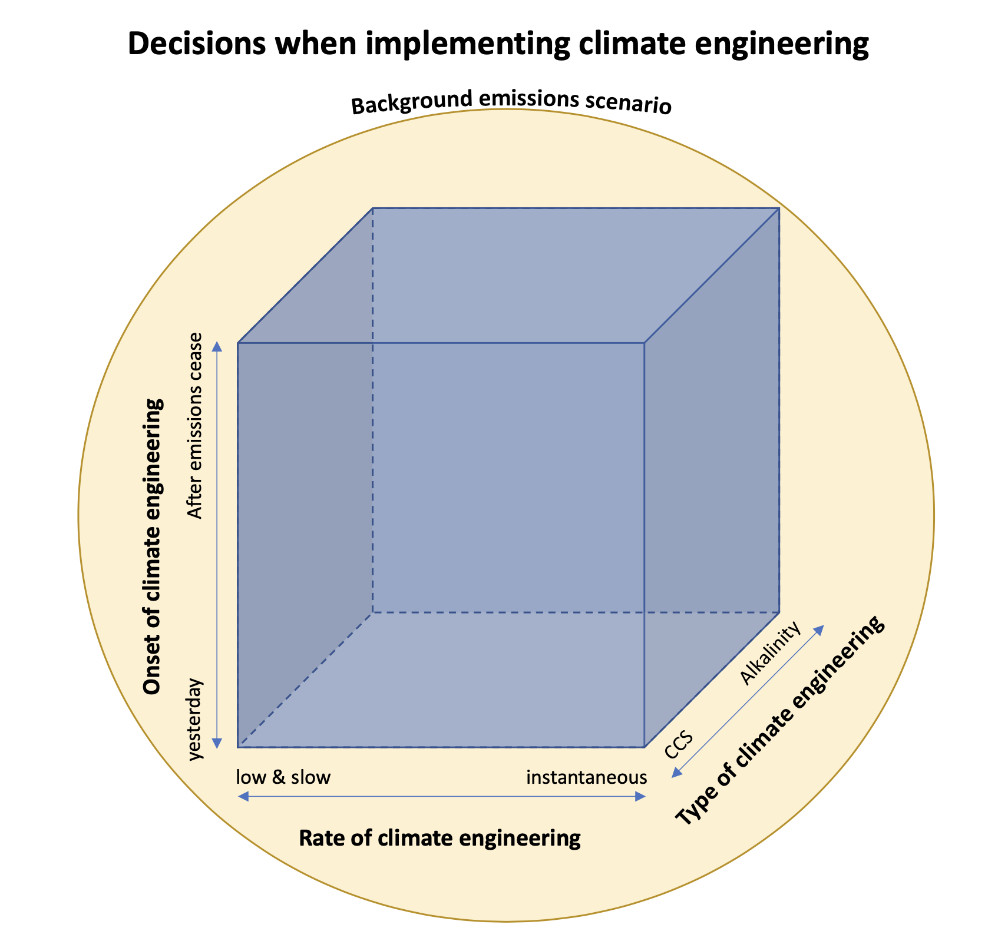
Is there an optimal method for negative emissions?
Climate engineering is mainly constrained by economic/political considerations, but emergent climate properties can create additional constraints
Warming patterns and carbon cycle dynamics are asymmetrical under positive and negative emissions (Tokarska and Zickfeld 2015, Tokarska et al. 2019)

Slide 4
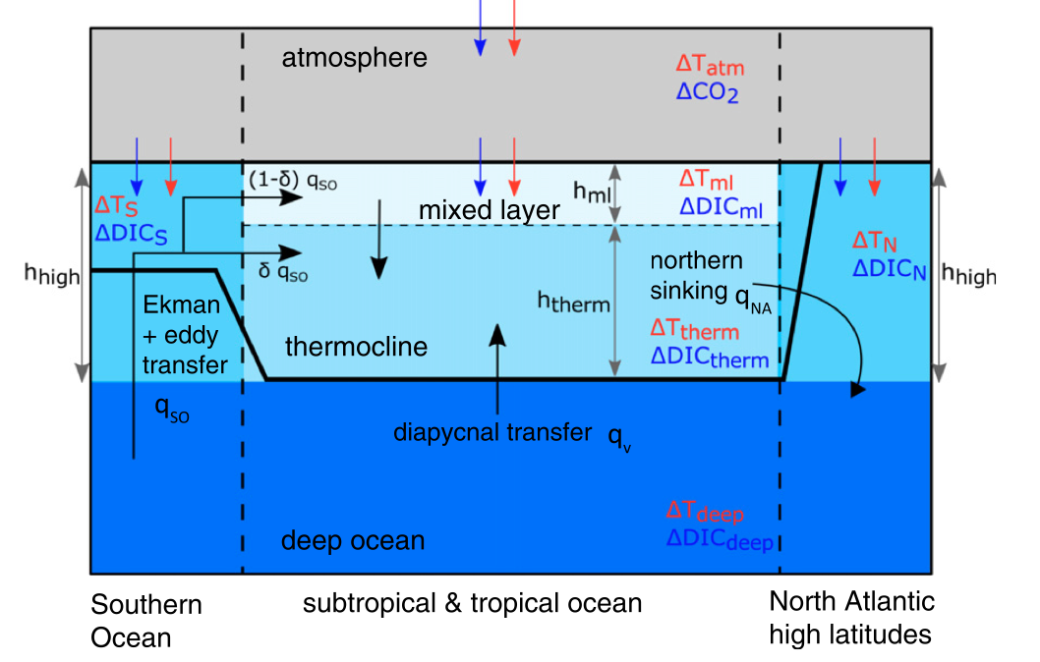
The Gnanadesikan Ocean-Atmosphere Model
Simplified ocean-atmosphere model with ocean ventilation
Dynamic overturning allows for circulation changes
Includes carbonate chemistry
Useful for understanding the oceanic drivers to the transient climate response to emissions (Katavouta et al. 2019)

Slide 5
Methods - Climate Engineering Scenarios
Control runs – RCP 4.5 and 8.5 carbon emissions up to 2100
Carbon capture of up to 2PgC/yr
Enhanced weathering (Beerling et al. 2018) / ocean alkalinization of up to 2 PgC/yr through uniform ocean flux of carbon and alkalinity
For all climate engineering scenarios we test sensitivities on:
Start of implementation (year 2000 vs. 2050 vs. 2100)
Rate of implementation, in terms of additivity of responses and how constrained the response is to the integrated amount of climate engineering

Slide 6
Weathering and carbon capture have near-additive impact
Carbon capture is more effective at reducing temperatures
Each PgC/yr captured by weathering rather than CCS leads to about ~5% reduction in effectiveness (not completely linearly additive)

Slide 7
Climate engineering is more effective under lower emissions scenarios

Slide 8
Model shows delayed warming and delayed impact for climate engineering
Under higher emissions, peak warming occurs later (year 2210 under RCP 8.5)
~80 years to maximum surface warming
Delay in peak weathering impact is independent of climate engineering method, rate, or background emissions
~140 years to maximum temperature reduction

Slide 9
Delayed warming and climate engineering signals mean that timing and adjustment matter
81% of impact realized at 2200 by extending implementation period
76% of impact realized at 2200 by delaying implementation

Slide 10
Take Home Messages
We examine how temperature reductions from climate engineering are sensitive to how climate engineering is implemented
While the temperature reductions from carbon capture and enhanced weathering are different, their impacts are nearly additive and the methods show similar sensitivities to timing and rate of implementation.
The temperature reduction magnitude is set by the background emissions scenario and type of climate engineering used
There is a delay in both the peak warming and peak climate engineering impact, so understanding the ocean adjustment is necessary to be able to time climate engineering to avoid the highest surface temperatures
Our results here show one setup of the Gnanadesikan model, but our work will be expanded to cover the parameter space to look at the specific drivers of these sensitivities
We will expand this work with the intermediate-complexity model GENIE to compare the impacts of climate engineering and drivers of the different climate signals
Next Steps

