Slide 1

FHLO: Forecasting Hurricanes using Large-Ensemble Output
Jonathan Lin¹, Kerry Emanuel¹, Jonathan Vigh²
¹ Lorenz Center, Department of Earth Atmospheric and Planetary Sciences
Massachusetts Institute of Technology
2 Joint Numerical Testbed Program, Research Applications Laboratory
National Center for Atmospheric Research, Boulder, Colorado

Slide 2
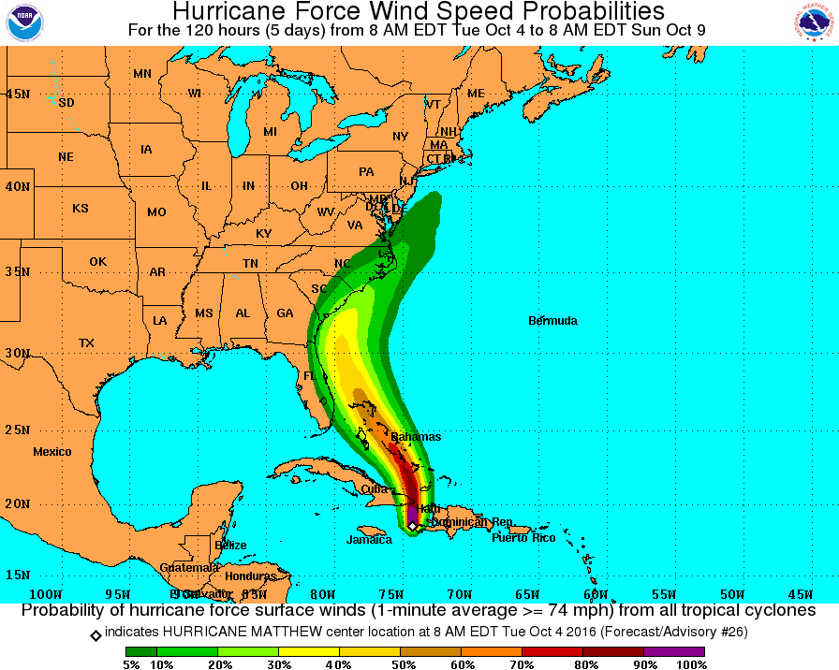
Introduction
TC forecasts separated into track and intensity
Point-wise wind speed probabilities more desirable
DeMaria and Knaff (2009)
DeMaria et. al. (2013)
Saffir-Simpson Scale
Category | 1 Min. Sustained Wind
1 | 74-95 mph
2 | 96-110 mph
3 | 111-129 mph
4 | 130-156 mph
5 | 157+ mph
Credit: National Hurricane Center
Notes:
TC forecasts => deterministic quantities.
Also, uncertainty always exists in a chaotic system.
Most relevant quantity is wind speeds at a particular location, and an added bonus is if they can characterize uncertainty in the forecast.

Slide 3
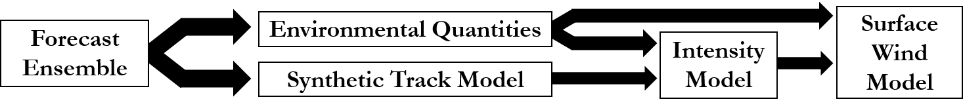
The FHLO Model
Incorporates state dependent forecast uncertainty using ensemble numerical weather prediction systems
Large-ensemble [O(1000)] (can be run on a laptop)
Forecasts track, intensity, and exceedance winds
Evaluated using 00z/12z forecasts from 2015-2018 hurricane seasons
Model Summary

Slide 4
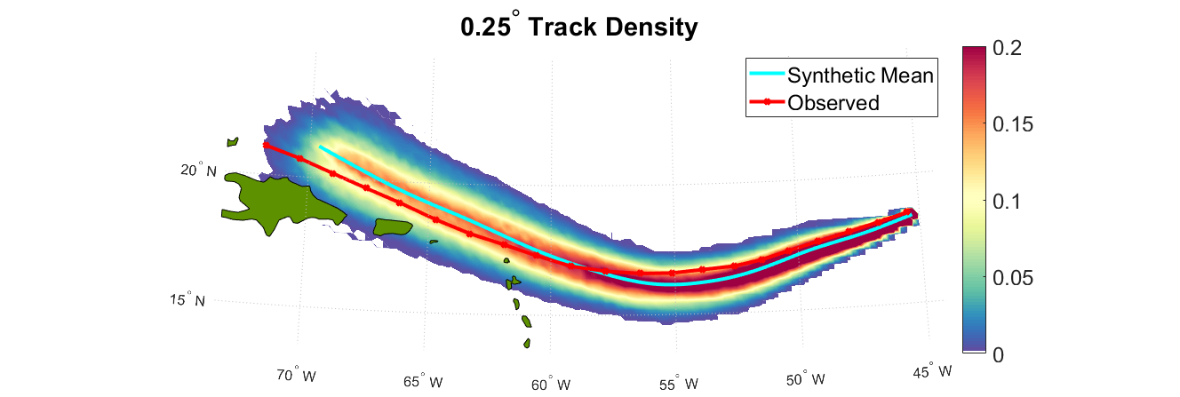
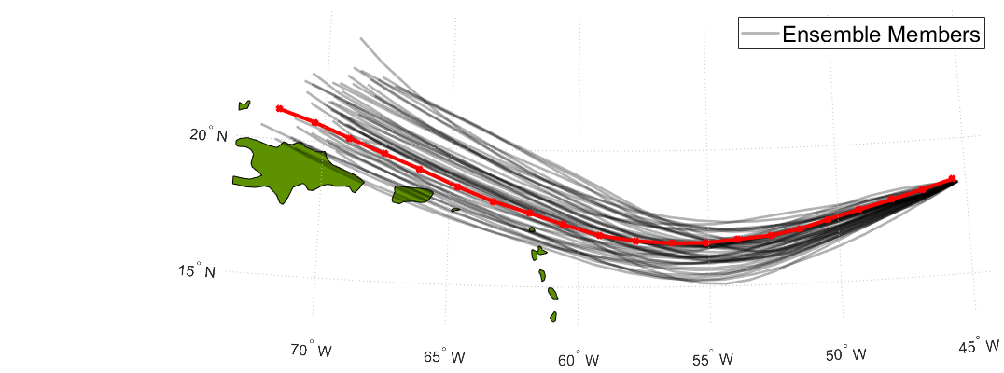
Synthetic Hurricane Tracks
Track largely determined by large-scale steering flow
Use translational speed covariance to generate synthetic displacements
Probability
Notes:
Beta drift
Nondivergent barotropic vorticity equation: D(zeta + f)/Dt = 0
d(zeta)/dt + V * nabla(zeta + f) = 0

Slide 5
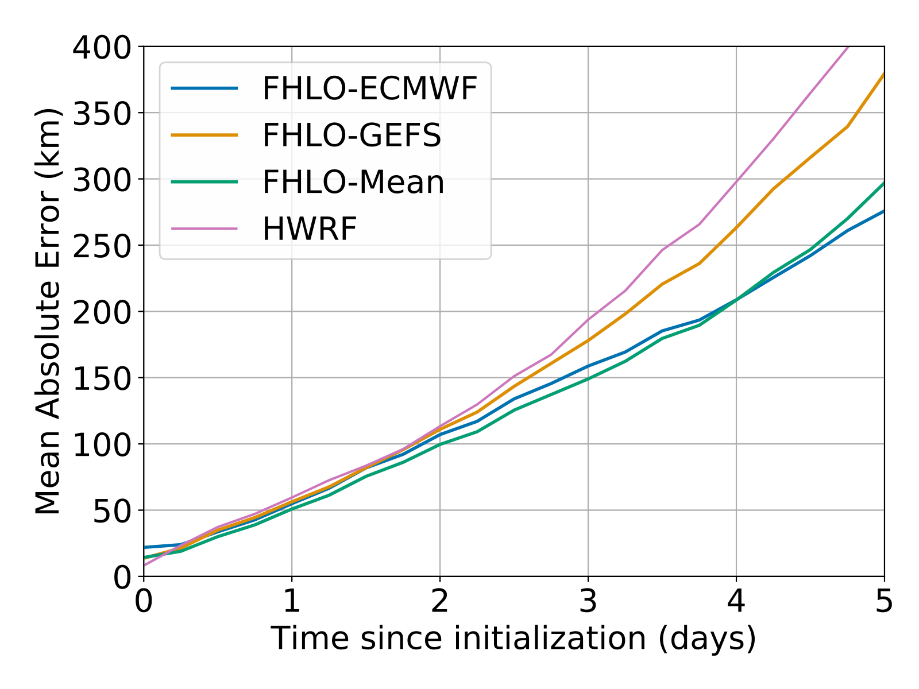
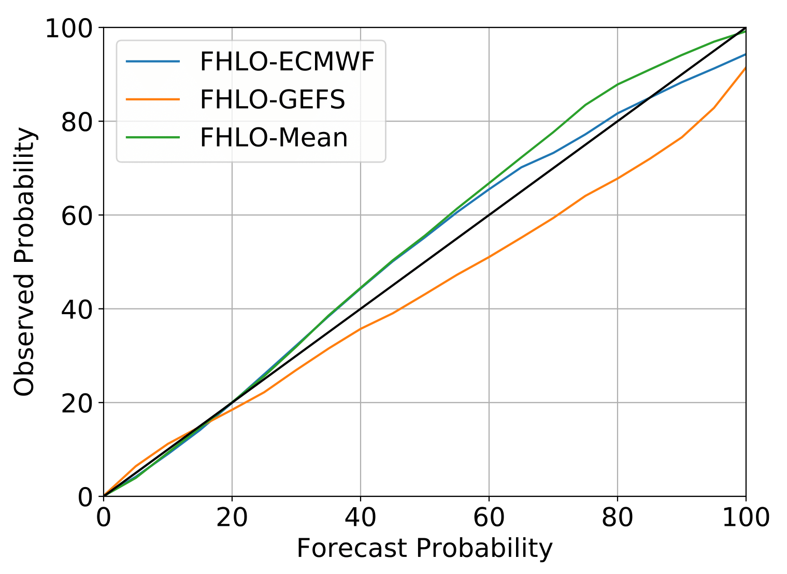
Synthetic Hurricane Tracks
Mean Absolute Error
Reliability Diagram
Notes:
Left: Mean absolute error (km) in track as a function of the time since initializations, for the mean of 1000 synthetic tracks for the FHLO-ECMWF ensemble (blue) and FHLO-GEFS (orange), as well the mean of the two. Sample set includes forecasts from 2015-2018 in the Atlantic basin.
Right: Same as above, except for the reliability curve for 50-km strike probability, cumulative over 5 days, using the ECMWF ensemble (blue) and GEFS (orange), as well as the mean of the strike probabilities from both ensembles (green). Solid black line indicates perfect reliability. Sample set includes forecasts from 2015-2018 in the Atlantic and Eastern Pacific basins

Slide 6
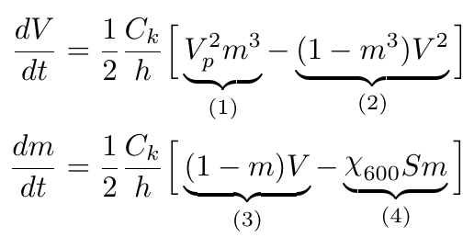
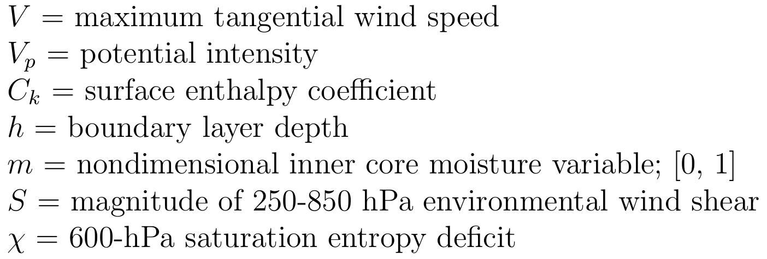
Intensity Modeling
FAST Intensity System (Emanuel, 2017)
(1): Spin-up
(2): Downdrafts
(3): Moistening
(4): Ventilation
Notes:
Spin-up; models surface fluxes that intensity storm
Spin-down; m < 1 means unsaturated and negative contribution to dv/dt; for instance downdrafts ; unsaturated column means you can have downdrafts since precipitation efficiency is less than 1

Slide 7
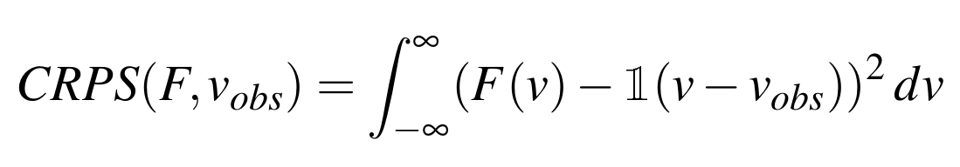
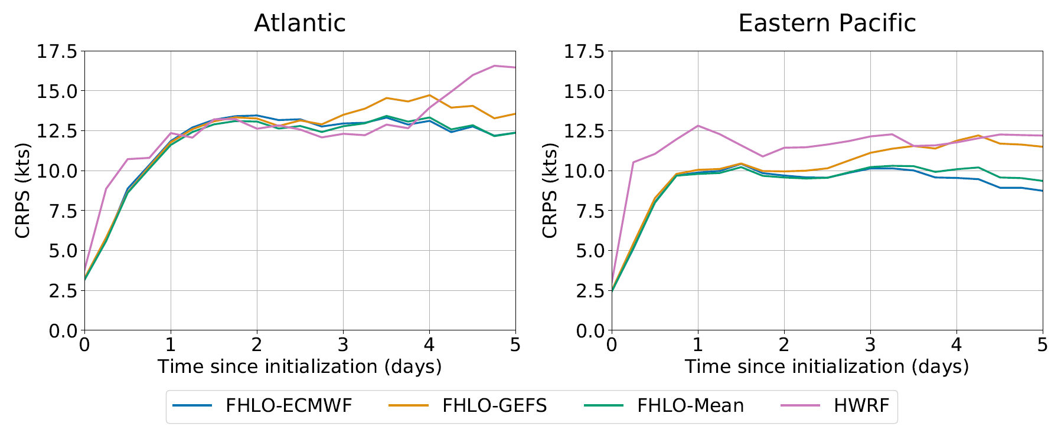
Intensity Evaluation
Notes:
CRPS is the integrated quadratic difference between the observed CDF and the forecasted CDF, and simplifies to the MAE.
We show only for forecasts where the initial TC intensity is stronger than 30 m/s.
Relatively competitive.

Slide 8
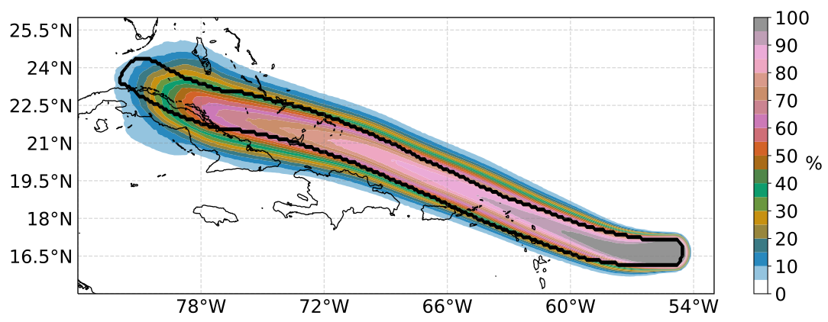
Probabilistic Winds
Use a physics-based axisymmetric wind-speed model (Chavas et. al, 2015)
Additional model, based on isallobaric wind, to compute asymmetric wind
Hurricane Irma: Initialized 00 UTC on 05 Sept. 2017
Notes:
The wind velocity when the Coriolis force exactly balances a locally accelerating geostrophic wind.

Slide 9
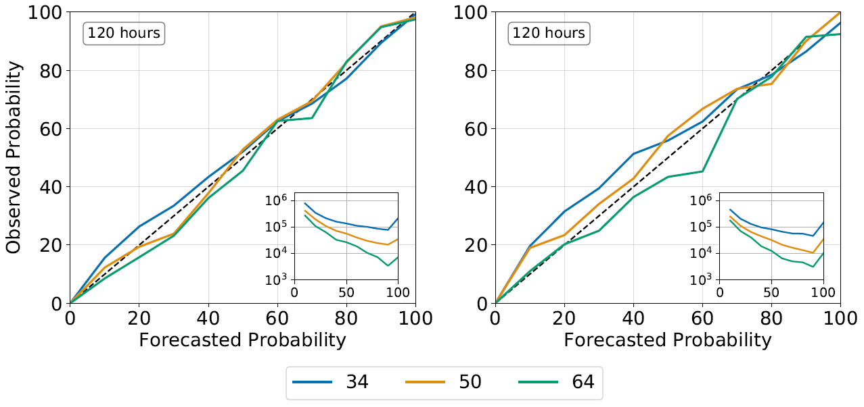
Probabilistic Wind Evaluation
Notes:
Reliability diagram for exceedence wind probabilities, cumulative over 120 hours, using the probabilities derived from FHLO-Mean.
Sample set only includes forecast south of 30N. Solid black line indicates perfect reliability.
Left column is for Atlantic Basin, and right column is the Eastern Pacific basin.

Slide 10
Summary
Developed FHLO, a physics-based, probabilistic hurricane model
  Probability derived from state-dependent uncertainty
  Generally reliable wind speed probability forecasts
FHLO should be considered a conceptual framework
  Could use a variety of intensity/wind models
Large-scale environment dominates contribution to uncertainty
Future Work
Include a real-time ocean model, variations in potential intensity
Generation and verification of precipitation forecasts
Use wind probabilities in Hurricane Risk Calculator
Notes:
Strong evidence that mid-level ventilation is the primary process by which TCs decay from interaction with vertical wind shear

Slide 11
Thanks for listening!
Email: jzlin@mit.edu
Website: linjonathan.github.io
Notes:
Average hindcast error (and standard error), based on 3 years of TC data in the Atlantic. Number at bottom is sample size.
Average storm error is around 11 kts

Slide 12
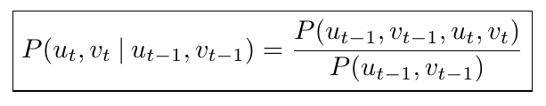
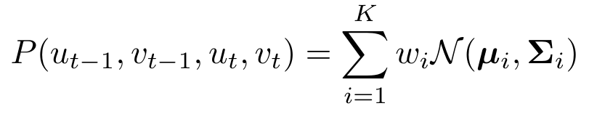
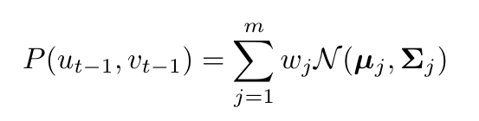
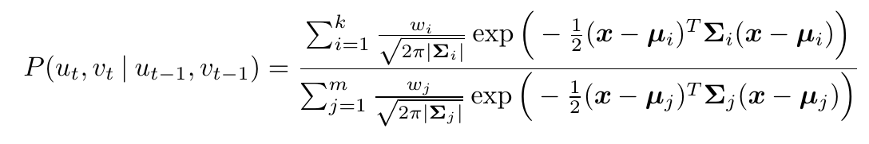
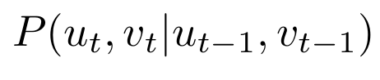


Synthetic Hurricane Tracks

Slide 13
FHLO Forecast Uncertainty
Where does the uncertainty come from?
Internal variability in large-scale system (forecast ensemble members)
  Dynamical quantities: vertical wind shear
  Thermodynamic quantities: entropy deficit
Spatial variability from track uncertainty
Stochastic initialization of v and m
Stochastic distribution of the outer radius
Notes:
Sweeping under the rug how to do the initialization; its not easy and conventional data assimilation use complex variational methods
A bit easier in this case because state is limited (v and m), but the model itself is very simple and cannot always be reasonably adjusted to fit the data

Slide 14
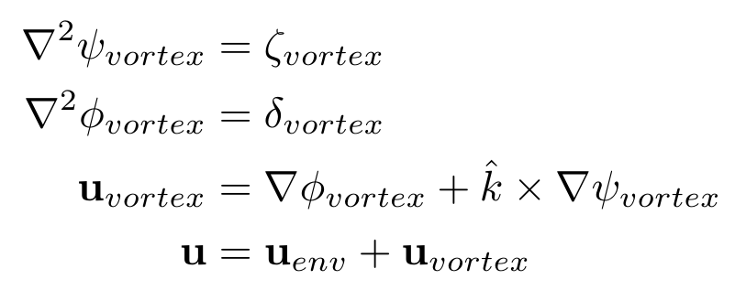
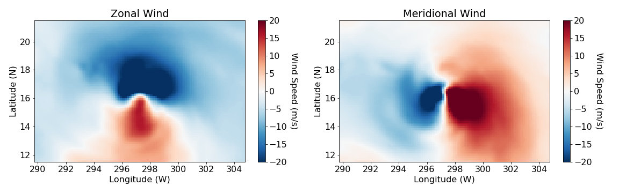
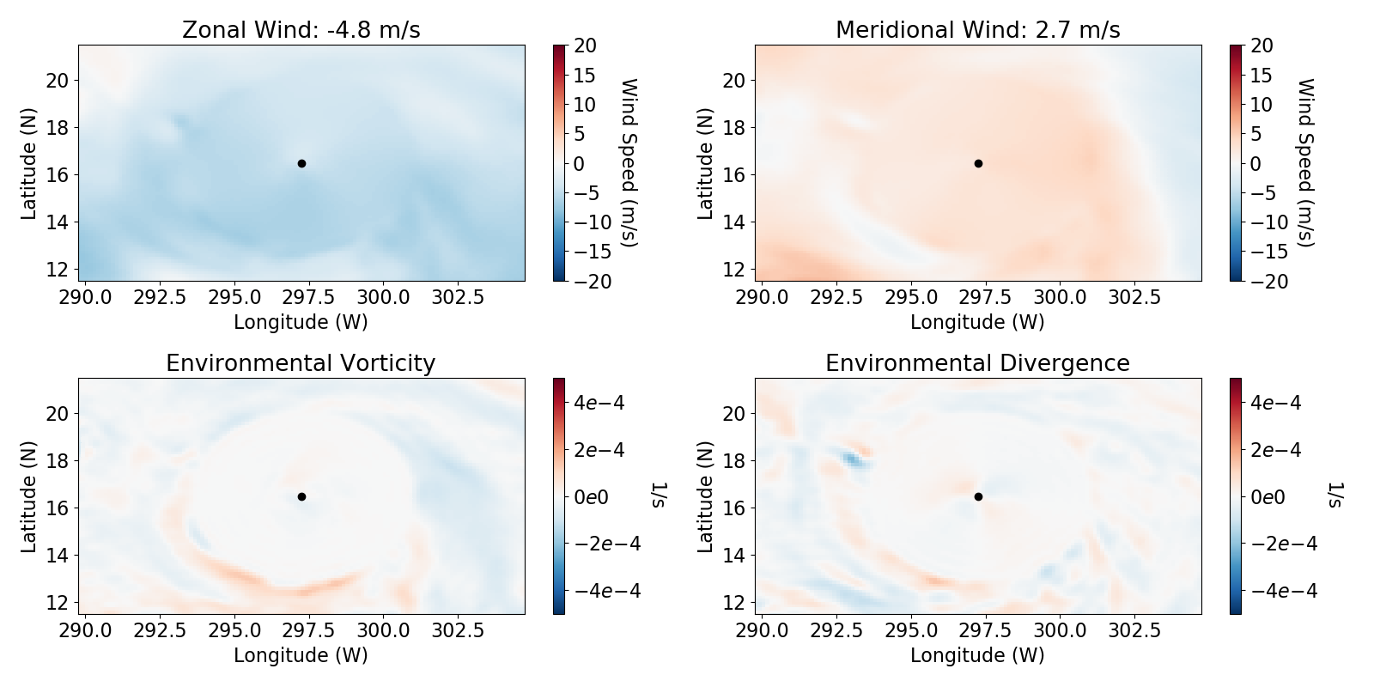
Vortex Surgery
How to define the environmental vertical wind shear?
Galarneau and Davis (2008)
Notes:
Raw vorticity and divergence

Slide 15
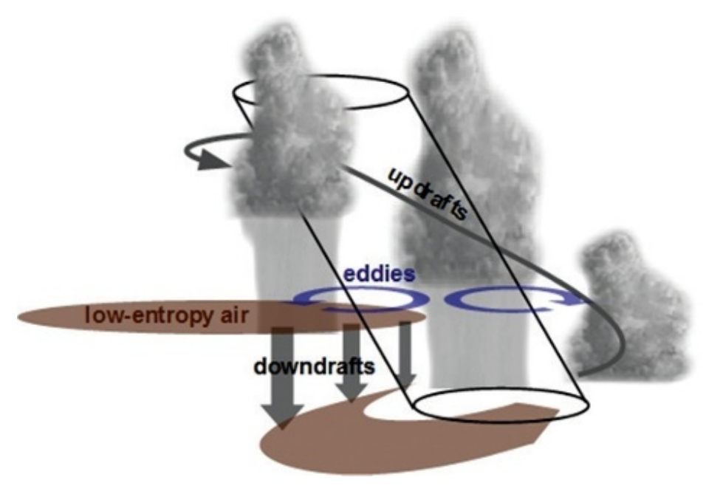

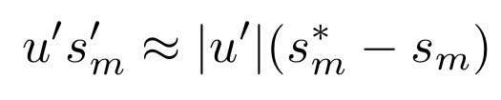
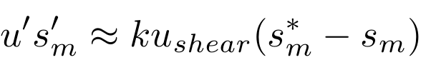
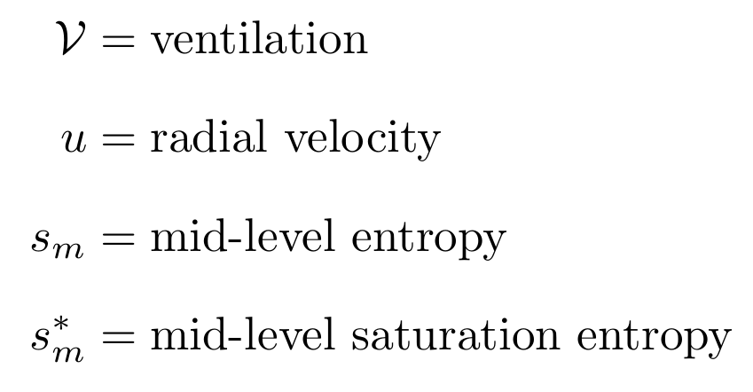
Midlevel-Ventilation
Vertical wind shear tilts inner core and excites mid-level eddies that mix low-entropy air into the inner core of a TC
Tang and Emanuel (2010), Tang and Emanuel (2012), Emanuel (1995)
Notes:
Ask, what is the optimal chi to use in our model? (1 dimensional)

Slide 16
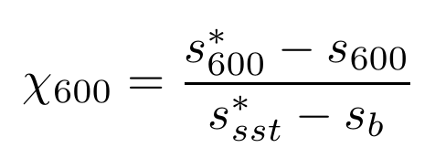

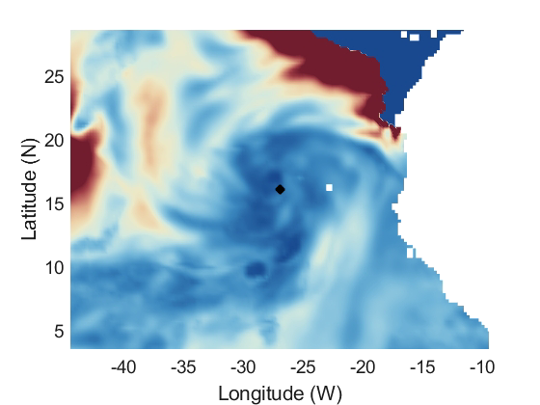

Midlevel-Ventilation
Notes:
ratio of the time scale for surface fluxes to saturate the troposphere to the time scale for surface fluxes to bring the whole troposphere into thermodynamic equilibrium with the ocean

Slide 17
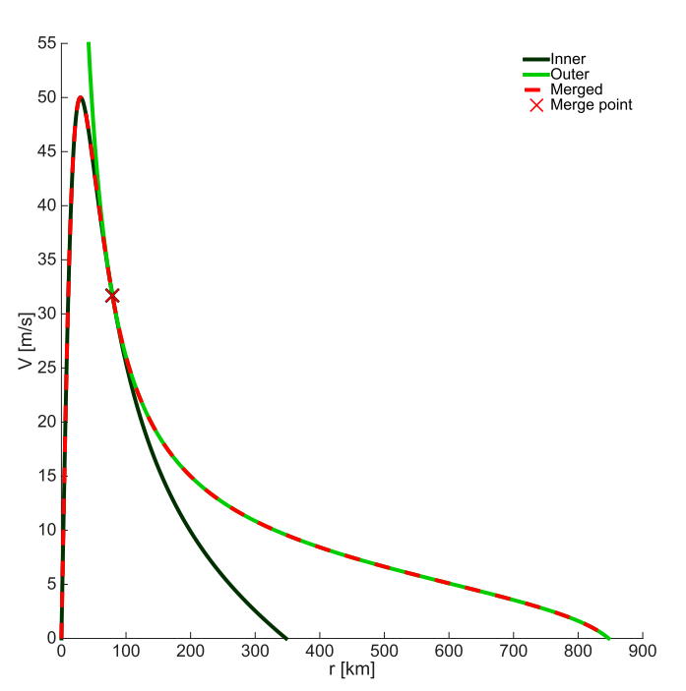
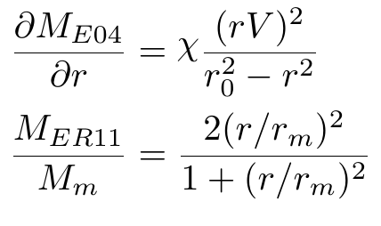
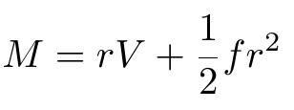


Surface Wind Model
Physically-based low-level wind-speed model (Chavas et. al, 2015)
Given two of $V, r_{m}, r_{0}$, the axisymmetric wind field is specified
$M=$ angular momentum
$V=$ surface azimuthal wind
$r_{m}=$ radius of maximum wind
$r_{0}=$ outer radius (V = 0)
$χ=2 C_{d} /$ $w_{cool}$
Outer Region
Inner Region

Slide 18
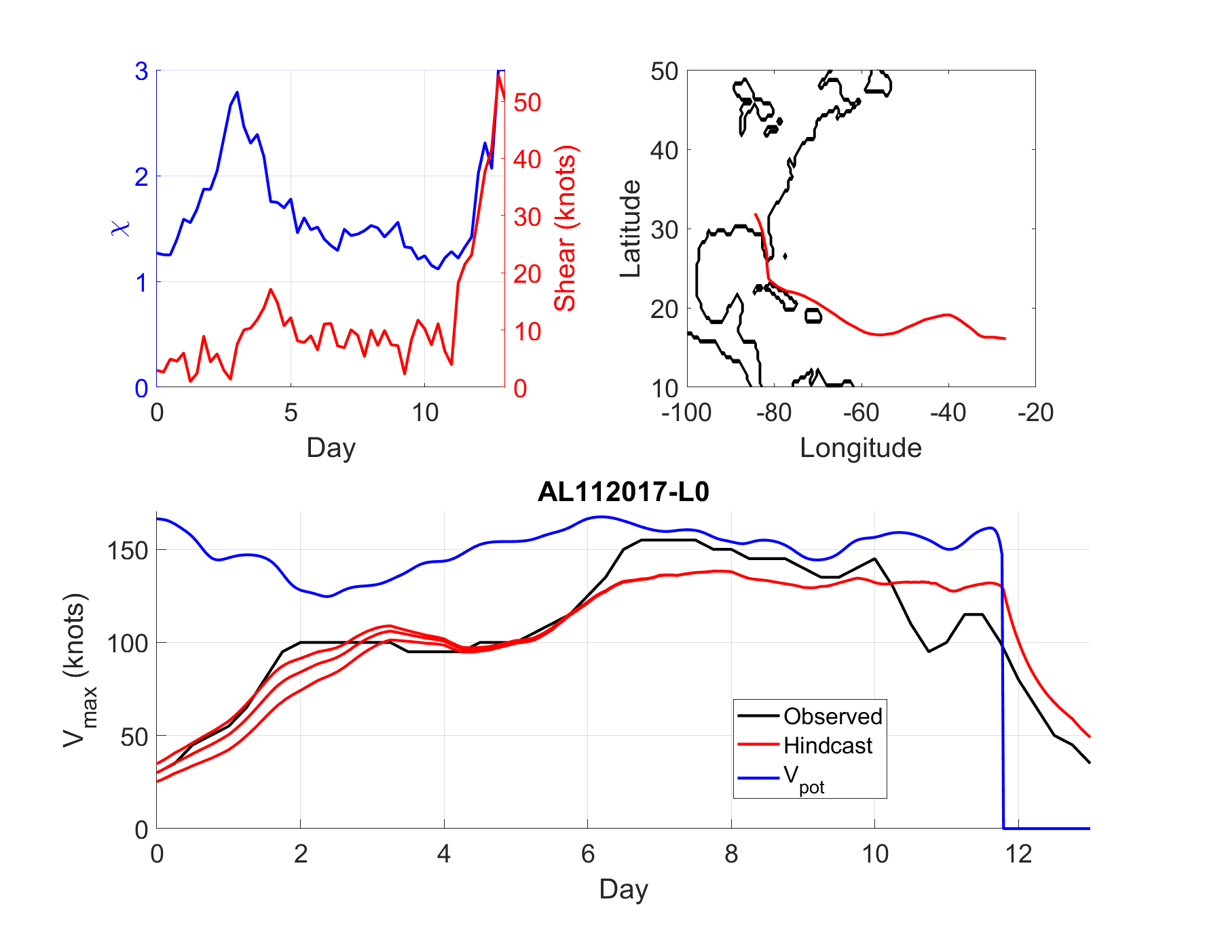
Intensity Verification
Run “hindcasts” – simulate intensity of past TCs
Use ERA5 analysis for “best-guess” fields
Hurricane Irma
Notes:
Hindcast of Hurricane Irma (2017)

Slide 19
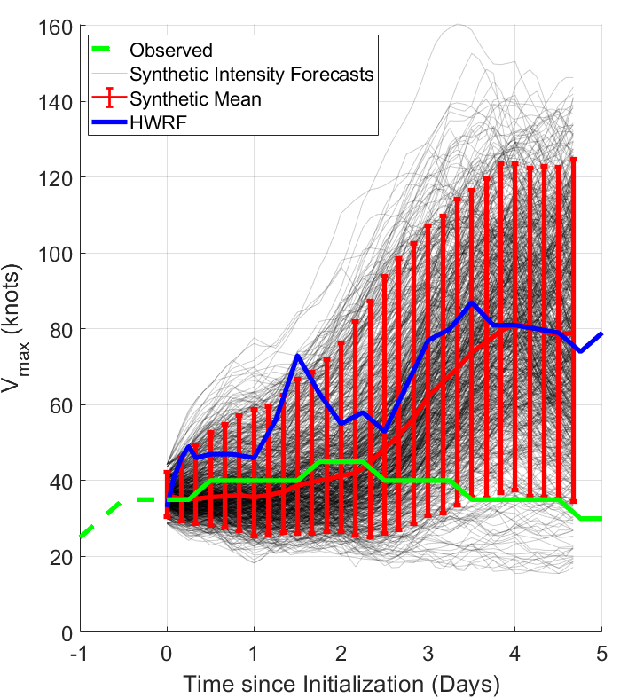
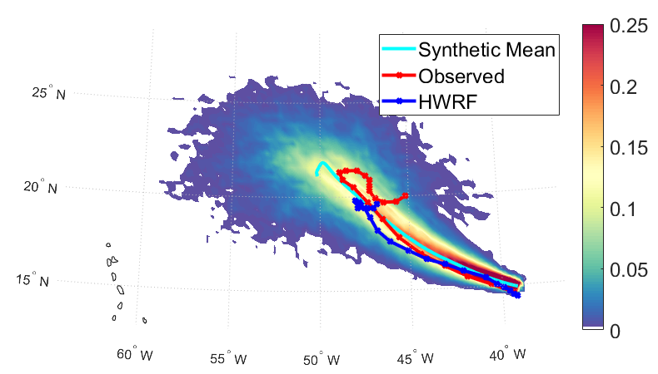
Uncertainty Quantification

