Slide 1
Assessing drivers of trends in CO₂ variability at Mace Head, Ireland using statistical analysis
5/3/2020
Alex Resovsky
Michel Ramonet
Leonard Rivier
Notes:
Good Morning my name is Alex I’m a data analyst at LSCE. I’ll be talking about my research which is to examine the functionalities of statistical software packages in extracting baseline signals and detecting synoptic-scale variations in atmospheric time series data.

Slide 2
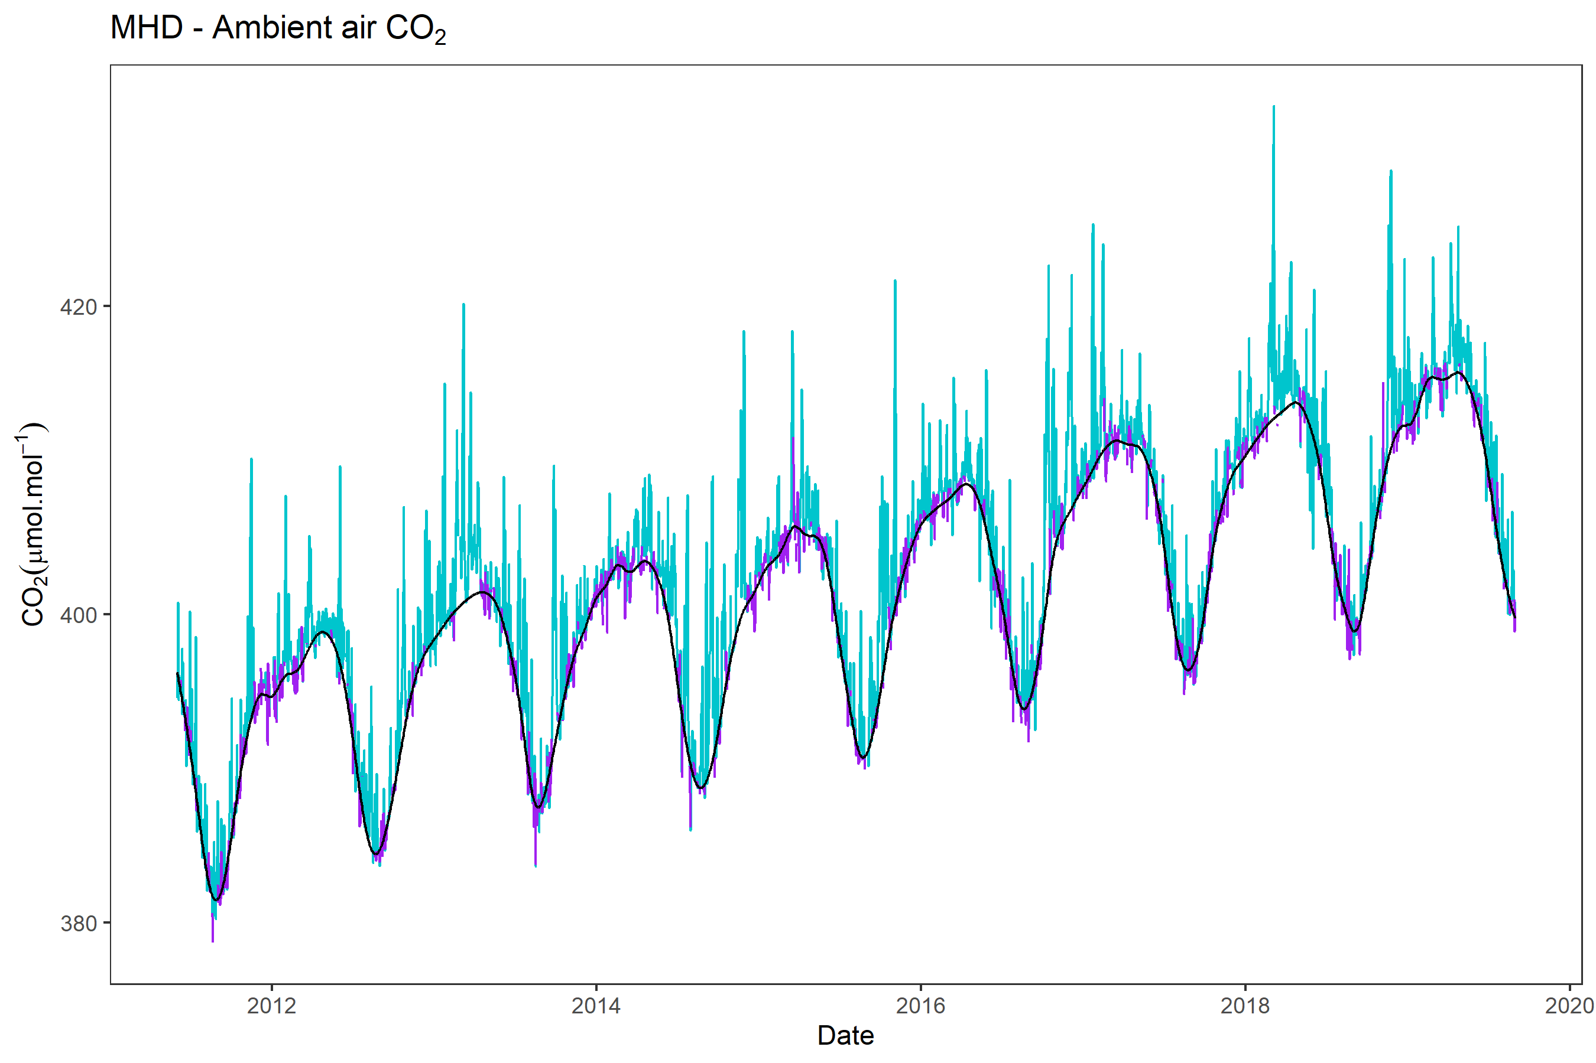
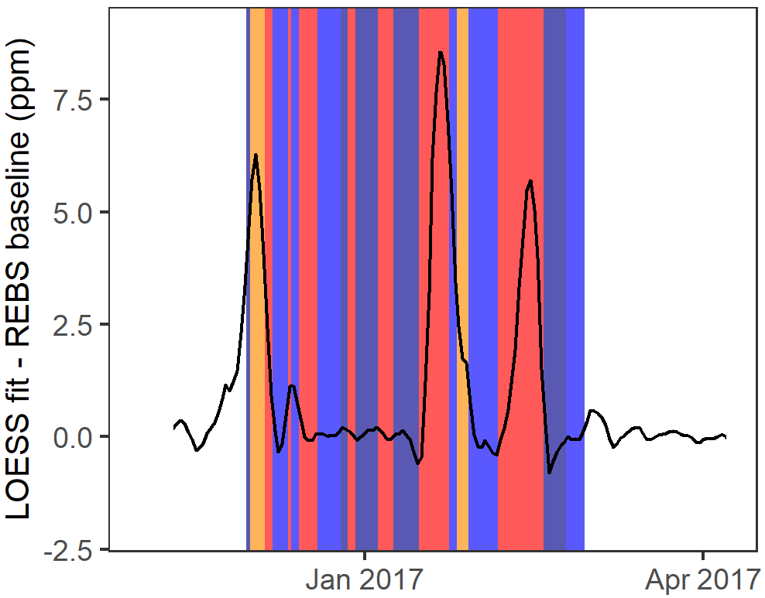
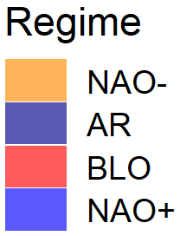
Summary
We extract the marine reference baseline at MHD from 2011-2019. We then calculate daily ΔCO₂ values, where ΔCO₂ is the difference between the observed CO₂ signal and the baseline.
A linear regression model is derived to model the relationship between ΔCO₂ values and observed daily weather regimes from the A2C2 dataset.
The model is then applied to examine the link between the relative strength of certain regimes and the observed CO₂ signal.
Y_{i} $=\text{g}\text{i} +b+\text{b}\text{n}\text{C}\text{n}+$ $\text{b}\text{rz}[max(\text{C}\text{r}\text{,}\text{C}\text{z}$)] + $\text{b}\text{b}\text{C}b$

Slide 3
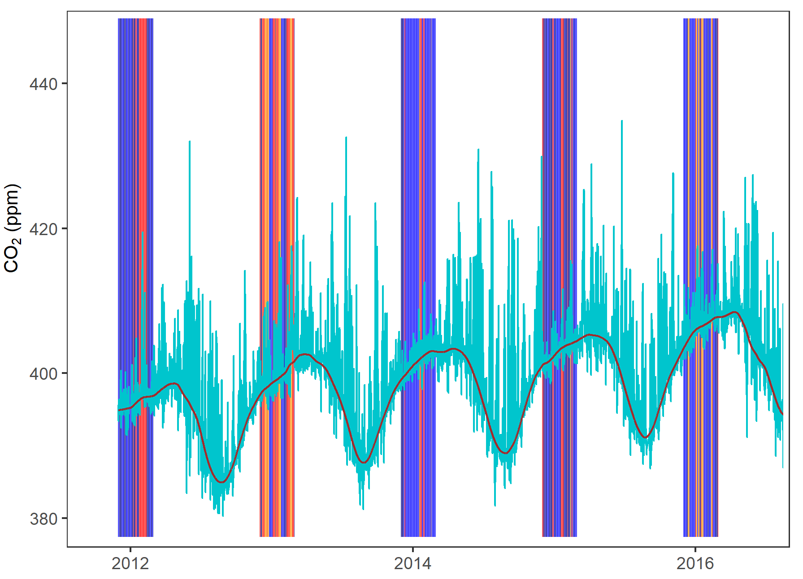
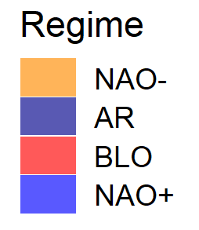
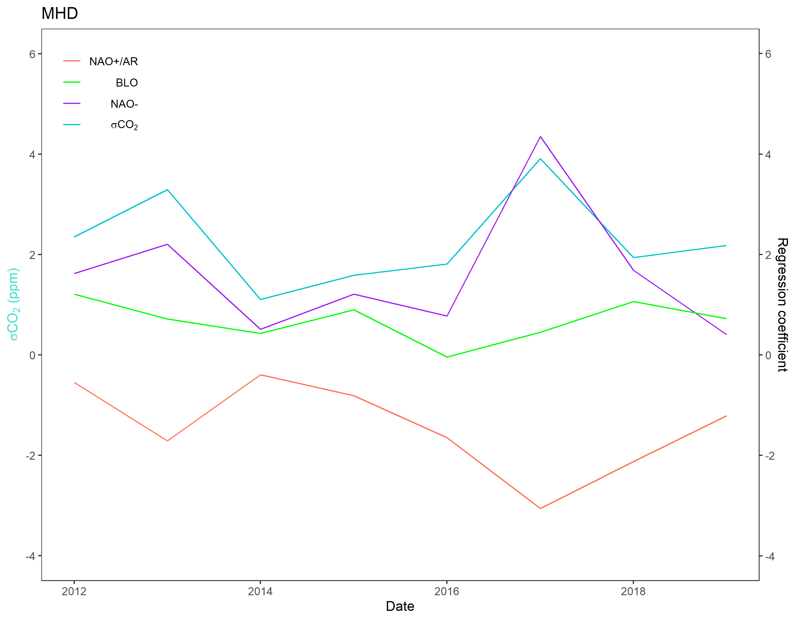
Summary
Only wintertime (DJF) values are used. This allows us to exclude the effects of terrestrial CO₂ uptake, which is highest during the spring and early summer months. The DJF signal variability thus primarily reflects the influence of anomalous positive signal spikes, whose occurrence is thought to be linked to synoptic scale CO₂ transport.
We then compare the overall DJF variability observed in the signal in each year (σCO₂) with the regime/ΔCO₂ coupling coefficients and assess the link between signal variability and regime/ΔCO₂ coupling.

Slide 4
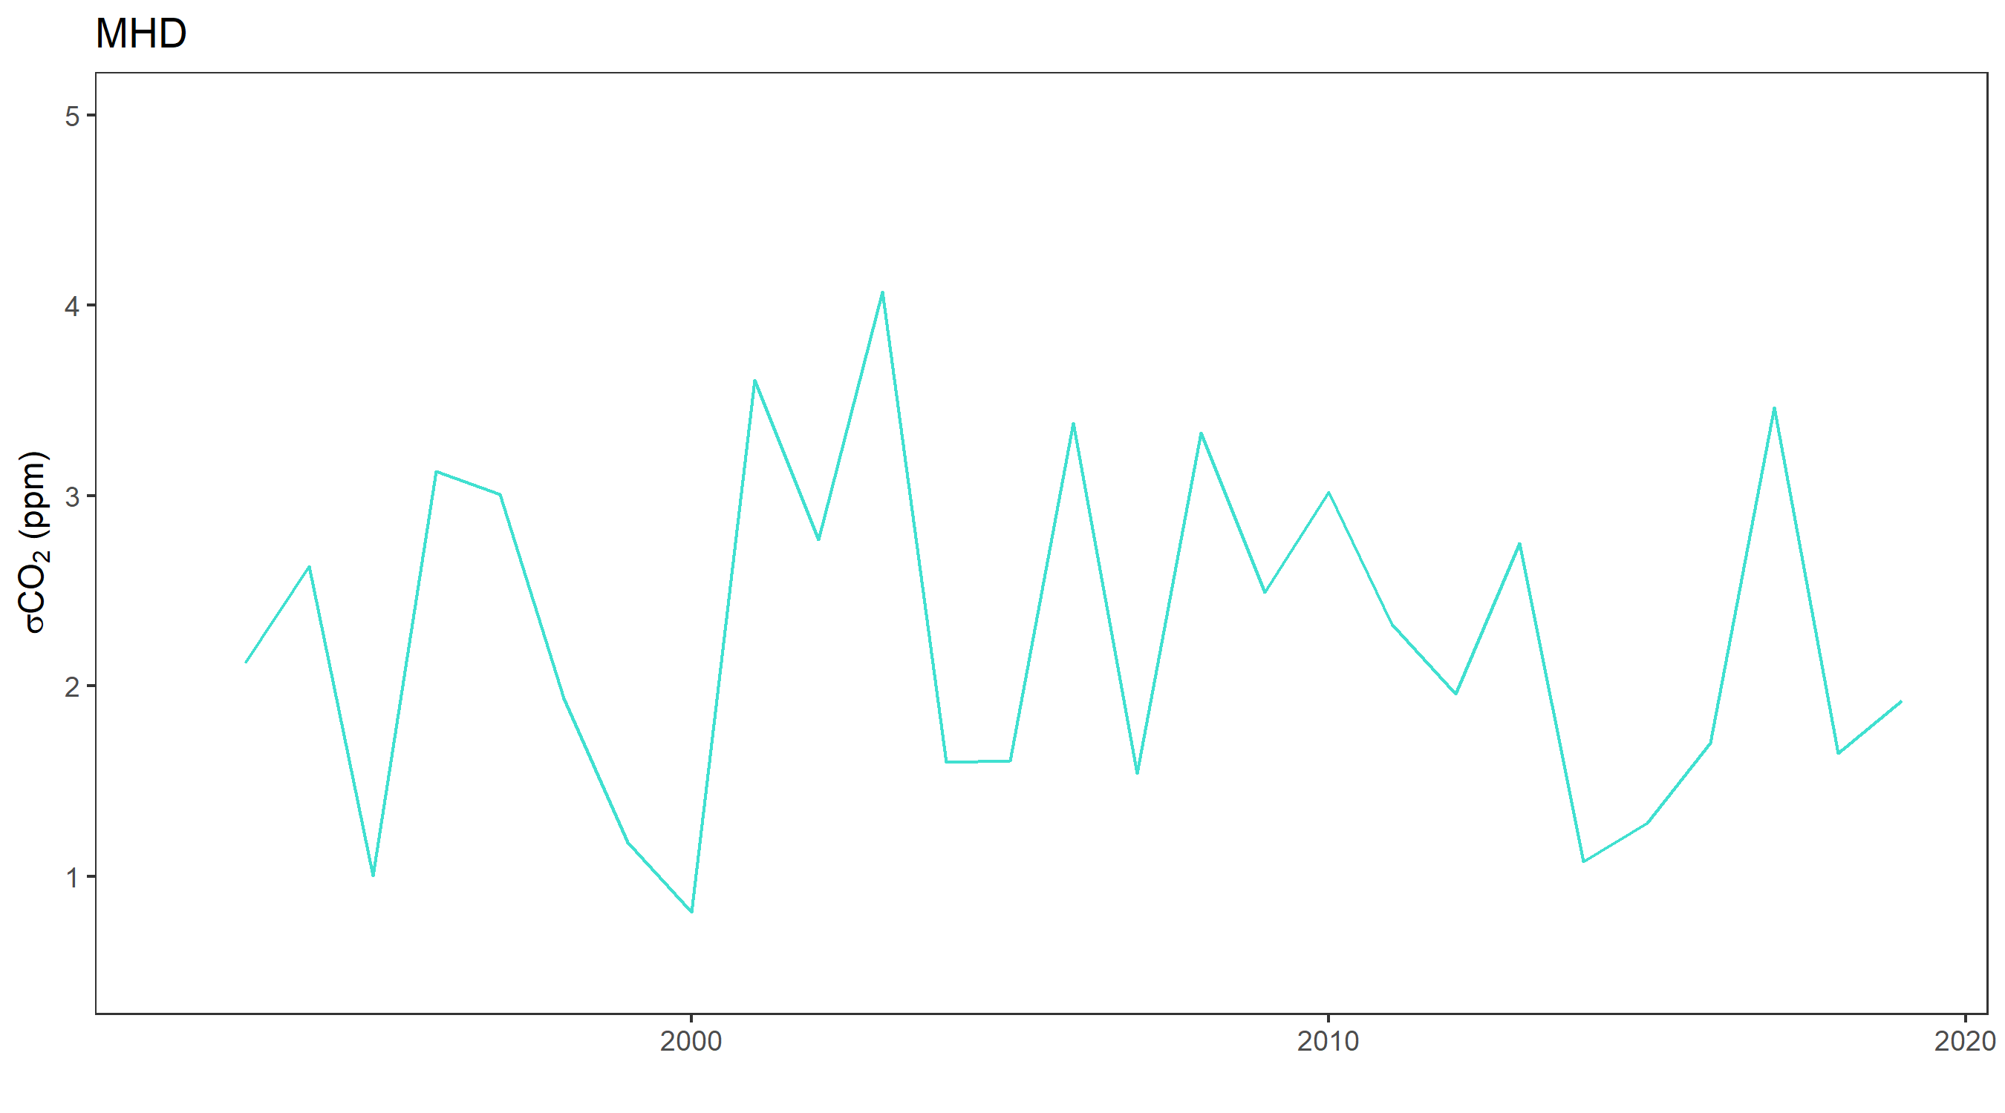
Summary
We then calculate σCO₂ values for 1992-2019 to assess the long-term trend in wintertime signal variability.
The results of the linear regression analysis indicate that the observed downward trend in variability since ~2003 is related to a decrease in the strength of coupling between the occurrence of certain synoptic scale weather patterns (notably NAO- regimes) and ΔCO₂. This implies reduced CO₂ transport from mainland Europe during these events.

Slide 5
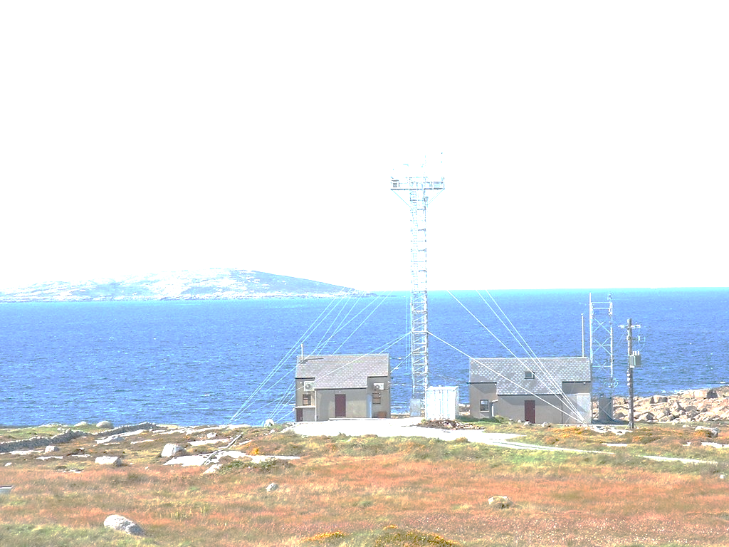
Reference CO₂ data
The Mace Head monitoring station (MHD) is located ~57km west of Galway. The main Atlantic shipping routes are > 150 km away, while the transatlantic air corridors are 80 km away (www.macehead.org).
Measurements at MHD are characterized as “clean” if arriving on westerly winds from over the North Atlantic Ocean (210 ̊ – 290 ̊ with velocities > 4ms⁻¹ or 210 ̊ – 290 ̊ and 290 ̊ – 300 ̊ with velocities > 8ms⁻¹) (Bousquet et al., 1996). Clean sector wind data has been used to approximate Northern Hemisphere background conditions at MHD for more than 30 years (e.g. Below et al., 1990, Jennings et al., 1997, Ebinghaus et al., 1999, Leinert et al., 2008, Grant et al., 2011).

Slide 6
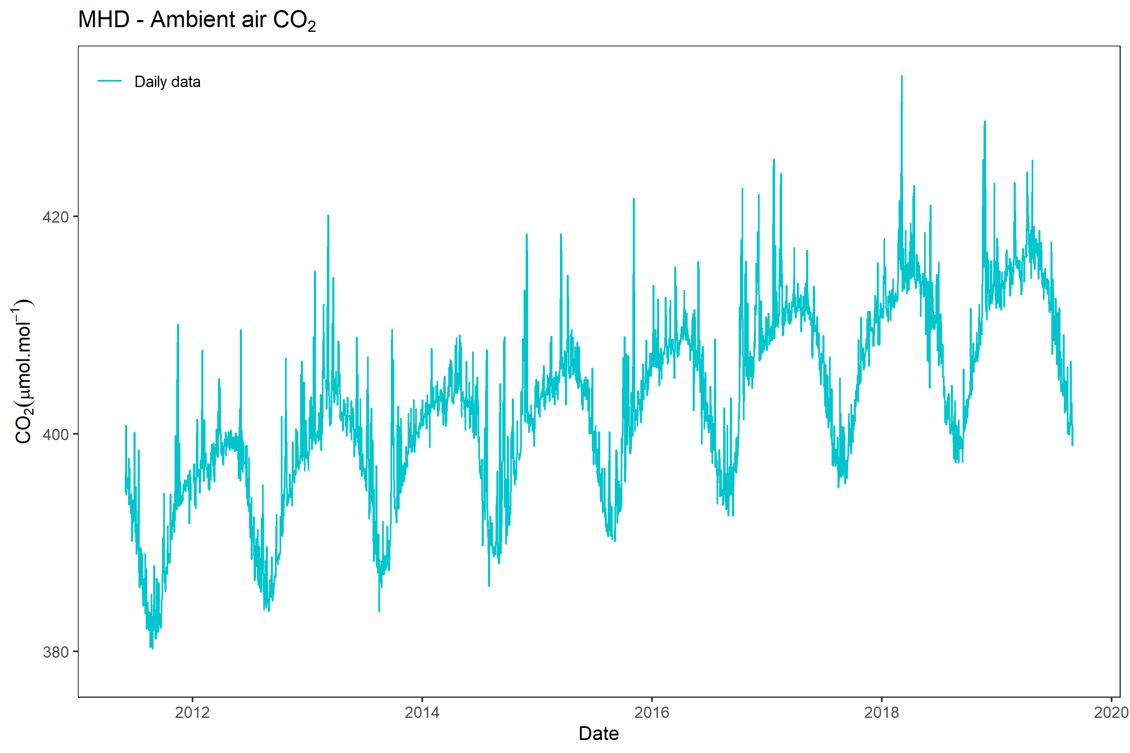
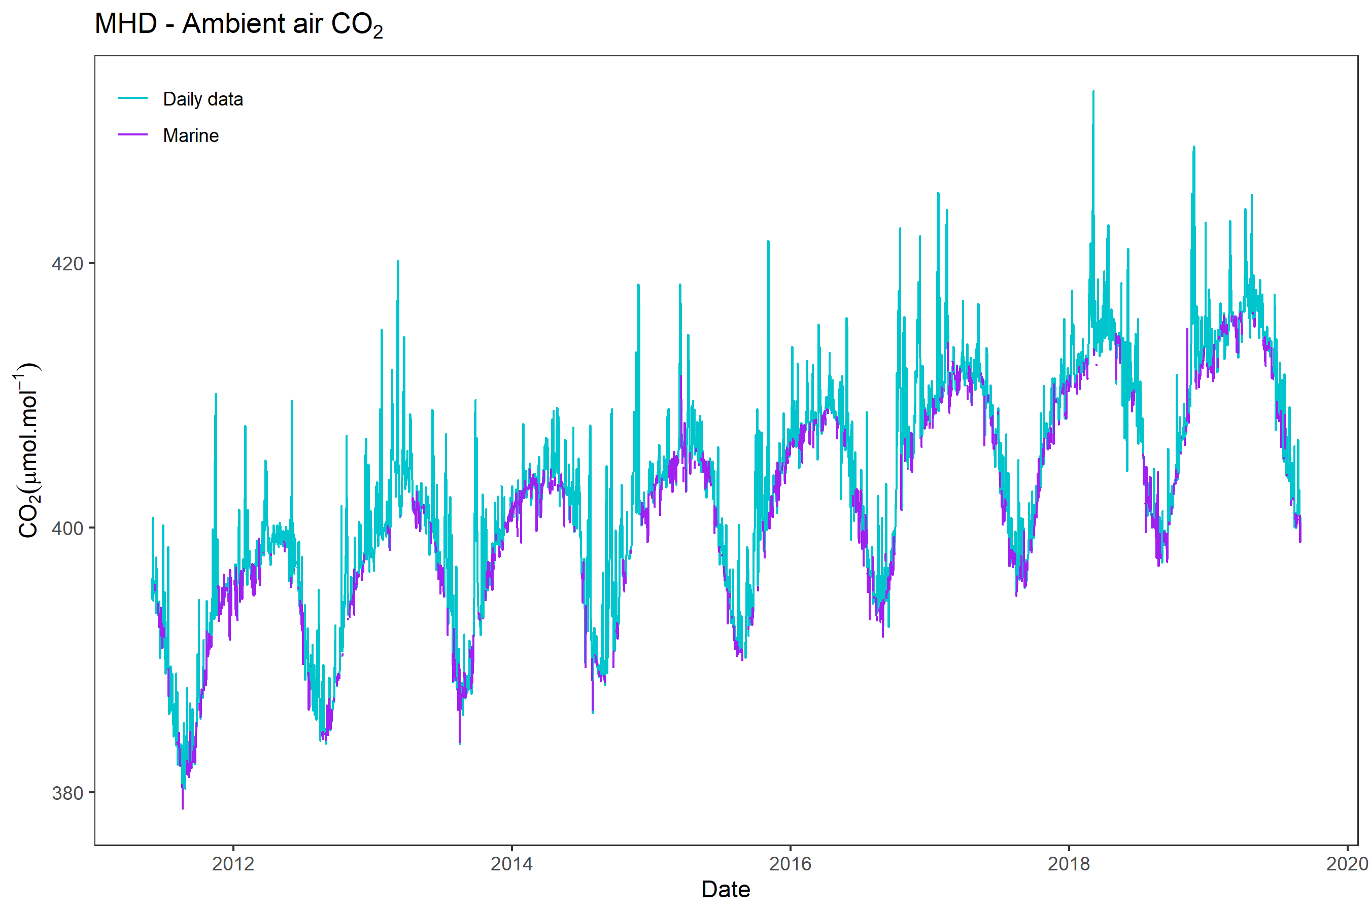
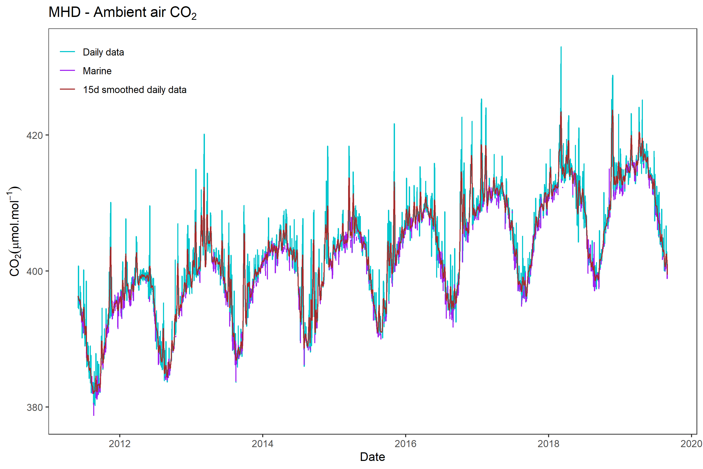
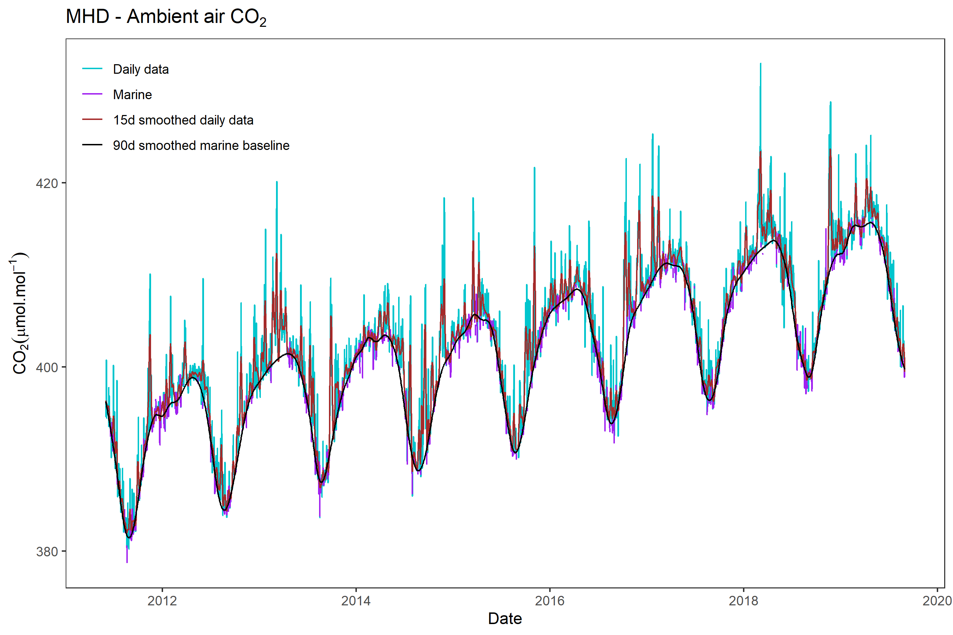
MHD

Slide 7
A2C2 Weather Regimes
Image credit: Cassou, 2004.
The A2C2 DJF weather regimes dataset (Yiou and Déandréis, 2019) is available at the daily timescale from 2011 to 2020. Flow analogues are computed from a wide array of databases in order to obtain probabilistic descriptions of analogue decompositions (https://a2c2.lsce.ipsl.fr).
Notes:
Our hypothesis is that these SSVs or “peaks” in CO₂ are related to observed weather patterns over Europe on a particular day or during a particular week. In particular, blocking events; when anticyclonic flow tends to transport air into Europe from the interior of the Eurasian landmass, we’d expect CO₂ in the atmosphere to build up. To some extent the same should occur when there is a negative anomaly of the North Atlantic Oscillation.

Slide 8
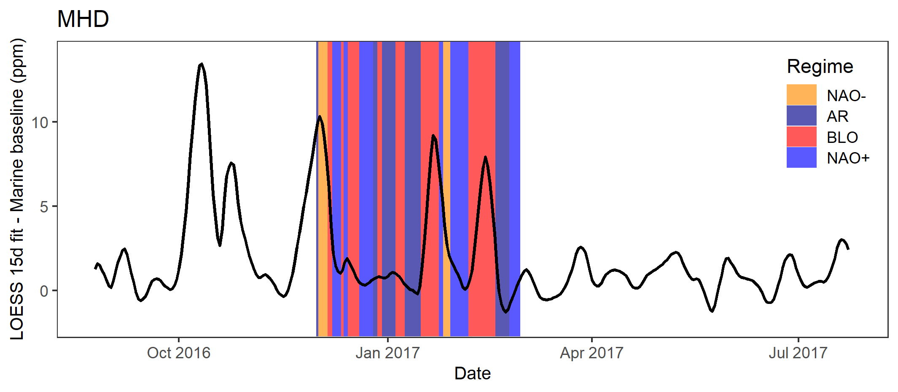
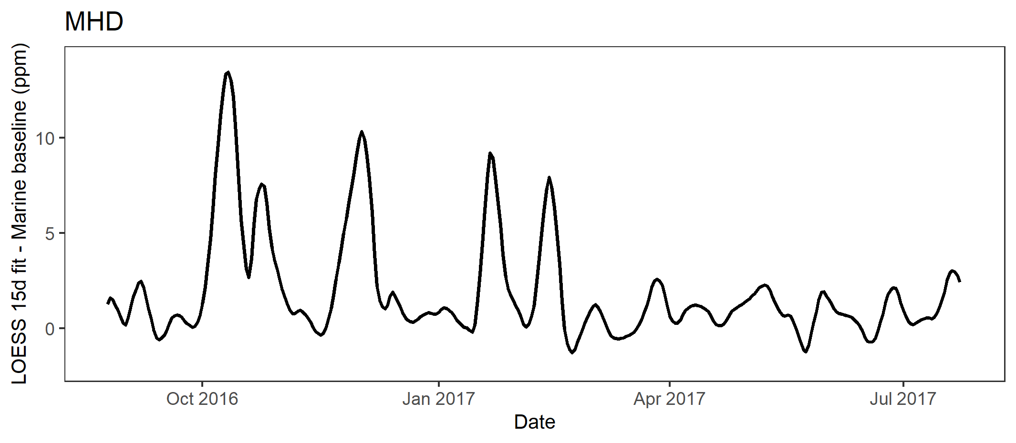
Synoptic scale variations vs. observed weather regimes 2016-2017
Comparing the timing of observed regimes with the ΔCO₂ curve shows that large (syntoptic scale) positive excursions from the baseline tend to preferentially coincide with the prevalence of certain weather patterns.

Slide 9
Coupling of weather regime strength and ΔCO₂
To quantify this relationship, we derive a multiple linear regression model of the form:
Y_{i} $=\text{g}\text{i} +b+\text{b}\text{n}\text{C}\text{n}+$ $\text{b}\text{rz}[max(\text{C}\text{r}\text{,}\text{C}\text{z}$)] + $\text{b}\text{b}\text{C}b$
Where:
b is the modeled average ΔC in winter, defined by a 15-day smooth curve fit to the daily data
b_{n} is the NAO- coefficient
b_{rz} is the coefficient of the maximum of Zonal (NAO+) and Atlantic Ridge (AR) strength
b_{b} is the blocking (BLO) coefficient
C_{p}, C_{r}, C_{z} and C_{b} represent the relative strengths of the NAO-, AR, NAO+ and BLO regimes

Slide 10
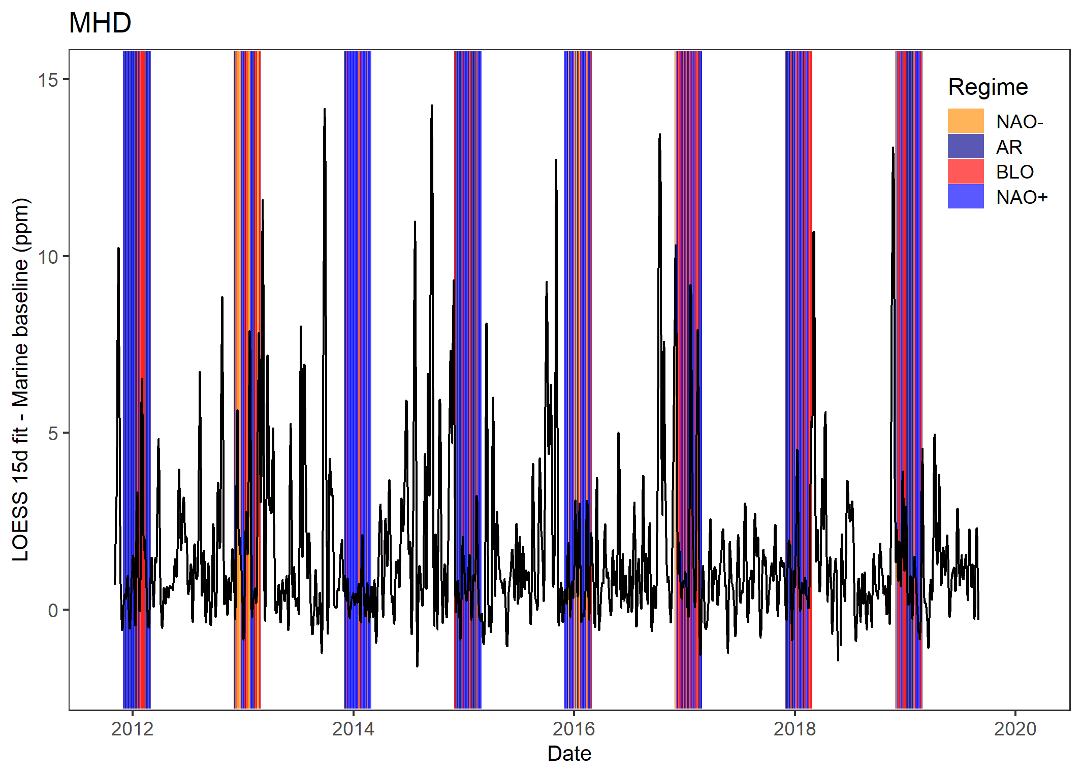
Synoptic scale variations vs. observed weather regimes 2011-2019
Applying the model to the full dataset of DJF days from 2011-2019 yields an adjusted R² of 0.3952.

Slide 11
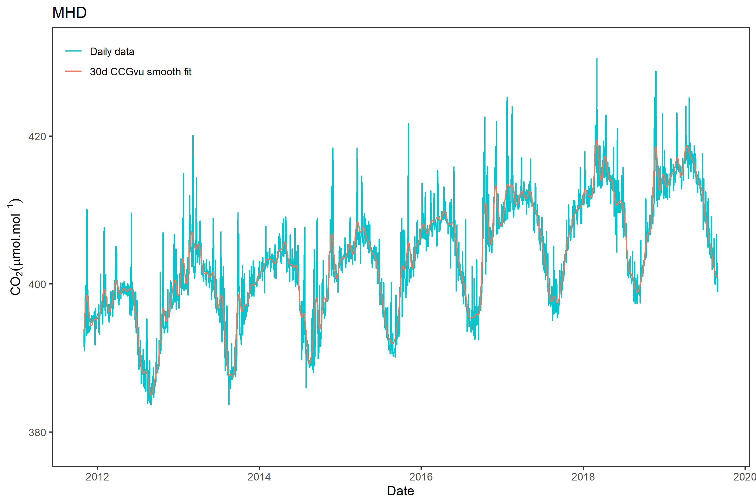
Estimation of wintertime signal variability
σ = 2.18
σ = 1.94
σ = 3.91
σ = 1.81
σ = 1.11
σ = 1.59
σ = 3.29
σ = 2.35
The overall signal variability (σCO₂) for each DJF period is then derived by applying the method of Thoning et al. (1989). The variability is approximated as the standard deviation of the residuals (the daily values) to a smooth curve fit to the data.

Slide 12
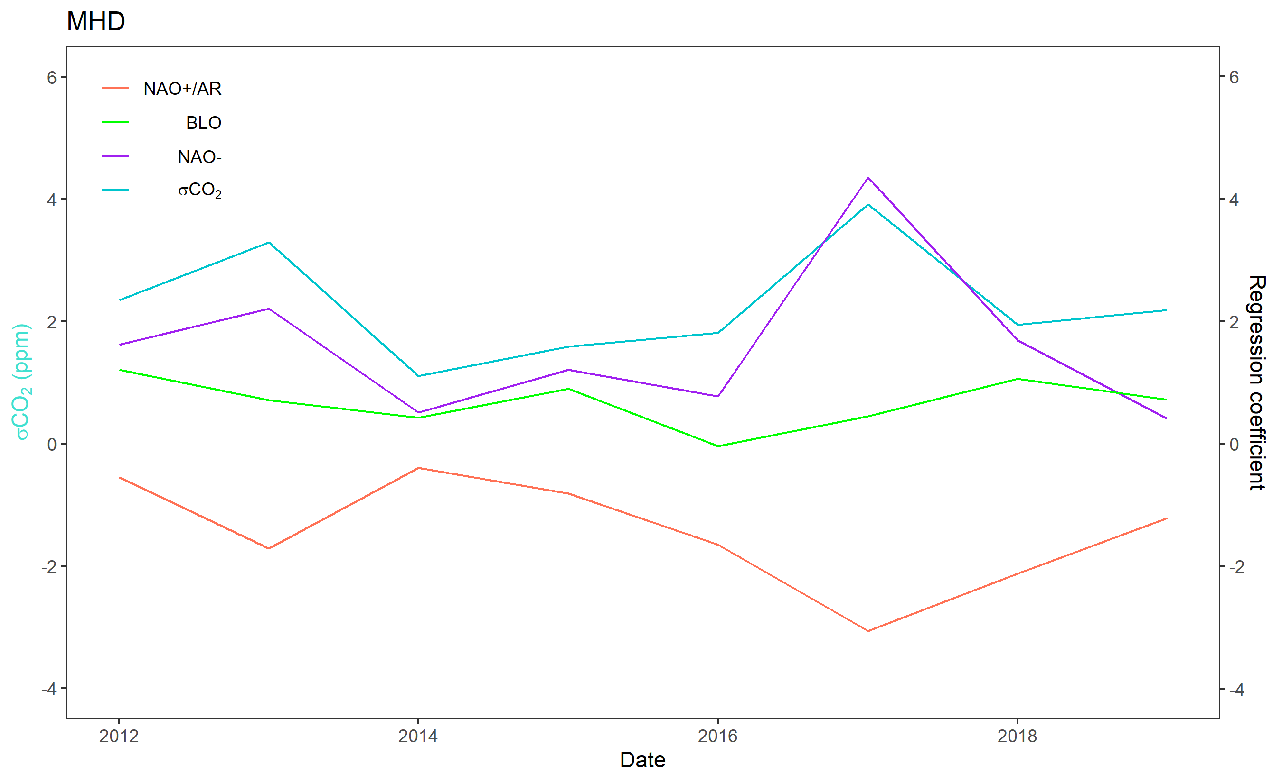
MHD σCO₂ vs. average NAO-, BLO and max[NAO+,AR] strength by year
When we evaluate the regression coefficients in each individual DJF season, the value of the NAO- coefficient is revealed to be positively correlated with σCO₂, while a negative correlation is apparent between σCO₂ and the maximum of the NAO+ (zonal) and the AR (Atlantic Ridge) coefficient.
This implies that overall wintertime signal variability is linked to the amount of CO₂ transported to the station during NAO- and BLO regimes, and not necessarily to how prevalent either regime is in any particular winter.

Slide 13
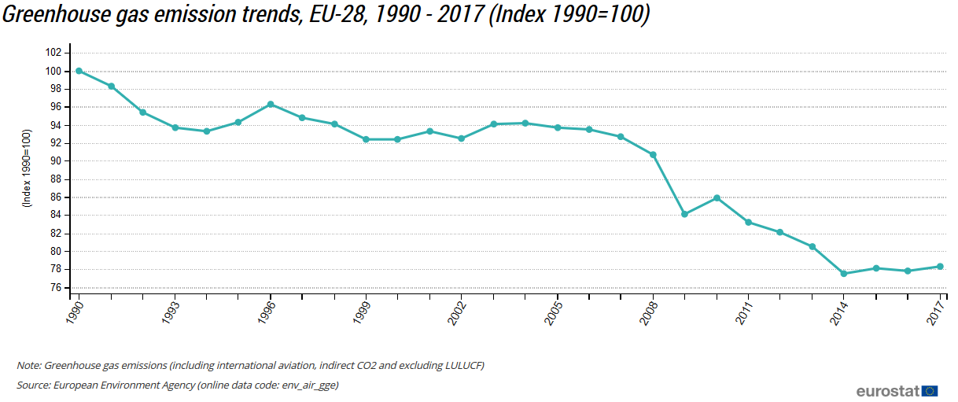
MHD DJF σCO₂ 1992-2019 (1992-2010 data from chromatograph readings).
The results of the regression analysis imply that the observed downward trend in wintertime signal variability since ~2003 is related to a decrease in the strength of coupling between NAO-/BLO regimes and ΔCO₂.
This may indicate reduced CO₂ transport from mainland Europe during these events, possibly linked to an overall decline in European emissions.

