Slide 1
From ZMAP to ZMAP7
⏩ ⏩ 25 yrs of software evolution ⏩ ⏩
Celso G. Reyes, Stefan Wiemer
Swiss Seismological Service, ETH Zurich
Notes:
The kernel of ZMAP was laid down during Stefan Wiemer's PhD Studies, back in the early 1990's. Since then, He and a host of collaborators (many, his graduate students) have grown it in a variety of directions depending upon the research they were pursuing. Much of the functionality had been tacked on in a cut-and-paste manner, with each slight modifications to the core code. Each person who has touched the code brings their own level of programming competence, their own biases of how code should work, their own desired functionality, and their own deadlines for getting ZMAP to provide results. The complexity grew over time, with menu items calling back and forth among the many figures that made up the GUI that is ZMAP.
And the whole while, while the core functionality was rooted in an ancient version of MATLAB: pre v5.0. Since then, changes to core MATLAB, and its environment have resulted in quirks, required changes (to parts of ZMAP) along the way. Eventually, matlab R2014b introduced graphical changes that broke the interface.
There was an attempt to rewrite it in the 2000's, which resulted in MapSeis. But this never gained wings.
In 2017, I [Celso] happened by, with a newly minted Ph.D. looking for seismology programming work. I brought with me a great amount of MATLAB experience, and a Seismology background. Eventually, I was tasked with updating ZMAP (or MapSeis) in order to get it usable again since inquiries continued.
I decided to modify ZMAP in situ, rather than start from scratch. I'm not sure that was the wisest decision, but it was fueled by, among other things, a fairly limited contract [I might be at the SED only a couple months]. There was no time to make the "RIGHT" decision... only the decisions that made sense in the moment. Since then, I've put roughly a year of effort into the program, spread out between other projects and duties.

Slide 2
A ~5min intro to ZMAP 7
Notes:
What is ZMAP? It may be best described as a catalog exploration tool. Time-series Here is a short video that hints at some of the functionality held within ZMAP 7

Slide 3
Input Catalogs
Sampling Grids
ZMAP, oversimplified
.mat files (from ZMAP)
s,z grid (x-sect)
select within radius
FDSN EVENT Webservices
(online)
.csv, .tab files
x,y grid
workspace variables
x,y,z grid
select closest N evts
user-defined formats
Output
Workspace
Area Selection
Analysis
ASCII files
Circle
𝑓(t)
Main Window
Polygon
image files
Main Map
Histograms
𝑓(s,z)
FMD
Time vs Mag
Box
𝑓(x,y)
Cum moment
Cum # events
Cross Section
𝑓(x,y,z)
Cross Sectional views
Time vs Depth
Result Maps
Notes:
What is ZMAP? It may be best described as a seismic catalog exploration tool. Time-series Here is a short video that hints at some of the functionality held within ZMAP 7
The general flow is:
Start with a catalog. This can be provide by you or from one of the FDSN Event Web services.
You filter or decluster the catalog as you see fit, including selecting sub-regions of the catalog for further analysis
Define a sampling grid for your region of interest
Define sampling parameters, such as selecting the N nearest events, or all events within a radus R.
Perform some sort of analysis.
Examine your results in the plots. Compare points & regions.
Iterate.
The

Slide 4
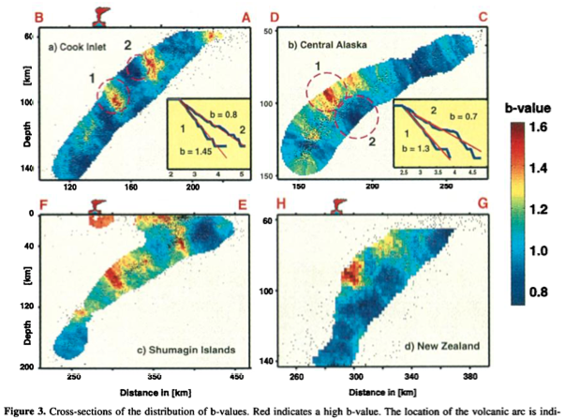
The Genesis of ZMAP
10.268 46.579 2000 1 1 1.5 13.00 2 2
10.325 46.546 2000 1 1 1.8 13.00 4 2
10.259 46.578 2000 1 1 1.8 13.00 18 24
10.257 46.564 2000 1 1 1.6 11.00 21 31
10.337 46.530 2000 1 2 2.1 8.00 12 26
10.323 46.561 2000 1 3 2.2 12.00 4 39
10.295 46.559 2000 1 4 2.2 10.00 5 13
10.271 46.566 2000 1 4 2.1 12.00 12 58
10.284 46.564 2000 1 5 1.7 6.00 11 44
Mapping the b‐value anomaly at 100 km depth in the Alaska and New Zealand subduction zones
S Wiemer, JP Benoit - Geophysical Research Letters, 1996
a = load('mycat.txt')
plot3(a(:,1), a(:2), a(:,3),'.')
x,y = ginput(1)
...
Bulletin of the Seismological Society of America, Vol. 84, No. 3, pp 900-916, June 1994
Seismic Quiescence before the Landers (M = 7.5) and Big Bear (M = 6.5) 1992 Earthquakes
by Stefan Wiemer and Max Wyss
Notes:
Excerpts from an interview with Stefan Wiemer, April 28, 2020 on the Origin of ZMAP
Celso: Did you start working on ZMAP while you were in Alaska?
Stefan: I did this as part of my PhD, which I started in 1992. It was about 1993 that I was starting to be more involved with ZMAP and Seismicity. The topic came from Max Weiss. At the time one of his former students, Ted Haberman, had several articles on Seismic Quiescence. That’s where we started. These were Fortran programs that you needed to run in a funky way. Then some analysis was done in Excel, done on the Sun Workstations.
These techniques were tiring, and as I learned a little about MATLAB, I realized it would be easier to do this in MATLAB. Max was encouraging but… he was open to it eventually, but he wasn’t programming MATLAB himself. One of the reasons to make it user friendly is so that other people, like my supervisor, could actually benefit from the code. He needed an interface that would allow it to happen that way.
The Landers earthquake was one of the first earthquakes I worked on, that was in 1992. In 1994, I had a publication on that. I think that was still using certain elements of ZMAP, but not in a graphical way. There, I was mostly plotting using GMT still, and had some decent color figures : slices through quiescent space, and so on. So, GMT was an inspiration on how to do mapping, I guess, and ZMAP picked up on some of that. The calculations were coming from excel-type things where you were doing very simple time series analysis, and FORTRAN programs that were plotting several ways.
Celso: So, first you were working on your own project, Quiescence for Max. Then you took some of these codes you that ended up with, and then put them together and made them prettier? Was there another influence that came into that?
Stefan: [...] Once he [Max] saw the potential, he was one of the drivers behind it. One thing that happened, It must have been around 1994 or so, when I started to look into b-values. It was together with John Benoit. He had looked at Seismicity beneath Redoubt [...] and we saw some interesting peaks there in b-value as a function of depth, and there’s a spike at 100km kind of thing. We looked into that and wrote a paper b-value with depth in New Zealand and wherever else. That is where we used ZMAP type features, and extended it to b-value analysis. Now we had two legs to stand on: Quiescence in seismicity rates, but also the B-values. That made it a broader application, I guess.
What I increasingly realized and started to appreciate is the benefit you have from an interactive user interface for quality control and rapid scientific interfacing with your data. So data exploration became more important. If you just do a FORTRAN script, you apply it, you have your polygon, you apply it, and a result comes out, that’s good. But, if you can move a cursor through, and then move your cursor over a little bit and see how it changes, that sort of thing is just much more empowering. And I think in the end that is the biggest invention, the potential that anybody could do a B-value or Z-value. In a way, the functions per-se weren’t important, but what nobody had so far was some sort of graphical user interface that would allow you to do this interactively and rapidly check certain areas.
And the partially the mapping also , not too many people had thought about mapping these sort of numbers in ways with circles. I mean, It’s not terribly innovative, but it hadn’t been done much for those sorts of analysis so that allows you to scan more systematically your parameter space. And then of course then the interaction of comparing this point and that point becomes a natural sort of evolution

Slide 5
ZMAP
1994 -
History
MATLAB
1992 - PhD. Project Starts
1994 - Initial ZMAP Version
structs, cells, switch, etc. added - v5.0
error handling - v5.2
2001 - ZMAP 6.0 Released
2003 -
initial class abilities added - v6.5
anonymous functions - v7
new (greatly improved) class support - R2008a
94 95 96 97 98 99 00 01 02 03 04 05 06 07 08 09 10 11 12 13 14 15 16 17 18 19 20
v v v v v v v v v v v v v v v v v v v v v v v v v v v
2014 - MapSeis Development
tables - R2013b
major graphics overhaul, datetime - R2014b
2017 - Zmap 7 Work starts
string type, app designer - R2016b
2020 - Now
Notes:
A project is defined by the times
When ZMAP was first created, limitations imposed by MATLAB included:
no structs ➠ no field names
no cells ➠ no mixed data
no Object Oriented abilities ➠ unconsolidated variables
no switch /case ➠ long lists of if/else if/ else if/ else if/end
no mapping toolbox ➠ included toolbox requires maintenance
different graphics engine ➠ incompatible UI for current version
error trapping used eval/feval ➠ quoted commands invisible to linter

Slide 6
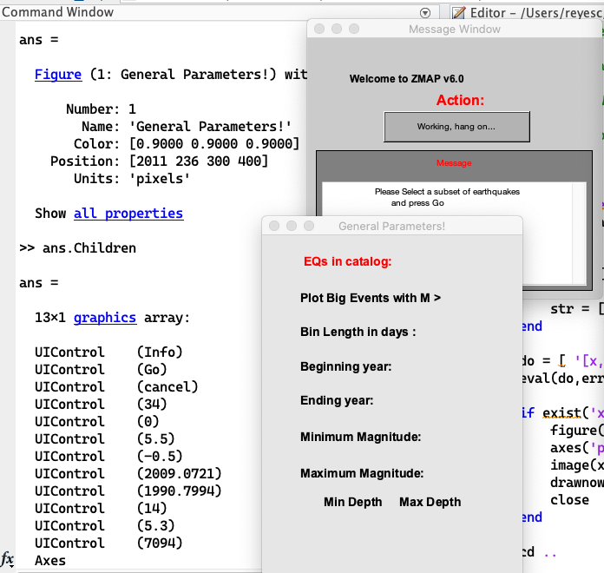
The ZMAP Makeover
"Maybe we can just get the graphics working again?"
ZMAP - missing buttons and fields MATLAB R2019b
Notes:
This first problem occurs because of a change to plotting positions. Relative, where a position within a figure ranges from 0 to 1 on each axis, or absolute, which could be in pixels or cm, ex. When the two get mixed, then items go missing. This was THE major issue throughout

Slide 7
spoiler: "Yes"
function c=uicontrol(fig, varargin)
% replacement uicontrol for ZMAP v6
if ~exist('fig','var')
c = builtin('uicontrol','Units','normalized');
return
end
if ~ishandle(fig)
v = [{fig}, varargin];
else
v = varargin;
end
ix = find(strcmpi('Units', v(1:2:end))) * 2 - 1;
if ~isempty(ix)
u = v(ix: ix+1);
v = [u, v(1:ix-1), v(ix+2:end)];
else
v = [{'Units','normalized'},v];
end
if ishandle(fig)
c=builtin('uicontrol',fig, v{:});
else
c=builtin('uicontrol',v{:});
end
end
no arguments were provided,
handle possibility figure handle wasn't provided
if 'UNITS' were provided, then use them at BEGINNING of parameter list
call the built-in MATLAB command with the updated parameter list
Notes:
To be fair, I started with something like this, but it was just the tip of the program iceberg.
to ensure that there are fewer side-effects, you could check where the call comes from. prepend:
s = dbstack('-completenames');
if ~contains([s.file],'zmap', 'IgnoreCase',true)
% if not in zmap, pas through
c = builtin('uicontrol', fig,varargin{:});
return
end

Slide 8
except...
function selclus.m
%call from Cluster Menu
if isempty(ttcat)
if isempty(newclcat)
tmp=cluscat;
else
tmp=newclcat;
end
else
tmp=ttcat;
end
if var1==1 %Cluster window values
tmp1=min(tmp(:,1));
tmp2=max(tmp(:,1));
tmp3=min(tmp(:,2));
tmp4=max(tmp(:,2));
tmp5=min(tmp(:,3));
tmp6=max(tmp(:,3));
tmp7=min(tmp(:,6));
tmp8=max(tmp(:,6));
tmp9=min(tmp(:,7));
tmp10=max(tmp(:,7));
elseif var1==2 %bigger values than cluster window
tmp1=min(tmp(:,1))-.2;
tmp2=max(tmp(:,1))+.2;
tmp3=min(tmp(:,2))-.2;
tmp4=max(tmp(:,2))+.2;
tmp5=min(tmp(:,3))-.2;
tmp6=max(tmp(:,3))+.2;
tmp7=min(tmp(:,6));
tmp8=max(tmp(:,6));
tmp9=min(tmp(:,7))-10;
tmp10=max(tmp(:,7))+10;
end tmp11=find(newccat(:,1)>=tmp1 & newccat(:,1)<=tmp2 & newccat(:,2)>=tmp3 & newccat(:,2)<=tmp4 & newccat(:,3)>=tmp5 & newccat(:,3)<=tmp6 & newccat(:,6)>=tmp7 & newccat(:,6)<=tmp8 & newccat(:,7)>=tmp9 & newccat(:,7)<=tmp10);
newccat=newccat(tmp11,:);
if isempty(newccat)
disp('No earthquakes with the same limits found')
end
Notes:
which tmp was which, again? The cognitive overheaed is stunning

Slide 9
and...
from script clusmenu.m
from loopmifi.m
global dplo1_h dplo2_h dplo3_h dep1 dep2 dep3 histo hisvar strii1 strii2
global plot1_h plot2_h %object handle for subplots
global mess check1 cum freq_field bgevent equi cluscat par1
global fs12 fs14 fs10 fs16 file1 clu h5 bg h1 ms6 ty
global clust original cluslength %bsubclus
global backcat backequi backbgevent swarmtmp eqtime %subclus
global maintmp dubletttmp
global ttcat tt1cat foresh aftersh mainsh %sinclus
global equi_button newclcat iwl3 par1 par5 newt2
global button1 button2 button3 st1 go_button action_button
global freq_field1 freq_field2 freq_field3 freq_field4 freq_field5
global winx winy sys minmag welx wely wex wey
global inp1 inp2 inp3 inp4 inp5 inp6 inp7 inp8 inp9 inp10
global tmp1 tmp2 tmp3 tmp4 tmp5 tmp6 tmp7 tmp8 tmp9 tmp10 clsel xt pyy
global fore_button after_button clop1 clop2 clop3 clop4 clop5
global clu1 fore_h after_h main_h bfig new freq_slider mouse_button
global close_ti_button pplot cinfo p1 Info_p cplot coastline
global mainfault main faults clus_button maepi clclose_button
global SizMenu TypMenu calll66 hndl1 tmvar map mapp decc
global tmm ctiplo hpndl1 callcheck magn mtpl %cltipval
[existFlag,mifmap]=figflag('Misfit-Map 2',1);
figure(mifmap)
delete(gca);delete(gca); delete(gca);delete(gca);
delete(gca);delete(gca); delete(gca);delete(gca);
set(gca,'visible','off','FontSize',fs12,'FontWeight','bold',...
'FontWeight','bold','LineWidth',[1.5],...
'Box','on','drawmode','fast')
... later [CGR]...
%construct a matrix for the color plot
normlap1=ones(length(tmpgri(:,1)),1);
normlap2=ones(length(tmpgri(:,1)),1)*nan;
normlap3=ones(length(tmpgri(:,1)),1)*nan;

Slide 10
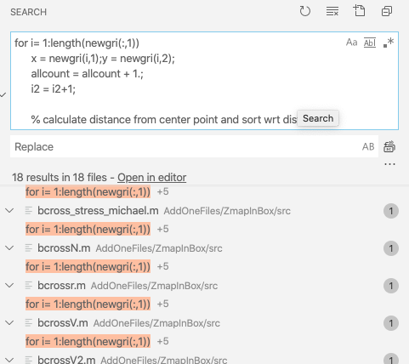
and...
copy/pasted snippets throughout...
codecheck_and_show_top_issues
total issues: 15308
3126 : If you intend to specify expression precedence, use parentheses () instead of brackets [].
2320 : Best practice is to separate output variables with commas.
851 : Terminate statement with semicolon to suppress output (within a script).
568 : Extra semicolon is unnecessary in END statement before newline.
480 : Extra semicolon is unnecessary in IF statement before newline.
440 : When both arguments are numeric scalars, consider replacing & with && for performance.
409 : If you are operating on scalar values, consider using STR2DOUBLE for faster performance.
331 : When both arguments are numeric scalars, consider replacing | with || for performance.
228 : Extra comma is unnecessary in IF statement before newline.
208 : 'hist' is not recommended. Use 'histogram' instead.
204 : EXIST with two input arguments is generally faster and clearer than with one input argument.
204 : Extra semicolon is unnecessary in ELSEIF statement before newline.
...

Slide 11
ZMAP (in a box) code Details
Files : *.m : 1672
Lines of code: 169764 non-blank lines, 41506 comments
Functions: 1104
Lines containing eval, feval: 1346
Non-function callbacks: 4057
UImenu: 2628
UIcontrol: 2093
GUIDE .m files 23
623 global variables [including tmp1 through tmp10]
Most important variable name : a
At LEAST:
1678 for loops
7427 if statements
204 while loops
1073 figure statements
1199 gcf usages,
~2180 gca usages
>> codecheck_and_show_top_issues
total issues: 15308
3126 : If you intend to specify expression precedence, use parentheses () instead of brackets [].
2320 : Best practice is to separate output variables with commas.
851 : Terminate statement with semicolon to suppress output (within a script).
568 : Extra semicolon is unnecessary in END statement before newline.
480 : Extra semicolon is unnecessary in IF statement before newline.
440 : When both arguments are numeric scalars, consider replacing & with && for performance.
409 : If you are operating on scalar values, consider using STR2DOUBLE for faster performance.
331 : When both arguments are numeric scalars, consider replacing | with || for performance.
228 : Extra comma is unnecessary in IF statement before newline.
208 : 'hist' is not recommended. Use 'histogram' instead.
204 : EXIST with two input arguments is generally faster and clearer than with one input argument.
204 : Extra semicolon is unnecessary in ELSEIF statement before newline.
...
Notes:
using things like :
cat `find . -name "*.m"` | egrep -i "eval[ \(]|feval[ \(]" | egrep "^ *[^%]"
"find all m files, list them, and keep anything that uses eval or feval (ignoring cases), but doesn't start with a comment

Slide 12
ZMAP overhaul process
Documentation
Compartmentalization
Testing & Debugging
Homogenization
Familiarization
Commit changes to Version Control System
Take Notes
analytics (dependency reports)
debug traces
instrumentation
Formatting & Style
Remove/reduce globals
Global Search/Replace
Rename Variables/Functions
Static testing: Linter
Profiling: profiler
subdivide code into functional units (functions!)
User Testing (do all the things)
Notes:
Commit ZmapInBox to Git
Get overview:
Conversations with original creator
Word histograms: determine most important variables/functions/scripts in use
dependency reports (inaccurate)
Look at uimenu names and callbacks
debug/trace for program flow
Reformat all files for consistency
reduce code base by eliminating files with no obvious entry points
Not an exact science

Slide 13
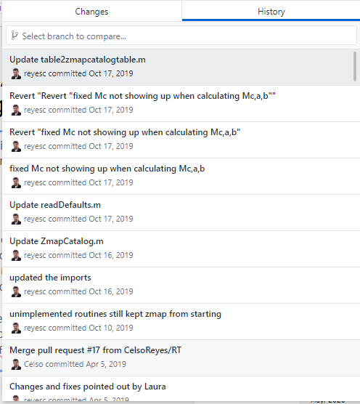
Track ALL the Changes
Before starting any project... or, in fact before modifying an existing project, I commit the code to a version control system, like Git. I can then:
... see exactly which changes I've just made
... figure out how and when I screwed up, and then UNDO the offending changes.
... compare performance between versions.
... delete code instead of commenting it out
... keep a continuous record of my progress.
... avoid ver1, ver2, may2020ver, finalver, finalfinalver, reallyfinal folders
Notes:
This first problem occurs because of a change to plotting positions. Relative, where a position within a figure ranges from 0 to 1 on each axis, or absolute, which could be in pixels or cm, ex. When the two get mixed, then items go missing. This was THE major issue throughout

Slide 14
Names are IMPORTANT
❌ 👍
a -> catalog
x -> dist_km
sigma -> stress_Pa
circ1() -> draw_circle()
sel1 -> useRadius
tmp1,tmp2 -> plz, anything else
ZMAP started as a personal project and grew organically, Some influences came from FORTRAN. This showed in the variable names
Reduce cognitive overhead by giving great names for variables, functions, and classes.
Name a function according to what it DOES: draw_circle : draws a circle filter_catalog: filters a catalog,
A variable should say what it CONTAINS: primaryCatalog : details for all events activeEventIndex: index positions of events being used useRadius: boolean, that if true means we use the Radius for calculations
Notes:
This first problem occurs because of a change to plotting positions. Relative, where a position within a figure ranges from 0 to 1 on each axis, or absolute, which could be in pixels or cm, ex. When the two get mixed, then items go missing. This was THE major issue throughout

Slide 15
Global changes and instrumentation: Wrapper/adapter functions
function c=uicontrol(fig, varargin)
% replacement uicontrol for ZMAP v6
% log some details,
% or disp diagnostics to screen
% or run some other function
...
%now, do the thing
if ishandle(fig)
c=builtin('uicontrol',fig, v{:});
else
c=builtin('uicontrol',v{:});
end
end
function [h] = figure_with_normalized_uicontrolunits(varargin)
% creates a figure, and sets the DefaultUicontrolUnits to 'normalized'
% see also figure
disp('creating figure with following arguments:')
disp(varargin)
h = figure(varargin{:});
set(h,'DefaultUiControlunits','normalized');
end
A wrapper function replaces a function in the code, but then calls it itself.
I created a wrapper function "figure_with_normalized_uicontrolunits", which accepted and passed along all the data required to create a figure, except that it forced the units to be normalized.
All callbacks called a function that logged the function being used.
* wrapper functions are like python decorators
Notes:
This first problem occurs because of a change to plotting positions. Relative, where a position within a figure ranges from 0 to 1 on each axis, or absolute, which could be in pixels or cm, ex. When the two get mixed, then items go missing.
How to fix? One could go everywhere and add "units", "normalized" everywhere. But, instead, one can also create a new function and call that function instead of the original

Slide 16
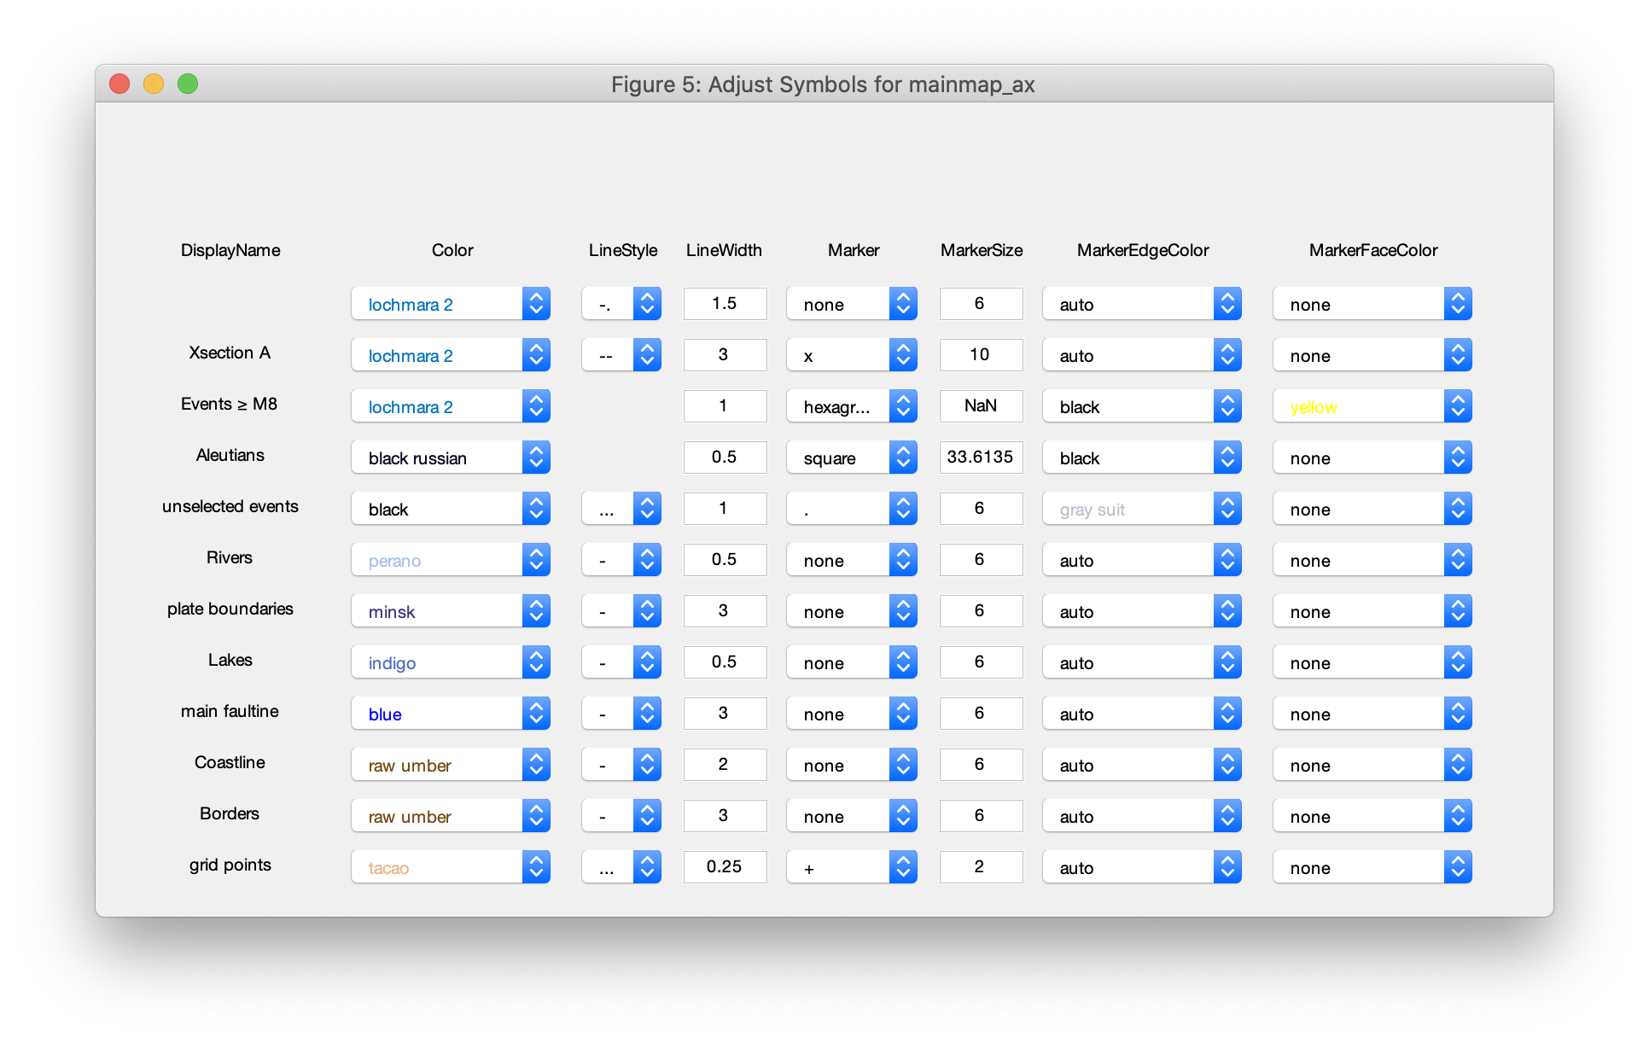
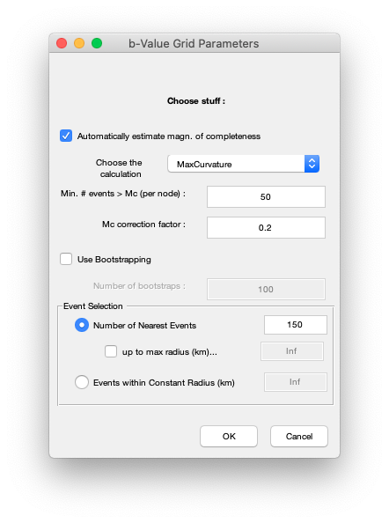
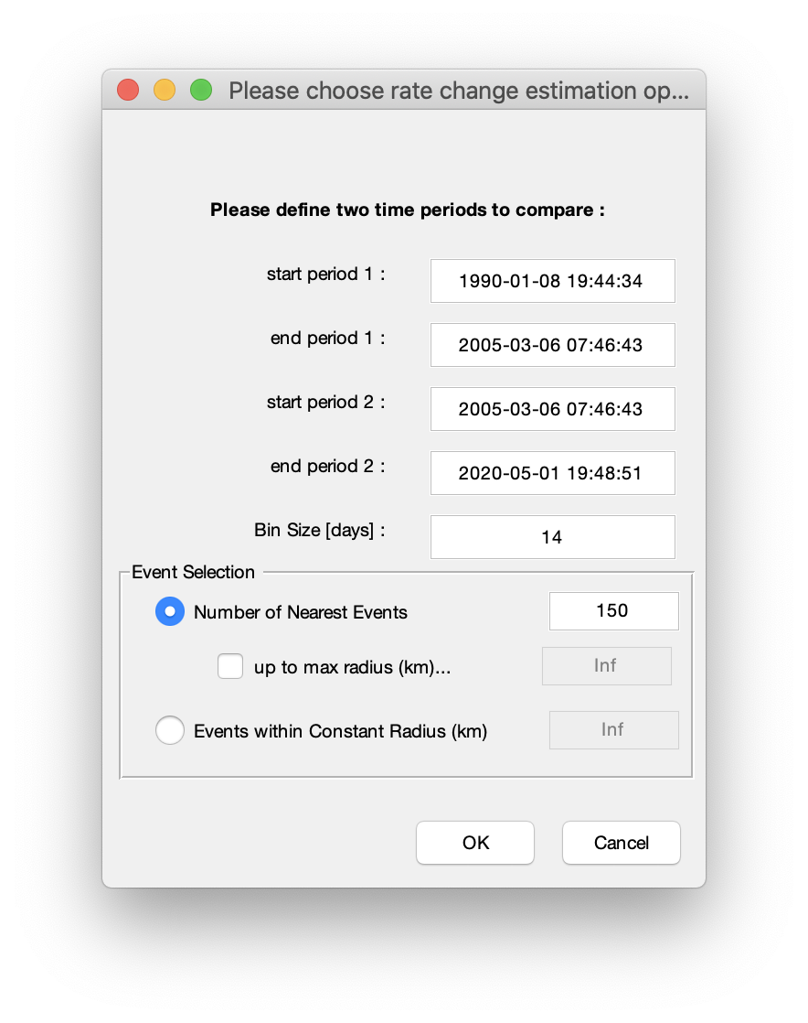
Automate Mundane Tasks
For example:
Tweaking the dialog boxes took a lot of time. Inserting a new item meant all the positions needed to be recalculated.
To alleviate this, I created a class that creates the dialog boxes. This class knows about data types, and special user-defined types, and can generate the boxes for me
Coming Soon!

Slide 17
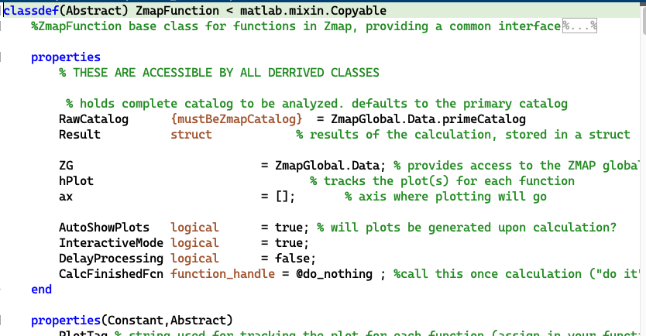
Prefer Classes & Functions to Scripts
In MATLAB, scripts share the variable space. This is the "global scope"
Functions have clear entry and exit values. Variables are limited to their containing function, meaning x inside one function is completely independent of the x in another function. Names are self documenting
Classes are a tight combination of variables and the functions that operate upon them as a result, you can tightly control values and ensure data correctness.
Notes:
ZMAP was written as a series of scripts. This made understanding the relationships between different working parts extremely difficult. Scripts just dump their variables into the global workspace. To further complicate matters, some scripts declared GLOBAL variables, which have a different lifetime and scope. [scope refers to the portion of a program where one can access the value of a particular variable (or access a particular function)
One of the first steps was to [in an automated way] convert all the scripts into functions. The variables within each function are then limited to the function, unless they are provided as arguments to the function, or if they are specifically declared GLOBAL. This completely broke ZMAP, but now the dependencies between one file and the next become more obvious.
Another great aspect of functions is that it provides a single work unit that is easy (well, easier) to judge whether it is working correctly or not.

Slide 18
Let the LINTER do the work
uimenu(op2, 'Label', 'Save current catalog (mat format) ',...
'Callback', 'eval(catSave);');
catSave =
['welcome(''Save Data'','' '');think;',...
'[file,path1] = uiputfile([hodi fs ''eq_data'' fs ''*.mat''], ''Earthquake Datafile'');',...
'if length(file1) > 1, wholePath=[path1 file1],sapa2 = [''save('' ''wholePath'' '',''''a'''', ''''faults'''', ''''main'''', ''''mainfault'''', ''''coastline'''', ''''infstri'''', ''''well'''')''],',...
'eval(sapa2), end, done';];
The MATLAB linter is a tool that detects syntax errors within your code. It does not look at quoted values.
The linter is your friend.
Original Code
The above creates a menu that will evaluate the contents of catSave when pressed.
catSave displays a welcome and thinking message, and then saves the variables to a path that was graphically chosen by the user.
By the time all the quotes are figured out, sapa2 evaluates to:
'save(wholePath, 'a','faults','main','mainfault','coastline','infstri','well')'
* I don't mention it otherwise, but these strings also violate the one-command-per-line good programming practice.
Notes:
ZMAP is a GUI that was written starting in MATLAB version 4.0 or 4.2. One method of error catching would be to create a text string that contained the commands you anticipated might fail, and pass them to eval. If the eval was unsuccessful, you could specify what action it would take. In general, using eval is now something to be avoided. There are several reasons why this is so, but the most relevant one for ZMAP is that the built-in error catching software (the MATLAB linter) cannot interpret the strings. An additional concern is the readability of strings inside strings inside strings.
So. to improve these sorts of code snippets, the entire containing script needs to be turned into a function. Then, the contents of the callback needs to be turned into a sub-function.

Slide 19
Let the LINTER do the work
function displayMenu()
... some more code up here...
uimenu(op2, 'Label', 'Save current catalog (mat format) ',...
'Callback', @save_catalog_cb);
function saveCatalog_cb(~,~)
welcome('Save Data',' ');
think;
[file,path1]=uiputfile([hodi fs 'eq_data' fs '*.mat'], 'Earthquake Datafile');
if length(file1) > 1
wholePath=[path1 file1]
try
save(wholePath,'a','faults','main','mainfault','coastline','infstri','well')
catch
disp('oops, it didn't work')
end
done
end
end
In addition to this version being much more readable, the linter can now determine if there are any errors within this section of the program.
One can also get a dependency report that shows that this file depends upon the welcome and think functions that were exist somewhere else in the file.
Refactored Code
* The @ symbol near the beginning of this code means "function handle"
Notes:
Callbacks are interesting and tricky creatures. It is important to know when values are bound to the call, and therefore represent the state of the program at the moment of UI creation, OR, if they are evaluated when the callback is called.
Callbacks can be:
text strings
function handles
anonymous(lambda) expressions:
'Callback', @(src, val)

Slide 20
Maintenance Challenges
zmap
dff abcde)
ipsum* (32)
fak2 toad
13o2 daktle 2dao
🎓💻🥼
𝚫
𝚫
𝚫
Notes:
Major challenges:
Funding for upkeep
Time to do upkeep
Distributing the program
Having someone to work on it with proper mixture of experience
Having someone who is aware of programming practices, and the perspective from several programming languages. Additionally, Having someone familiar with the general science is a strong bonus.
Changes - in requirements and in the programming system
Frequent changes to the language and toolboxes remains a major challenge.
Read the release notes, which will foreshadow major changes.
Even during ZMAP 7's development, the capabilities of MATLAB have changed.
Which version should I target? Whenever possible, target the latest version. (No, this is not obvious)
community involvement
Getting feedback from the community will allow your toolbox to grow stronger. Of course, that feedback would need to be implemented (see the note about *time*)

Slide 21
In Conclusion: Lessons Learned
You can only see so far into the forest After cleaning up a section of code, a bigger picture is revealed which may, or may not mean that you have to do it again, differently.
The second time around is much easier.
GUIs are difficult.
Don't expect the community to offer fixes & changes. But it is a pleasant surprise when they do ☺
Notes:
ZMAP remains an unfinished gem, but I've managed to bring it up to date, improve its performance, and polish its interface. I think it is a useful piece of software, and also beautiful. At least on the surface. More work will solidify it further, and bring some of the unconverted/missing functionality back. But, it is guaranteed to fall into disrepair, just like so many other software projects, unless users step in and give back to the project by submitting bug reports or better yet, providing fixes, and adding new functionality.
What would I have done differently?

Slide 22
In Conclusion – Making a Maintainable Mess
use accurate, descriptive names for everything [include Units!]
Leverage the built-in documentation system [eg. first comment line is concise, searchable summary of function, not "****", "copyright xyz", or "proudly written by"]
Delete dead code [don't just comment it out]
Follow conventions for existing functions [don't reverse inputs or reinvent the wheel]
Write (good) tests [poke along the edges of acceptable input]
Don't duplicate code [extract instead into new, reusable functions]
Be exacting with input [with great flexibility comes great code overhead]
Give instructional errors ["something went wrong!!" is useless. Explain how to make it right]
Tag all graphical objects
Notes:
These are in No particular order – except for the "use good names"
The items listed here

Slide 23
Final Note
What drove ZMAP into existence as a Tool?
"What I increasingly realized and started to appreciate is the benefit you have from an interactive user interface for quality control and rapid scientific interfacing with your data. [...] If you just do a FORTRAN script, you apply it, you have your polygon, you apply it, and a result comes out, that’s good. But, if you can move a cursor through, and then move your cursor over a little bit and see how it changes, that sort of thing is just much more empowering. And I think in the end that is the biggest invention, the potential that anybody could do a B-value or Z-value. In a way, the functions per-se weren’t important, but what nobody had so far was some sort of graphical user interface that would allow you to do this interactively and rapidly check certain areas."
- Stefan W. (2020, pers. communication)

Slide 24
Appendix:
One programmer's Changing priorities
ObsPy: FederatorRoutingClient
Python
Consulting
Web Services
IrisFetch
SED
MATLAB
IRIS
ZMAP 7.x
FORTRAN
UA Fairbanks PhD
Java
🎓
Pascal
C
🔨
Waveform Suite
GISMO
FORTRAN
asm
C++
MATLAB
Python
INTUIT
BASIC
C
C++
Professional Training
Data Recovery Lead
CRDUMP
ZMAP
ZMAP
ZMAP
A.A.
2017 -
2018 -
2019 -
2020 -
TI 99/4a
👶
1980 -
1990 -
2000 -
2010 -
Now -
Notes:
The point? Projects come and go. No matter how interested you are in the subject matter, if the program doesn't apply to daily life, it will probably be left to the wayside
Yes, this graph is messy, but then again, so has my career with regards to computers.
I enjoy writing software that enables others to do their jobs easier. However, attention shifts and projects get stale unless someone else picks up maintenance. Hammer: Represents my BA in Geology, when I swore off computers
1980: Department store computer-display groupie
1982: First computer: Timex Sinclair (2kb!) TI-99/4a (The Timex ruined my tv.) I used to write quiz games to help my friends sort through typical junior highschool relationship issues.
1991: AA Computer Science
1993-2000: Intuit Tech. Support ➫ Data Recovery Technical Lead. CRDUMP was a data analysis tool (looking for bad data within financial files) that I wrote in a weekend and added to during my entire tenure. I'd forgotten all about it, but it was still brought up at a reunion 20 years later!.
2003-2011: MS, converted to a PhD Program in Alaska Fairbanks. The ancient SUN machines and unfathomable time spent converting data inspired the data handling for the Waveform Suite.
2011-2014: IRIS Data Management Center, where I established a software QA position. There I wrote IrisFetch, which connected MATLAB to the Nacent Web Services

Slide 25
Tricks
Dealing with known / upcoming breaking changes
function s = MenuSelectedField()
% provide compatibility for uimenu callbacks
persistent ss
if isempty(ss)
if verLessThan('matlab','9.3')
ss = 'Callback';
else
ss = 'MenuSelectedFcn';
end
end
s=ss;
end
uimenu(⋯, MenuSelectedField(), @do_it, ⋯)
Use instead of 'Callback'

Slide 26
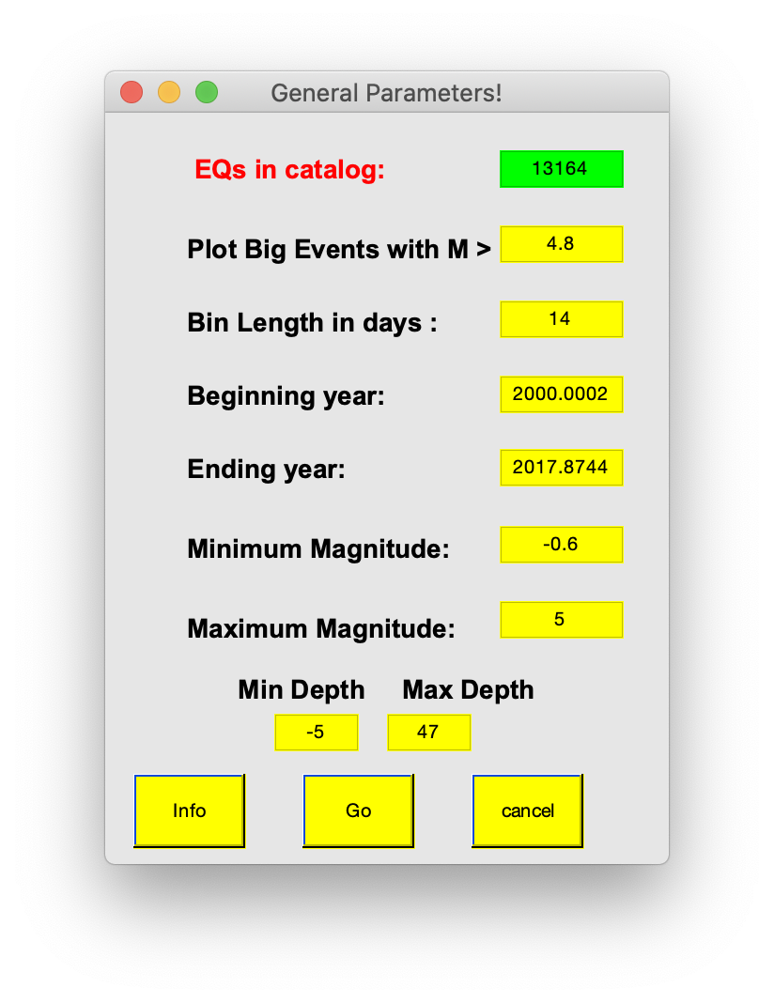
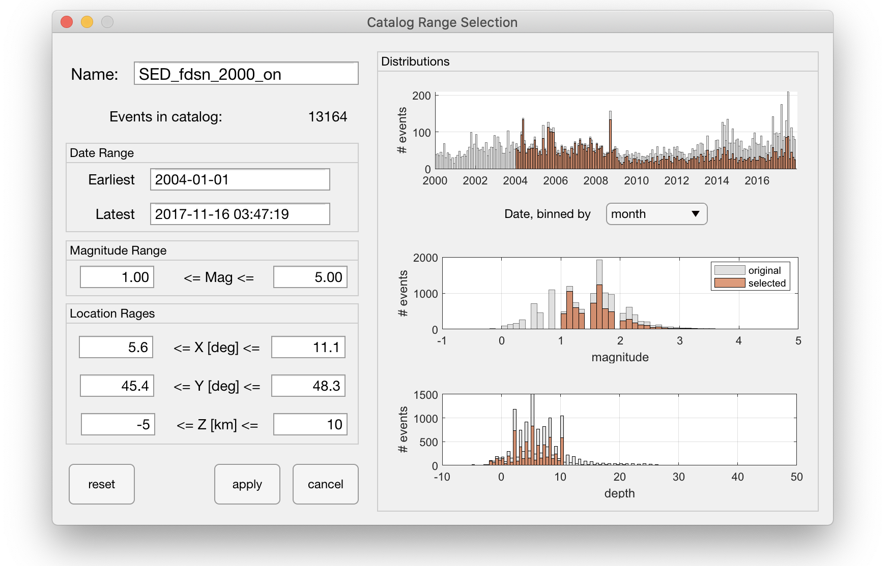
Then and Now: Catalog filtering
v6.0
v7.x
Notes:
Distributions show your affected changes

Slide 27
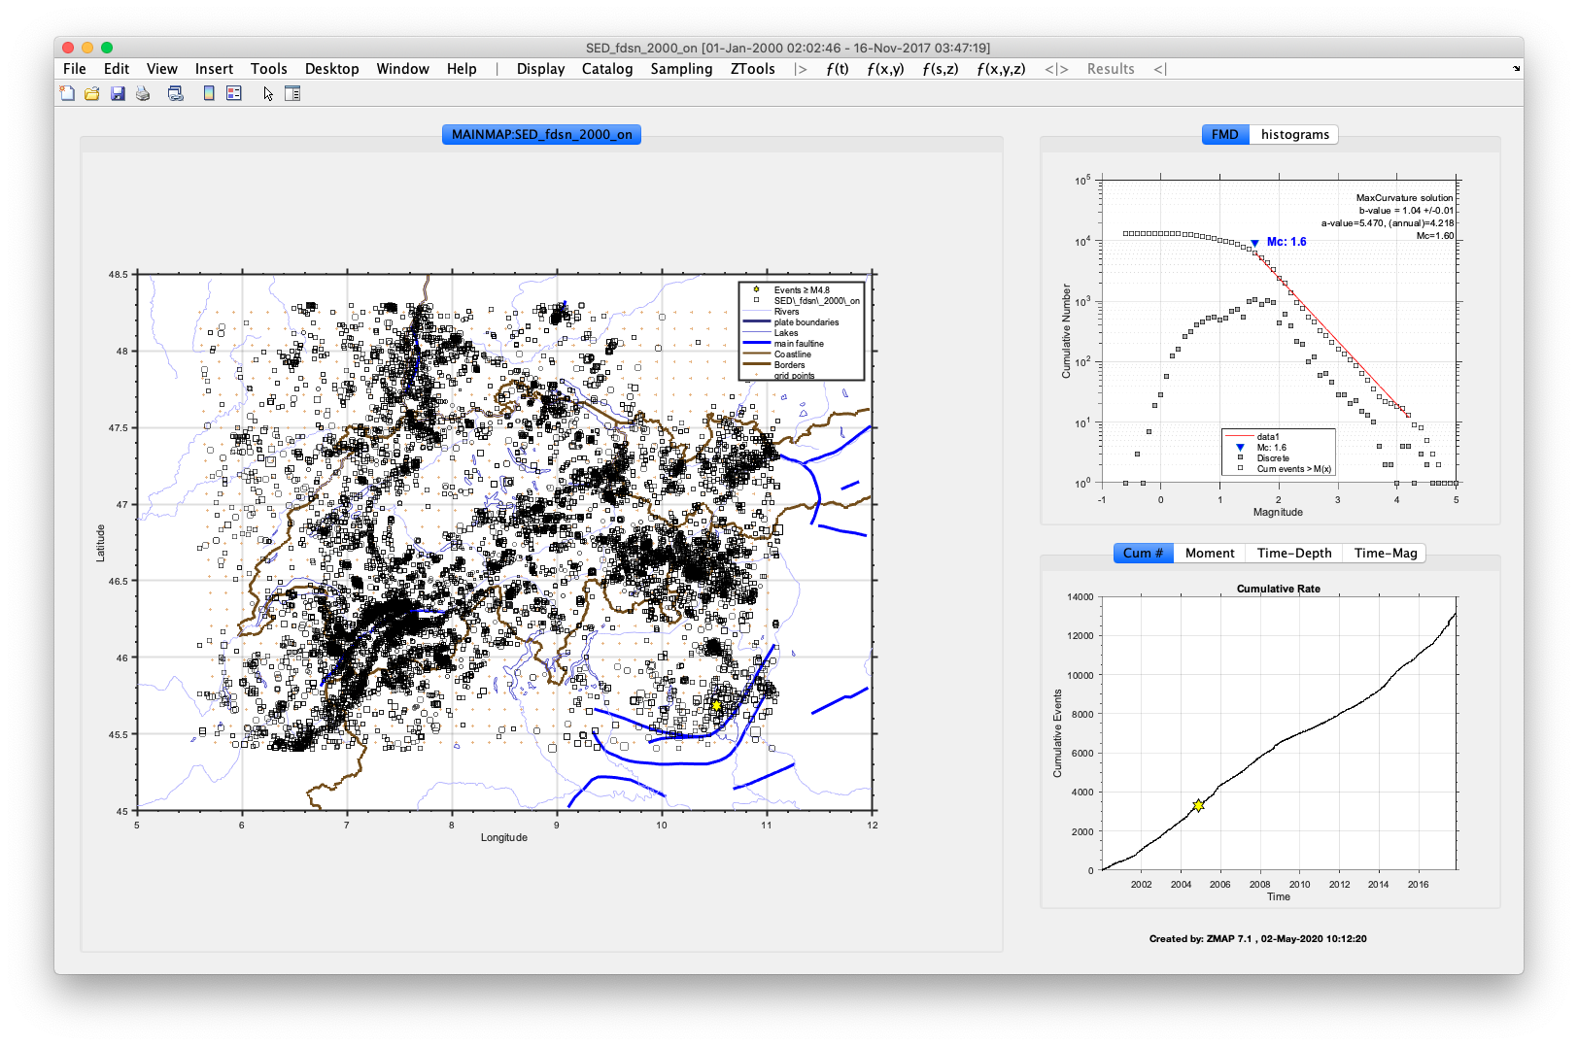
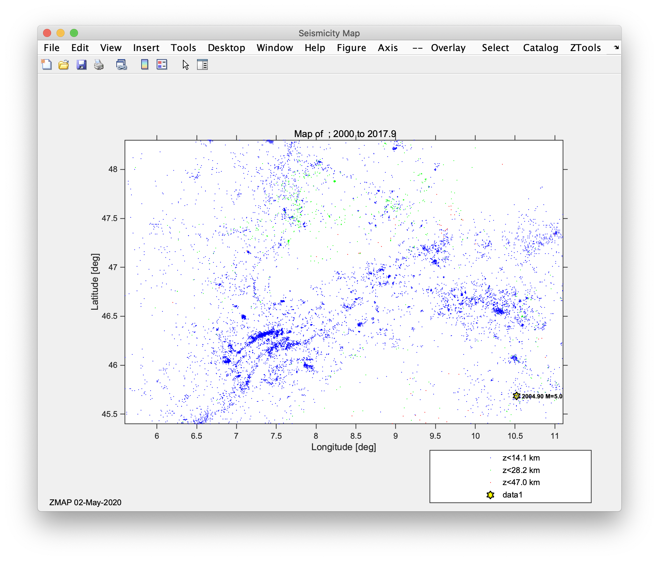
Then and Now: Main interactive window
v6.0
v7.x
Notes:
Main map menus:
ƒ(t) : functions through time
ƒ(s,z) : functions evaluated along a cross-section
ƒ(x,y) : functions evaluated on a grid (no depth consideration)
ƒ(x,y,z) : functions evaluated through a volume

