Slide 1
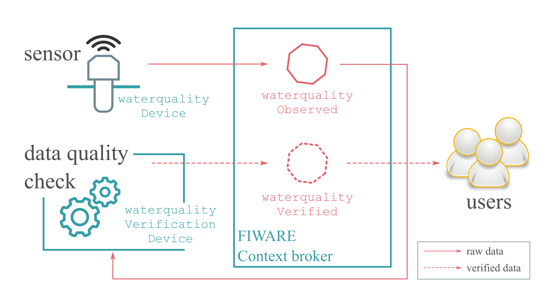
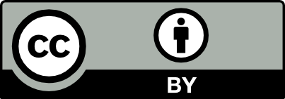
Real time data quality control applied on an IOT sensor water quality network
Matthias Maeyens ¹ , Brianna Pagán ¹ , Piet Seuntjens ¹ , Bino Maiheu ¹ , Nele Desmet ¹ , Maarten van Loo ¹ , and Stijn van Hoey ²
¹ VITO- Flemish Institute for Technological Research, Mol, Belgium
² Fluves, Ghent, Belgium
Abstract
In recent years, extended periods of drought have been affecting the water quality and availability in the Flanders region in Belgium. Especially the coastal region experienced an increased salinization of ground and surface water. The Flemish government therefore decided to invest in a dense IoT water quality monitoring network aiming to deploy 2500 water quality sensors primarily in surface water but also in ground water and sewers. The so called internet of water(IOW).
However, as with any sensor system, the quality of the data can vary in time due to problems with the sensors, incorrect calibration or unforeseen issues. With such a large amount of sensors it is especially important to have a method to automatically detect these issues and not have experts manually check these measurements. We focus on discussing such a system built upon the NGSIv2 API from FIWARE.
Objectives
The context broker is the core component of the FIWARE architecture. An end user can subscribe to the broker for a given entity (i.e. sensor) and whenever a new measurement arrives, that data is sent to the subscribed user. For water measurements this data is sent in the form of a WaterQualityObserved entity, which contains all the relevant info of a water quality measurement. This entity is contained in a JSON format:
{
"id": "waterqualityobserved:Mol:CTD1",
"type": "WaterQualityObserved",
"dateObserved": "2019-02-31T08:45:00Z",
"location": {
"type": "Point",
"coordinates": [ 5.1171, 51.1911 ]
},
"temperature" : 15.2,
"conductivity": 0.004
}
For the IOW we were interested in using and adapting this NGSI API to be able to also include simple quality checks. So a user can not only subscribe to the raw measurements but also subscribe to a flagged version of this data which has undergone these tests.
Test selection
To aid the end users in quick decision making these checks need to be performed as quick as possible and the results of these checks must be visualized and sent to the end user as fast as possible. Only simple checks that could be performed easily with minimal memory requirement were therefore selected. As well as simple pass or fail flags to visualize each check. These include a minmax flag which will check if the measured value is within the expected bounds for the measurand and a zscore flag which will check whether or not the newest measurement is an expected measurement by checking how many standard deviations it deviates from the mean.
Implementation in NGSI
Figure 1 visualizes how the verified data is sent to the users. A new WaterQualityVerified entity is created that contains the measurement information as well as a separate flag added to each measured parameter for each check that was performed on that parameter. This data is sent to the context broker and the context broker will then sent this entity to each subscribed user.
This way we end up with the following JSON that gets send to the context broker which contains the verified information:
{
"id": "waterqualityverified:Mol:CTD1",
"type": "WaterQualityVerified",
"dateObserved": "2019-02-31T08:45:00Z",
"location": {
"type": "Point",
"coordinates": [ 5.1171, 51.1911 ]
},
"temperature" : {
“value” :15.2,
“metadata”: {
“zscore_flag” : Failed,
“minmax_flag” : Passed
}
"conductivity": {
“value” :0.004,
“metadata”: {
“zscore_flag” : Passed,
“minmax_flag” : Passed
}
}
Conclusion
The integration of simple data quality checks with the FIWARE architecture allows users to quickly be informed about possible issues with their sensors, whilst keeping the implementation easily expandable to multiple sensors with different required checks for each.
References:
Cantera, J.M. & Márquez, F.G. 2019 FIWARE-NGSI version 2 API specification http://fiware.github.io/specifications/ngsiv2/stable/
Figure 1: Shows the architecture of the data quality checks, where the data quality app is subscribed to the data. Performs data quality checks on it and then sends it back to the context broker as a data quality verified entity

