Slide 1



Unusual Location of the Geotail Magnetopause Near Lunar Orbit:
A Case Study
Wensai Shang^{1,2,3}, Binbin Tang², Quanqi Shi¹, Anmin Tian¹, Xiaoyan Zhou⁴, Zhonghua Yao⁵, Alex W. Degeling¹, Iain Jonathan Rae⁶, Suiyan Fu⁷, Jianyong Lu³, Zuyin Pu⁷, Andrew N. Fazakerley⁶, Malcolm M. Dunlop⁸, Gabor Facskó⁹, Jiang Liu⁴, Ming Wang³
1. Institute of Space Sciences, Shandong University, Weihai, China,
2. State Key Laboratory of Space Weather, CSSAR, CAS, Beijing, China,
3. Institute of Space Weather, NUIST, Nanjing, China,
4. Earth, Planetary, and Space Sciences, UCLA, Los Angeles, CA, USA,
5. Laboratoire de Physique Atmosphérique et Planétaire, STAR institute,
Université de Liège, Liège, Belgium,
6. UCL MSSL, Dorking, RH5 6NT, UK,
7. School of Earth and Space Sciences, Peking University, Beijing, China,
8. Space Sciences Division, SSTD, RAL, Oxfordshire, UK,
9. Rhea System GmbH, Darmstadt, Germany.
Email：vencent_s@163.com; sqq@sdu.edu.cn

Slide 2

Introduction
The magnetopause is a boundary that separates the magnetospheric plasma from the solar wind.
Both IMF By and IMF Bz have important effects on the location and shape of the magnetotail at lunar distance [e.g. Akay et al., 2019; Liu et al., 2016, Sibeck & Lin, 2014; Vörös et al., 2014;Wang et al., 2014].
How about the effect of solar wind Vy and Vz?
During full moon time, the Moon is in the midnight region of the magnetosphere and will be shielded by the Earth's stretched magnetic field.

Slide 3
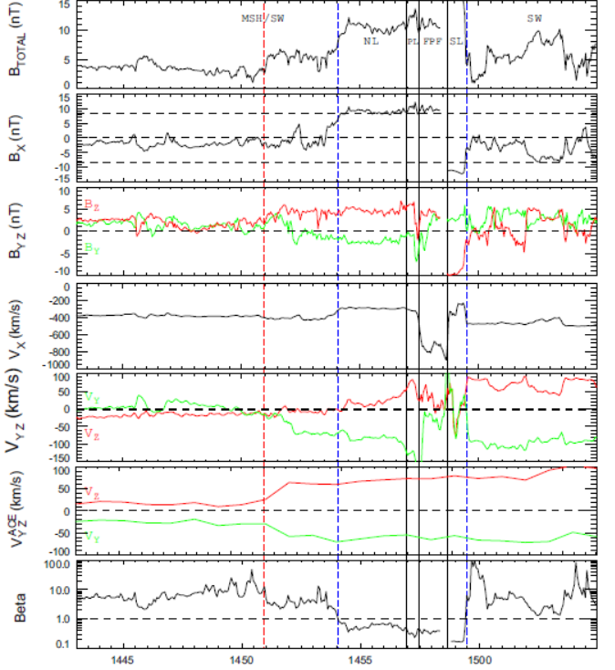
Howe et al. [1972] first recognized that the magnetotail axis lies aligned with the direction of the solar wind velocity.
The magnetosphere crossing from north MSH to south MSH was observed by Wind at -230Re after the shock arrival. [Grygorov et al., 2014]
However, the flapping amplitude of the magnetotail becomes large as the distance from the Earth increases. [Howe and Binsack, 1972]
How about at lunar distance？
Grygorov et al., 2014

Slide 4
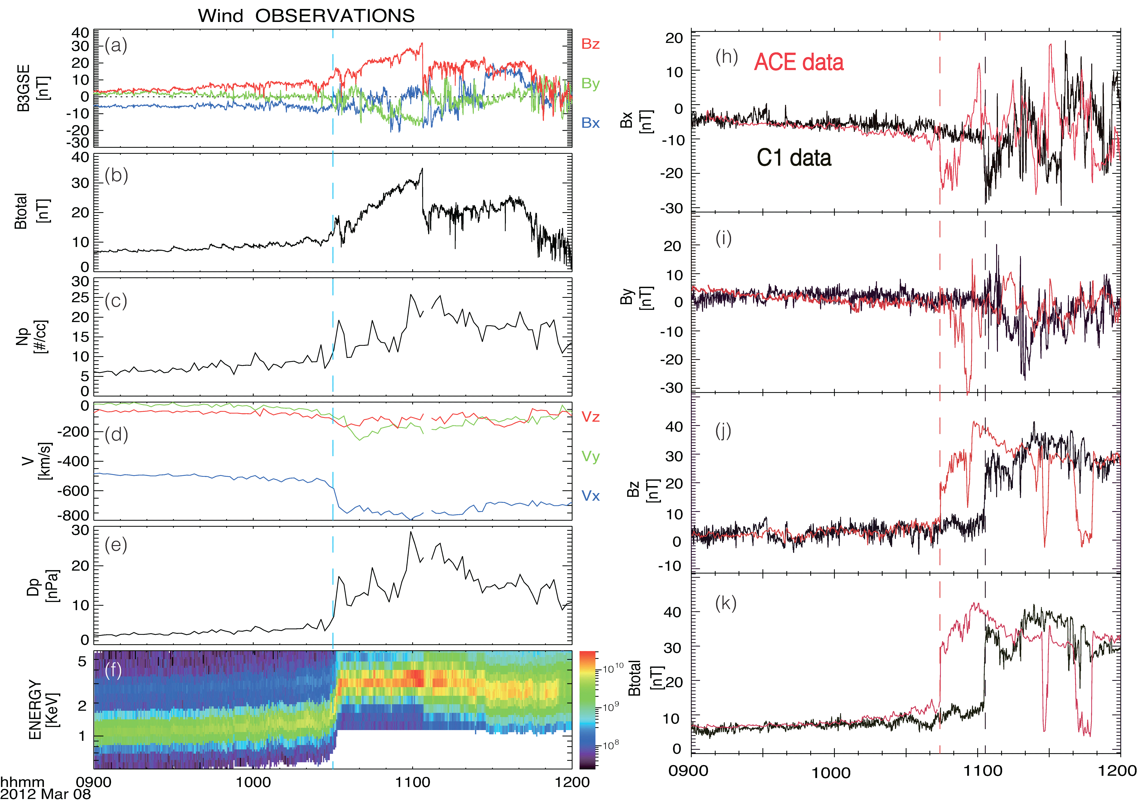
Wind Observations
at ∼(209, 93, 6) Re
IMF Bz turned to further north after the shock arrival.
IMF By close to 0 nT before 10:40UT.
At 10:30UT, solar wind Vx jumped from ~500 to 750 km/s;
Vy turned to further dawnward from -50 to -200 km/s;
the dynamic pressure increased from ~3 to 15 nPa .
Oblique Shock: V=653 km/s, N= (-0.75, -0.47, -0.46) by Cluster FGM data and timing method
Interplanetary shock

Slide 5
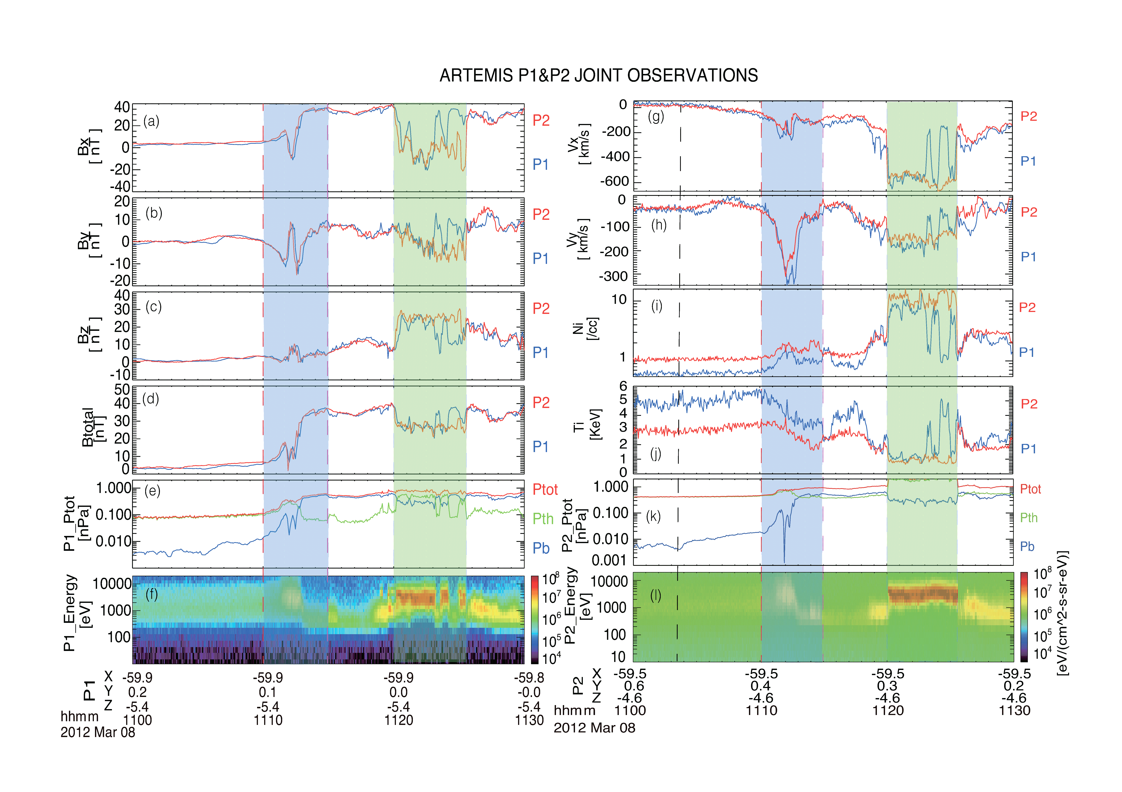
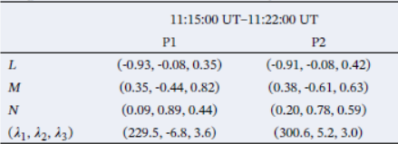
ARTEMIS Observations
t1
t2
t3
Neutral Sheet
Lobe
MSH
BL
Inside the Msphere, Bx=4 nT, By=Bz=0 nT.
The external shock arrived at t1, when the magnetic field started abruptly increasing.
t2: the end of the compression.
t3: the magnetopause crossing from Msphere into MSH.
compressed
a dawnward plasma flow
MVA
Y=0 Re means the full moon time.

Slide 6
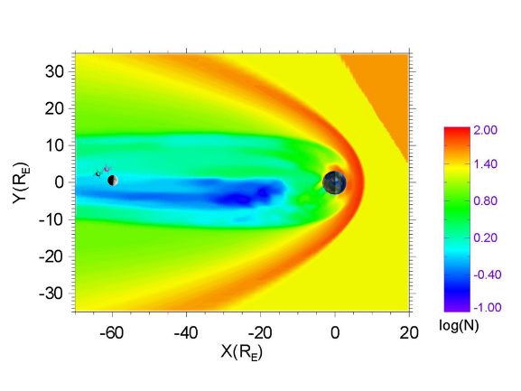
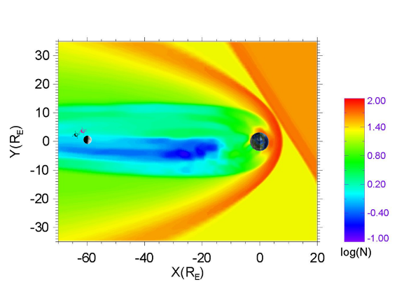
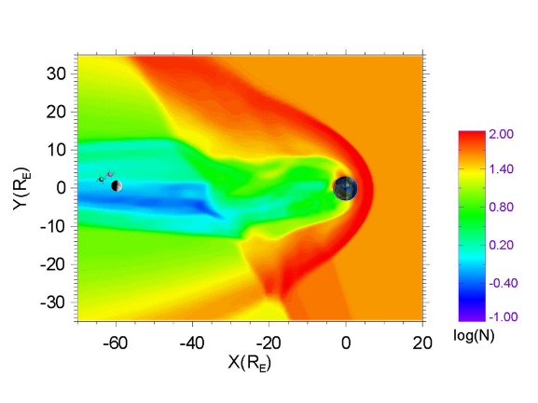
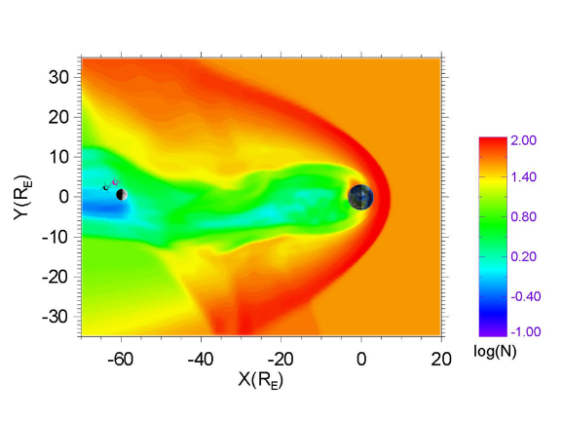
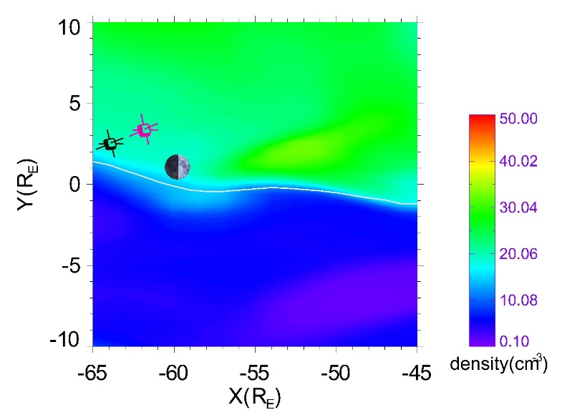
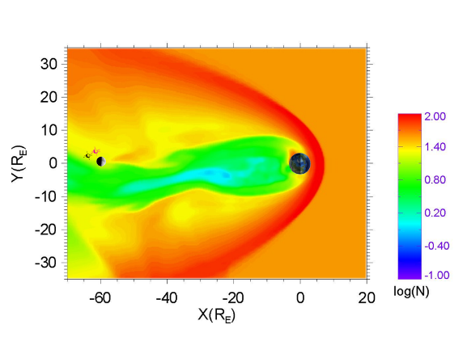
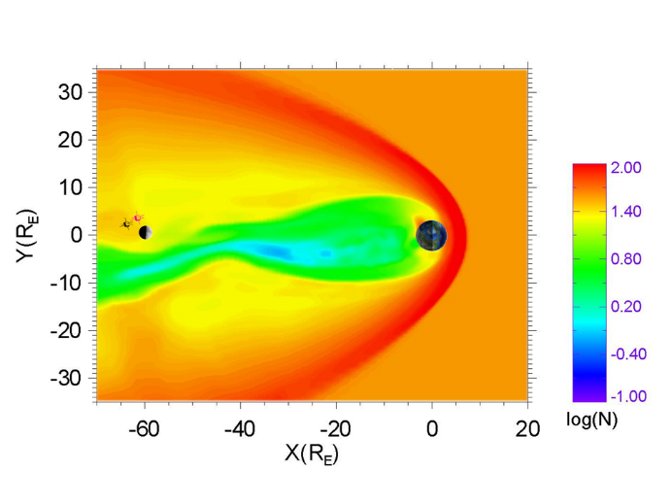
Global PPM MHD simulation
Ion density in X-Y plane at Z=-5.4 Re
t=0s
t=112s
PPM global MHD model [Hu et al., 2007]
  Input settings:
  Upstream: V=(-550,0,0)km/s; Np=20 cm⁻³, B=(-10.9, -1.7, 8.1)nT
  Downstream: V=(-700,-150,-50)km/s; Np=40 cm⁻³, B=(-26.8, -0.4, 32.1)nT
  Nshock=(-0.75,-0.47, -0.46)
  Simulations showed a qualitative consistence with observations.
t=420s
t=560s
t=700s
t=840s
t=700s
MSH
Msphere

Slide 7
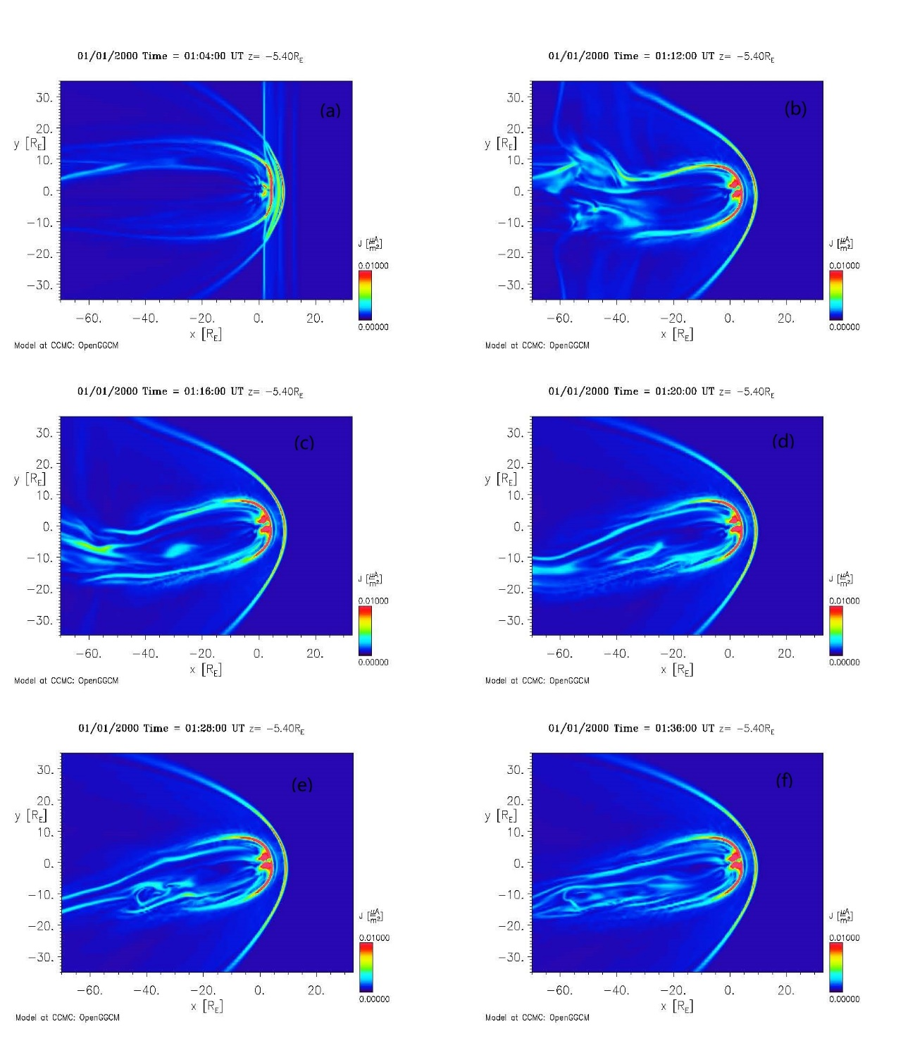
Global OpenGGCM simulation
01:04:00
01:12:00
Is Vy or shock normal dominate?
Same input parameters in OpenGGCM simulation, except that the shock normal is (-1,0,0).
The OpenGGCM simulation shows that the magnetotail is deflected and the Msphere is considerably compressed at the lunar orbit, as before.
➔the shocked tail at lunar distance is mainly controlled by the solar wind Vy (Windsock) rather than the shock normal.
➔the flapping time is about a quarter hour.
01:14:00
01:20:00
01:28:00
01:36:00

Slide 8

Summary and conclusion
$\frac{Rx}{Ry}$=$\frac{Vx}{Vy}$
The compressed and deflected magnetopause in response to the shock arrival and solar wind Vy changes.
The s/c & Moon were enveloped by the solar wind/MSH flow at lunar distance near midnight.
Normally during full moon time we traditionally thought the Moon is 'safe' by the protection of the Earth's Msphere. Hence, the prediction for manned activity on the Moon will be very important.
Ry
Rx
During this interval, the case provides unique advantage for investigating the interaction between solar wind and lunar nearside surface at the full moon time.

Slide 9
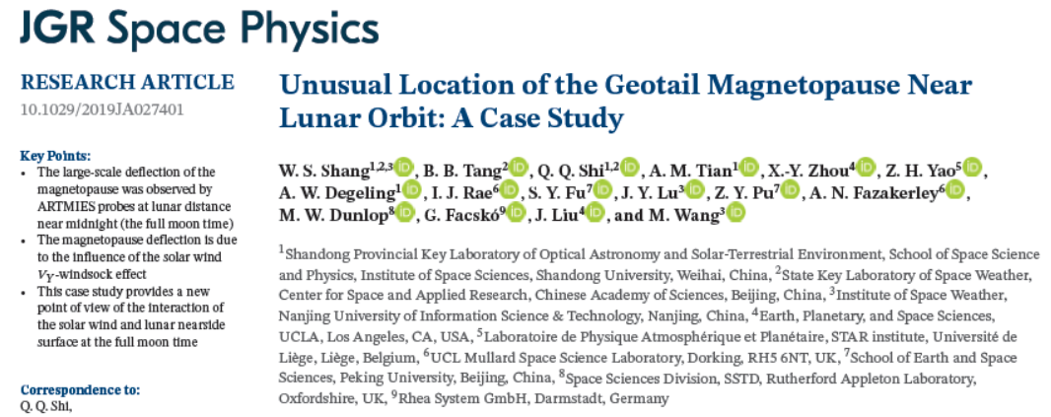
Summary and conclusion
1.The large-scale deflection of the magnetopause was observed by ARTMIES probes at the full moon time.
2. The first time to observe this kind of crossing at lunar distance.
3. The Moon was suddenly exposed in the solar wind when there was a large solar wind blowing in the dawn-dusk direction. The deviation of the magnetotail from its normal position, like the wind blowing a windsock.
4. This can be potentially very important to space weather and applying to future lunar exploration planning.

Slide 10
Thanks !

